Slide 1

Fastapi Python Complete Tutorial How To Use Path Variable In Fastapi Python Tutorial :4

Slide 2

Official doc link :https://fastapi.tiangolo.com/

Slide 3
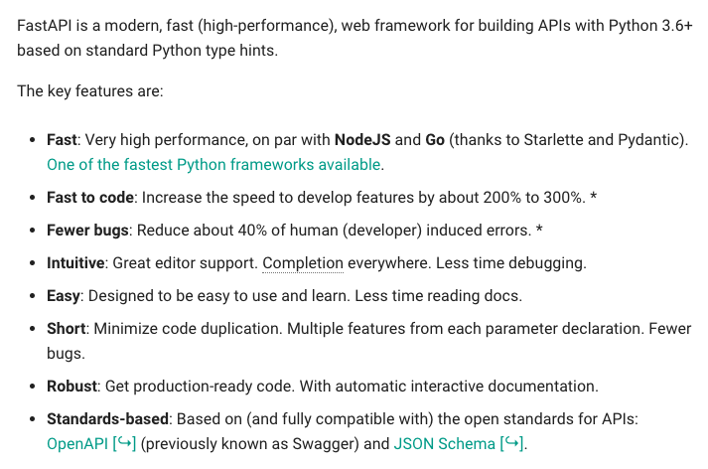
What is Fastapi

Slide 4
Pre-requisite
Python 3.6 or higher required
Install fastapi using pip
Install uvicorn using pip

Slide 5
Fastapi Path Variable
from fastapi import FastAPI
app=FastAPI()
@app.get("/profile/{id}")
def show(id:int):
return {"ID":id}

Slide 6
How to run
uvicorn main:app –port 8700 --reload

