Slide 1

Fastapi Python Complete Tutorial Query Parameters In Details In Fastapi Tutorial :7

Slide 2

Official doc link :https://fastapi.tiangolo.com/

Slide 3
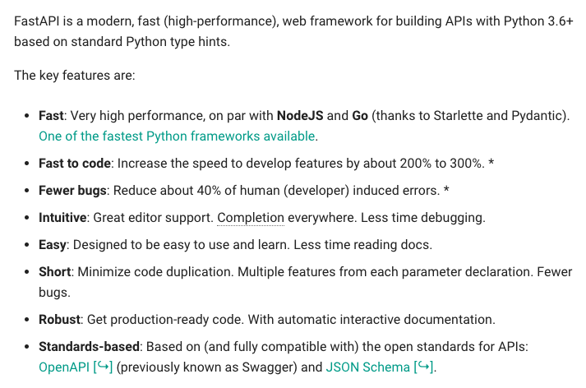
What is Fastapi

Slide 4
Pre-requisite
Python 3.6 or higher required
Install fastapi using pip
Install uvicorn using pip

Slide 5
Fastapi query parameters with default value
from fastapi import FastAPI
app=FastAPI()
@app.get("/users")
def users(id=6,name="roni"):
return {"user_id":id,"name":name}

Slide 6
Fastapi query parameters with bool value
from fastapi import FastAPI
app=FastAPI()
@app.get("/users")
def users(isactive:bool):
if (isactive):
val="yes"
else:
val="no"
return{"active":val}

Slide 7
Fastapi query parameters with json file
@app.get("/user")
def user(id):
data=read_json("users.json")
user_data=data["users"]
name="invalid"
for row in user_data:
if (row["id"]==id):
name=row["name"]
break
return{"id":id,"name":name}

Slide 8
How to run
uvicorn main:app –port 8700 --reload

