Slide 1


LLAMAINDEX complete tutorial for beginners
Build KeywordTable Index using LlamaIndex
TUTORIAL : 7

Slide 2
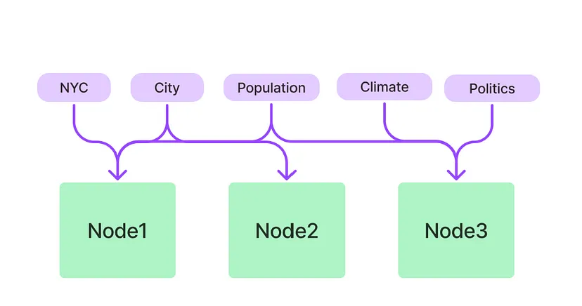
What is keyword table index

Slide 3
Github link
https://github.com/ronidas39/llamaindex/tree/main/tutorial7

