Slide 1

Predicting Employee Turnover

Slide 2

Introduction
Employee Turnover (definition)
Measurement how many employees are leaving the company.
Why Predict Employee Turnover?
Employee Turnover is expensive, and incremental improvements will give significant results. It will help us in designing better retention plans and improving employee satisfaction.
Notes:
Employee turnover, or staff turnover, is a measurement of how many employees are leaving a company. It’s a way to track whether a company has more employees leaving than is typically expected. This includes employees that either quit, were let go, or retired. However, companies that measure their employee turnover often separate these to manage each type of turnover.
Employee churn is expensive, and incremental improvements will give significant results. It will help us in designing better retention plans and improving employee satisfaction.
Employee churn is the overall turnover in an organization's staff as existing employees leave and new ones are hired. The churn rate is usually calculated as the percentage of employees leaving the company over some specified time period. Although some staff turnover is inevitable, a high rate of churn is costly.
It is very costly for organizations, where costs include but not limited to: separation, vacancy, recruitment, training and replacement
Cost of Recruitment
Cost of Training new employee
Cost of Letting Go (severance/bonus packages, separation pay)
Effect of Low Morale of those that stayed (they will probably shoulder your workload)
Customer satisfaction is affected (change in account reps or skills/knowledge lost)

Slide 3

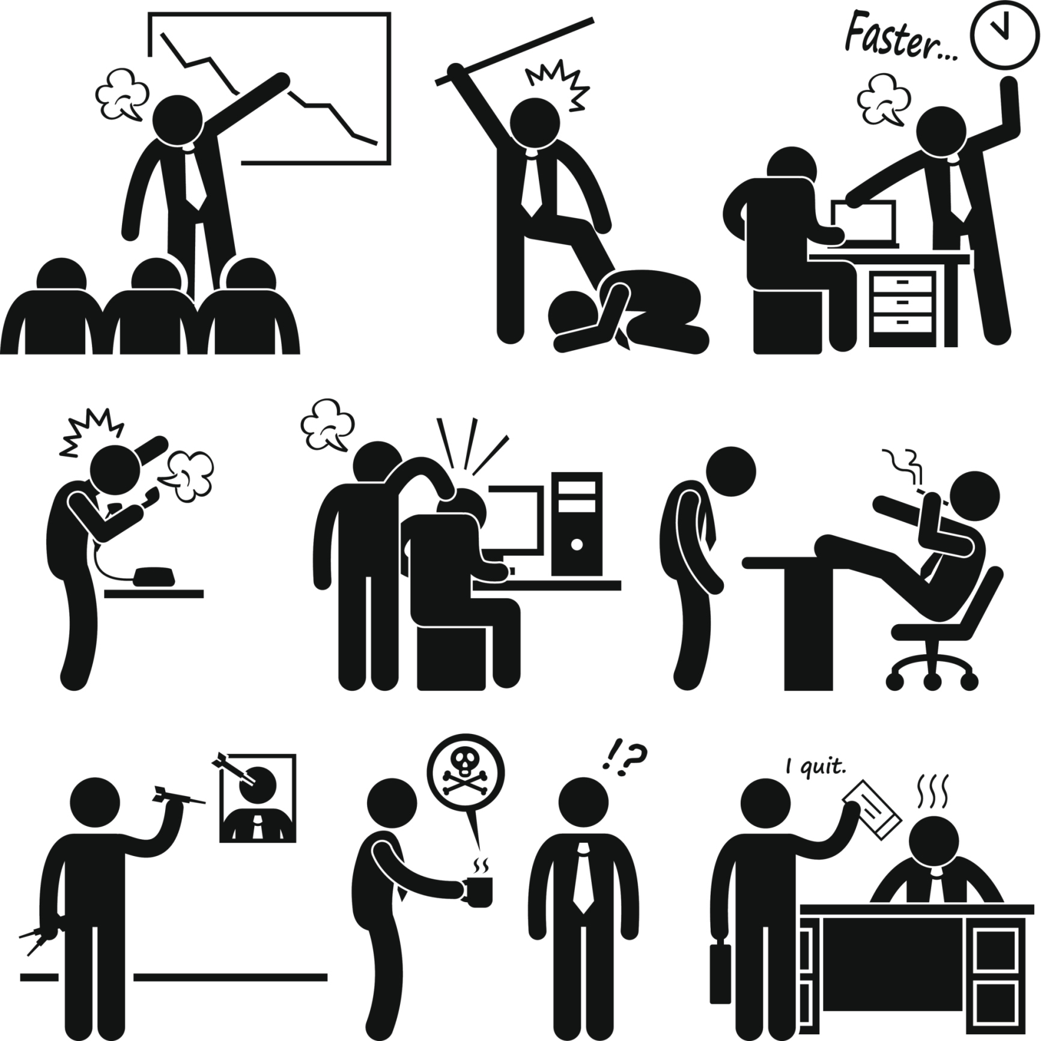
Objective
To find out what are the best factors affecting Employee Turnover.
To Predict Employee Turnover

Slide 4

Analysis Approach
Dataset
EDA
Models
Interpretation of Model Results

Slide 5
The Data
Simulated HR Data from Kaggle
Contains 14,999 Records and 10 features
No Null or Missing Values Found
Features:
satisfaction_level, last_evaluation, number_project, salary average_montly_hours, time_spend_company, Work_accident
Left (0,1) [0:Stayed; 1:Left]

Slide 6
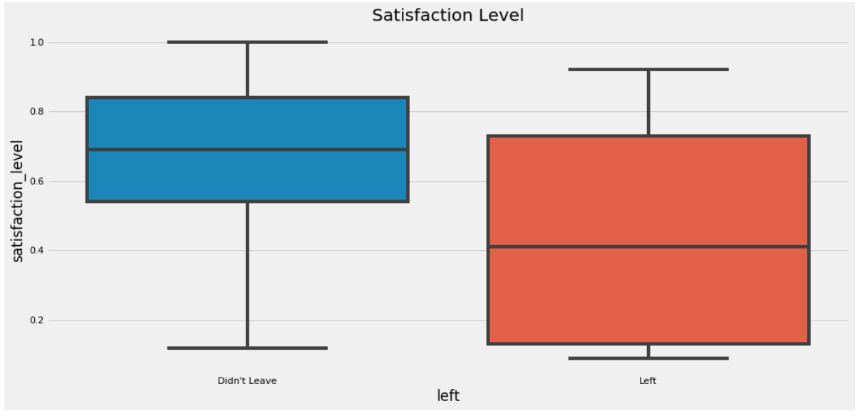
EDA - Satisfaction Level
Stayed:
Satisfaction Median 0.7
Left:
Satisfaction Median 0.4
Notes:
As Expected, most of those that left had low satisfaction levels.

Slide 7
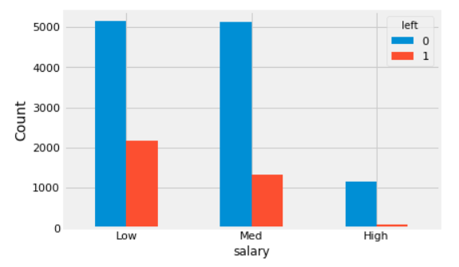
EDA - Salary Levels
48.78% have Low Salary, with 29.69% Left
42.98% have Medium Salary, with 20.43% Left.
8.25% have High Salary, with 6.63% Left.
5144 2172
5129 1317
1155 82
Notes:
Based on graph above, most of the employees that left had low and medium salary ranges. Those that had higher salary stayed.
Label Y
Include percentage of figures
70.31% 29.69% 79.57% 20.43% 93.37% 6.63%

Slide 8
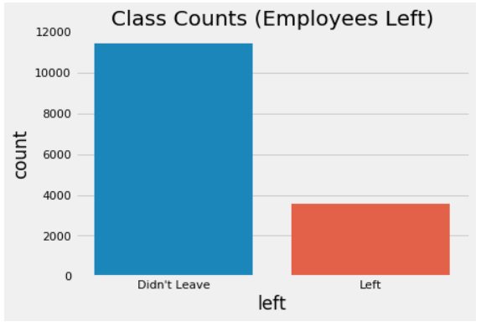
EDA - Employees Left
Out of 15,000 Employees
23% Left.
3,571 Left
11428 Stayed.
Imbalanced Dataset
Notes:
Around 23% of the employees have left
Proportion of positive to negative examples: 31.25%

Slide 9
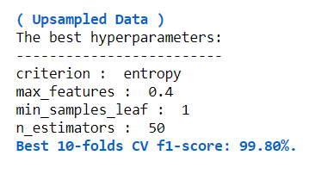
Models - Methodology
Determine Best Method for Imbalanced Dataset
Use Several Model Classifiers and fit the model using Train data.
Use GridSearchCV to tune hyperparameters using 10-folds cross
Use AUC & F1-Score, and Accuracy Rate Metrics to compare Model Results
Random Forest
Gradient Boosting Trees
K-Nearest Neighbors
Logistic Regression
Support Vector Machine
AUC & F1-Score is Preferred
Notes:
Note that some of the hyperparameter ranges will be guided by the paper [Data-driven Advice for Applying Machine Learning to Bioinformatics Problems](https://arxiv.org/pdf/1708.05070.pdf)
Standardize the data to make all the features on the same scale.
Use GridSearchCV to tune the hyperparameters using 10-folds cross validations. We can use RandomizedSearchCV which is faster and may outperform GridSearchCV especially if we have more than two hyperparameters and the range for each one is very big; however, GridSearchCV will work just fine since we have only two hyperparameters and descent range.

Slide 10
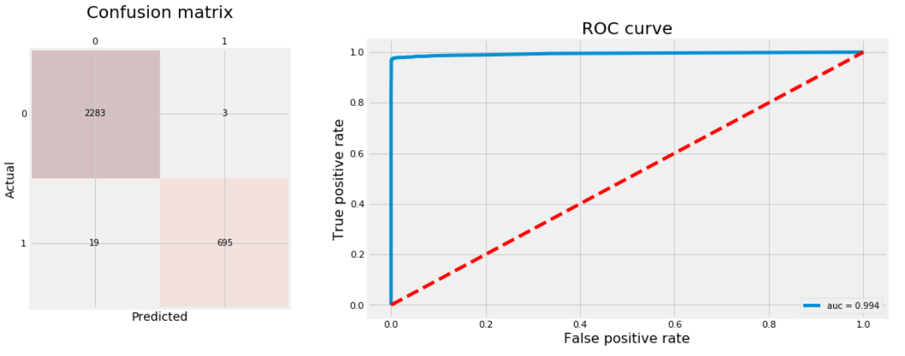
Models - Random Forest
Notes:
The only hyperparameters we'll tune are:
max_feature: how many features to consider randomly on each split. This will help avoid having few strong features to be picked on each split and let other features have the chance to contribute. Therefore, predictions will be less correlated and the variance of each tree will decrease.
min_samples_leaf: how many examples to have for each split to be a final leaf node.
Random Forest is an ensemble model that has multiple trees (n_estimators), where each tree is a weak learner. The final prediction would be a weighting average or mode of the predictions from all estimators. Note: high number of trees don't cause overfitting.

Slide 11
Hyper Parameters Used
Model Classifier | Hyper Parameter | Best 10-folds CV f1-score:
Random Forest | criterion : entropy max_features : 0.4 min_samples_leaf : 1 n_estimators : 50 | 99.80%
Gradient Boosting Trees | learning_rate : 0.1 max_depth : 3 max_features : 0.5 n_estimators : 500 | 97.88%
K-Nearest Neighbors | n_neighbors : 1 weights : uniform | 98.24%
Logistic Regression | C : 1.0 fit_intercept : True penalty : l1 | 77.20%
Support Vector Machine | C=0.01, gamma=0.1, kernel='poly', degree=5, coef0=10 | 96.38%
Notes:
Around 23% of the employees have left
Proportion of positive to negative examples: 31.25%
Up-sampling is the process of randomly duplicating observations from the minority class in order to reinforce its signal.
Down-sampling involves randomly removing observations from the majority class to prevent its signal from dominating the learning algorithm.

Slide 12
Evaluate Model Results
Model | AUC | Accuracy Rate | F1-score
Random Forest | 0.994 | 99.27% | 98.44%
Logistic Regression | 0.830 | 76.33% | 61.29%
SVM | 0.978 | 95.90% | 91.69%
Grad Boost Trees | 0.995 | 97.97% | 95.74%
KNN | 0.971 | 97.23% | 94.33%
RF has Best F1-score & Accuracy Rate
GBT has best AUC Score followed by RF.
RF is the best Classifier among the list.
Notes:
Results are based on Test Data
RF is the best. Not much difference between GBT & RF AUC Score but RF has better Accuracy Rate & F1-Score.
accuracy_score(y_test, estimators[estimator].predict(X_test)) * 100,
f1_score(y_test, estimators[estimator].predict(X_test)) * 100))

Slide 13
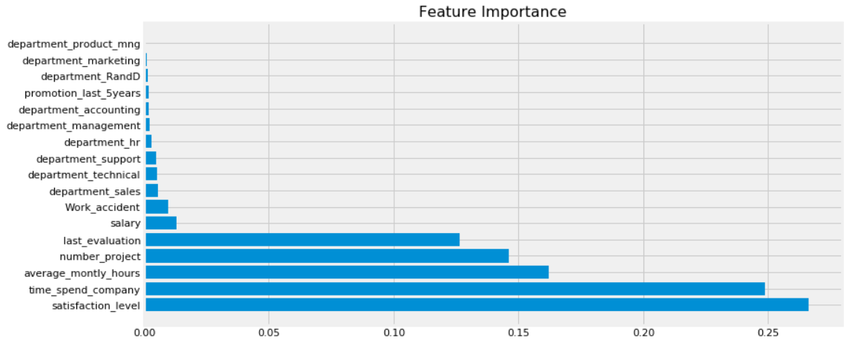
Feature Importance
TOP 5 Features:
satisfaction_level
time_spend_company
average_montly_hours
number_project
last_evaluation
Notes:
Random Forest Classifier Important Features

Slide 14
Summary, Lessons Learned & Limitations
For this project, we have determined that the best classifier model is Random Forest based on AUC & F1-scores.
Top Features: satisfaction_level, time_spend_company, average_montly_hours, number_project, last_evaluation
For imbalanced classes, accuracy is not a good method to evaluate your models. AUC & F1-Score are the preferred metrics to use.
Upsampling/downsampling are good methods to improve accuracy of classifier for imbalanced classes datasets
The Dataset used resulted in very good Scores. In Future, look into more features that can provide further insights such as Personal(Age, Gender, Marital Status), Roles, Relationship Satisfaction, overtime pay, etc
Notes:
Comments:
From the model, limitations, improve further model.

Slide 15
Questions?
Thank You
Notes:
Random Forest Classifier Important Features

Slide 16
Supplementary Slides
<This is hidden slide>
Notes:
PRESENTATION STOPS HERE!!!!

Slide 17
Models - Methodology
1. Build a pipeline using make_pipeline command
a. Standardize Data
b. Create classifier we want to use to fit model
2. Use GridSearchCV to tune hyperparameters using 10-folds cross validations.
3. Fit Model using training data
4. Plot confusion matrix and ROC curve for best estimator using test data.
Notes:
Note that some of the hyperparameter ranges will be guided by the paper [Data-driven Advice for Applying Machine Learning to Bioinformatics Problems](https://arxiv.org/pdf/1708.05070.pdf)
Standardize the data to make all the features on the same scale.
Use GridSearchCV to tune the hyperparameters using 10-folds cross validations. We can use RandomizedSearchCV which is faster and may outperform GridSearchCV especially if we have more than two hyperparameters and the range for each one is very big; however, GridSearchCV will work just fine since we have only two hyperparameters and descent range.

Slide 18
Data Preprocessing
Check for null or missing values
Rename sales feature to department
Create dummy features for department
Convert salary into ordinal categorical feature (low:0, medium:1, high:2)

Slide 19
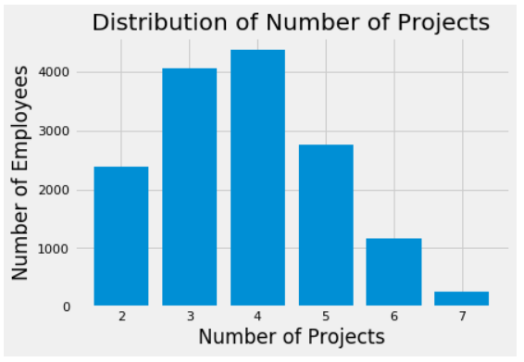
EDA - Number of Projects
Notes:
Findings: Most Employees have done 3-5 Projects.

Slide 20
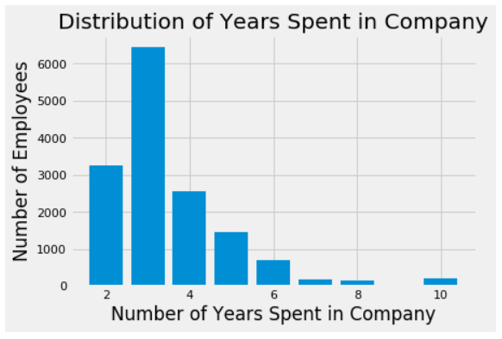
EDA - Time Spent in Company
Notes:
Findings: Majority of Employees have 2-4 Years of Experience
Better x has all values not just in ranges

Slide 21
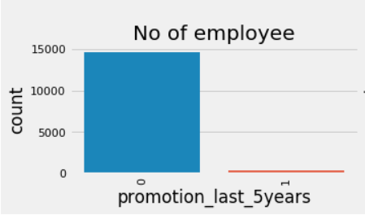
EDA – Promotion last 5 years
Notes:
Those that left the company were not promoted in the last 5 years.

Slide 22
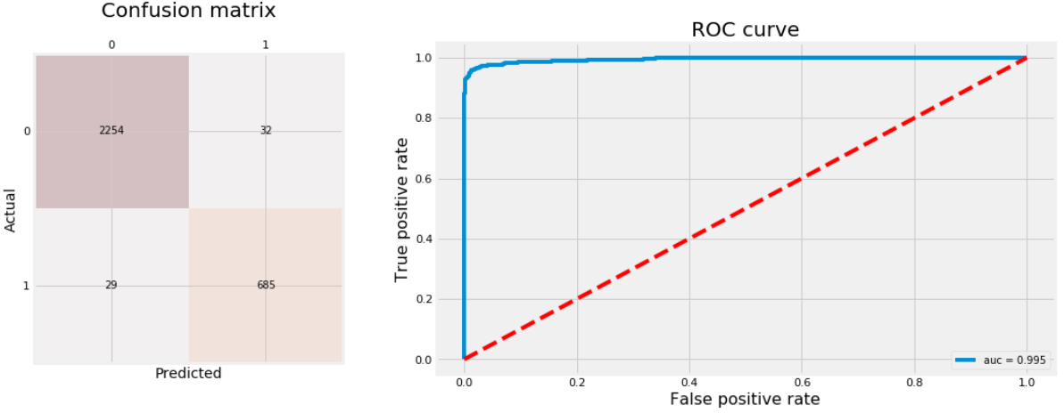
Models - Gradient Boosting Trees
Notes:
The two other hyperparameters other than max_features and n_estimators that we're going to tune are:
learning_rate: rate the tree learns, the slower the better.
max_depth: number of split each time a tree is growing which limits the number of nodes in each tree.

Slide 23
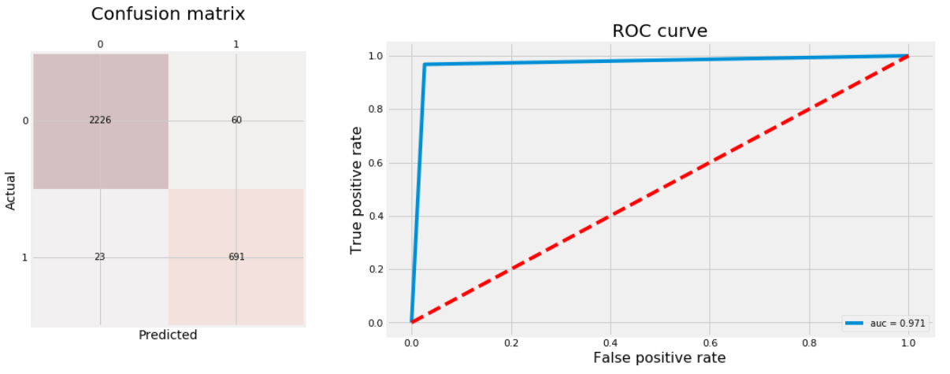
Models - K-Nearest Neighbors
Notes:
The two hyperparameters we're going to tune are:
n_neighbors: number of neighbors to use in prediction.
weights: how much weight to assign neighbors based on:
"uniform": all neighboring points have the same weight.
"distance": use the inverse of euclidean distance of each neighboring point used in prediction.

Slide 24
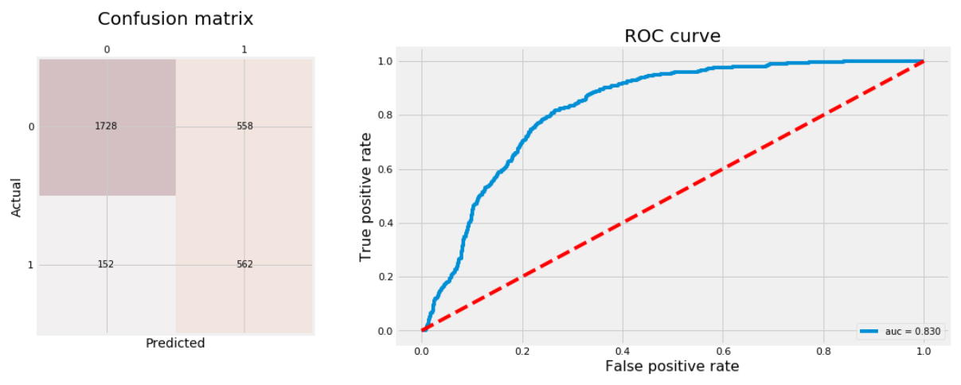
Models - Logistic Regression
Notes:
For logistic regression, we'll tune three hyperparameters:
penalty: type of regularization, L2 or L1 regularization.
C: the opposite of regularization of parameter 𝜆 . The higher C the less regularization. We'll use values that cover the full range between unregularized to fully regularized where model is the mode of the examples' label.
fit_intercept: whether to include intercept or not.

Slide 25
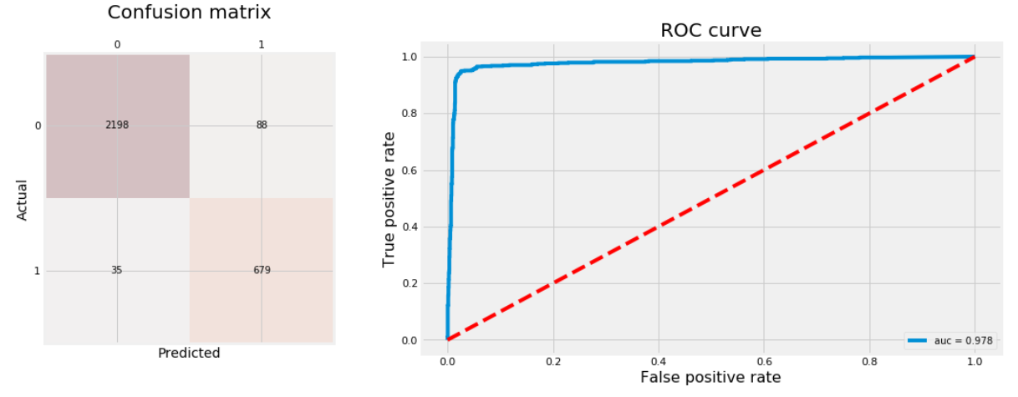
Models - Support Vector Machine (SVM)

Slide 26
Objective
To Predict Employee Turnover
To find out what are the best factors affecting Employee Turnover.

Slide 27
DataSet
Feature | Type | Description
satisfaction_level | Numeric | Level of satisfaction {0–1}
last_evaluationTime | Numeric | Time since last performance evaluation (in years)
number_project | Numeric | Number of projects completed while at work
average_montly_hours | Numeric | Average monthly hours at workplace
time_spend_company | Numeric | Number of years spent in the company
Work_accident | Numeric | Whether the employee had a workplace accident
left | Numeric | Whether the employee left the workplace or not {0, 1}
promotion_last_5years | Numeric | Whether the employee was promoted in the last five years
Sales (a.k.a. Department) | Categorical | Department the employee works for
Salary | Categorical | Relative level of salary {low, medium, high}

