Slide 1

Predicting Employee Turnover

Slide 2

Introduction
Employee Turnover (definition)
Cost of Turnover

Slide 3

Objective
Objective:
To Predict Employee Turnover
To find out what are the best factors that affect Employee Turnover.

Slide 4

Analysis Approach
Dataset
EDA
Feature Engineering
Models
Interpretation of Model Results

Slide 5
DataSet
Feature | Type | Description
satisfaction_level | Numeric | Level of satisfaction {0–1}
last_evaluationTime | Numeric | Time since last performance evaluation (in years)
number_project | Numeric | Number of projects completed while at work
average_montly_hours | Numeric | Average monthly hours at workplace
time_spend_company | Numeric | Number of years spent in the company
Work_accident | Numeric | Whether the employee had a workplace accident
left | Numeric | Whether the employee left the workplace or not {0, 1}
promotion_last_5years | Numeric | Whether the employee was promoted in the last five years
Sales (a.k.a. Department) | Categorical | Department the employee works for
Salary | Categorical | Relative level of salary {low, medium, high}

Slide 6
Feature Engineering
Check for null or missing values
Rename sales feature to department
Create dummy features for department
Convert salary into ordinal categorical feature (low:0, medium:1, high:2)

Slide 7
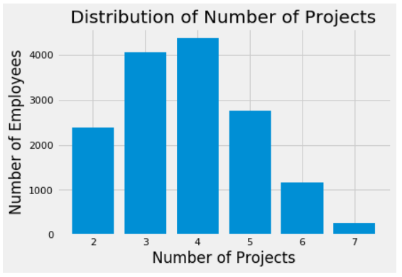
EDA - Number of Projects
Description
Notes:
Findings: Most Employees have done 3-5 Projects.

Slide 8
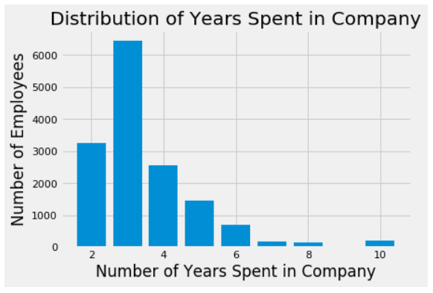
EDA - Time Spent in Company
Notes:
Findings: Majority of Employees have 2-4 Years of Experience

Slide 9
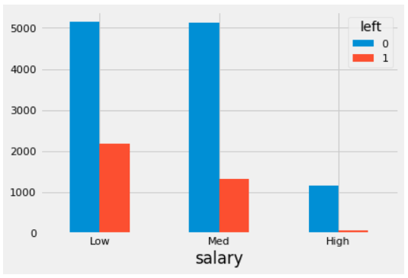
EDA - Salary Levels
Notes:
Based on graph above, most of the employees that left had low and medium salary ranges. Those that had higher salary stayed.

Slide 10
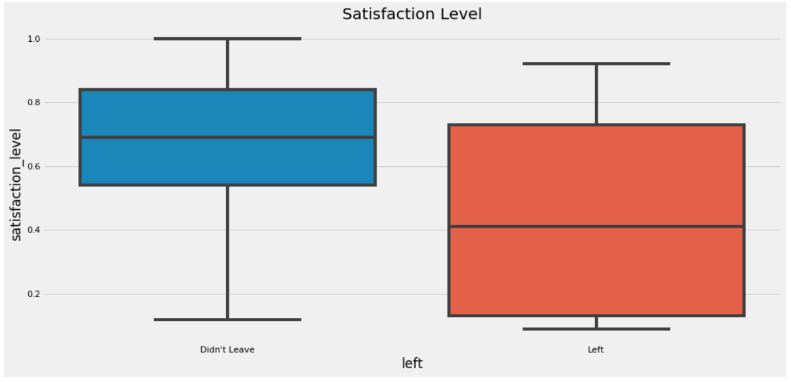
EDA - Satisfaction Level
Notes:
As Expected, most of those that left had low satisfaction levels.

Slide 11
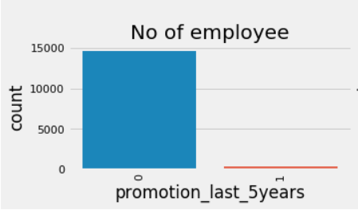
EDA – Promotion last 5 years
Notes:
Those that left the company were not promoted in the last 5 years.

Slide 12
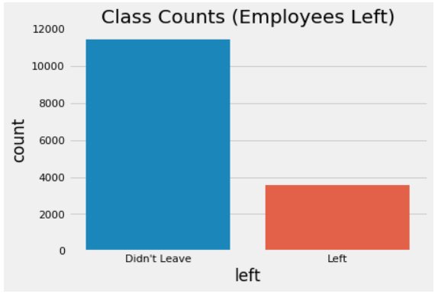
EDA - Employees Left Feature
Notes:
31.25% of the employees have left
Dataset is imbalanced.

Slide 13
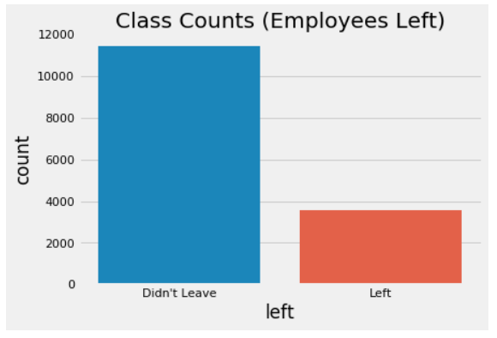
Models
Imbalanced Dataset
Up-sample the minority Class
Notes:
Up-sampling is the process of randomly duplicating observations from the minority class in order to reinforce its signal.
Down-sampling involves randomly removing observations from the majority class to prevent its signal from dominating the learning algorithm.

Slide 14
Models - Methodology
1. Build a pipeline using make_pipeline command
a. Standardize Data
b. Create classifier we want to use to fit model
2. Use GridSearchCV to tune hyperparameters using 10-folds cross validations.
3. Fit Model using training data
4. Plot confusion matrix and ROC curve for best estimator using test data.
Notes:
Note that some of the hyperparameter ranges will be guided by the paper [Data-driven Advice for Applying Machine Learning to Bioinformatics Problems](https://arxiv.org/pdf/1708.05070.pdf)

Slide 15
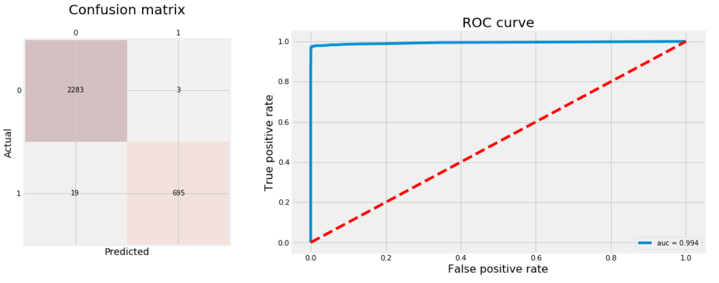
Models - Random Forest
Notes:
The only hyperparameters we'll tune are:
max_feature: how many features to consider randomly on each split. This will help avoid having few strong features to be picked on each split and let other features have the chance to contribute. Therefore, predictions will be less correlated and the variance of each tree will decrease.
min_samples_leaf: how many examples to have for each split to be a final leaf node.
Random Forest is an ensemble model that has multiple trees (n_estimators), where each tree is a weak learner. The final prediction would be a weighting average or mode of the predictions from all estimators. Note: high number of trees don't cause overfitting.

Slide 16
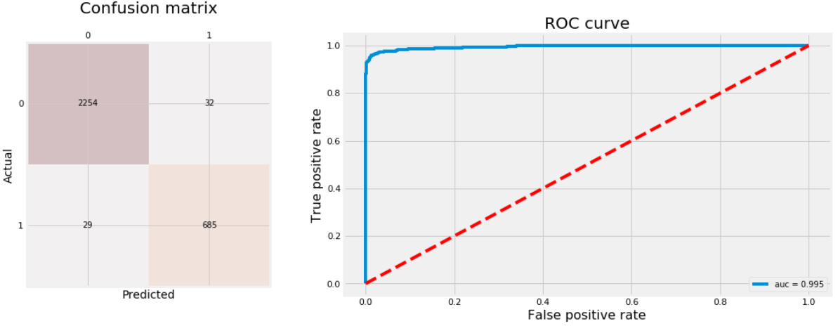
Models - Gradient Boosting Trees
Notes:
The two other hyperparameters other than max_features and n_estimators that we're going to tune are:
learning_rate: rate the tree learns, the slower the better.
max_depth: number of split each time a tree is growing which limits the number of nodes in each tree.

Slide 17
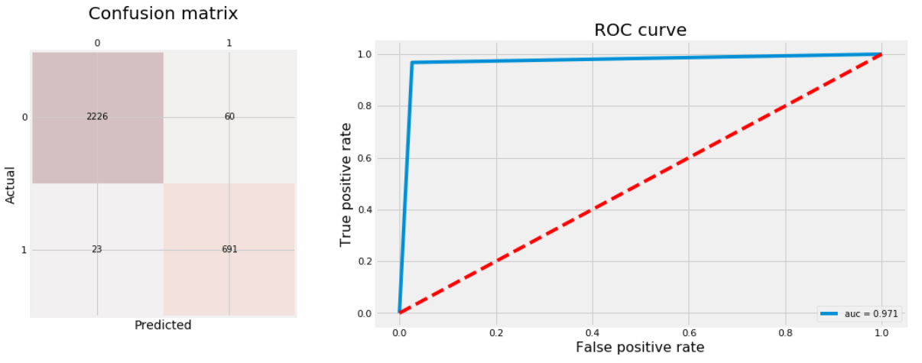
Models - K-Nearest Neighbors
Notes:
The two hyperparameters we're going to tune are:
n_neighbors: number of neighbors to use in prediction.
weights: how much weight to assign neighbors based on:
"uniform": all neighboring points have the same weight.
"distance": use the inverse of euclidean distance of each neighboring point used in prediction.

Slide 18
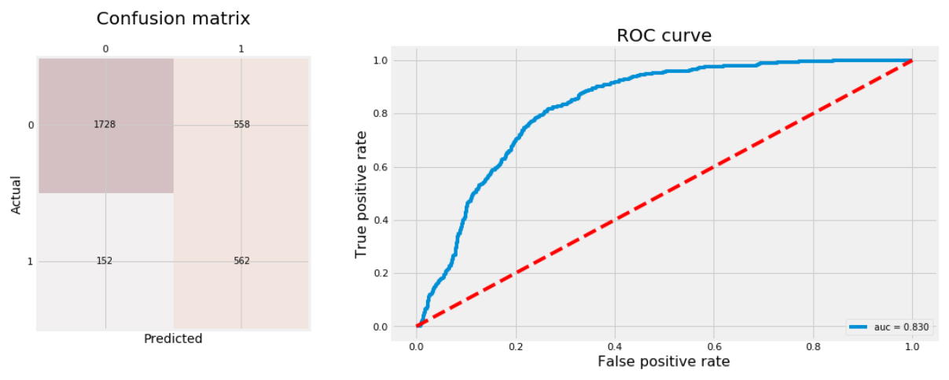
Models - Logistic Regression
Notes:
For logistic regression, we'll tune three hyperparameters:
penalty: type of regularization, L2 or L1 regularization.
C: the opposite of regularization of parameter 𝜆 . The higher C the less regularization. We'll use values that cover the full range between unregularized to fully regularized where model is the mode of the examples' label.
fit_intercept: whether to include intercept or not.

Slide 19
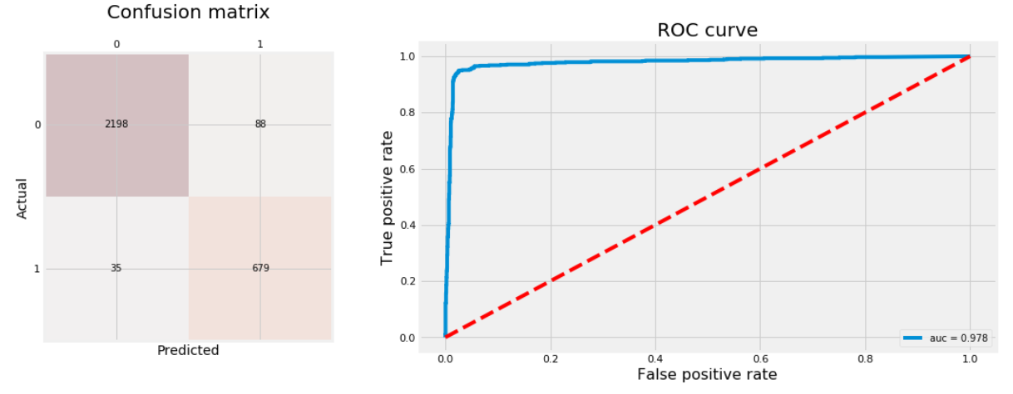
Models - Support Vector Machine (SVM)

Slide 20
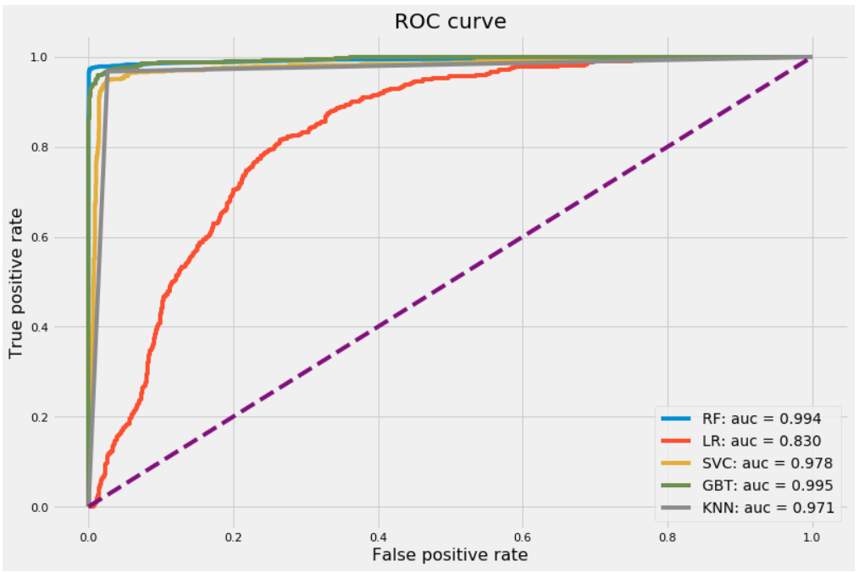
Evaluate Model Results
Model | Accuracy Rate | F1-score
Random Forest | 99.27% | 98.44%
Linear Regression | 76.33% | 61.29%
SVM | 95.90% | 91.69%
Grad Boost Trees | 97.97% | 95.74%
KNN | 97.23% | 94.33%
GBT has best AUC Score followed by RF.
RF has Best F1-score & Accuracy Rate
Notes:
RF is the best. Not much difference between GBT & RF AUC Score but RF has better Accuracy Rate & F1-Score.

Slide 21
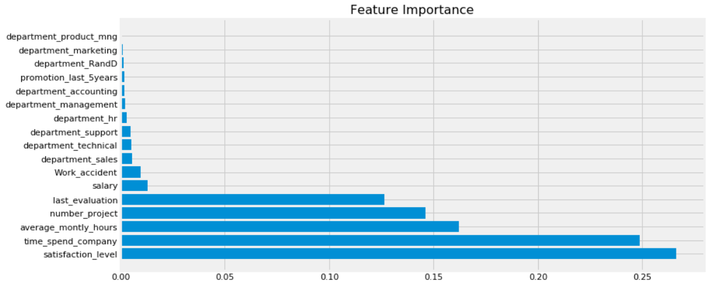
Feature Importance
TOP 5 Features:
satisfaction_level
time_spend_company
average_montly_hours
number_project
last_evaluation
Notes:
Random Forest Classifier Important Features

Slide 22
Summary
For imbalanced classes, accuracy is not a good method to evaluate your models. AUC & F1-Score are the preferred metrics to use.
Upsampling/downsampling are good methods to improve accuracy of classifier for imbalanced classes datasets
For this dataset, we have determined that the best classifier model is Random Forest using Upsampling Method.
Based on EDA, HR should be wary of employees with
- low/medium salary going in their 3rd year tenure.
- Has worked with 3-5 projects
- Hasn't been promoted yet.

