Slide 1
Team Herricane presents..

Slide 2
Detect and Act upon Fraud

Slide 3
Problem Statement
Organizations lose several million of dollars due to due to online fraud. The fraudsters use stolen credit card details ad place orders in ecommerce site. Organization ends up losing money and reputation when these payments are rejected by the bank and credit card owner.
On the other side genuine customer transactions should not be marked as fraud and also they should not be marked as fraud and also they should not be made to wait to long for the fraud check.

Slide 4
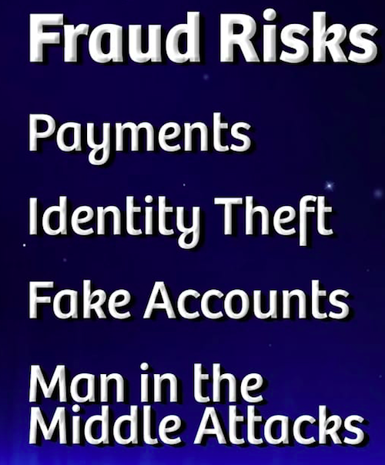

Slide 5
Technology Stack
Python 3.0
Django Framework
HTML
CSS
Bootstrap
Jupyter
Spyder

Slide 6
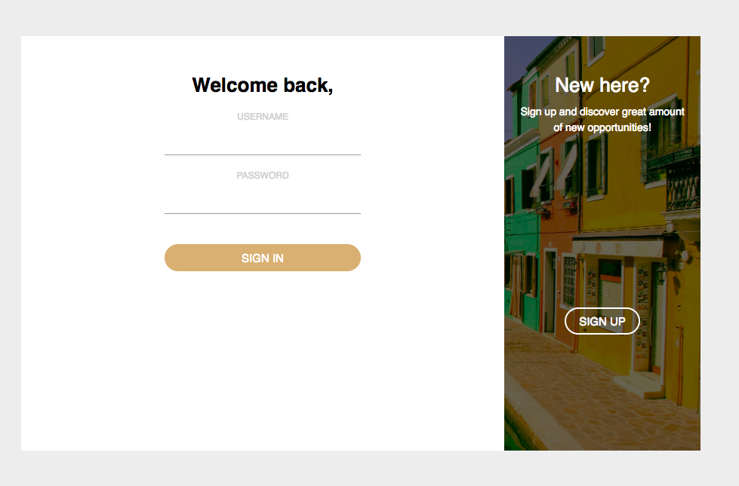
Front End
Login/Signup Page

Slide 7
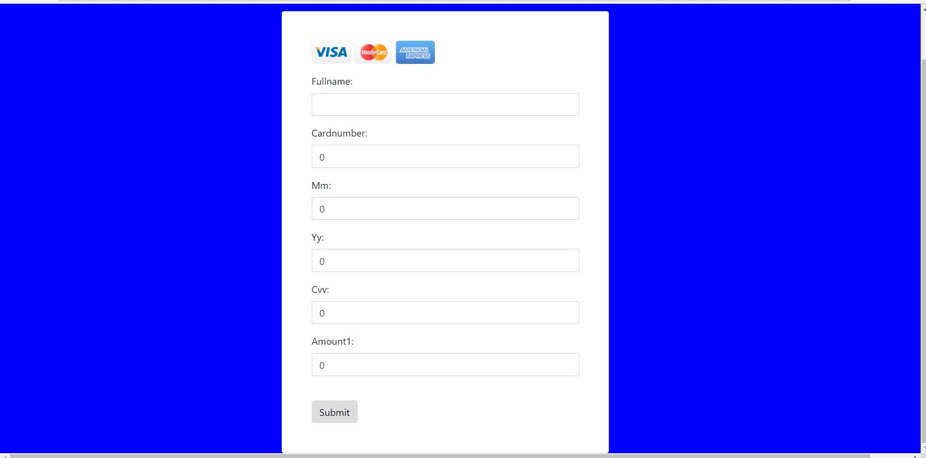
Transaction Portal

Slide 8
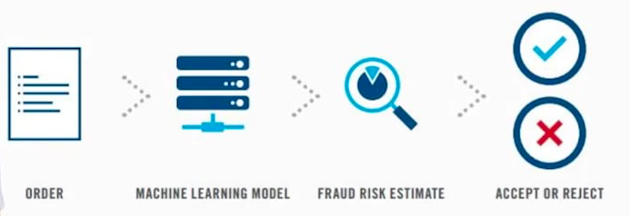
Procedure Followed

Slide 9
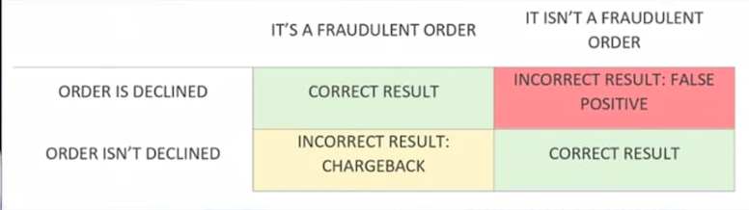
Checking

Slide 10
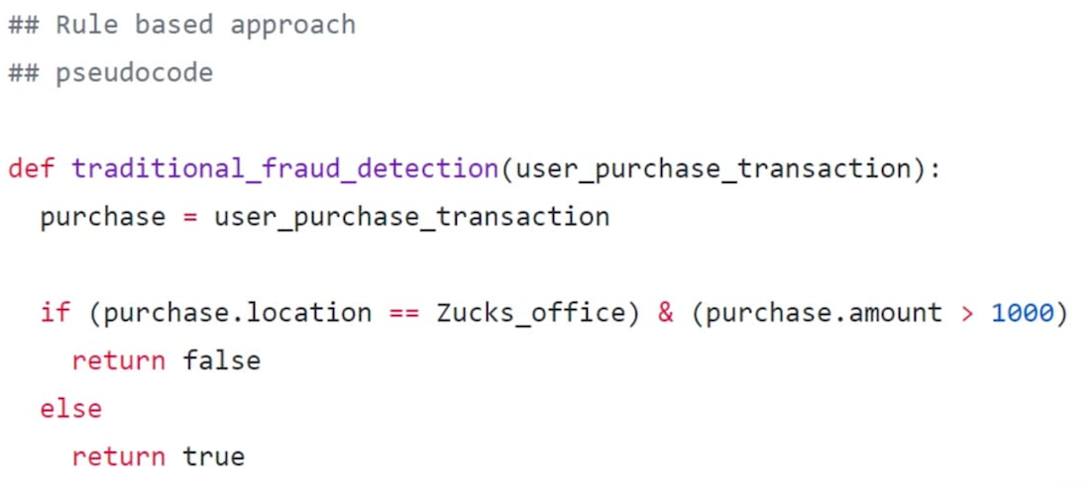
Pseudocode

Slide 11
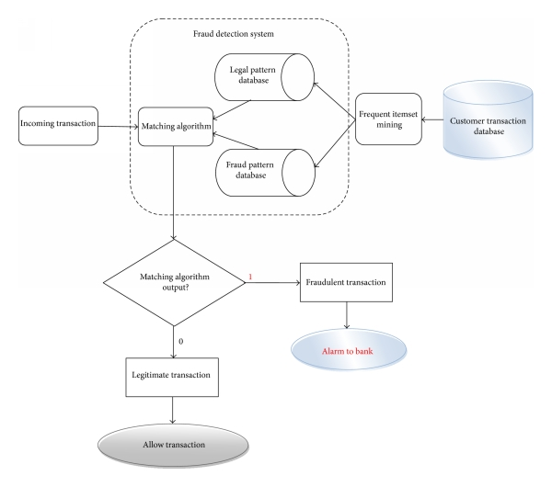
Credit Card Fraud Detection Model

Slide 12
Detection Approach
The following is the head of the csv file and one row data: "Time","V1","V2","V3","V4","V5","V6","V7","V8","V9","V10","V11","V12","V13","V14","V15","V16","V17","V18","V19","V20","V21","V22","V23","V24","V25","V26","V27","V28","Amount","Class"
We are not going to perform feature engineering in first instance. The dataset has been downgraded in order to contain 30 features (28 anonamised + time + amount).
The last column of the row is "Class", where "0" is for genuine (true) transaction and "1" is for fraud transaction.
We are using the K - Nearest Neighbor Method which will use Unsupervised Learning from the dataset.

Slide 13
K Nearest Neighbor is simple algorithm that stores all the available cases and classifies the new data or case based on similarity measure.
Advantages:
k-nearest neighbour can predict both qualitative & quantitative attributes
Creation of predictive model for each attribute with missing data is not required
Attributes with multiple missing values can be easily treated
Correlation structure of the data is taken into consideration
Disadvantage:
KNN algorithm is very time-consuming in analyzing large database. It searches through all the dataset looking for the most similar instances.
Choice of k-value is very critical. Higher value of k would include attributes which are significantly different from what we need whereas lower value of k implies missing out of significant attributes.
KNN

Slide 14
Handle Data
Open the dataset from CSV and split into test/train set
Similarity
Calculate the distance between two data instances
Neighbors
Locate k most similar data instance
STEPS
Response
Generate report from a set of data instance
Accuracy
Summarizing the accuracy of predictions
Main
Tie it all together

Slide 15
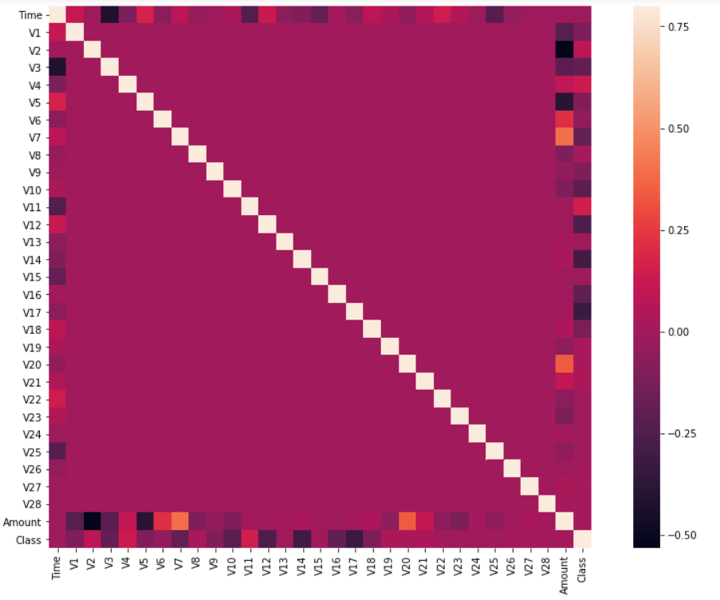
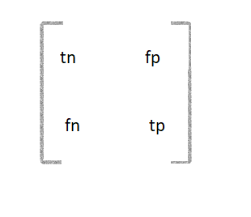
Place your screenshot here
Heat-Map created for correlational matrix.
tn - true negatives
fp - false positive
tp - true positives
Fn - false negatives

Slide 16
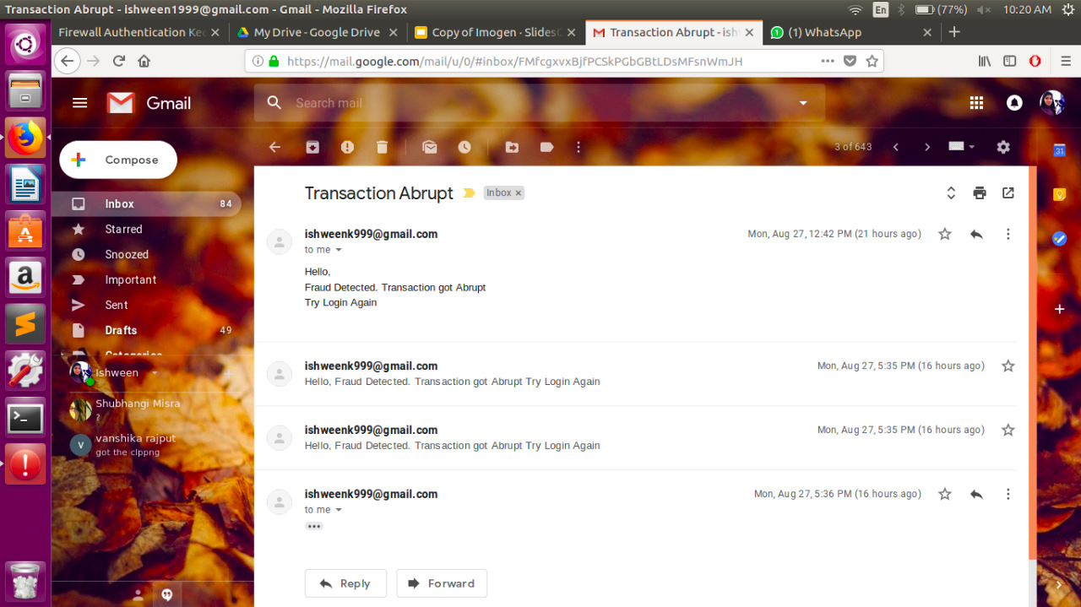
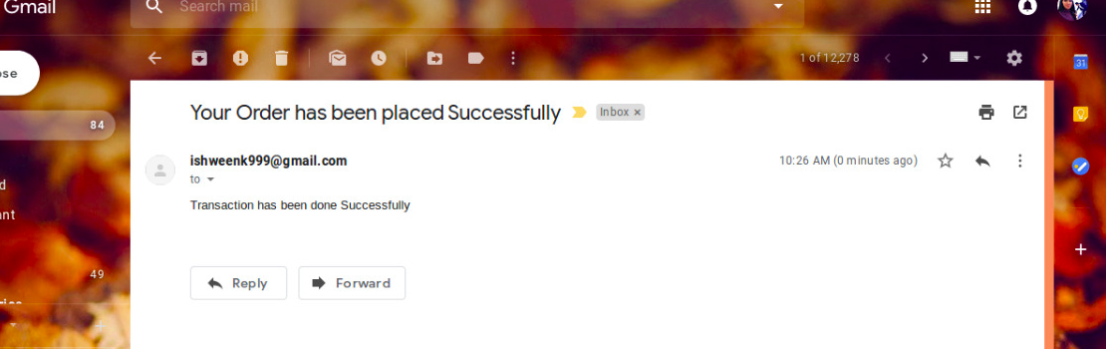
ACT- when fraud
Rollback transaction to login page for re - login of user
Send mails to organisation and customer regarding fraudulent transaction

Slide 17
Thank You!

