Slide 1
Databall
Baseball’s new- found love of analytics.
Roni Kaakaty
DSC530-T301

Slide 2
Hypothesis
Traditionalists would say that a good hitter has a batting average above .300 and doesn’t strike out. Since baseball has dramatically shifted towards the use of analytics, I want to see if batting average is still the most sought-after commodity in free agency.

Slide 3
Variables
Batting average
On-base percentage
Slugging percentage
Home runs
Strikeouts
Defensive runs saved
Wins above replacement
Age
Annual salary

Slide 4
Variables
Batting average: Average performance of the batter. Safe hits divided by plate opportunities.
On-base percentage: Frequency a batter reaches base per plate appearance.
Slugging percentage: Total number of bases recorded per at-bat.
Home run: A fair ball that a batter scores on without being called out.

Slide 5
Variables
Strikeout: A batter accumulates 3 strikes in an at bat resulting in an out.
Defensive runs saved: Measures how many runs a player saved or cost his team relative to an average player.
Wins above replacement: Measures players value in all facets of the game by determining how many more wins he’s worth than a replacement player in the same position.

Slide 6
Variables
Age: Age of player at time of free agency.
Average annual salary: Yearly salary based on total contract worth divided by duration.

Slide 7
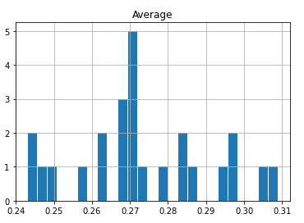
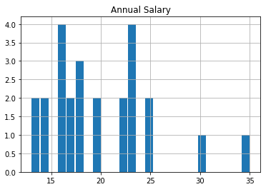
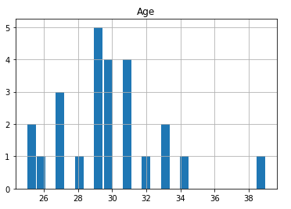
Variable histograms
Figure 1-1. Histogram of batting averages.
Figure 1-2. Histogram of annual salaries.
Figure 1-3. Histogram of age at time of free agency.

Slide 8
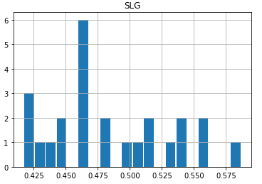
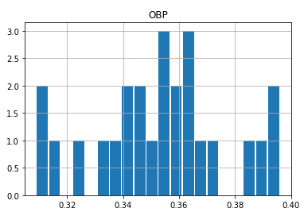
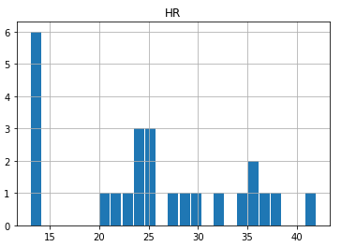
Variable histograms
Figure 1-4. Histogram of slugging percentage.
Figure 1-5. Histogram of on base percentage.
Figure 1-6. Histogram of home runs.

Slide 9
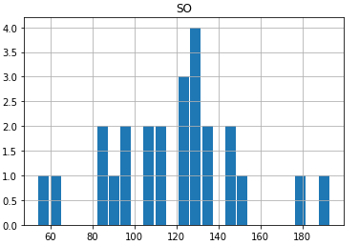
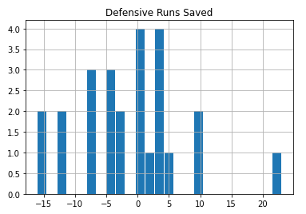
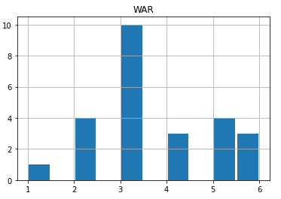
Variable histograms
Figure 1-7. Histogram of player strike outs.
Figure 1-8. Histogram of players defensive runs saved relative to the average.
Figure 1-9. Histogram of wins above replacement.

Slide 10
Outliers
Salaries to position players above 30 million annually.
Age above 35 at time of contract.
Defensive runs saved over 10.
Strikeouts exceeding 180 per year.

Slide 11
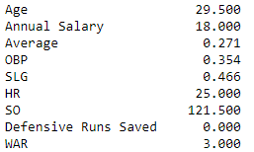
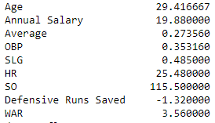
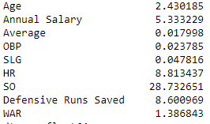
Summary Analysis
Median
Mean
I removed the largest age (39) and the largest strike outs (191) because they weren’t a true reflection of the typical free agent.
Strikeouts had the largest standard deviation at 28.73.
Biggest takeaway from these statistics is that defense isn’t prioritized as much as I anticipated.
Standard Deviation

Slide 12
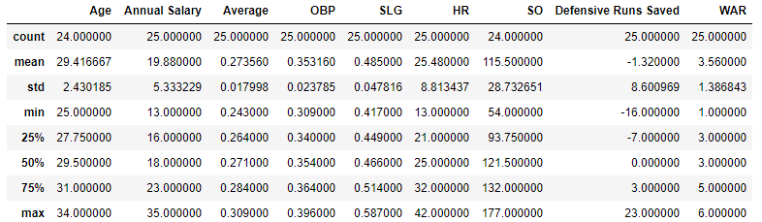
Summary Analysis
Not much variation between the average, on base percentage, and slugging of the players.
This figure highlights the disparity between the worst fielder (-16) and the best (23).

Slide 13
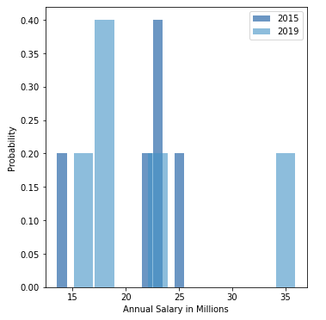
Probability mass function
Probability Mass Function of the salaries of players in 2015 and in 2019. I wanted to see if there was a dramatic shift in salaries due to inflation. Probability would say there was not.

Slide 14
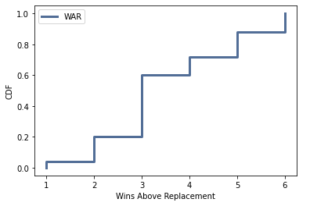
cumulative distribution function
Cumulative distribution function of the wins above replacement statistic. This function tells us that there’s an 80% probability that a random observation taken from the sample will be at below a WAR of 5.

Slide 15
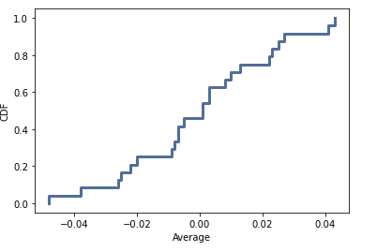
Exponential Distribution
I chose to chart the batting averages of players using the exponential distribution function because there should be no drastic difference between times. Batting averages haven’t fluctuated from 2015-2019.

Slide 16
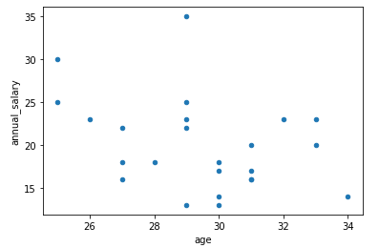
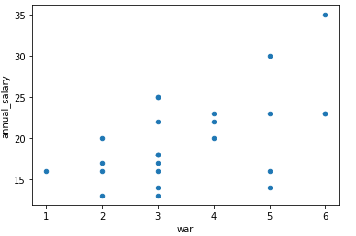
Scatter plot
Figure 1-10. Scatter plot of age vs. annual salary.
Figure 1-10 shows that there isn’t a strong correlation between the age of the player and their annual salary. Younger players do tend to make more annually, but not a strong enough correlation. Correlation = NaN.
Figure 1-11 shows that there is a linear relationship between the wins above replacement stat and the player’s annual salary. Correlation = .53
Figure 1-11. Scatter plot of WAR vs. annual salary.

Slide 17
Hypothesis Testing
Used T-test to test null hypothesis that batters with a batting average of over .300 are the most sought after. The test rejected the null hypothesis.

Slide 18
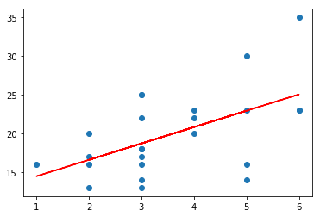
Regression Analysis
Fitted a linear regression line to plot the explanatory variable (WAR) with the dependent variable (Salary).
Line shows that as WAR increases, the salary also increases.
Figure 1-12. Linear regression that plots Wins above replacement vs. Annual Salary.

