Slide 1
Node.js
Introduction & Basics

Slide 2
Agenda
What is Node.js?
Architecture of Node.js
Node.js Event Loop
Why Node.js?
Demos
Where to use Node JS

Slide 3
What is Node.js
It was created by Ryan Dahl in 2009
It is an open source , cross platform runtime environment for server side and networking application
It is written in JavaScript and can run on Linux , Mac , Windows , FreeBSD
It provided an event driven architecture and a non blocking I/O that optimize and scalability
It used Google JavaScript V8 Engine to Execute Code
In ‘Node.js’ , ‘JS’ doesn’t mean that its solely written JavaScript. It is 40% JS and 60% C++.

Slide 4
JavaScript !== Java

Slide 5
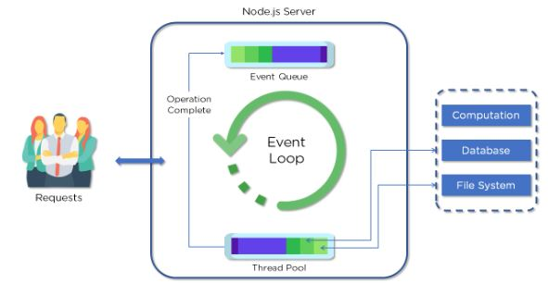
Architecture of Node.js
Everything inside Node.js runs in a single-thread
One process
One thread
One event loop
One JS Engine Instance
One Node.js Instance

Slide 6
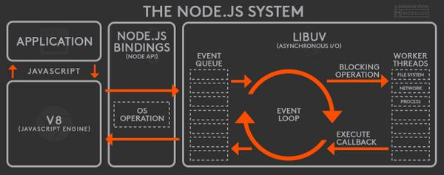
Architecture of Node.js (2)

Slide 7
Advantages
Provide Easy Way to Build Scalable Network Program
Node.js are free from worries of dead-locking the process, since there are no locks
Almost no function in Node.js directly performs I/O, so the process never blocks
Because nothing blocks, scalable systems are very reasonable to develop in Node.js

Slide 8
Why Node.js
Provide Easy Way to Build Scalable Network Programs
Allows to run JavaScript code in the backend, outside a browse.
Enable to use Same programming language (Javascript) for both front-end and back-end

Slide 9

Demo – Hello World
Target: Print “Hello World”;
Open CMD
Type “node” to start node process
Type “console.log(‘Hello World’)”

Slide 10
Demo – First Applications
Create server.js file
Copy the next content to your file
Open cmd and run “node server.js”
Test your application with chrome http://127.0.0.1:8080
const http = require('http'); http.createServer(function (req, res) { res.writeHead(200, {'Content-Type': 'text/plain'}); res.end('Hello World!'); }).listen(8080);

Slide 11
When to use Node.js
Few CPU Cycles
I/O Operations
Chat/ messaging
Real – Time Applications
Communication Hubs
High Concurrency Applications
Microservices

Slide 12
When looking for other platforms
Heavy Computation
Large and Complicated Web Applications

Slide 13
Node.js concepts
Non blocking I/O
Callbacks
Asynchronous code
Promises
Async/Await
Modules
Require
Core Modules – os, fs, path ….
User Defined Modules

Slide 14

More information resources
Node.js documentation - https://nodejs.org/en/docs/
Node.js Tutorial - https://www.tutorialspoint.com/nodejs/index.htm

