Slide 1
npm
Introduction

Slide 2
What is npm?
npm is the package manager for Node.js
It was created in 2009 as an open source project to help JavaScript developers easily share packaged modules of code
The npm Registry is a public collection of packages of open-source code
npm is the command line client that allows developers to install and publish those packages.

Slide 3
Basic CLI Commands
npm init – Create package.json
npm install - Install the dependencies in the local node_modules folder
npm test
npm start
npm publish – Publish a package

Slide 4
Demo
Create new folder
Open CMD from the folder
Type npm init
Type npm install express
Type npm install –-save-dev typescript

Slide 5
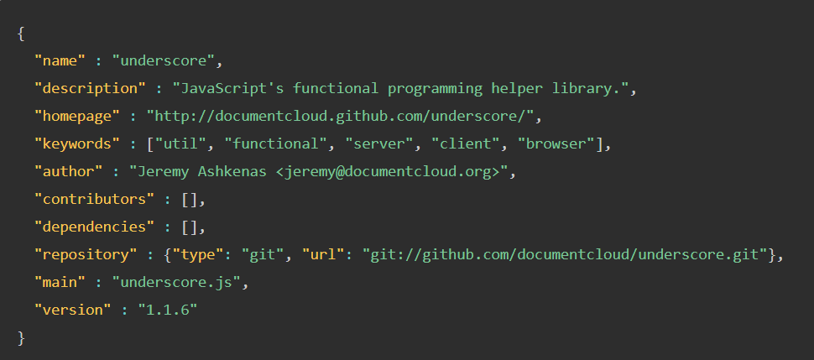
What is package.json
This file holds various metadata relevant to the project
This file is used to give information to npm that allows it to identify the project as well as handle the project's dependencies

Slide 6
What is node_modules folder
The node_modules folder contains libraries downloaded from npm
You shouldn't push it to your git source code !!!
Use .gitignore to avoid it

Slide 7
Popular Packages
React
Express
PM2
Jest
Mocha
ESLint
Socket.io
Passport
MongoDB Driver
Moment

