Slide 1
Introduction to causal inference Roni Kobrosly, PhD SciPy 2022
G
A
B
E
H
C
D
F
I

Slide 2
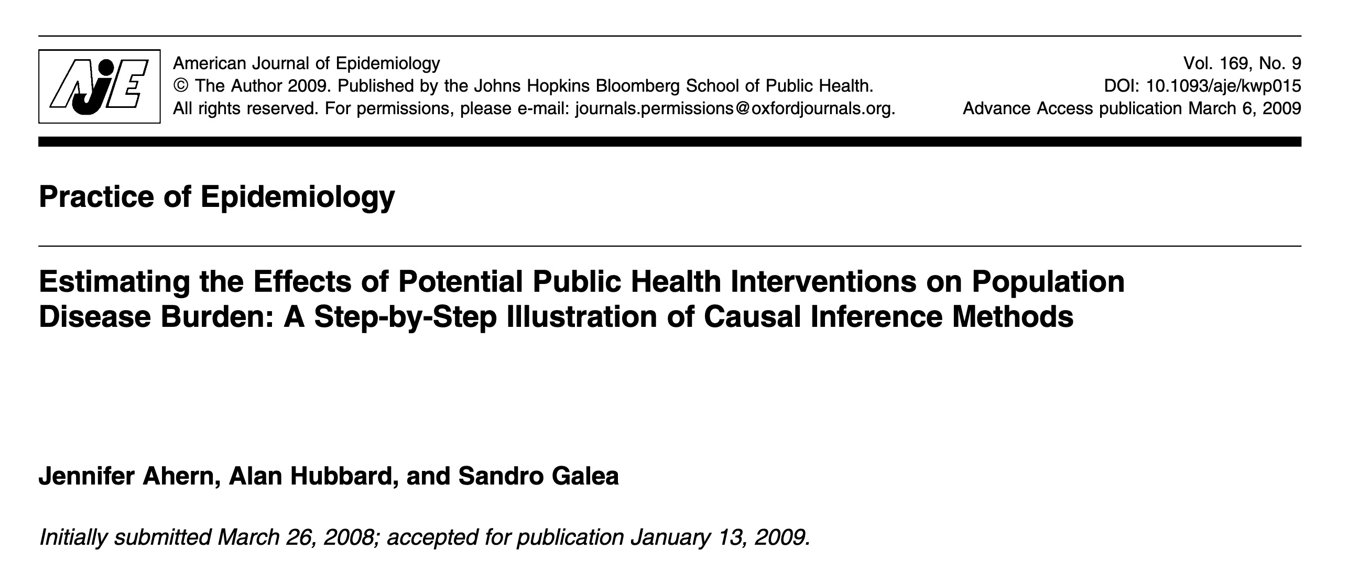

Slide 3
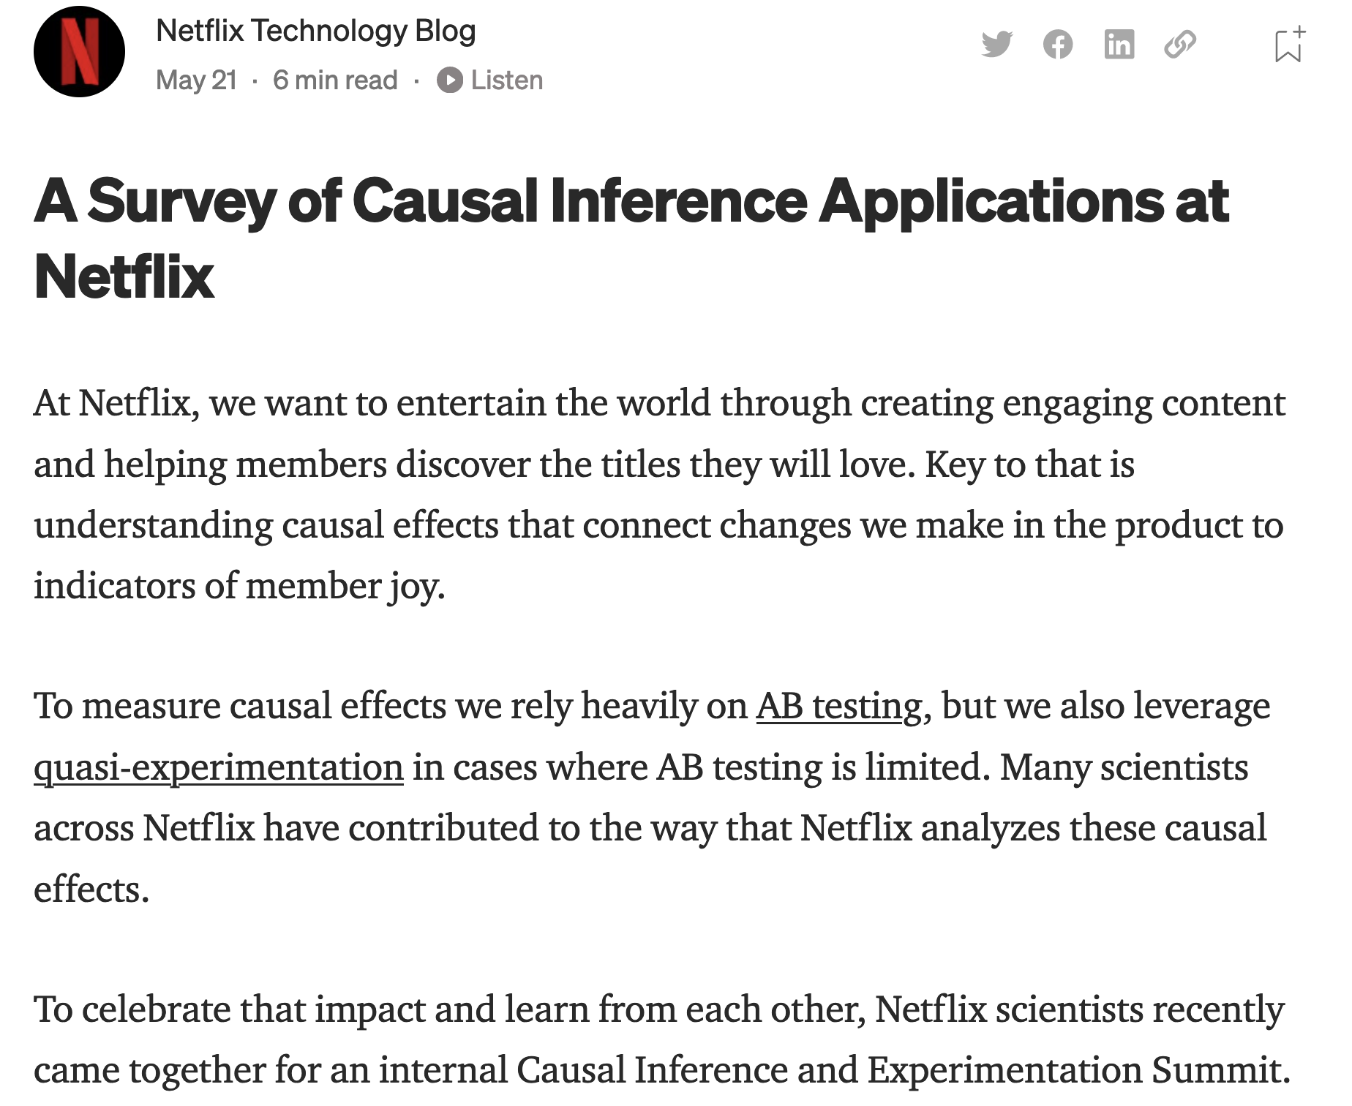

Slide 4
By the end of this tutorial, you should be able to
Understand the pitfalls of observational data analysis
Understand the various types of causal relationships
Describe the hierarchy of statistical analyses, causal inference, and experiments
Start conducting preliminary causal analyses on your own data
Confidently explore the topic on your own (now that you have a solid foundational understanding of causal thinking)

Slide 5
Does Vitamin D supplementation prevent severe covid symptoms?

Slide 6

The alternative universe example
Our
Observed reality

Slide 7
The alternative universe example
Early 2020
Starts Taking
Vitamin D
Our
Observed reality

Slide 8
The alternative universe example
Early 2020
Starts Taking
Vitamin D
Our
Observed reality
Lives
life

Slide 9
The alternative universe example
Early 2020
Starts Taking
Vitamin D
Mid 2020
Gets covid with
Mild symptoms
Our
Observed reality
Lives
life

Slide 10
The alternative universe example
Early 2020
Starts Taking
Vitamin D
Mid 2020
Gets covid with
Mild symptoms
Our
Observed reality
Lives
life
An alternative reality

Slide 11
The alternative universe example
Early 2020
Starts Taking
Vitamin D
Mid 2020
Gets covid with
Mild symptoms
Our
Observed reality
Lives
life
Early 2020
Never takes vitamin D
An alternative reality

Slide 12
The alternative universe example
Early 2020
Starts Taking
Vitamin D
Mid 2020
Gets covid with
Mild symptoms
Our
Observed reality
Lives
life
Early 2020
Never takes vitamin D
An alternative reality
Lives
life

Slide 13
The alternative universe example
Early 2020
Starts Taking
Vitamin D
Mid 2020
Gets covid with
Mild symptoms
Our
Observed reality
Lives
life
Early 2020
Never takes vitamin D
An alternative reality
Mid 2020
???
Lives
life

Slide 14

Experiments (AKA A/B Tests, AKA Randomized Controlled Trials)
Treatment group
Control group

Slide 15
Experiments (AKA A/B Tests, AKA Randomized Controlled Trials)
Treatment group
given blank vitamin D pills
Control group
given blank sugar pills

Slide 16
Experiments (AKA A/B Tests, AKA Randomized Controlled Trials)
See how many people get severe covid symptoms over next 2 months
Treatment group
given blank vitamin D pills
See how many people get severe covid symptoms over next 2 months
Control group
given blank sugar pills

Slide 17
Experiments won’t always save us
NOT ETHICAL: randomly assign some people to be exposed to lead paint while others are not, then see which group is more likely to develop neurological disorders. NOT FEASIBLE: modify household incomes in neighborhoods, to see if changing a neighborhood’s income inequality improves local crime rate.

Slide 18
Pearl’s causal hierarchy
Level | Typical Activity | Examples
1) Association | Seeing | Is increased income inequality in a city correlated with more violent crime?
2) Intervention | Doing, intervening | What happens if we ban the sale of cigarettes in this county?
3) Counterfactual | Imagining, Retrospection | If Lucy hadn’t been smoking cigarettes the last 10 years, would she still have developed cancer? Was it the aspirin that stopped my headache?
J. Pearl. 2018. “The Seven Tools of Causal Inference with Reflections on Machine Learning”

Slide 19
A simplified hierarchy…
Weaker
causal
claims
Stronger
causal
claims
statistical associations / correlations
randomized experiments
causal inference
More difficult
Easier

Slide 20
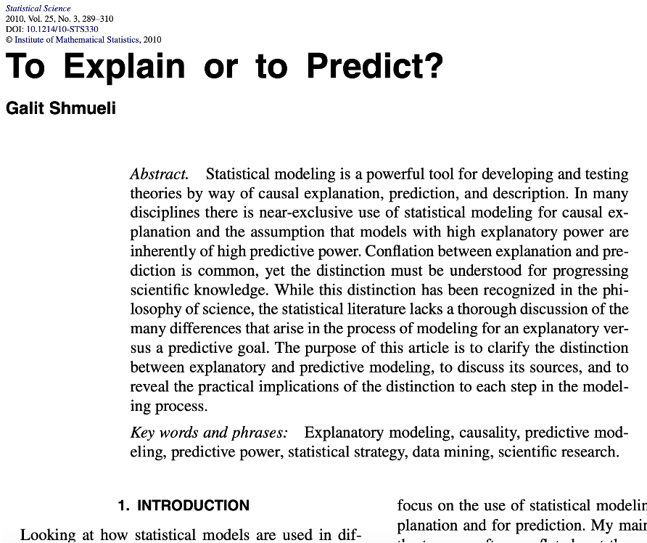
Inference vs prediction in modeling
Inference:
What is the sample mean of X?
Is X associated with Y?
What is strength of that association?
Prediction:
How can I best predict Y?
Between A, B, and C, what variable is the best predictor of Y?
Why did the model make a particular prediction (AKA interpretability)

Slide 21
A causal graph
A
B
E
C
D

Slide 22

Car insurance exercise

Slide 23
Make & model
Car safety rating
Antilock
Socioeconomics
Theft history
Vehicle Year
Age
Advanced airbag
Car value
Good student?
Risk aversion
Driving course?
Accident history
Anti-theft tech
Property Cost
Medical Cost

Slide 24
Ice cream and violent crime
Ice cream sales
Violent
crime

Slide 25
Summer weather induces a false association between ice cream sales and violent crime
Hot Weather
Ice cream sales
Violent
crime

Slide 26
Summer weather induces a false association between ice cream sales and violent crime
Hot Weather
Ice cream sales
Violent
crime

Slide 27
Summer weather induces a false association between ice cream sales and violent crime
Hot Weather
Ice cream sales
Violent
crime

Slide 28
Control for the season and then the ice cream-violent crime association disappears
Hot Weather
Ice cream sales
Violent
crime

Slide 29
Control for the season and then the ice cream-violent crime association disappears
Hot Weather
Ice cream sales
Violent
crime

Slide 30
Confounders
Always want to control for / condition on confounders in inferential modeling
Confounding changes the effect size and possibly statistical significance of your association of interest
Confounders can flip the sign of your association of interest
Leftover confounding in a model is named “residual confounding”
Smoking
Lung Cancer
Coffee

Slide 31
Confounders
Positive confounding: confounder introduces a bias that pushes association of interest away from the “null”
Negative confounding: confounder biases association towards the “null”
Smoking
Lung Cancer
Coffee

Slide 32
Colliders
Never want to control for / condition on colliders
Conditioning on a common effect causes collider bias, which can be in positive or negative direction
# of
sick
days taken
Lung Cancer
smoking

Slide 33
Mediators
Controlling for a mediator will nullify associations of interest
There are statistical tests of mediation you can use to help determine causal relationships in observational data
Clinical signs of lung damage
Lung cancer
Smoking

Slide 34
Unrelated predictors
If they are unrelated to your independent variable / treatment / exposure of interest, there is no harm in controlling for them.
In fact, leaving them in could improve model performance.
Gene that increases risk of lung cancer
Lung cancer
Smoking

Slide 35
Causality is complicated!
# of sick
Days taken
Smoking
Gene that increases risk of lung cancer
Peers
That
Smoke
Lung
cancer
Socio-
economic
disadvantage
Clinical
signs of lung damage
Construction
Work
Asbestos
Exposure

Slide 36
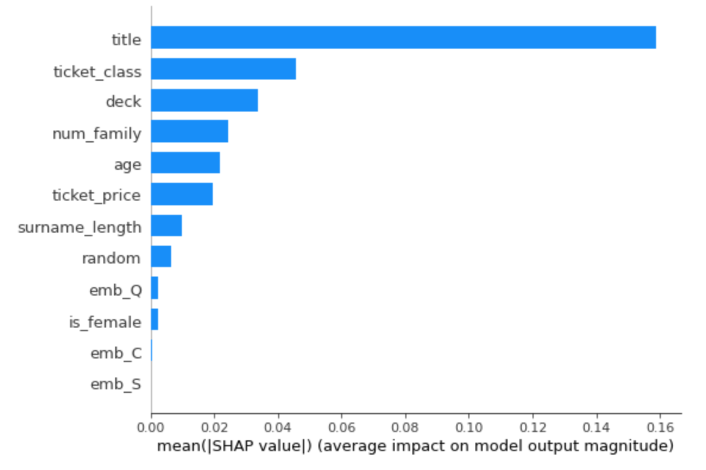
nota bene!
Traditional variable importance methods don't tell you anything about causality!

Slide 37
If you are doing causal modeling…
First, think carefully about quantities of interest and their relationships before looking at any data - this requires domain knowledge
Stick with a small set of important variables that you have domain knowledge on
Before modeling, understand bivariate relationships between independent vars, also between independent vars and dependent var
Identify potential confounders and identify covariates not to control for

Slide 38
Bias and fairness
In 2022 it’s pretty clear that applying black box models towards decision making in any broad social process is a terrible idea
e.g. predicting crime location, recidivism, who gets approved for a credit card, which job applicant’s resume should be looked at, etc…

Slide 39
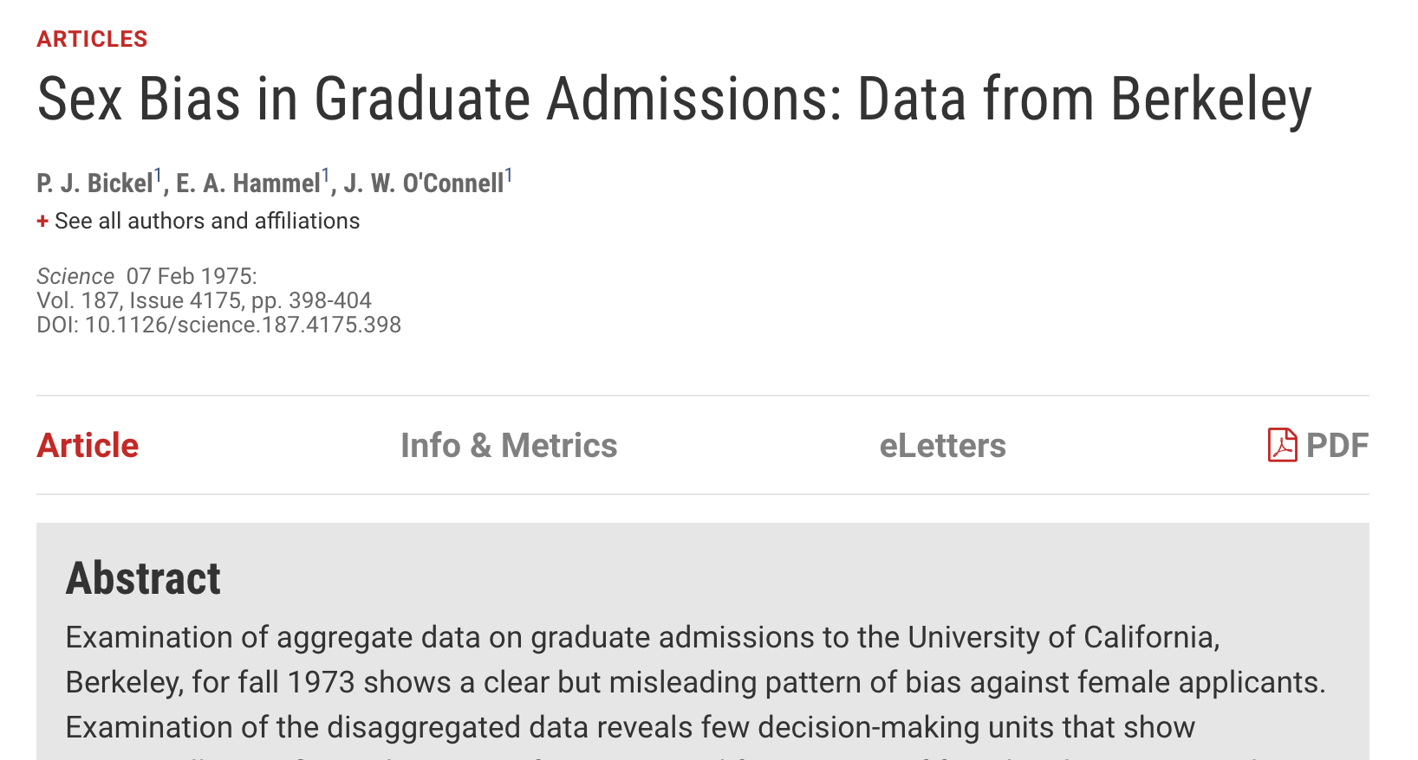

Slide 40
The college admission process
Gender
Qualifications
Department
Admission
S chiappa et al. deepmind blog: “Causal Bayesian Networks: A flexible tool to enable fairer machine learning”. 2019
Notes:
By defining unfairness as the presence of a harmful influence from the sensitive attribute in the graph, CBNs provide us with a simple and intuitive visual tool for describing different possible unfairness scenarios underlying a dataset. In addition, CBNs provide us with a powerful quantitative tool to measure unfairness in a dataset and to help researchers develop techniques for addressing it.
Whilst the direct influence of the sensitive attribute on admission is considered unfair for social and legal reasons, the indirect influence could be considered fair or unfair depending on contextual factors.

Slide 41
Scenario #1
Gender
Qualifications
Department
Admission
Notes:
By defining unfairness as the presence of a harmful influence from the sensitive attribute in the graph, CBNs provide us with a simple and intuitive visual tool for describing different possible unfairness scenarios underlying a dataset. In addition, CBNs provide us with a powerful quantitative tool to measure unfairness in a dataset and to help researchers develop techniques for addressing it.
Whilst the direct influence of the sensitive attribute on admission is considered unfair for social and legal reasons, the indirect influence could be considered fair or unfair depending on contextual factors.

Slide 42
Scenario #2
Gender
Qualifications
Department
Admission
Notes:
By defining unfairness as the presence of a harmful influence from the sensitive attribute in the graph, CBNs provide us with a simple and intuitive visual tool for describing different possible unfairness scenarios underlying a dataset. In addition, CBNs provide us with a powerful quantitative tool to measure unfairness in a dataset and to help researchers develop techniques for addressing it.
Whilst the direct influence of the sensitive attribute on admission is considered unfair for social and legal reasons, the indirect influence could be considered fair or unfair depending on contextual factors.

Slide 43
Scenario #3
Gender
Qualifications
Department
Admission
Notes:
By defining unfairness as the presence of a harmful influence from the sensitive attribute in the graph, CBNs provide us with a simple and intuitive visual tool for describing different possible unfairness scenarios underlying a dataset. In addition, CBNs provide us with a powerful quantitative tool to measure unfairness in a dataset and to help researchers develop techniques for addressing it.
Whilst the direct influence of the sensitive attribute on admission is considered unfair for social and legal reasons, the indirect influence could be considered fair or unfair depending on contextual factors.

Slide 44
If extra time… here are some slides on causal structure learning…

Slide 45
Causal graph learning (is very hard)
It’s a combinatorial nightmare: the number of possible DAGs can grow super-exponentially with the number of nodes.
Blindly using structure learning on data without having domain knowledge is an awful idea
A few classes of algorithms to assist with this:
Constraint-based algos
Score-based algos
Newer graph neural network approaches

Slide 46
Constraint-based algos (AKA lots of little tests of association)
A
B
F
C
E
D
Notes:
https://www.bnlearn.com/about/slides/slides-pgm18.pdf

Slide 47
Constraint-based algos (AKA lots of little tests of association)
X
A
B
F
C
E
D
Notes:
https://www.bnlearn.com/about/slides/slides-pgm18.pdf

Slide 48
Constraint-based algos (AKA lots of little tests of association)
A
B
X
F
C
E
D
Notes:
https://www.bnlearn.com/about/slides/slides-pgm18.pdf

Slide 49
Constraint-based algos (AKA lots of little tests of association)
A
B
✓
F
C
E
D
Notes:
https://www.bnlearn.com/about/slides/slides-pgm18.pdf

Slide 50
Constraint-based algos (AKA lots of little tests of association)
A
B
✓
✓
F
C
E
D
Notes:
https://www.bnlearn.com/about/slides/slides-pgm18.pdf

Slide 51
Constraint-based algos (AKA lots of little tests of association)
A
B
X
✓
✓
F
C
E
D
Notes:
https://www.bnlearn.com/about/slides/slides-pgm18.pdf

Slide 52
Constraint-based algos (AKA lots of little tests of association)
A
B
F
C
E
D
Notes:
https://www.bnlearn.com/about/slides/slides-pgm18.pdf

Slide 53
Constraint-based algos (AKA lots of little tests of association)
A
B
F
C
E
D
Notes:
https://www.bnlearn.com/about/slides/slides-pgm18.pdf

Slide 54
Constraint-based algos (AKA lots of little tests of association)
A
B
F
C
E
D
Notes:
https://www.bnlearn.com/about/slides/slides-pgm18.pdf

Slide 55
Score-based algos (AKA randomly tweak structure and check fit)
A
B
F
C
E
D

Slide 56
Score-based algos (AKA randomly tweak structure and check fit)
A
B
F
C
E
D
Fit score: 58

Slide 57
Score-based algos (AKA randomly tweak structure and check fit)
A
B
F
C
E
D
Fit score: 55

Slide 58
Score-based algos (AKA randomly tweak structure and check fit)
A
B
F
C
E
D
Fit score: 62

Slide 59
Score-based algos (AKA randomly tweak structure and check fit)
A
B
F
C
E
D
Fit score: 54

Slide 60
Graph Neural Network approach
A
B
0.24
-0.4
1.5
F
C
-0.15
1.9
E
D

Slide 61
Graph Neural Network approach
Destination
 | A | B | C | D | E | F
A | -0.3 | -2.2 | 0.001 | 1.1 | 0.2 | 0.3
B | 2.5 | 1.3 | 0.002 | 0.01 | 0.4 | 0.35
C | 0.03 | 0.2 | 0.09 | -0.3 | -0.3 | 1.04
D | 0.01 | 0.4 | 0.093 | -0.41 | 1.1 | -0.2
E | 0.003 | 0.031 | -0.05 | 0.07 | 0.03 | -0.1
F | 2.3 | 0.6 | -0.01 | 0 | 0.1 | 0.033
Source

Slide 62
Graph Neural Network approach
Destination
 | A | B | C | D | E | F
A | 0 | 1 | 0 | 1 | 0 | 0
B | 1 | 0 | 0 | 0 | 0 | 0
C | 0 | 0 | 0 | 0 | 0 | 1
D | 0 | 0 | 0 | 0 | 1 | 0
E | 0 | 0 | 0 | 0 | 0 | 0
F | 1 | 1 | 0 | 0 | 0 | 0
Source

Slide 63
Structure learning ain’t easy
A
B
C
These three graphs belong to the same “Markov Equivalence Class” and are indistinguishable with observational data!
A
B
C
A
B
C
Notes:
Equivalence class

Slide 64
Back to the regularly scheduled program…

Slide 65
Assumptions of causal inference
Temporality. Causes always occur before effects: The treatment variable needs to occur before measured outcome. Covariates should occur before treatment (prevents you from controlling on colliders).
Stable Unit Treatment Value. The treatment status of a given individual does not affect the potential outcomes of any other individuals.
Positivity. For each level of each covariate in your data, there needs to be some variability of the treatment and outcome variables.
Ignorability. All major confounding variables are included in your data. This is a tough one, but necessary to get an unbiased estimate of the treatment effect.

Slide 66
Shout out which assumptions are violated!

Slide 67
Example #1
I want to understand whether frequent emails to customers might impact customer satisfaction.
I have survey data with customer, self-reported satisfaction from a year ago, and I use this past month’s number of emails for each customer as a proxy for how often we email them generally.

Slide 68
Example #2
I want to see the causal impact of a neighborhood’s cleanliness on crime rates, controlling for 20 known confounders.
I pull up an academic dataset with data on 40 distinct neighborhoods. The unit of analysis in my study will be the neighborhood.

Slide 69
Example #3
I want to see how releasing a new in-app, multiplayer game through my social media app impacts user engagement. I only want to give it to some test users initially.
With this multiplayer game you can play with anyone who has the social media app by sending them invites. Accidentally, our test users can invite non-test users.

Slide 70
Example #4
We’re curious how a job training program could impact a person’s income 3 years in the future.
Unfortunately we don’t have lots of data on the participants so we perform a causal inference analysis only controlling for the person’s age.

Slide 71
The familiar modeling spectrum…
Less complex
More complex
PSM
G-computation
Double ML methods
More interpretable
Less interpretable

Slide 72
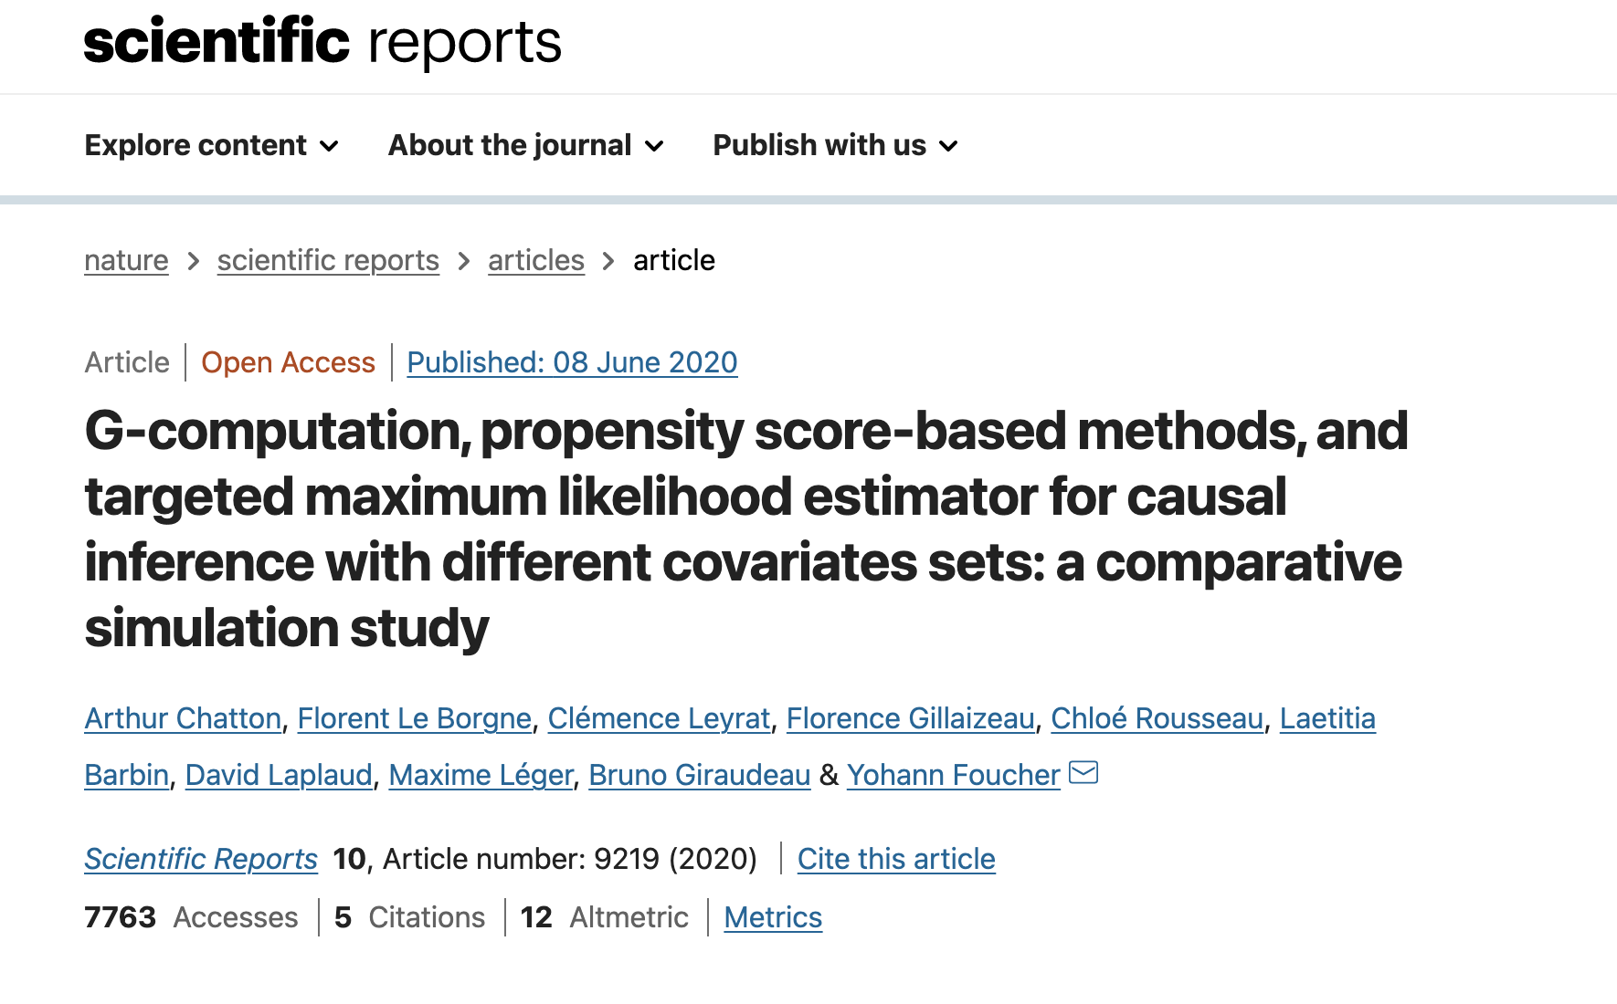
Some empirical studies have been conducted, but jury is still out. Largely depends on your audience? (PSM easier to explain)

Slide 73
Counterfactuals (with a binary treatment)
Our
Observed reality
10-year smoker
An alternative reality
Never
smokes

Slide 74
Counterfactuals (with a binary treatment)
Our
Observed reality
Systolic blood pressure
10-year smoker
An alternative reality
Never
smokes
Systolic blood pressure

Slide 75
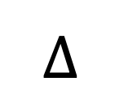
Counterfactuals (with a binary treatment)
Our
Observed reality
Systolic blood pressure
10-year smoker
$$∆$$
An alternative reality
Never
smokes
Systolic blood pressure

Slide 76
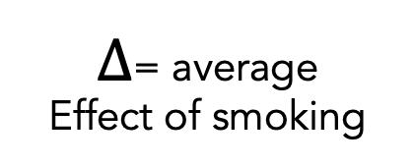
Counterfactuals (with a binary treatment)
Our
Observed reality
Smokes for 10 years
Mean Measure blood pressure at age 30
$∆$= average
Effect of smoking
An alternative reality
Never smokes
Mean Measure blood pressure at age 30

Slide 77
Causal inference metrics
Average treatment effect (ATE)
Average treatment effect among treated (ATT)
Average treatment effect among untreated (ATU)
Average treatment effect among segment X or Y
Treatment effect for an individual
And much more…

Slide 78
Propensity score matching
(PS)

Slide 79
1) Start with a set of participants for whom we have complete treatment, outcome, and covariate data
ID# | Covar 1 | Covar 2 | treat | outcome
1 | … | … | 1 | 20
2 | … | … | 1 | 15
3 | … | … | 0 | 10
4 | … | … | 0 | 10
5 | … | … | 1 | 20

Slide 80
2) For all participants, calculate probability of them receiving treatment, based on covariate data (a propensity score)
ID# | Covar 1 | Covar 2 | treat | ps | outcome
1 | … | … | 1 | 0.65 | 20
2 | … | … | 1 | 0.33 | 15
3 | … | … | 0 | 0.64 | 10
4 | … | … | 0 | 0.33 | 10
5 | … | … | 1 | 0.97 | 20

Slide 81
3) Take sub-sample of treated participants and match to sub-sample of control participants, based on similar ps values
ID# | Covar 1 | Covar 2 | treat | ps | outcome
1 | … | … | 1 | 0.65 | 20
3 | … | … | 0 | 0.64 | 10
ID# | Covar 1 | Covar 2 | treat | ps | outcome
2 | … | … | 1 | 0.33 | 15
4 | … | … | 0 | 0.33 | 10

Slide 82
4) Calculate treatment effect on these two sub-samples using standard approaches
ID# | Covar 1 | Covar 2 | treat | ps | outcome
1 | … | … | 1 | 0.65 | 20
2 | … | … | 1 | 0.33 | 15
3 | … | … | 0 | 0.64 | 10
4 | … | … | 0 | 0.33 | 10
Average treatment effect among matched
participants
$$= {\overline{x}}_{treated}−{\overline{x}}_{untreated}=\frac{\left(20+15\right)}{2}−\frac{\left(10+10\right)}{2}=7.5$$

Slide 83
Causal dose-response curve estimation
(AKA estimating the causal curve)

Slide 84
Counterfactuals (with a continuous treatment)
Outcome
Treatment

Slide 85
Counterfactuals (with a continuous treatment)
Outcome
Treatment

Slide 86
Counterfactuals (with a continuous treatment)
Outcome
Treatment

Slide 87
Counterfactuals (with a continuous treatment)
Outcome
Treatment

Slide 88
Counterfactuals (with a continuous treatment)
Outcome
Treatment

Slide 89
Counterfactuals (with a continuous treatment)
Outcome
Treatment

Slide 90
Estimating the “causal curve”
GPS is an extension of the standard propensity score method. It is the treatment assignment density calculated at a particular treatment value
Calculate the GPS associated with each treatment value observation
Fit a curve of treatment values predicting outcome values, adjusted for the GPS
The resulting treatment against outcome curve is your causal dose response curve (AKA your causal curve)

Slide 91
G-computation

Slide 92
1) Start with a set of participants for whom we have complete treatment, outcome, and covariate data
ID# | Covar 1 | Covar 2 | treat | outcome
1 | … | … | 1 | 20
2 | … | … | 1 | 15
3 | … | … | 0 | 10
4 | … | … | 0 | 10
5 | … | … | 1 | 20

Slide 93
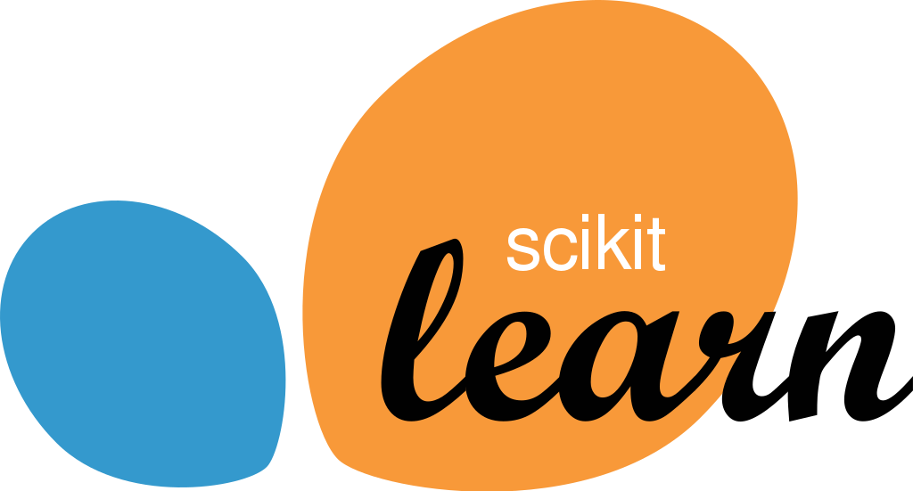
2) train a model that predicts the outcome from all covariates and treatment variable. Aim for high recall and precision.
ID# | Covar 1 | Covar 2 | treat | outcome
1 | … | … | 1 | 20
2 | … | … | 1 | 15
3 | … | … | 0 | 10
4 | … | … | 0 | 10
5 | … | … | 1 | 20

Slide 94
3) “force” every observation in the dataset to receive the treatment
ID# | Covar 1 | Covar 2 | treat | outcome
1 | … | … | 1 | 20
2 | … | … | 1 | 15
3 | … | … | 1 | 10
4 | … | … | 1 | 10
5 | … | … | 1 | 20

Slide 95
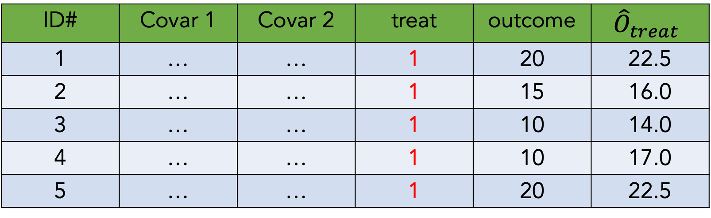
4) Predict outcome values with these covariate and treatment values
ID# | Covar 1 | Covar 2 | treat | outcome | $${\hat{O}}_{treat}$$
1 | … | … | 1 | 20 | 22.5
2 | … | … | 1 | 15 | 16.0
3 | … | … | 1 | 10 | 14.0
4 | … | … | 1 | 10 | 17.0
5 | … | … | 1 | 20 | 22.5

Slide 96
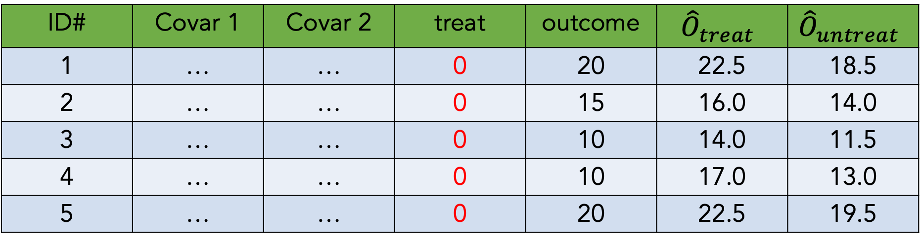
5) Now “force” every observation to not receive treatment,
And make outcome predictions again
ID# | Covar 1 | Covar 2 | treat | outcome | $${\hat{O}}_{treat}$$ | $${\hat{O}}_{untreat}$$
1 | … | … | 0 | 20 | 22.5 | 18.5
2 | … | … | 0 | 15 | 16.0 | 14.0
3 | … | … | 0 | 10 | 14.0 | 11.5
4 | … | … | 0 | 10 | 17.0 | 13.0
5 | … | … | 0 | 20 | 22.5 | 19.5

Slide 97
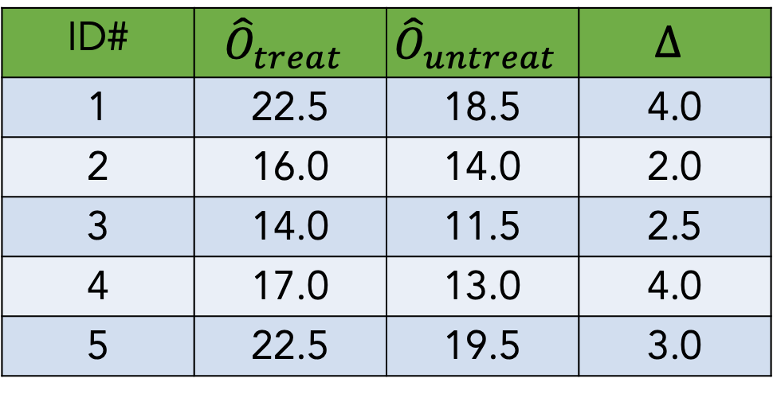
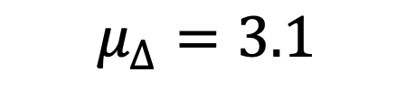
6) Calculate the average difference between treated and untreated outcome estimates
ID# | $${\hat{O}}_{treat}$$ | $${\hat{O}}_{untreat}$$ | $$∆$$
1 | 22.5 | 18.5 | 4.0
2 | 16.0 | 14.0 | 2.0
3 | 14.0 | 11.5 | 2.5
4 | 17.0 | 13.0 | 4.0
5 | 22.5 | 19.5 | 3.0
$$μ_{∆}=3.1$$

Slide 98
Double ML
And
Targeted maximum likelihood estimation (TMLE)

Slide 99
The double modeling approaches
Using any machine learning method (or an ensemble of them), make an initial model to predict the outcome given the treatment and covariates: Y ~ A + W1+ W2 + Wi. With this, you are able to calculate an initial, crude estimate of the treatment effect by artificially setting A = 1 for all observations, and then by setting A = 0 for all individuals, and observing the difference in Y.
Using the same or different machine learning method, make a model to predict treatment assignment using the covariates: A ~ W1+ W2 + Wi. For each individual, estimate the probability of A = 1, given the covariates, and the probability of A = 0, given the covariates
Use the model and probabilities from step 2, update the initial model in step 1 in a “targeting step”. In step 2 we exploit information about the relationship between the treatment and covariates to reduce bias of the estimate from step 1.

Slide 100
The double modeling approaches
Pros
Double-robust
Unlike other approaches, Can handle as many covariates as needed (as long as there are enough observations)
Can handle more complex causal inference scenarios (e.g. control for time-varying confounding in panel data)
Doesn’t require bootstrapping to estimate confidence bounds
Cons
Slower than other methods (depending on what ML you use)
Least explainable relative to other methods

Slide 101
Closing thoughts: troubleshooting
Understanding the data-generating process is often way more valuable than employing an algo
There is value in trying multiple techniques to understand their range of estimates (use p-value correction if you’re running lots of analyses)
You’ll never be able to capture all confounders, but aim to capture the major ones
If your results don’t make sense, you’re probably missing a big source of bias
Causal inference and modeling is not as trustworthy as running proper experiments. Approach all results with healthy skepticism

Slide 102
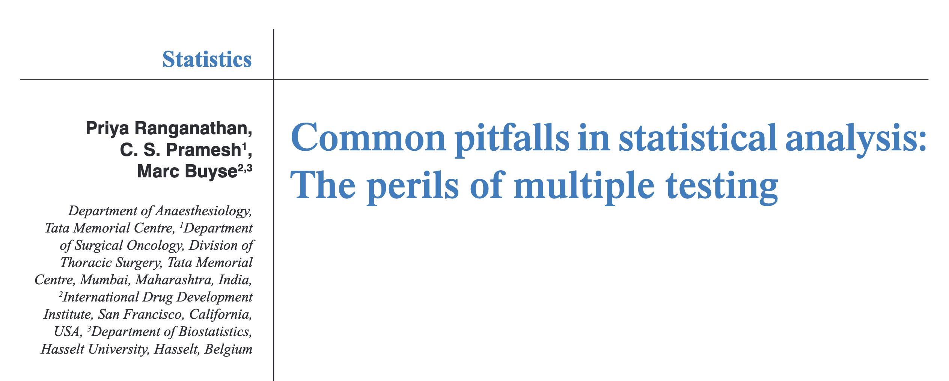
Closing thoughts: the perils of multiple testing…

Slide 103
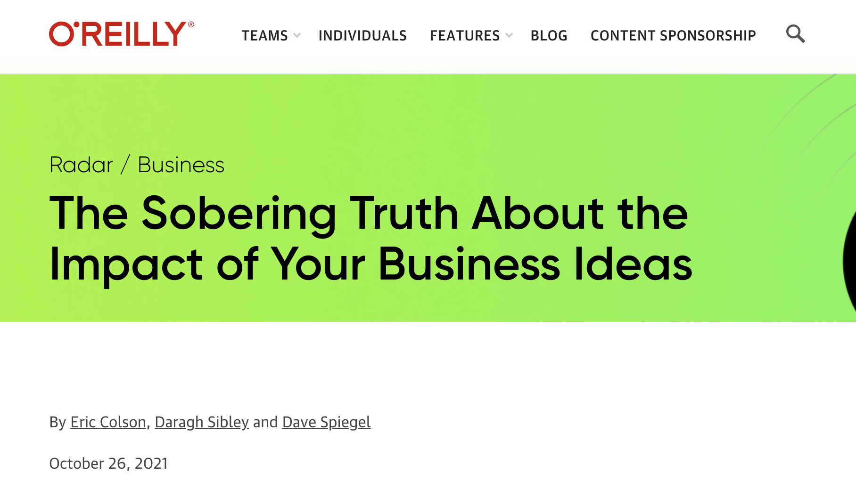
Closing thoughts: be humble, it’s likely your research or business idea doesn’t work!

