Slide 1
Introduction to causal modeling Roni Kobrosly, PhD
G
A
B
H
C
D
F
I
E

Slide 2
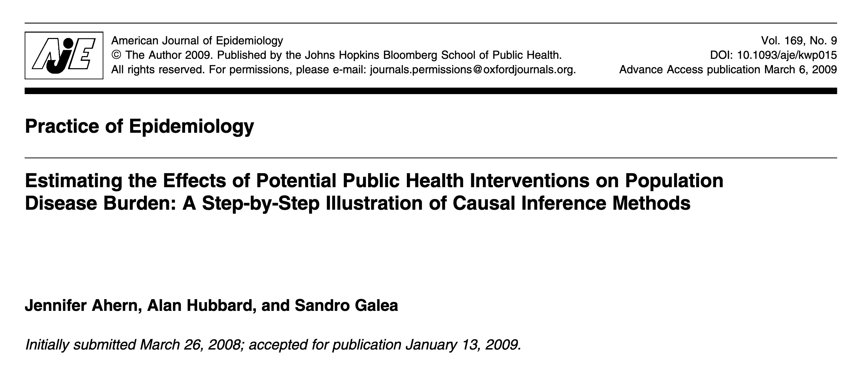

Slide 3
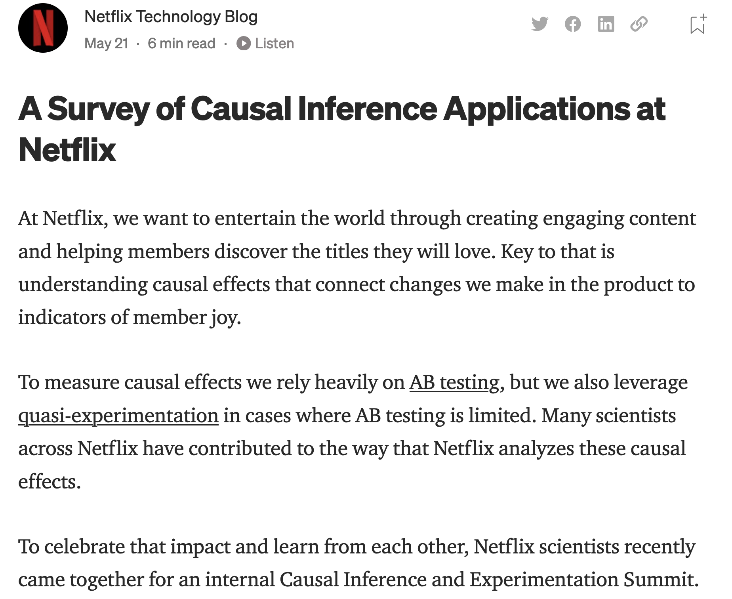

Slide 4
By the end of this tutorial, you should be able to
Understand the pitfalls of observational data analysis
Know the various types of causal relationships to look out for
Describe the hierarchy of statistical analyses, causal inference, and experiments
Start conducting preliminary causal analyses on your own data
Confidently explore the topic on your own (now that you have a solid foundational understanding of causal thinking)

Slide 5
Does Vitamin D supplementation prevent severe covid symptoms?

Slide 6

The alternative universe example
Our
Observed reality

Slide 7
The alternative universe example
Early 2020
Starts Taking
Vitamin D
Our
Observed reality

Slide 8
The alternative universe example
Early 2020
Starts Taking
Vitamin D
Our
Observed reality
Lives
life

Slide 9
The alternative universe example
Early 2020
Starts Taking
Vitamin D
Mid 2020
Gets covid with
Mild symptoms
Our
Observed reality
Lives
life

Slide 10
The alternative universe example
Early 2020
Starts Taking
Vitamin D
Mid 2020
Gets covid with
Mild symptoms
Our
Observed reality
Lives
life
An alternative reality

Slide 11
The alternative universe example
Early 2020
Starts Taking
Vitamin D
Mid 2020
Gets covid with
Mild symptoms
Our
Observed reality
Lives
life
Early 2020
Never takes vitamin D
An alternative reality

Slide 12
The alternative universe example
Early 2020
Starts Taking
Vitamin D
Mid 2020
Gets covid with
Mild symptoms
Our
Observed reality
Lives
life
Early 2020
Never takes vitamin D
An alternative reality
Lives
life

Slide 13
The alternative universe example
Early 2020
Starts Taking
Vitamin D
Mid 2020
Gets covid with
Mild symptoms
Our
Observed reality
Lives
life
Early 2020
Never takes vitamin D
An alternative reality
Mid 2020
???
Lives
life

Slide 14

Experiments (AKA A/B Tests, AKA Randomized Controlled Trials)
Treatment group
Control group

Slide 15
Experiments (AKA A/B Tests, AKA Randomized Controlled Trials)
Treatment group
given blank vitamin D pills
Control group
given blank sugar pills

Slide 16
Experiments (AKA A/B Tests, AKA Randomized Controlled Trials)
See how many people get severe covid symptoms over next 2 months
Treatment group
given blank vitamin D pills
See how many people get severe covid symptoms over next 2 months
Control group
given blank sugar pills

Slide 17
Experiments won’t always save us
NOT ETHICAL: randomly assign some people to be exposed to lead paint while others are not, then see which group is more likely to develop neurological disorders. NOT FEASIBLE: modify household incomes in neighborhoods, to see if reducing a neighborhood’s income inequality reduces the local crime rate.

Slide 18
Causal Inference vs Typical ML Project Questions
Causal Inference:
How does improving neighborhood income inequality reduce neighborhood crime rate?
How does increasing or decreasing the price of a product would impact demand?
What would be the impact on the number of people with diabetes if we enacted a policy to reduce the average amount of sugar consumed per day by X grams.
Typical ML:
Can I cluster neighborhoods by their characteristics and tell a story about these different segments and how it relates to crime rates?
Can I predict whether someone will convert from a lead to a customer?
How well can I predict whether a patient will be diagnosed with diabetes later in life?

Slide 19
A simple hierarchy…
Weaker
causal
claims
Stronger
causal
claims
statistical associations / correlations
randomized experiments
causal inference
Less easy
Easier

Slide 20
Pearl’s causal hierarchy
Level | Typical Activity | Examples
1) Association | Seeing | Is increased income inequality in a city correlated with more violent crime?
2) Intervention | Doing, intervening | What happens if we ban the sale of cigarettes in this county?
3) Counterfactual | Imagining, Retrospection | If Lucy hadn’t been smoking cigarettes the last 10 years, would she still have developed cancer? Was it the aspirin that stopped my headache?
J. Pearl. 2018. “The Seven Tools of Causal Inference with Reflections on Machine Learning”

Slide 21
A causal graph
A
B
E
C
D

Slide 22

Exercise time!

Slide 23
Make & model
Car safety rating
Age
Theft history
Car value
Advanced airbag
Risk aversion
Antilock
Driving course?
Accident history
Vehicle Year
Medical Cost of Accident
Good student?

Slide 24
Four types of causal relationships…

Slide 25
1) Confounders

Slide 26
Confounders
???
Treatment
Outcome

Slide 27
Confounders
Confounder
Treatment
Outcome

Slide 28
Confounders
Always want to control for / condition on confounders in inferential modeling
Confounding changes the effect size and possibly statistical significance of your association of interest
Confounders can also flip the direction of your association of interest
A model will ideally control for confounding, but leftover confounding in a model is named “residual confounding”
Smoking
Lung Cancer
Coffee

Slide 29
Confounders
Positive confounding: confounder introduces a bias that pushes association of interest away from the “null”
Negative confounding: confounder biases association towards the “null”
Smoking
Lung Cancer
Coffee

Slide 30
Violent crime in your city!
???
Ice cream sales
Violent
crime

Slide 31
Summer weather induces a false association between ice cream sales and violent crime
Hot Weather
Ice cream sales
Violent
crime

Slide 32
Summer weather induces a false association between ice cream sales and violent crime
Hot Weather
Ice cream sales
Violent
crime

Slide 33
If you control for the season, any ice cream-violent crime association in your dataset will disappear
Hot Weather
Ice cream sales
Violent
crime

Slide 34
Experiments or A/B tests are wonderful because the act of randomization breaks all confounding (treatment status is not allowed to be associated with any covariate)
Causal inference is when we take non-experimental data (AKA observational data) and carefully try to pick apart the confounding ourselves

Slide 35
2) Colliders

Slide 36
Colliders
???
Treatment
Outcome

Slide 37
Colliders
Collider
Treatment
Outcome

Slide 38
Colliders
Never want to control for / condition on colliders
Conditioning on a common effect causes collider bias, which can be in positive or negative direction
# of
sick
days taken
Lung Cancer
smoking

Slide 39
3) Mediators

Slide 40
Mediators
???
Treatment
Outcome

Slide 41
Mediators
Mediator
Treatment
Outcome

Slide 42
Mediators
Controlling for a mediator will nullify associations of interest
There are statistical tests of mediation you can use to help determine causal relationships in observational data
Clinical signs of lung damage
Lung cancer
Smoking

Slide 43
4) Unrelated Predictors

Slide 44
Unrelated predictors
???
Treatment
Outcome

Slide 45
Unrelated predictors
Some other predictor
Treatment
Outcome

Slide 46
Unrelated predictors
If they are unrelated to your independent variable / treatment / exposure of interest, there is no harm in controlling for them.
In fact, leaving them in could improve model performance.
Gene that increases risk of lung cancer
Lung cancer
Smoking

Slide 47
Causality is complicated!
# of sick
Days taken
Smoking
Gene that increases risk of lung cancer
Peers
That
Smoke
Lung
cancer
Socio-
economic
disadvantage
Clinical
signs of lung damage
Construction
Work
Asbestos
Exposure

Slide 48
This all sounds nice, but how do I “control” for things?
1) The simple/naive way:
“Stratify” on the variable you want to control for
AKA filter your dataset so that variable only takes on 1 value.
For example, when calculating the following you’re controlling for / conditioning on smoking status
p(lung problems = 1 | smoker = 0)
2) Use a model!
Sit tight, the second half of this tutorial will goes deep on this topic

Slide 49
Notebook exercise #1: 1_student_causal_graphs.ipynb

Slide 50
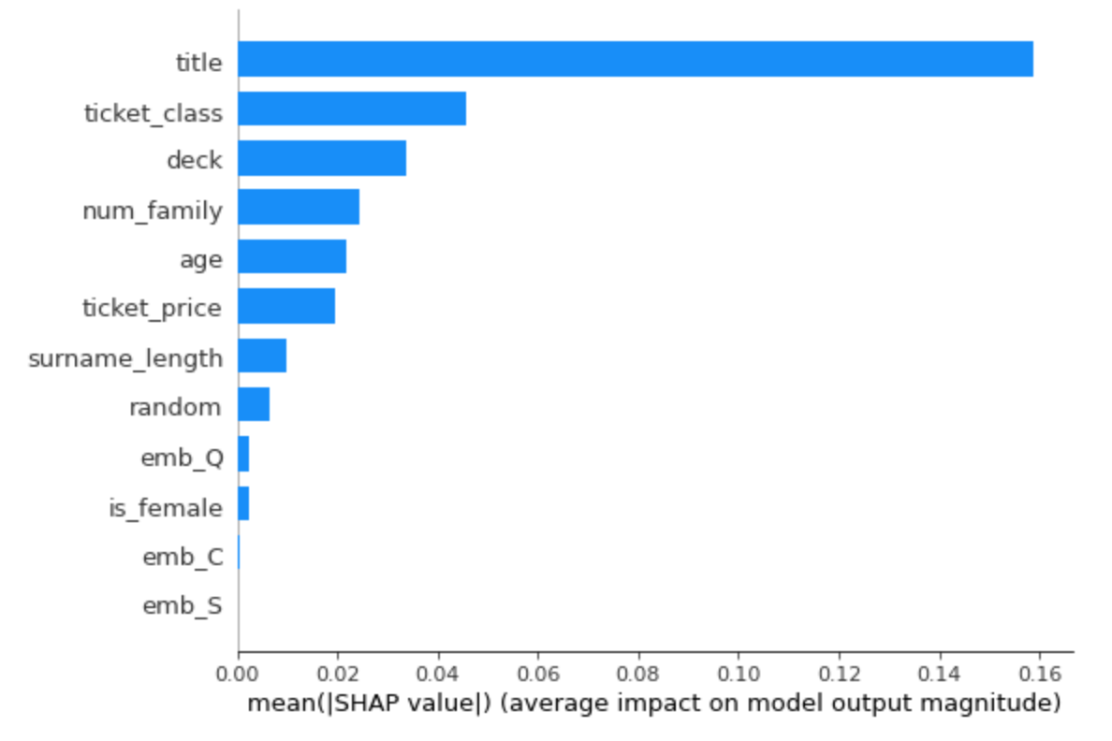
Nota bene!
Traditional variable importance methods don't tell you anything about causality!

Slide 51
If you are doing causal modeling…
First, think carefully about quantities of interest and their relationships before looking at any data - this requires domain knowledge
Stick with a small set of important variables that you have domain knowledge on.
Before modeling, understand bivariate relationships between independent vars, also between independent vars and dependent var
Identify potential confounders and identify covariates not to control for

Slide 52
Avoid automated causal graph structure learning, stick with good domain knowledge
A
B
C
These three graphs belong to the same “Markov Equivalence Class” and are indistinguishable with observational data!
A
B
C
A
B
C
Notes:
Equivalence class

Slide 53
A quick aside on bias and fairness…
In 2022 it’s very clear that applying black box models towards decision making in any broad social process is a terrible idea
e.g. predicting crime location, recidivism, who gets approved for a credit card, which job applicant’s resume should be looked at, etc…

Slide 54
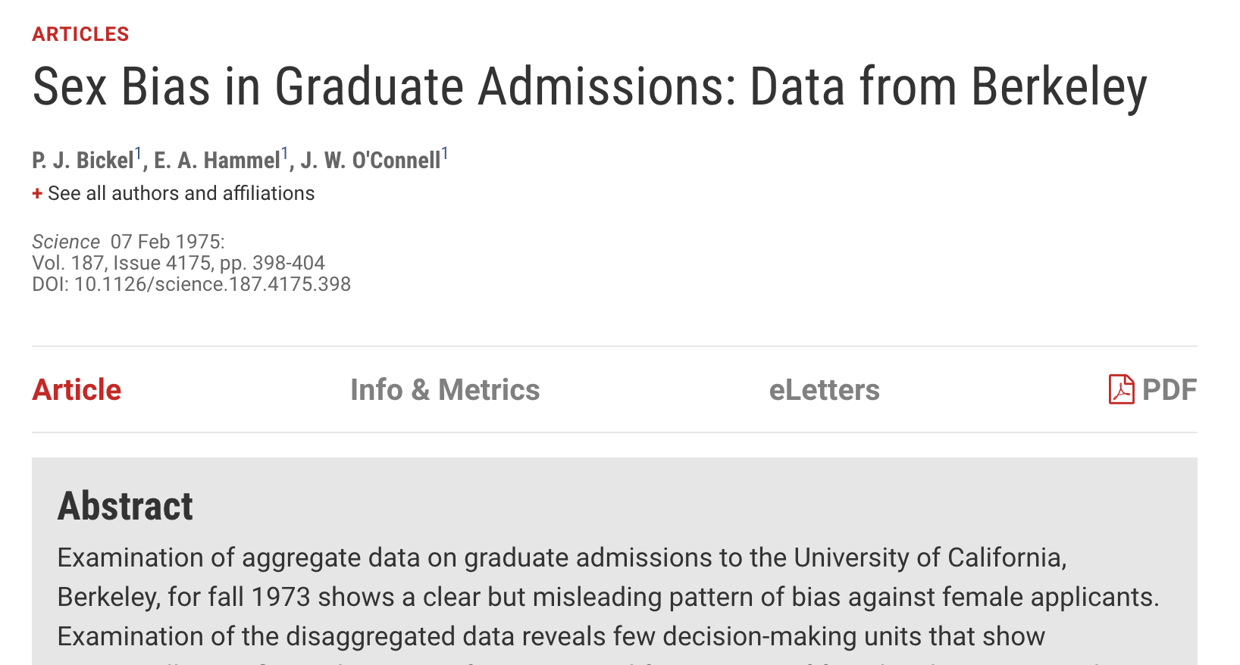

Slide 55
The college admission process
Gender
Qualifications
Department
Admission
S chiappa et al. deepmind blog: “Causal Bayesian Networks: A flexible tool to enable fairer machine learning”. 2019
Notes:
By defining unfairness as the presence of a harmful influence from the sensitive attribute in the graph, CBNs provide us with a simple and intuitive visual tool for describing different possible unfairness scenarios underlying a dataset. In addition, CBNs provide us with a powerful quantitative tool to measure unfairness in a dataset and to help researchers develop techniques for addressing it.
Whilst the direct influence of the sensitive attribute on admission is considered unfair for social and legal reasons, the indirect influence could be considered fair or unfair depending on contextual factors.

Slide 56
Assumptions of causal inference
Temporality. Causes always occur before effects: The treatment variable needs to occur before measured outcome. Covariates should occur before treatment (prevents you from controlling on colliders).
Stable Unit Treatment Value. The treatment status of a given individual does not affect the potential outcomes of any other individuals.
Positivity. For each level of each covariate in your data, there needs to be some variability of the treatment and outcome variables.
Ignorability. All major confounding variables are included in your data. This is a tough one, but necessary to get an unbiased estimate of the treatment effect.

Slide 57
Shout out which assumptions are violated!

Slide 58
Example #1
I want to understand whether frequent emails to customers might impact customer satisfaction.
I have survey data with customer, self-reported satisfaction from a year ago, and I use this past month’s number of emails for each customer as a proxy for how often we email them generally.

Slide 59
Example #2
I want to see the causal impact of a neighborhood’s cleanliness on crime rates, controlling for 20 known confounders.
I pull up an academic dataset with data on 40 distinct neighborhoods. So, my sample size is 40.

Slide 60
Example #3
I want to see how releasing a new in-app, multiplayer game through my social media app impacts user engagement. I only want to give it to some test users initially.
With this multiplayer game you can play with anyone who has the social media app by sending them invites. Accidentally, our test users can invite non-test users.

Slide 61
Example #4
We’re curious how a job training program could impact a person’s income 3 years in the future.
Unfortunately we don’t have lots of data on the participants so we perform a causal inference analysis only controlling for the person’s age.

Slide 62
We’ve discussed four types of causal relationships. Going forward, we’re going to assume you identified key confounders you want to control for, as you estimate the causal impact between a “treatment” and an “outcome”…

Slide 63
The familiar modeling spectrum…
Less complex
More complex
PSM
G-computation
Double ML methods
More interpretable
Less interpretable

Slide 64
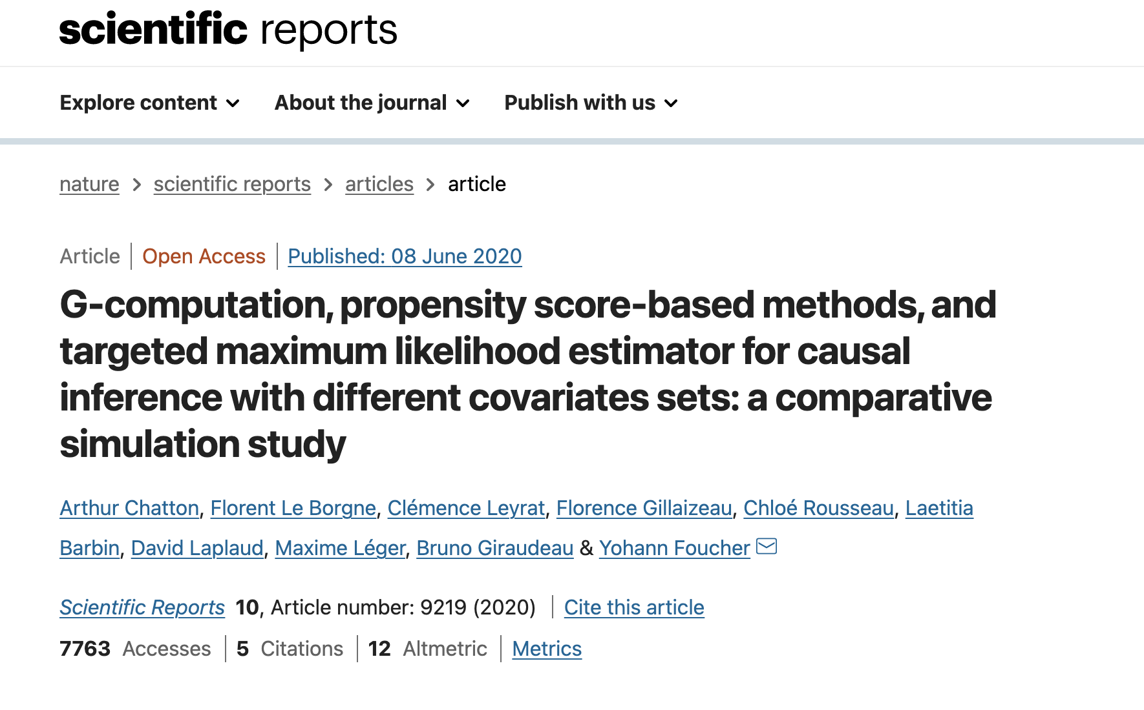
Some empirical studies have been conducted, but jury is still out. Largely depends on your audience? (PSM easier to explain)

Slide 65
Counterfactuals (with a binary treatment)
Our
Observed reality
10-year smoker
An alternative reality
Never
smokes

Slide 66
Counterfactuals (with a binary treatment)
Our
Observed reality
Systolic blood pressure
10-year smoker
An alternative reality
Never
smokes
Systolic blood pressure

Slide 67
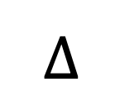
Counterfactuals (with a binary treatment)
Our
Observed reality
Systolic blood pressure
10-year smoker
$$∆$$
An alternative reality
Never
smokes
Systolic blood pressure

Slide 68
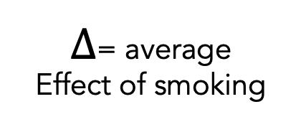
Counterfactuals (with a binary treatment)
Our
Observed reality
Smokes for 10 years
Mean Measure blood pressure at age 30
$∆$= average
Effect of smoking
An alternative reality
Never smokes
Mean Measure blood pressure at age 30

Slide 69
Causal inference metrics
Average treatment effect (ATE)
Average treatment effect among treated (ATT)
Average treatment effect among untreated (ATU)
Average treatment effect among segment X or Y
Treatment effect for an individual
And much more…

Slide 70
Propensity score matching
(PS)

Slide 71
1) Start with a set of participants for whom we have complete treatment, outcome, and covariate data
ID# | Covar 1 | Covar 2 | treat | outcome
1 | … | … | 1 | 20
2 | … | … | 1 | 15
3 | … | … | 0 | 10
4 | … | … | 0 | 10
5 | … | … | 1 | 20

Slide 72
2) For all participants, calculate probability of them receiving treatment, based on covariate data (a propensity score)
ID# | Covar 1 | Covar 2 | treat | ps | outcome
1 | … | … | 1 | 0.65 | 20
2 | … | … | 1 | 0.33 | 15
3 | … | … | 0 | 0.64 | 10
4 | … | … | 0 | 0.33 | 10
5 | … | … | 1 | 0.97 | 20

Slide 73
3) Take sub-sample of treated participants and match to sub-sample of control participants, based on similar ps values
ID# | Covar 1 | Covar 2 | treat | ps | outcome
1 | … | … | 1 | 0.65 | 20
3 | … | … | 0 | 0.64 | 10
ID# | Covar 1 | Covar 2 | treat | ps | outcome
2 | … | … | 1 | 0.33 | 15
4 | … | … | 0 | 0.33 | 10

Slide 74
4) Calculate treatment effect on these two sub-samples using standard approaches
ID# | Covar 1 | Covar 2 | treat | ps | outcome
1 | … | … | 1 | 0.65 | 20
2 | … | … | 1 | 0.33 | 15
3 | … | … | 0 | 0.64 | 10
4 | … | … | 0 | 0.33 | 10
Average treatment effect among matched
participants
$$= {\overline{x}}_{treated}−{\overline{x}}_{untreated}=\frac{\left(20+15\right)}{2}−\frac{\left(10+10\right)}{2}=7.5$$

Slide 75
Notebook exercise #2: 2_student_PSM.ipynb

Slide 76
Causal dose-response curve estimation
(AKA estimating the causal curve)

Slide 77
Counterfactuals (with a continuous treatment)
Outcome
Treatment

Slide 78
Counterfactuals (with a continuous treatment)
Outcome
Treatment

Slide 79
Counterfactuals (with a continuous treatment)
Outcome
Treatment

Slide 80
Counterfactuals (with a continuous treatment)
Outcome
Treatment

Slide 81
Counterfactuals (with a continuous treatment)
Outcome
Treatment

Slide 82
Counterfactuals (with a continuous treatment)
Outcome
Treatment

Slide 83
Estimating the “causal curve”
GPS is an extension of the standard propensity score method. It is the treatment assignment density calculated at a particular treatment value
Calculate the GPS associated with each treatment value observation
Fit a curve of treatment values predicting outcome values, adjusted for the GPS
The resulting treatment against outcome curve is your causal dose response curve (AKA your causal curve)

Slide 84
Notebook exercise #3: 3_student_continuous_treatments.ipynb

Slide 85
G-computation

Slide 86
1) Start with a set of participants for whom we have complete treatment, outcome, and covariate data
ID# | Covar 1 | Covar 2 | treat | outcome
1 | … | … | 1 | 20
2 | … | … | 1 | 15
3 | … | … | 0 | 10
4 | … | … | 0 | 10
5 | … | … | 1 | 20

Slide 87

2) Train a model that predicts the outcome from all covariates and treatment variable. Aim for high recall and precision.
ID# | Covar 1 | Covar 2 | treat | outcome
1 | … | … | 1 | 20
2 | … | … | 1 | 15
3 | … | … | 0 | 10
4 | … | … | 0 | 10
5 | … | … | 1 | 20

Slide 88
3) “Force” every observation in the dataset to receive the treatment
ID# | Covar 1 | Covar 2 | treat | outcome
1 | … | … | 1 | 20
2 | … | … | 1 | 15
3 | … | … | 1 | 10
4 | … | … | 1 | 10
5 | … | … | 1 | 20

Slide 89
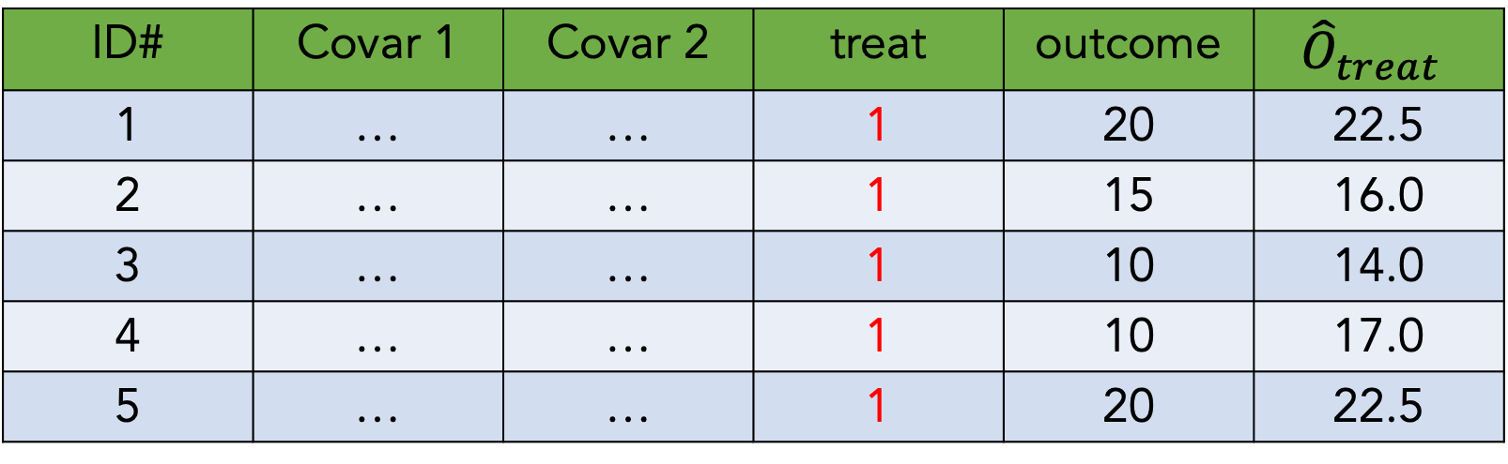
4) Predict outcome values with these covariate and treatment values
ID# | Covar 1 | Covar 2 | treat | outcome | $${\hat{O}}_{treat}$$
1 | … | … | 1 | 20 | 22.5
2 | … | … | 1 | 15 | 16.0
3 | … | … | 1 | 10 | 14.0
4 | … | … | 1 | 10 | 17.0
5 | … | … | 1 | 20 | 22.5

Slide 90
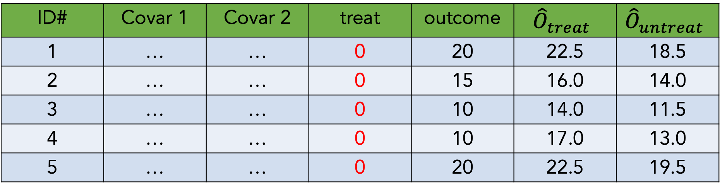
5) Now “force” every observation to not receive treatment,
And make outcome predictions again
ID# | Covar 1 | Covar 2 | treat | outcome | $${\hat{O}}_{treat}$$ | $${\hat{O}}_{untreat}$$
1 | … | … | 0 | 20 | 22.5 | 18.5
2 | … | … | 0 | 15 | 16.0 | 14.0
3 | … | … | 0 | 10 | 14.0 | 11.5
4 | … | … | 0 | 10 | 17.0 | 13.0
5 | … | … | 0 | 20 | 22.5 | 19.5

Slide 91
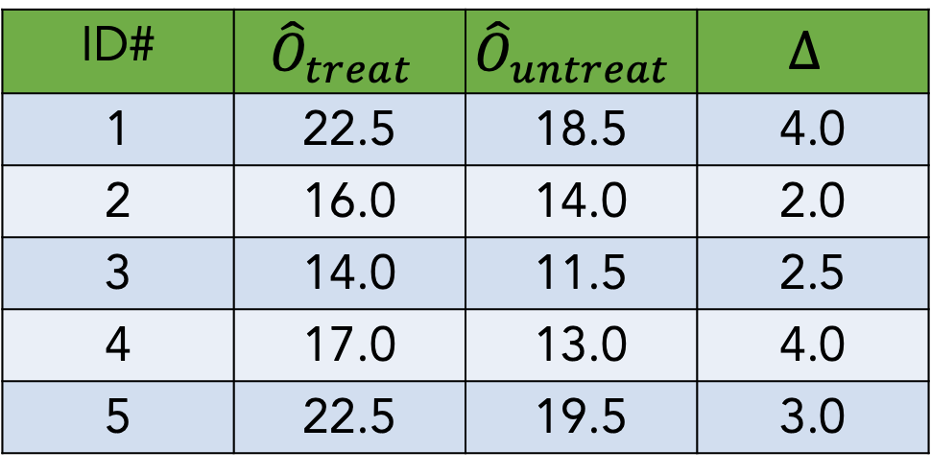

6) Calculate the average difference between treated and untreated outcome estimates
ID# | $${\hat{O}}_{treat}$$ | $${\hat{O}}_{untreat}$$ | $$∆$$
1 | 22.5 | 18.5 | 4.0
2 | 16.0 | 14.0 | 2.0
3 | 14.0 | 11.5 | 2.5
4 | 17.0 | 13.0 | 4.0
5 | 22.5 | 19.5 | 3.0
$$μ_{∆}=3.1$$

Slide 92
Notebook exercise #4: 4_student_g_comp.ipynb

Slide 93
Double ML
And
Targeted maximum likelihood estimation (TMLE)

Slide 94
The various double modeling approaches have similar steps…
1) Start by doing exactly what you did in g-computation. Make a predictive model, that predicts the outcome using the treatment and other covariates. For each individual, estimate the outcome assuming everyone is treated and then estimate the outcome assuming no one is treated.
2) Much like what you did with PSM approach, create another predictive model where you try to predict treatment using only the covariates.
3) Using the treatment model from step 2, update the model in step 1 in a special adjustment step. We exploit information about the relationship between the treatment and covariates to reduce bias of the estimates from step 1.

Slide 95
Notebook exercise #5: 5_student_double_ML.ipynb

Slide 96
Closing thoughts: troubleshooting
Having domain knowledge and understanding the data-generating process is often way more productive than just throwing an algo at the problem
There is value in trying multiple techniques to understand their range of estimates (but use p-value correction if you’re running lots of analyses)
You’ll never be able to capture all confounders, but do aim to capture the major ones
If your results don’t make sense and your code isn’t buggy, you’re probably missing a big source of bias
Causal inference and modeling is powerful but still not as trustworthy as running a proper experiment. Approach all results with healthy skepticism.

Slide 97
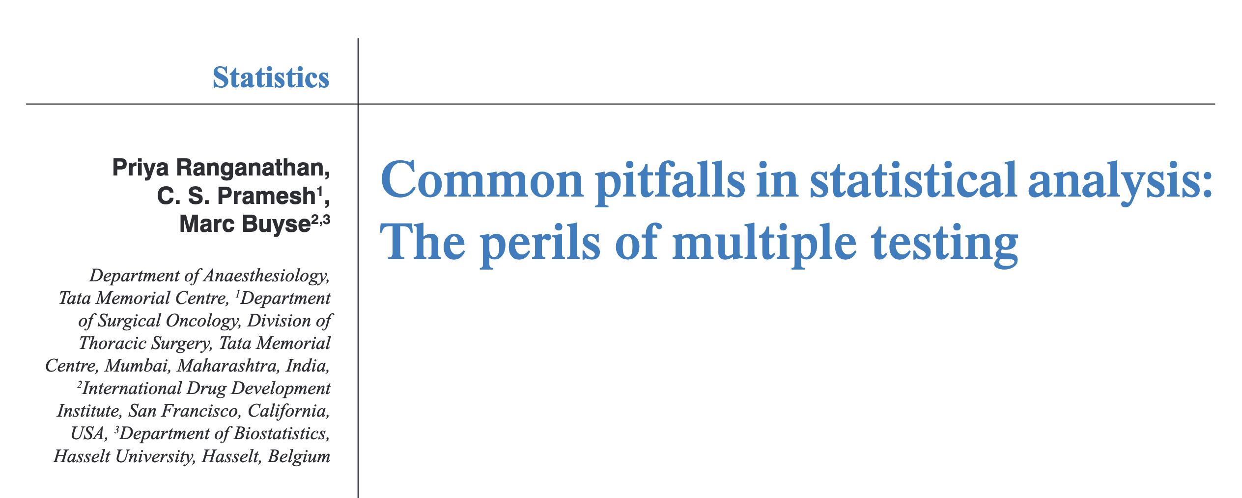
Closing thoughts: the perils of multiple testing…

Slide 98
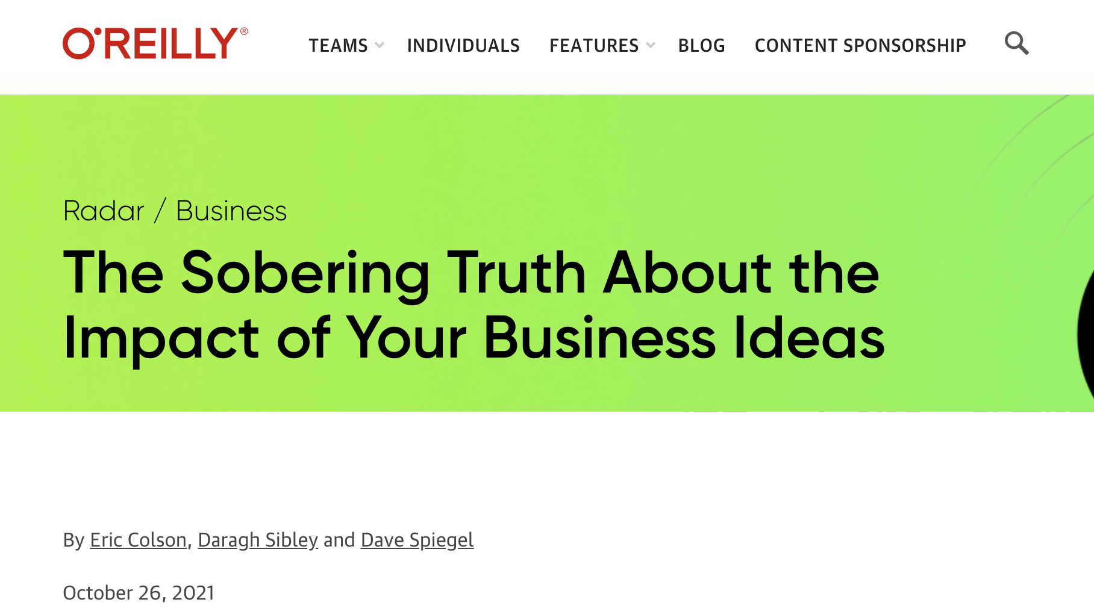
Closing thoughts: be humble, it’s likely your research or business idea doesn’t work!

