Slide 1
Introduction to causal inference PyData NYC 2022 Roni Kobrosly, PhD
G
A
B
H
C
D
F
I
E

Slide 2
By the end of this tutorial, you should be able to
Understand the pitfalls of observational data analysis
Know the various types of causal relationships to look out for
Describe the hierarchy of statistical analyses, causal inference, and experiments
Start conducting preliminary causal analyses on your own data
Confidently explore the topic on your own (now that you have a solid foundational understanding of causal thinking)

Slide 3
Does Vitamin D supplementation prevent severe covid symptoms?

Slide 4

The alternative universe example
Our
Observed reality

Slide 5
The alternative universe example
Early 2020
Starts Taking
Vitamin D
Our
Observed reality

Slide 6
The alternative universe example
Early 2020
Starts Taking
Vitamin D
Our
Observed reality
Lives
life

Slide 7
The alternative universe example
Early 2020
Starts Taking
Vitamin D
Mid 2020
Gets covid with
Mild symptoms
Our
Observed reality
Lives
life

Slide 8
The alternative universe example
Early 2020
Starts Taking
Vitamin D
Mid 2020
Gets covid with
Mild symptoms
Our
Observed reality
Lives
life
An alternative reality

Slide 9
The alternative universe example
Early 2020
Starts Taking
Vitamin D
Mid 2020
Gets covid with
Mild symptoms
Our
Observed reality
Lives
life
Early 2020
Never takes vitamin D
An alternative reality

Slide 10
The alternative universe example
Early 2020
Starts Taking
Vitamin D
Mid 2020
Gets covid with
Mild symptoms
Our
Observed reality
Lives
life
Early 2020
Never takes vitamin D
An alternative reality
Lives
life

Slide 11
The alternative universe example
Early 2020
Starts Taking
Vitamin D
Mid 2020
Gets covid with
Mild symptoms
Our
Observed reality
Lives
life
Early 2020
Never takes vitamin D
An alternative reality
Mid 2020
???
Lives
life

Slide 12

Experiments (AKA A/B Tests, AKA Randomized Controlled Trials)
Treatment group
Control group

Slide 13
Experiments (AKA A/B Tests, AKA Randomized Controlled Trials)
Treatment group
given blank vitamin D pills
Control group
given blank sugar pills

Slide 14
Experiments (AKA A/B Tests, AKA Randomized Controlled Trials)
See how many people get severe covid symptoms over next 2 months
Treatment group
given blank vitamin D pills
See how many people get severe covid symptoms over next 2 months
Control group
given blank sugar pills

Slide 15
Experiments won’t always save us
NOT ETHICAL: randomly assign some people to be exposed to lead paint while others are not, then see which group is more likely to develop neurological disorders. NOT FEASIBLE: modify household incomes in neighborhoods, to see if reducing a neighborhood’s income inequality reduces the local crime rate.

Slide 16
A simple hierarchy…
Weaker
causal
claims
Stronger
causal
claims
statistical associations / correlations
randomized experiments
causal inference
Less easy
Easier

Slide 17
Causal Inference vs Typical ML Project Questions
Causal Inference:
How does improving neighborhood income inequality reduce neighborhood crime rate?
How does increasing or decreasing the price of a product impact demand?
What would be the impact on the number of people with diabetes if we enacted a policy to reduce the average amount of sugar consumed per day by X grams.
Typical ML:
Can I cluster neighborhoods by their characteristics and tell a story about these different segments and how it relates to crime rates?
Can I predict whether someone will convert from a lead to a customer?
How well can I predict whether a patient will be diagnosed with diabetes later in life?

Slide 18
A causal graph
A
B
E
C
D

Slide 19

Exercise time!

Slide 20
Make & model
Car safety rating
Age
Theft history
Car value
Advanced airbag
Risk aversion
Antilock
Driving course?
Accident history
Vehicle Year
Medical Cost of Accident
Good student?

Slide 21
Three important types of causal relationships…

Slide 22
1) Confounders

Slide 23
Confounders
???
Treatment
Outcome

Slide 24
Confounders
Confounder
Treatment
Outcome

Slide 25
Confounders
Always want to control for / condition on confounders in inferential modeling
Confounding changes the effect size and possibly statistical significance of your association of interest
Confounders can also flip the direction of your association of interest
A model will ideally control for confounding, but leftover confounding in a model is named “residual confounding”
Smoking
Lung Cancer
Coffee

Slide 26
Confounders
Positive confounding: confounder introduces a bias that pushes association of interest away from the “null”
Negative confounding: confounder biases association towards the “null”
Smoking
Lung Cancer
Coffee

Slide 27
Violent crime in your city!
???
Ice cream sales
Violent
crime

Slide 28
Summer weather induces a false association between ice cream sales and violent crime
Hot Weather
Ice cream sales
Violent
crime

Slide 29
Summer weather induces a false association between ice cream sales and violent crime
Hot Weather
Ice cream sales
Violent
crime

Slide 30
If you control for the season, any ice cream-violent crime association in your dataset will disappear
Hot Weather
Ice cream sales
Violent
crime

Slide 31
2) Colliders

Slide 32
Colliders
???
Treatment
Outcome

Slide 33
Colliders
Collider
Treatment
Outcome

Slide 34
Colliders
Never want to control for / condition on colliders
Conditioning on a common effect causes collider bias, which can be in positive or negative direction
# of
sick
days taken
Lung Cancer
smoking

Slide 35
3) Mediators

Slide 36
Mediators
???
Treatment
Outcome

Slide 37
Mediators
Mediator
Treatment
Outcome

Slide 38
Mediators
Controlling for a mediator will nullify associations of interest
There are statistical tests of mediation you can use to help determine causal relationships in observational data
Clinical signs of lung damage
Lung cancer
Smoking

Slide 39
Causality is complicated!
# of sick
Days taken
Smoking
Gene that increases risk of lung cancer
Peers
That
Smoke
Lung
cancer
Socio-
economic
disadvantage
Clinical
signs of lung damage
Construction
Work
Asbestos
Exposure

Slide 40
This all sounds nice, but how do I “control” for things?
1) The simple/naive way:
“Stratify” on the variable you want to control for
AKA filter your dataset so that variable only takes on 1 value.
For example, when calculating the following you’re controlling for / conditioning on smoking status
p(lung problems = 1 | smoker = 0)
2) Use a model!
Sit tight, the second half of this tutorial goes deep on this topic

Slide 41
Notebook exercise #1: Causal graphs

Slide 42
We’ve discussed four types of causal relationships. Going forward, we’re going to assume you identified key confounders you want to control for, as you estimate the causal impact between a “treatment” and an “outcome”…

Slide 43
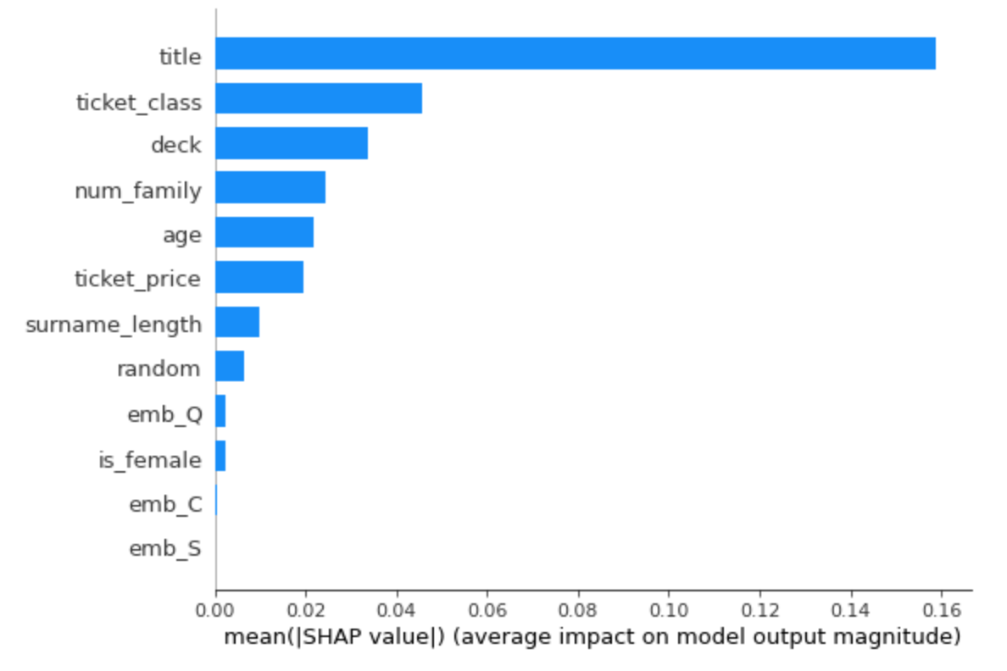
Nota bene!
Traditional variable importance methods don't tell you anything about causality!

Slide 44
Assumptions of causal inference
Temporality. Causes always occur before effects: The treatment variable needs to occur before measured outcome. Covariates should occur before treatment (prevents you from controlling on colliders).
Stable Unit Treatment Value. The treatment status of a given individual does not affect the potential outcomes of any other individuals.
Positivity. For each level of each covariate in your data, there needs to be some variability of the treatment and outcome variables.
Ignorability. All major confounding variables are included in your data. This is a tough one, but necessary to get an unbiased estimate of the treatment effect.

Slide 45
Example #1
I want to understand whether frequent emails to customers might impact customer satisfaction.
I have survey data with customer, self-reported satisfaction from a year ago, and I use this past month’s number of emails for each customer as a proxy for how often we email them generally.

Slide 46
Example #2
I want to see the causal impact of a neighborhood’s cleanliness on crime rates, controlling for 20 known confounders.
I pull up an academic dataset with data on 40 distinct neighborhoods. So, my sample size is 40.

Slide 47
Example #3
I want to see how releasing a new in-app, multiplayer game through my social media app impacts user engagement. I only want to give it to some test users initially.
With this multiplayer game you can play with anyone who has the social media app by sending them invites. Accidentally, our test users can invite non-test users.

Slide 48
Example #4
We’re curious how a job training program could impact a person’s income 3 years in the future.
Unfortunately we don’t have lots of data on the participants so we perform a causal inference analysis only controlling for the person’s age.

Slide 49
G-computation

Slide 50
1) Start with a set of participants for whom we have complete treatment, outcome, and covariate data
ID# | Covar 1 | Covar 2 | treat | outcome
1 | … | … | 1 | 20
2 | … | … | 1 | 15
3 | … | … | 0 | 10
4 | … | … | 0 | 10
5 | … | … | 1 | 20

Slide 51

2) Train a model that predicts the outcome from all covariates and treatment variable. Aim for high recall and precision.
ID# | Covar 1 | Covar 2 | treat | outcome
1 | … | … | 1 | 20
2 | … | … | 1 | 15
3 | … | … | 0 | 10
4 | … | … | 0 | 10
5 | … | … | 1 | 20

Slide 52
3) “Force” every observation in the dataset to receive the treatment
ID# | Covar 1 | Covar 2 | treat | outcome
1 | … | … | 1 | 20
2 | … | … | 1 | 15
3 | … | … | 1 | 10
4 | … | … | 1 | 10
5 | … | … | 1 | 20

Slide 53
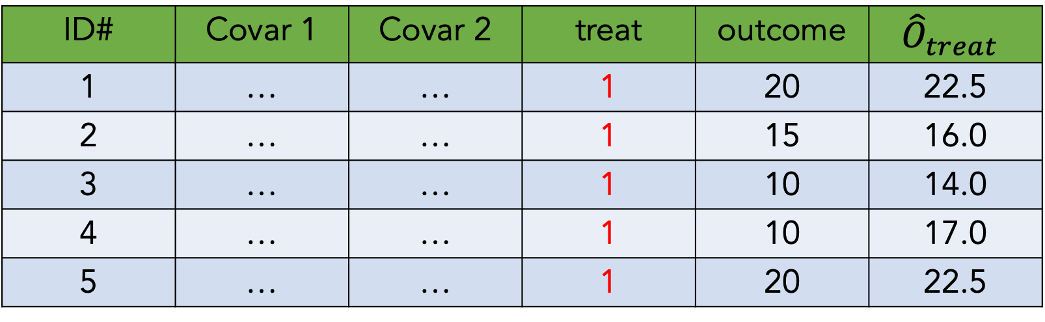
4) Predict outcome values with these covariate and treatment values
ID# | Covar 1 | Covar 2 | treat | outcome | $${\hat{O}}_{treat}$$
1 | … | … | 1 | 20 | 22.5
2 | … | … | 1 | 15 | 16.0
3 | … | … | 1 | 10 | 14.0
4 | … | … | 1 | 10 | 17.0
5 | … | … | 1 | 20 | 22.5

Slide 54
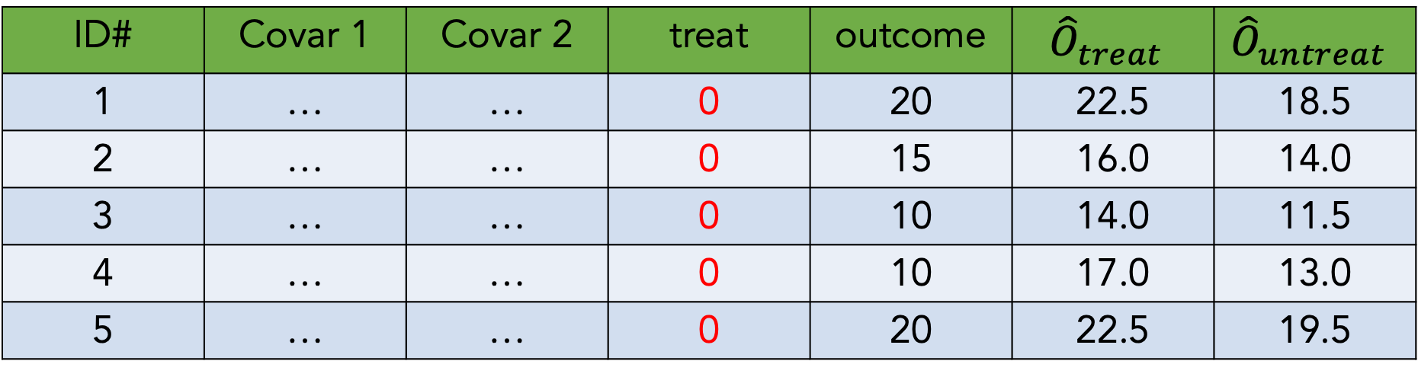
5) Now “force” every observation to not receive treatment,
And make outcome predictions again
ID# | Covar 1 | Covar 2 | treat | outcome | $${\hat{O}}_{treat}$$ | $${\hat{O}}_{untreat}$$
1 | … | … | 0 | 20 | 22.5 | 18.5
2 | … | … | 0 | 15 | 16.0 | 14.0
3 | … | … | 0 | 10 | 14.0 | 11.5
4 | … | … | 0 | 10 | 17.0 | 13.0
5 | … | … | 0 | 20 | 22.5 | 19.5

Slide 55
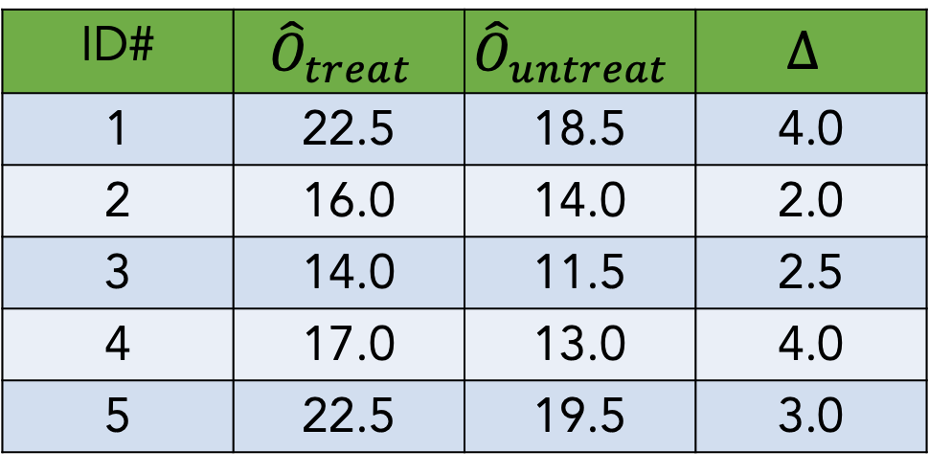

6) Calculate the average difference between treated and untreated outcome estimates
ID# | $${\hat{O}}_{treat}$$ | $${\hat{O}}_{untreat}$$ | $$∆$$
1 | 22.5 | 18.5 | 4.0
2 | 16.0 | 14.0 | 2.0
3 | 14.0 | 11.5 | 2.5
4 | 17.0 | 13.0 | 4.0
5 | 22.5 | 19.5 | 3.0
$$μ_{∆}=3.1$$

Slide 56
Notebook exercise #2

Slide 57
Causal dose-response curve estimation
(AKA estimating the causal curve)

Slide 58
Counterfactuals (with a continuous treatment)
Outcome
Treatment

Slide 59
Counterfactuals (with a continuous treatment)
Outcome
Treatment

Slide 60
Counterfactuals (with a continuous treatment)
Outcome
Treatment

Slide 61
Counterfactuals (with a continuous treatment)
Outcome
Treatment

Slide 62
Counterfactuals (with a continuous treatment)
Outcome
Treatment

Slide 63
Counterfactuals (with a continuous treatment)
Outcome
Treatment

Slide 64
Estimating the “causal curve”
GPS is an extension of the standard propensity score method. It is the treatment assignment density calculated at a particular treatment value
Calculate the GPS associated with each treatment value observation
Fit a curve of treatment values predicting outcome values, adjusted for the GPS
The resulting treatment against outcome curve is your causal dose response curve (AKA your causal curve)

Slide 65
Notebook exercise #3

Slide 66

A simple causal inference flowchart
Is the “treatment” variable binary, nominal, ordinal, or continuous ?
binary
continuous
nominal
or ordinal
Use `scikit-learn` to do g-computation. Is the outcome binary or continuous?
Use the `causal-curve` package. Is the outcome binary or continuous?
Split into sensible binary comparisons using domain knowledge. Do binary analysis
continuous
continuous
binary
binary
Estimate average treatment effect as shown in previous slides
Calculate average probability of outcome when all units receive and don’t receive treatment. “Causal difference” is p₁ – p₀ and the “causal ratio” is p₁ / p₀
Use
GPS_Regressor
model
Use
GPS_Classifier
model

Slide 67
Closing thoughts: troubleshooting
Having domain knowledge and understanding the data-generating process is often way more productive than just throwing an algo at the problem
There is value in trying multiple techniques to understand their range of estimates (but use p-value correction if you’re running lots of analyses)
You’ll never be able to capture all confounders, but do aim to capture the major ones
If your results don’t make sense and your code isn’t buggy, you’re probably missing a big source of bias
Causal inference and modeling is powerful but still not as trustworthy as running a proper experiment. Approach all results with healthy skepticism.

Slide 68
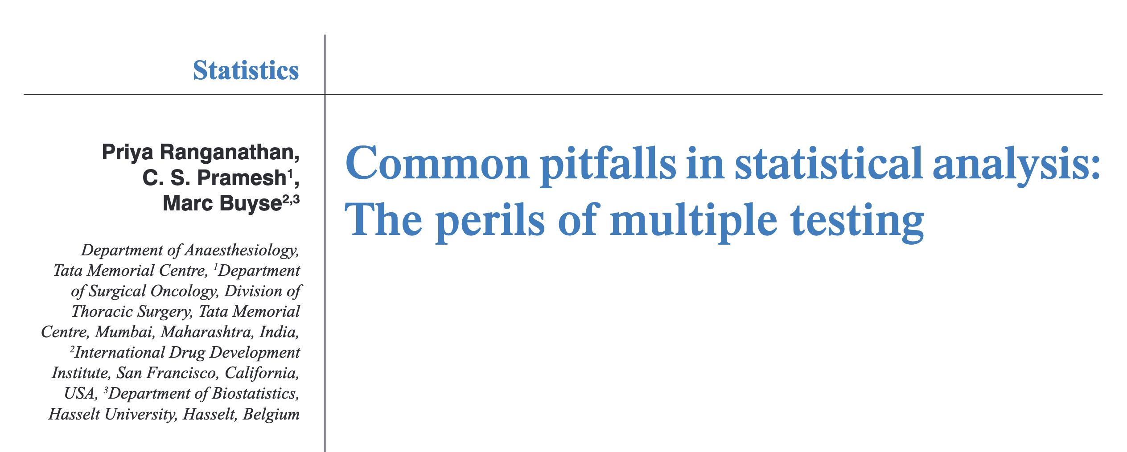
Closing thoughts: the perils of multiple testing…

Slide 69
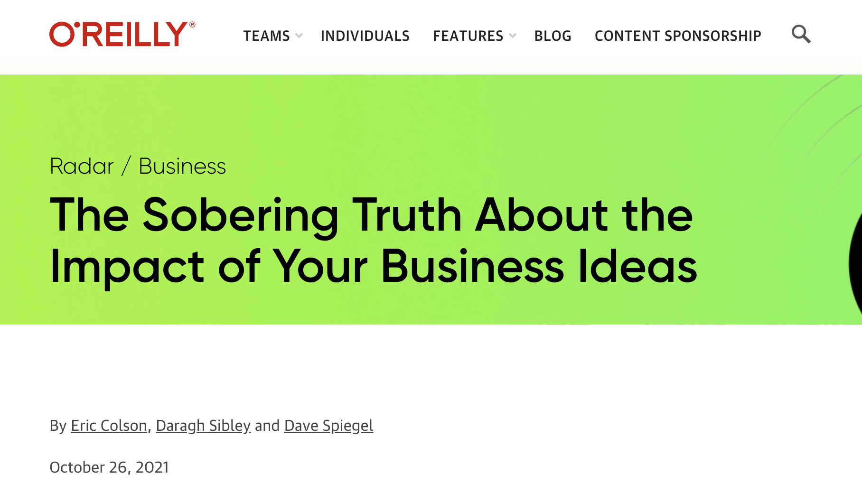
Closing thoughts: be humble, it’s likely your research or business idea doesn’t work!

