Slide 1
Introduction to causal inference Roni Kobrosly, PhD
G
A
B
H
C
D
F
I
E

Slide 2
By the end of this tutorial, you should be able to
Understand the pitfalls of observational data analysis
Know the various types of causal relationships to look out for
Describe the hierarchy of statistical analyses, causal inference, and experiments
Start conducting preliminary causal analyses on your own data
Confidently explore the topic on your own (now that you have a solid foundational understanding of causal thinking)

Slide 3
Does Vitamin D supplementation prevent severe covid symptoms?

Slide 4

The alternative universe example
Our
Observed reality

Slide 5
The alternative universe example
Early 2020
Starts Taking
Vitamin D
Our
Observed reality

Slide 6
The alternative universe example
Early 2020
Starts Taking
Vitamin D
Our
Observed reality
Lives
life

Slide 7
The alternative universe example
Early 2020
Starts Taking
Vitamin D
Mid 2020
Gets covid with
Mild symptoms
Our
Observed reality
Lives
life

Slide 8
The alternative universe example
Early 2020
Starts Taking
Vitamin D
Mid 2020
Gets covid with
Mild symptoms
Our
Observed reality
Lives
life
An alternative reality

Slide 9
The alternative universe example
Early 2020
Starts Taking
Vitamin D
Mid 2020
Gets covid with
Mild symptoms
Our
Observed reality
Lives
life
Early 2020
Never takes vitamin D
An alternative reality

Slide 10
The alternative universe example
Early 2020
Starts Taking
Vitamin D
Mid 2020
Gets covid with
Mild symptoms
Our
Observed reality
Lives
life
Early 2020
Never takes vitamin D
An alternative reality
Lives
life

Slide 11
The alternative universe example
Early 2020
Starts Taking
Vitamin D
Mid 2020
Gets covid with
Mild symptoms
Our
Observed reality
Lives
life
Early 2020
Never takes vitamin D
An alternative reality
Mid 2020
???
Lives
life

Slide 12

Experiments (AKA A/B Tests, AKA Randomized Controlled Trials)
Treatment group
Control group

Slide 13
Experiments (AKA A/B Tests, AKA Randomized Controlled Trials)
Treatment group
given blank vitamin D pills
Control group
given blank sugar pills

Slide 14
Experiments (AKA A/B Tests, AKA Randomized Controlled Trials)
See how many people get severe covid symptoms over next 2 months
Treatment group
given blank vitamin D pills
See how many people get severe covid symptoms over next 2 months
Control group
given blank sugar pills

Slide 15
Experiments won’t always save us
NOT ETHICAL: randomly assign some people to be exposed to lead paint while others are not, then see which group is more likely to develop neurological disorders. NOT FEASIBLE: modify household incomes in neighborhoods, to see if reducing a neighborhood’s income inequality reduces the local crime rate.

Slide 16
A simple hierarchy…
Weaker
causal
claims
Stronger
causal
claims
statistical associations / correlations
randomized experiments
causal inference
Less easy
Easier

Slide 17
Causal Inference vs Typical ML Project Questions
Causal Inference:
How does improving neighborhood income inequality reduce neighborhood crime rate?
How does increasing or decreasing the price of a product would impact demand?
What would be the impact on the number of people with diabetes if we enacted a policy to reduce the average amount of sugar consumed per day by X grams.
Typical ML:
Can I cluster neighborhoods by their characteristics and tell a story about these different segments and how it relates to crime rates?
Can I predict whether someone will convert from a lead to a customer?
How well can I predict whether a patient will be diagnosed with diabetes later in life?

Slide 18
A causal graph
A
B
E
C
D

Slide 19
Four types of causal relationships…

Slide 20
1) Confounders

Slide 21
Confounders
???
Treatment
Outcome

Slide 22
Confounders
Confounder
Treatment
Outcome

Slide 23
Confounders
Always want to control for / condition on confounders in inferential modeling
Confounding changes the effect size and possibly statistical significance of your association of interest
Confounders can also flip the direction of your association of interest
A model will ideally control for confounding, but leftover confounding in a model is named “residual confounding”
Smoking
Lung Cancer
Coffee

Slide 24
Confounders
Positive confounding: confounder introduces a bias that pushes association of interest away from the “null”
Negative confounding: confounder biases association towards the “null”
Smoking
Lung Cancer
Coffee

Slide 25
Violent crime in your city!
???
Ice cream sales
Violent
crime

Slide 26
Summer weather induces a false association between ice cream sales and violent crime
Hot Weather
Ice cream sales
Violent
crime

Slide 27
Summer weather induces a false association between ice cream sales and violent crime
Hot Weather
Ice cream sales
Violent
crime

Slide 28
If you control for the season, any ice cream-violent crime association in your dataset will disappear
Hot Weather
Ice cream sales
Violent
crime

Slide 29
2) Colliders

Slide 30
Colliders
???
Treatment
Outcome

Slide 31
Colliders
Collider
Treatment
Outcome

Slide 32
Colliders
Never want to control for / condition on colliders
Conditioning on a common effect causes collider bias, which can be in positive or negative direction
# of
sick
days taken
Lung Cancer
smoking

Slide 33
3) Mediators

Slide 34
Mediators
???
Treatment
Outcome

Slide 35
Mediators
Mediator
Treatment
Outcome

Slide 36
Mediators
Controlling for a mediator will nullify associations of interest
There are statistical tests of mediation you can use to help determine causal relationships in observational data
Clinical signs of lung damage
Lung cancer
Smoking

Slide 37
4) Unrelated Predictors

Slide 38
Unrelated predictors
???
Treatment
Outcome

Slide 39
Unrelated predictors
Some other predictor
Treatment
Outcome

Slide 40
Unrelated predictors
If they are unrelated to your independent variable / treatment / exposure of interest, there is no harm in controlling for them.
In fact, leaving them in could improve model performance.
Gene that increases risk of lung cancer
Lung cancer
Smoking

Slide 41
G-computation

Slide 42
1) Start with a set of participants for whom we have complete treatment, outcome, and covariate data
ID# | Covar 1 | Covar 2 | treat | outcome
1 | … | … | 1 | 20
2 | … | … | 1 | 15
3 | … | … | 0 | 10
4 | … | … | 0 | 10
5 | … | … | 1 | 20

Slide 43

2) Train a model that predicts the outcome from all covariates and treatment variable. Aim for high recall and precision.
ID# | Covar 1 | Covar 2 | treat | outcome
1 | … | … | 1 | 20
2 | … | … | 1 | 15
3 | … | … | 0 | 10
4 | … | … | 0 | 10
5 | … | … | 1 | 20

Slide 44
3) “Force” every observation in the dataset to receive the treatment
ID# | Covar 1 | Covar 2 | treat | outcome
1 | … | … | 1 | 20
2 | … | … | 1 | 15
3 | … | … | 1 | 10
4 | … | … | 1 | 10
5 | … | … | 1 | 20

Slide 45
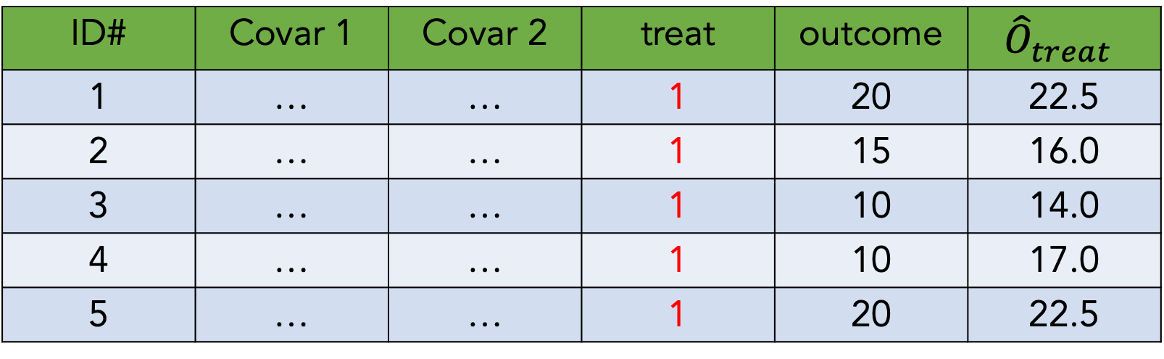
4) Predict outcome values with these covariate and treatment values
ID# | Covar 1 | Covar 2 | treat | outcome | $${\hat{O}}_{treat}$$
1 | … | … | 1 | 20 | 22.5
2 | … | … | 1 | 15 | 16.0
3 | … | … | 1 | 10 | 14.0
4 | … | … | 1 | 10 | 17.0
5 | … | … | 1 | 20 | 22.5

Slide 46
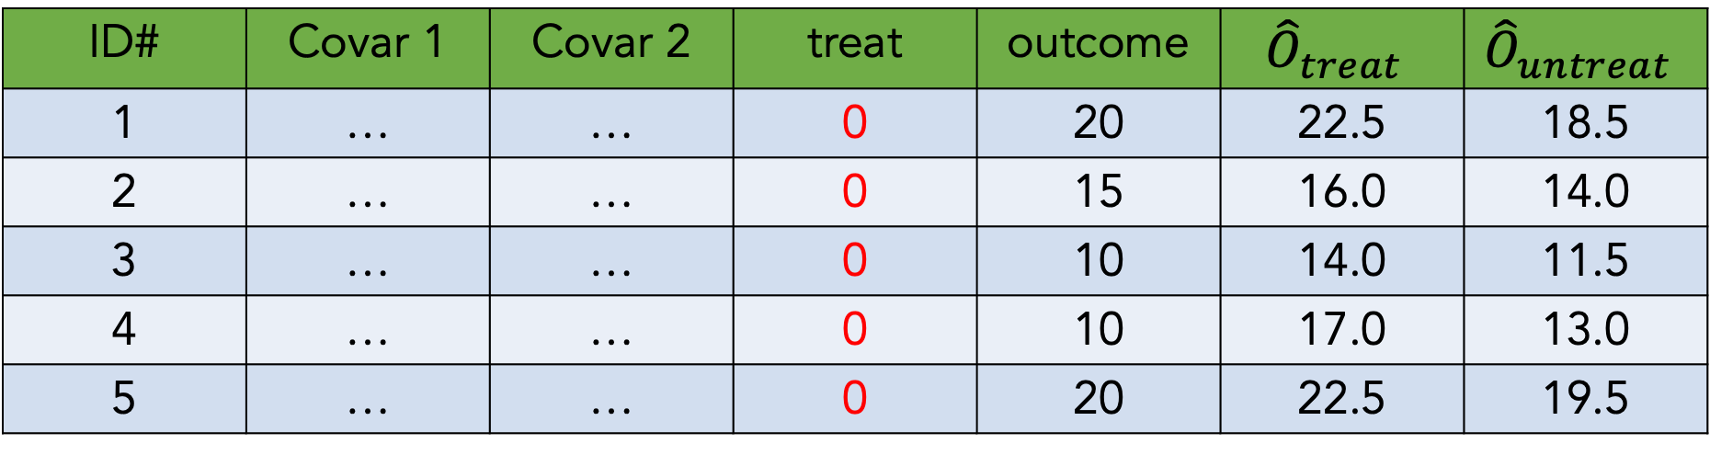
5) Now “force” every observation to not receive treatment,
And make outcome predictions again
ID# | Covar 1 | Covar 2 | treat | outcome | $${\hat{O}}_{treat}$$ | $${\hat{O}}_{untreat}$$
1 | … | … | 0 | 20 | 22.5 | 18.5
2 | … | … | 0 | 15 | 16.0 | 14.0
3 | … | … | 0 | 10 | 14.0 | 11.5
4 | … | … | 0 | 10 | 17.0 | 13.0
5 | … | … | 0 | 20 | 22.5 | 19.5

Slide 47
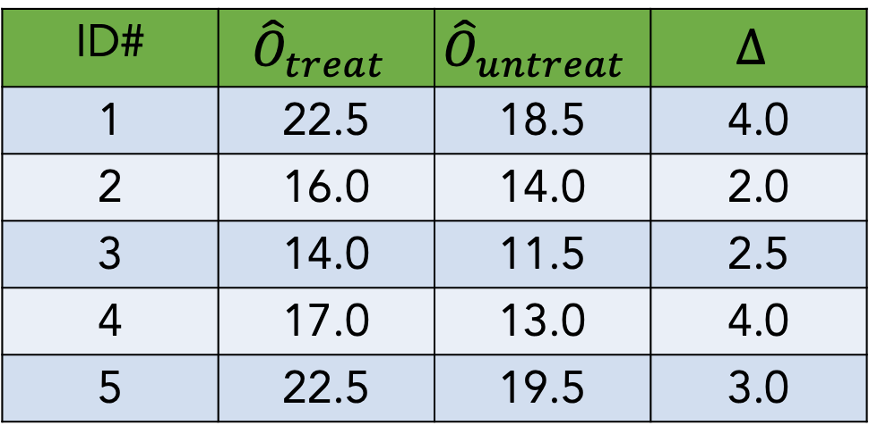

6) Calculate the average difference between treated and untreated outcome estimates
ID# | $${\hat{O}}_{treat}$$ | $${\hat{O}}_{untreat}$$ | $$∆$$
1 | 22.5 | 18.5 | 4.0
2 | 16.0 | 14.0 | 2.0
3 | 14.0 | 11.5 | 2.5
4 | 17.0 | 13.0 | 4.0
5 | 22.5 | 19.5 | 3.0
$$μ_{∆}=3.1$$

Slide 48
Notebook exercise #1

Slide 49
Causal dose-response curve estimation
(AKA estimating the causal curve)

Slide 50
Counterfactuals (with a continuous treatment)
Outcome
Treatment

Slide 51
Counterfactuals (with a continuous treatment)
Outcome
Treatment

Slide 52
Counterfactuals (with a continuous treatment)
Outcome
Treatment

Slide 53
Counterfactuals (with a continuous treatment)
Outcome
Treatment

Slide 54
Counterfactuals (with a continuous treatment)
Outcome
Treatment

Slide 55
Counterfactuals (with a continuous treatment)
Outcome
Treatment

Slide 56
Estimating the “causal curve”
GPS is an extension of the standard propensity score method. It is the treatment assignment density calculated at a particular treatment value
Calculate the GPS associated with each treatment value observation
Fit a curve of treatment values predicting outcome values, adjusted for the GPS
The resulting treatment against outcome curve is your causal dose response curve (AKA your causal curve)

Slide 57
Notebook exercise #2

Slide 58
Closing thoughts: troubleshooting
Having domain knowledge and understanding the data-generating process is often way more productive than just throwing an algo at the problem
There is value in trying multiple techniques to understand their range of estimates (but use p-value correction if you’re running lots of analyses)
You’ll never be able to capture all confounders, but do aim to capture the major ones
If your results don’t make sense and your code isn’t buggy, you’re probably missing a big source of bias
Causal inference and modeling is powerful but still not as trustworthy as running a proper experiment. Approach all results with healthy skepticism.

Slide 59
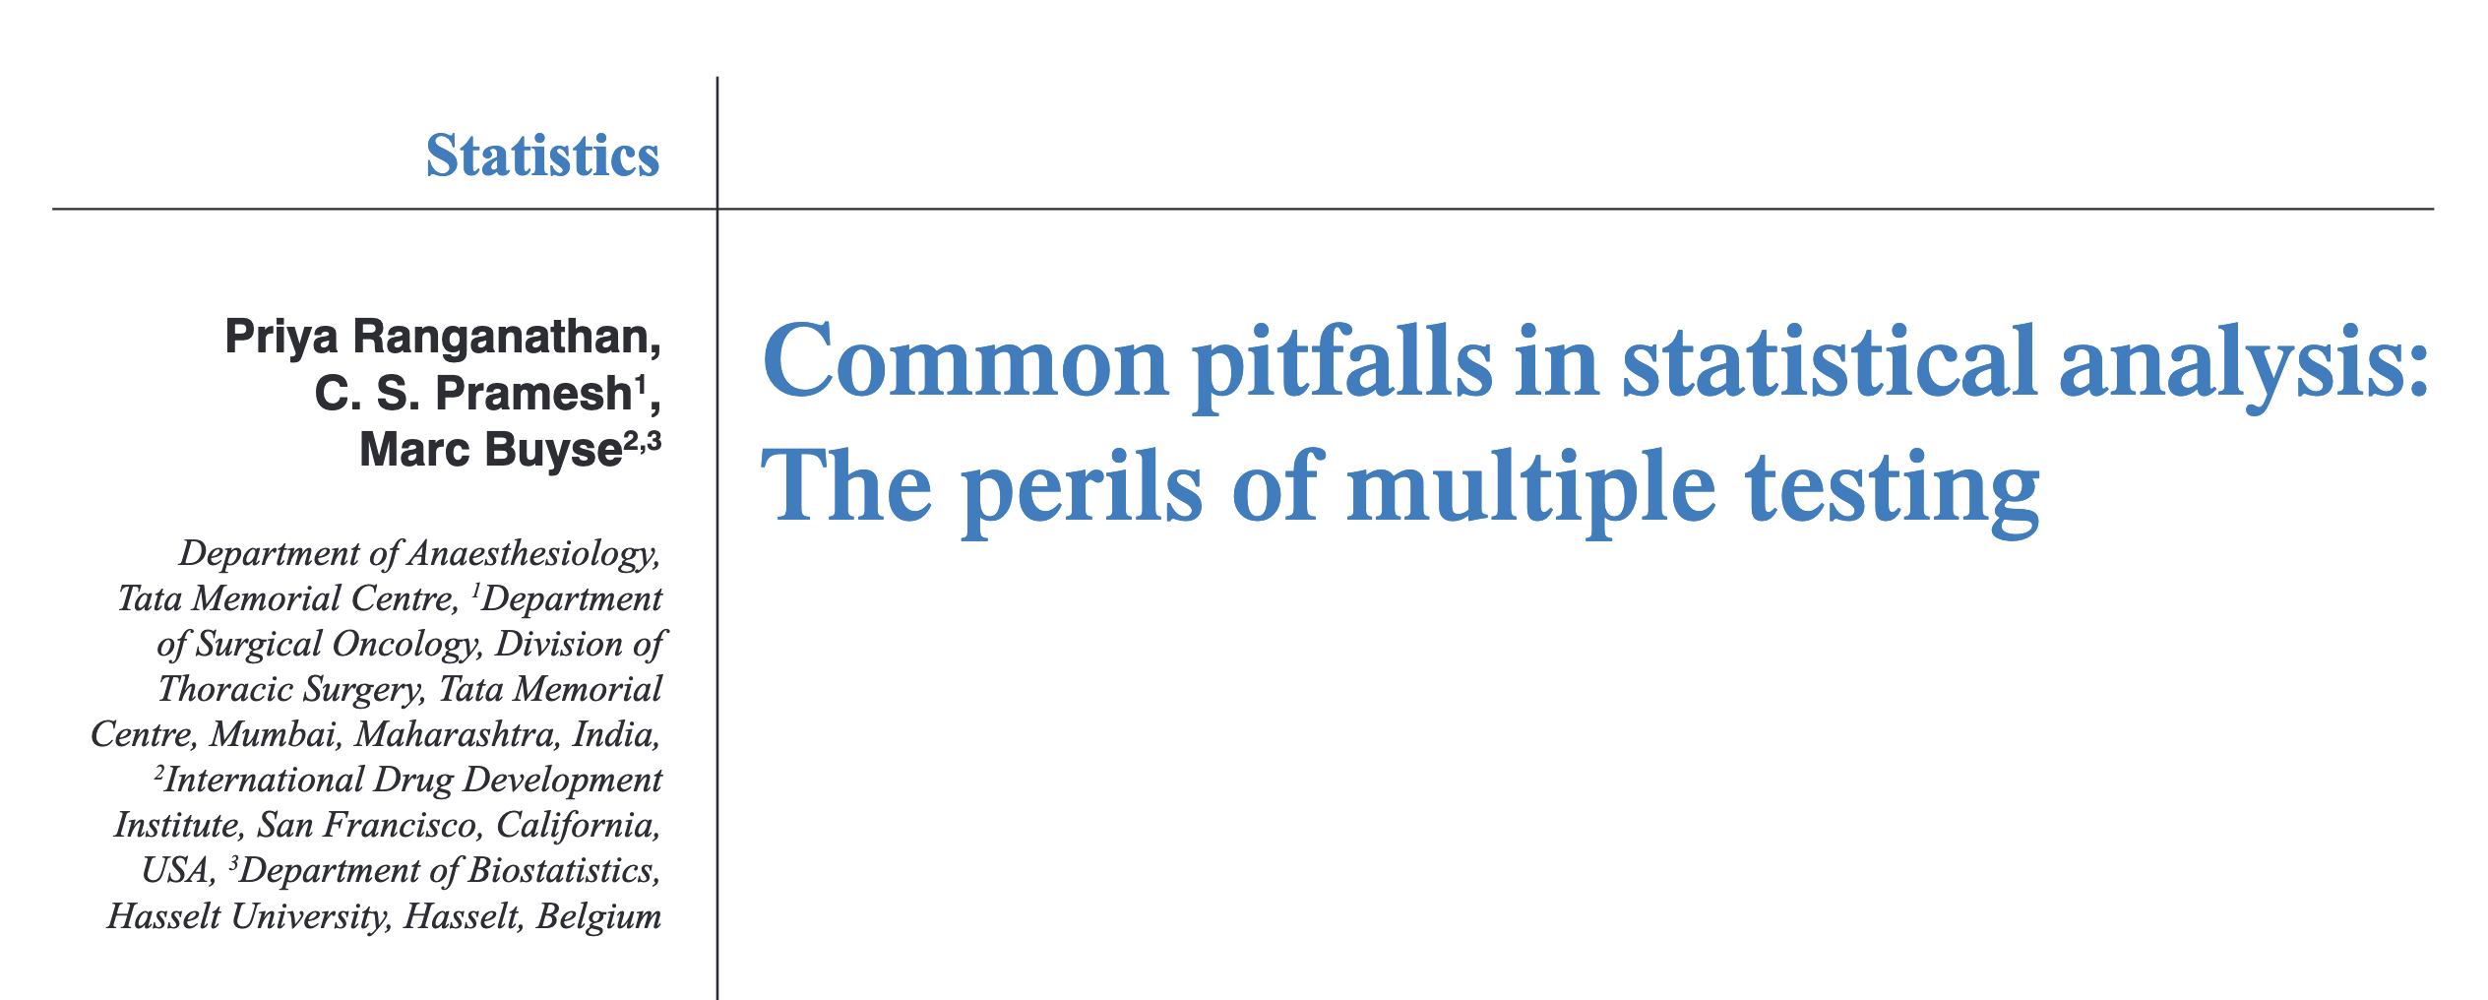
Closing thoughts: the perils of multiple testing…

Slide 60
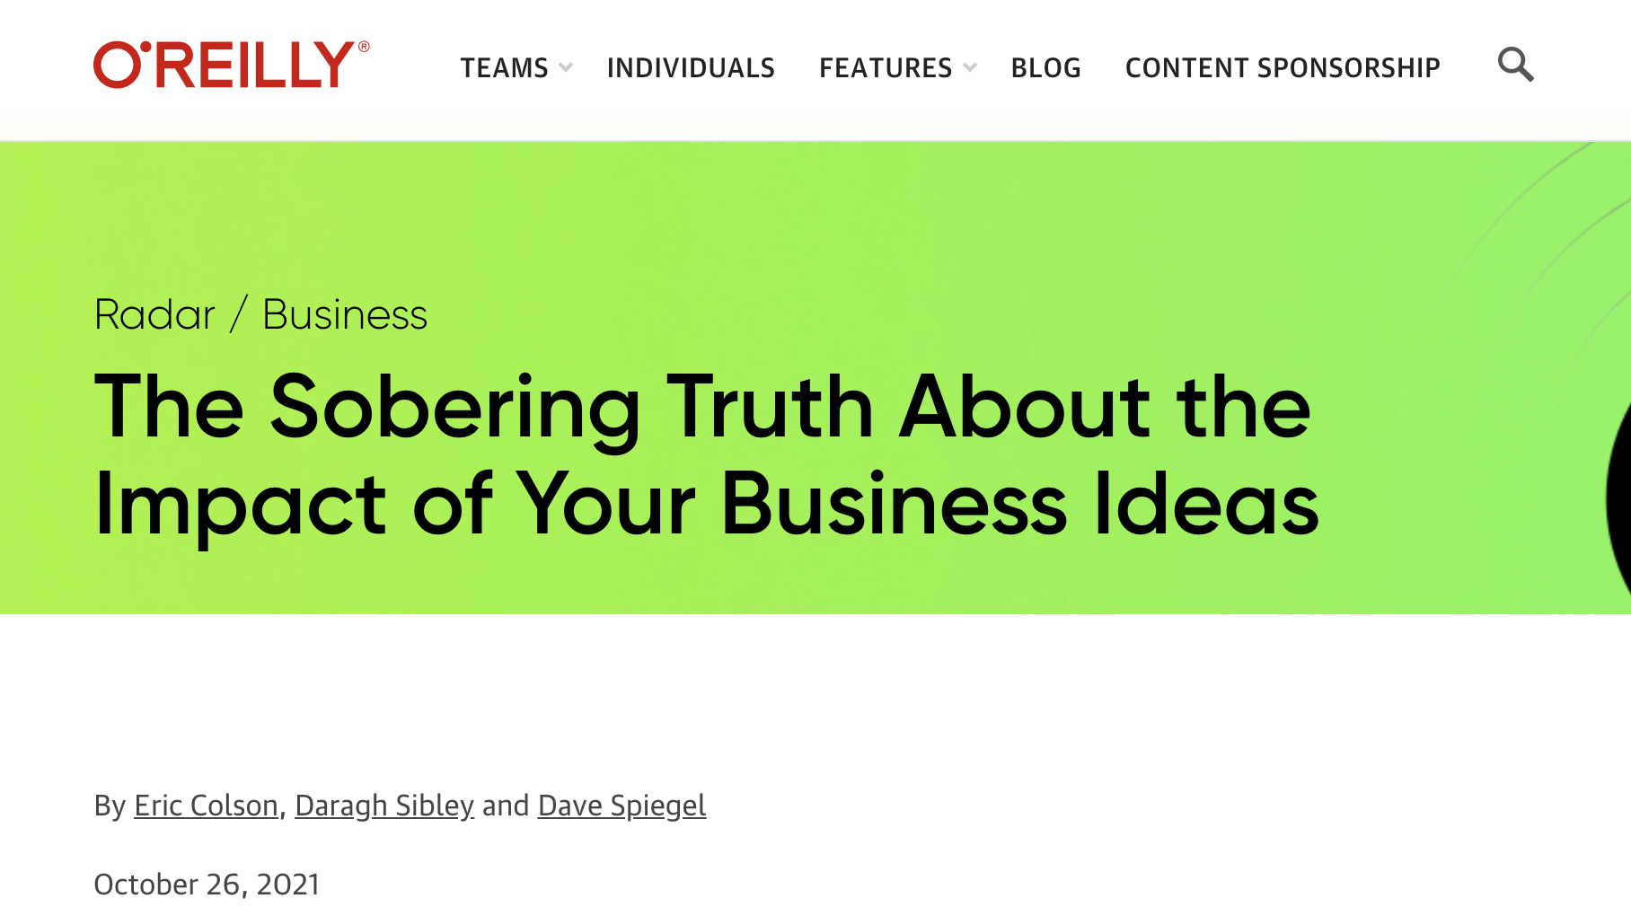
Closing thoughts: be humble, it’s likely your research or business idea doesn’t work!

