Slide 1
Real-time ASL Gesture Recognition
Ronil Christian (A20489525)

Slide 2
Introduction
America Sign Language is a visual communication language used by deaf and hard of hearing community in the United States and Canada.
According to the National Institute on Deafness and Other Communication Disorders, approximately 15% of American adults (37.5 million people) report some trouble hearing, and around 2 to 3 out of every 1,000 children in the United States are born with a detectable level of hearing loss.

Slide 3
Problem Statement
To use Convolutional Neural Networks in real time to translate a video of user’s ASL signs to text.
Aims is to carry out three tasks in real time:
Obtain video of user signing (input)
Extracting and classifying each frame in the video to a letter
Reconstructing and displaying the most likely character from classification scores (output)

Slide 4
From a Computer Vision Perspective
Aims to tackle:
Environmental concerns (e.g., lighting sensitivity, background and camera position)
Occlusion (e.g., some or all fingers, or an entire hand can be out of the field of view)
Sign boundary detection (when a sign ends and next begins)
Co-articulation (when a sign is affected by the preceding or succeeding sign)

Slide 5
Data Source
Each training and test case represents a label (0-25) as a one-to-one map for each alphabetic letter A-Z (and no cases for 9=J or 25=Z because of gesture motions).
The training data (27,455 cases) and test data (7172 cases) are approximately half the size of the standard MNIST but otherwise similar with a header row of label, pixel1, pixel2, …, pixel784 which represent a single 28x28 pixel image with grayscale values between 0-255.

Slide 6
Data Source
A - 0 1126
B - 1 1010
C - 2 1144
D - 3 1196
E - 4 957
F - 5 1204
G - 6 1090
H - 7 1013
I - 8 1162
K - 10 1114
L - 11 1241
M - 12 1055
N - 13 1151
O - 14 1196
P - 15 1088
Q - 16 1279
R - 17 1294
S - 18 1199
T - 19 1186
U - 20 1161
V - 21 1082
W - 22 1225
X - 23 1164
Y - 24 1118

Slide 7
Preprocessing
Training Data:
Resize to (28,28,1)
Normalize
One-Hot encode labels
Images extracted from frames:
Capture frame
Convert to gray
Apply Gaussian Blur
Resize to (28,28,1)

Slide 8
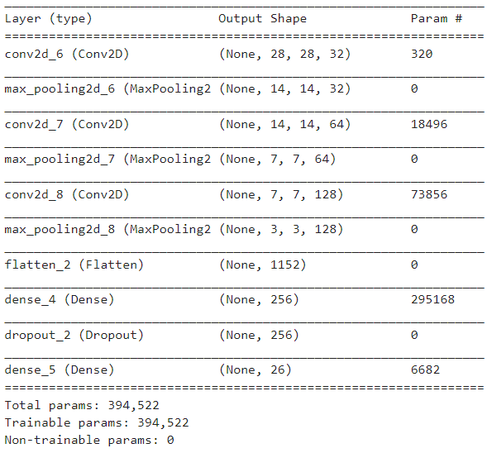
Model

Slide 9
Parameters
Input Size: (28,28,1)
3 Conv layers, 1 Dropout layer, 2 Dense layers
Epochs: 12
Optimizer: Adam
Loss: Categorical Cross-entropy
Batch Size: 32

Slide 10
Results
accuracy
training (min: 0.609, max: 0.996, cur: 0.995)
validation (min: 0.928, max: 0.974, cur: 0.956)
Loss
training (min: 0.014, max: 1.245, cur: 0.014)
validation (min: 0.106, max: 0.238, cur: 0.204)

Slide 11
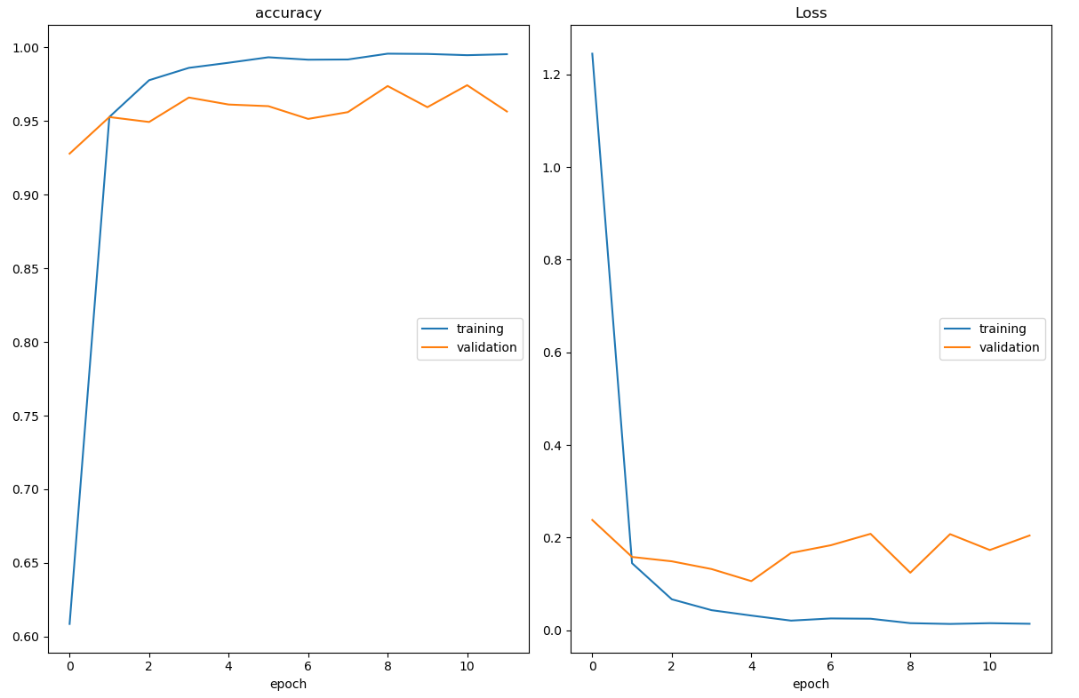

Slide 12
Next Steps and Future Scope
End-to-end web application
More training data under different environmental settings
Fine-tuning model
Static frame captures limit performance

Slide 13
Thank You

