Slide 1
CS241 Assignment 2 Demo
Project Team: Group 14
Ranveer Singh (S11230141)
Ronil Prasad (S11231541)
Shivan Prasad (S11231502)
Mohammed Suhail (S11230995)
Mohammed Afeef (S11229568)

Slide 2
Introduction
Schools in Fiji face issues of data management like paperwork errors and inefficient marks and grades management
Our Solution to the issue is the Student Administration System (SAS) which is a web-based platform that can automate tasks for schools data management of teachers, administrator, parents and students.
Our system will provide real-time data access, reduce errors and provide a secure role-based access to it users that saves time and enhances productivity of the entire school.

Slide 3
System Architecture
Database
Presentation Layer (View)
What the user sees and interacts with.
Controller Layer
The traffic cop and the request handler
Service Layer (Business Logic)
Core application operation and function
Persistence Layer
(Data access gateway)
Communication directly with the database

Slide 4
Features
Register Students and Teachers and create their accounts.
Role-based access for different users.
Assign teachers to classes and subjects.
Password Reset for student and teachers.
Update grades and attendance of students.
Update student information

Slide 5
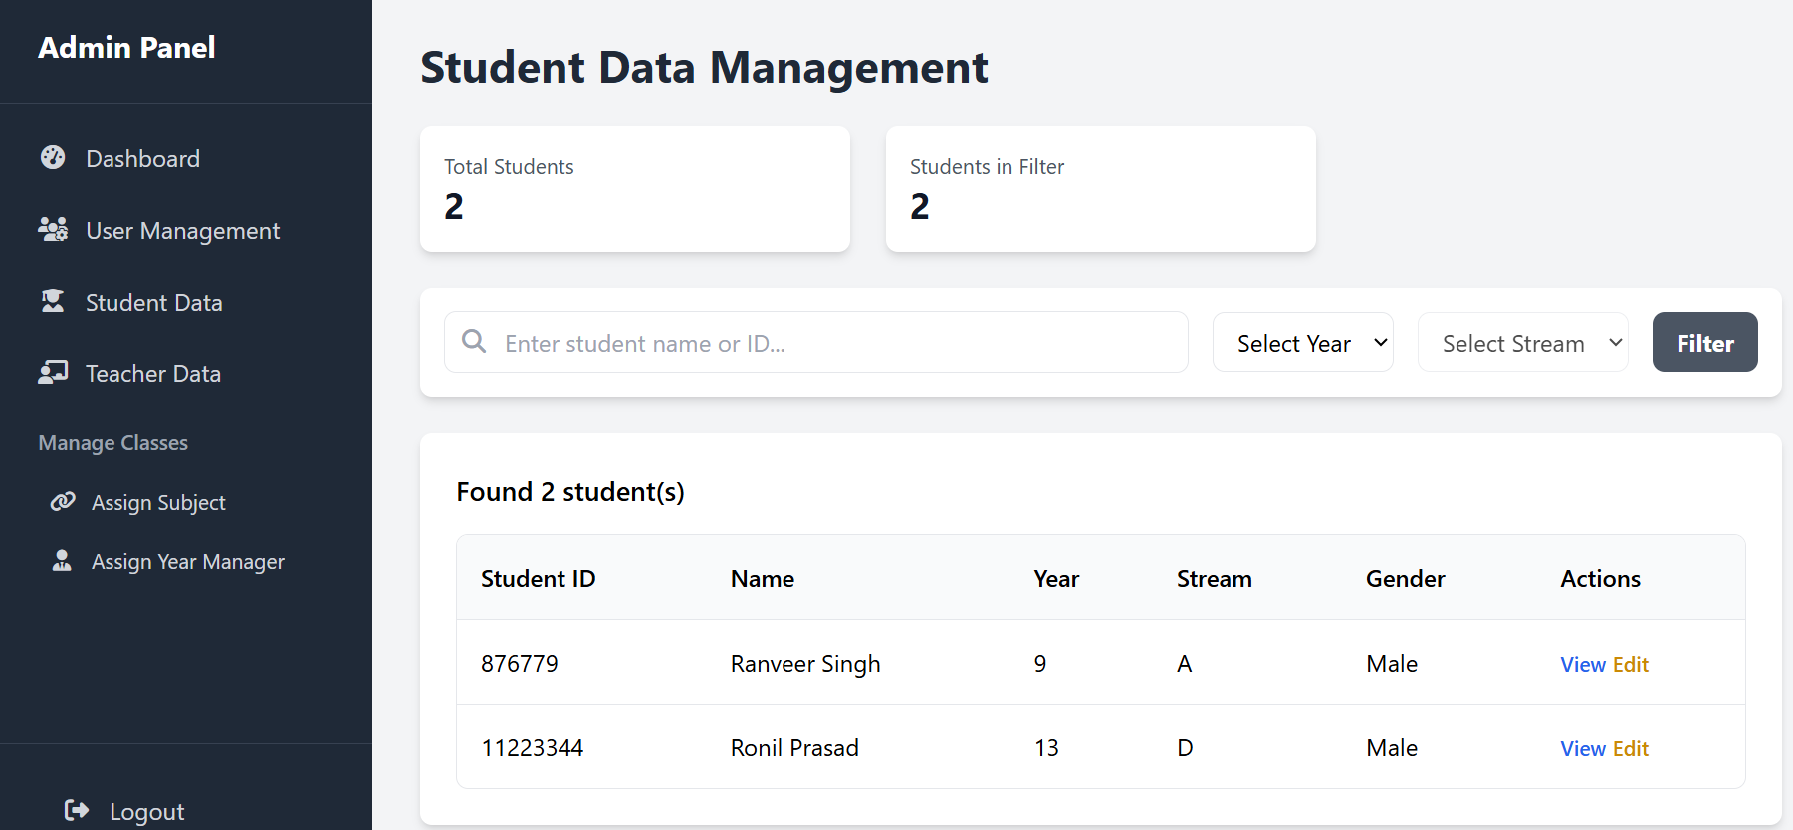
Admin View of Student data

Slide 6
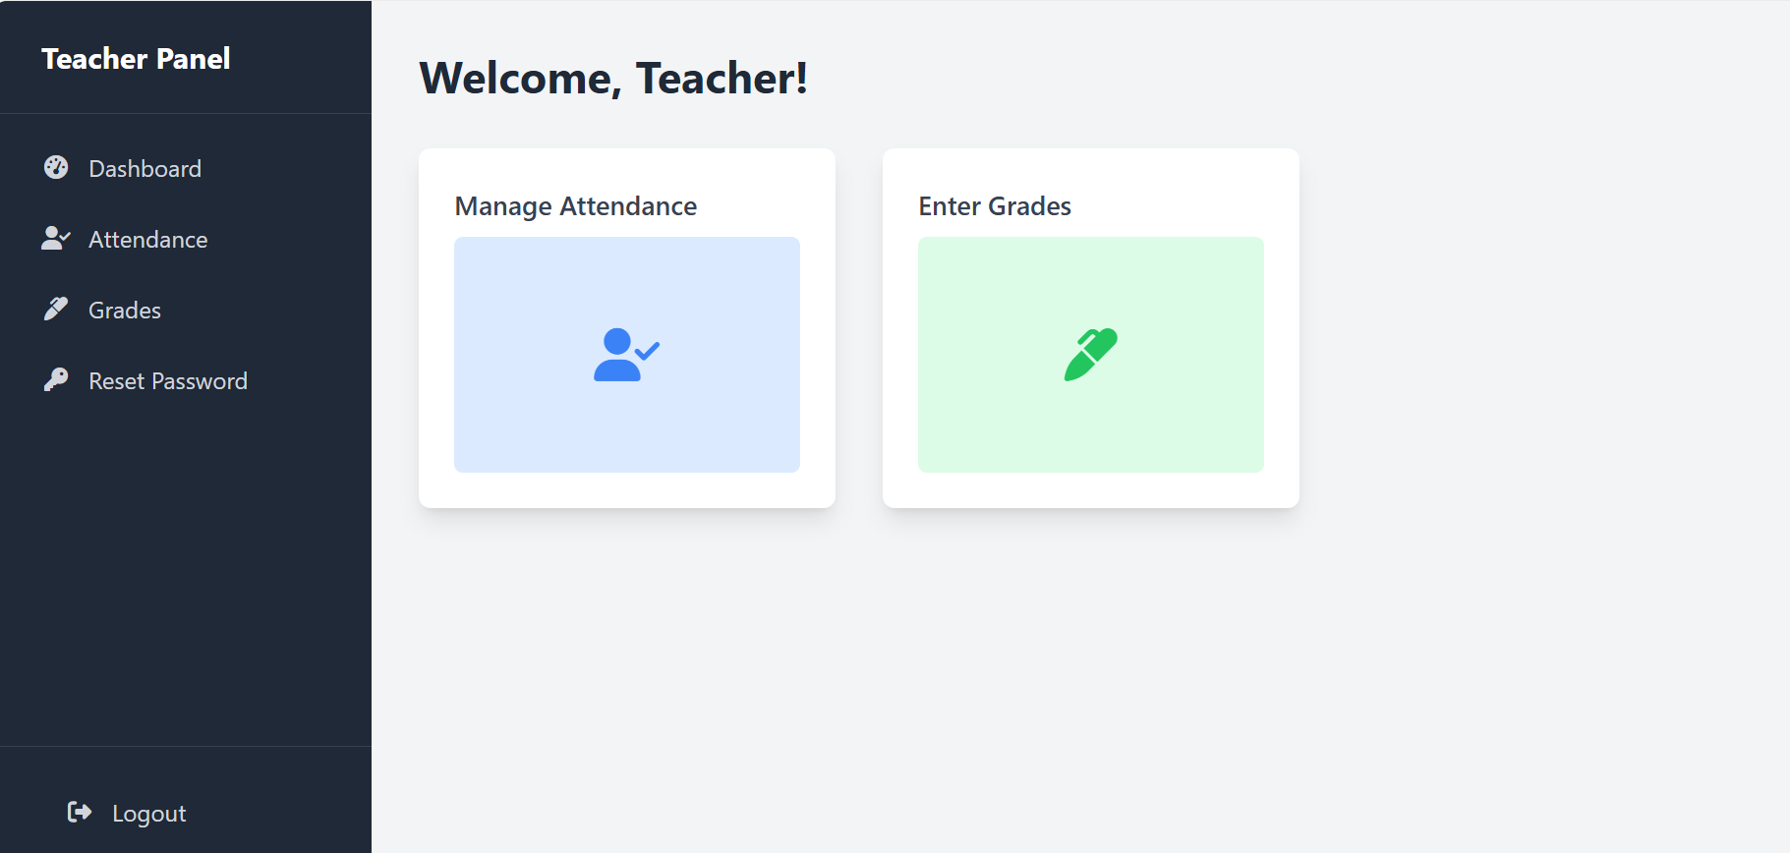
Teachers Dashboard

Slide 7
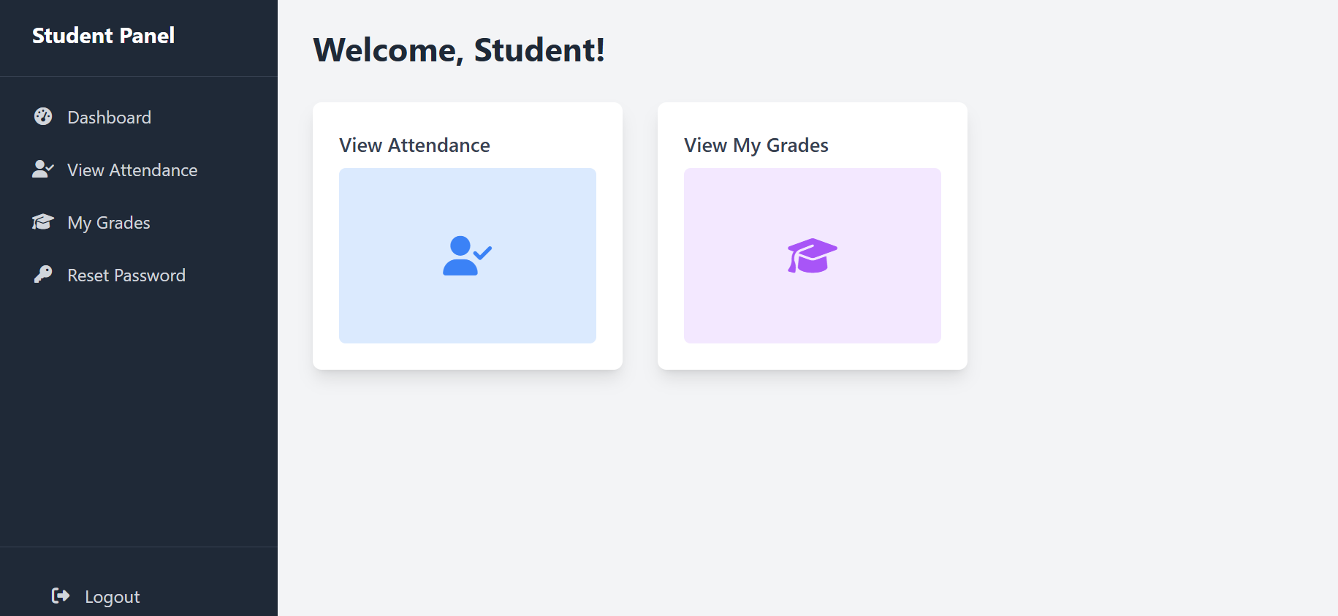
Student Dashboard

Slide 8
Testing and Integration
Logical artifacts such as controller endpoints for students and teachers were tested using Top-Down Integration.
Operational artifacts such creating user accounts, assigning roles and resetting passwords were tested using Bottom-Up integration.
All functional artifacts were unit tested with various input to inspects its behaviour.

Slide 9
Lessons Learnt
Divide into Modules– Break the program into smaller parts so that when issues occur they can be solved without changes to the whole system.
Testing and Integration – Test older components as new ones are added to the system to ensure integration.
Plan and Schedule – organize work and set deadlines for steady progress and meeting the requirements on time.

Slide 10
Contribution Sheet
Name | Student ID | Role | Contribution
Ranveer Singh | S11230141 | Frontend/Backend | 20%
Ronil Prasad | S11231541 | Frontend/Backend | 20%
Shivan Prasad | S11231502 | Frontend/Backend | 20%
Mohammed Suhail | S11230995 | Frontend/Backend | 20%
Mohammed Afeef | S11229568 | Frontend/Backend | 20%

Slide 11
Reference
https://docs.spring.io/spring-boot/appendix/dependency-versions/index.html

