Slide 1

Presentation On Thrift
Presented by: Presented to:
Ronish Maharjan Sujit Sir
Puja Maharjan

Slide 2
Table Of Content
Introduction
Problem of Statement
Objective
Features
Methodology
Feasibility Study
Economic
Technical
Operational
Requirement Analysis
ER Diagram
Use Case Diagram
flowchart diagram
Reference
Conclusion

Slide 3
INTRODUCTION
Thrift will be an online version of a thrift store.
The web based online store will have two main sections: the first section will be for selling and buying used, or refurbished items provided by customers and the second section will be for selling and buying new items belong to end-of-season or old seasons stock that have not been sold by on ground retailers of fashion brands or new items provided by small businesses with discounted prices.
The used items must satisfy a comprehensive set of criteria before being accepted to be sold on the online store.
The offered new items must be in a high quality and low prices.

Slide 4
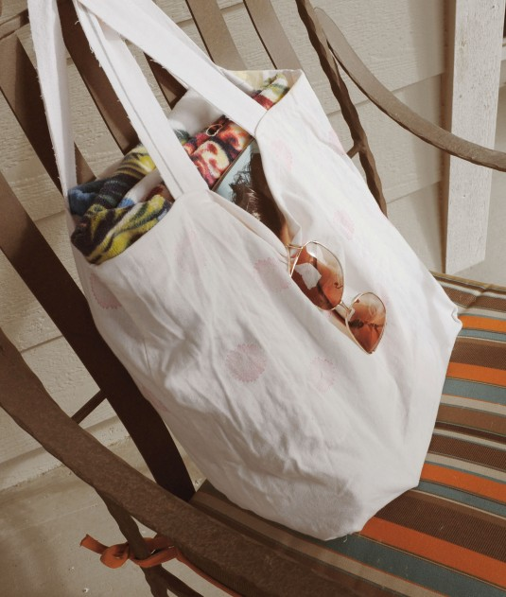
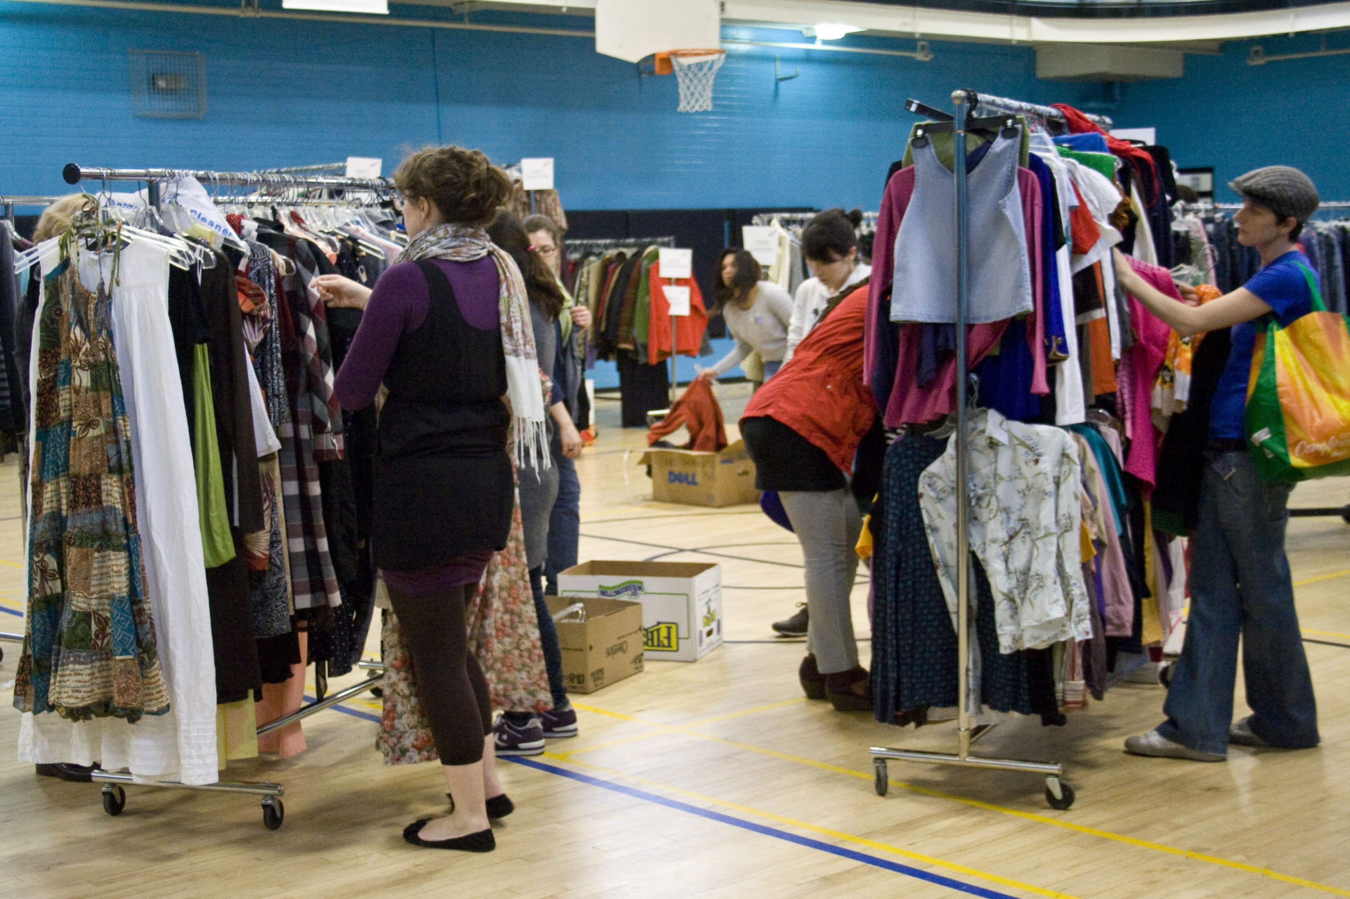
Problem statement
Today’s world is all about fast fashion.After we buy new dress we don’t wanna repeate same dress everyday.
so here we have a solution you can sale old clothes that you don’t wanna wear and make income or we can buy different style dress you wanna were in affordable price.

Slide 5
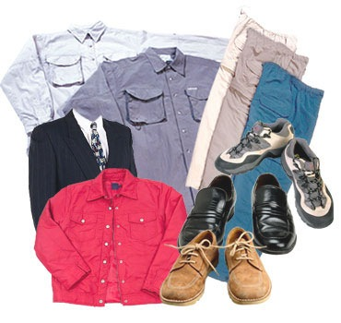
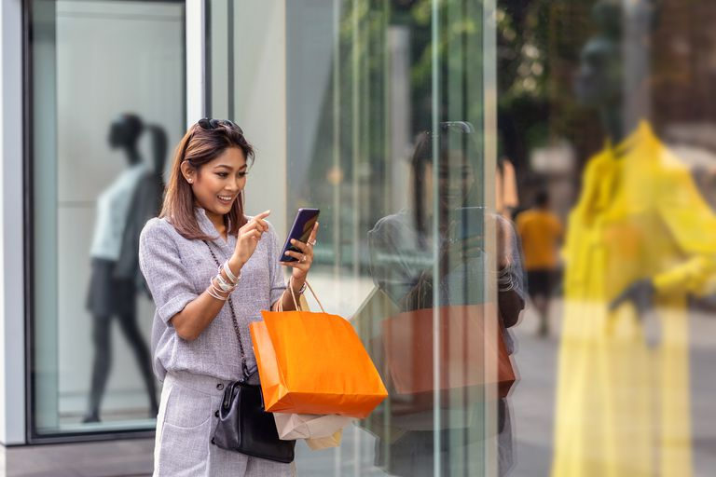
Objectives:
Reusability of unwanted/ unfitable clothes
In our locality we don’t have this store so we are the first one to make it happen

Slide 6
Features:
Browse: Easy-to-navigate interface to browse through various categories (clothing, furniture, etc.).
Search: Efficient search function with filters by category, size, price, brand & condition.
Product Details: Clear and detailed descriptions and high-quality photos of each item.
Wishlists/Favorites: Allow users to save items they like for later consideration.
Secure Shopping Cart & Checkout: Secure platform for handling payment information.
Reviews & Ratings: Enable user reviews and ratings to build trust and inform purchase decisions.
Communication: Easy way for users to contact the seller with questions or concerns.
For Sellers:
Listing Creation: Simple and user-friendly process for listing items with clear instructions.
Photos & Description: Upload multiple high-quality photos and detailed descriptions.
Pricing & Shipping Options: Set competitive prices and various shipping options.
Inventory Management: Track inventory levels and monitor sales easily.
Communication Tools: Interact with potential buyers and answer their questions.

Slide 7
Feasibility Study
Market Analysis
Identify the target market
Analyze the demand
Business Model
Define the business model
Pricing strategy
Technology and Infrastructure
E-commerce platform
Website development

Slide 8
Supply Chain Management
Sourcing inventory
Inventory management
Financial Projections
Revenue forecasts
Cost analysis
Risk Assessment
Identify potential risks and challenges
Develop mitigation strategies

Slide 9
Economic Feasibility Study
Market Demand and Potential Revenue: Analyze the market demand for second-hand goods by researching consumer behavior, trends, and preferences.
Cost Analysis: Identify and quantify the startup costs required to launch the online thrift store.
Revenue Projection: Forecast revenue based on the projected sales volume and pricing strategy.
Profitability Analysis: Calculate the gross profit margin by subtracting the cost of goods sold (COGS) from total revenue
Cash Flow Analysis: Prepare a cash flow projection to track the inflows and outflows of cash over a specific period
Risk Assessment: Identify potential risks and uncertainties that could affect the financial viability of the online thrift store, such as competition, market volatility, regulatory changes, and operational challenges.

Slide 10
Technical Feasibility Study
Technical Knowledge | Hardware Required | Software Required
HTML | Laptop | MS-word
CSS | Keyboard | Vs Code
JavaScript | Mouse | Photoshop
MYSQL |  | WAMP SERVER
PHP |  | Browsers
 |  | Draw.io

Slide 11
Operational Feasibility Study
Define Objectives and Scope: Identify the target market, types of products to be sold, and geographical reach.
Resource Assessment: Identify the resources required to establish and operate.
Technology Infrastructure: Assess the technological infrastructure required to support the operations of the online thrift store.
Risk Assessment: Identify potential risks and challenges that could impact the operational feasibility of the thrift
Cost-Benefit Analysis: Conduct a simple cost-benefit analysis to assess the financial implications of establishing and operating the online thrift store.

Slide 12
Methodology
Software Project Development followed the Waterfall Model as an appropriate software development model, and the following phases were implemented.
Project Proposal
Implementing Project Planning and Scheduling
System Analysis
System Design
Implementation & Testing
System Production (Publishing) and Maintenance

Slide 13
Requirement of Analysis
Stakeholder Identification
Gather Requirements
Prioritization
User Requirements
Documentation
Validation and Review

Slide 14
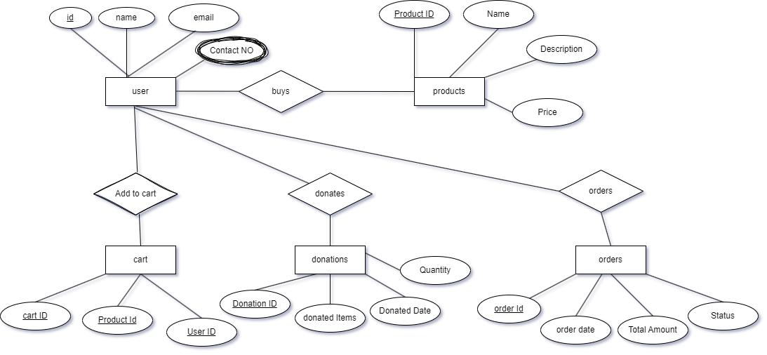
ER DIAGRAM

Slide 15
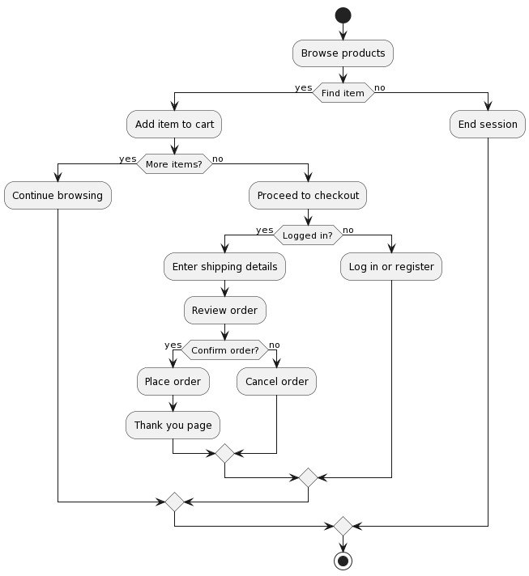
Flowchart

Slide 16
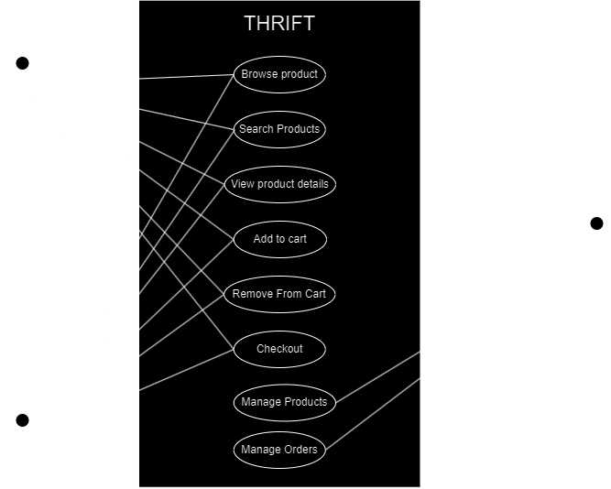
Use Case Diagram

Slide 17
REFRENCES
Chatgpt-https://chat.openai.com/
gemini-https://gemini.google.com/app
pintrest-https://www.pinterest.com/

Slide 18
Conclusion
In conclusion, the feasibility analysis indicates that launching an thrift is not only viable but also offers significant opportunities for success. With a strategic approach to business planning, implementation, and ongoing management, the thrift has the potential to thrive in the competitive e-commerce landscape while providing value to customers and stakeholders alike.

Slide 19


