Slide 1
h₁=10
h₂=40
F_{max}(S)=40
Expansion order:
S(40)
B(40)
G₁(40)
S
5
10
F_{max}(A)=65
h₁=5
h₂=60
A
50
10
B
h₁=10
h₂=30
F_{max}(B)=40
5
50
h₁=0
h₂=0
h₁=0
h₂=0
Inconsistent
F_{max}(G₁)=20
G₁
G₂
F_{max}(G₂)=60

Slide 2
h₁=10
h₂=40
F_{max}(S)=40
Expansion order:
S(40)
B(40)
G₁(40)
S
5
10
F_{max}(A)=55
h₁=5
h₂=50
A
50
10
B
h₁=10
h₂=30
F_{max}(B)=40
5
50
h₁=0
h₂=20
h₁=20
h₂=0
Inconsistent
F_{max}(G₁)=40
g₁
g₂
F_{max}(G₂)=80

Slide 3
h(S)=(10,40)
F_{max}(B)=40
Expansion order:
S(40)
B(40)
G₁(40)
S
5
10
h(A)=(5,50)
F_{max}(A)=55
h(B)=(10,30)
F_{max}(B)=40
A
50
10
B
5
50
Inconsistent
h(g₁)=(0,20)
F_{max}(g₁)=40
h(g₂)=(20,0)
F_{max}(g₂)=80
g₁
g₂

Slide 4
h(S)=(10,40)
F_{max}(B)=40
Expansion order:
S(40)
B(40)
G₁(40)
S
5
10
h(A)=(5,60)
F_{max}(A)=65
h(B)=(10,30)
F_{max}(B)=40
A
B
5
10
50
Inconsistent
h(g₁)=(0,0)
F_{max}(g₁)=20
h(g₂)=(0,0)
F_{max}(g₂)=60
g₁
g₂
6

Slide 5
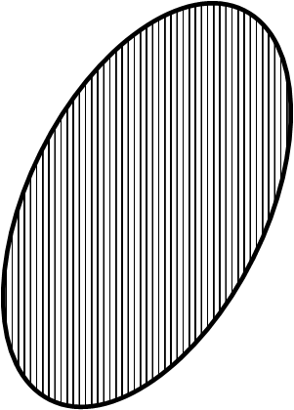
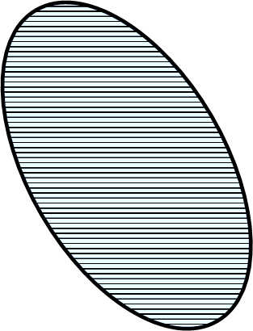
Gen(g₁)
S
Gen(g₂)
G₁
G₂
Gen(g₂)
Gen(g₁)
Gen(g₁)
Gen(g₂)
G₁
S
G₂
S
G₂
G₁

Slide 6
S
g₁
g₂
g₃
g_{k}
Gen(g₂)
Gen(g₁)
Gen(g₁)
Gen(g₃)
Gen(g_{k})
S
G₁
G₂
G₃
G_{k}

Slide 7


$$F_{max}\left(n_{1}\right)=\max\left(10,3\right)=10$$
$$F_{min}\left(n_{1}\right)=\min\left(10,3\right)=3$$
8
n₁
1
g₁
2
5
g₂
s
2
5
5
n₂
$$F_{max}\left(n_{2}\right)=\max\left(7,7\right)=7$$
$$F_{min}\left(n_{2}\right)=\min\left(7,7\right)=7$$

Slide 8





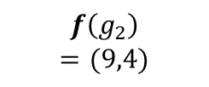


$$F_{max}\left(n_{1}\right)=10$$
$$f\left(n_{1}\right)=(10,4)$$
n₁
s
OPEN(0)
F(n1)=10
F(n2)=7
F(n3)=10
OPEN(1)
F(n1)=10
F(g1)=9
F(g2)=9
F(n3)=10
OPEN(2)
F(n1)=10
F(n3)=10
F(g2)=9
OPEN(3)
F(n1)=10
F(n3)=10
$$f\left(g_{1}\right)$$
$$=(5,9)$$
n₂
g₂
g₁
$$f\left(n_{2}\right)$$
$$=(7,7)$$
$$F_{max}\left(n_{2}\right)$$
$$=7$$
$$f\left(g_{2}\right)$$
$$=(9,4)$$
n₃
Fmax
$$f\left(n_{3}\right)=(5,10)$$
OPEN(0)
F(n2)=7
F(n1)=10
F(n3)=10
OPEN(1)
F(g1)=9
F(g2)=9
F(n1)=10
F(n3)=10
OPEN(2)
F(g2)=9
F(n1)=10
F(n3)=10
OPEN(3)
F(g2)=4
F(n1)=10
F(n3)=10
OPEN(4)
F(n1)=10
F(n3)=10
$$F_{max}\left(n_{3}\right)=10$$
Fmin
OPEN(0)
F(n1)=4
F(n2)=7
F(n3)=5
OPEN(1)
F(g2)=4
F(n3)=5
F(n2)=7
OPEN(2)
F(n3)=5
F(n2)=7
OPEN(3)
F(g1)=5
F(n2)=7

Slide 9
$$F_{max}\left(n_{1}\right)=10$$
$$f\left(n_{1}\right)=(10,4)$$
n₁
s
OPEN(0)
F(n1)=10
F(n2)=7
F(n3)=10
OPEN(1)
F(n1)=10
F(g1)=9
F(g2)=9
F(n3)=10
OPEN(2)
F(n1)=10
F(n3)=10
F(g2)=9
OPEN(3)
F(n1)=10
F(n3)=10
$$f\left(g_{1}\right)$$
$$=(5,9)$$
n₂
g₂
g₁
$$f\left(n_{2}\right)$$
$$=(7,7)$$
$$F_{max}\left(n_{2}\right)$$
$$=7$$
$$f\left(g_{2}\right)$$
$$=(9,4)$$
n₃
Fmax
$$f\left(n_{3}\right)=(5,10)$$
OPEN(0)
F(n2)=7
F(n1)=10
F(n3)=10
OPEN(1)
F(g1)=9
F(g2)=9
F(n1)=10
F(n3)=10
OPEN(2)
F(g2)=9
F(n1)=10
F(n3)=10
OPEN(3)
F(g2)=4
F(n1)=10
F(n3)=10
OPEN(4)
F(n1)=10
F(n3)=10
$$F_{max}\left(n_{3}\right)=10$$
Fmin
OPEN(0)
F(n1)=4
F(n2)=7
F(n3)=5
OPEN(1)
F(g2)=4
F(n3)=5
F(n2)=7
OPEN(2)
F(n3)=5
F(n2)=7
OPEN(3)
F(g1)=5
F(n2)=7

Slide 10
$$F_{max}\left(n_{1}\right)=10$$
$$f\left(n_{1}\right)=(10,4)$$
n₁
s
OPEN(0)
F(n1)=10
F(n2)=7
F(n3)=10
OPEN(1)
F(n1)=10
F(g1)=9
F(g2)=9
F(n3)=10
OPEN(2)
F(n1)=10
F(n3)=10
F(g2)=9
OPEN(3)
F(n1)=10
F(n3)=10
$$f\left(g_{1}\right)$$
$$=(5,9)$$
n₂
g₂
g₁
$$f\left(n_{2}\right)$$
$$=(7,7)$$
$$F_{max}\left(n_{2}\right)$$
$$=7$$
$$f\left(g_{2}\right)$$
$$=(9,4)$$
n₃
Fmax
$$f\left(n_{3}\right)=(5,10)$$
OPEN(0)
F(n2)=7
F(n1)=10
F(n3)=10
OPEN(1)
F(g1)=9
F(g2)=9
F(n1)=10
F(n3)=10
OPEN(2)
F(g2)=9
F(n1)=10
F(n3)=10
OPEN(3)
F(g2)=4
F(n1)=10
F(n3)=10
OPEN(4)
F(n1)=10
F(n3)=10
$$F_{max}\left(n_{3}\right)=10$$
Fmin
OPEN(0)
F(n1)=4
F(n2)=7
F(n3)=5
OPEN(1)
F(g2)=4
F(n3)=5
F(n2)=7
OPEN(2)
F(n3)=5
F(n2)=7
OPEN(3)
F(g1)=5
F(n2)=7

Slide 11

$$f\left(n_{1}\right)=(10,4)$$
n₁
s
$$f\left(g_{1}\right)$$
$$=(5,9)$$
n₂
g₂
g₁
$$f\left(n_{2}\right)=(7,7)$$
$$f\left(g_{2}\right)$$
$$=(9,4)$$
n₃
$$f\left(n_{3}\right)=(5,10)$$

Slide 12




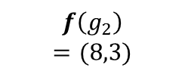
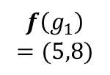

$$f\left(n_{1}\right)=(7,3)$$
$$f\left(n_{1}\right)=(10,3)$$
1
n₁
n₁
$$f\left(g_{1}\right)$$
$$=(5,8)$$
5
s
2
s
1
$$f\left(g_{1}\right)$$
$$=(5,9)$$
g₁
g₂
n₂
g₂
6
n₂
3
$$f\left(g_{2}\right)=(11,3)$$
g₁
$$f\left(n_{2}\right)=(7,4)$$
$$f\left(g_{2}\right)$$
$$=(8,3)$$
$$f\left(n_{2}\right)=(7,4)$$
n₃
$$f\left(n_{3}\right)=(5,10)$$

Slide 13
$$f\left(n_{1}\right)=(10,4)$$
n₁
s
n₂
g₂
g₁
$$f\left(n_{2}\right)=(7,7)$$
n₃
$$f\left(n_{3}\right)=(5,10)$$

Slide 14




$$f\left(n_{1}\right)=\left(10,3\right)$$
$$f\left(n_{1}\right)=\left(10,5\right)$$
n₁
n₁
g₁
5
g₂
g₁
4
g₂
s
s
n₂
n₂
$$f\left(n_{2}\right)=\left(7,7\right)$$
$$f\left(n_{2}\right)=\left(7,14\right)$$
(a)
(b)

Slide 15


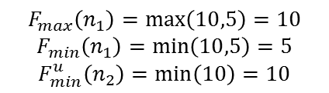
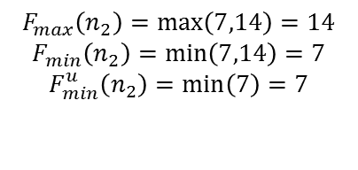
$$F_{max}\left(n_{1}\right)=\max\left(10,5\right)=10$$
$$F_{min}\left(n_{1}\right)=\min\left(10,5\right)=5$$
$$F_{min}^{u}\left(n_{2}\right)=\min\left(10\right)=10$$
$$F_{max}\left(n_{1}\right)=\max\left(10,3\right)=10$$
$$F_{min}\left(n_{1}\right)=\min\left(10,3\right)=3$$
8
n₁
8
n₁
3
1
g₁
2
g₁
2
5
g₂
4
g₂
s
s
2
2
5
5
5
12
n₂
n₂
$$F_{max}\left(n_{2}\right)=\max\left(7,7\right)=7$$
$$F_{min}\left(n_{2}\right)=\min\left(7,7\right)=7$$
$$F_{max}\left(n_{2}\right)=\max\left(7,14\right)=14$$
$$F_{min}\left(n_{2}\right)=\min\left(7,14\right)=7$$
$$F_{min}^{u}\left(n_{2}\right)=\min\left(7\right)=7$$
(a)
(b)

Slide 16


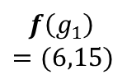

$$F_{max}\left(n_{1}\right)=\max\left(10,5\right)=10$$
$$F_{min}\left(n_{1}\right)=\min\left(10,5\right)=5$$
$$F_{min}^{u}\left(n_{2}\right)=\min\left(10\right)=10$$
$$f\left(n_{1}\right)=(8,3)$$
8
n₁
3
1
n₁
2
$$f\left(g_{1}\right)$$
$$=(6,15)$$
2
g₁
4
g₂
6
s
1
s
g₁
g₂
2
6
n₂
4
5
12
$$f\left(g_{2}\right)=(12,3)$$
n₂
$$f\left(n_{2}\right)=(7,5)$$
$$F_{max}\left(n_{2}\right)=\max\left(7,14\right)=14$$
$$F_{min}\left(n_{2}\right)=\min\left(7,14\right)=7$$
$$F_{min}^{u}\left(n_{2}\right)=\min\left(7\right)=7$$

Slide 17
h(n₁₁)=(k+1,m+2)
g₁
n_{1k}
n₁₂
n₁₁
S
n₂₁
n₂₂
n_{2m}
g₂

Slide 18
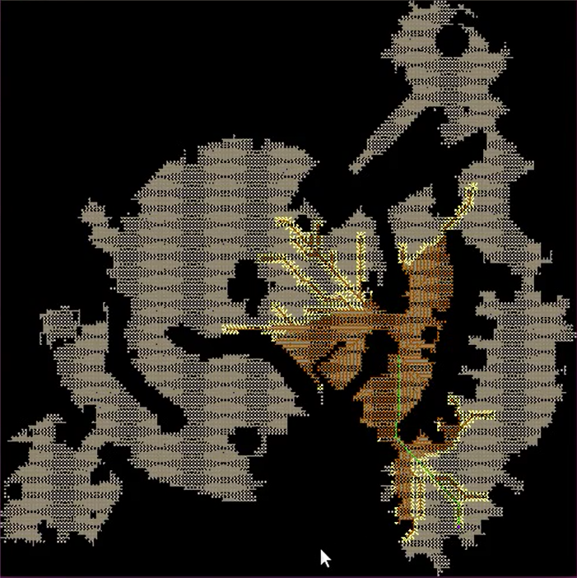
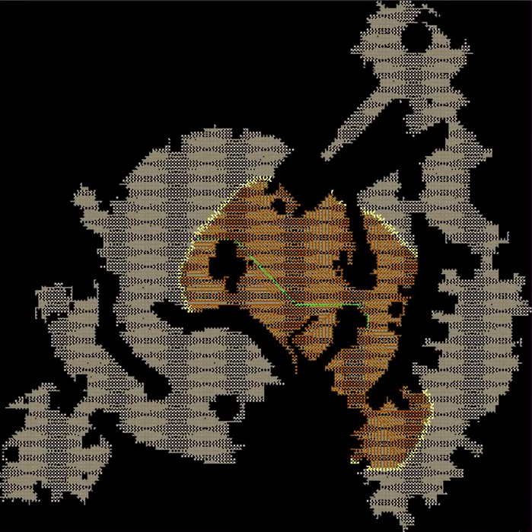
Min-f
Max-f

Slide 19

Lazy kA*min

