Slide 1
h₁=10
h₂=40
F_{max}(S)=40
Expansion order:
S(40)
B(40)
G₁(40)
S
5
10
F_{max}(A)=55
h₁=5
h₂=50
A
50
10
B
h₁=10
h₂=30
F_{max}(B)=40
5
50
h₁=0
h₂=20
h₁=20
h₂=0
Inconsistent
F_{max}(G₁)=40
G₁
G₂
F_{max}(G₂)=80

Slide 2
h₁=10
h₂=40
F_{max}(S)=40
Expansion order:
S(40)
B(40)
G₁(40)
S
5
10
F_{max}(A)=55
h₁=5
h₂=50
A
50
10
B
h₁=10
h₂=30
F_{max}(B)=40
5
50
h₁=0
h₂=20
h₁=20
h₂=0
Inconsistent
F_{max}(G₁)=40
G₁
G₂
F_{max}(G₂)=80

Slide 3
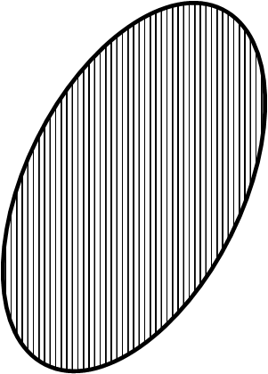
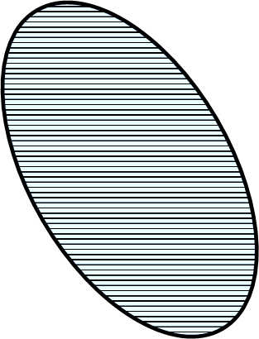
Gen(g₁)
S
Gen(g₂)
G₁
G₂
Gen(g₂)
Gen(g₁)
Gen(g₁)
Gen(g₂)
G₁
S
G₂
S
G₂
G₁

Slide 4
S
G₁
G₂
G₃
G_{k}
Gen(g₂)
Gen(g₁)
Gen(g₁)
Gen(g₃)
Gen(g_{k})
S
G₁
G₂
G₃
G_{k}

Slide 5


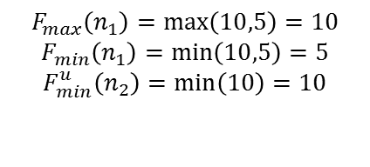
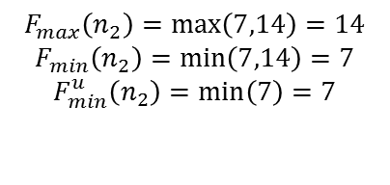
$$F_{max}\left(n_{1}\right)=\max\left(10,5\right)=10$$
$$F_{min}\left(n_{1}\right)=\min\left(10,5\right)=5$$
$$F_{min}^{u}\left(n_{2}\right)=\min\left(10\right)=10$$
$$F_{max}\left(n_{1}\right)=\max\left(10,3\right)=10$$
$$F_{min}\left(n_{1}\right)=\min\left(10,3\right)=3$$
8
n₁
8
n₁
3
1
G₁
2
G₁
2
5
G₂
4
G₂
s
s
2
2
5
5
5
12
n₂
n₂
$$F_{max}\left(n_{2}\right)=\max\left(7,7\right)=7$$
$$F_{min}\left(n_{2}\right)=\min\left(7,7\right)=7$$
$$F_{max}\left(n_{2}\right)=\max\left(7,14\right)=14$$
$$F_{min}\left(n_{2}\right)=\min\left(7,14\right)=7$$
$$F_{min}^{u}\left(n_{2}\right)=\min\left(7\right)=7$$
(a)
(b)

Slide 6
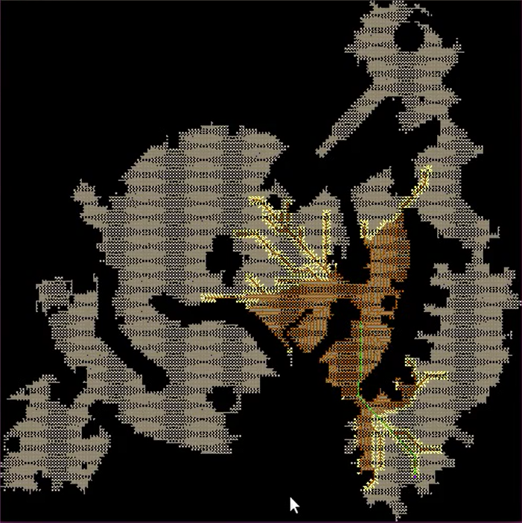
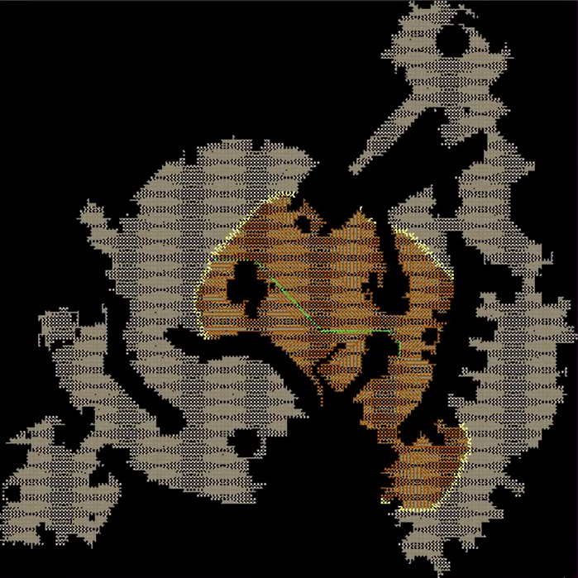
Min-f
Max-f

