Slide 1
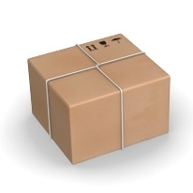
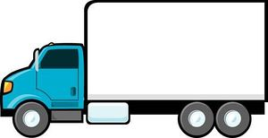
State: (TruckAt=A, PackageAt=B)
Action: Move(A,B)
State: (TruckAt=B, PackageAt=B)
Action: Pickup(Truck,B)
State: (TruckAt=B, PackageAt=Truck)
Action: Move(B,C)
State: (TruckAt=C, PackageAt=Truck)
Action: Unload(Truck,C)
State: (TruckAt=C, PackateAt=C)
Action: Move(A,B)
Pre: (TruckAt=A, PackageAt=B)
Eff: TruckAt=B
Action: Pickup(Truck,B)
Pre: (TruckAt=B, PackageAt=B)
Eff: (PackageAt=Truck)
Action: Move(B,C)
Pre: (TruckAt=B, PackageAt=Truck)
Eff: (TruckAt=C)
Action: Unload(Truck,C)
Pre: (TruckAt=C, PackageAt=Truck)
Eff: (PackateAt=C)
A
B
C
State: (TruckAt=A, PackageAt=B)
Action: Move(A,B)
State: (TruckAt=B, PackageAt=B)
Action: Pickup(Truck,B)
State: (TruckAt=B, PackageAt=Truck)
Action: Move(B,C)
State: (TruckAt=C, PackageAt=Truck)
Action: Unload(Truck,C)
State: (TruckAt=C, PackateAt=C)

Slide 2
A
B
C
Trajectory #1:
State: (TruckAt=A, PackageAt=B)
Action: Move(A,B)
State: (TruckAt=B, PackageAt=B)
Action: Pickup(Truck,B)
State: (TruckAt=B, PackageAt=Truck)
Action: Move(B,C)
State: (TruckAt=C, PackageAt=Truck)
Action: Unload(Truck,C)
State: (TruckAt=C, PackateAt=C)
Action: Move(A,B)
Pre: (TruckAt=A, PackageAt=B)
Eff: TruckAt=B
Action: Pickup(Truck,B)
Pre: (TruckAt=B, PackageAt=B)
Eff: (PackageAt=Truck)
Action: Move(B,C)
Pre: (TruckAt=B, PackageAt=Truck)
Eff: (TruckAt=C)
Action: Unload(Truck,C)
Pre: (TruckAt=C, PackageAt=Truck)
Eff: (PackateAt=C)
Trajectory #2:
State: (TruckAt=A, PackageAt=C)
Action: Move(A,B)
State: (TruckAt=B, PackageAt=C)
Action: Move(B,C)
State: (TruckAt=C, PackageAt=C)

Slide 3
A
B
C
Trajectory #1:
State: (A, B)
Action: Move(A,B)
State: (TruckAt=B, PackageAt=B)
Action: Pickup(Truck,B)
State: (TruckAt=B, PackageAt=Truck)
Action: Move(B,C)
State: (TruckAt=C, PackageAt=Truck)
Action: Unload(Truck,C)
State: (TruckAt=C, PackateAt=C)
Action: Move(A,B)
Pre: (TruckAt=A, PackageAt=B)
Eff: TruckAt=B
Action: Pickup(Truck,B)
Pre: (TruckAt=B, PackageAt=B)
Eff: (PackageAt=Truck)
Action: Move(B,C)
Pre: (TruckAt=B, PackageAt=Truck)
Eff: (TruckAt=C)
Action: Unload(Truck,C)
Pre: (TruckAt=C, PackageAt=Truck)
Eff: (PackateAt=C)
Trajectory #2:
State: (TruckAt=A, PackageAt=C)
Action: Move(A,B)
State: (TruckAt=B, PackageAt=C)
Action: Move(B,C)
State: (TruckAt=C, PackageAt=C)

Slide 4
P | T
B | A | S1
B | A | Move
B | B | S2
B | T | Pick
T | B | S3
C | B | Move
T | C | S4
C | T | Unload
C | C | S5
P | T
B | A | Move
B | A | Pre
 | B | Eff
C | B | Move
T | B | Pre
 | C | Eff
B | T | Pick
B | B | Pre
T |  | Eff
C | T | Unload
T | C | Pre
C |  | Eff
P | T
A | A | S1
B | A | Move
A | B | S2
C | B | Move
T | C | S3
P | T
B | A | Move
 | A | Pre
 | B | Eff
C | B | Move
 | B | Pre
 | C | Eff
B | T | Pick
B | B | Pre
T |  | Eff
C | T | Unload
T | C | Pre
C |  | Eff

Slide 5

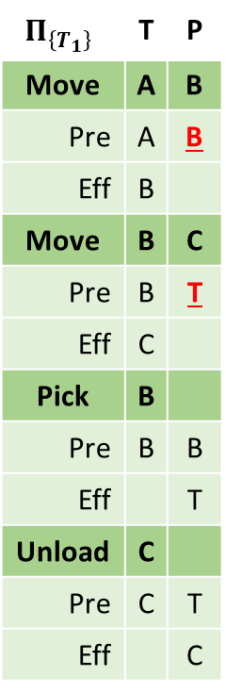

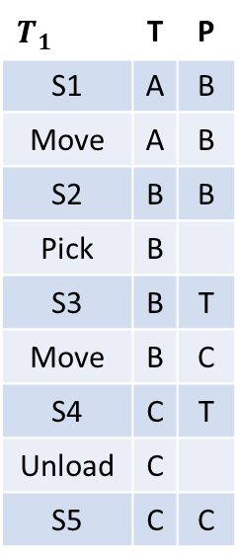
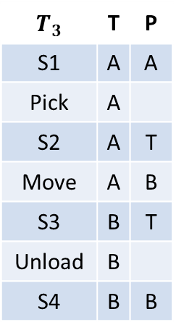
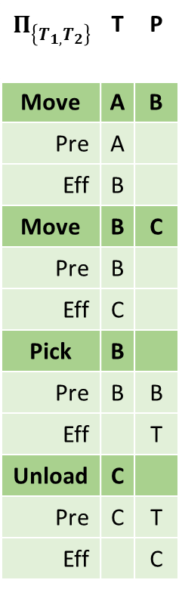
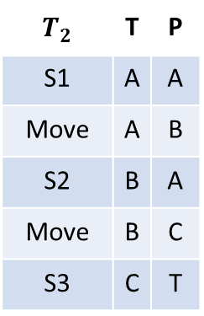

P | T | $$T_{1}$$
B | A | S1
B | A | Move
B | B | S2
 | B | Pick
T | B | S3
C | B | Move
T | C | S4
 | C | Unload
C | C | S5
P | T | $$Π_{\left\{T_{1}\right\}}$$
B | A | Move
B | A | Pre
 | B | Eff
C | B | Move
T | B | Pre
 | C | Eff
 | B | Pick
B | B | Pre
T |  | Eff
 | C | Unload
T | C | Pre
C |  | Eff
P | T | $$T_{2}$$
A | A | S1
B | A | Move
A | B | S2
C | B | Move
T | C | S3
P | T | $$Π_{\left\{T_{1,}T_{2}\right\}}$$
B | A | Move
 | A | Pre
 | B | Eff
C | B | Move
 | B | Pre
 | C | Eff
 | B | Pick
B | B | Pre
T |  | Eff
 | C | Unload
T | C | Pre
C |  | Eff
P | T | $$T_{3}$$
A | A | S1
 | A | Pick
T | A | S2
B | A | Move
T | B | S3
 | B | Unload
B | B | S4
P | T
B | A | Move
 | A | Pre
 | B | Eff
C | B | Move
 | B | Pre
 | C | Eff
 | B | Pick
B | B | Pre
T |  | Eff
 | A | Pick
A | A | Pre
T |  | Eff
P | T
 | B | Unload
T | B | Pre
B |  | Eff
 | C | Unload
T | C | Pre
C |  | Eff
Unknown
Pick(A)=?
Pick(C)=?
Unload(A)=?
Unload(B)=?
Unknown
Pick(A)=?
Pick(C)=?
Unload(A)=?
Unload(B)=?
Unknown
Pick(C)=?
Unload(A)=?
$$Π_{\left\{T_{1,}T_{2}\right\}}$$
$$Π_{\left\{T_{1}\right\}}$$
$$Π_{\left\{T_{1},T_{2}{,T}_{3}\right\}}$$

Slide 6

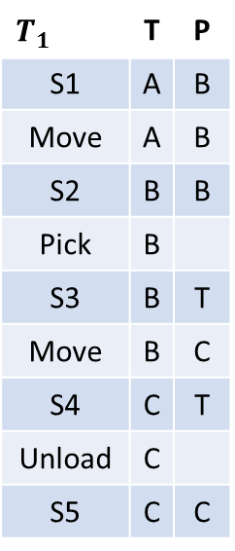


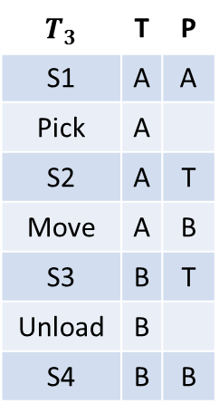
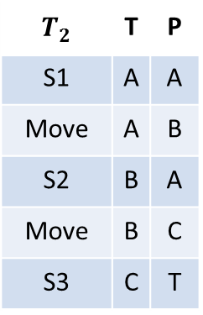
$$Π_{\left\{T_{1}\right\}}$$
$$Π_{\left\{T_{1,}T_{2}\right\}}$$
$$Π_{\left\{T_{1},T_{2}{,T}_{3}\right\}}$$
P | T
B | A | Move
B | A | Pre
 | B | Eff
C | B | Move
T | B | Pre
 | C | Eff
 | B | Pick
B | B | Pre
T |  | Eff
 | C | Unload
T | C | Pre
C |  | Eff
P | T
B | A | Move
 | A | Pre
 | B | Eff
C | B | Move
 | B | Pre
 | C | Eff
 | B | Pick
B | B | Pre
T |  | Eff
 | C | Unload
T | C | Pre
C |  | Eff
P | T
B | A | Move
 | A | Pre
 | B | Eff
C | B | Move
 | B | Pre
 | C | Eff
 | B | Pick
B | B | Pre
T |  | Eff
 | A | Pick
A | A | Pre
T |  | Eff
P | T
 | B | Unload
T | B | Pre
B |  | Eff
 | C | Unload
T | C | Pre
C |  | Eff
A
B
C
Observed Trajectories
P | T | $$T_{1}$$
B | A | S1
B | A | Move
B | B | S2
 | B | Pick
T | B | S3
C | B | Move
T | C | S4
 | C | Unload
C | C | S5
P | T | $$T_{2}$$
A | A | S1
B | A | Move
A | B | S2
C | B | Move
T | C | S3
P | T | $$T_{3}$$
A | A | S1
 | A | Pick
T | A | S2
B | A | Move
T | B | S3
 | B | Unload
B | B | S4
Unknown
Pick(A)=?
Pick(C)=?
Unload(A)=?
Unload(B)=?
Unknown
Pick(C)=?
Unload(A)=?
Unknown
Pick(A)=?
Pick(C)=?
Unload(A)=?
Unload(B)=?

Slide 7








$$T_{1}$$
$$T_{2}$$
$$T_{3}$$
$${F(Π}_{\left\{T_{1}\right\}})$$
$${F(Π}_{\left\{T_{1,}T_{2}\right\}})$$
$${F(Π}_{\left\{T_{1},T_{2}{,T}_{3}\right\}})$$
P | T
B | A | Move
B | A | Pre
 | B | Eff
C | B | Move
T | B | Pre
 | C | Eff
 | B | Pick
B | B | Pre
T |  | Eff
 | C | Unload
T | C | Pre
C |  | Eff
P | T
B | A | Move
 | A | Pre
 | B | Eff
C | B | Move
 | B | Pre
 | C | Eff
 | B | Pick
B | B | Pre
T |  | Eff
 | C | Unload
T | C | Pre
C |  | Eff
P | T
B | A | Move
 | A | Pre
 | B | Eff
C | B | Move
 | B | Pre
 | C | Eff
 | B | Pick
B | B | Pre
T |  | Eff
 | A | Pick
A | A | Pre
T |  | Eff
P | T
 | B | Unload
T | B | Pre
B |  | Eff
 | C | Unload
T | C | Pre
C |  | Eff
A
B
C
A
B
C
A
B
C
P | T
B | A | S1
B | A | Move
B | B | S2
 | B | Pick
T | B | S3
C | B | Move
T | C | S4
 | C | Unload
C | C | S5
P | T
A | A | S1
B | A | Move
A | B | S2
C | B | Move
T | C | S3
P | T
A | A | S1
 | A | Pick
T | A | S2
B | A | Move
T | B | S3
 | B | Unload
B | B | S4
A
B
C
A
B
C
A
B
C

Slide 8
$$T_{1}$$
$$T_{2}$$
$$T_{3}$$
$${F(Π}_{\left\{T_{1}\right\}})$$
$${F(Π}_{\left\{T_{1,}T_{2}\right\}})$$
$${F(Π}_{\left\{T_{1},T_{2}{,T}_{3}\right\}})$$
P | T
B | A | Move
B | A | Pre
 | B | Eff
C | B | Move
T | B | Pre
 | C | Eff
 | B | Pick
B | B | Pre
T |  | Eff
 | C | Unload
T | C | Pre
C |  | Eff
P | T
B | A | Move
 | A | Pre
 | B | Eff
C | B | Move
 | B | Pre
 | C | Eff
 | B | Pick
B | B | Pre
T |  | Eff
 | C | Unload
T | C | Pre
C |  | Eff
P | T
B | A | Move
 | A | Pre
 | B | Eff
C | B | Move
 | B | Pre
 | C | Eff
 | B | Pick
B | B | Pre
T |  | Eff
 | A | Pick
A | A | Pre
T |  | Eff
P | T
 | B | Unload
T | B | Pre
B |  | Eff
 | C | Unload
T | C | Pre
C |  | Eff
A
B
C
A
B
C
A
B
C
P | T
B | A | s₁
Move_{A,B} |  | a₁
B | B | s₂
Pick_{B} |  | a₂
T | B | s₃
Move_{B,C} |  | a₃
T | C | s₄
Unload_{C} |  | a₄
C | C | s₅
P | T
A | A | s₁
Move_{A,B} |  | a₁
A | B | s₂
Move_{B,C} |  | a₂
A | C | s₃
P | T
A | A | s₁
Pick_{A} |  | a₁
T | A | s₂
Move_{A,B} |  | a₂
T | B | s₃
Unload_{B} |  | a₃
B | B | s₄
P | T
A | A | S1
B | A | Move
A | B | S2
C | B | Move
T | C | S3
P | T
A | A | S1
 | A | Pick
T | A | S2
B | A | Move
T | B | S3
 | B | Unload
B | B | S4
A
B
C
A
B
C
A
B
C

Slide 9
$$T_{1}$$
$$T_{2}$$
$$T_{3}$$
$${F(Π}_{\left\{T_{1}\right\}})$$
$${F(Π}_{\left\{T_{1,}T_{2}\right\}})$$
$${F(Π}_{\left\{T_{1},T_{2}{,T}_{3}\right\}})$$
A
B
C
A
B
C
P | T
Move_{A,B}
B | A | Pre
 | B | Eff
Move_{B,C}
T | B | Pre
 | C | Eff
Pick_{B}
B | B | Pre
T |  | Eff
Unload_{C}
T | C | Pre
C |  | Eff
P | T
Move_{A,B}
 | A | Pre
 | B | Eff
Move_{B,C}
 | B | Pre
 | C | Eff
Pick_{B}
B | B | Pre
T |  | Eff
Unload_{C}
T | C | Pre
C |  | Eff
P | T
Move_{A,B}
 | A | Pre
 | B | Eff
Move_{B,C}
 | B | Pre
 | C | Eff
Pick_{A}
A | A | Pre
T |  | Eff
Pick_{B}
B | B | Pre
T |  | Eff
P | T
Unload_{B}
T | B | Pre
B |  | Eff
Unload_{C}
T | C | Pre
C |  | Eff
A
B
C
P | T
B | A | s₁
Move_{A,B} |  | a₁
B | B | s₂
Pick_{B} |  | a₂
T | B | s₃
Move_{B,C} |  | a₃
T | C | s₄
Unload_{C} |  | a₄
C | C | s₅
P | T
A | A | s₁
Move_{A,B} |  | a₁
A | B | s₂
Move_{B,C} |  | a₂
A | C | s₃
P | T
A | A | s₁
Pick_{A} |  | a₁
T | A | s₂
Move_{A,B} |  | a₂
T | B | s₃
Unload_{B} |  | a₃
B | B | s₄
A
B
C
A
B
C
A
B
C

