Slide 1
HEARTBEAT APPLICATION
Mentor:
Dr. Uttam Kumar Roy
By:
Ronit Baidya
Roll no.: 001411001018
Neelanjan Saha
Roll no.: 001411001003

Slide 2
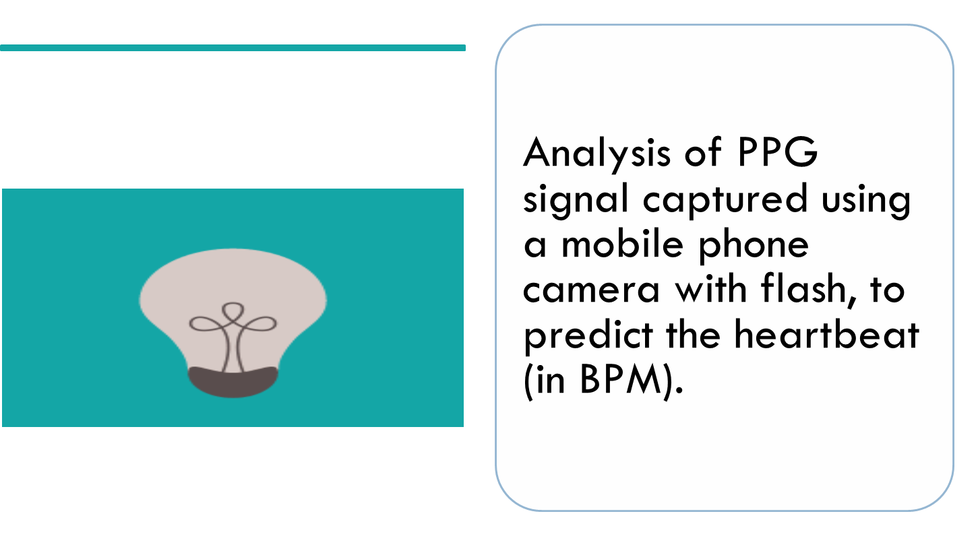

Problem Statement

Slide 3
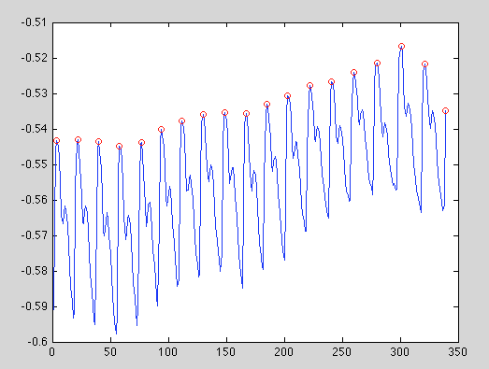
What is a PPG signal?
Photoplethysmography measures the volumetric change of the heart by measuring light transmission or reflection. As the heart contracts, blood pressure within the left ventricle – the main pumping chamber – increases.

Slide 4
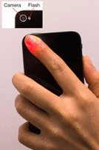
How PPG signal is obtained?
By simply shining a light on a patch of skin with an LED light source, the increased pulse pressure will cause a measurable difference in the amount of light reflected back onto or transmitted through to a light sensor. The LED light should be placed in an area where arteries are close to the skin, such as a fingertip, or an earlobe.

Slide 5
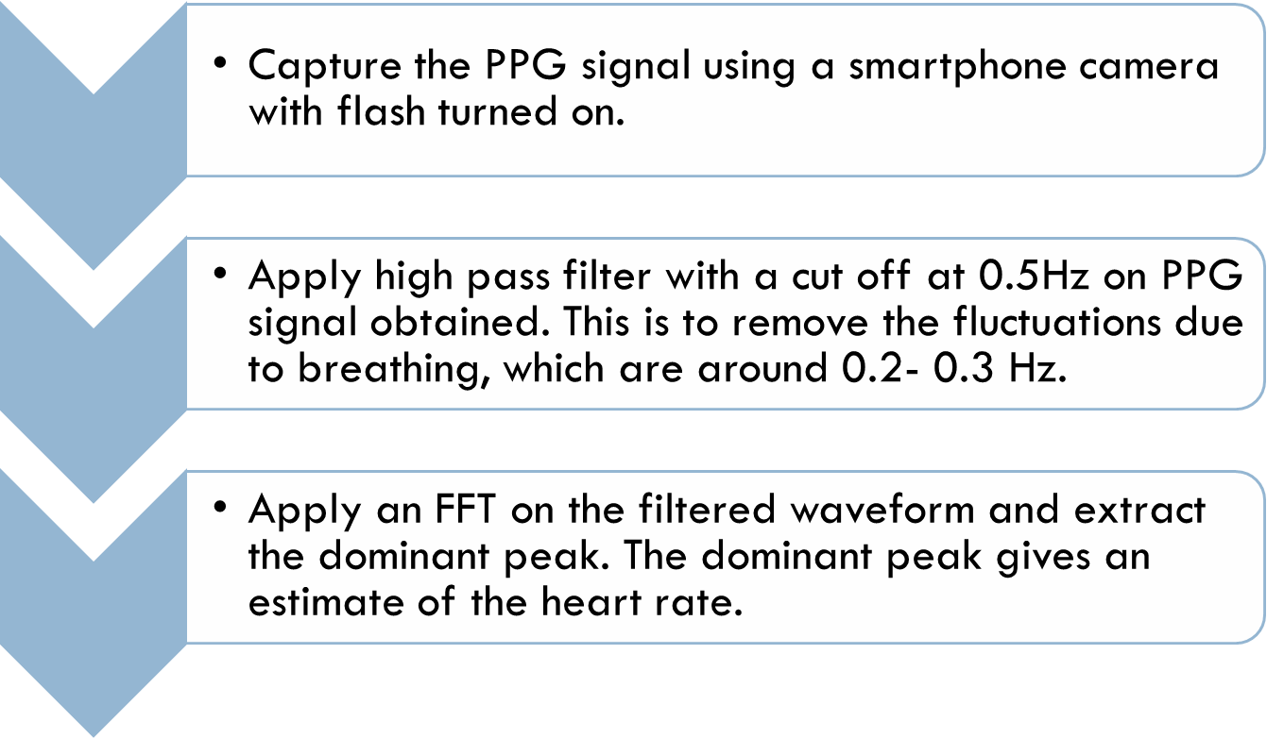
Heartbeat Monitoring

Slide 6
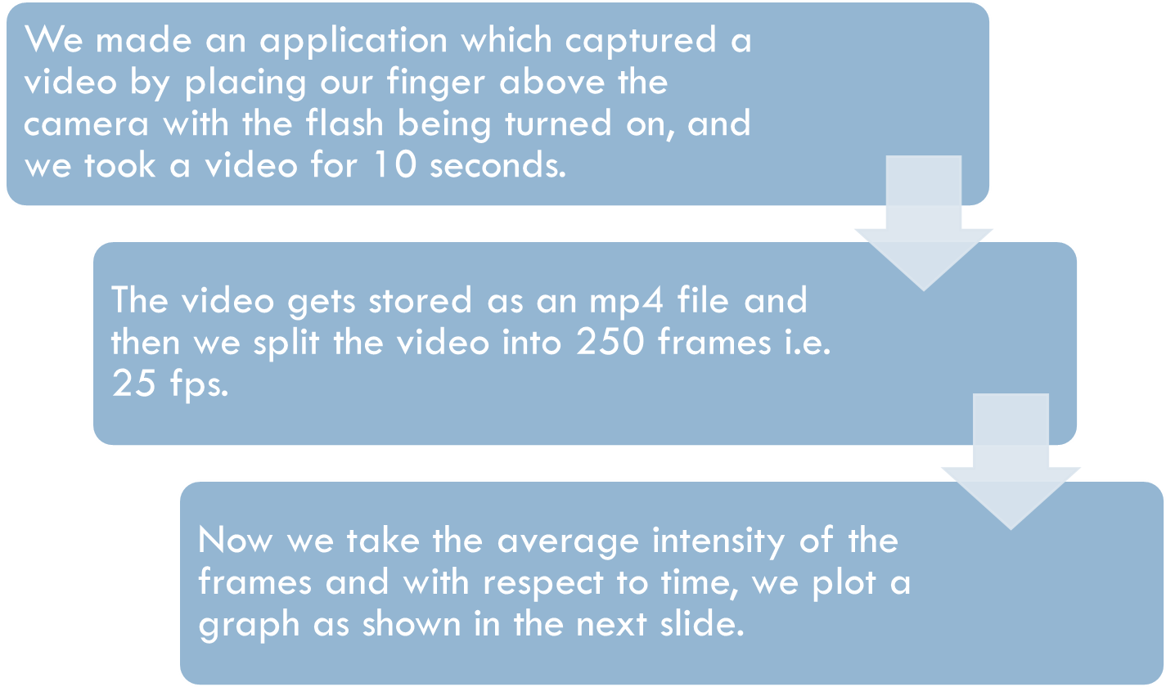
Our Progress

Slide 7
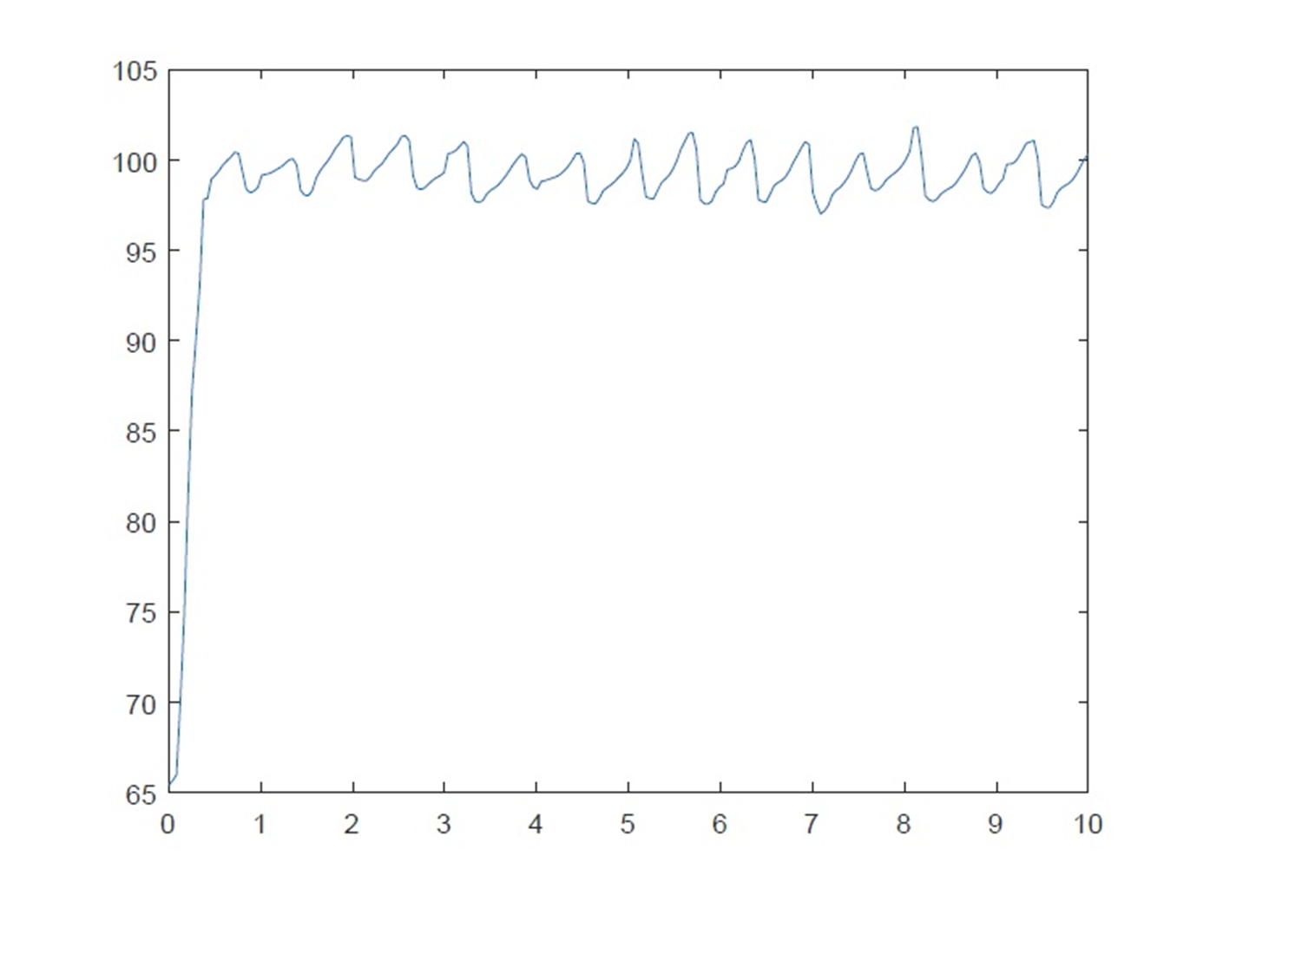
Our Progress

Slide 8
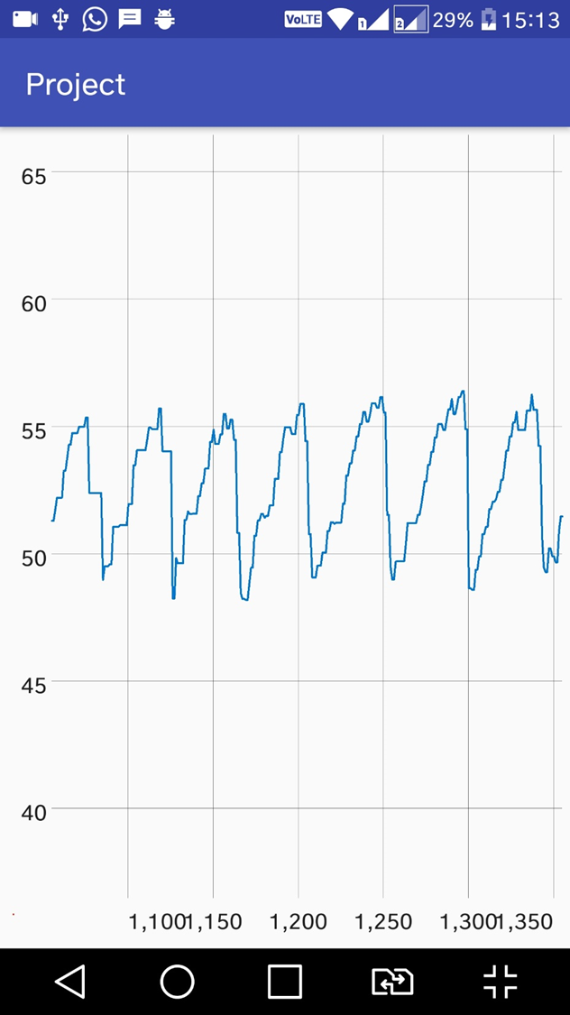
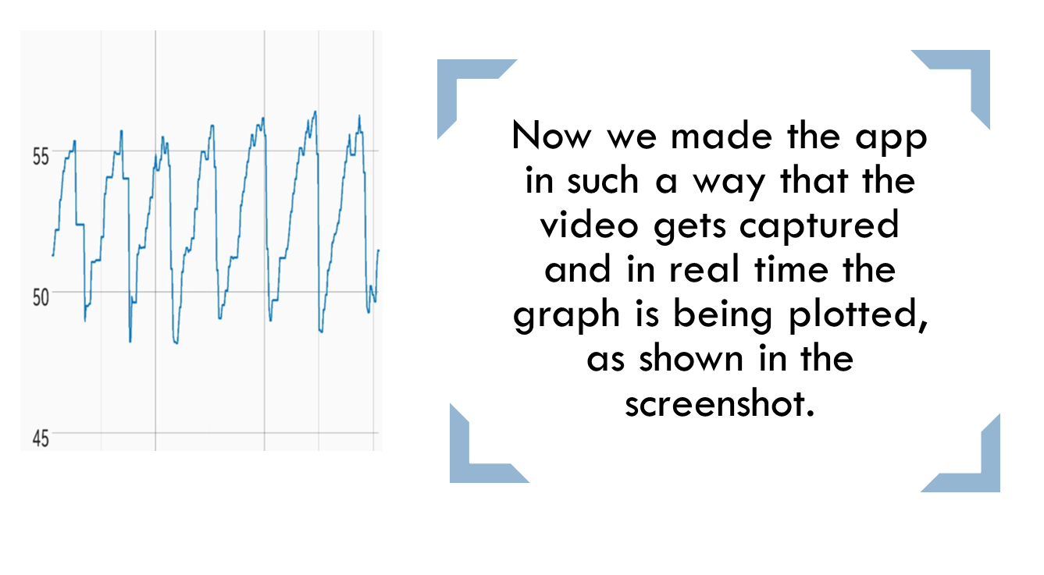
Our Progress

Slide 9
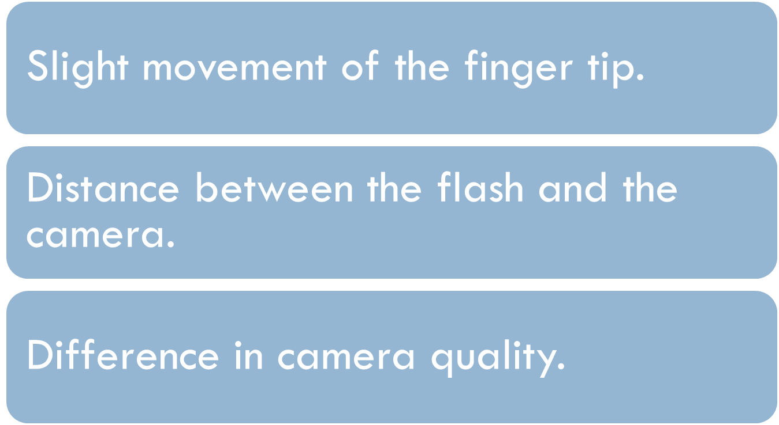
Problems

Slide 10
References
https://ubicomplab.cs.washington.edu/pdfs/hemaapp.pdf
https://in.mathworks.com/help/matlab/

Slide 11
THANK YOU!

