Slide 1


Current-voltage and temporal analysis of NMOS capacitor leakage current for
SiO₂ and Al₂O₃ oxide dielectric
TEAM PROJECT
99.503 - NANOELECTRONICS
Members:
Ronit Dutta (1010683)
Mohamed Mukhtar (1009406)
Kang Yufan (1009416)

Slide 2







Objective
In this project, the primary objective is to study how leakage current evolves in an NMOS capacitor under different electrical stresses.
The device is treated strictly as a two-terminal structure, with only the gate and substrate active and no lateral drain current involved.
The experimental analysis focuses on two behaviours: current as a function of applied voltage (I–V sweeps) and current as a function of time under constant bias (I–t sampling).
Two dielectric materials (SiO2 & Al2O3) are examined to illustrate how the choice of oxide influences the leakage characteristics and breakdown behaviour of the MOS capacitor.
Simulation was performed on Nanohub : MosCAP tool to determine inversion voltage, threshold voltage and oxide capacitance for a given MOS device under fixed parameters.
Machine Learning Professional Project Presentation
Nanoelectronics Project Presentation
Nanoelectronics Project Presentation
Nanoelectronics Project Presentation
Term Paper Presentation | Ronit Dutta
Term Paper Presentation | Ronit Dutta
Machine Learning Professional Project Presentation
Machine Learning Professional Project Presentation

Slide 3
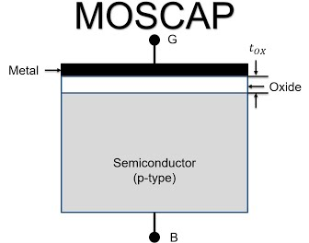
OUTLINE
Introduction
Simulation
Experiments
High-K dielectric
Fabrication
Discussions
Machine Learning Professional Project Presentation
Nanoelectronics Project Presentation
Nanoelectronics Project Presentation
Nanoelectronics Project Presentation
Term Paper Presentation | Ronit Dutta
Term Paper Presentation | Ronit Dutta
Machine Learning Professional Project Presentation
Machine Learning Professional Project Presentation

Slide 4
OUTLINE
Introduction
Simulation
Experiments
High-K dielectric
Fabrication
Discussions
Machine Learning Professional Project Presentation
Machine Learning Professional Project Presentation
Nanoelectronics Project Presentation
Nanoelectronics Project Presentation
Term Paper Presentation | Ronit Dutta
Term Paper Presentation | Ronit Dutta
Machine Learning Professional Project Presentation
Machine Learning Professional Project Presentation

Slide 5
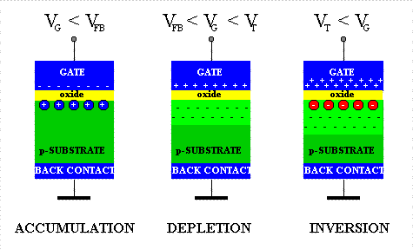
Introduction - Basic MOS operation
Gate voltage controls surface potential in Si:
Accumulation - Gate voltage < 0 (holes accumulate in the substrate-oxide boundary driven by the negative voltage)
Depletion - Gate voltage ≥ 0 (gate voltage is positive but less than threshold voltage; depletion zone of immobile negative ions, free of holes which go deeper down repelled by the positive applied voltage)
Inversion - Gate voltage >> 0 > V(threshold) (gate voltage is greater than threshold voltage and has net positive overdrive voltage; high positive voltage draws in electrons from S/D, facilitating the formation of a uniform thin sheet of mobile electrons. )
Machine Learning Professional Project Presentation
Nanoelectronics Project Presentation
Nanoelectronics Project Presentation
Term Paper Presentation | Ronit Dutta
Term Paper Presentation | Ronit Dutta
Machine Learning Professional Project Presentation
Machine Learning Professional Project Presentation

Slide 6

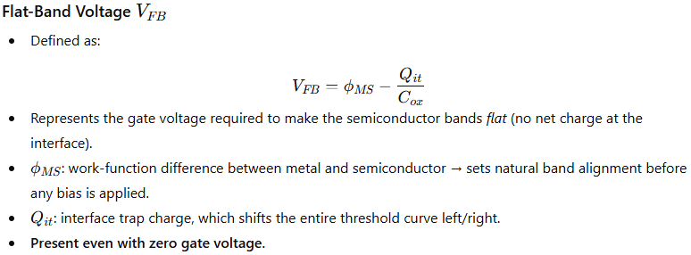
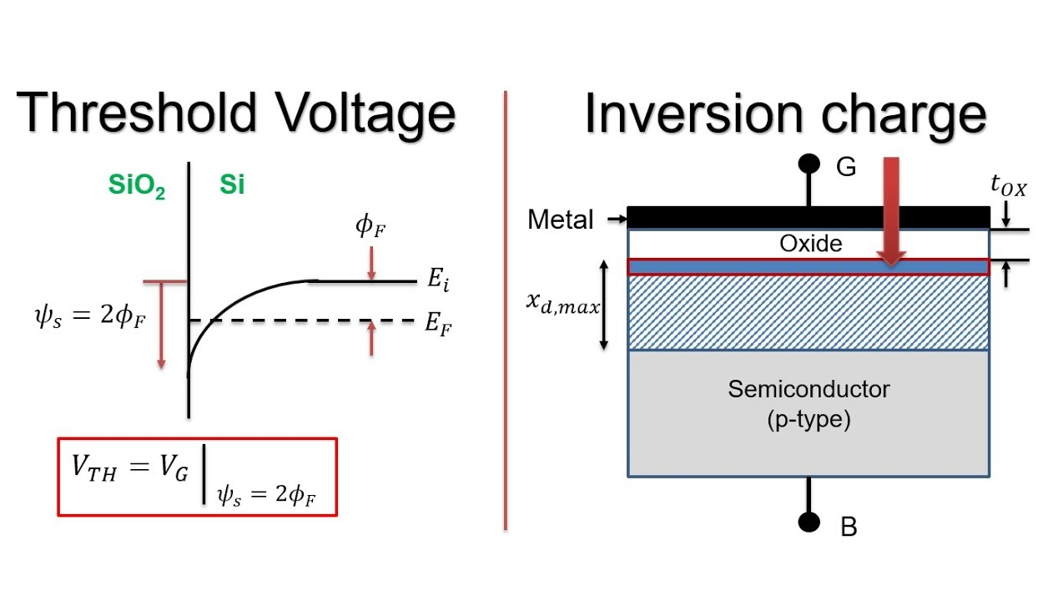
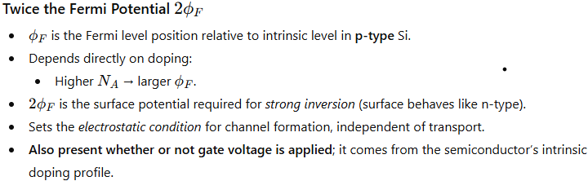
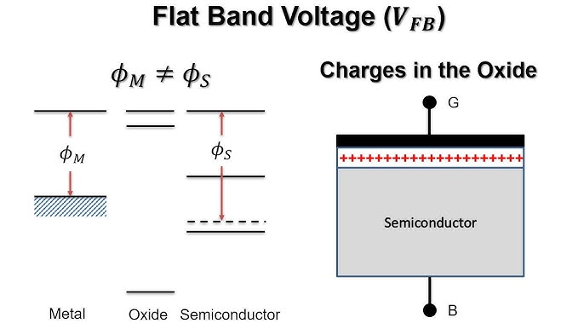
THRESHOLD VOLTAGE
Flat Band Voltage :-
Fermi potential (x2) :-
Machine Learning Professional Project Presentation
Nanoelectronics Project Presentation
Nanoelectronics Project Presentation
Term Paper Presentation | Ronit Dutta
Term Paper Presentation | Ronit Dutta
Machine Learning Professional Project Presentation
Machine Learning Professional Project Presentation

Slide 7
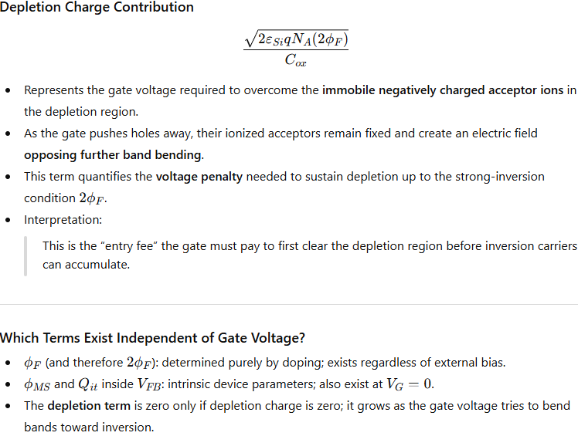
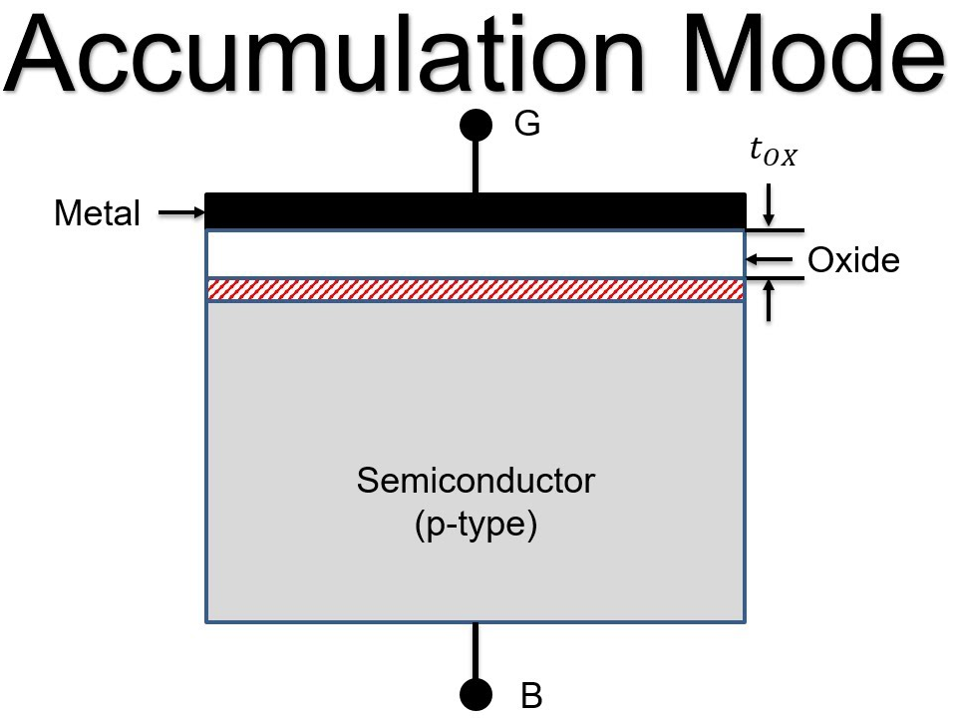
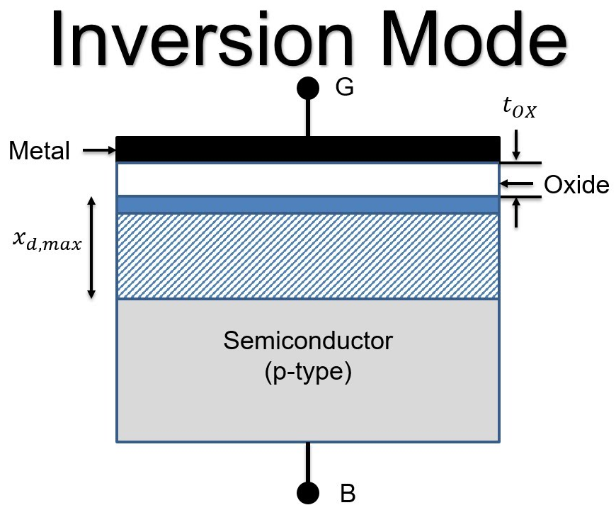
THRESHOLD VOLTAGE
Machine Learning Professional Project Presentation
Nanoelectronics Project Presentation
Nanoelectronics Project Presentation
Term Paper Presentation | Ronit Dutta
Term Paper Presentation | Ronit Dutta
Machine Learning Professional Project Presentation
Machine Learning Professional Project Presentation

Slide 8
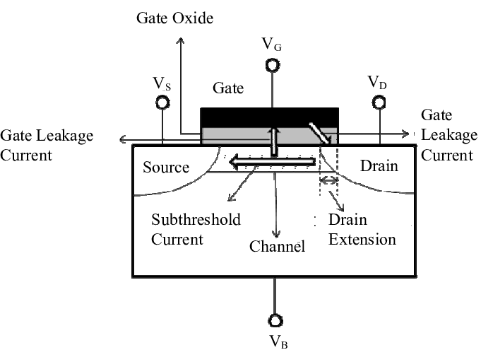
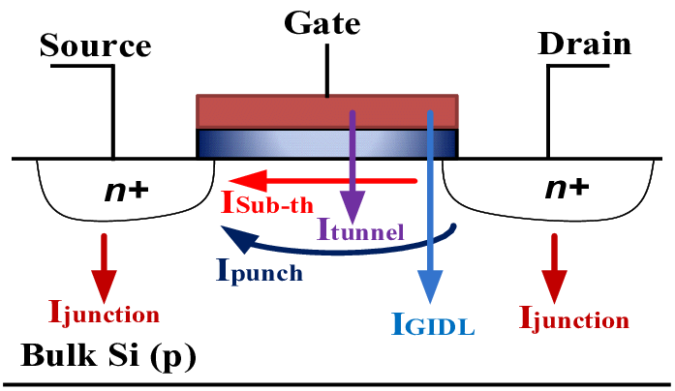
Leakage Current - sources & mechanisms
SBD : soft breakdown
HBD : hard breakdown
Direct tunneling ->
Electrons pass through an intact but very thin SiO₂ layer purely by quantum tunneling, producing a small but measurable gate leakage under normal operating fields; this is not tied to SBD or HBD and happens even in healthy devices.
Fowler–Nordheim tunneling ->
At higher oxide electric fields the barrier at the oxide becomes triangular and electrons tunnel through it more easily, causing a rapid rise in gate current
FN tunneling can occur before SBD, and prolonged FN stress is one of the pathways that initiates SBD.
Trap-assisted tunneling (most dominant mechanism)
Electrons hop through defect states inside the oxide instead of tunneling directly across, giving leakage that depends strongly on how many traps exist
This mechanism becomes significantly stronger during soft breakdown, because SBD creates new traps that form partial conduction paths.
Machine Learning Professional Project Presentation
Nanoelectronics Project Presentation
Nanoelectronics Project Presentation
Term Paper Presentation | Ronit Dutta
Term Paper Presentation | Ronit Dutta
Machine Learning Professional Project Presentation
Machine Learning Professional Project Presentation

Slide 9
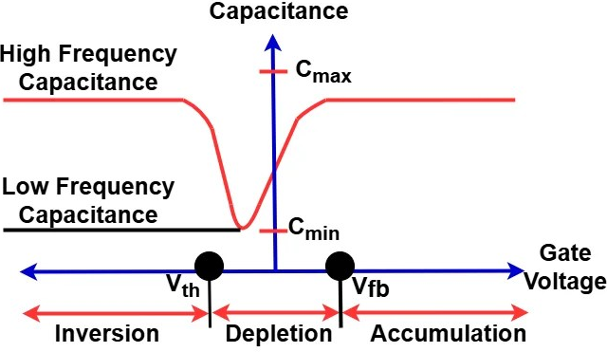
Leakage Current - SBD and HBD behaviour
Soft-breakdown leakage path conduction:
Once enough traps have formed to create partial percolation chains, the oxide still stands but current increases in irregular steps or fluctuates over time
This leakage is exclusive to SBD and represents the oxide in a degraded but not yet ruptured state.
Hard-breakdown filament conduction:
When the percolation paths merge into a continuous conductive filament through the oxide, the gate current rises abruptly and becomes limited only by compliance
This large, irreversible leakage mechanism appears only during HBD and signals physical oxide rupture.
Machine Learning Professional Project Presentation
Nanoelectronics Project Presentation
Nanoelectronics Project Presentation
Term Paper Presentation | Ronit Dutta
Term Paper Presentation | Ronit Dutta
Machine Learning Professional Project Presentation
Machine Learning Professional Project Presentation

Slide 10
OUTLINE
Introduction
Simulation
Experiments
High-K dielectric
Fabrication
Discussions
Machine Learning Professional Project Presentation
Nanoelectronics Project Presentation
Nanoelectronics Project Presentation
Term Paper Presentation | Ronit Dutta
Term Paper Presentation | Ronit Dutta
Machine Learning Professional Project Presentation
Machine Learning Professional Project Presentation

Slide 11
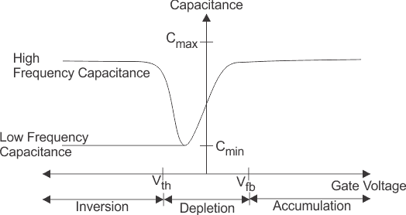
C-V characteristics - theoretically expected behaviour
Machine Learning Professional Project Presentation
Nanoelectronics Project Presentation
Nanoelectronics Project Presentation
Term Paper Presentation | Ronit Dutta
Term Paper Presentation | Ronit Dutta
Machine Learning Professional Project Presentation
Machine Learning Professional Project Presentation

Slide 12
Simulation: NANOhub -> MOSCap simulation
Simulation parameters | Simulation values
Doping Concentration | 1e+18
Dielectric Thickness | 10 nm
Substrate Thickness | 1e-4 m / 0.1 mm
Dielectric Nodes | 5
Substrate Nodes | 500
Temperature (Ambient) | 300K
Gate Electrode | Aluminium
Start to End Voltage | 0 -> {3,5,10} V
Machine Learning Professional Project Presentation
Nanoelectronics Project Presentation
Nanoelectronics Project Presentation
Term Paper Presentation | Ronit Dutta
Term Paper Presentation | Ronit Dutta
Machine Learning Professional Project Presentation
Machine Learning Professional Project Presentation

Slide 13
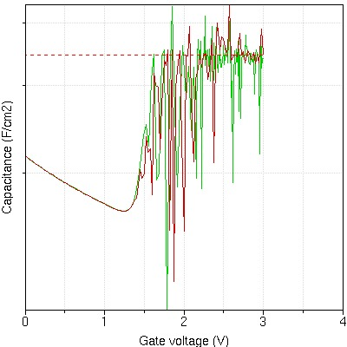
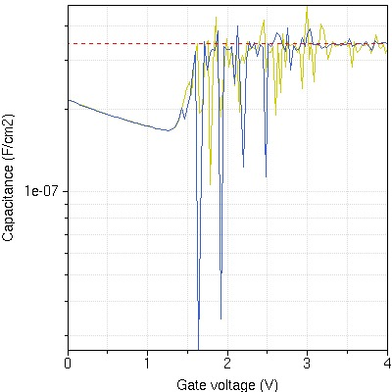
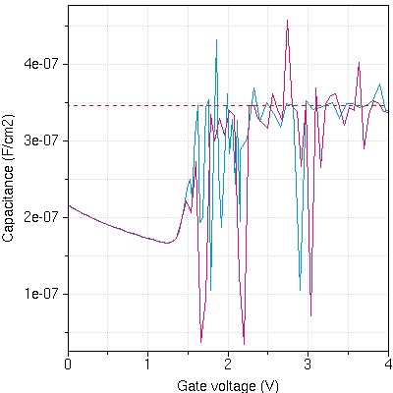
Simulation: C-V plots (Capacitance vs applied voltage)
0V → 3V
0V → 5V
0V → 10V
Machine Learning Professional Project Presentation
Nanoelectronics Project Presentation
Nanoelectronics Project Presentation
Term Paper Presentation | Ronit Dutta
Term Paper Presentation | Ronit Dutta
Machine Learning Professional Project Presentation
Machine Learning Professional Project Presentation

Slide 14
Simulation: Inferences (C_ox approximate value)
The three C–V traces correspond to different maximum gate-bias sweeps: 3 V (green–red), 5 V (blue–yellow), and 10 V (pink–cyan).
All sweeps exhibit the expected MOSCAP behaviour: a depletion capacitance minimum around ~1.1–1.3 V followed by a return toward C(ox) which is approximately 3.3–3.5*e-7 F/cm^2 in the inversion region.
The 3 V sweep shows the most stable characteristics (lower variance in chaotic zone), with only mild fluctuations once inversion is reached; the simulation remains within a moderate electric-field regime.
The 5 V sweep introduces stronger numerical instability (comparatively higher variance in deep inversion) in the inversion region due to increased channel conductance and elevated oxide electric field.
The 10 V sweep shows the most severe capacitance oscillations (highest variance in inversion region); at such high overdrive voltage, the small-signal admittance (reciprocal of impedance) is dominated by conductive pathways rather than displacement current, causing the capacitance extraction to become unreliable.
0V → 10V
Machine Learning Professional Project Presentation
Nanoelectronics Project Presentation
Nanoelectronics Project Presentation
Term Paper Presentation | Ronit Dutta
Term Paper Presentation | Ronit Dutta
Machine Learning Professional Project Presentation
Machine Learning Professional Project Presentation

Slide 15
Simulation: NANOhub -> MOSCap simulation (V_threshold)
The 3 V sweep provides only a limited gate overdrive above V(T), so the strong-inversion region is narrow and the “return” to C(ox) appears less well-defined.
As the maximum sweep voltage increases to 5 V and 10 V, the device spends a larger voltage range in strong inversion, and the simulated capacitance more clearly saturates near C(ox) before numerical noise dominates.
Across all sweeps, the simulated threshold behaviour remains consistent V(Threshold) ≈ 1.2 V confirming that the underlying electrostatics of the 10 nm SiO₂ MOSCAP structure are stable and reproducible.
The progressive increase in capacitance noise with higher maximum gate bias reflects the transition into a high-field, high-conductance regime, which aligns with the experimental observation that real devices exhibit increased leakage and breakdown under strong gate stress.
0V → 3V
0V → 5V
Q(dep) is fixed ionic space charge
Q(inv) is mobile electronic charge
Q(interface) is defect charge at the boundary whose occupancy depends on bias.
Machine Learning Professional Project Presentation
Nanoelectronics Project Presentation
Nanoelectronics Project Presentation
Term Paper Presentation | Ronit Dutta
Term Paper Presentation | Ronit Dutta
Machine Learning Professional Project Presentation
Machine Learning Professional Project Presentation

Slide 16
Simulation: Conceptual justification about the above inferences
Onset/ shallow inversion: The surface has just transitioned to n-type, with depletion charge still dominant and a newly formed but relatively weak inversion layer that only partially governs the electrostatics.
Deep inversion: The inversion layer contains far more charge than the depletion region, creating a dense, conductive electron sheet such that additional gate bias mostly increases the oxide electric field rather than altering the semiconductor charge distribution.
Threshold voltage marks the boundary between “depletion-governed” and “inversion-governed” electrostatics.
Pushing beyond threshold just increases inversion charge; once deep enough, the silicon stops responding and the oxide takes the brunt of the field increase.
Why C–V Simulations Become Unstable/Chaotic in Deep Inversion ???
Strong inversion creates extremely high surface conductance under the oxide.
The AC small-signal solver interprets this as a large real (conductive) admittance in parallel with the oxide capacitance.
Converting this mixed admittance into a single “capacitance” produces spikes, dips, and numerical oscillations.
At very high gate bias, the inversion layer dominates current flow and becomes extremely conductive so much that capacitance extraction ceases to be physically meaningful.
Machine Learning Professional Project Presentation
Nanoelectronics Project Presentation
Nanoelectronics Project Presentation
Term Paper Presentation | Ronit Dutta
Term Paper Presentation | Ronit Dutta
Machine Learning Professional Project Presentation
Machine Learning Professional Project Presentation

Slide 17
OUTLINE
Introduction
Simulation
Experiments
High-K dielectric
Fabrication
Discussions
Machine Learning Professional Project Presentation
Nanoelectronics Project Presentation
Nanoelectronics Project Presentation
Term Paper Presentation | Ronit Dutta
Term Paper Presentation | Ronit Dutta
Machine Learning Professional Project Presentation
Machine Learning Professional Project Presentation

Slide 18
Experiment : Setup & Measurement Modes
Sweep mode: measures I–V characteristics by ramping the gate voltage from 0 up to the chosen maximum value.
Sampling mode: records I(t) at a fixed gate voltage to observe time-dependent leakage and soft-breakdown behaviour.
Instrument: Keithley source-measure unit connected to PC control software.
Device probing: the gate terminal is contacted through the metal pad under an optical microscope; the substrate is grounded and used as the reference terminal.
Compliance current: 0.1 mA (to prevent permanent damage and to clearly indicate hard-breakdown events when the device reaches this limit)
Machine Learning Professional Project Presentation
Nanoelectronics Project Presentation
Nanoelectronics Project Presentation
Term Paper Presentation | Ronit Dutta
Term Paper Presentation | Ronit Dutta
Machine Learning Professional Project Presentation
Machine Learning Professional Project Presentation

Slide 19
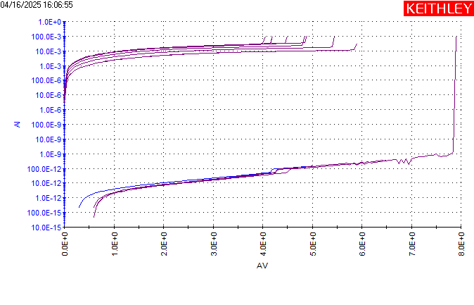
Experiment : I-V Sweep: (Device 1)
Leakage increases smoothly from ~10⁻¹⁵ A at low bias to ~10⁻¹¹–10⁻¹⁰ A by ~6–7 V, indicating a clean, tunnel-limited oxide over most of the range.
Around ~7.5–8 V, small irregular steps and slight slope changes appear in the lower current branch, consistent with the onset of soft breakdown and defect-assisted conduction.
All sweeps show a sharp current jump near ~8–8.5 V to the compliance region in the upper branch, marking reproducible hard breakdown of the SiO₂ layer.
Machine Learning Professional Project Presentation
Nanoelectronics Project Presentation
Nanoelectronics Project Presentation
Term Paper Presentation | Ronit Dutta
Term Paper Presentation | Ronit Dutta
Machine Learning Professional Project Presentation
Machine Learning Professional Project Presentation

Slide 20
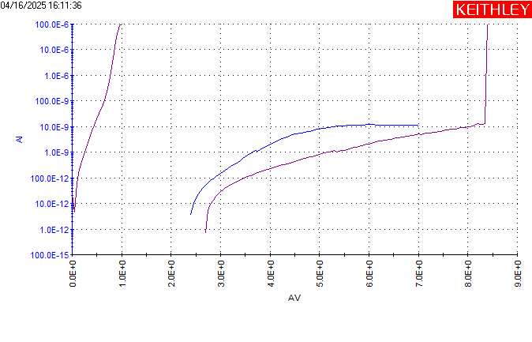
Experiment : I-V Sweep (0 → 10 V) (Device 2)
Current follows a smooth exponential-like rise from ~10⁻¹⁵ A up to ~10⁻¹¹ A as AV increases from 0 to ~6–7 V, characteristic of pre-breakdown leakage.
Between ~7 and ~8.5 V the leakage slope increases and the curve starts to flatten toward ~10⁻⁹–10⁻⁸ A, indicating enhanced trap-assisted conduction without catastrophic failure.
A sudden vertical jump close to ~8.5–9 V drives the current into the 10⁻⁴–10⁻³ A range, identifying the hard breakdown point for this device.
Machine Learning Professional Project Presentation
Nanoelectronics Project Presentation
Nanoelectronics Project Presentation
Term Paper Presentation | Ronit Dutta
Term Paper Presentation | Ronit Dutta
Machine Learning Professional Project Presentation
Machine Learning Professional Project Presentation

Slide 21
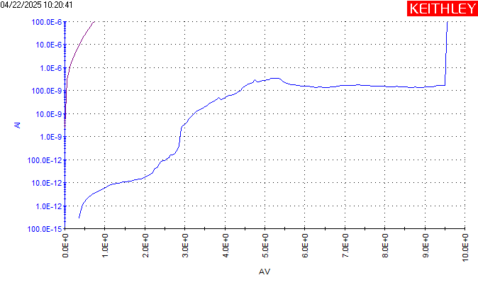
Experiment : I-V Sweep (0 → 10 V) (Device 3)
At low AV (0–~3 V), current rises from ~10⁻¹⁵ A to ~10⁻¹¹ A with a gradual change in slope, showing normal tunneling and field-assisted leakage.
A pronounced soft-breakdown region appears around ~3–5 V, where the curve exhibits step-like increases and then saturates into a broad plateau around 10⁻⁹–10⁻⁸ A up to ~8–9 V.
Near ~9.5–10 V, the current abruptly shoots to the compliance limit (~10⁻⁴–10⁻³ A), marking a clear hard breakdown event.
Machine Learning Professional Project Presentation
Nanoelectronics Project Presentation
Nanoelectronics Project Presentation
Term Paper Presentation | Ronit Dutta
Term Paper Presentation | Ronit Dutta
Machine Learning Professional Project Presentation
Machine Learning Professional Project Presentation

Slide 22
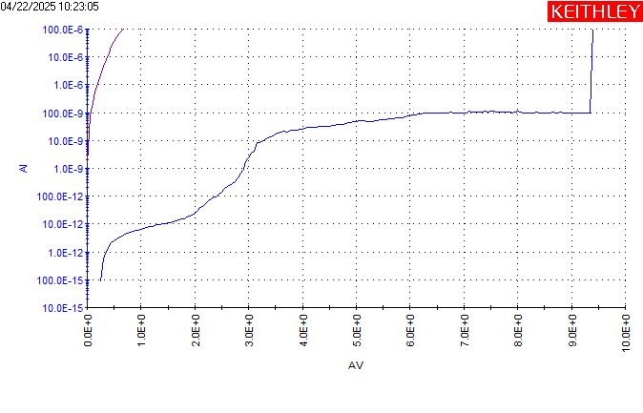
Experiment : I-V Sweep (0 → 10 V) (Device 4)
Leakage increases smoothly from ~10⁻¹⁵ A at low bias to ~10⁻¹²–10⁻¹¹ A by ~3 V, indicating a healthy oxide in the low-field regime.
Between ~3 and ~6–7 V the current climbs into the 10⁻⁹–10⁻⁸ A decade and then forms a relatively flat plateau up to ~9 V, consistent with sustained soft-breakdown-assisted conduction without full rupture.
A sharp rise at ~9.5–10 V drives the current abruptly into the compliance region, identifying the hard breakdown point similar to Device 4.
Machine Learning Professional Project Presentation
Nanoelectronics Project Presentation
Nanoelectronics Project Presentation
Term Paper Presentation | Ronit Dutta
Term Paper Presentation | Ronit Dutta
Machine Learning Professional Project Presentation
Machine Learning Professional Project Presentation

Slide 23
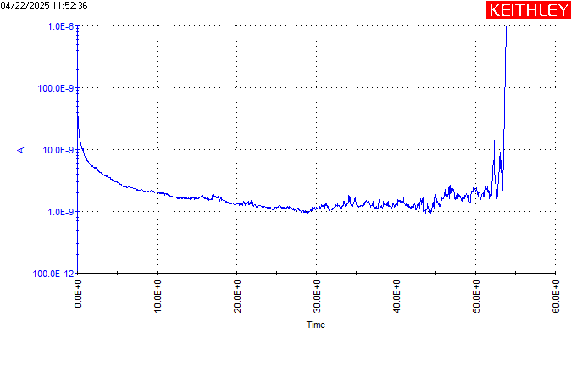
Experiment : I-T Sweep (Device 5 - 7V driving voltage)
Initial current starts near ~10⁻⁶ A and decays rapidly within the first few seconds down to ~10⁻⁹–10⁻¹⁰ A, reflecting transient charging of oxide and interface traps.
From ~5 to ~45 s, the current remains in a relatively stable low-noise band around 10⁻¹⁰–10⁻⁹ A, characteristic of a stressed but not yet ruptured oxide.
After ~50 s, the current begins to fluctuate and then spikes sharply toward ~10⁻⁶ A, signalling a time-dependent hard breakdown at 7 V stress.
Machine Learning Professional Project Presentation
Nanoelectronics Project Presentation
Nanoelectronics Project Presentation
Term Paper Presentation | Ronit Dutta
Term Paper Presentation | Ronit Dutta
Machine Learning Professional Project Presentation
Machine Learning Professional Project Presentation

Slide 24
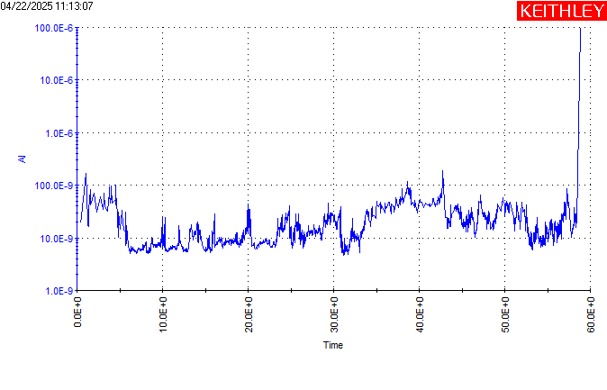
Experiment : I-T Sweep (Device 6 - 8.5V driving voltage)
Current starts in the 10⁻⁹–10⁻⁸ A range with strong initial fluctuations, indicating a more aggressively stressed oxide compared to the 7 V case.
Throughout ~5–55 s, the trace shows persistent noisy, step-like variations with a slight upward trend, consistent with progressive soft-breakdown and ongoing defect generation.
Near ~60 s, the current rises abruptly to ~10⁻⁶ A, forming a high-current tail that marks hard breakdown under higher stress voltage.
Machine Learning Professional Project Presentation
Nanoelectronics Project Presentation
Nanoelectronics Project Presentation
Term Paper Presentation | Ronit Dutta
Term Paper Presentation | Ronit Dutta
Machine Learning Professional Project Presentation
Machine Learning Professional Project Presentation

Slide 25
OUTLINE
Introduction
Simulation
Experiments
High-K dielectric
Fabrication
Discussions
Machine Learning Professional Project Presentation
Nanoelectronics Project Presentation
Nanoelectronics Project Presentation
Term Paper Presentation | Ronit Dutta
Term Paper Presentation | Ronit Dutta
Machine Learning Professional Project Presentation
Machine Learning Professional Project Presentation

Slide 26
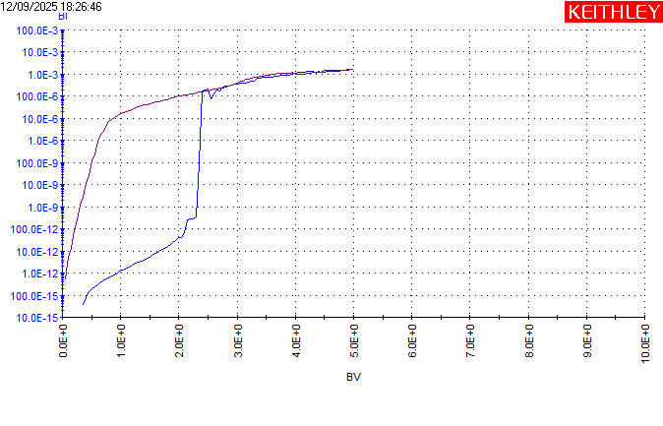
High-k Dielectric experiment : I-V Sweep (Device 1)
Leakage rises gradually from ~10⁻¹⁴ to ~10⁻¹¹ A as the bias increases toward ~2 V, showing typical trap-assisted tunneling through a high-k dielectric.
A distinct soft-breakdown region appears around ~2.0–2.3 V, where the curve departs from smooth exponential growth and shows accelerated current increase with small irregular jumps.
Hard breakdown occurs near ~2.3–2.5 V as the current abruptly transitions to the compliance region, indicating formation of a stable conductive filament.
Machine Learning Professional Project Presentation
Nanoelectronics Project Presentation
Nanoelectronics Project Presentation
Term Paper Presentation | Ronit Dutta
Term Paper Presentation | Ronit Dutta
Machine Learning Professional Project Presentation
Machine Learning Professional Project Presentation

Slide 27

High-k Dielectric experiment : I-V Sweep (Device 2)
The leakage path begins in the 10⁻¹3–10⁻¹² A range, rising smoothly with voltage until ~2.2 V, consistent with a trap-rich dielectric under field stress.
Soft breakdown develops between ~2.2–2.4 V, where the I–V curve becomes noticeably steeper and exhibits noisy, stepwise increases.
Hard breakdown is observed around ~2.5–2.6 V, where the current sharply jumps into the 10⁻⁴–10⁻³ A decade, confirming oxide rupture.
Machine Learning Professional Project Presentation
Nanoelectronics Project Presentation
Nanoelectronics Project Presentation
Term Paper Presentation | Ronit Dutta
Term Paper Presentation | Ronit Dutta
Machine Learning Professional Project Presentation
Machine Learning Professional Project Presentation

Slide 28
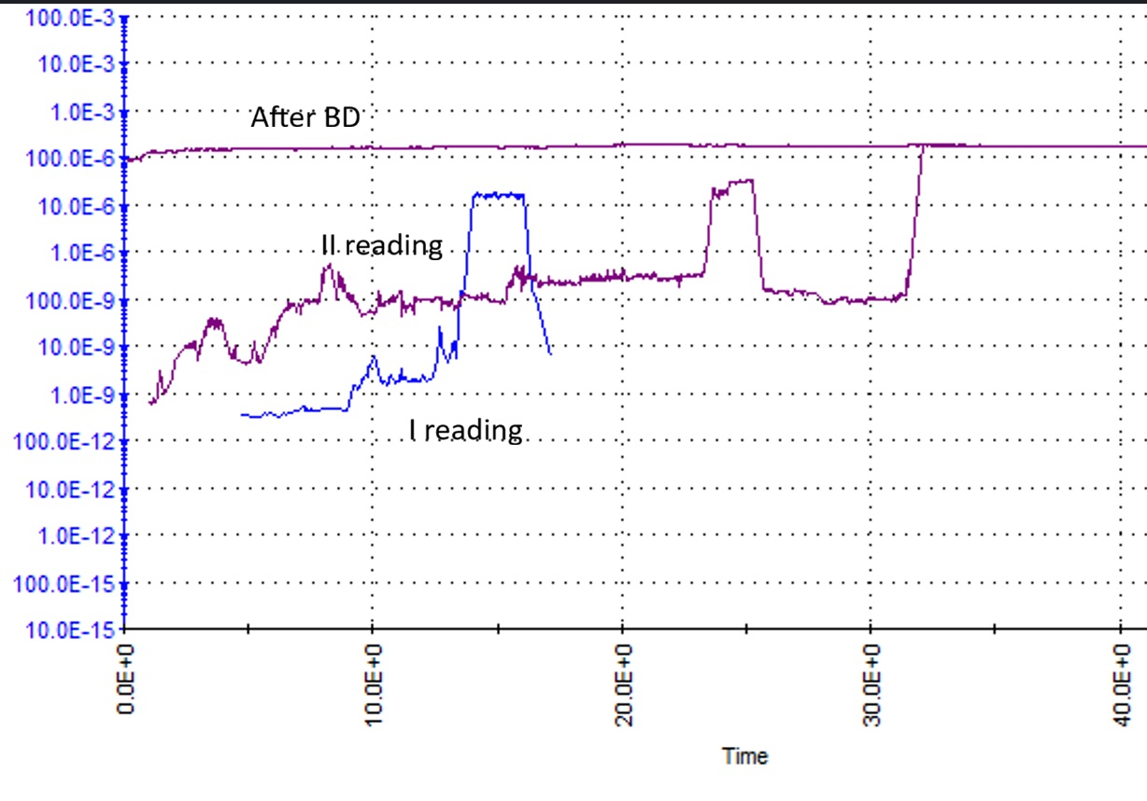
High-k Dielectric experiment : I-T Sweep (Device 3)
The current begins in the 10⁻¹¹–10⁻¹⁰ A range, showing fluctuations as the oxide charges traps and settles under the applied field.
Soft-breakdown behaviour emerges within the first few seconds as small current steps accumulate, reflecting progressive trap creation and partial conduction paths.
Hard breakdown occurs when the current suddenly rises into the 10⁻⁵–10⁻⁶ A range and remains pinned there, indicating a stable percolation filament.
Machine Learning Professional Project Presentation
Nanoelectronics Project Presentation
Nanoelectronics Project Presentation
Term Paper Presentation | Ronit Dutta
Term Paper Presentation | Ronit Dutta
Machine Learning Professional Project Presentation
Machine Learning Professional Project Presentation

Slide 29
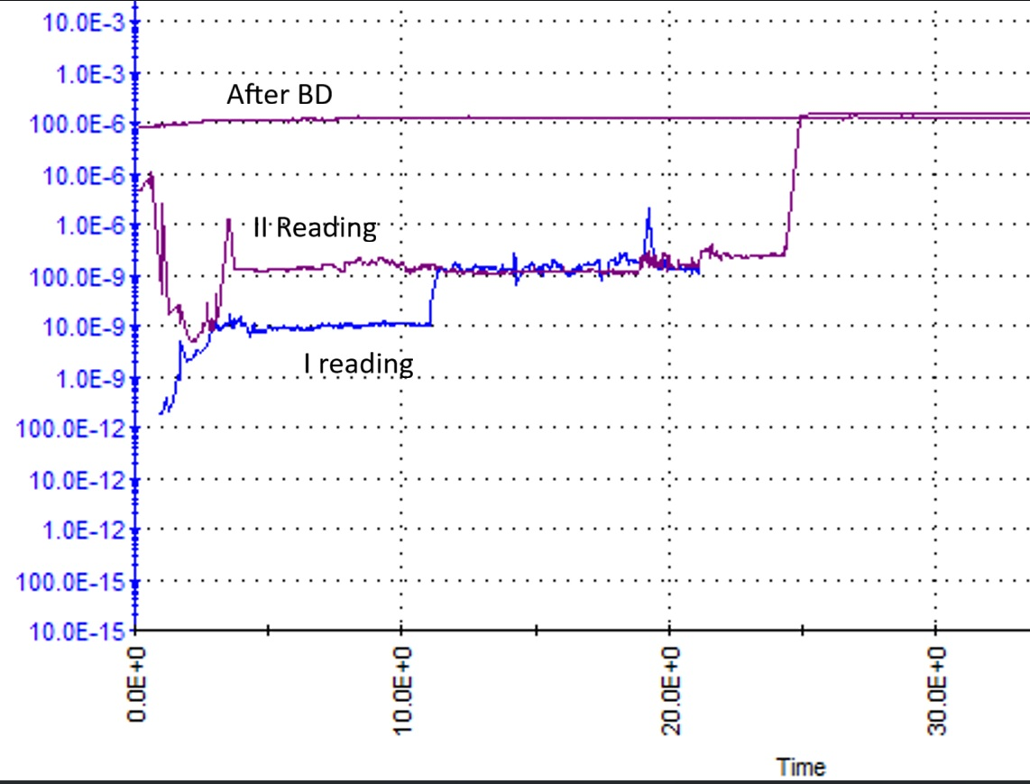
High-k Dielectric experiment : I-T Sweep (Device 4)
The stress current begins at ~10⁻⁹–10⁻⁸ A with strong noise, indicating a heavily stressed oxide with active trap generation even at early times.
A prolonged soft-breakdown regime is observed, where the current displays repeated upward steps and high-frequency fluctuations as trap networks evolve.
Hard breakdown is marked by a sharp current surge to ~10⁻⁶ A followed by a stable plateau, confirming irreversible dielectric rupture under elevated field.
Machine Learning Professional Project Presentation
Nanoelectronics Project Presentation
Nanoelectronics Project Presentation
Term Paper Presentation | Ronit Dutta
Term Paper Presentation | Ronit Dutta
Machine Learning Professional Project Presentation
Machine Learning Professional Project Presentation

Slide 30
High-K : Capacitive Storage Comparison
Al₂O₃ provides a significantly higher dielectric constant, increasing C (ox) relative to SiO₂ for identical thickness.
When scaled to the same EOT, Al₂O₃ can be deposited with a larger physical thickness, but its leakage behaviour is still dominated by abundant trap-assisted conduction rather than geometric scaling alone.
Experimental I–V curves show substantially higher leakage currents and a breakdown onset around 2–3 V, revealing a considerably lower breakdown field compared to SiO₂.
Time-dependent stress measurements reveal stepwise current growth and abrupt current jumps, characteristic of soft → hard breakdown transition in trap-rich high-k oxides.
Overall, the data highlights the classical trade-off: higher capacitance density but weaker reliability for Al₂O₃, driven by its higher defect density and lower intrinsic breakdown strength.
Machine Learning Professional Project Presentation
Nanoelectronics Project Presentation
Nanoelectronics Project Presentation
Term Paper Presentation | Ronit Dutta
Term Paper Presentation | Ronit Dutta
Term Paper Presentation | Ronit Dutta
Machine Learning Professional Project Presentation
Machine Learning Professional Project Presentation

Slide 31
High-K : KEY DIFFERENCES from plots
Categories | SiO2 dielectric | Al2O3 dielectric
Leakage Behaviour | Very low leakage at low and moderate fields (10⁻¹³–10⁻¹¹ A range). Leakage increases smoothly until the soft-breakdown region near high voltage | Higher leakage even at low fields due to abundant trap-assisted conduction pathways. Leakage rises rapidly with gate bias, showing early departure from ideal insulating behaviour.
Breakdown Voltage | Breakdown consistently occurs near ~9–10 V, corresponding to an effective field of ~9 MV/cm for the measured oxide thickness. | Breakdown onset appears at ~2.5–3 V, reflecting a significantly lower breakdown field, typical of defect-rich high-k materials.
SBD and HBD Signatures | Clear soft-breakdown onset near ~7–8 V. Fluctuations remain moderate until abrupt hard breakdown at the compliance limit. Post-BD leakage stabilizes at a high but controlled level. | Strong SBD signatures (SBD @ 2.0-2.3 approx) with pronounced stepwise current jumps even under moderate stress. Hard breakdown produces a sustained high-current plateau, indicating stable filament formation.
Defect Behaviour | Relatively low intrinsic defect density; breakdown driven primarily by field-induced trap generation. Slower percolation path formation, reflected in delayed soft breakdown. | High density of oxygen vacancies and deep traps results in early trap-assisted tunneling. Faster percolation and filament formation under stress.
Reliability Implications | Exhibits classic, predictable breakdown characteristics with strong field endurance. Serves as a robust reference oxide for benchmarking dielectric reliability. | Higher capacitance density but significantly reduced reliability under electrical stress. Performance dominated by defect chemistry rather than geometric scaling benefits.
Machine Learning Professional Project Presentation
Nanoelectronics Project Presentation
Nanoelectronics Project Presentation
Term Paper Presentation | Ronit Dutta
Term Paper Presentation | Ronit Dutta
Term Paper Presentation | Ronit Dutta
Machine Learning Professional Project Presentation
Machine Learning Professional Project Presentation

Slide 32
OUTLINE
Introduction
Simulation
Experiments
High-K dielectric
Fabrication
Discussions
Machine Learning Professional Project Presentation
Nanoelectronics Project Presentation
Nanoelectronics Project Presentation
Term Paper Presentation | Ronit Dutta
Term Paper Presentation | Ronit Dutta
Machine Learning Professional Project Presentation
Machine Learning Professional Project Presentation

Slide 33
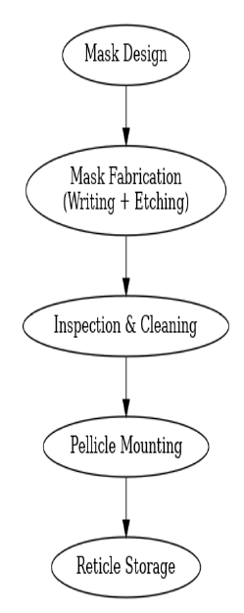
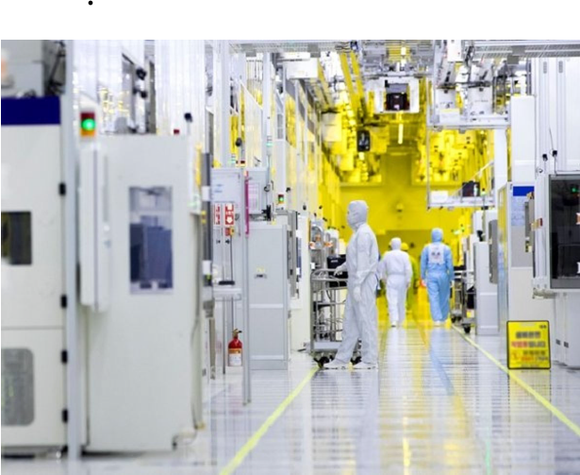
Fabrication : MOS Capacitor Fabrication Overview
Begin with a lightly doped p-type silicon wafer as the substrate.
Grow the gate dielectric by thermal oxidation, forming a SiO₂ layer in the 5–10 nm thickness range.
Define the capacitor area and deposit the gate metal (typically Al) using standard photolithography followed by lift-off or etching.
Form a backside metal contact to ensure a stable, low-resistance connection to the substrate.
Completed devices present metal pads visible under the optical microscope, which serve as the gate terminals during measurement.
Machine Learning Professional Project Presentation
Nanoelectronics Project Presentation
Nanoelectronics Project Presentation
Term Paper Presentation | Ronit Dutta
Term Paper Presentation | Ronit Dutta
Machine Learning Professional Project Presentation
Machine Learning Professional Project Presentation

Slide 34
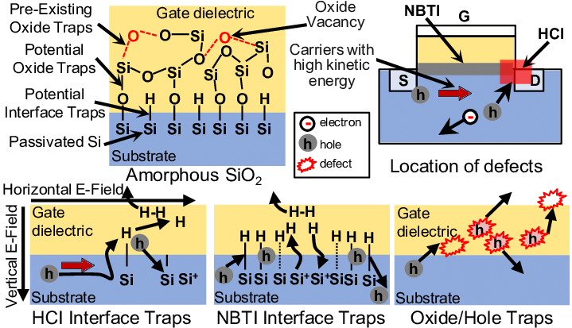
Fabrication : Defect Generation in MOS Oxides
High electric fields across the SiO₂ layer can generate broken Si–O bonds, oxygen vacancies, and other charged defect states.
These defects increase trap-assisted tunneling and progressively weaken the insulating properties of the oxide.
As defect density grows, they begin to link into partial percolation paths, which are precursors to soft and eventually hard breakdown.
Electrical stress during measurement effectively creates and modifies defects in real time, changing the oxide’s behaviour as voltage increases.
Machine Learning Professional Project Presentation
Nanoelectronics Project Presentation
Nanoelectronics Project Presentation
Term Paper Presentation | Ronit Dutta
Term Paper Presentation | Ronit Dutta
Machine Learning Professional Project Presentation
Machine Learning Professional Project Presentation

Slide 35
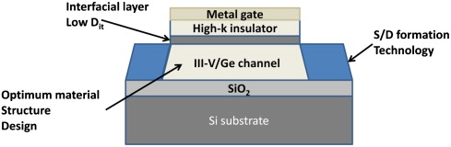
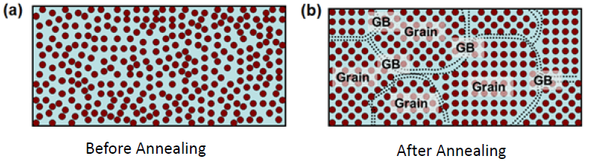
Slide 15 – Passivation & Annealing Concepts
Post-fabrication treatments such as forming-gas annealing and hydrogen passivation help neutralize dangling bonds at the Si/SiO₂ interface by forming stable Si–H bonds.
These steps reduce both the interface trap density and the bulk trap density, improving oxide quality.
Well-passivated oxides exhibit lower leakage and higher breakdown voltages, while insufficient passivation leads to earlier soft and hard breakdown.
In this experiment, the observed breakdown behaviour reflects how effectively the oxide was passivated and annealed before electrical stress was applied.
Machine Learning Professional Project Presentation
Nanoelectronics Project Presentation
Nanoelectronics Project Presentation
Term Paper Presentation | Ronit Dutta
Term Paper Presentation | Ronit Dutta
Term Paper Presentation | Ronit Dutta
Machine Learning Professional Project Presentation
Machine Learning Professional Project Presentation

Slide 36
OUTLINE
Introduction
Simulation
Experiments
High-K dielectric
Fabrication
Discussions
Machine Learning Professional Project Presentation
Nanoelectronics Project Presentation
Nanoelectronics Project Presentation
Term Paper Presentation | Ronit Dutta
Term Paper Presentation | Ronit Dutta
Machine Learning Professional Project Presentation
Machine Learning Professional Project Presentation

Slide 37
Dielectric degradation and breakdown in 10 nm SiO₂
I–V sweeps on the SiO₂ MOS capacitors show very low leakage (≈10⁻¹³–10⁻¹¹ A) at low and moderate fields, followed by a gradual slope increase and noisy current steps as the gate voltage approaches the high-field regime.
A sharp current jump near ≈9–10 V drives the current to the compliance limit, giving a hard-breakdown voltage V (HBD) ≈ 9–10 V, corresponding to a breakdown field of order 9–10 MV/cm for a 10 nm oxide.
Constant-voltage stress (e.g. ~7 V) exhibits an initial decay of current, a noisy plateau dominated by trap-assisted conduction, and finally a large current spike after ≈50–60 s, defining the time-to-breakdown and confirming a soft-to-hard breakdown sequence driven by defect generation, trap percolation, and local Joule heating in the SiO₂.
Machine Learning Professional Project Presentation
Nanoelectronics Project Presentation
Nanoelectronics Project Presentation
Term Paper Presentation | Ronit Dutta
Term Paper Presentation | Ronit Dutta
Machine Learning Professional Project Presentation
Machine Learning Professional Project Presentation

Slide 38

Analysis of the ALD-grown Al₂O₃ sample
(a) Extracted Al₂O₃ Thickness from Breakdown : From the Al₂O₃ I–V curves, hard breakdown occurs at a gate voltage of approximately 2.5–3.0 V.
(b) If the intended ALD thickness was 10 nm, discuss the possible reasons for any discrepancy between the target value and the experimentally extracted thickness :
The discrepancy between the intended 10 nm and the extracted ~3 nm can arise from ALD process factors such as nucleation delay on the substrate, incorrect growth-per-cycle calibration, rate drift, or incomplete surface coverage during the first cycles.
Additional deviation can come from metrology: ellipsometry or model fitting that assumes bulk optical constants, neglects interfacial layers or porosity, or misinterprets a multi-layer stack as a single uniform Al₂O₃ film, all of which can distort the apparent thickness.
Machine Learning Professional Project Presentation
Nanoelectronics Project Presentation
Nanoelectronics Project Presentation
Term Paper Presentation | Ronit Dutta
Term Paper Presentation | Ronit Dutta
Machine Learning Professional Project Presentation
Machine Learning Professional Project Presentation

Slide 39
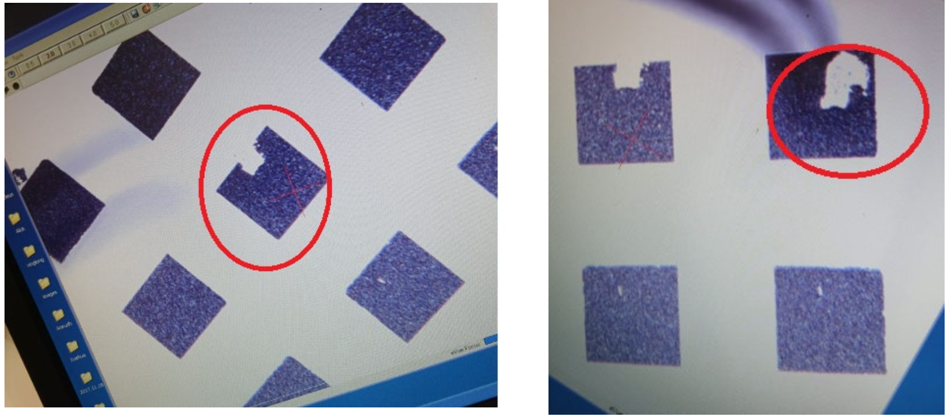
Observation of damaged metal electrode pads
During hard breakdown, current is forced through a highly localized conductive filament in the oxide, producing extreme local power density and Joule heating that can partially melt or reflow the thin gate metal, leaving burnt or roughened regions on the pad.
Large, localized current densities drive electromigration and thermal-mechanical stress in the metal film, which can generate voids, hillocks, cracking or partial delamination of the electrode near the breakdown site.
Sudden breakdown events can resemble micro-ESD (electrostatic discharge), creating small craters or lifted areas on the metal pads in combination with repeated mechanical probing, which explains the visibly damaged contacts after electrical characterization.
Machine Learning Professional Project Presentation
Nanoelectronics Project Presentation
Nanoelectronics Project Presentation
Term Paper Presentation | Ronit Dutta
Term Paper Presentation | Ronit Dutta
Term Paper Presentation | Ronit Dutta
Machine Learning Professional Project Presentation
Machine Learning Professional Project Presentation

Slide 40
Thickness deviation in e-beam-evaporated Ta₂O₅
The target thickness of 10 nm and the measured value of 25 nm suggest a substantial error in the deposition calibration, e.g. incorrect quartz-crystal microbalance settings, wrong density/tooling factor, or an unaccounted increase in deposition rate during the e-beam run.
Additional material-related effects, such as non-stoichiometric evaporation followed by post-deposition oxidation, can change the film density and volume, making the physical thickness larger than predicted from mass-per-area alone.
Thickness metrology can also contribute: ellipsometric fits that use inaccurate optical constants or oversimplified layer models, or profilometry across steps that include resist residues or multiple layers, can all inflate the apparent Ta₂O₅ thickness.
Overall, the 25 nm result is consistent with a combination of deposition-rate miscalibration and modeling/measurement uncertainties, rather than with the intended, correctly controlled 10 nm process.
Machine Learning Professional Project Presentation
Nanoelectronics Project Presentation
Nanoelectronics Project Presentation
Term Paper Presentation | Ronit Dutta
Term Paper Presentation | Ronit Dutta
Term Paper Presentation | Ronit Dutta
Machine Learning Professional Project Presentation
Machine Learning Professional Project Presentation

Slide 41
Thank You !!
Q&A
Machine Learning Professional Project Presentation
Nanoelectronics Project Presentation
Nanoelectronics Project Presentation
Term Paper Presentation | Ronit Dutta
Term Paper Presentation | Ronit Dutta
Machine Learning Professional Project Presentation
Machine Learning Professional Project Presentation

