Slide 1


Efficient Image Retrieval Using Hierarchical K-Means Clustering
TEAM PROJECT
Subject : MACHINE LEARNING PROFESSIONAL
Members:
Ronit Dutta (1010683)
Nan Li (1009421)
Mohamed Mukhtar (1009406)
Afifah Mesha Putri (1010690)
Timothy Wee (1005545)

Slide 2
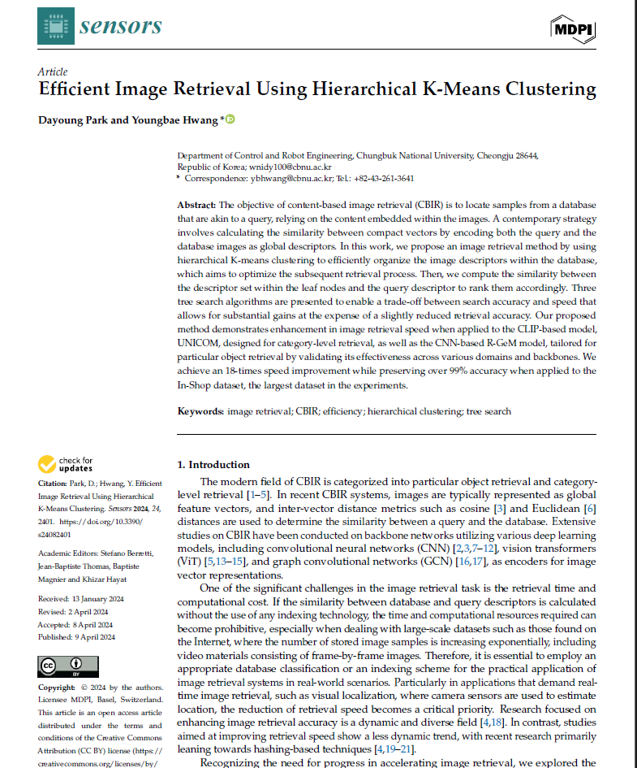

Machine Learning Professional Project Presentation

Slide 3



OUTLINE
Introduction & Data Selection
Mechanics
Accuracy vs compute tradeoff
Advantages, Disadvantages and Experimental Results
Future directions
Machine Learning Professional Project Presentation
Term Paper Presentation | Ronit Dutta
Term Paper Presentation | Ronit Dutta
Machine Learning Professional Project Presentation
Machine Learning Professional Project Presentation

Slide 4
OUTLINE
Introduction & Data Selection
Mechanics
Accuracy vs compute tradeoff
Advantages, Disadvantages and Experimental Results
Future directions
Machine Learning Professional Project Presentation
Term Paper Presentation | Ronit Dutta
Term Paper Presentation | Ronit Dutta
Machine Learning Professional Project Presentation
Machine Learning Professional Project Presentation

Slide 5
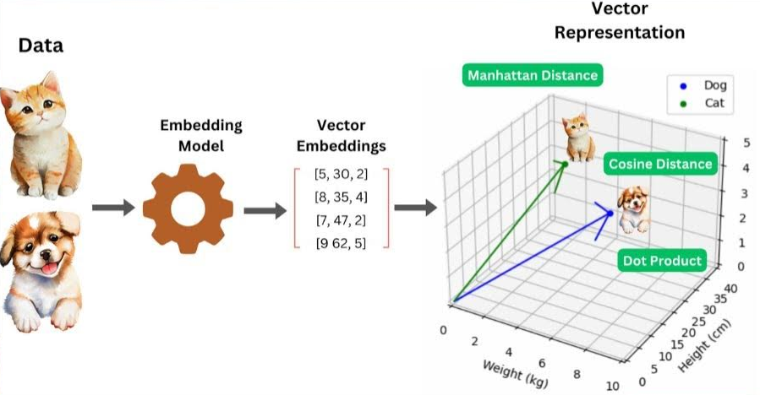
Introduction
Content-based Image Retrieval (CBIR): allows users to retrieve images from a large scale dataset, by describing the content of the image.
General approach: Modern CBIR strategies represent images as compact vectors, then utilise image-query similarity search.
Machine Learning Professional Project Presentation
Term Paper Presentation | Ronit Dutta
Term Paper Presentation | Ronit Dutta
Machine Learning Professional Project Presentation
Machine Learning Professional Project Presentation
Notes:
Define what a query is - images that

Slide 6
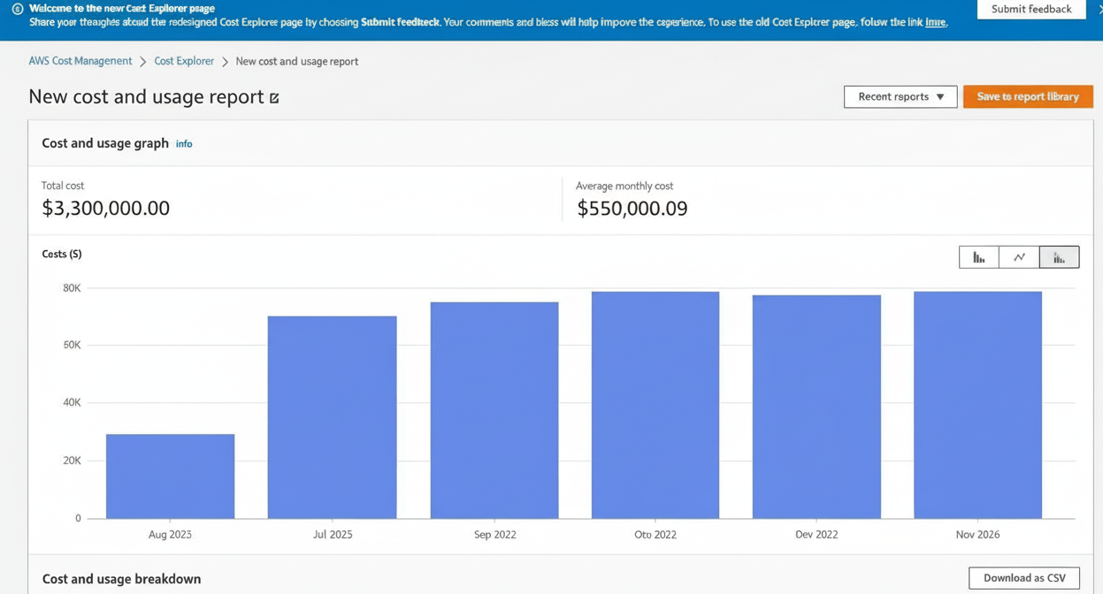
Introduction
Challenge: As image datasets grow extremely large, most CBIR strategies becomes slow and computationally expensive.
Research question: how can we perform CBIR more quickly, with a lower computational cost?
Machine Learning Professional Project Presentation
Term Paper Presentation | Ronit Dutta
Term Paper Presentation | Ronit Dutta
Machine Learning Professional Project Presentation
Machine Learning Professional Project Presentation
Notes:
Define what a query is - images that

Slide 7

Core Motivations
Computational Cost: Computing similarity between query and all database images is prohibitively expensive
Scale: Internet-scale datasets with exponentially growing images and videos
Real-time Requirement: Fields like visual localisation in robotics need fast retrieval
Research Gap: While much is done to improve accuracy, retrieval speed improvements lag behind. Speed is needed for real-world applications
Machine Learning Professional Project Presentation
Term Paper Presentation | Ronit Dutta
Term Paper Presentation | Ronit Dutta
Machine Learning Professional Project Presentation
Machine Learning Professional Project Presentation
Machine Learning Professional Project Presentation

Slide 8
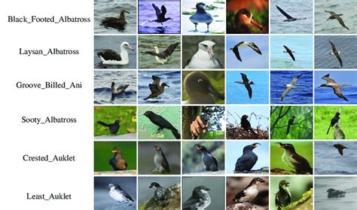
Data Selection
For categorical-level retrieval, three datasets were chosen:
Caltech-UCSD Birds (CUB) - 11,788 images of 200 bird species
The Stanford Cars dataset (CARS) - 8,131 images categorised into 98 car types. Inshop - 12612 clothing item images, 3985 classes
These three datasets are standard test datasets, allowing authors to benchmark accuracy and speed of their approach against more traditional approaches.
Caltech-UCSD Birds (CUB) - 11,788 images of 200 bird species
Machine Learning Professional Project Presentation
Term Paper Presentation | Ronit Dutta
Term Paper Presentation | Ronit Dutta
Machine Learning Professional Project Presentation
Machine Learning Professional Project Presentation

Slide 9
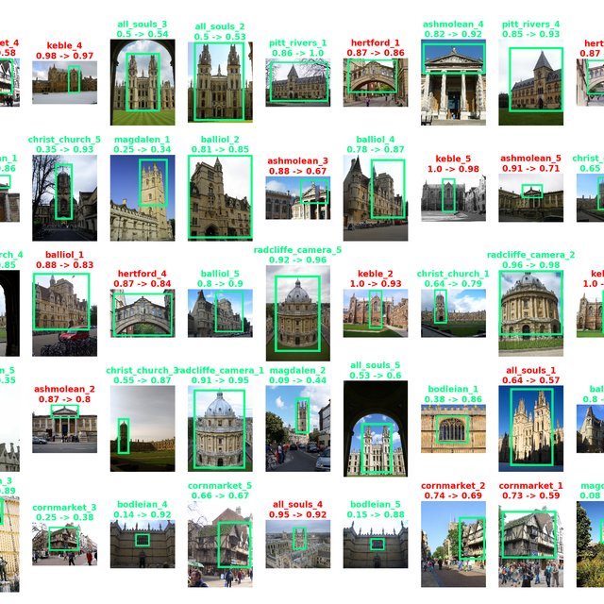
Data Selection
For Particular Object Retrieval, four datasets were chosen:
Oxford - 5063 images, 11 classes Paris - 6392 images, 11 classes
The Oxford and Paris datasets are well-known benchmarks used in particular object image retrieval tasks. Both datasets contain images categorised into landmark or object classes, and include query images for evaluation.
Oxford Dataset - 5063 images, 11 classes
Machine Learning Professional Project Presentation
Term Paper Presentation | Ronit Dutta
Term Paper Presentation | Ronit Dutta
Machine Learning Professional Project Presentation
Machine Learning Professional Project Presentation

Slide 10
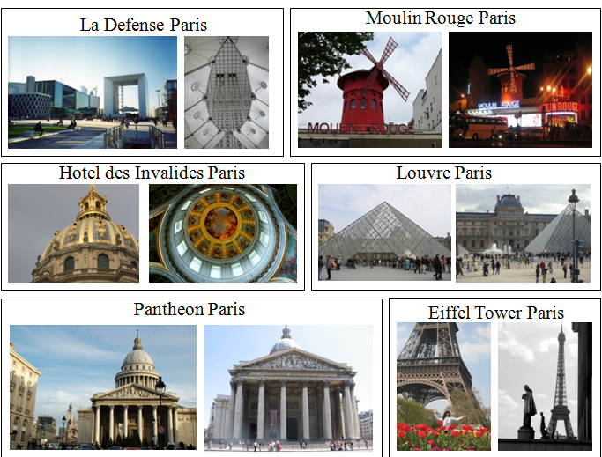
Data Selection
Two newer datasets were also used:
ROxford - Revisited version of Oxford with 4993 images, 13 categories, 70 queries. RParis - Revisited version of Paris with 6322 images, 12 classes, 70 queries.
Revisited datasets (ROxford and RParis) stratify queries into easy, medium, and hard, reflecting increasing difficulty in retrieval due to factors like occlusion or distortion.
RParis - 6322 images, 12 classes
Machine Learning Professional Project Presentation
Term Paper Presentation | Ronit Dutta
Term Paper Presentation | Ronit Dutta
Machine Learning Professional Project Presentation
Machine Learning Professional Project Presentation

Slide 11
OUTLINE
Introduction & Data Selection
Mechanics
Accuracy vs compute tradeoff
Advantages, Disadvantages and Experimental Results
Future directions
Machine Learning Professional Project Presentation
Term Paper Presentation | Ronit Dutta
Term Paper Presentation | Ronit Dutta
Machine Learning Professional Project Presentation
Machine Learning Professional Project Presentation

Slide 12
Implementation Mechanics review — STEP 1
BEGIN ->
Step 1 : Dataset encoding
Step 3 : OFFLINE :- HKM Tree
Data Input :
Image dataset of size D. Total number of images N. Candidate image is d_j and label for the same is y_j.
Encoding Machine :
Path 1 : R-GEM method
Path 2 : ViT method
Data Output :
Vector descriptor of vector space dimension Δ for every image in the database
HKM tree (level “L”):
Set hyperparameters for k-means aka branching ratio (k) and tree depth (L).
Calculate appropriate centroids using image global descriptors.
Set up appropriate cluster bucket for each centroid.
HKM TREE -
Constructed using recursive k-means at each SUB-LEVEL
Go down to the next level for each branch with total descriptors in sets of bucket size b_k RECURSIVELY.
Query (single/set)
Query output :
Vector of space dimension Δ for each query q_i in set Q or single query.
You repeat the k-means step for every internal node. Full process: offline HKM indexing.
Step 2 : Query encoding
Calculate the similarity between query set and pairwise similarity vector for internal centroid node.
Sort {<v_q , μ_k>} vector. Select argmin/argmax.
Choose similarity metric : cosine/ distance.
Choose BEST internal node (μ*). Explore it’s leaf nodes
Step 5 : Leaf level traversal
Calculate similarity vector {<v_q , v*_d>}.
Step 4 : ONLINE : Tree Traversal
Choose BEST candidate (INTENSIVE SEARCH) (or try different search strategy)
Go down that “BEST” candidate and then explore the k-centroids of the next level
Repeat loop
argsort and retrieve top-1. (INTENSIVE)
-> END
Machine Learning Professional Project Presentation
Term Paper Presentation | Ronit Dutta
Term Paper Presentation | Ronit Dutta
Machine Learning Professional Project Presentation
Machine Learning Professional Project Presentation

Slide 13
Retrieval strategies
 | Category Level Retrieval | Particular Object Level Retrieval
Goal / Intuition | Retrieve images with the same semantic category. (semantic / content similarity) | Retrieve the same specific instance/object (e.g. exact landmark). (instance-level, fine-grained appearance matching.)
Dataset | CUB, CARS, In-Shop. | Oxford, Paris, ROxford, RParis.
Backbone | UNICOM - CLIP/ViT (Vision Transformer) -based. | R-GeM (CNN + GeM pooling).
Metric | Recall@1. | mAP (mean Average Precision)
Machine Learning Professional Project Presentation
Term Paper Presentation | Ronit Dutta
Term Paper Presentation | Ronit Dutta
Machine Learning Professional Project Presentation
Machine Learning Professional Project Presentation

Slide 14
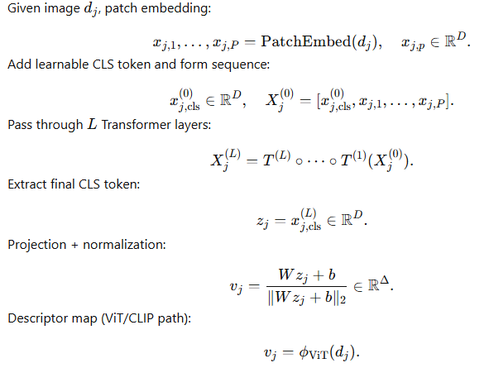
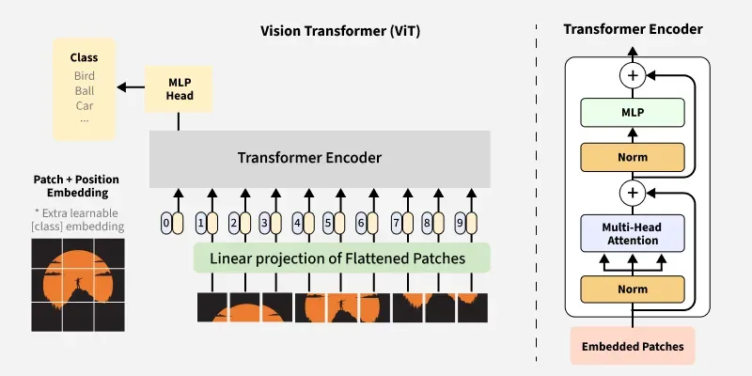
STEP 1 : Encoding - ViT based (category wise retrieval)
Δ is set by the authors. It can be 256/ 512/ 1024.
Machine Learning Professional Project Presentation
Term Paper Presentation | Ronit Dutta
Term Paper Presentation | Ronit Dutta
Machine Learning Professional Project Presentation
Machine Learning Professional Project Presentation

Slide 15
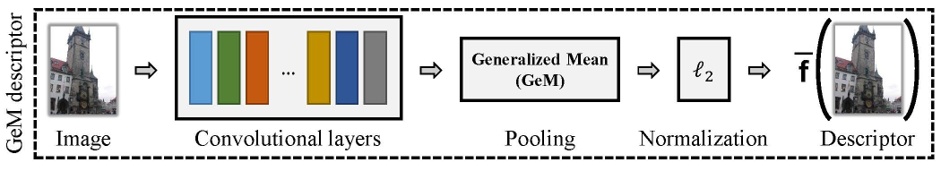
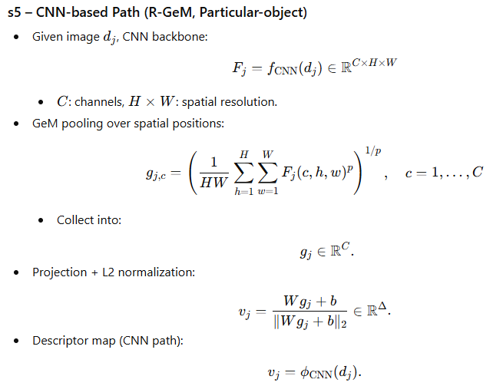
STEP 1 : Encoding - CNN based (object retrieval)
j
3.
4.
“p” -> GeMpool exponent, Projection Weights (W,b) are not arbitrary but learned during training via gradient updates.
Machine Learning Professional Project Presentation
Term Paper Presentation | Ronit Dutta
Term Paper Presentation | Ronit Dutta
Machine Learning Professional Project Presentation
Machine Learning Professional Project Presentation

Slide 16
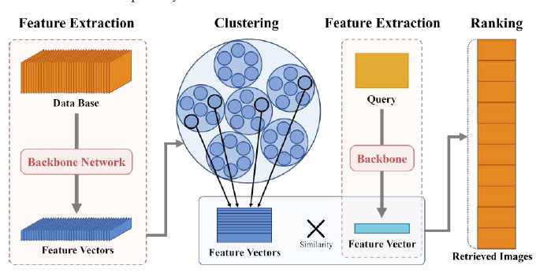
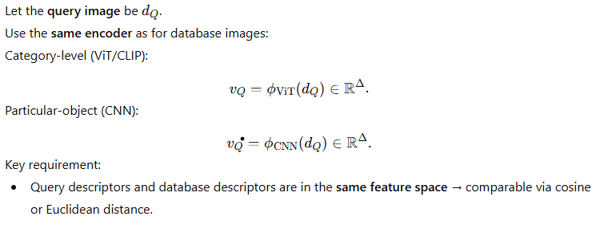
STEP 2 : Query Encoding
`
Machine Learning Professional Project Presentation
Term Paper Presentation | Ronit Dutta
Term Paper Presentation | Ronit Dutta
Machine Learning Professional Project Presentation
Machine Learning Professional Project Presentation

Slide 17
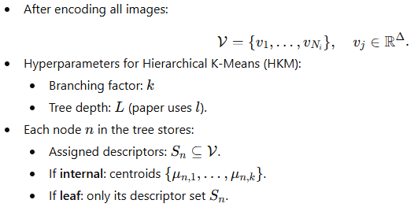
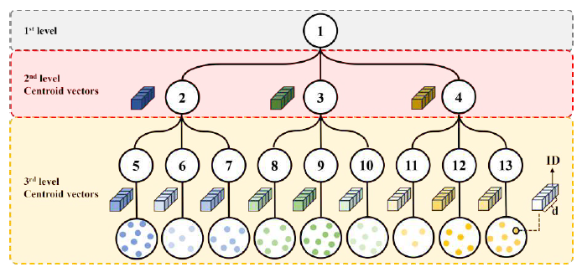
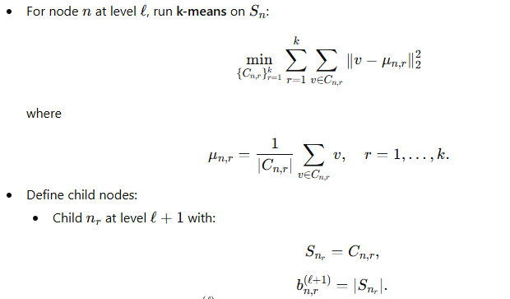
STEP 3 : Offline - HKM tree building
Machine Learning Professional Project Presentation
Term Paper Presentation | Ronit Dutta
Term Paper Presentation | Ronit Dutta
Machine Learning Professional Project Presentation
Machine Learning Professional Project Presentation

Slide 18
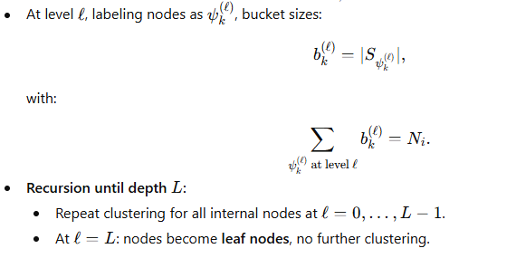
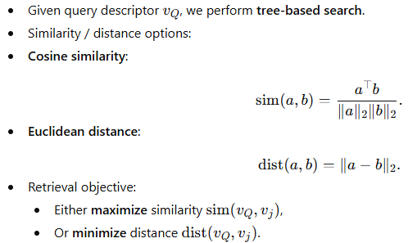
STEP 4 : ONLINE STAGE
OFFLINE STAGE
ONLINE STAGE
Machine Learning Professional Project Presentation
Term Paper Presentation | Ronit Dutta
Term Paper Presentation | Ronit Dutta
Machine Learning Professional Project Presentation
Machine Learning Professional Project Presentation

Slide 19
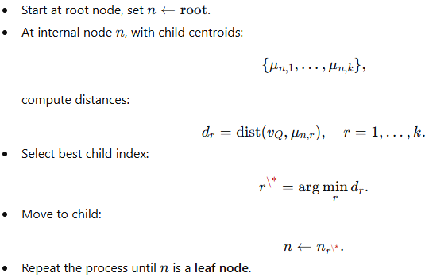
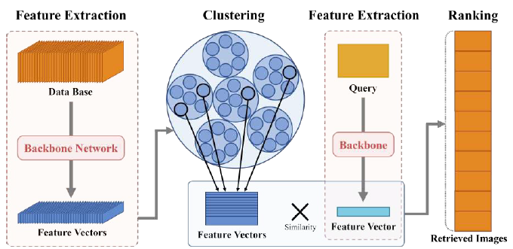
STEP 4 : ONLINE STAGE
Calculate pairwise similarity and produce similarity matrix!!
Machine Learning Professional Project Presentation
Term Paper Presentation | Ronit Dutta
Term Paper Presentation | Ronit Dutta
Machine Learning Professional Project Presentation
Machine Learning Professional Project Presentation

Slide 20
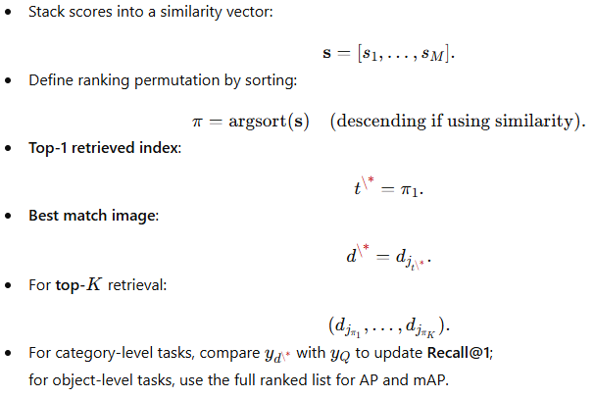
STEP 5 : Final Retrieval
Now we select the best child node and then traverse the “leaf” image descriptors inside the bucket of the “best” internal node.
Sort the ranked vector to get the best/ closest image to our query!!
Machine Learning Professional Project Presentation
Term Paper Presentation | Ronit Dutta
Term Paper Presentation | Ronit Dutta
Machine Learning Professional Project Presentation
Machine Learning Professional Project Presentation

Slide 21



Performance Metrics
Recall@1 -> [category level retrieval] | mAP (mean Average Precision) -> [object level retrieval]
Fraction of queries where the top retrieved image has the correct label. Absolute aggregation happens in this method. | R_q is number of relevant images and P_q is Precision@k. Then mAP takes the mean over all the queries.
Machine Learning Professional Project Presentation
Term Paper Presentation | Ronit Dutta
Term Paper Presentation | Ronit Dutta
Machine Learning Professional Project Presentation
Machine Learning Professional Project Presentation

Slide 22
OUTLINE
Introduction & Data Selection
Mechanics
Accuracy vs compute tradeoff
Advantages, Disadvantages and Experimental Results
Future directions
Machine Learning Professional Project Presentation
Term Paper Presentation | Ronit Dutta
Term Paper Presentation | Ronit Dutta
Machine Learning Professional Project Presentation
Machine Learning Professional Project Presentation

Slide 23
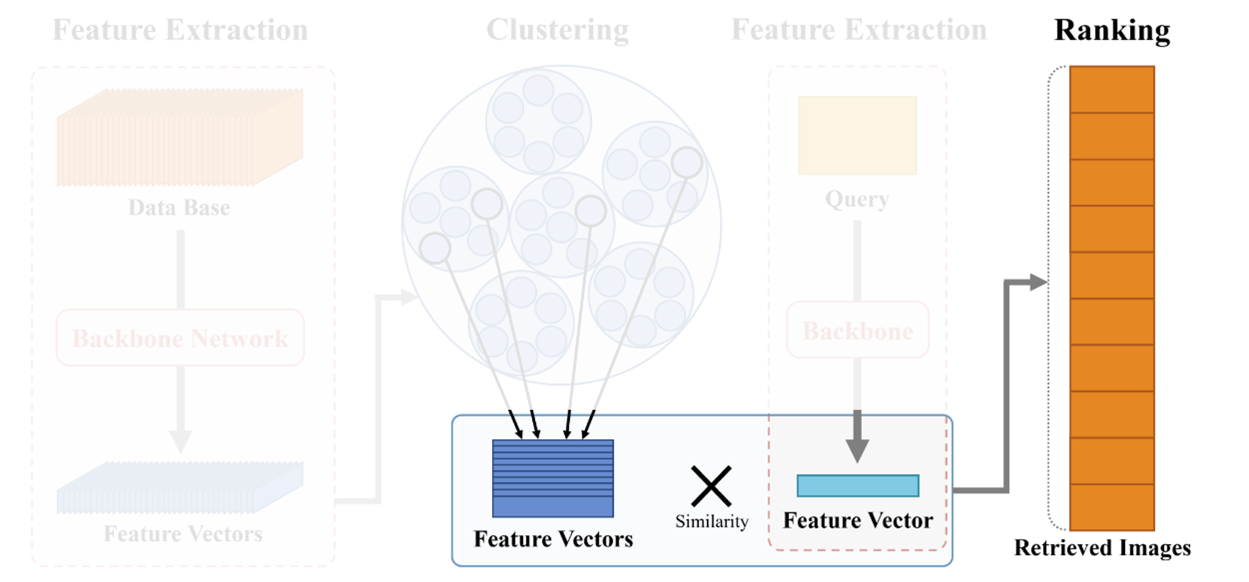
Online Step
Process: Tree Traversal → Distance Calculation → Ranking
Machine Learning Professional Project Presentation
Term Paper Presentation | Ronit Dutta
Term Paper Presentation | Ronit Dutta
Machine Learning Professional Project Presentation
Machine Learning Professional Project Presentation

Slide 24
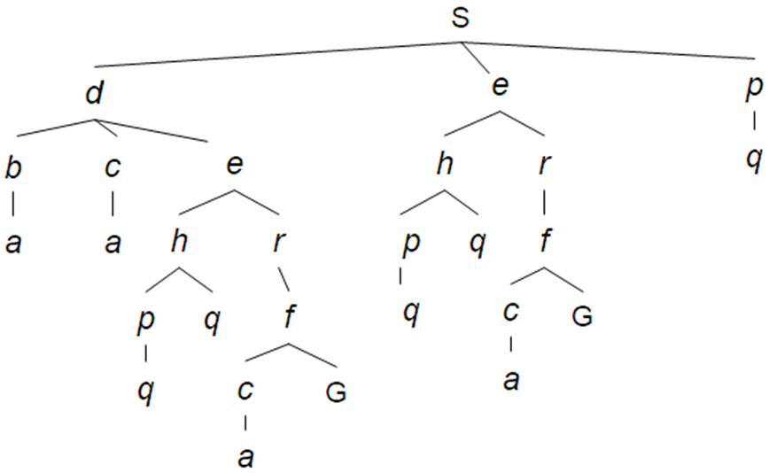
Accuracy vs. Compute Trade-off
The Offline Step constructs a hierarchical K-means tree to index global descriptors
Traverse the pre-built Hierarchical K-Means tree to find candidate leaf nodes
Machine Learning Professional Project Presentation
Term Paper Presentation | Ronit Dutta
Term Paper Presentation | Ronit Dutta
Machine Learning Professional Project Presentation
Machine Learning Professional Project Presentation

Slide 25
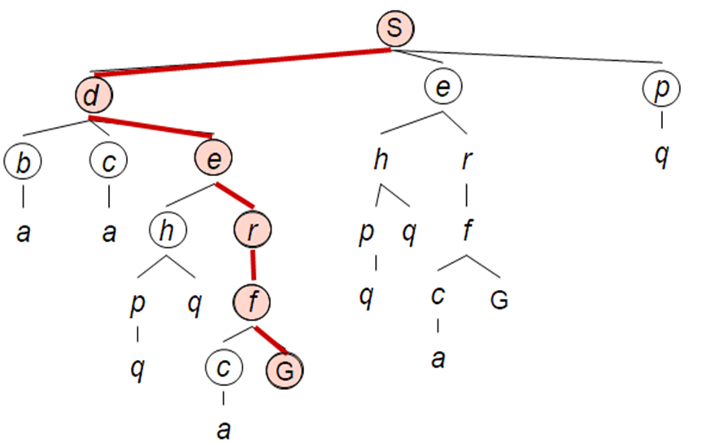
Accuracy vs. Compute Trade-off
Selecting the closest node is computationally efficient but risky
Neighboring clusters that are further from the query centroid but contain the target image
Machine Learning Professional Project Presentation
Term Paper Presentation | Ronit Dutta
Term Paper Presentation | Ronit Dutta
Machine Learning Professional Project Presentation
Machine Learning Professional Project Presentation

Slide 26
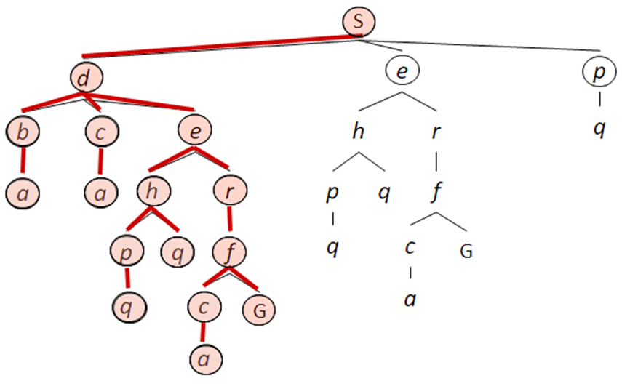
Accuracy vs. Compute Trade-off
To develop an "Online Step" that balances the trade-off between retrieval speed (pruning the tree) and retrieval accuracy (exploring multiple branches)
Machine Learning Professional Project Presentation
Term Paper Presentation | Ronit Dutta
Term Paper Presentation | Ronit Dutta
Machine Learning Professional Project Presentation
Machine Learning Professional Project Presentation

Slide 27
Search Algorithms
Intensive Search
Relaxed Search
Auto Search
Machine Learning Professional Project Presentation
Term Paper Presentation | Ronit Dutta
Term Paper Presentation | Ronit Dutta
Machine Learning Professional Project Presentation
Machine Learning Professional Project Presentation

Slide 28
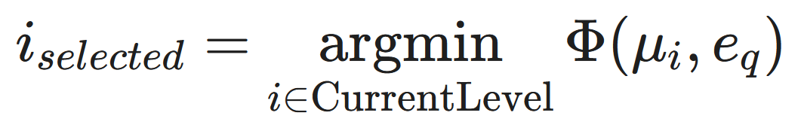
Intensive Search
Prioritize maximum retrieval speed.
Mechanism:
Select one node per level.
Centroid vector closest to the query descriptor.
Children of unselected nodes are excluded.
Identifies a single leaf node.
Fastest execution at the cost of accuracy loss.
Machine Learning Professional Project Presentation
Term Paper Presentation | Ronit Dutta
Term Paper Presentation | Ronit Dutta
Machine Learning Professional Project Presentation
Machine Learning Professional Project Presentation

Slide 29

Relaxed Search
Traverse multiple branches → Max. accuracy retention.
Mechanism:
multiple nodes (N^{m}) at each level based on two hyperparameters:
s₁​ (Absolute Threshold): Selects nodes within distance s₁​ of the query.
s₂​ (Relative Margin): Selects nodes within margin s_{2​} of the closest node.
Explores a broader set of candidate leaf nodes.
Preserves retrieval accuracy but increases computational cost.
Machine Learning Professional Project Presentation
Term Paper Presentation | Ronit Dutta
Term Paper Presentation | Ronit Dutta
Machine Learning Professional Project Presentation
Machine Learning Professional Project Presentation

Slide 30
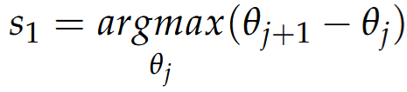
Auto Search
Balance speed and accuracy and automates parameter selection
Mechanism:
Sorts distances at the current level (D^{m})
Identifies the largest difference (gap) between neighbor distances.
Dynamically sets the threshold s₁​ to this gap value.
Eliminates the need for s_{2​} and manual tuning.
Faster than Relaxed, more accurate than Intensive.
Machine Learning Professional Project Presentation
Term Paper Presentation | Ronit Dutta
Term Paper Presentation | Ronit Dutta
Machine Learning Professional Project Presentation
Machine Learning Professional Project Presentation

Slide 31
OUTLINE
Introduction & Data Selection
Mechanics
Accuracy vs compute tradeoff
Advantages, Disadvantages and Experimental Results
Future directions
Machine Learning Professional Project Presentation
Term Paper Presentation | Ronit Dutta
Term Paper Presentation | Ronit Dutta
Machine Learning Professional Project Presentation
Machine Learning Professional Project Presentation

Slide 32
Advantages
Large speedup with high accuracy
For particular object retrieval, mAP retention stays between about 92.5% and 102%, with an average of 97.8%.​
Flexible trade-off:
Intensive search: maximum speed.
Relaxed search: best accuracy retention.
Auto search: balanced speed and accuracy, no extra hyperparameters.​
Works with different backbones and tasks:
CLIP-based model (UNICOM) for category-level retrieval.
CNN-based model (R-GeM) for particular object retrieval.​
Shows that the framework is model-agnostic and reusable
Machine Learning Professional Project Presentation
Term Paper Presentation | Ronit Dutta
Term Paper Presentation | Ronit Dutta
Term Paper Presentation | Ronit Dutta
Machine Learning Professional Project Presentation
Machine Learning Professional Project Presentation

Slide 33
Advantages
Scales well with dataset size: The larger the database, the more retrieval time is reduced
Offline/online separation: Tree construction is done offline, online step becomes much faster and can be plugged into existing CBIR pipelines without retraining the backbone.
Machine Learning Professional Project Presentation
Term Paper Presentation | Ronit Dutta
Term Paper Presentation | Ronit Dutta
Term Paper Presentation | Ronit Dutta
Machine Learning Professional Project Presentation
Machine Learning Professional Project Presentation

Slide 34
Disadvantages
Speed–accuracy trade-off: Intensive search gives the highest speed but can significantly hurt accuracy on large datasets (big drop in Recall@1 on In-Shop).​
Less benefit on small datasets or dynamic data
The cluster tree is built offline, when many new images arrive the tree may need to be rebuilt which is less ideal for highly dynamic systems.​
Implementation-level limitation: All experiments use Python, the authors note that using a compiled language could further reduce overhead and improve speed beyond the reported numbers.
Machine Learning Professional Project Presentation
Term Paper Presentation | Ronit Dutta
Term Paper Presentation | Ronit Dutta
Term Paper Presentation | Ronit Dutta
Machine Learning Professional Project Presentation
Machine Learning Professional Project Presentation

Slide 35
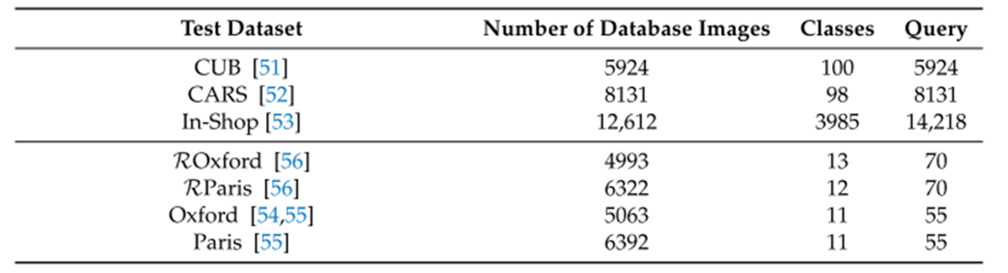
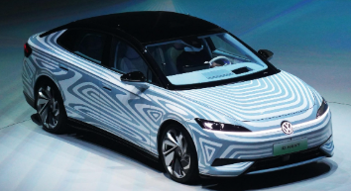


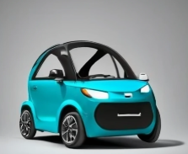
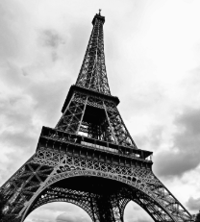
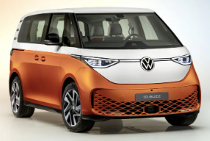


Experiment
Category-Level Retrieval
Particular Object Retrieval
Category-Level Retrieval
Particular Object Retrieval
Machine Learning Professional Project Presentation
Term Paper Presentation | Ronit Dutta
Term Paper Presentation | Ronit Dutta
Term Paper Presentation | Ronit Dutta
Machine Learning Professional Project Presentation
Machine Learning Professional Project Presentation

Slide 36
OUTLINE
Introduction & Data Selection
Mechanics
Accuracy vs compute tradeoff
Advantages, Disadvantages and Experimental Results
Future directions
Machine Learning Professional Project Presentation
Term Paper Presentation | Ronit Dutta
Term Paper Presentation | Ronit Dutta
Machine Learning Professional Project Presentation
Machine Learning Professional Project Presentation

Slide 37
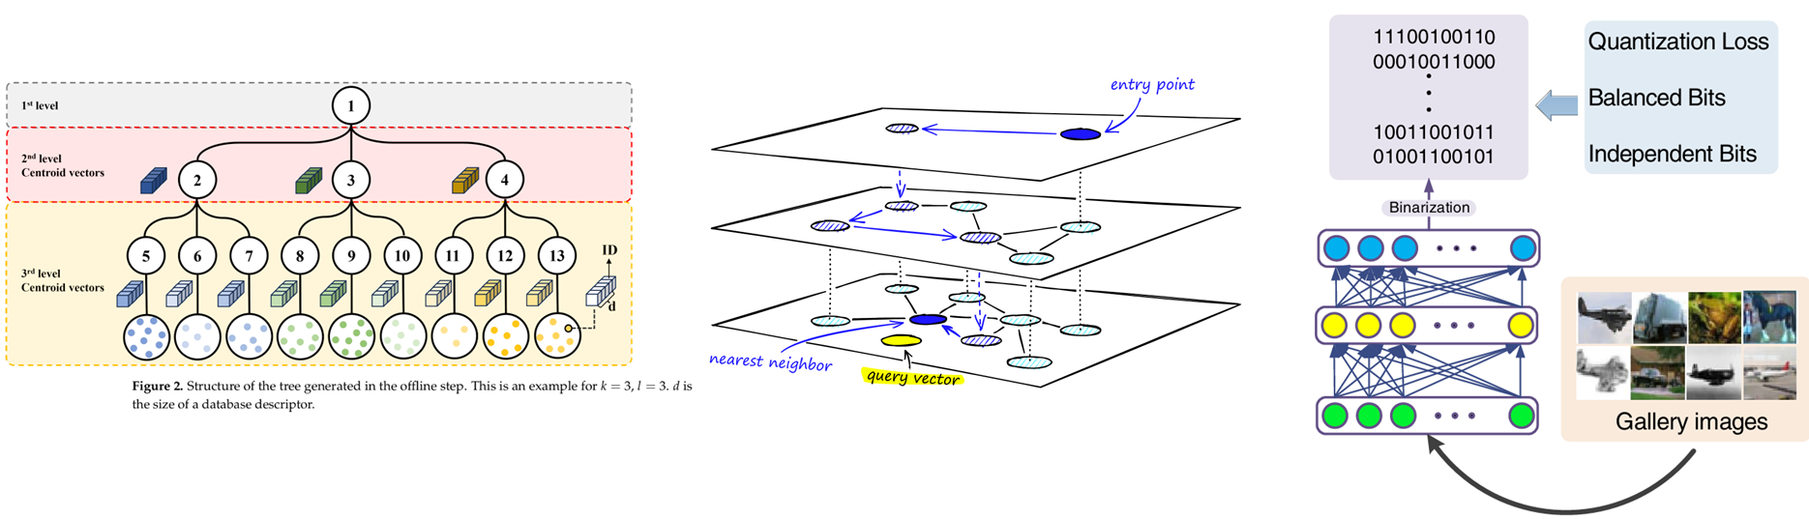
ANN (Approximate Nearest Neighbors Search) Overview
Purpose: Quickly find the top-K most similar points to a query in large-scale data (vectors)
Categories:
Tree-based
Graph-based
Hashing-based
Machine Learning Professional Project Presentation
Term Paper Presentation | Ronit Dutta
Term Paper Presentation | Ronit Dutta
Term Paper Presentation | Ronit Dutta
Machine Learning Professional Project Presentation
Machine Learning Professional Project Presentation
Notes:
In current industry practice, tree-based approaches are only one category of commonly adopted solutions. Graph-based and hashing-based methods are also widely used at the industry level.

Slide 38
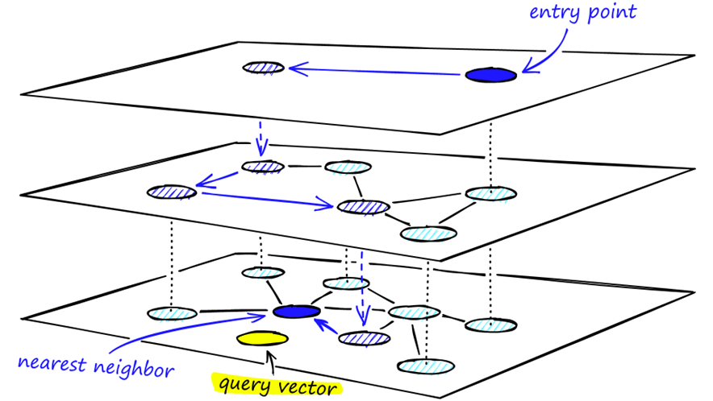
Example1: HNSW (Hierarchical Navigable Small World)
Industry standard: excellent trade-off between high recall and low latency
Hierarchical structure: fast coarse search + accurate local search
Machine Learning Professional Project Presentation
Term Paper Presentation | Ronit Dutta
Term Paper Presentation | Ronit Dutta
Term Paper Presentation | Ronit Dutta
Machine Learning Professional Project Presentation
Machine Learning Professional Project Presentation
Notes:
HNSW is widely regarded as the industrial standard today. HNSW organizes data in a multi-layer graph. The upper layers allow very fast coarse search, while the lower layers provide accurate local refinement. Both the graph construction process and the search process follow a top-down navigation strategy.

Slide 39
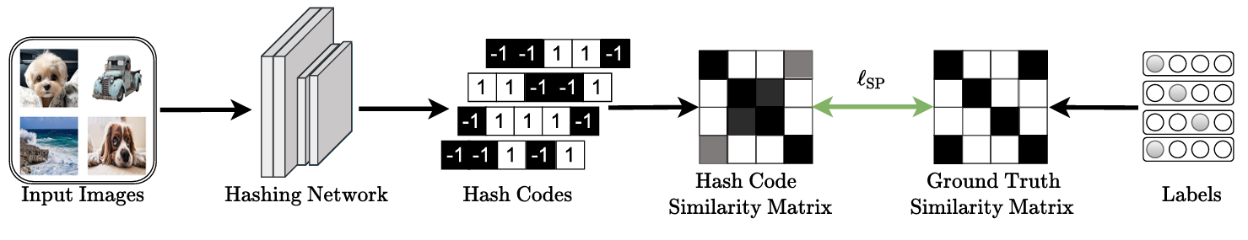


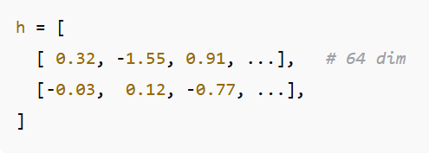

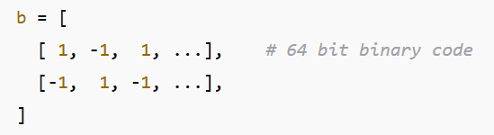
Example 2: Deep Hashing
What: DNNs + Hashing → convert each image into a binary hash code
Why:
Dramatically reduce storage requirements and enable extremely fast comparisons;
Suitable for million–billion scale databases.
Machine Learning Professional Project Presentation
Term Paper Presentation | Ronit Dutta
Term Paper Presentation | Ronit Dutta
Term Paper Presentation | Ronit Dutta
Machine Learning Professional Project Presentation
Machine Learning Professional Project Presentation
Notes:
Deep hashing aims to convert the high-dimensional feature vectors produced by neural networks into compact binary codes；Apply binarization layer → output binary code; Store code in database; Query = compute binary code → compare using fast Hamming distance

Slide 40
Content-based Image Retrieval
Q&A
Machine Learning Professional Project Presentation
Term Paper Presentation | Ronit Dutta
Term Paper Presentation | Ronit Dutta
Machine Learning Professional Project Presentation
Machine Learning Professional Project Presentation

Slide 41
Credit
Introduction & Data Selection - Timothy
Mechanics - Ronit
Accuracy vs compute tradeoff - Mohamed
Advantages, Disadvantages and Experimental Results - Afifah
Future directions - Nan
Machine Learning Professional Project Presentation
Term Paper Presentation | Ronit Dutta
Term Paper Presentation | Ronit Dutta
Machine Learning Professional Project Presentation
Machine Learning Professional Project Presentation

