Slide 1


The dynamics of quantum scattering and confinement in 1D & 3D geometries for time-independent potentials
Ronit Dutta
PhD researcher, SMT pillar
MIDTERM PROJECT
Applied Mathematics for Engineering

Slide 2



Abstract and Motivation
Scattering theory provides a setting in which several standard mathematical tools like ordinary differential equations, special functions, Fourier methods, and complex analysis appear together in a natural and unified way. Rather than separating physical situations into “bound” and “unbound” problems, the same underlying framework can be used to study how wavefunctions behave both near regions of interaction and far away from them. The central idea is to treat the motion of a particle as a propagation problem: given an incident wave, determine how it evolves under a potential, and understand how its structure changes between the interaction region and the asymptotic regime. In this sense, confinement and scattering are not distinct categories but different manifestations of the same dynamics viewed under different boundary conditions.
At the level of the Schrödinger equation, the problem reduces to solving a second-order linear differential equation in regions of constant or slowly varying potential, and enforcing continuity conditions at interfaces. In one dimension this leads directly to reflection and transmission amplitudes, while in three dimensions separation of variables produces a radial equation with an effective centrifugal term. The resulting solutions are expressed in terms of Bessel and spherical Bessel functions, and form the basis of the partial wave decomposition.
Fourier methods enter through the representation of incident states as superpositions of plane waves, making explicit the relation between momentum space and position space descriptions. Extending the analysis to complex wave numbers reveals further structure: poles of the scattering amplitudes correspond to bound states and resonances, providing a direct link between analytic properties and physical spectra.
The aim of this project is to use scattering as a framework in which these techniques are not introduced separately, but seen operating together in a single, coherent construction.
Machine Learning Professional Project Presentation
Machine Learning Professional Project Presentation
Nanoelectronics - Seminar Presentation Ronit Dutta
Machine Learning Professional Project Presentation
Machine Learning Professional Project Presentation
Nanoelectronics - Seminar Presentation Ronit Dutta
Term Paper Presentation | Ronit Dutta
Term Paper Presentation | Ronit Dutta
Machine Learning Professional Project Presentation
Machine Learning Professional Project Presentation
Term Paper Presentation | Ronit Dutta
Term Paper Presentation | Ronit Dutta
Machine Learning Professional Project Presentation
Machine Learning Professional Project Presentation
Applied Mathematics for Engineering [MIDTERM PROJECT] Ronit Dutta
Applied Mathematics for Engineering [MIDTERM PROJECT] Ronit Dutta

Slide 3
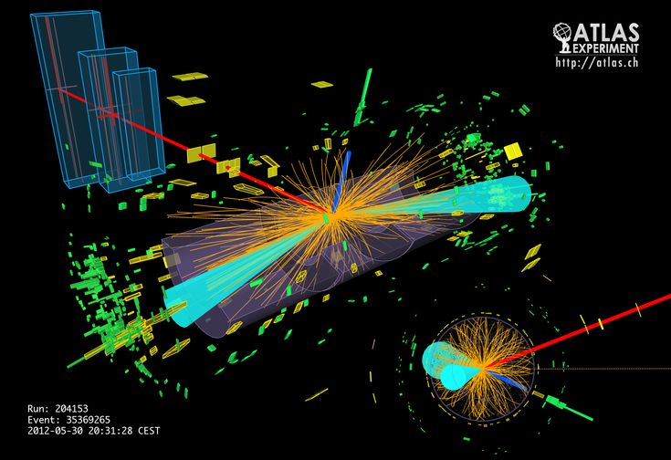
OUTLINE
Introduction
Schrodinger equation as energy conservation and eigenvalue equation
Fourier conjugates & uncertainty principle
Confined vs scattering states
Common 1D scattering
S-matrix and its properties
1D solutions using S matrix
Resonance
3D potentials and cross section formula
Partial waves & Phase shifts
Hard sphere solution
Bound states & scattering length
Machine Learning Professional Project Presentation
Machine Learning Professional Project Presentation
Nanoelectronics - Seminar Presentation Ronit Dutta
Machine Learning Professional Project Presentation
Machine Learning Professional Project Presentation
Nanoelectronics - Seminar Presentation Ronit Dutta
Machine Learning Professional Project Presentation
Machine Learning Professional Project Presentation
Nanoelectronics - Seminar Presentation Ronit Dutta
Machine Learning Professional Project Presentation
Machine Learning Professional Project Presentation
Nanoelectronics - Seminar Presentation Ronit Dutta
Machine Learning Professional Project Presentation
Machine Learning Professional Project Presentation
Nanoelectronics - Seminar Presentation Ronit Dutta
Machine Learning Professional Project Presentation
Machine Learning Professional Project Presentation
Nanoelectronics - Seminar Presentation Ronit Dutta
Machine Learning Professional Project Presentation
Machine Learning Professional Project Presentation
Nanoelectronics - Seminar Presentation Ronit Dutta
Term Paper Presentation | Ronit Dutta
Term Paper Presentation | Ronit Dutta
Machine Learning Professional Project Presentation
Machine Learning Professional Project Presentation
Term Paper Presentation | Ronit Dutta
Term Paper Presentation | Ronit Dutta
Machine Learning Professional Project Presentation
Machine Learning Professional Project Presentation
Term Paper Presentation | Ronit Dutta
Term Paper Presentation | Ronit Dutta
Machine Learning Professional Project Presentation
Machine Learning Professional Project Presentation
Term Paper Presentation | Ronit Dutta
Term Paper Presentation | Ronit Dutta
Machine Learning Professional Project Presentation
Machine Learning Professional Project Presentation
Term Paper Presentation | Ronit Dutta
Term Paper Presentation | Ronit Dutta
Machine Learning Professional Project Presentation
Machine Learning Professional Project Presentation
Term Paper Presentation | Ronit Dutta
Term Paper Presentation | Ronit Dutta
Machine Learning Professional Project Presentation
Machine Learning Professional Project Presentation
Term Paper Presentation | Ronit Dutta
Term Paper Presentation | Ronit Dutta
Machine Learning Professional Project Presentation
Machine Learning Professional Project Presentation
Applied Mathematics for Engineering [MIDTERM PROJECT] Ronit Dutta
Applied Mathematics for Engineering [MIDTERM PROJECT] Ronit Dutta
Applied Mathematics for Engineering [MIDTERM PROJECT] Ronit Dutta
Applied Mathematics for Engineering [MIDTERM PROJECT] Ronit Dutta
Applied Mathematics for Engineering [MIDTERM PROJECT] Ronit Dutta
Applied Mathematics for Engineering [MIDTERM PROJECT] Ronit Dutta

Slide 4
OUTLINE
Introduction
Schrodinger equation as energy conservation and eigenvalue equation
Fourier conjugates & uncertainty principle
Confined vs scattering states
Common 1D scattering
S-matrix and its properties
1D solutions using S matrix
Resonances
3D potentials and cross section formula
Partial waves & Phase shifts
Hard sphere solution
Bound states & scattering length
Machine Learning Professional Project Presentation
Machine Learning Professional Project Presentation
Nanoelectronics - Seminar Presentation Ronit Dutta
Machine Learning Professional Project Presentation
Machine Learning Professional Project Presentation
Nanoelectronics - Seminar Presentation Ronit Dutta
Machine Learning Professional Project Presentation
Machine Learning Professional Project Presentation
Nanoelectronics - Seminar Presentation Ronit Dutta
Machine Learning Professional Project Presentation
Machine Learning Professional Project Presentation
Nanoelectronics - Seminar Presentation Ronit Dutta
Machine Learning Professional Project Presentation
Machine Learning Professional Project Presentation
Nanoelectronics - Seminar Presentation Ronit Dutta
Machine Learning Professional Project Presentation
Machine Learning Professional Project Presentation
Nanoelectronics - Seminar Presentation Ronit Dutta
Machine Learning Professional Project Presentation
Machine Learning Professional Project Presentation
Nanoelectronics - Seminar Presentation Ronit Dutta
Term Paper Presentation | Ronit Dutta
Term Paper Presentation | Ronit Dutta
Machine Learning Professional Project Presentation
Machine Learning Professional Project Presentation
Term Paper Presentation | Ronit Dutta
Term Paper Presentation | Ronit Dutta
Machine Learning Professional Project Presentation
Machine Learning Professional Project Presentation
Term Paper Presentation | Ronit Dutta
Term Paper Presentation | Ronit Dutta
Machine Learning Professional Project Presentation
Machine Learning Professional Project Presentation
Term Paper Presentation | Ronit Dutta
Term Paper Presentation | Ronit Dutta
Machine Learning Professional Project Presentation
Machine Learning Professional Project Presentation
Term Paper Presentation | Ronit Dutta
Term Paper Presentation | Ronit Dutta
Machine Learning Professional Project Presentation
Machine Learning Professional Project Presentation
Term Paper Presentation | Ronit Dutta
Term Paper Presentation | Ronit Dutta
Machine Learning Professional Project Presentation
Machine Learning Professional Project Presentation
Term Paper Presentation | Ronit Dutta
Term Paper Presentation | Ronit Dutta
Machine Learning Professional Project Presentation
Machine Learning Professional Project Presentation
Applied Mathematics for Engineering [MIDTERM PROJECT] Ronit Dutta
Applied Mathematics for Engineering [MIDTERM PROJECT] Ronit Dutta
Applied Mathematics for Engineering [MIDTERM PROJECT] Ronit Dutta
Applied Mathematics for Engineering [MIDTERM PROJECT] Ronit Dutta
Applied Mathematics for Engineering [MIDTERM PROJECT] Ronit Dutta
Applied Mathematics for Engineering [MIDTERM PROJECT] Ronit Dutta

Slide 5
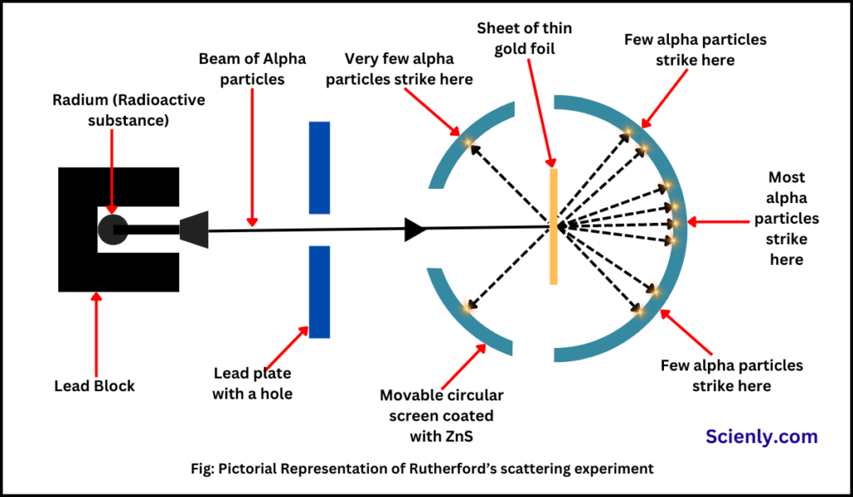
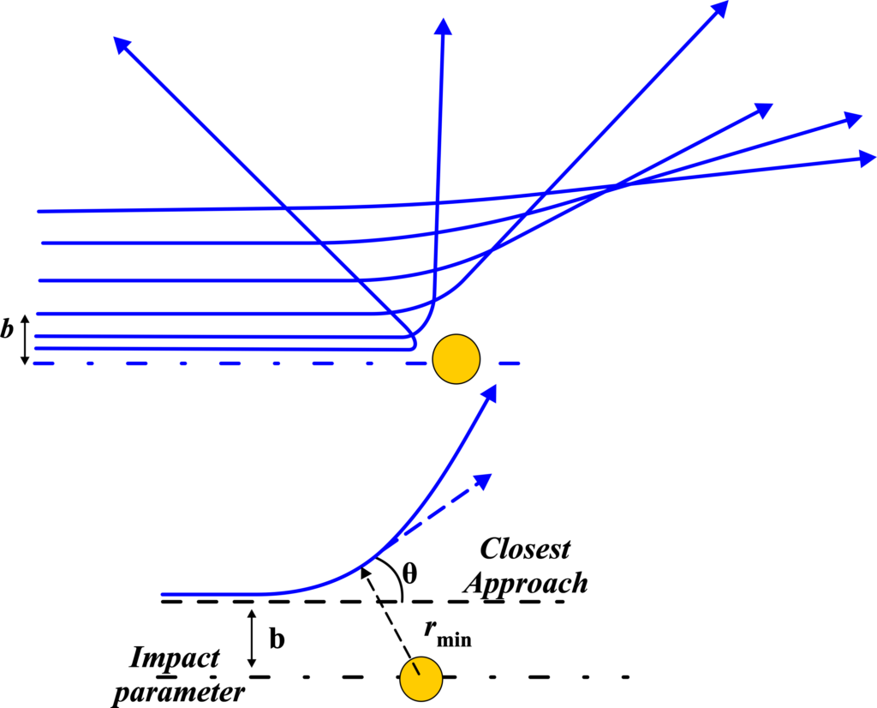
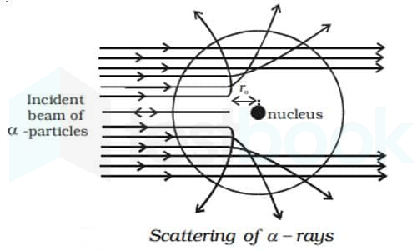
What is meant by scattering?
Rutherford’s scattering (One of the most famous scattering experiments ever conducted)
General 3D scattering setup
Microscopic view
Machine Learning Professional Project Presentation
Machine Learning Professional Project Presentation
Nanoelectronics - Seminar Presentation Ronit Dutta
Machine Learning Professional Project Presentation
Machine Learning Professional Project Presentation
Nanoelectronics - Seminar Presentation Ronit Dutta
Term Paper Presentation | Ronit Dutta
Term Paper Presentation | Ronit Dutta
Machine Learning Professional Project Presentation
Machine Learning Professional Project Presentation
Term Paper Presentation | Ronit Dutta
Term Paper Presentation | Ronit Dutta
Machine Learning Professional Project Presentation
Machine Learning Professional Project Presentation
Applied Mathematics for Engineering [MIDTERM PROJECT] Ronit Dutta
Applied Mathematics for Engineering [MIDTERM PROJECT] Ronit Dutta

Slide 6
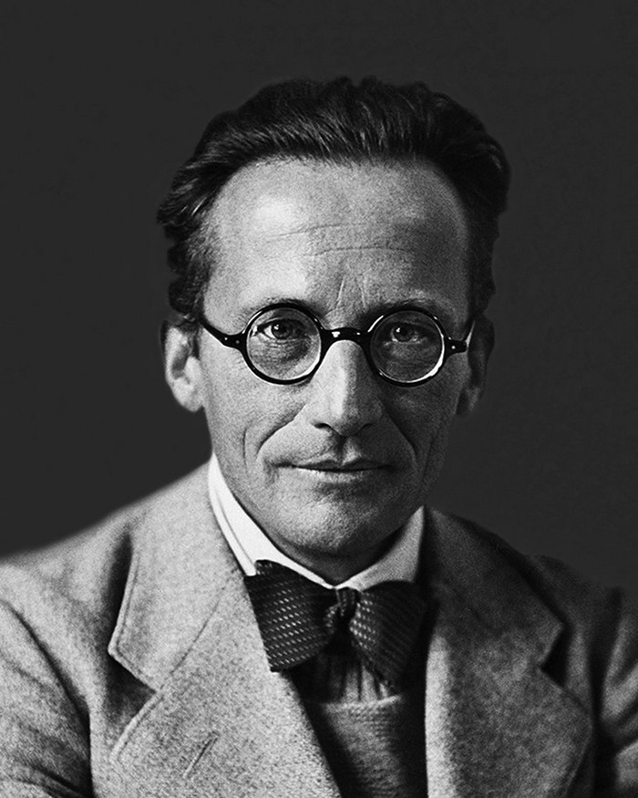
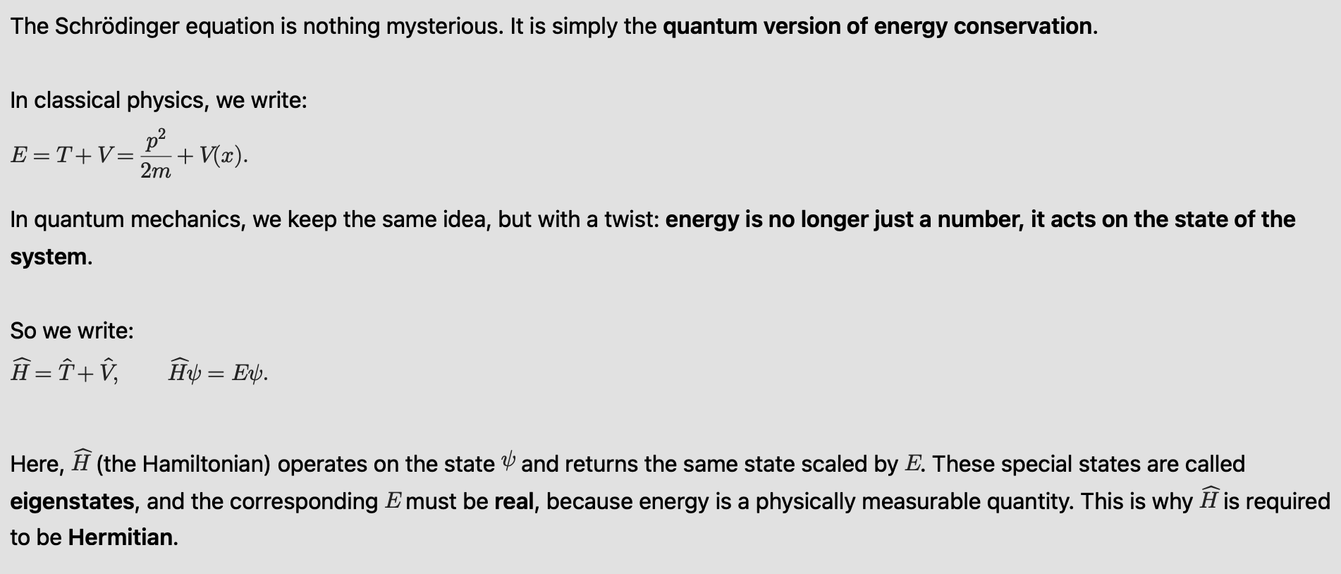
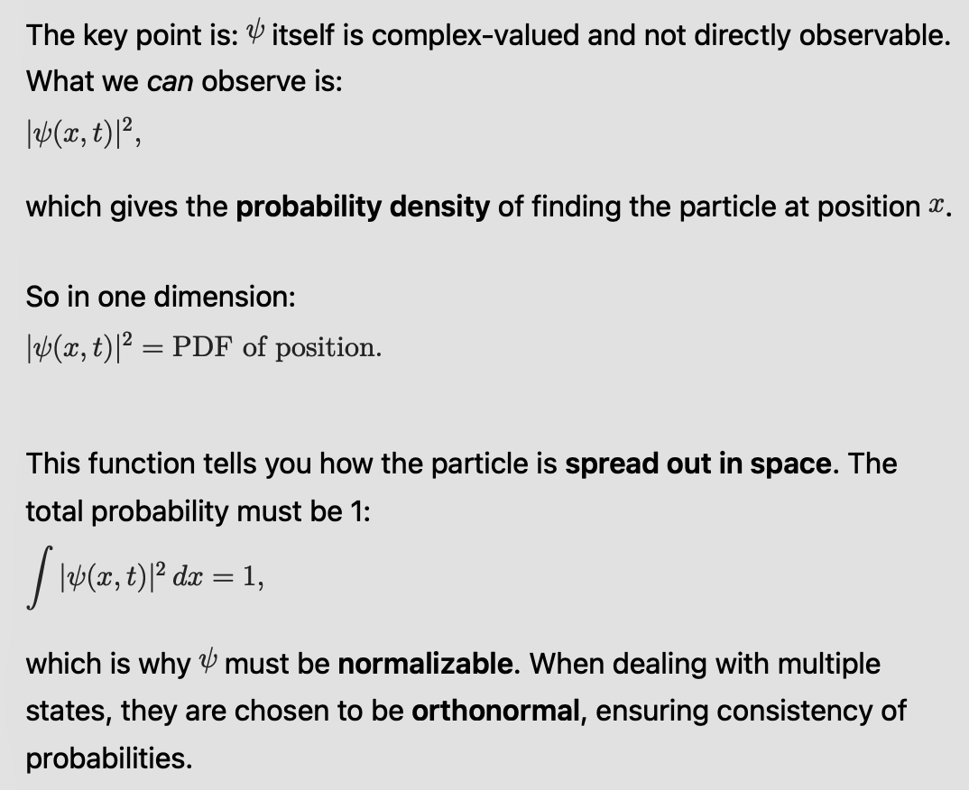
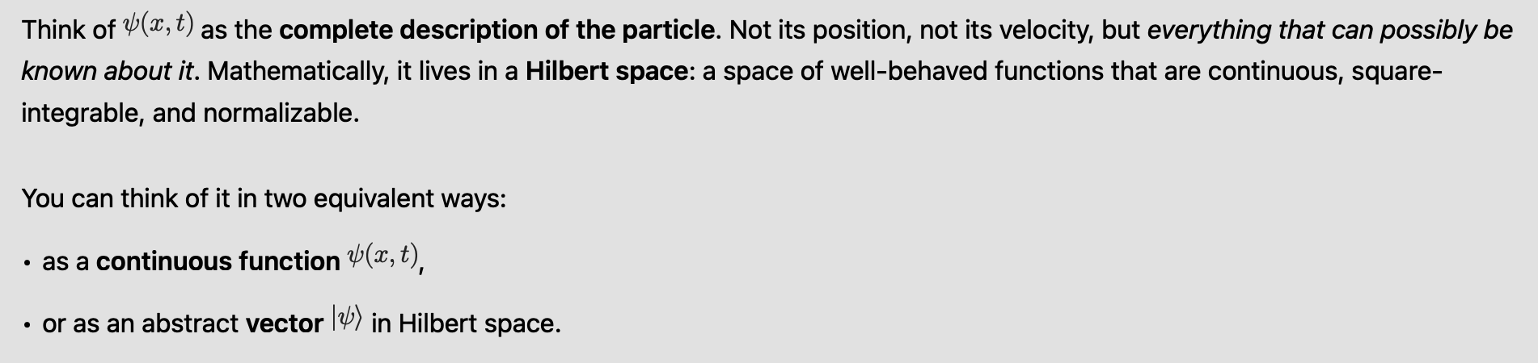




Schrodinger equation as energy conservation & eigenvalue equation
Machine Learning Professional Project Presentation
Nanoelectronics - Seminar Presentation Ronit Dutta
Machine Learning Professional Project Presentation
Machine Learning Professional Project Presentation
Nanoelectronics - Seminar Presentation Ronit Dutta
Machine Learning Professional Project Presentation
Machine Learning Professional Project Presentation
Nanoelectronics - Seminar Presentation Ronit Dutta
Machine Learning Professional Project Presentation
Machine Learning Professional Project Presentation
Nanoelectronics - Seminar Presentation Ronit Dutta
Machine Learning Professional Project Presentation
Machine Learning Professional Project Presentation
Nanoelectronics - Seminar Presentation Ronit Dutta
Term Paper Presentation | Ronit Dutta
Term Paper Presentation | Ronit Dutta
Machine Learning Professional Project Presentation
Machine Learning Professional Project Presentation
Term Paper Presentation | Ronit Dutta
Term Paper Presentation | Ronit Dutta
Machine Learning Professional Project Presentation
Machine Learning Professional Project Presentation
Term Paper Presentation | Ronit Dutta
Term Paper Presentation | Ronit Dutta
Machine Learning Professional Project Presentation
Machine Learning Professional Project Presentation
Term Paper Presentation | Ronit Dutta
Term Paper Presentation | Ronit Dutta
Machine Learning Professional Project Presentation
Machine Learning Professional Project Presentation
Term Paper Presentation | Ronit Dutta
Term Paper Presentation | Ronit Dutta
Machine Learning Professional Project Presentation
Machine Learning Professional Project Presentation
Applied Mathematics for Engineering [MIDTERM PROJECT] Ronit Dutta
Applied Mathematics for Engineering [MIDTERM PROJECT] Ronit Dutta
Applied Mathematics for Engineering [MIDTERM PROJECT] Ronit Dutta
Applied Mathematics for Engineering [MIDTERM PROJECT] Ronit Dutta

Slide 7
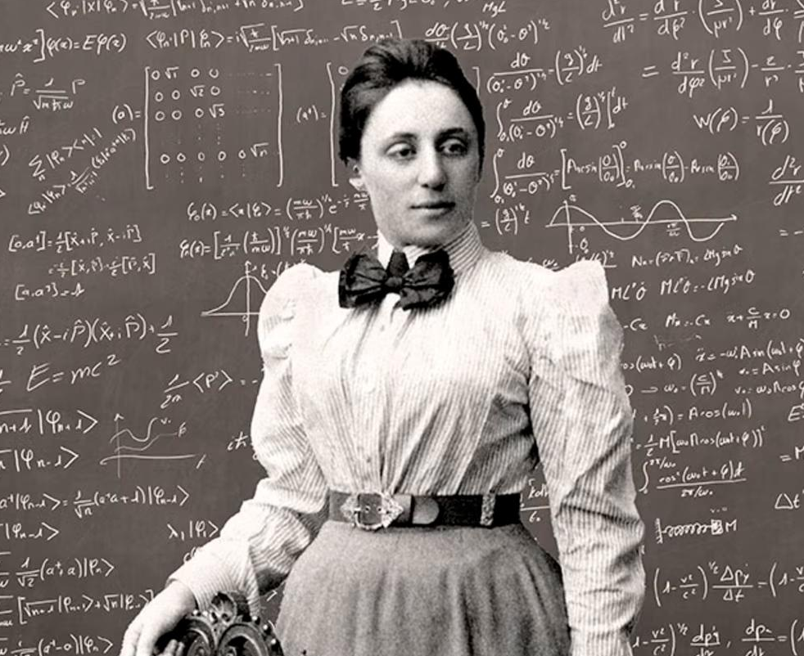
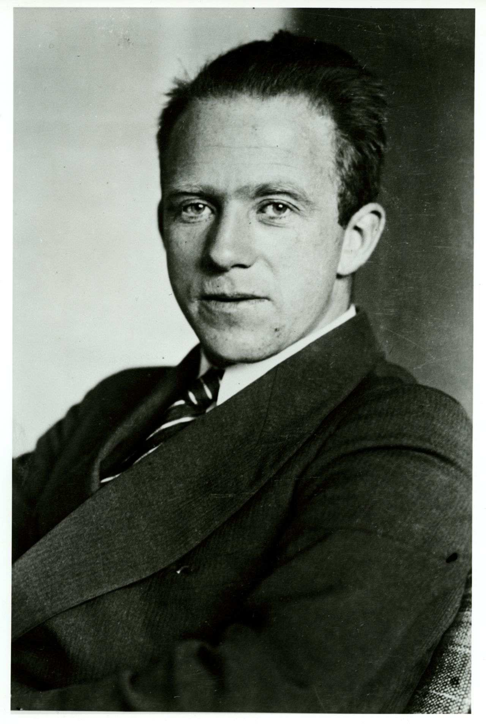
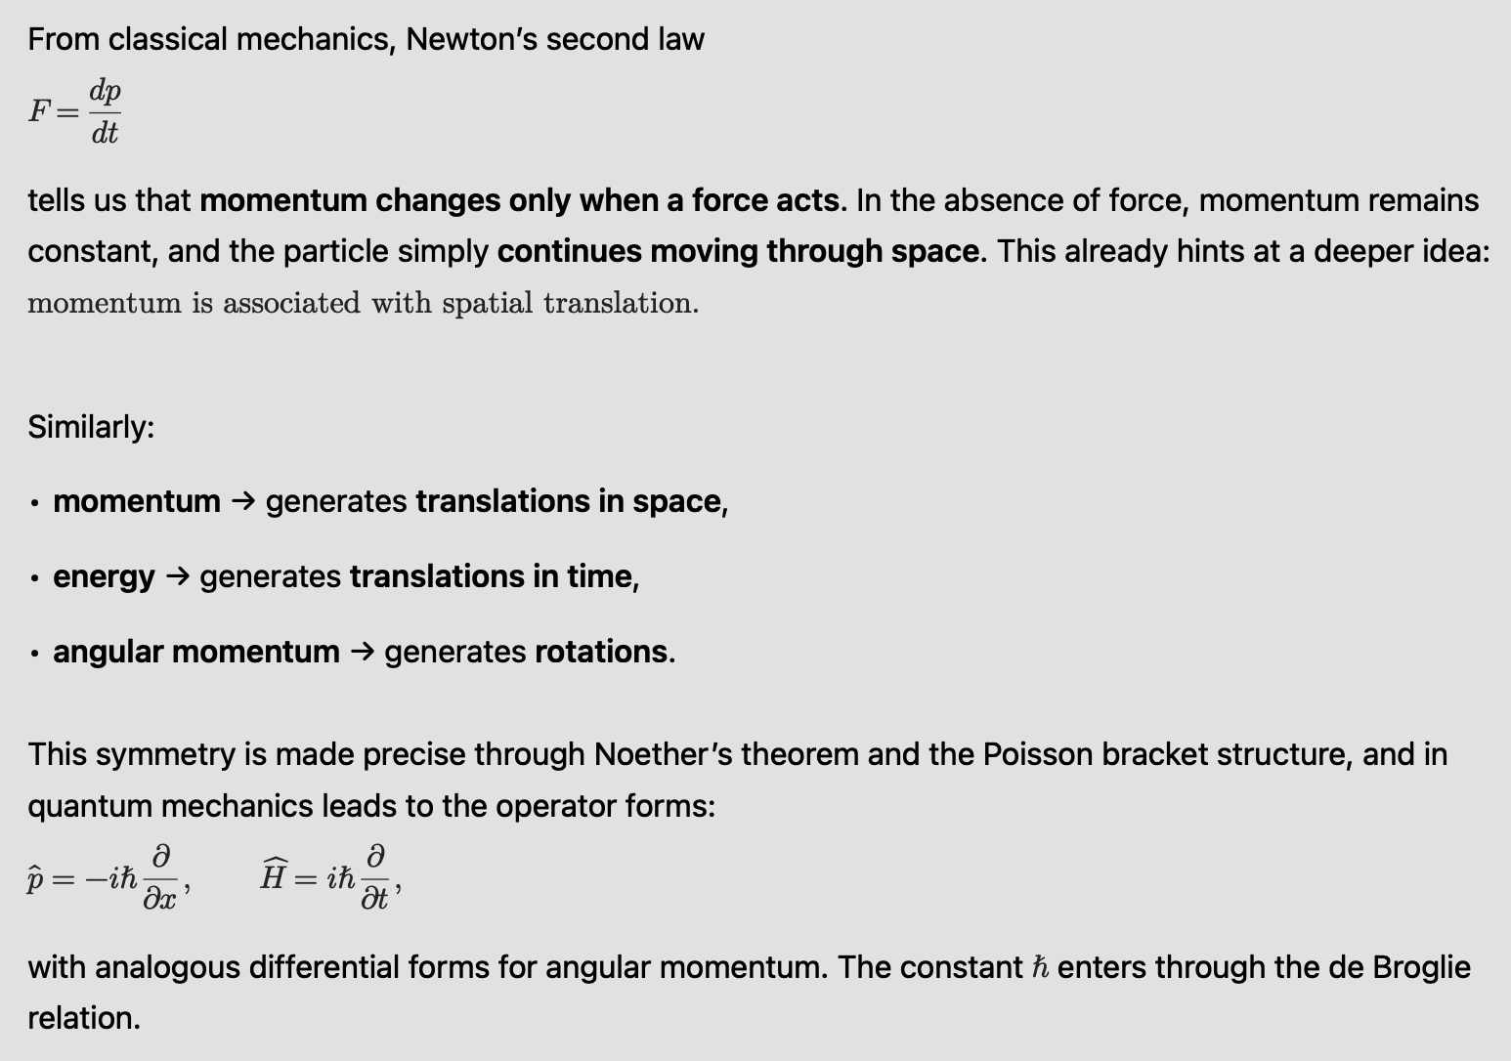
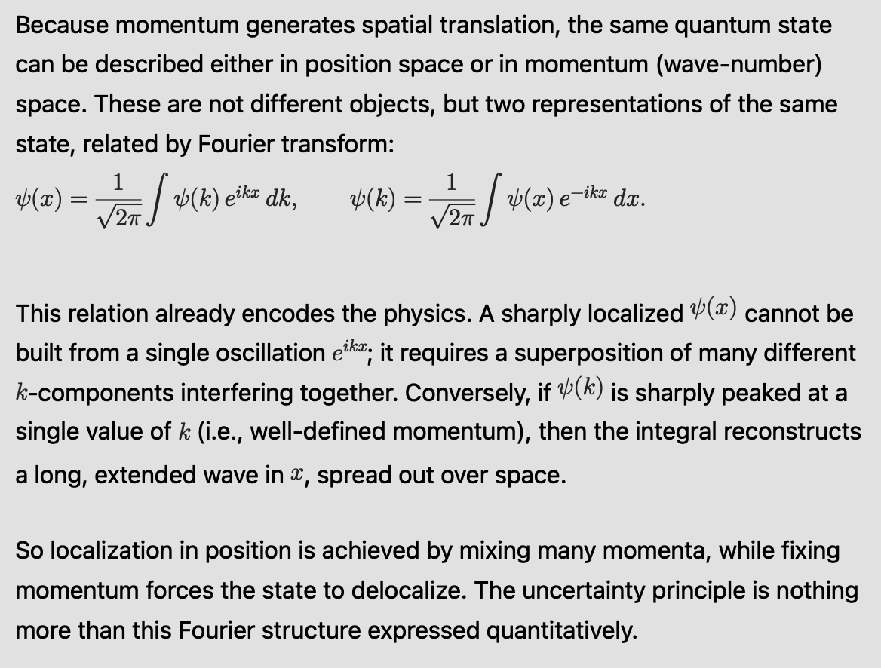
Fourier conjugates and uncertainty principle
Machine Learning Professional Project Presentation
Nanoelectronics - Seminar Presentation Ronit Dutta
Machine Learning Professional Project Presentation
Machine Learning Professional Project Presentation
Nanoelectronics - Seminar Presentation Ronit Dutta
Machine Learning Professional Project Presentation
Machine Learning Professional Project Presentation
Nanoelectronics - Seminar Presentation Ronit Dutta
Machine Learning Professional Project Presentation
Machine Learning Professional Project Presentation
Nanoelectronics - Seminar Presentation Ronit Dutta
Machine Learning Professional Project Presentation
Machine Learning Professional Project Presentation
Nanoelectronics - Seminar Presentation Ronit Dutta
Term Paper Presentation | Ronit Dutta
Term Paper Presentation | Ronit Dutta
Machine Learning Professional Project Presentation
Machine Learning Professional Project Presentation
Term Paper Presentation | Ronit Dutta
Term Paper Presentation | Ronit Dutta
Machine Learning Professional Project Presentation
Machine Learning Professional Project Presentation
Term Paper Presentation | Ronit Dutta
Term Paper Presentation | Ronit Dutta
Machine Learning Professional Project Presentation
Machine Learning Professional Project Presentation
Term Paper Presentation | Ronit Dutta
Term Paper Presentation | Ronit Dutta
Machine Learning Professional Project Presentation
Machine Learning Professional Project Presentation
Term Paper Presentation | Ronit Dutta
Term Paper Presentation | Ronit Dutta
Machine Learning Professional Project Presentation
Machine Learning Professional Project Presentation
Applied Mathematics for Engineering [MIDTERM PROJECT] Ronit Dutta
Applied Mathematics for Engineering [MIDTERM PROJECT] Ronit Dutta
Applied Mathematics for Engineering [MIDTERM PROJECT] Ronit Dutta
Applied Mathematics for Engineering [MIDTERM PROJECT] Ronit Dutta

Slide 8
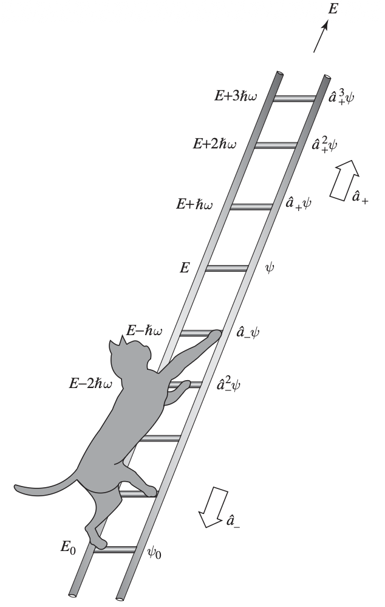
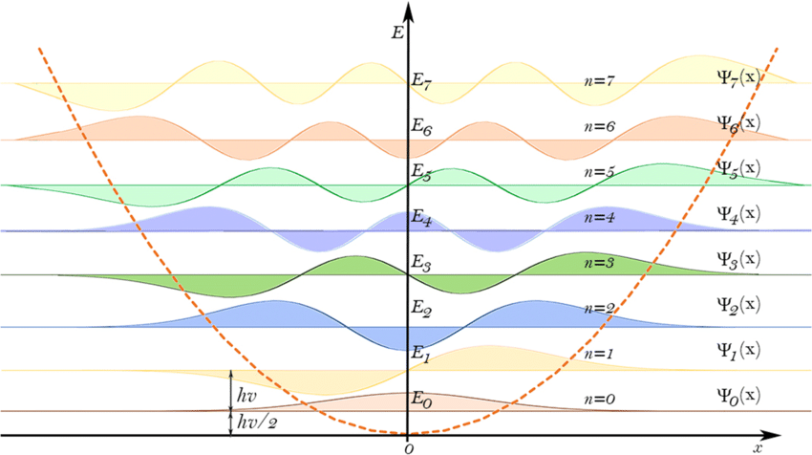
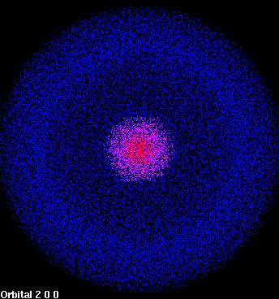
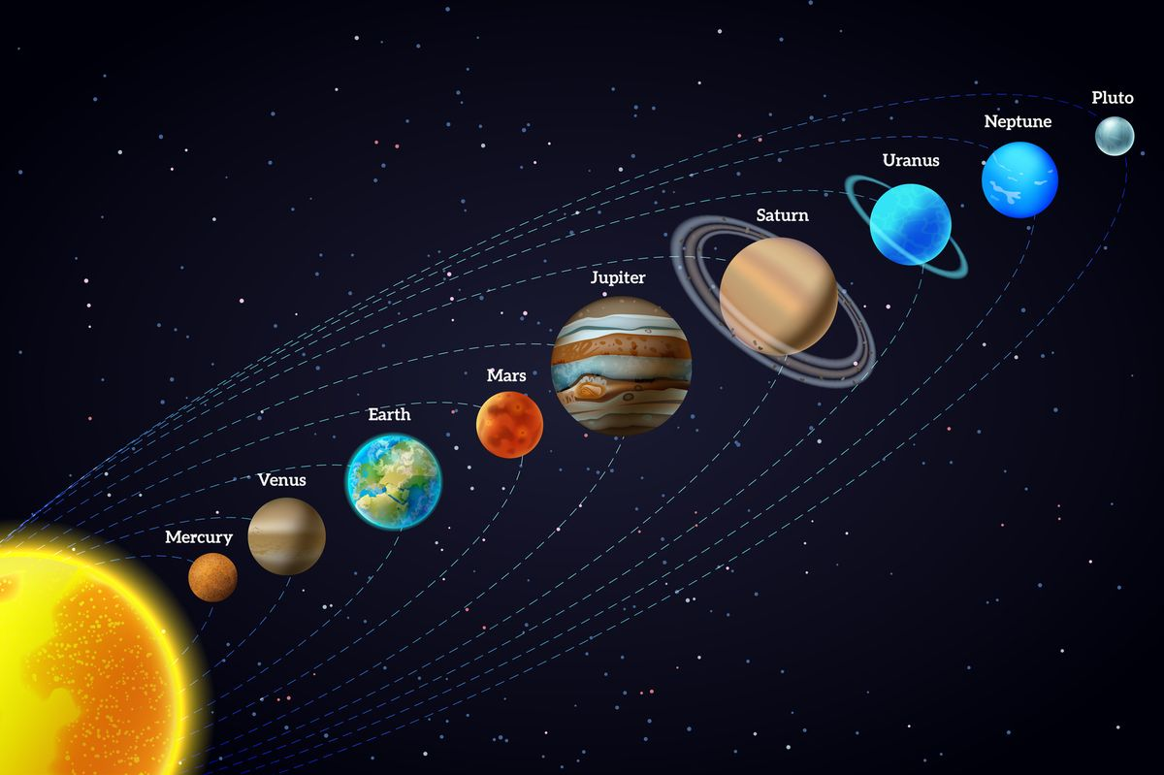
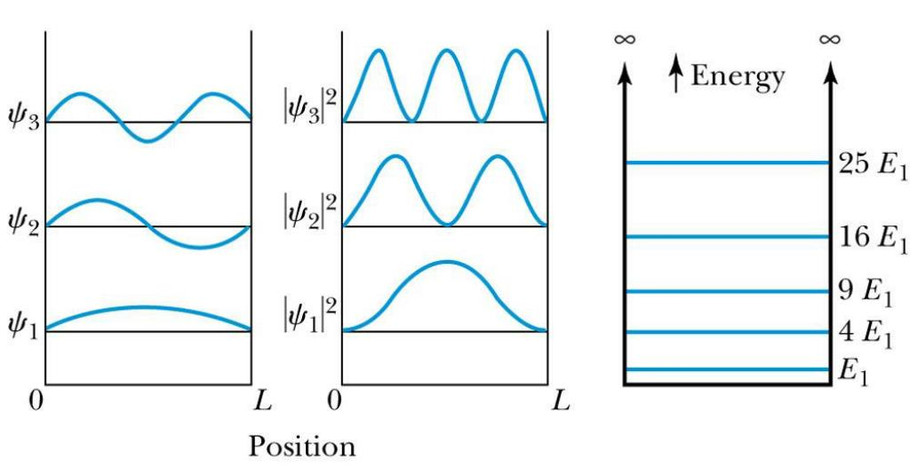
Confined (bound) vs Scattering (unbound) states
`
Confinement is the exact opposite of scattering as previously shown. Some common examples of “Bound” or “Confined” states.
Harmonic oscillator (proportional to x²)
Hydrogen atom (in pic) In fact any atomic/ molecular system
Solar system (most famous “bound” system)
Infinite square well potential (Rudimentary model for quantum dots)
Machine Learning Professional Project Presentation
Nanoelectronics - Seminar Presentation Ronit Dutta
Machine Learning Professional Project Presentation
Machine Learning Professional Project Presentation
Nanoelectronics - Seminar Presentation Ronit Dutta
Machine Learning Professional Project Presentation
Machine Learning Professional Project Presentation
Nanoelectronics - Seminar Presentation Ronit Dutta
Machine Learning Professional Project Presentation
Machine Learning Professional Project Presentation
Nanoelectronics - Seminar Presentation Ronit Dutta
Machine Learning Professional Project Presentation
Machine Learning Professional Project Presentation
Nanoelectronics - Seminar Presentation Ronit Dutta
Term Paper Presentation | Ronit Dutta
Term Paper Presentation | Ronit Dutta
Machine Learning Professional Project Presentation
Machine Learning Professional Project Presentation
Term Paper Presentation | Ronit Dutta
Term Paper Presentation | Ronit Dutta
Machine Learning Professional Project Presentation
Machine Learning Professional Project Presentation
Term Paper Presentation | Ronit Dutta
Term Paper Presentation | Ronit Dutta
Machine Learning Professional Project Presentation
Machine Learning Professional Project Presentation
Term Paper Presentation | Ronit Dutta
Term Paper Presentation | Ronit Dutta
Machine Learning Professional Project Presentation
Machine Learning Professional Project Presentation
Term Paper Presentation | Ronit Dutta
Term Paper Presentation | Ronit Dutta
Machine Learning Professional Project Presentation
Machine Learning Professional Project Presentation
Applied Mathematics for Engineering [MIDTERM PROJECT] Ronit Dutta
Applied Mathematics for Engineering [MIDTERM PROJECT] Ronit Dutta
Applied Mathematics for Engineering [MIDTERM PROJECT] Ronit Dutta
Applied Mathematics for Engineering [MIDTERM PROJECT] Ronit Dutta

Slide 9
Core difference between bound and unbound states.
Bound state
Scattering state
A bound state arises when the wavefunction is confined within the potential, meaning it remains localized in a finite region of space and decays as we move away from that region.
This happens when the energy eigenvalue lies within the bounds set by the potential, typically below its asymptotic value at infinity. Thus, if V(∞) = 0, E_{max}<0 always.
In this regime, the particle does not have sufficient energy to exist freely outside the potential, so it remains trapped.
As a result, only specific standing-wave configurations are allowed, leading to discrete (quantized) energy levels.
These states are normalizable, meaning the total probability over all space is finite and equal to one.
A scattering state is the opposite regime. Here the potential does not confine the particle globally.
Far from the interaction region, the potential effectively vanishes, and the wavefunction behaves like a free particle (V= 0 regime). Instead of dying out, it instead acts like a freely propagating wave.
Physically, this means the particle comes in with some definite momentum, interacts with the potential over a finite region, and then either reflects or transmits, but it never gets trapped. (E > 0)
These states are not normalizable. (E(k) => continuous spectra ≡ ħ²k²/2m ≡ p²/2m ≡ pure kinetic energy)
Their energies are not restricted by confinement, so they form a continuous spectrum; positive and spread out over all space.
The clean distinction is this: bound states are localized and discrete because the potential traps them; scattering states are extended and continuous because the potential cannot hold them.
Machine Learning Professional Project Presentation
Nanoelectronics - Seminar Presentation Ronit Dutta
Machine Learning Professional Project Presentation
Machine Learning Professional Project Presentation
Nanoelectronics - Seminar Presentation Ronit Dutta
Machine Learning Professional Project Presentation
Machine Learning Professional Project Presentation
Nanoelectronics - Seminar Presentation Ronit Dutta
Machine Learning Professional Project Presentation
Machine Learning Professional Project Presentation
Nanoelectronics - Seminar Presentation Ronit Dutta
Machine Learning Professional Project Presentation
Machine Learning Professional Project Presentation
Nanoelectronics - Seminar Presentation Ronit Dutta
Term Paper Presentation | Ronit Dutta
Term Paper Presentation | Ronit Dutta
Machine Learning Professional Project Presentation
Machine Learning Professional Project Presentation
Term Paper Presentation | Ronit Dutta
Term Paper Presentation | Ronit Dutta
Machine Learning Professional Project Presentation
Machine Learning Professional Project Presentation
Term Paper Presentation | Ronit Dutta
Term Paper Presentation | Ronit Dutta
Machine Learning Professional Project Presentation
Machine Learning Professional Project Presentation
Term Paper Presentation | Ronit Dutta
Term Paper Presentation | Ronit Dutta
Machine Learning Professional Project Presentation
Machine Learning Professional Project Presentation
Term Paper Presentation | Ronit Dutta
Term Paper Presentation | Ronit Dutta
Machine Learning Professional Project Presentation
Machine Learning Professional Project Presentation
Applied Mathematics for Engineering [MIDTERM PROJECT] Ronit Dutta
Applied Mathematics for Engineering [MIDTERM PROJECT] Ronit Dutta
Applied Mathematics for Engineering [MIDTERM PROJECT] Ronit Dutta
Applied Mathematics for Engineering [MIDTERM PROJECT] Ronit Dutta

Slide 10
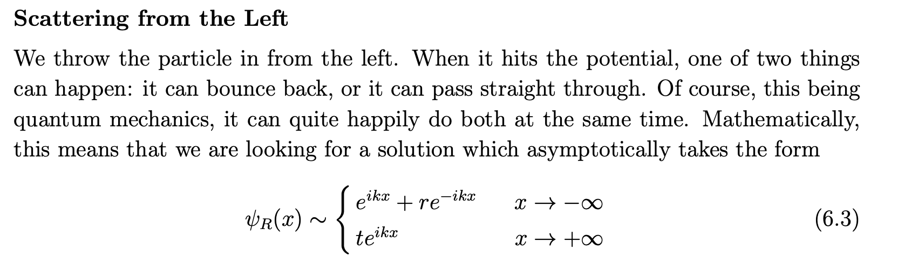
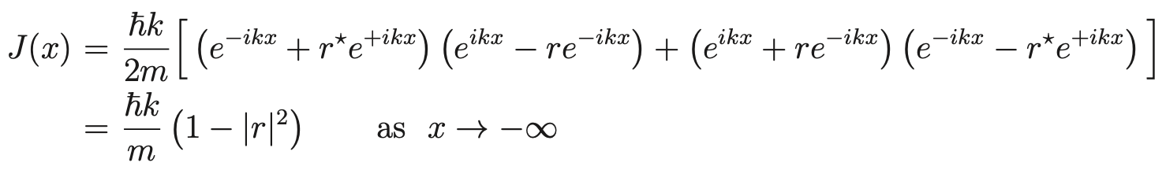

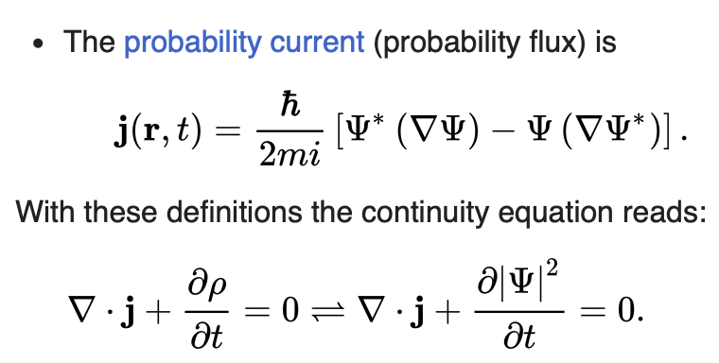
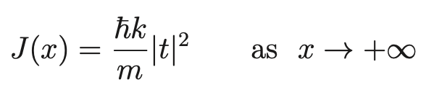
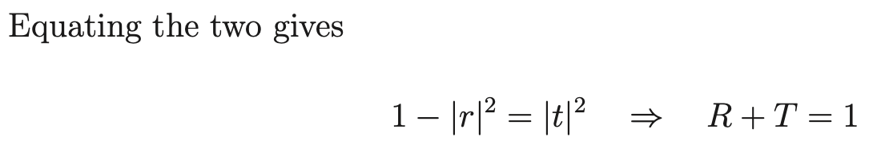
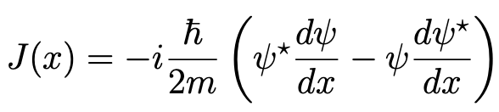

1D Scattering setup
Additionally upon solving the left and right scattering problem respectively and forcing the probability current constraint one shall get:
Using this probability current as a conserved quantity we get
Machine Learning Professional Project Presentation
Nanoelectronics - Seminar Presentation Ronit Dutta
Machine Learning Professional Project Presentation
Machine Learning Professional Project Presentation
Nanoelectronics - Seminar Presentation Ronit Dutta
Machine Learning Professional Project Presentation
Machine Learning Professional Project Presentation
Nanoelectronics - Seminar Presentation Ronit Dutta
Machine Learning Professional Project Presentation
Machine Learning Professional Project Presentation
Nanoelectronics - Seminar Presentation Ronit Dutta
Machine Learning Professional Project Presentation
Machine Learning Professional Project Presentation
Nanoelectronics - Seminar Presentation Ronit Dutta
Term Paper Presentation | Ronit Dutta
Term Paper Presentation | Ronit Dutta
Machine Learning Professional Project Presentation
Machine Learning Professional Project Presentation
Term Paper Presentation | Ronit Dutta
Term Paper Presentation | Ronit Dutta
Machine Learning Professional Project Presentation
Machine Learning Professional Project Presentation
Term Paper Presentation | Ronit Dutta
Term Paper Presentation | Ronit Dutta
Machine Learning Professional Project Presentation
Machine Learning Professional Project Presentation
Term Paper Presentation | Ronit Dutta
Term Paper Presentation | Ronit Dutta
Machine Learning Professional Project Presentation
Machine Learning Professional Project Presentation
Term Paper Presentation | Ronit Dutta
Term Paper Presentation | Ronit Dutta
Machine Learning Professional Project Presentation
Machine Learning Professional Project Presentation
Applied Mathematics for Engineering [MIDTERM PROJECT] Ronit Dutta
Applied Mathematics for Engineering [MIDTERM PROJECT] Ronit Dutta
Applied Mathematics for Engineering [MIDTERM PROJECT] Ronit Dutta
Applied Mathematics for Engineering [MIDTERM PROJECT] Ronit Dutta

Slide 11
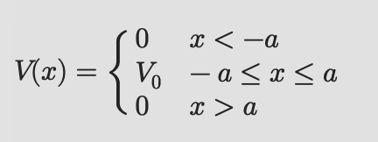
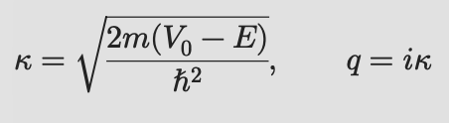
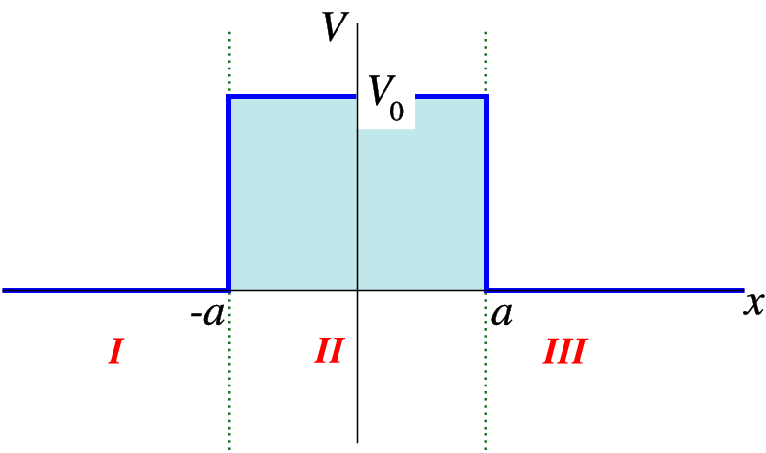
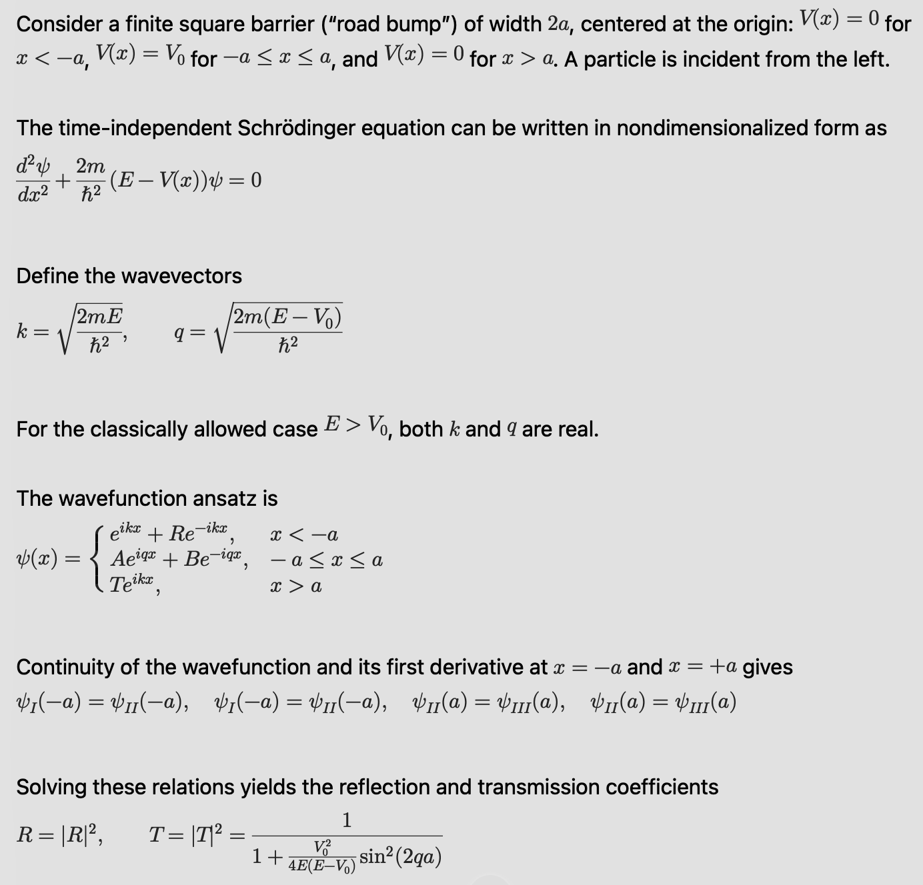
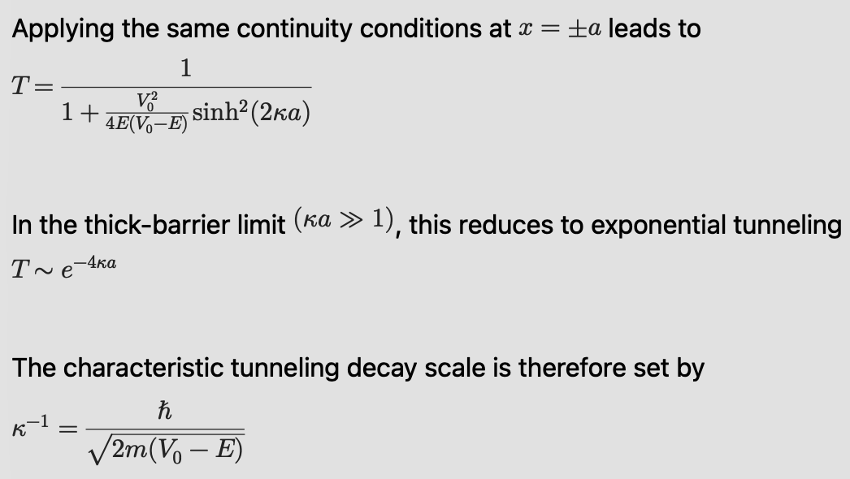
Common 1D scattering :- “Roadbump” potential
In classically allowed regime (E < V₀):
‘q’ is real, as a result [-a,a] is a standing wave solution.
In classically “forbidden” regime (E < V₀):
‘q’ is imaginary => [-a,a] is an exponentially decaying function.
This phenomenon is called “quantum tunneling”, because of which the wavefunction might survive only if barrier width is small enough.
Machine Learning Professional Project Presentation
Nanoelectronics - Seminar Presentation Ronit Dutta
Machine Learning Professional Project Presentation
Machine Learning Professional Project Presentation
Nanoelectronics - Seminar Presentation Ronit Dutta
Machine Learning Professional Project Presentation
Machine Learning Professional Project Presentation
Nanoelectronics - Seminar Presentation Ronit Dutta
Machine Learning Professional Project Presentation
Machine Learning Professional Project Presentation
Nanoelectronics - Seminar Presentation Ronit Dutta
Machine Learning Professional Project Presentation
Machine Learning Professional Project Presentation
Nanoelectronics - Seminar Presentation Ronit Dutta
Term Paper Presentation | Ronit Dutta
Term Paper Presentation | Ronit Dutta
Machine Learning Professional Project Presentation
Machine Learning Professional Project Presentation
Term Paper Presentation | Ronit Dutta
Term Paper Presentation | Ronit Dutta
Machine Learning Professional Project Presentation
Machine Learning Professional Project Presentation
Term Paper Presentation | Ronit Dutta
Term Paper Presentation | Ronit Dutta
Machine Learning Professional Project Presentation
Machine Learning Professional Project Presentation
Term Paper Presentation | Ronit Dutta
Term Paper Presentation | Ronit Dutta
Machine Learning Professional Project Presentation
Machine Learning Professional Project Presentation
Term Paper Presentation | Ronit Dutta
Term Paper Presentation | Ronit Dutta
Machine Learning Professional Project Presentation
Machine Learning Professional Project Presentation
Applied Mathematics for Engineering [MIDTERM PROJECT] Ronit Dutta
Applied Mathematics for Engineering [MIDTERM PROJECT] Ronit Dutta
Applied Mathematics for Engineering [MIDTERM PROJECT] Ronit Dutta
Applied Mathematics for Engineering [MIDTERM PROJECT] Ronit Dutta

Slide 12
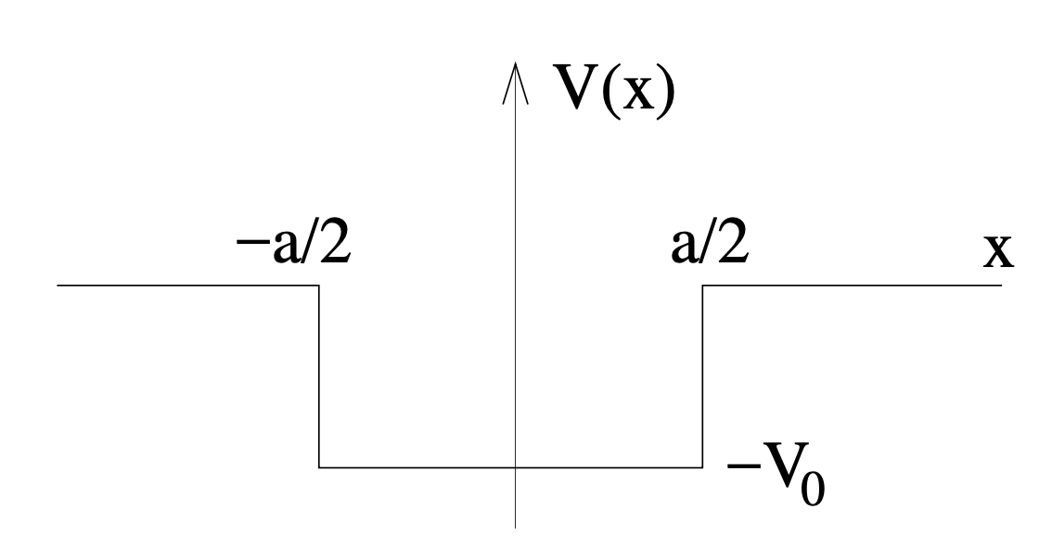
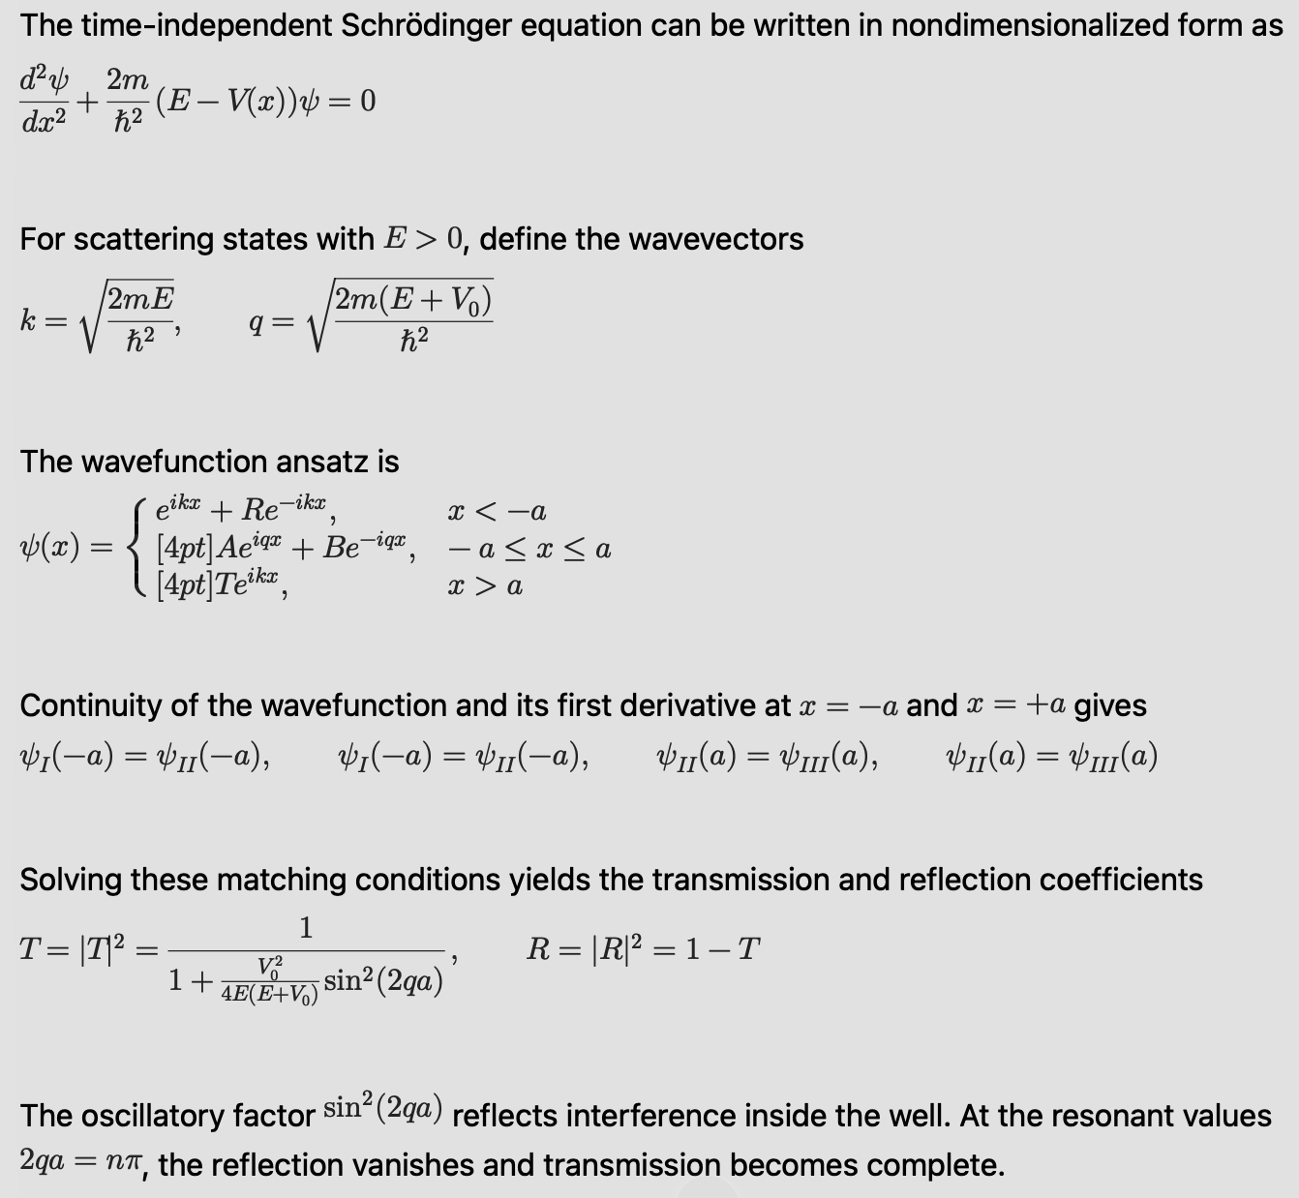
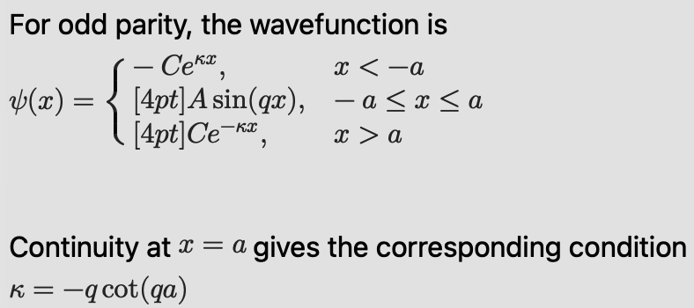
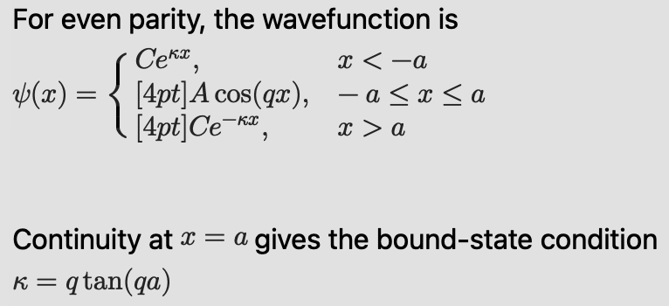
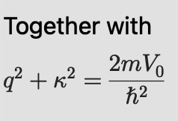
Common 1D scattering :- “Pothole” potential
The nature of solutions for this system would be very similar to that of the previous system. However, in this case both bound and scattering states exist.
Wavefunctions with E>0 would be scattering because V(∞)= 0 and E>V(∞). However the “standing wave” nature for scattered states remains the same.
For E<0, confinement occurs and because of the symmetric nature of the potential two types of solutions Even and Odd parity solutions arise.
In the potential boundary the wavefunction simply tunnels inside (because E<0)
These transcendental equations determine the allowed bound-state energies.
The even-parity equation always admits at least one solution, so a finite attractive well always supports at least one bound state, while additional even and odd states appear as the well becomes deeper or wider.
Machine Learning Professional Project Presentation
Nanoelectronics - Seminar Presentation Ronit Dutta
Machine Learning Professional Project Presentation
Machine Learning Professional Project Presentation
Nanoelectronics - Seminar Presentation Ronit Dutta
Machine Learning Professional Project Presentation
Machine Learning Professional Project Presentation
Nanoelectronics - Seminar Presentation Ronit Dutta
Machine Learning Professional Project Presentation
Machine Learning Professional Project Presentation
Nanoelectronics - Seminar Presentation Ronit Dutta
Machine Learning Professional Project Presentation
Machine Learning Professional Project Presentation
Nanoelectronics - Seminar Presentation Ronit Dutta
Term Paper Presentation | Ronit Dutta
Term Paper Presentation | Ronit Dutta
Machine Learning Professional Project Presentation
Machine Learning Professional Project Presentation
Term Paper Presentation | Ronit Dutta
Term Paper Presentation | Ronit Dutta
Machine Learning Professional Project Presentation
Machine Learning Professional Project Presentation
Term Paper Presentation | Ronit Dutta
Term Paper Presentation | Ronit Dutta
Machine Learning Professional Project Presentation
Machine Learning Professional Project Presentation
Term Paper Presentation | Ronit Dutta
Term Paper Presentation | Ronit Dutta
Machine Learning Professional Project Presentation
Machine Learning Professional Project Presentation
Term Paper Presentation | Ronit Dutta
Term Paper Presentation | Ronit Dutta
Machine Learning Professional Project Presentation
Machine Learning Professional Project Presentation
Applied Mathematics for Engineering [MIDTERM PROJECT] Ronit Dutta
Applied Mathematics for Engineering [MIDTERM PROJECT] Ronit Dutta
Applied Mathematics for Engineering [MIDTERM PROJECT] Ronit Dutta
Applied Mathematics for Engineering [MIDTERM PROJECT] Ronit Dutta

Slide 13
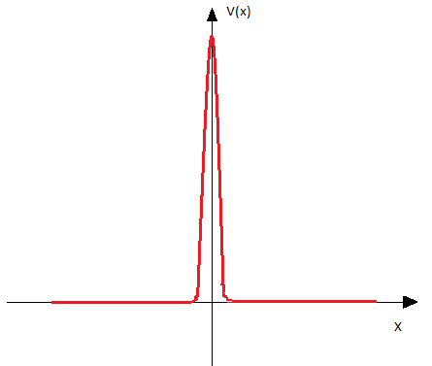
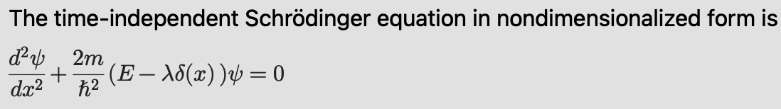
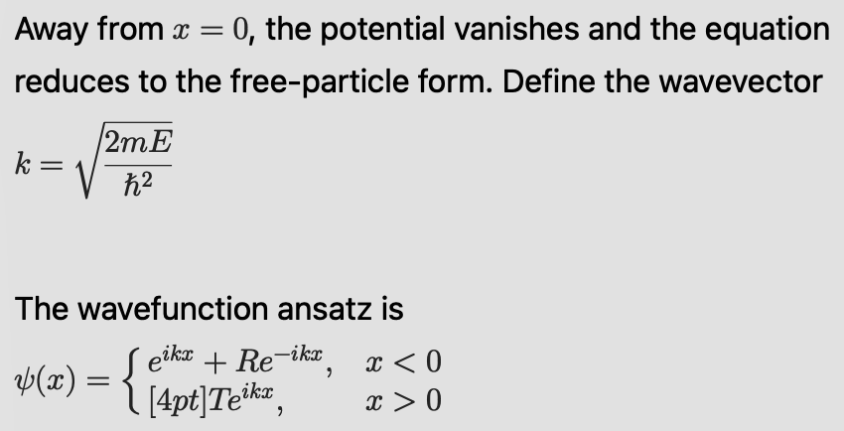
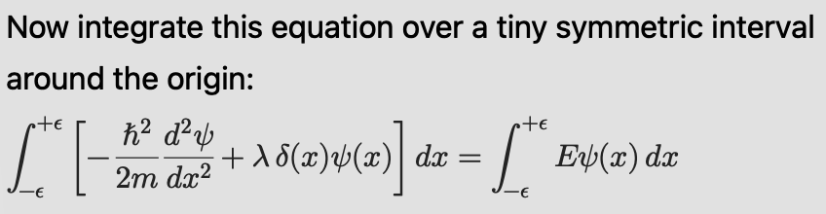
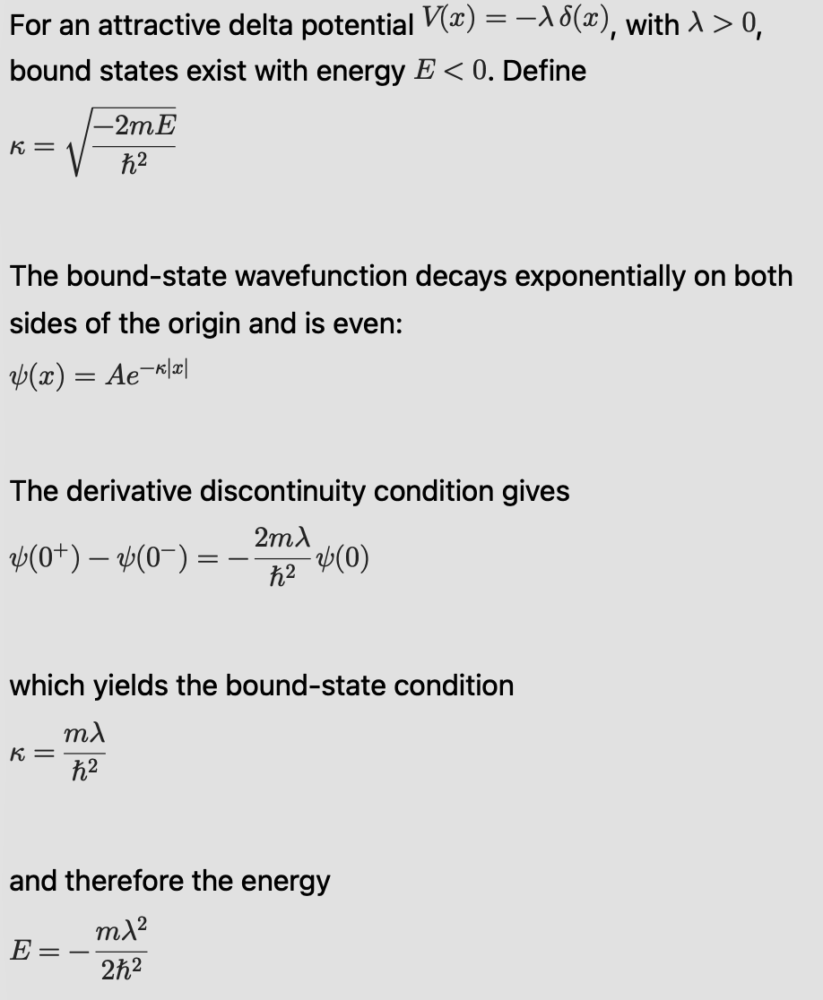
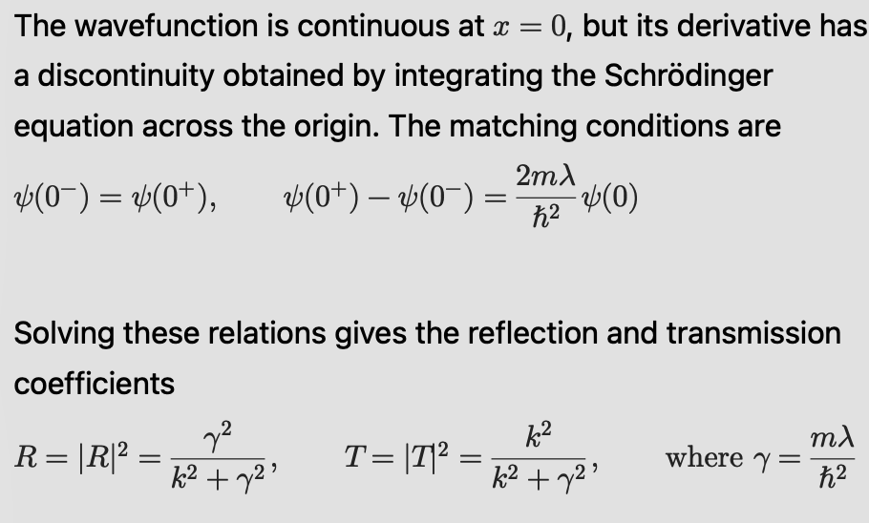
Common 1D scattering :- δ-function barrier
The bound-state wavefunction decays exponentially on both sides of the origin and is even:
Therefore only single energy eigenstate exists with energy:
Machine Learning Professional Project Presentation
Nanoelectronics - Seminar Presentation Ronit Dutta
Machine Learning Professional Project Presentation
Machine Learning Professional Project Presentation
Nanoelectronics - Seminar Presentation Ronit Dutta
Machine Learning Professional Project Presentation
Machine Learning Professional Project Presentation
Nanoelectronics - Seminar Presentation Ronit Dutta
Machine Learning Professional Project Presentation
Machine Learning Professional Project Presentation
Nanoelectronics - Seminar Presentation Ronit Dutta
Machine Learning Professional Project Presentation
Machine Learning Professional Project Presentation
Nanoelectronics - Seminar Presentation Ronit Dutta
Term Paper Presentation | Ronit Dutta
Term Paper Presentation | Ronit Dutta
Machine Learning Professional Project Presentation
Machine Learning Professional Project Presentation
Term Paper Presentation | Ronit Dutta
Term Paper Presentation | Ronit Dutta
Machine Learning Professional Project Presentation
Machine Learning Professional Project Presentation
Term Paper Presentation | Ronit Dutta
Term Paper Presentation | Ronit Dutta
Machine Learning Professional Project Presentation
Machine Learning Professional Project Presentation
Term Paper Presentation | Ronit Dutta
Term Paper Presentation | Ronit Dutta
Machine Learning Professional Project Presentation
Machine Learning Professional Project Presentation
Term Paper Presentation | Ronit Dutta
Term Paper Presentation | Ronit Dutta
Machine Learning Professional Project Presentation
Machine Learning Professional Project Presentation
Applied Mathematics for Engineering [MIDTERM PROJECT] Ronit Dutta
Applied Mathematics for Engineering [MIDTERM PROJECT] Ronit Dutta
Applied Mathematics for Engineering [MIDTERM PROJECT] Ronit Dutta
Applied Mathematics for Engineering [MIDTERM PROJECT] Ronit Dutta

Slide 14
OUTLINE
Introduction
Schrodinger equation as energy conservation and eigenvalue equation
Fourier conjugates & uncertainty principle
Confined vs scattering states
Common 1D scattering
S-matrix and its properties
1D solutions using S matrix
Resonances
3D potentials and cross section formula
Partial waves & Phase shifts
Hard sphere solution
Bound states & scattering length
Machine Learning Professional Project Presentation
Machine Learning Professional Project Presentation
Nanoelectronics - Seminar Presentation Ronit Dutta
Machine Learning Professional Project Presentation
Machine Learning Professional Project Presentation
Nanoelectronics - Seminar Presentation Ronit Dutta
Machine Learning Professional Project Presentation
Machine Learning Professional Project Presentation
Nanoelectronics - Seminar Presentation Ronit Dutta
Machine Learning Professional Project Presentation
Machine Learning Professional Project Presentation
Nanoelectronics - Seminar Presentation Ronit Dutta
Machine Learning Professional Project Presentation
Machine Learning Professional Project Presentation
Nanoelectronics - Seminar Presentation Ronit Dutta
Machine Learning Professional Project Presentation
Machine Learning Professional Project Presentation
Nanoelectronics - Seminar Presentation Ronit Dutta
Machine Learning Professional Project Presentation
Machine Learning Professional Project Presentation
Nanoelectronics - Seminar Presentation Ronit Dutta
Term Paper Presentation | Ronit Dutta
Term Paper Presentation | Ronit Dutta
Machine Learning Professional Project Presentation
Machine Learning Professional Project Presentation
Term Paper Presentation | Ronit Dutta
Term Paper Presentation | Ronit Dutta
Machine Learning Professional Project Presentation
Machine Learning Professional Project Presentation
Term Paper Presentation | Ronit Dutta
Term Paper Presentation | Ronit Dutta
Machine Learning Professional Project Presentation
Machine Learning Professional Project Presentation
Term Paper Presentation | Ronit Dutta
Term Paper Presentation | Ronit Dutta
Machine Learning Professional Project Presentation
Machine Learning Professional Project Presentation
Term Paper Presentation | Ronit Dutta
Term Paper Presentation | Ronit Dutta
Machine Learning Professional Project Presentation
Machine Learning Professional Project Presentation
Term Paper Presentation | Ronit Dutta
Term Paper Presentation | Ronit Dutta
Machine Learning Professional Project Presentation
Machine Learning Professional Project Presentation
Term Paper Presentation | Ronit Dutta
Term Paper Presentation | Ronit Dutta
Machine Learning Professional Project Presentation
Machine Learning Professional Project Presentation
Applied Mathematics for Engineering [MIDTERM PROJECT] Ronit Dutta
Applied Mathematics for Engineering [MIDTERM PROJECT] Ronit Dutta
Applied Mathematics for Engineering [MIDTERM PROJECT] Ronit Dutta
Applied Mathematics for Engineering [MIDTERM PROJECT] Ronit Dutta
Applied Mathematics for Engineering [MIDTERM PROJECT] Ronit Dutta
Applied Mathematics for Engineering [MIDTERM PROJECT] Ronit Dutta

Slide 15
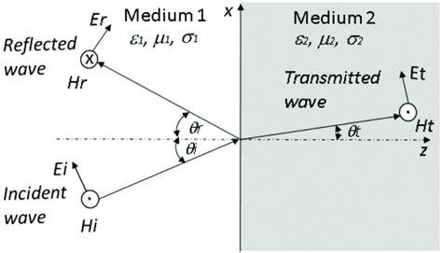
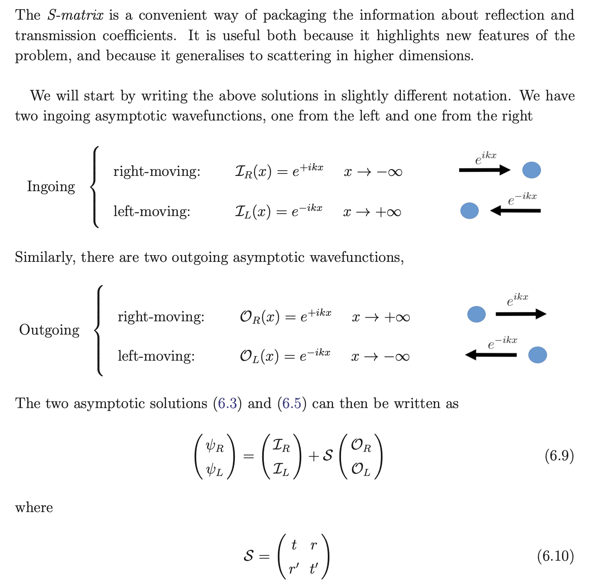
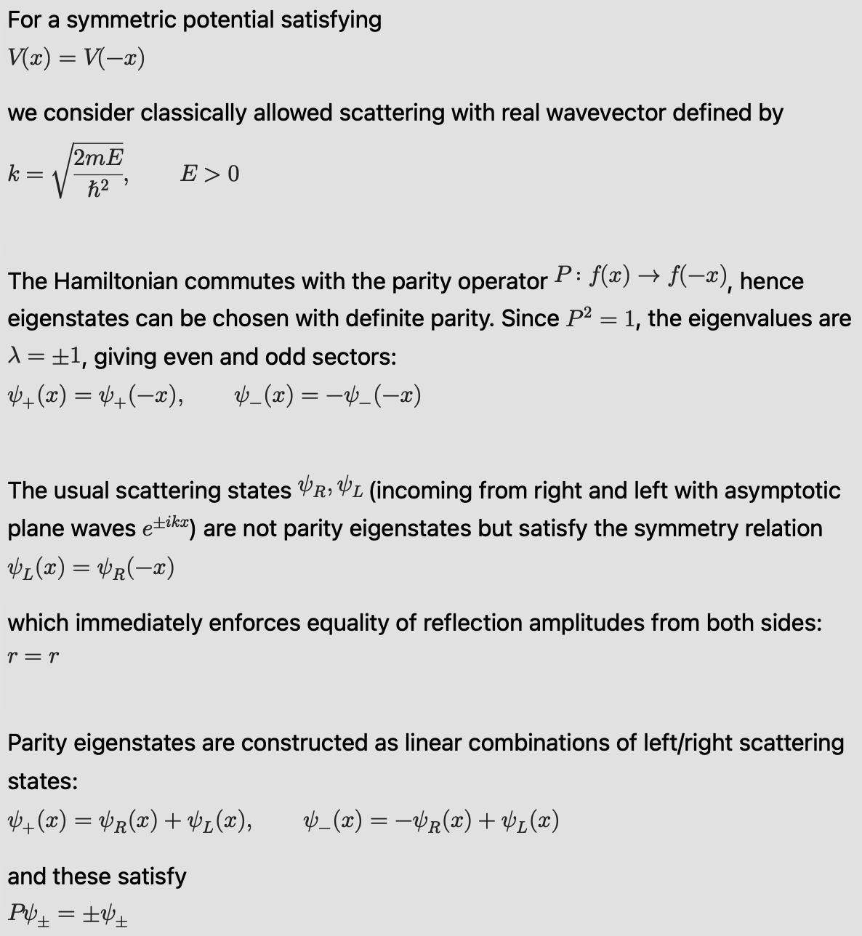
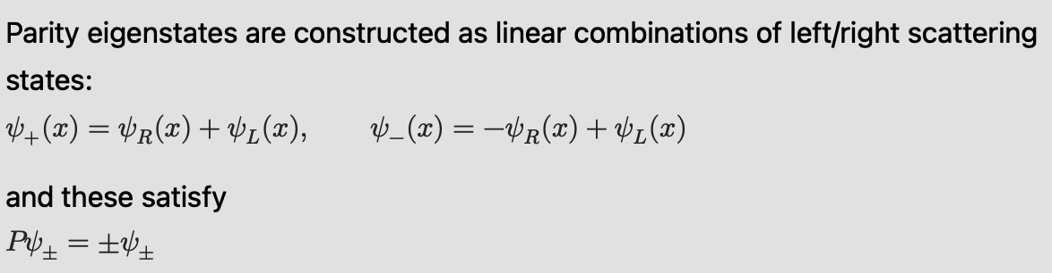
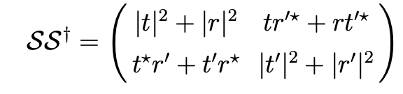
S-matrix and its properties : unitarity & parity basis
For symmetric potential i.e V(x) = V(-x)
Property of Unitarity :
The off-diagonal elements vanish by virtue of the relations t′= t and r′ =−r*t/t* (from probability current proof).
Meanwhile, the diagonal elements are equal to 1 (again conservation of probability current).
The eigenstates in the parity basis
which obey
Machine Learning Professional Project Presentation
Nanoelectronics - Seminar Presentation Ronit Dutta
Machine Learning Professional Project Presentation
Machine Learning Professional Project Presentation
Nanoelectronics - Seminar Presentation Ronit Dutta
Machine Learning Professional Project Presentation
Machine Learning Professional Project Presentation
Nanoelectronics - Seminar Presentation Ronit Dutta
Machine Learning Professional Project Presentation
Machine Learning Professional Project Presentation
Nanoelectronics - Seminar Presentation Ronit Dutta
Machine Learning Professional Project Presentation
Machine Learning Professional Project Presentation
Nanoelectronics - Seminar Presentation Ronit Dutta
Term Paper Presentation | Ronit Dutta
Term Paper Presentation | Ronit Dutta
Machine Learning Professional Project Presentation
Machine Learning Professional Project Presentation
Term Paper Presentation | Ronit Dutta
Term Paper Presentation | Ronit Dutta
Machine Learning Professional Project Presentation
Machine Learning Professional Project Presentation
Term Paper Presentation | Ronit Dutta
Term Paper Presentation | Ronit Dutta
Machine Learning Professional Project Presentation
Machine Learning Professional Project Presentation
Term Paper Presentation | Ronit Dutta
Term Paper Presentation | Ronit Dutta
Machine Learning Professional Project Presentation
Machine Learning Professional Project Presentation
Term Paper Presentation | Ronit Dutta
Term Paper Presentation | Ronit Dutta
Machine Learning Professional Project Presentation
Machine Learning Professional Project Presentation
Applied Mathematics for Engineering [MIDTERM PROJECT] Ronit Dutta
Applied Mathematics for Engineering [MIDTERM PROJECT] Ronit Dutta
Applied Mathematics for Engineering [MIDTERM PROJECT] Ronit Dutta
Applied Mathematics for Engineering [MIDTERM PROJECT] Ronit Dutta

Slide 16
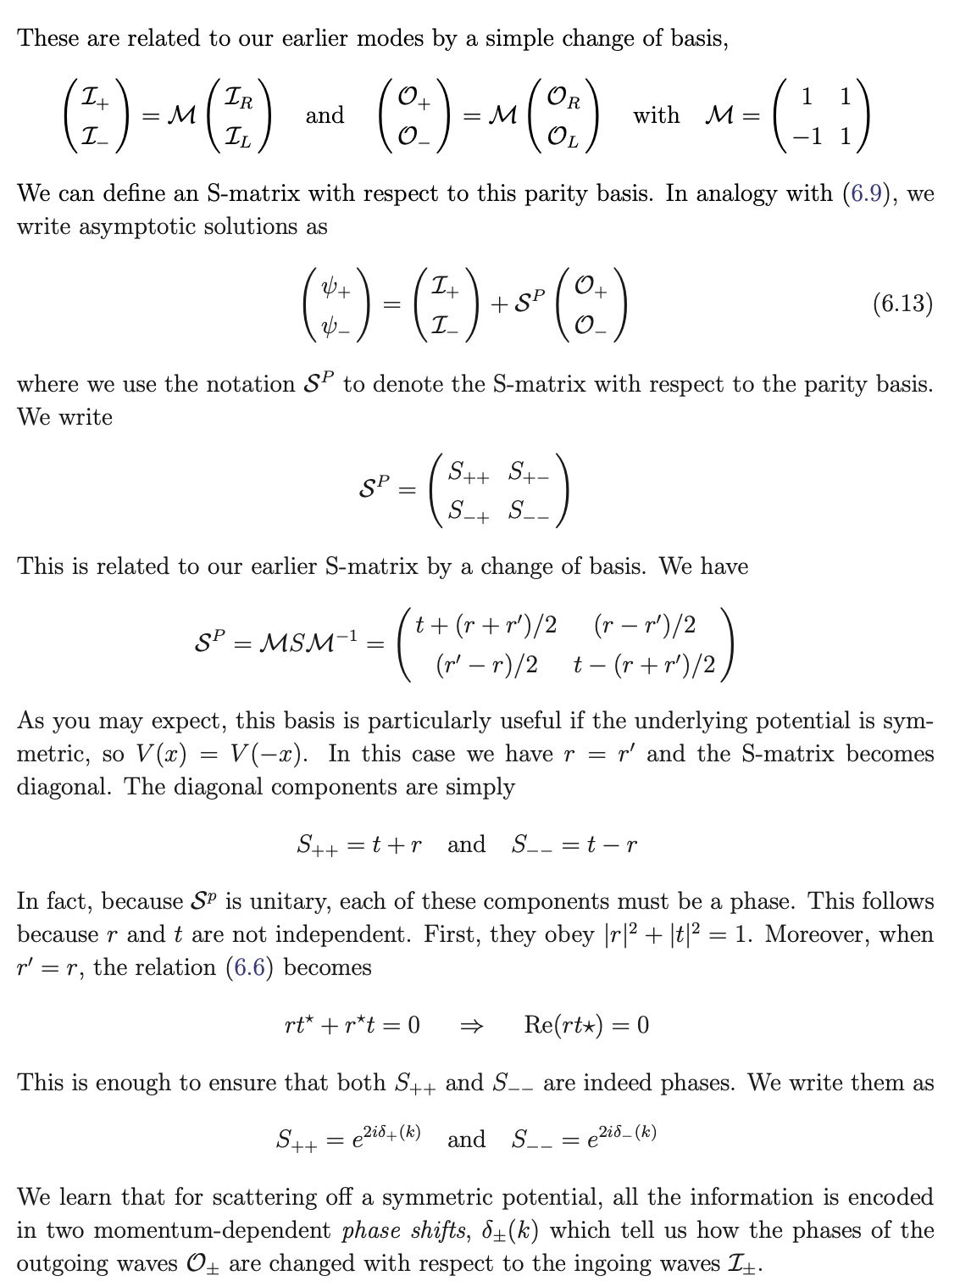
Parity Basis (diagonal trick) & phase shift
Machine Learning Professional Project Presentation
Nanoelectronics - Seminar Presentation Ronit Dutta
Machine Learning Professional Project Presentation
Machine Learning Professional Project Presentation
Nanoelectronics - Seminar Presentation Ronit Dutta
Machine Learning Professional Project Presentation
Machine Learning Professional Project Presentation
Nanoelectronics - Seminar Presentation Ronit Dutta
Machine Learning Professional Project Presentation
Machine Learning Professional Project Presentation
Nanoelectronics - Seminar Presentation Ronit Dutta
Machine Learning Professional Project Presentation
Machine Learning Professional Project Presentation
Nanoelectronics - Seminar Presentation Ronit Dutta
Term Paper Presentation | Ronit Dutta
Term Paper Presentation | Ronit Dutta
Machine Learning Professional Project Presentation
Machine Learning Professional Project Presentation
Term Paper Presentation | Ronit Dutta
Term Paper Presentation | Ronit Dutta
Machine Learning Professional Project Presentation
Machine Learning Professional Project Presentation
Term Paper Presentation | Ronit Dutta
Term Paper Presentation | Ronit Dutta
Machine Learning Professional Project Presentation
Machine Learning Professional Project Presentation
Term Paper Presentation | Ronit Dutta
Term Paper Presentation | Ronit Dutta
Machine Learning Professional Project Presentation
Machine Learning Professional Project Presentation
Term Paper Presentation | Ronit Dutta
Term Paper Presentation | Ronit Dutta
Machine Learning Professional Project Presentation
Machine Learning Professional Project Presentation
Applied Mathematics for Engineering [MIDTERM PROJECT] Ronit Dutta
Applied Mathematics for Engineering [MIDTERM PROJECT] Ronit Dutta
Applied Mathematics for Engineering [MIDTERM PROJECT] Ronit Dutta
Applied Mathematics for Engineering [MIDTERM PROJECT] Ronit Dutta

Slide 17
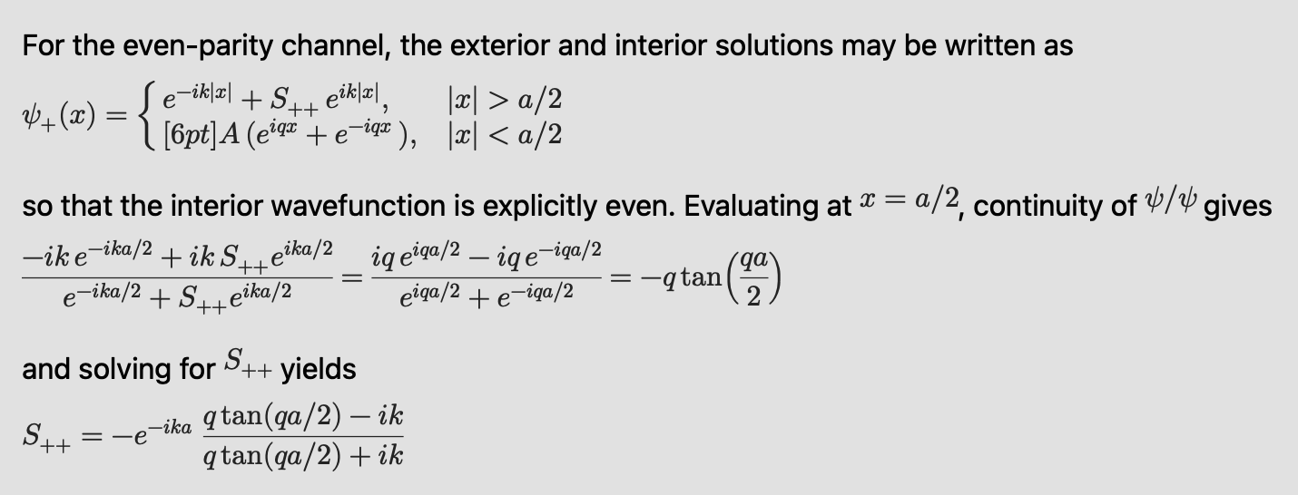
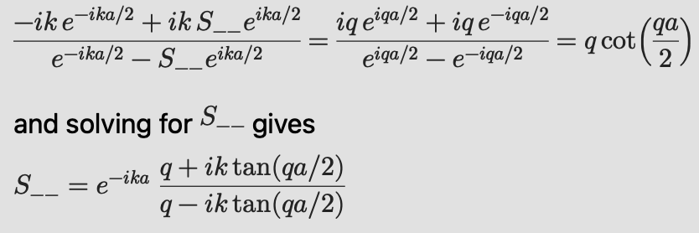
1D solution using s matrix : pothole revisited
so that the interior wavefunction is explicitly even. Evaluating at x=a/2, continuity of Ψ'/Ψ (Robin type boundary condition), gives
Method of solving :
We start with the ‘roadbump’ potential and assume standing waves inside the interaction region (classically allowed regime aka NO tunneling).
We solve using the S-matrix formalism at x= a/2 boundary for first diagonal (even states) and then second diagonal (odd states).
Similarly for odd parity states, robin boundary condition at x = a/2 gives
Now let us observe both observe the complex poles of S++ and S–.
For bound states, k = iλ, subsequently this produces the transcendental equations like before.
But this time we solved it using S-matrix formulation!
Machine Learning Professional Project Presentation
Nanoelectronics - Seminar Presentation Ronit Dutta
Machine Learning Professional Project Presentation
Machine Learning Professional Project Presentation
Nanoelectronics - Seminar Presentation Ronit Dutta
Machine Learning Professional Project Presentation
Machine Learning Professional Project Presentation
Nanoelectronics - Seminar Presentation Ronit Dutta
Machine Learning Professional Project Presentation
Machine Learning Professional Project Presentation
Nanoelectronics - Seminar Presentation Ronit Dutta
Machine Learning Professional Project Presentation
Machine Learning Professional Project Presentation
Nanoelectronics - Seminar Presentation Ronit Dutta
Term Paper Presentation | Ronit Dutta
Term Paper Presentation | Ronit Dutta
Machine Learning Professional Project Presentation
Machine Learning Professional Project Presentation
Term Paper Presentation | Ronit Dutta
Term Paper Presentation | Ronit Dutta
Machine Learning Professional Project Presentation
Machine Learning Professional Project Presentation
Term Paper Presentation | Ronit Dutta
Term Paper Presentation | Ronit Dutta
Machine Learning Professional Project Presentation
Machine Learning Professional Project Presentation
Term Paper Presentation | Ronit Dutta
Term Paper Presentation | Ronit Dutta
Machine Learning Professional Project Presentation
Machine Learning Professional Project Presentation
Term Paper Presentation | Ronit Dutta
Term Paper Presentation | Ronit Dutta
Machine Learning Professional Project Presentation
Machine Learning Professional Project Presentation
Applied Mathematics for Engineering [MIDTERM PROJECT] Ronit Dutta
Applied Mathematics for Engineering [MIDTERM PROJECT] Ronit Dutta
Applied Mathematics for Engineering [MIDTERM PROJECT] Ronit Dutta
Applied Mathematics for Engineering [MIDTERM PROJECT] Ronit Dutta

Slide 18
OUTLINE
Introduction
Schrodinger equation as energy conservation and eigenvalue equation
Fourier conjugates & uncertainty principle
Confined vs scattering states
Common 1D scattering
S-matrix and its properties
1D solutions using S matrix
Resonances
3D potentials and cross section formula
Partial waves & Phase shifts
Hard sphere solution
Bound states & scattering length
Machine Learning Professional Project Presentation
Machine Learning Professional Project Presentation
Nanoelectronics - Seminar Presentation Ronit Dutta
Machine Learning Professional Project Presentation
Machine Learning Professional Project Presentation
Nanoelectronics - Seminar Presentation Ronit Dutta
Machine Learning Professional Project Presentation
Machine Learning Professional Project Presentation
Nanoelectronics - Seminar Presentation Ronit Dutta
Machine Learning Professional Project Presentation
Machine Learning Professional Project Presentation
Nanoelectronics - Seminar Presentation Ronit Dutta
Machine Learning Professional Project Presentation
Machine Learning Professional Project Presentation
Nanoelectronics - Seminar Presentation Ronit Dutta
Machine Learning Professional Project Presentation
Machine Learning Professional Project Presentation
Nanoelectronics - Seminar Presentation Ronit Dutta
Machine Learning Professional Project Presentation
Machine Learning Professional Project Presentation
Nanoelectronics - Seminar Presentation Ronit Dutta
Term Paper Presentation | Ronit Dutta
Term Paper Presentation | Ronit Dutta
Machine Learning Professional Project Presentation
Machine Learning Professional Project Presentation
Term Paper Presentation | Ronit Dutta
Term Paper Presentation | Ronit Dutta
Machine Learning Professional Project Presentation
Machine Learning Professional Project Presentation
Term Paper Presentation | Ronit Dutta
Term Paper Presentation | Ronit Dutta
Machine Learning Professional Project Presentation
Machine Learning Professional Project Presentation
Term Paper Presentation | Ronit Dutta
Term Paper Presentation | Ronit Dutta
Machine Learning Professional Project Presentation
Machine Learning Professional Project Presentation
Term Paper Presentation | Ronit Dutta
Term Paper Presentation | Ronit Dutta
Machine Learning Professional Project Presentation
Machine Learning Professional Project Presentation
Term Paper Presentation | Ronit Dutta
Term Paper Presentation | Ronit Dutta
Machine Learning Professional Project Presentation
Machine Learning Professional Project Presentation
Term Paper Presentation | Ronit Dutta
Term Paper Presentation | Ronit Dutta
Machine Learning Professional Project Presentation
Machine Learning Professional Project Presentation
Applied Mathematics for Engineering [MIDTERM PROJECT] Ronit Dutta
Applied Mathematics for Engineering [MIDTERM PROJECT] Ronit Dutta
Applied Mathematics for Engineering [MIDTERM PROJECT] Ronit Dutta
Applied Mathematics for Engineering [MIDTERM PROJECT] Ronit Dutta
Applied Mathematics for Engineering [MIDTERM PROJECT] Ronit Dutta
Applied Mathematics for Engineering [MIDTERM PROJECT] Ronit Dutta

Slide 19
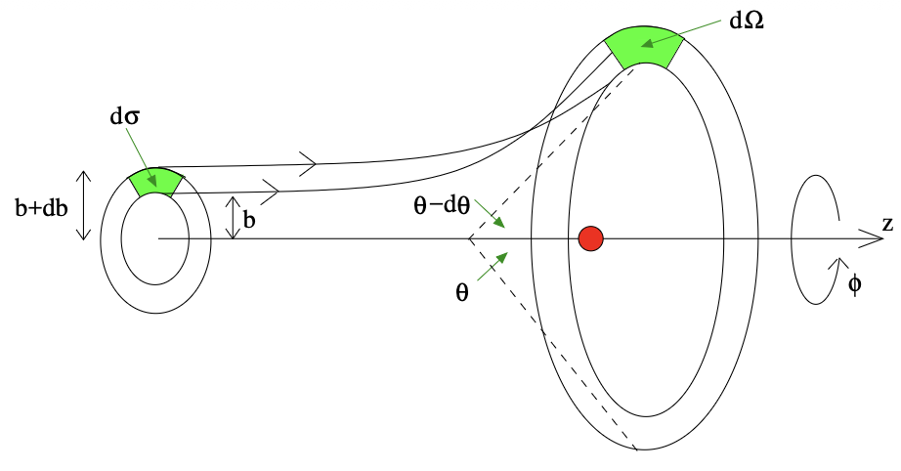
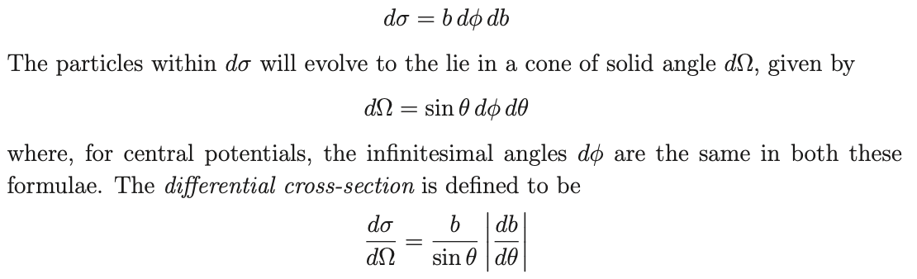
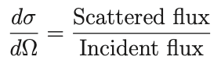



3D potentials and cross section formula : cross section
Cross section
3D wavefunction => plane wave incident, spherical wave scattered
Machine Learning Professional Project Presentation
Nanoelectronics - Seminar Presentation Ronit Dutta
Machine Learning Professional Project Presentation
Machine Learning Professional Project Presentation
Nanoelectronics - Seminar Presentation Ronit Dutta
Machine Learning Professional Project Presentation
Machine Learning Professional Project Presentation
Nanoelectronics - Seminar Presentation Ronit Dutta
Machine Learning Professional Project Presentation
Machine Learning Professional Project Presentation
Nanoelectronics - Seminar Presentation Ronit Dutta
Machine Learning Professional Project Presentation
Machine Learning Professional Project Presentation
Nanoelectronics - Seminar Presentation Ronit Dutta
Term Paper Presentation | Ronit Dutta
Term Paper Presentation | Ronit Dutta
Machine Learning Professional Project Presentation
Machine Learning Professional Project Presentation
Term Paper Presentation | Ronit Dutta
Term Paper Presentation | Ronit Dutta
Machine Learning Professional Project Presentation
Machine Learning Professional Project Presentation
Term Paper Presentation | Ronit Dutta
Term Paper Presentation | Ronit Dutta
Machine Learning Professional Project Presentation
Machine Learning Professional Project Presentation
Term Paper Presentation | Ronit Dutta
Term Paper Presentation | Ronit Dutta
Machine Learning Professional Project Presentation
Machine Learning Professional Project Presentation
Term Paper Presentation | Ronit Dutta
Term Paper Presentation | Ronit Dutta
Machine Learning Professional Project Presentation
Machine Learning Professional Project Presentation
Applied Mathematics for Engineering [MIDTERM PROJECT] Ronit Dutta
Applied Mathematics for Engineering [MIDTERM PROJECT] Ronit Dutta
Applied Mathematics for Engineering [MIDTERM PROJECT] Ronit Dutta
Applied Mathematics for Engineering [MIDTERM PROJECT] Ronit Dutta

Slide 20

Phase shifts
Machine Learning Professional Project Presentation
Nanoelectronics - Seminar Presentation Ronit Dutta
Machine Learning Professional Project Presentation
Machine Learning Professional Project Presentation
Nanoelectronics - Seminar Presentation Ronit Dutta
Machine Learning Professional Project Presentation
Machine Learning Professional Project Presentation
Nanoelectronics - Seminar Presentation Ronit Dutta
Machine Learning Professional Project Presentation
Machine Learning Professional Project Presentation
Nanoelectronics - Seminar Presentation Ronit Dutta
Machine Learning Professional Project Presentation
Machine Learning Professional Project Presentation
Nanoelectronics - Seminar Presentation Ronit Dutta
Term Paper Presentation | Ronit Dutta
Term Paper Presentation | Ronit Dutta
Machine Learning Professional Project Presentation
Machine Learning Professional Project Presentation
Term Paper Presentation | Ronit Dutta
Term Paper Presentation | Ronit Dutta
Machine Learning Professional Project Presentation
Machine Learning Professional Project Presentation
Term Paper Presentation | Ronit Dutta
Term Paper Presentation | Ronit Dutta
Machine Learning Professional Project Presentation
Machine Learning Professional Project Presentation
Term Paper Presentation | Ronit Dutta
Term Paper Presentation | Ronit Dutta
Machine Learning Professional Project Presentation
Machine Learning Professional Project Presentation
Term Paper Presentation | Ronit Dutta
Term Paper Presentation | Ronit Dutta
Machine Learning Professional Project Presentation
Machine Learning Professional Project Presentation
Applied Mathematics for Engineering [MIDTERM PROJECT] Ronit Dutta
Applied Mathematics for Engineering [MIDTERM PROJECT] Ronit Dutta
Applied Mathematics for Engineering [MIDTERM PROJECT] Ronit Dutta
Applied Mathematics for Engineering [MIDTERM PROJECT] Ronit Dutta

Slide 21

Partial waves
Physically each l is an independent scattering channel, the potential modifies only the phase.
No change in amplitude occurs, only a phase shift, so interference between incoming and outgoing waves produces scattering.
Machine Learning Professional Project Presentation
Nanoelectronics - Seminar Presentation Ronit Dutta
Machine Learning Professional Project Presentation
Machine Learning Professional Project Presentation
Nanoelectronics - Seminar Presentation Ronit Dutta
Machine Learning Professional Project Presentation
Machine Learning Professional Project Presentation
Nanoelectronics - Seminar Presentation Ronit Dutta
Machine Learning Professional Project Presentation
Machine Learning Professional Project Presentation
Nanoelectronics - Seminar Presentation Ronit Dutta
Machine Learning Professional Project Presentation
Machine Learning Professional Project Presentation
Nanoelectronics - Seminar Presentation Ronit Dutta
Term Paper Presentation | Ronit Dutta
Term Paper Presentation | Ronit Dutta
Machine Learning Professional Project Presentation
Machine Learning Professional Project Presentation
Term Paper Presentation | Ronit Dutta
Term Paper Presentation | Ronit Dutta
Machine Learning Professional Project Presentation
Machine Learning Professional Project Presentation
Term Paper Presentation | Ronit Dutta
Term Paper Presentation | Ronit Dutta
Machine Learning Professional Project Presentation
Machine Learning Professional Project Presentation
Term Paper Presentation | Ronit Dutta
Term Paper Presentation | Ronit Dutta
Machine Learning Professional Project Presentation
Machine Learning Professional Project Presentation
Term Paper Presentation | Ronit Dutta
Term Paper Presentation | Ronit Dutta
Machine Learning Professional Project Presentation
Machine Learning Professional Project Presentation
Applied Mathematics for Engineering [MIDTERM PROJECT] Ronit Dutta
Applied Mathematics for Engineering [MIDTERM PROJECT] Ronit Dutta
Applied Mathematics for Engineering [MIDTERM PROJECT] Ronit Dutta
Applied Mathematics for Engineering [MIDTERM PROJECT] Ronit Dutta

Slide 22






Recap so far before we solve for specific potentials
Therefore if we modify the f(θ) expansion for the spherical wave:
For the same impact parameter we have orbital angular momentum ‘l’ dependent channel separation and the scattering amplitude f(θ) given by :
We get the general form of our complete wavefunction:
Partial wave was expanded for the initial incident plane wave using z = r*cos(θ) given by :
We now have:
Partial wave expansion of both the incident plane and scattered spherical wave.
We also have the partial wave expansion of ‘l’-dependent channel based scattering amplitude f(θ).
We have impact parameter ‘b’ dependent scattering angle θ formula [db/dθ = (sin(θ)/b) (dσ/d𝛀)].
Hence our scattering mathematical arsenal is complete and we can now solve for specific potentials.
Naturally the hard sphere (V[r<r₀]=∞) becomes the easiest to solve at first and then we can soften this boundary for attractive ( V[r<r₀]< 0 ) & repulsive ( V(r<r₀) > 0 ) potentials!
and using bessel function asymptotics it becomes
Total wavefunction should be :
Machine Learning Professional Project Presentation
Nanoelectronics - Seminar Presentation Ronit Dutta
Machine Learning Professional Project Presentation
Machine Learning Professional Project Presentation
Nanoelectronics - Seminar Presentation Ronit Dutta
Machine Learning Professional Project Presentation
Machine Learning Professional Project Presentation
Nanoelectronics - Seminar Presentation Ronit Dutta
Machine Learning Professional Project Presentation
Machine Learning Professional Project Presentation
Nanoelectronics - Seminar Presentation Ronit Dutta
Machine Learning Professional Project Presentation
Machine Learning Professional Project Presentation
Nanoelectronics - Seminar Presentation Ronit Dutta
Term Paper Presentation | Ronit Dutta
Term Paper Presentation | Ronit Dutta
Machine Learning Professional Project Presentation
Machine Learning Professional Project Presentation
Term Paper Presentation | Ronit Dutta
Term Paper Presentation | Ronit Dutta
Machine Learning Professional Project Presentation
Machine Learning Professional Project Presentation
Term Paper Presentation | Ronit Dutta
Term Paper Presentation | Ronit Dutta
Machine Learning Professional Project Presentation
Machine Learning Professional Project Presentation
Term Paper Presentation | Ronit Dutta
Term Paper Presentation | Ronit Dutta
Machine Learning Professional Project Presentation
Machine Learning Professional Project Presentation
Term Paper Presentation | Ronit Dutta
Term Paper Presentation | Ronit Dutta
Machine Learning Professional Project Presentation
Machine Learning Professional Project Presentation
Applied Mathematics for Engineering [MIDTERM PROJECT] Ronit Dutta
Applied Mathematics for Engineering [MIDTERM PROJECT] Ronit Dutta
Applied Mathematics for Engineering [MIDTERM PROJECT] Ronit Dutta
Applied Mathematics for Engineering [MIDTERM PROJECT] Ronit Dutta

Slide 23


Solution for the hard sphere
Machine Learning Professional Project Presentation
Nanoelectronics - Seminar Presentation Ronit Dutta
Machine Learning Professional Project Presentation
Machine Learning Professional Project Presentation
Nanoelectronics - Seminar Presentation Ronit Dutta
Machine Learning Professional Project Presentation
Machine Learning Professional Project Presentation
Nanoelectronics - Seminar Presentation Ronit Dutta
Machine Learning Professional Project Presentation
Machine Learning Professional Project Presentation
Nanoelectronics - Seminar Presentation Ronit Dutta
Machine Learning Professional Project Presentation
Machine Learning Professional Project Presentation
Nanoelectronics - Seminar Presentation Ronit Dutta
Term Paper Presentation | Ronit Dutta
Term Paper Presentation | Ronit Dutta
Machine Learning Professional Project Presentation
Machine Learning Professional Project Presentation
Term Paper Presentation | Ronit Dutta
Term Paper Presentation | Ronit Dutta
Machine Learning Professional Project Presentation
Machine Learning Professional Project Presentation
Term Paper Presentation | Ronit Dutta
Term Paper Presentation | Ronit Dutta
Machine Learning Professional Project Presentation
Machine Learning Professional Project Presentation
Term Paper Presentation | Ronit Dutta
Term Paper Presentation | Ronit Dutta
Machine Learning Professional Project Presentation
Machine Learning Professional Project Presentation
Term Paper Presentation | Ronit Dutta
Term Paper Presentation | Ronit Dutta
Machine Learning Professional Project Presentation
Machine Learning Professional Project Presentation
Applied Mathematics for Engineering [MIDTERM PROJECT] Ronit Dutta
Applied Mathematics for Engineering [MIDTERM PROJECT] Ronit Dutta
Applied Mathematics for Engineering [MIDTERM PROJECT] Ronit Dutta
Applied Mathematics for Engineering [MIDTERM PROJECT] Ronit Dutta

Slide 24
Solution for the hard sphere
Machine Learning Professional Project Presentation
Nanoelectronics - Seminar Presentation Ronit Dutta
Machine Learning Professional Project Presentation
Machine Learning Professional Project Presentation
Nanoelectronics - Seminar Presentation Ronit Dutta
Machine Learning Professional Project Presentation
Machine Learning Professional Project Presentation
Nanoelectronics - Seminar Presentation Ronit Dutta
Machine Learning Professional Project Presentation
Machine Learning Professional Project Presentation
Nanoelectronics - Seminar Presentation Ronit Dutta
Machine Learning Professional Project Presentation
Machine Learning Professional Project Presentation
Nanoelectronics - Seminar Presentation Ronit Dutta
Term Paper Presentation | Ronit Dutta
Term Paper Presentation | Ronit Dutta
Machine Learning Professional Project Presentation
Machine Learning Professional Project Presentation
Term Paper Presentation | Ronit Dutta
Term Paper Presentation | Ronit Dutta
Machine Learning Professional Project Presentation
Machine Learning Professional Project Presentation
Term Paper Presentation | Ronit Dutta
Term Paper Presentation | Ronit Dutta
Machine Learning Professional Project Presentation
Machine Learning Professional Project Presentation
Term Paper Presentation | Ronit Dutta
Term Paper Presentation | Ronit Dutta
Machine Learning Professional Project Presentation
Machine Learning Professional Project Presentation
Term Paper Presentation | Ronit Dutta
Term Paper Presentation | Ronit Dutta
Machine Learning Professional Project Presentation
Machine Learning Professional Project Presentation
Applied Mathematics for Engineering [MIDTERM PROJECT] Ronit Dutta
Applied Mathematics for Engineering [MIDTERM PROJECT] Ronit Dutta
Applied Mathematics for Engineering [MIDTERM PROJECT] Ronit Dutta
Applied Mathematics for Engineering [MIDTERM PROJECT] Ronit Dutta

Slide 25


Bound states (for attractive potential)
Asteroids coming from outer space asymptotically far from the attractive field of a star/planet attain bound state orbits!
Machine Learning Professional Project Presentation
Nanoelectronics - Seminar Presentation Ronit Dutta
Machine Learning Professional Project Presentation
Machine Learning Professional Project Presentation
Nanoelectronics - Seminar Presentation Ronit Dutta
Machine Learning Professional Project Presentation
Machine Learning Professional Project Presentation
Nanoelectronics - Seminar Presentation Ronit Dutta
Machine Learning Professional Project Presentation
Machine Learning Professional Project Presentation
Nanoelectronics - Seminar Presentation Ronit Dutta
Machine Learning Professional Project Presentation
Machine Learning Professional Project Presentation
Nanoelectronics - Seminar Presentation Ronit Dutta
Term Paper Presentation | Ronit Dutta
Term Paper Presentation | Ronit Dutta
Machine Learning Professional Project Presentation
Machine Learning Professional Project Presentation
Term Paper Presentation | Ronit Dutta
Term Paper Presentation | Ronit Dutta
Machine Learning Professional Project Presentation
Machine Learning Professional Project Presentation
Term Paper Presentation | Ronit Dutta
Term Paper Presentation | Ronit Dutta
Machine Learning Professional Project Presentation
Machine Learning Professional Project Presentation
Term Paper Presentation | Ronit Dutta
Term Paper Presentation | Ronit Dutta
Machine Learning Professional Project Presentation
Machine Learning Professional Project Presentation
Term Paper Presentation | Ronit Dutta
Term Paper Presentation | Ronit Dutta
Machine Learning Professional Project Presentation
Machine Learning Professional Project Presentation
Applied Mathematics for Engineering [MIDTERM PROJECT] Ronit Dutta
Applied Mathematics for Engineering [MIDTERM PROJECT] Ronit Dutta
Applied Mathematics for Engineering [MIDTERM PROJECT] Ronit Dutta
Applied Mathematics for Engineering [MIDTERM PROJECT] Ronit Dutta

Slide 26

Bound states and Scattering states
Repulsion by scattering potential, channel separation due to db/dθ = K(dσ/dΩ).
For same b, ‘l’ dependent channel separation given by f(θ) amplitude partial wave expansion!
KEY :
Bound state solution : Attractive potential
Scattering solution : Repulsive potential.
Machine Learning Professional Project Presentation
Nanoelectronics - Seminar Presentation Ronit Dutta
Machine Learning Professional Project Presentation
Machine Learning Professional Project Presentation
Nanoelectronics - Seminar Presentation Ronit Dutta
Machine Learning Professional Project Presentation
Machine Learning Professional Project Presentation
Nanoelectronics - Seminar Presentation Ronit Dutta
Machine Learning Professional Project Presentation
Machine Learning Professional Project Presentation
Nanoelectronics - Seminar Presentation Ronit Dutta
Machine Learning Professional Project Presentation
Machine Learning Professional Project Presentation
Nanoelectronics - Seminar Presentation Ronit Dutta
Term Paper Presentation | Ronit Dutta
Term Paper Presentation | Ronit Dutta
Machine Learning Professional Project Presentation
Machine Learning Professional Project Presentation
Term Paper Presentation | Ronit Dutta
Term Paper Presentation | Ronit Dutta
Machine Learning Professional Project Presentation
Machine Learning Professional Project Presentation
Term Paper Presentation | Ronit Dutta
Term Paper Presentation | Ronit Dutta
Machine Learning Professional Project Presentation
Machine Learning Professional Project Presentation
Term Paper Presentation | Ronit Dutta
Term Paper Presentation | Ronit Dutta
Machine Learning Professional Project Presentation
Machine Learning Professional Project Presentation
Term Paper Presentation | Ronit Dutta
Term Paper Presentation | Ronit Dutta
Machine Learning Professional Project Presentation
Machine Learning Professional Project Presentation
Applied Mathematics for Engineering [MIDTERM PROJECT] Ronit Dutta
Applied Mathematics for Engineering [MIDTERM PROJECT] Ronit Dutta
Applied Mathematics for Engineering [MIDTERM PROJECT] Ronit Dutta
Applied Mathematics for Engineering [MIDTERM PROJECT] Ronit Dutta

Slide 27

Bound states
Machine Learning Professional Project Presentation
Nanoelectronics - Seminar Presentation Ronit Dutta
Machine Learning Professional Project Presentation
Machine Learning Professional Project Presentation
Nanoelectronics - Seminar Presentation Ronit Dutta
Machine Learning Professional Project Presentation
Machine Learning Professional Project Presentation
Nanoelectronics - Seminar Presentation Ronit Dutta
Machine Learning Professional Project Presentation
Machine Learning Professional Project Presentation
Nanoelectronics - Seminar Presentation Ronit Dutta
Machine Learning Professional Project Presentation
Machine Learning Professional Project Presentation
Nanoelectronics - Seminar Presentation Ronit Dutta
Term Paper Presentation | Ronit Dutta
Term Paper Presentation | Ronit Dutta
Machine Learning Professional Project Presentation
Machine Learning Professional Project Presentation
Term Paper Presentation | Ronit Dutta
Term Paper Presentation | Ronit Dutta
Machine Learning Professional Project Presentation
Machine Learning Professional Project Presentation
Term Paper Presentation | Ronit Dutta
Term Paper Presentation | Ronit Dutta
Machine Learning Professional Project Presentation
Machine Learning Professional Project Presentation
Term Paper Presentation | Ronit Dutta
Term Paper Presentation | Ronit Dutta
Machine Learning Professional Project Presentation
Machine Learning Professional Project Presentation
Term Paper Presentation | Ronit Dutta
Term Paper Presentation | Ronit Dutta
Machine Learning Professional Project Presentation
Machine Learning Professional Project Presentation
Applied Mathematics for Engineering [MIDTERM PROJECT] Ronit Dutta
Applied Mathematics for Engineering [MIDTERM PROJECT] Ronit Dutta
Applied Mathematics for Engineering [MIDTERM PROJECT] Ronit Dutta
Applied Mathematics for Engineering [MIDTERM PROJECT] Ronit Dutta

Slide 28





THANK YOU FOR YOUR TIME!!
Questions?
Machine Learning Professional Project Presentation
Nanoelectronics - Seminar Presentation Ronit Dutta
Machine Learning Professional Project Presentation
Machine Learning Professional Project Presentation
Nanoelectronics - Seminar Presentation Ronit Dutta
Machine Learning Professional Project Presentation
Machine Learning Professional Project Presentation
Nanoelectronics - Seminar Presentation Ronit Dutta
Machine Learning Professional Project Presentation
Machine Learning Professional Project Presentation
Nanoelectronics - Seminar Presentation Ronit Dutta
Machine Learning Professional Project Presentation
Machine Learning Professional Project Presentation
Nanoelectronics - Seminar Presentation Ronit Dutta
Term Paper Presentation | Ronit Dutta
Term Paper Presentation | Ronit Dutta
Machine Learning Professional Project Presentation
Machine Learning Professional Project Presentation
Term Paper Presentation | Ronit Dutta
Term Paper Presentation | Ronit Dutta
Machine Learning Professional Project Presentation
Machine Learning Professional Project Presentation
Term Paper Presentation | Ronit Dutta
Term Paper Presentation | Ronit Dutta
Machine Learning Professional Project Presentation
Machine Learning Professional Project Presentation
Term Paper Presentation | Ronit Dutta
Term Paper Presentation | Ronit Dutta
Machine Learning Professional Project Presentation
Machine Learning Professional Project Presentation
Term Paper Presentation | Ronit Dutta
Term Paper Presentation | Ronit Dutta
Machine Learning Professional Project Presentation
Machine Learning Professional Project Presentation
Applied Mathematics for Engineering [MIDTERM PROJECT] Ronit Dutta
Applied Mathematics for Engineering [MIDTERM PROJECT] Ronit Dutta
Applied Mathematics for Engineering [MIDTERM PROJECT] Ronit Dutta
Applied Mathematics for Engineering [MIDTERM PROJECT] Ronit Dutta

