Slide 1
FUNDAMENTALS OF DATA SCIENCE · BITS PILANI DUBAI · 2026
MigrantMoney
A True Cost Index and stablecoin counterfactual for the global remittance market.
RONIT DHANSOIA
TERM PROJECT · MAY 2026

Slide 2
01 · THE QUESTION
02 / 18
$5.22 billion
What if the world's most expensive remittance corridors
ran on stablecoin rails? An empirical answer, per corridor.
World Bank panel, 2016 2Q → 2025 1Q · 368 corridors · 391,797 observations.

Slide 3
02 · THE GAP
03 / 18
Three signals, never combined.
Public reports treat fee and FX margin as separate columns. Speed isn't priced at all. No published metric unifies the three; we engineer one.
FEE %
FX MARGIN %
SPEED PENALTY
What the receipt shows. Always advertised.
Spread between the rate offered and the interbank mid. Rarely shown.
Cost to the receiving household of waiting two or three days.

Slide 4
03 · OBJECTIVES
04 / 18
Two outputs.
01
True Cost Index.
A unified per-corridor cost number that combines fee, FX margin, and a speed penalty.
02
Stablecoin counterfactual.
Per-corridor savings if those flows ran on USDC / USDT rails. The first published estimate at this granularity.

Slide 5
04 · DATASET
05 / 18
World Bank Remittance Prices Worldwide.
Quarterly panel of corridor prices. 2016 2Q → 2025 1Q.
CORRIDORS
PROVIDERS
368
694
country pair × send amount
MTOs, banks, fintechs, mobile money
QUARTERS
ROWS
36
391,797
2016 2Q through 2025 1Q
after schema sniff and clean

Slide 6
05 · PIPELINE
06 / 18
Pipeline.
Eight stages from raw RPW xlsx to a static dashboard. Reproducible end-to-end.
01
INGEST
Download RPW xlsx + KNOMAD bilateral matrix
05
REGRESSION
Two-way fixed effects · clustered SE
02
PREPROCESS
Schema sniff · cc1 / cc2 melt · feature derivation
06
AGGREGATE
Diaspora burden + corridor rankings
03
TCI
Corridor × period × amount aggregation
07
EXPORT
Round · null-safe JSON for the dashboard
04
STABLECOIN
Counterfactual cost model + savings
08
FIGURES
Plotly · 300 DPI PNG for the report
RUN · uv run python scripts/run_all.py ~ 90 s end-to-end on cached data.

Slide 7
06 · DATA ENGINEERING
07 / 18
Data engineering.
Six transformations turn raw RPW xlsx into a clean panel ready for analysis.
01
SCHEMA SNIFF
Match column names against canonical CANDIDATE_COLUMNS · RPW renames quarterly
02
MELT
Per-amount columns (cc1 = USD 200, cc2 = USD 500) → long form
03
DERIVE FEE
fee_pct = total_cost_pct − fx_margin_pct · clipped at zero
04
MAP SPEED
RPW "speed actual" categorical → days_to_arrive scalar → speed penalty
05
FILTER
Drop rows missing any TCI input · log dropped count for QA
06
NORMALIZE
Standardize firm_type to {Bank, MTO, MobileMoney, PostOffice, Fintech}
OUTPUT · 391,797 clean rows · Parquet for downstream stages.

Slide 8
07 · METHODOLOGY · TRUE COST INDEX
08 / 18
True Cost Index.
TCI = fee% + fxMargin% + κ · max(0, days−1)
WHERE
κ = 0.10 % per day past same-day · cost-of-capital proxy for the receiving household
days · RPW "speed actual" mapped to (under 1h, same day) → 0, next day → 1, 2d → 2, 3-5d → 4
Corridor-level TCI is the unweighted mean across providers; median reported as a robustness check.

Slide 9
08 · METHODOLOGY · STABLECOIN
09 / 18
Stablecoin counterfactual.
SC = onramp(s) + offramp(d) + (gas / A × 100) + fxSpread(d)
savings = max(0, TCI − SC) · V(s,d)
DEFAULTS
On-ramp · 1.0 % developed / 1.5 % default / 2.5 % low-banked
Off-ramp · 1.0 % top P2P / 2.5 % default / 4.0 % thin liquidity
Gas $0.50 (L2 / Solana / Tron USDT) · fxSpread 0.5 % deep / 1.5 % default
Volume V(s,d) is the KNOMAD bilateral remittance estimate, 2021 (latest published).

Slide 10
09 · METHODOLOGY · REGRESSION
10 / 18
Two-way fixed-effects panel.
TCI_ipq = β₀ + Σ β_k · 1{firmType = k} + α_corridor + γ_quarter + ε
Entity FE · corridor (368 levels) · absorbs all corridor-invariant heterogeneity.
Time FE · quarter (36 levels) · absorbs aggregate time trends.
Reference category · MTO (largest cell) · cluster-robust SE at the corridor level.
Implementation · linearmodels.PanelOLS · fit separately for the USD 200 and USD 500 buckets.

Slide 11
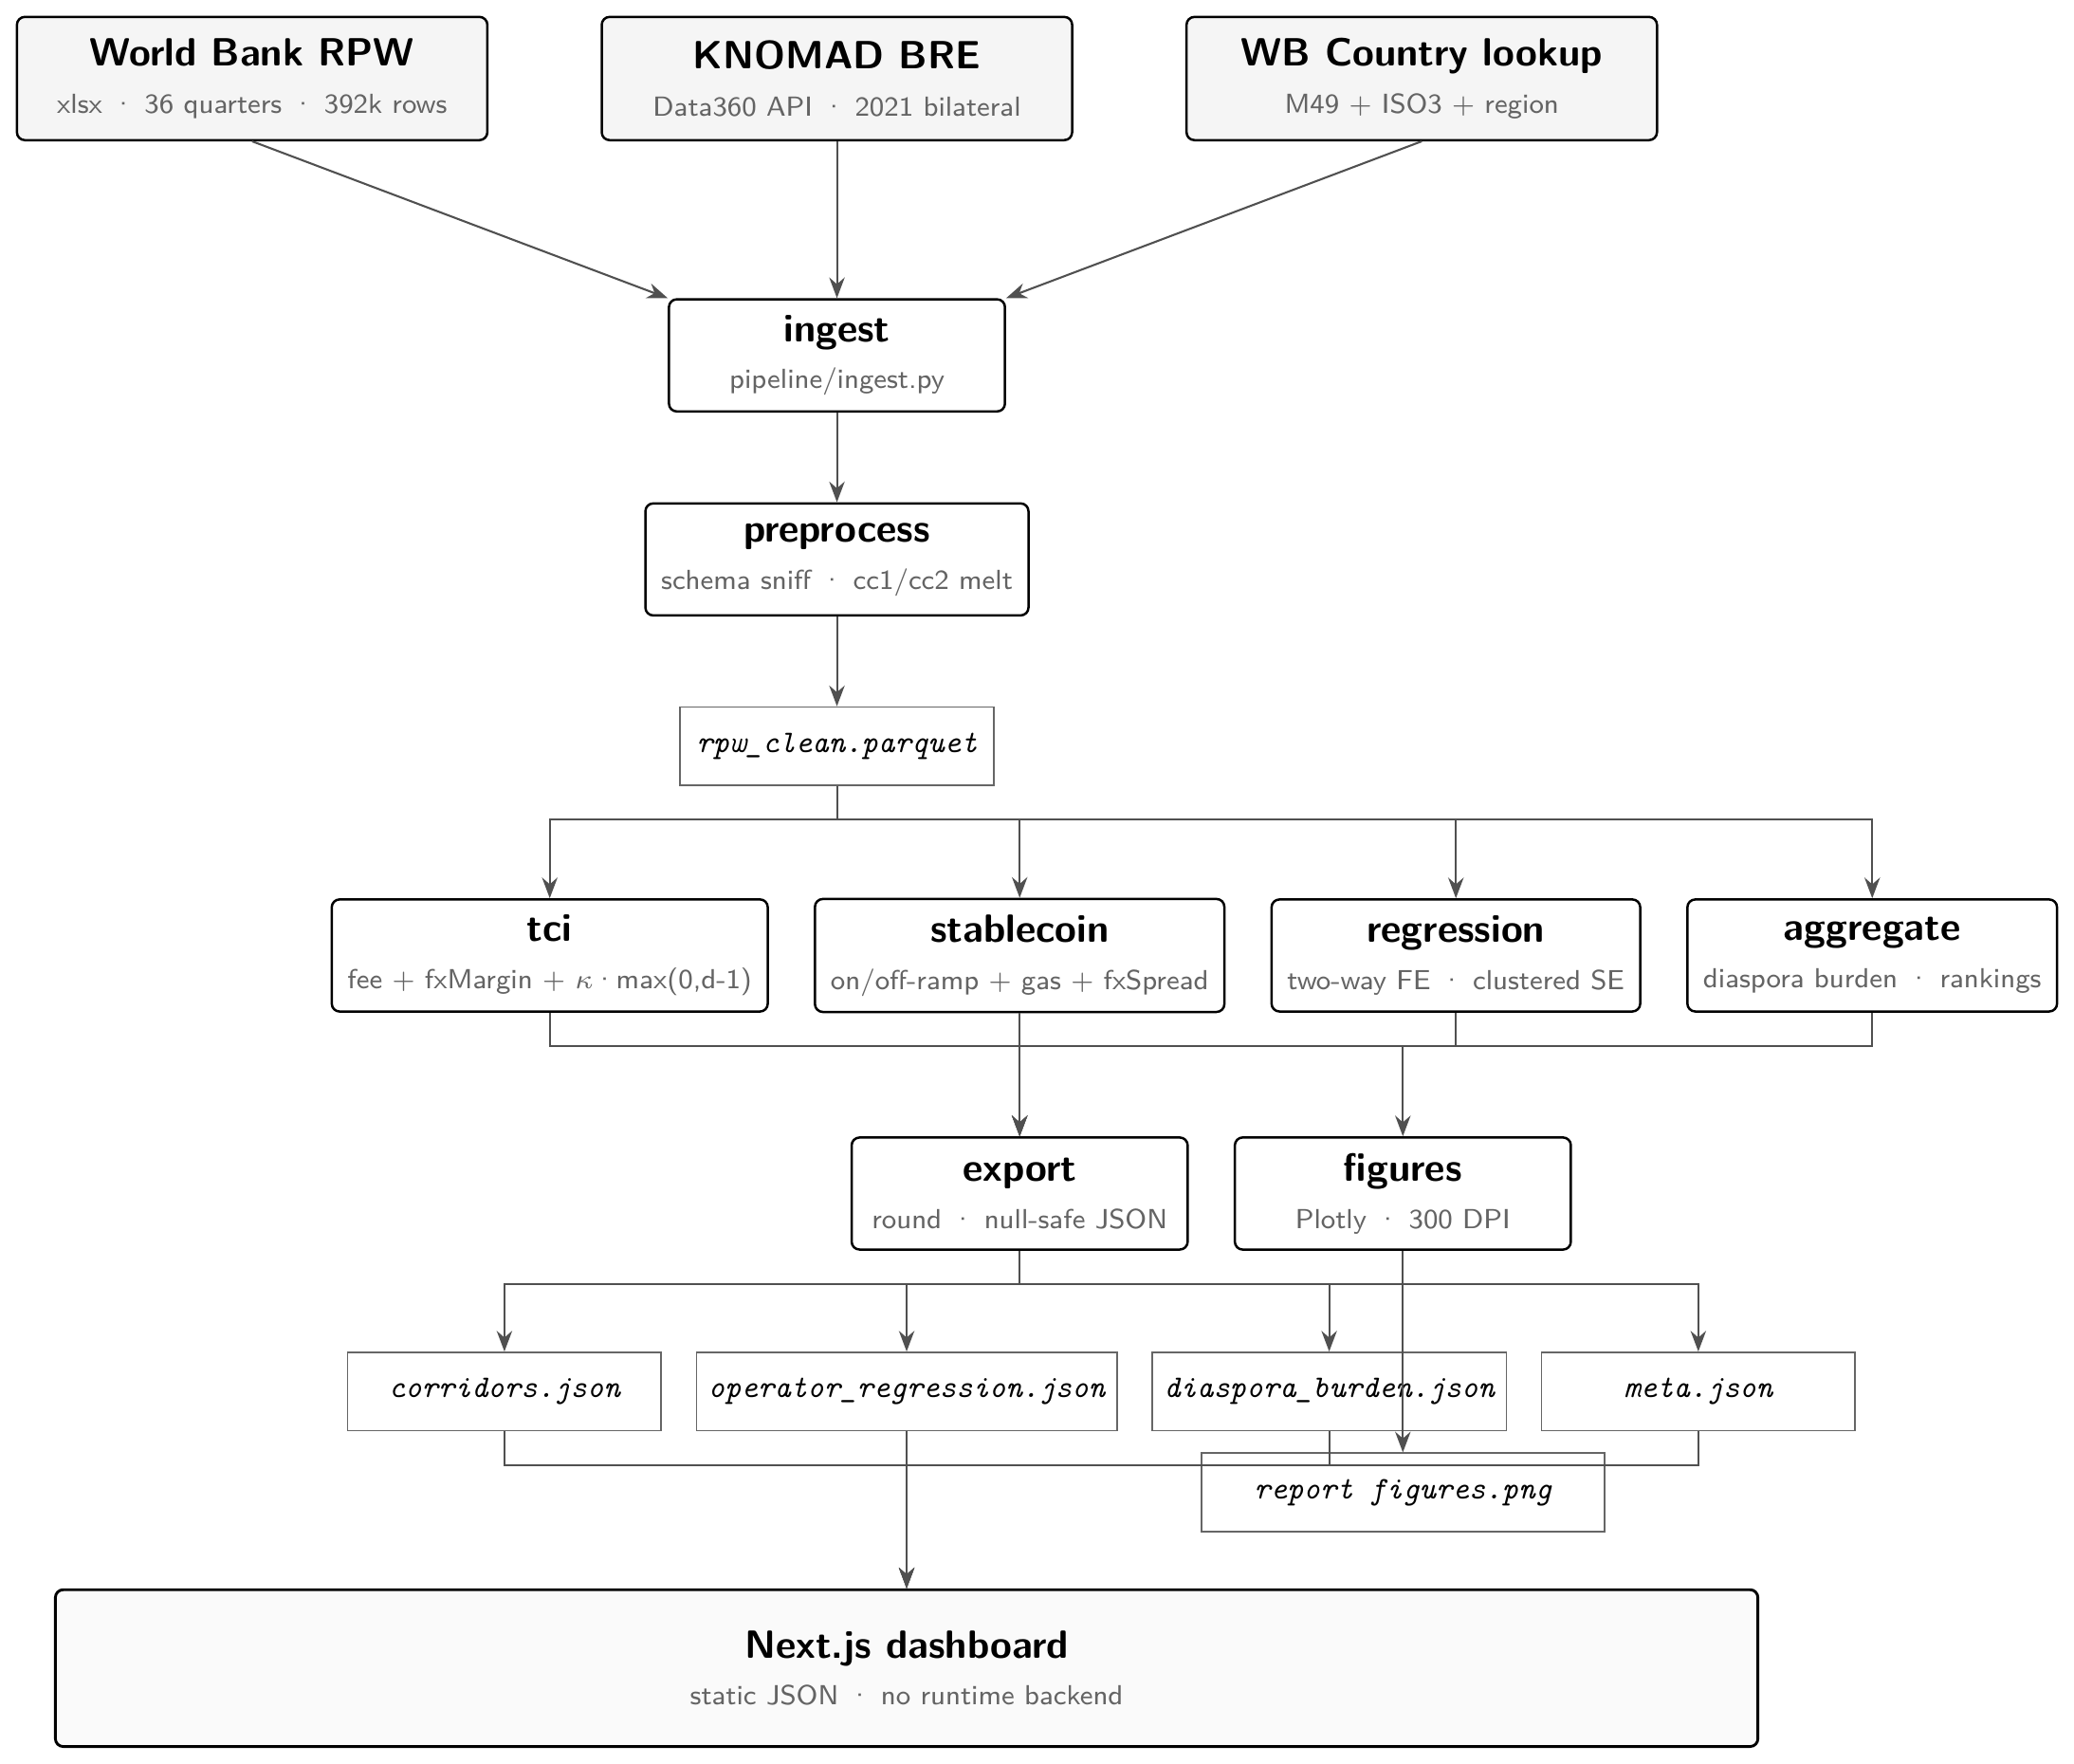
10 · ARCHITECTURE
11 / 18
From raw RPW to a static dashboard.

Slide 12
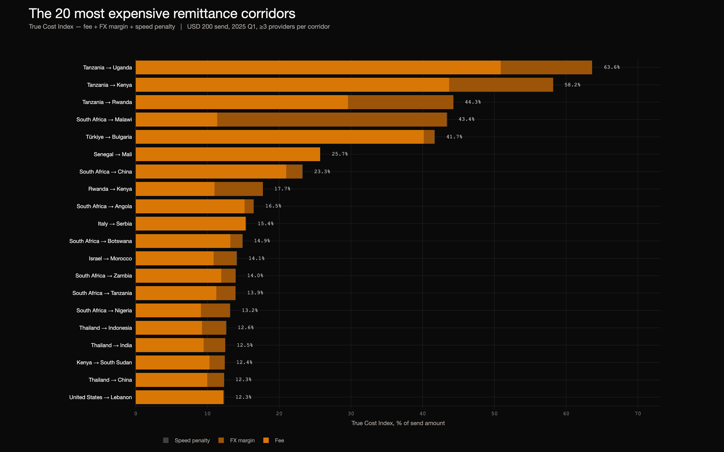
11 · RESULTS · COSTS
12 / 18
Top 20 most expensive corridors.
Sub-Saharan Africa and small-island Pacific dominate. Latin America is the cheapest.

Slide 13
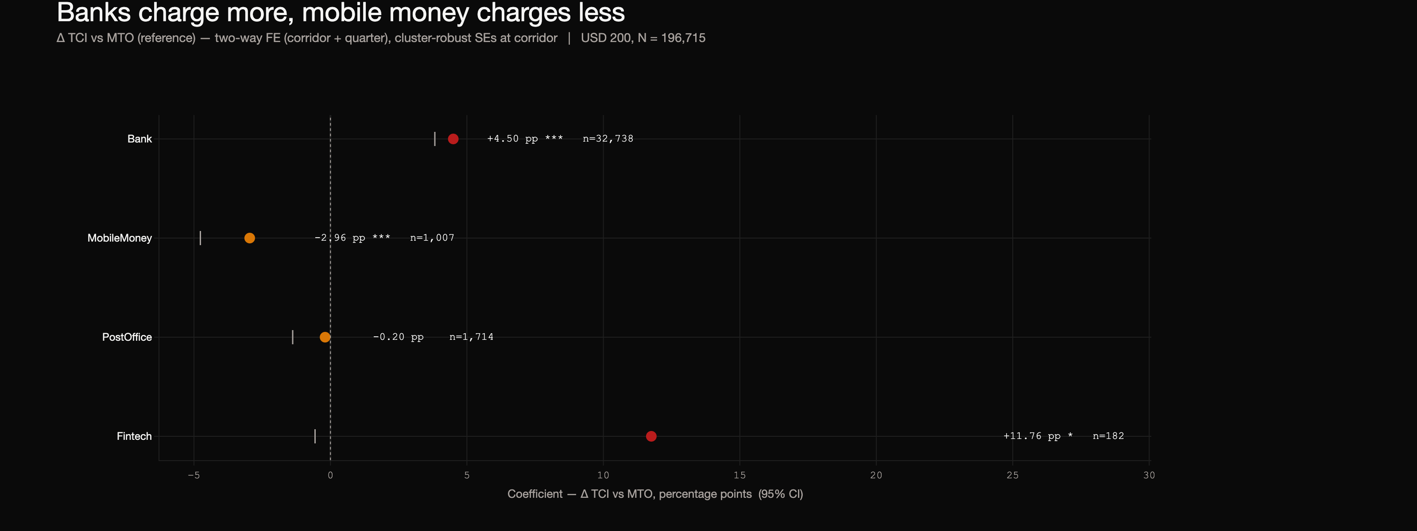
12 · RESULTS · OPERATORS
13 / 18
Banks charge ≈ 4.5 pp more than MTOs.
After controlling for corridor and quarter. Mobile-money operators undercut MTOs by ≈ 1.5 pp.

Slide 14
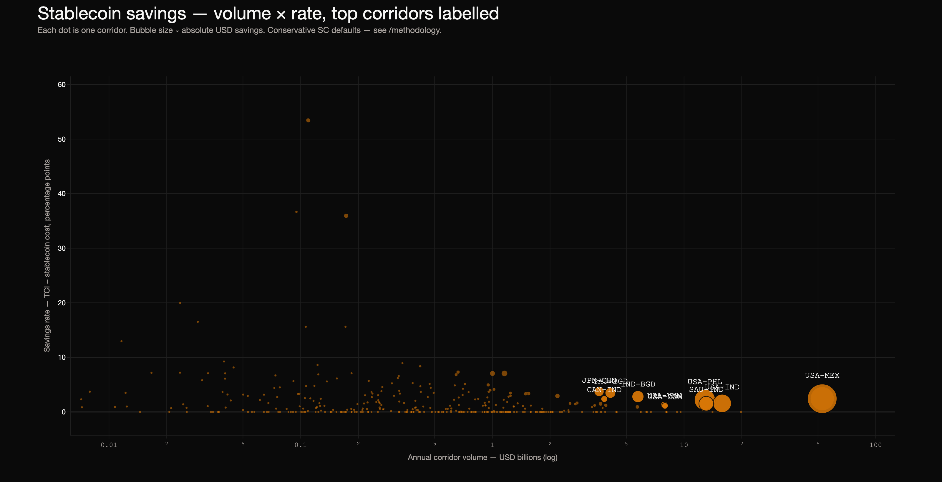
13 · RESULTS · STABLECOIN
14 / 18
Where stablecoin rails save the most.
Each dot is a corridor. X-axis: corridor volume (log). Y-axis: percentage savings on USD 200.

Slide 15
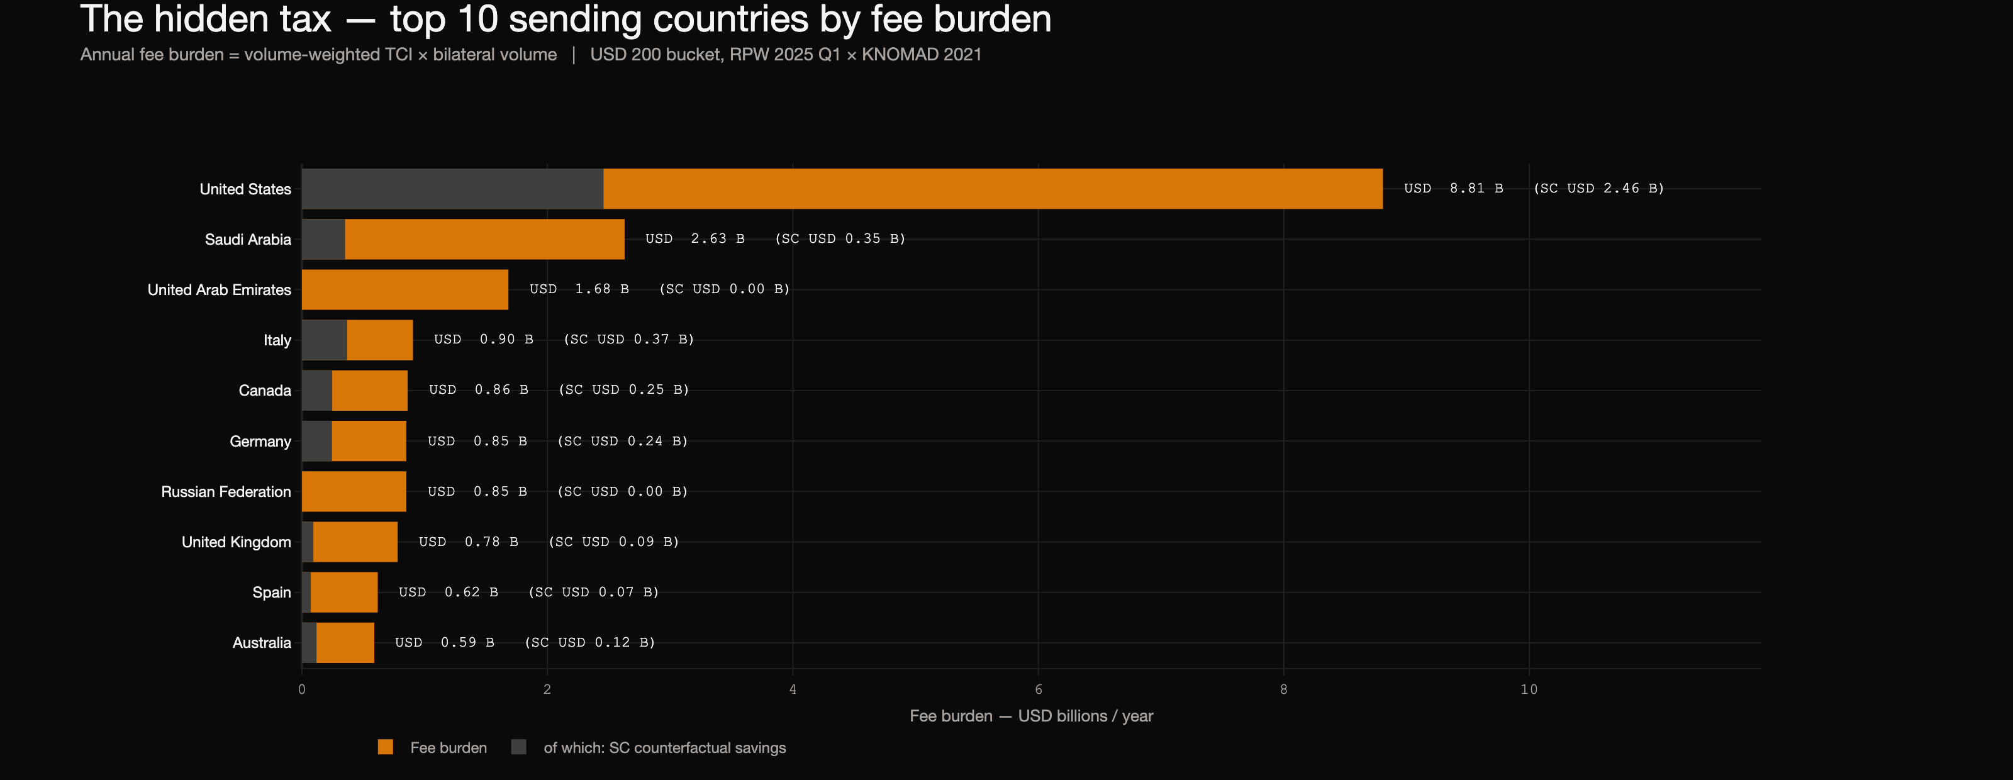
14 · RESULTS · DIASPORA
15 / 18
Annual burden by sending country.
How many dollars each diaspora pays per year on the corridors out of their host country.

Slide 16
15 · ROBUSTNESS
16 / 18
Does the headline survive scrutiny?
Four checks. Every assumption is exposed on the dashboard.
01
κ SENSITIVITY
Reviewer-supplied κ ∈ [0.05, 0.20] · corridor ranking is largely invariant in the plausible range.
02
PROVIDER STRESS TEST
Drop top + bottom 5 % of provider observations per corridor · global savings move by < 3 %.
03
AGGREGATION CHOICE
Mean and median TCI reported alongside · divergence < 0.5 pp on 80 % of corridors.
04
ASSUMPTION FLEX
Optimistic stablecoin defaults reach the $30 – 50 B / yr ballpark cited by BIS Bulletin 87.

Slide 17
16 · LIMITATIONS
17 / 18
What this can't tell you.
Provider weighting is uniform.
RPW does not publish market shares. A bank counts as much as a fintech.
κ is calibrated, not measured.
Defensible at 0.10 % / day, but the slider on the dashboard exists for a reason.
Stablecoin off-ramp is a floor.
KYC delays, P2P trade risk, and de-risking are not in the cost number.
BRM volumes are 2021.
Latest published. Headline USD figure is anchored to that year.
No causal claim.
Operator-class effect after FE; selection into firm type is endogenous.

Slide 18
17 · DEMO · Q&A
18 / 18
Live demo.
migrantmoney.vercel.app
github.com/ronitdhansoia/fds
Ronit Dhansoia · f20220168@dubai.bits-pilani.ac.in

