Slide 1
Introduction
HTML stands for Hyper Text Markup Language
HTML is the standard markup language for creating Web pages
HTML describes the structure of a Web page
HTML consists of a series of elements
HTML elements tell the browser how to display the content
HTML elements label pieces of content such as "this is a heading", "this is a paragraph", "this is a link", etc.

Slide 2
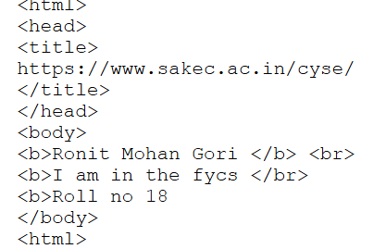

DAY 1

Slide 3
Code 1
We learnt how to save an HTML.
How to run a HTM file.
What is the function of the <head>, <title>, <body>, <b>, <br>.
<head> for the head of the code.
<title> for the title of the code
<body>where the code is performed

Slide 4
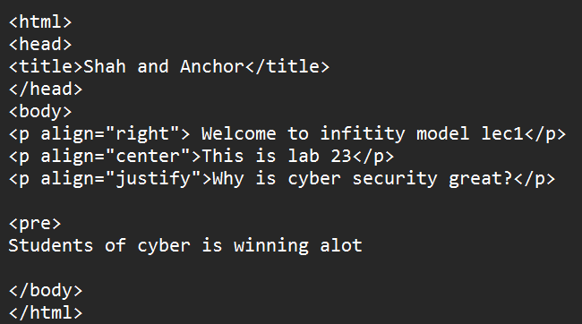
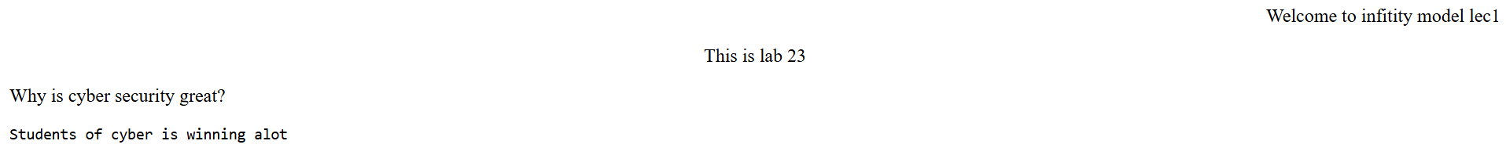
Alignment
Learning about Left, Right and center alignment.
<pre> command for the same format.

Slide 5
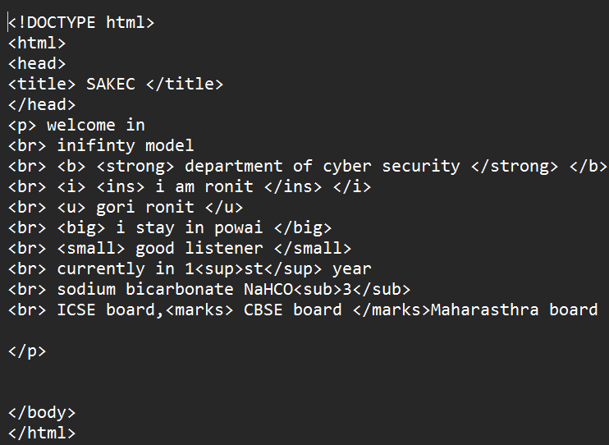
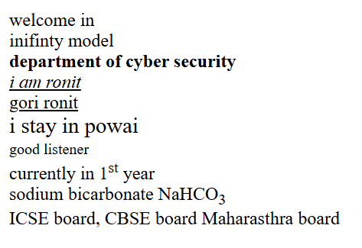
TAGS

Slide 6
Code 3
1. In code 2 we learnt about the paragraph tag <p> which used to display paragraph
content
2. In brief about paragraph tag, we learnt about alignment which is an attribute of the
paragraph tag used to align text in center, left, right or justify.
3. We learnt about the pre tag <pre> which is used to display the content as it has
been written in the code

Slide 7
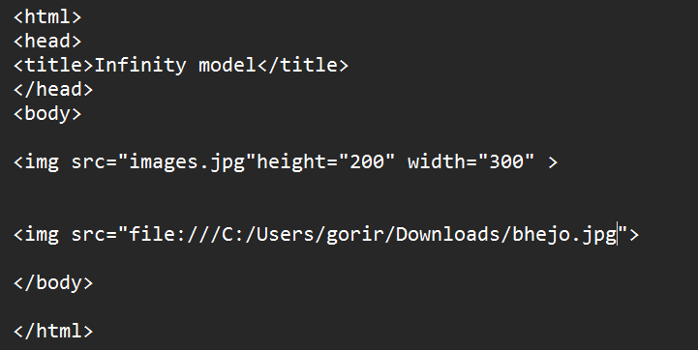

Images

Slide 8
Code 4
1. In code 5 we learnt about how we can insert an image in our website by using <img
src> tag
2. This tag has attribute to set the height and width of the image < height="500"
width="500" >
3. We were also taught different ways to insert an image being y saving an image in the
designated folder as a .jpg file and calling it in the tag another way being by using the
path link of your stored image and pasting it in the tag and the last being using an
online image without downloading directly pasting its link

Slide 9
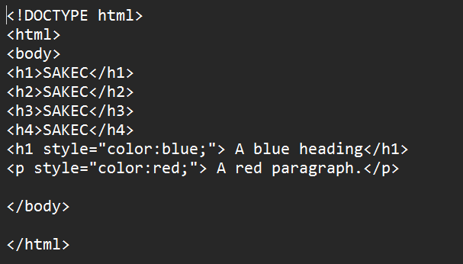
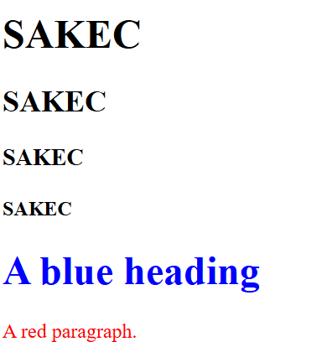
Headings

Slide 10
Code 5
1. In this code we learnt about the heading tag <h1> being the biggest and <h6> the
smallest
2. Also did we learn about the attributes of the heading tag to change color of the text

Slide 11
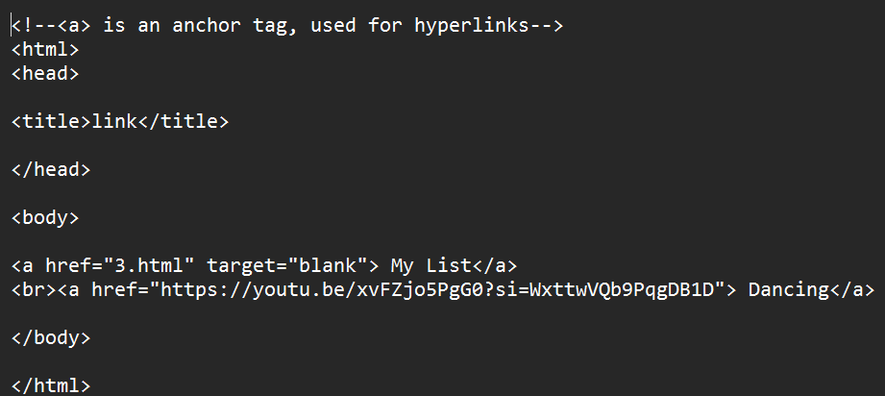

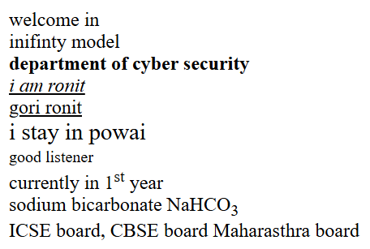
Hyperlinks

Slide 12
Code 6
1. In this code we learnt about hyper links which are used to move between different
pages of a website by the tag <a href>
2. The text written in this tag when clicked takes the user to the designated site link
pasted

Slide 13
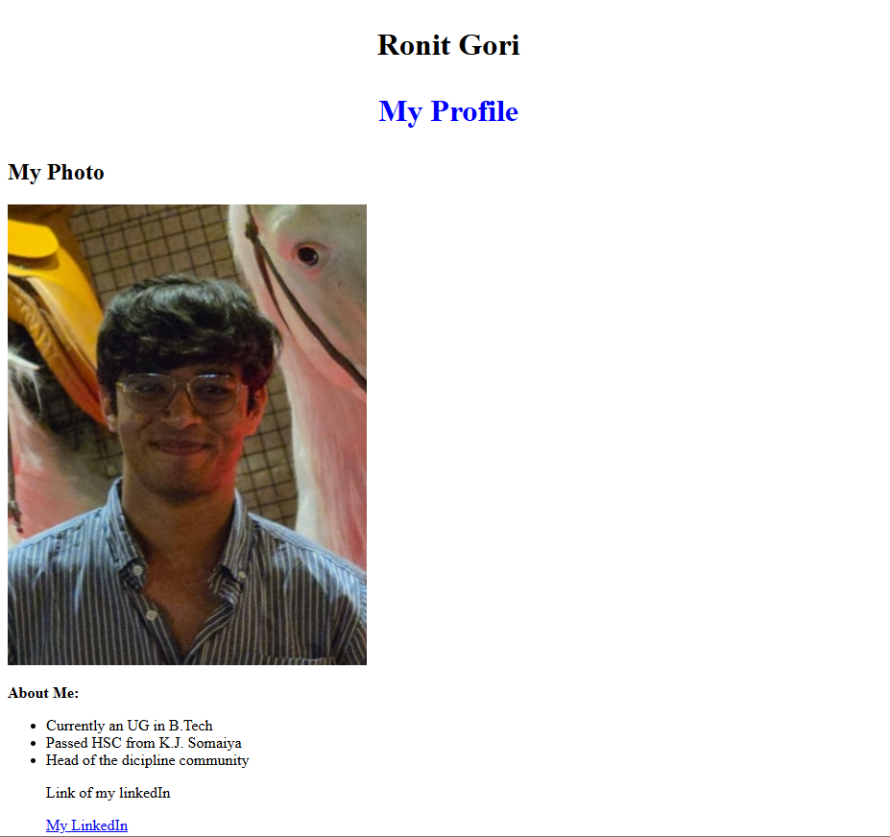
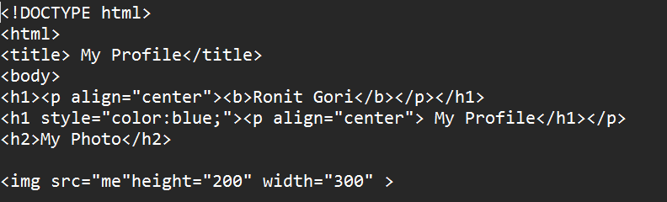
Profile

Slide 14
Code 7
1. This code was designated to display a profile about yourself using what ever we had
learnt till now

Slide 15
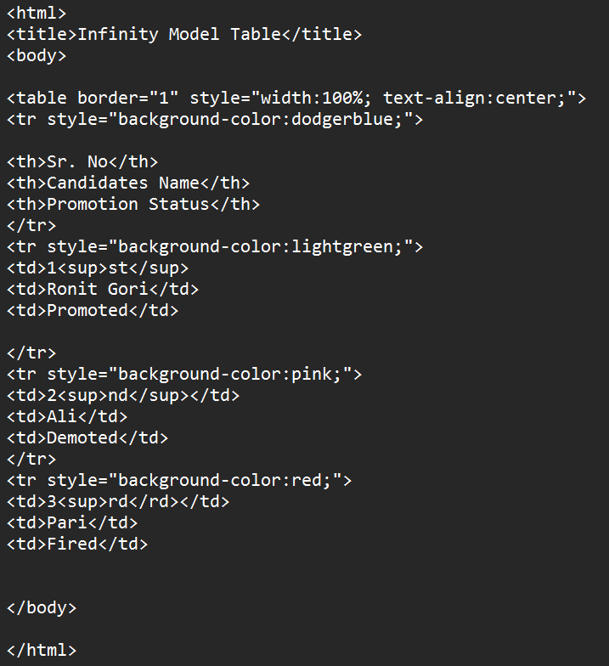
DAY 2

Slide 16
Code 1
1. We learnt about how to make a table using codes it starts by using <table> tab to
open a table it also has attributes to set table border cell spacing and alignment
2. Then we use <tr> tag to enable a new row <td> tags to write the content of the row
and so on.

Slide 17
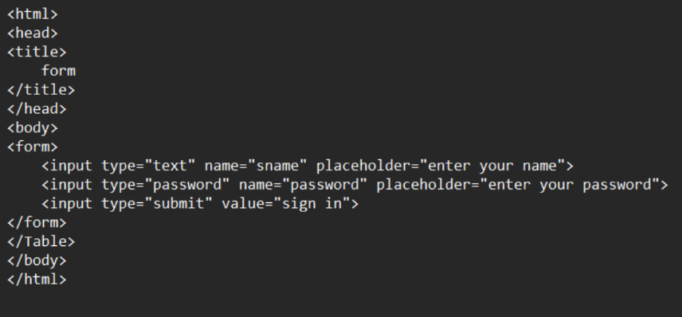
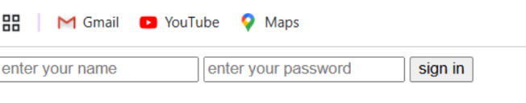
Inputs

Slide 18
Code 2
1. In this code we learnt hoe we can insert a form in a page by using <form> tag
2. The form tag uses <input> tag which has css to style the type of content being
entered <input type="text" name="sname" placeholder="enter your name"> type
defines text or numbers and place holder acts as the text displayed in the cell

Slide 19
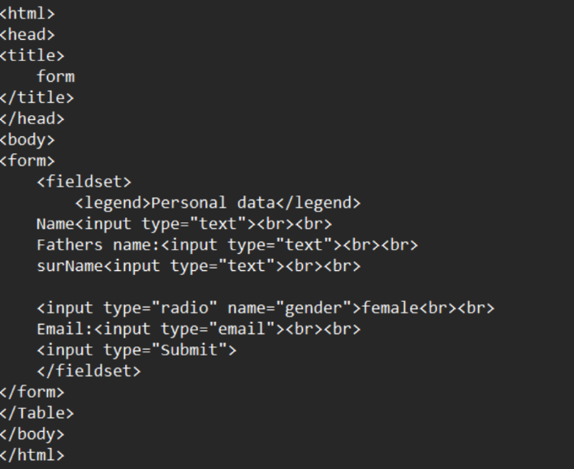
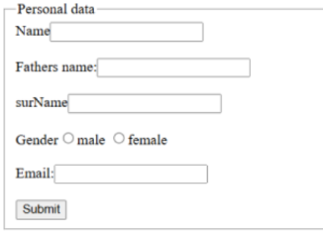
Personal Info

Slide 20
Code 3
1. This code made us learn additional styling in form tag
2. We used <fieldset> tag which makes a box around the form
3. We used the <legend> tag which gave a title on the fieldset
4. We also learnt different types of input <input type="radio"
name="gender">female<br><br>

