Slide 1
QChat: Quantum Safe Chat App
Applied Cryptography
By
Ronith

Slide 2
AGENDA
Introduction​
Issues with current tech
​Proposed Solution
Implementation
​Future Work

Slide 3
Introduction
In an age of digitized information, secure communication is pivotal.
As Quantum Computers start getting traction, the existing Crypto Systems which kept our data secure fails to do so.
The Quantum Safe Chat App, QChat, addresses the looming threat of quantum computing to encryption. Combining GGH and AES, it offers dual-layer defense for resilient messaging security in a post-quantum world.

Slide 4
Issues with current Crypto System
The cryptographic foundations of current systems, relying on RSA and ECC, face imminent threats from quantum advancements.
Shor's algorithm, a quantum breakthrough, endangers RSA by efficiently factoring large integers and compromises ECC by solving discrete logarithms.
Period Finding: Identifies the smallest positive integer r for which f(x + r) = f(x) holds for all x.
Quantum Fourier Transform (QFT): Utilizes QFT, a quantum analogue of the classical Fourier transform, to find the period efficiently.

Slide 5
Proposed solution
Lattice-Based Cryptography

Slide 6
Lattice Cryptography: GGH
Derives strength from the hardness of certain mathematical problems related to lattices thus being Quantum Resistant.
Process
Key Generation
Encrypt using Public Basis
Decrypt using Private Basis

Slide 7
Implementation
Python (Server-Client Model) & QChat

Slide 8
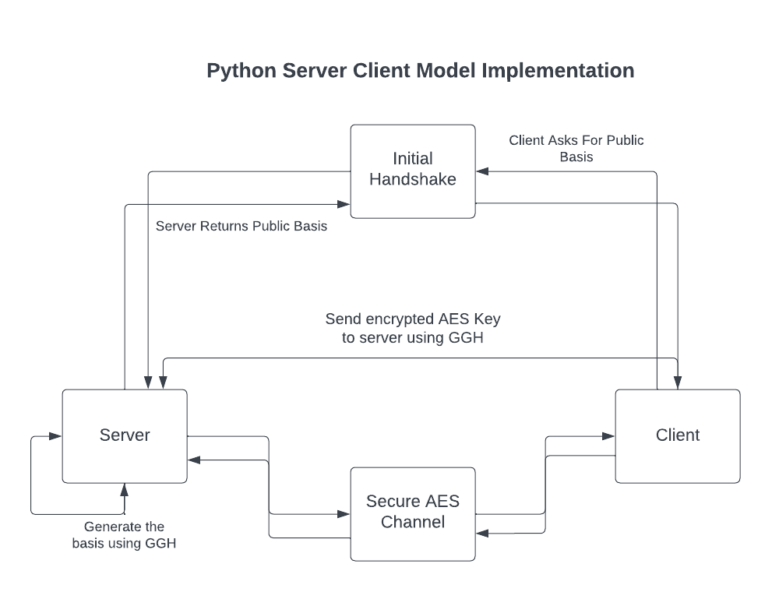
8

Slide 9
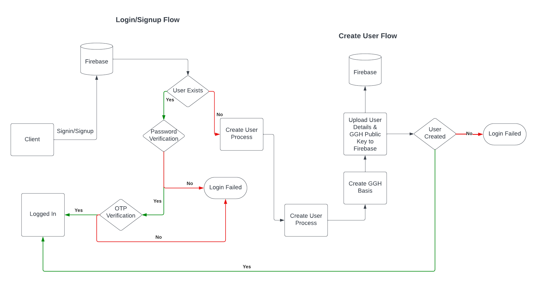
QChat App
9

Slide 10
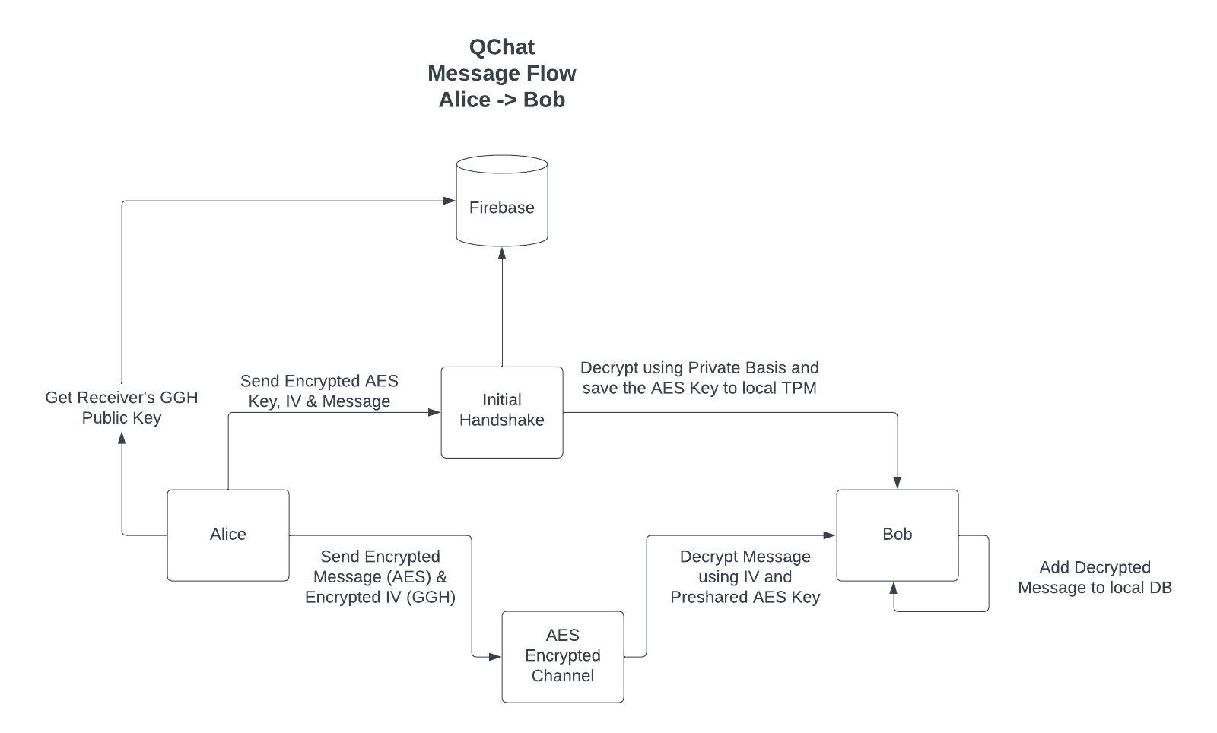
QChat App
10

Slide 11
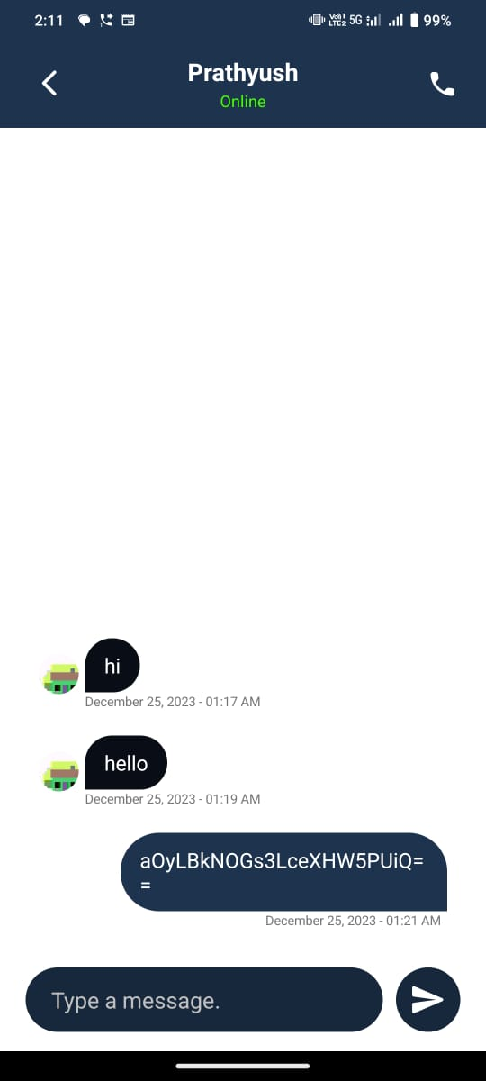
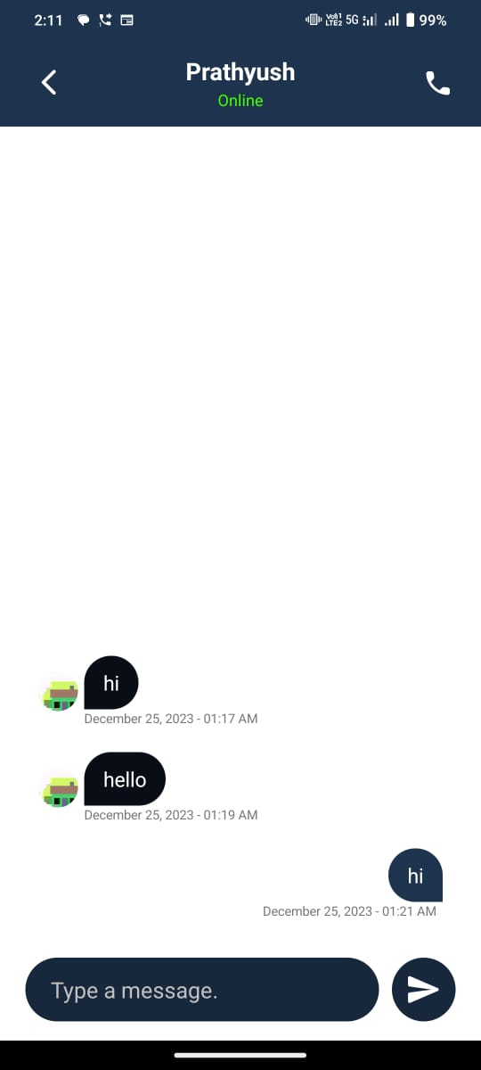
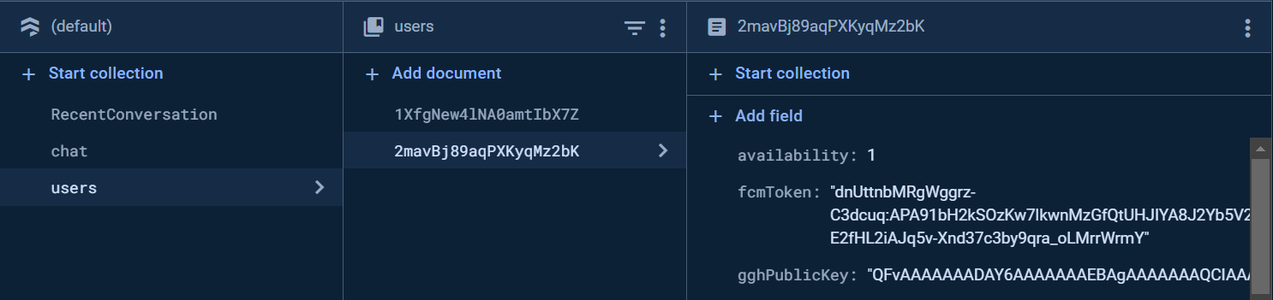
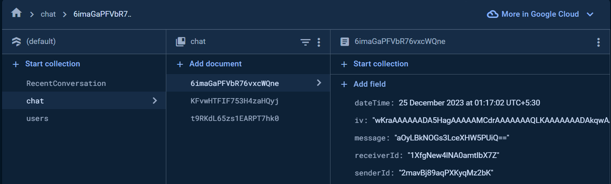
Demo
11
Encrypted Message
Decrypted Message
Firebase Data

Slide 12
Future Work
Public Testing
Publish on Play Store
Add in-app purchase for server credits

Slide 13
THANK YOU
Ronith S : [CB.EN.U4AIE21051]

