Slide 1
Wine Prediction Problem
By,
Ronith Raj.K.

Slide 2
Problem Statement
In Industries, understanding the demands of wine safety testing can be a complex task for the laboratory with numerous analytes and residues to monitor.
But, our application’s prediction, provide ideal solution for the analysis of wine, which will make the whole process efficient and cheaper with less human interaction.

Slide 3
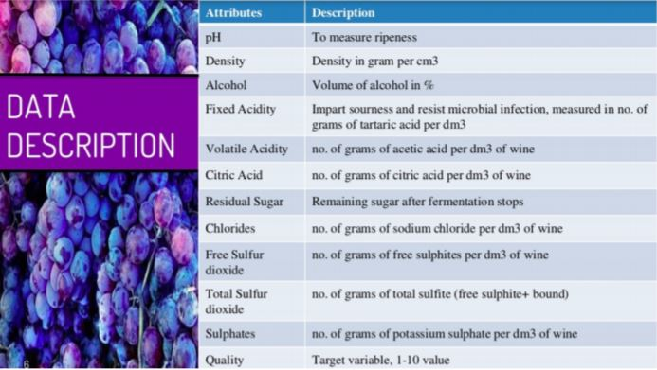
Our main objective is to predict the wine quality with above attributes using the Machine Learning models.

Slide 4
Agenda:
Using machine learning models, we need to predict the quality of the wine.
I have approached this problem in three cases,
First converting this into a classification problem by dividing all the qualities above or equal to 7 as good and others as bad.
As the above data was imbalanced, Considered all the qualities above or equal to 6 as good and others as bad.
Handling the imbalanced data from case-1.

Slide 5
ML Algorithms Used
Logistic Regression
K-Nearest Neighbours
Decision Trees
Random Forest
SVM
AdaBoost

Slide 6
Case-1: Considering all the wine qualities as good which are greater than or equal to 7.

Slide 7
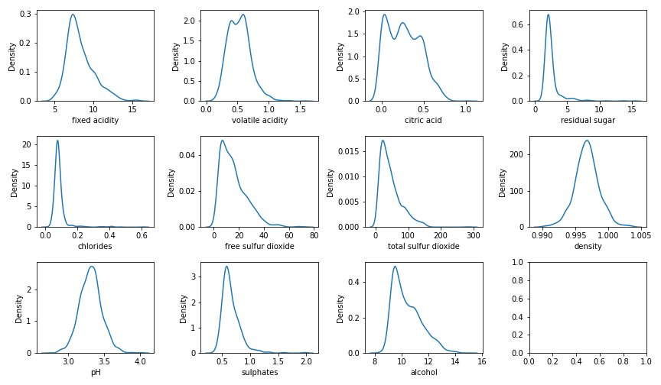
Distribution of the features variables.

Slide 8
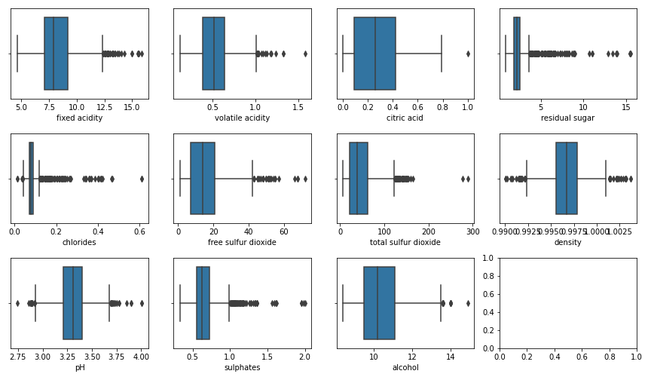
Box-plot of all the feature variables.

Slide 9
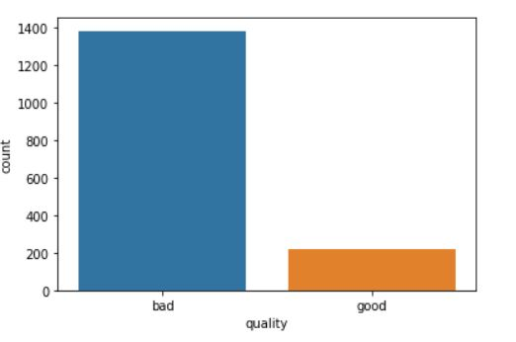
Imbalanced Data

Slide 10
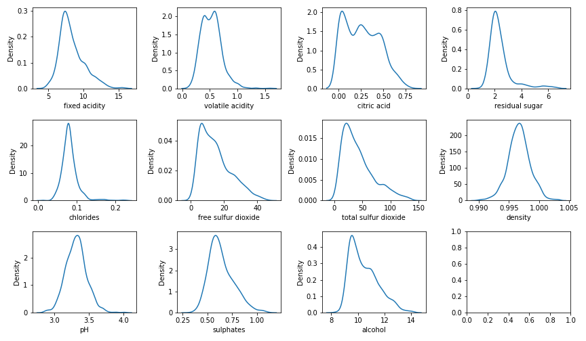
After detecting the outliers and removing them.

Slide 11
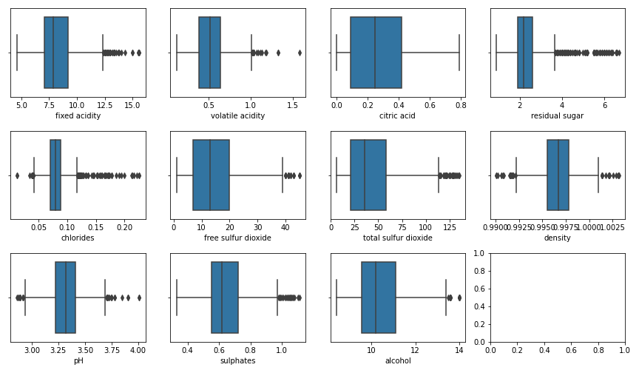

Slide 12
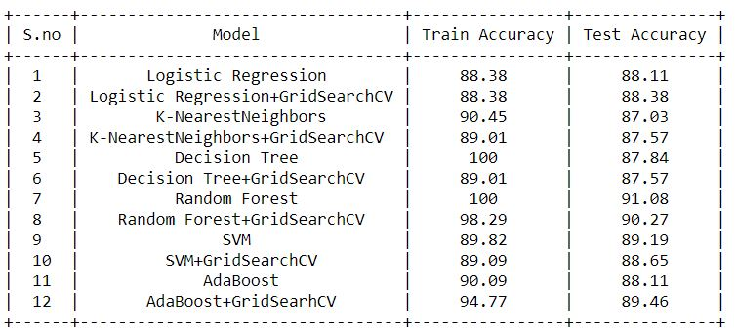
Results after model training.

Slide 13
Case-2: Considering all the wine qualities as good which are greater than or equal to 6.

Slide 14
Distribution of the features variables.

Slide 15
Box-plot of all the feature variables.

Slide 16
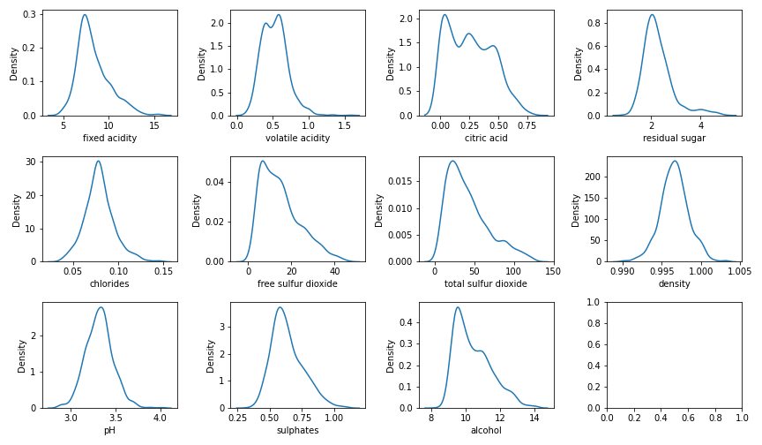
After detecting the outliers and removing them.

Slide 17
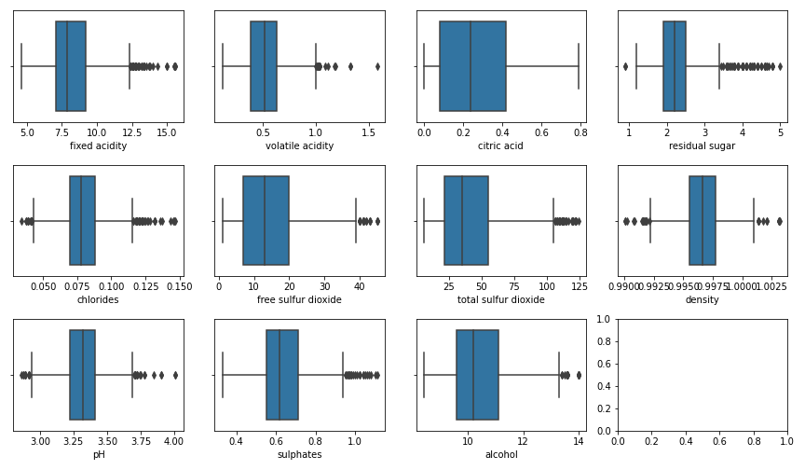

Slide 18
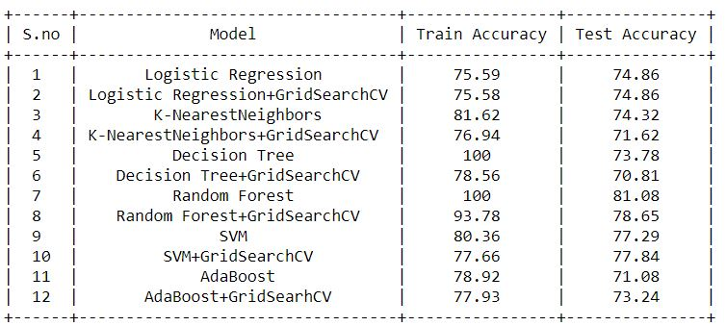
Results after model training.

Slide 19
Case-3: Handling the imbalanced data with the wine quality greater than or equal to 7(case-1).

Slide 20
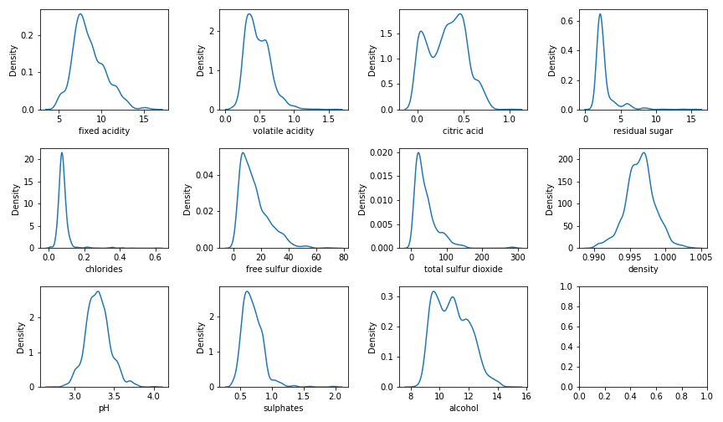
Distribution of the features variables.

Slide 21
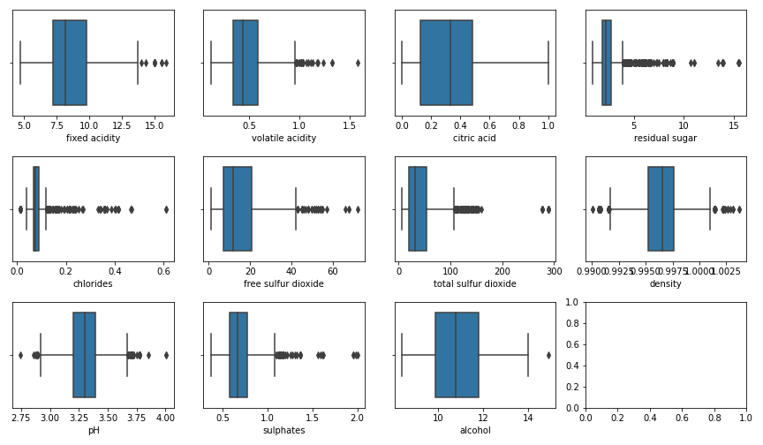
Box-plot of all the feature variables.

Slide 22
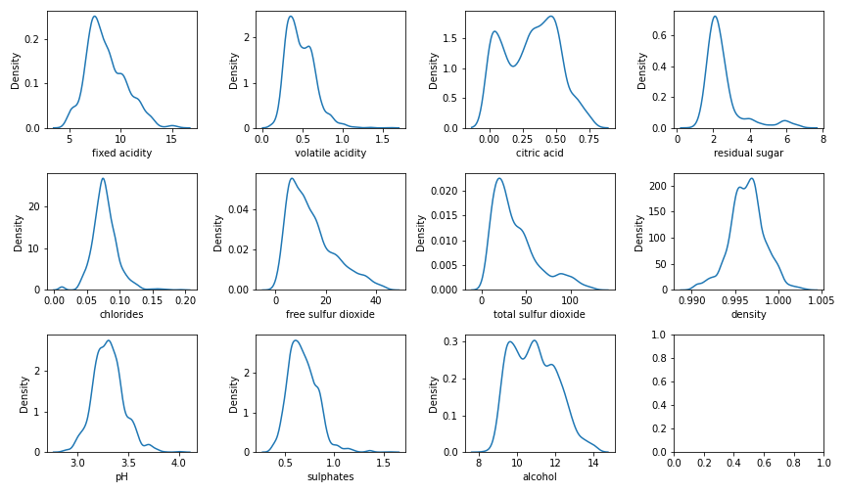
After detecting the outliers and removing them.

Slide 23
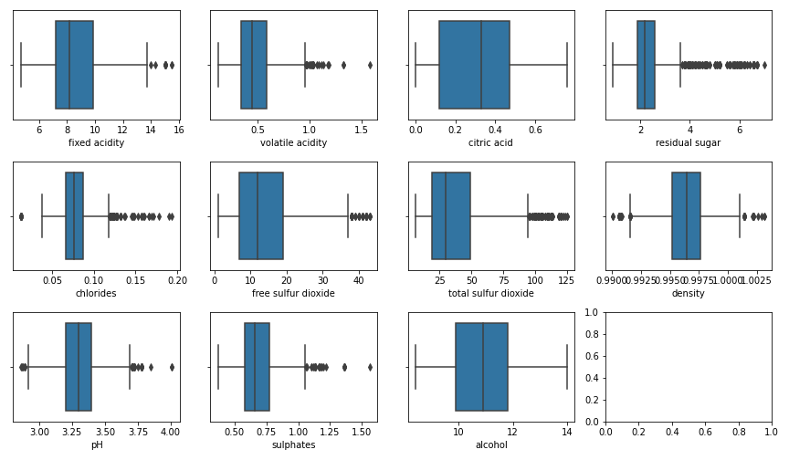

Slide 24
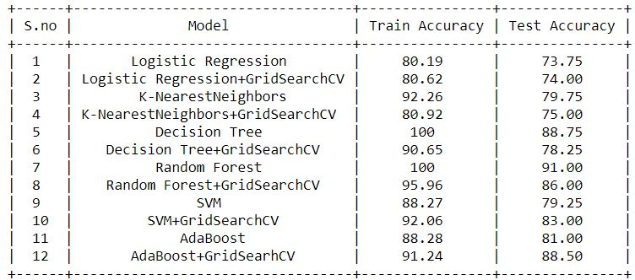
Results after model training.

Slide 25
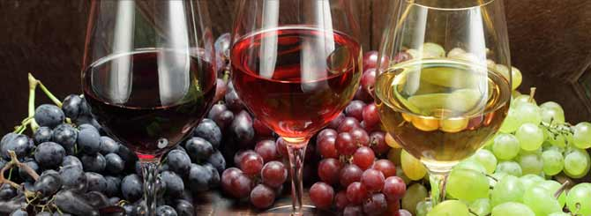
Thank you.!

