Slide 1
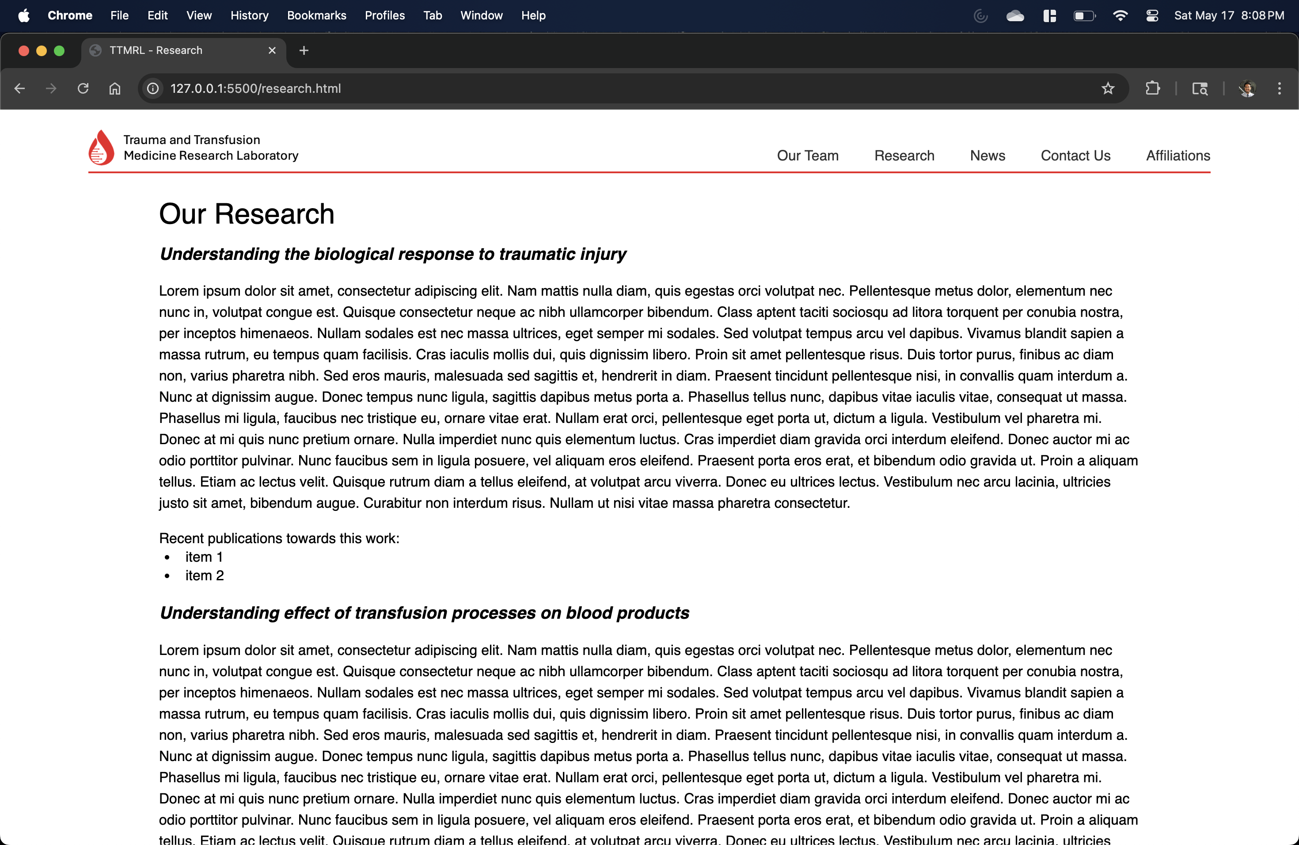

Slide 2
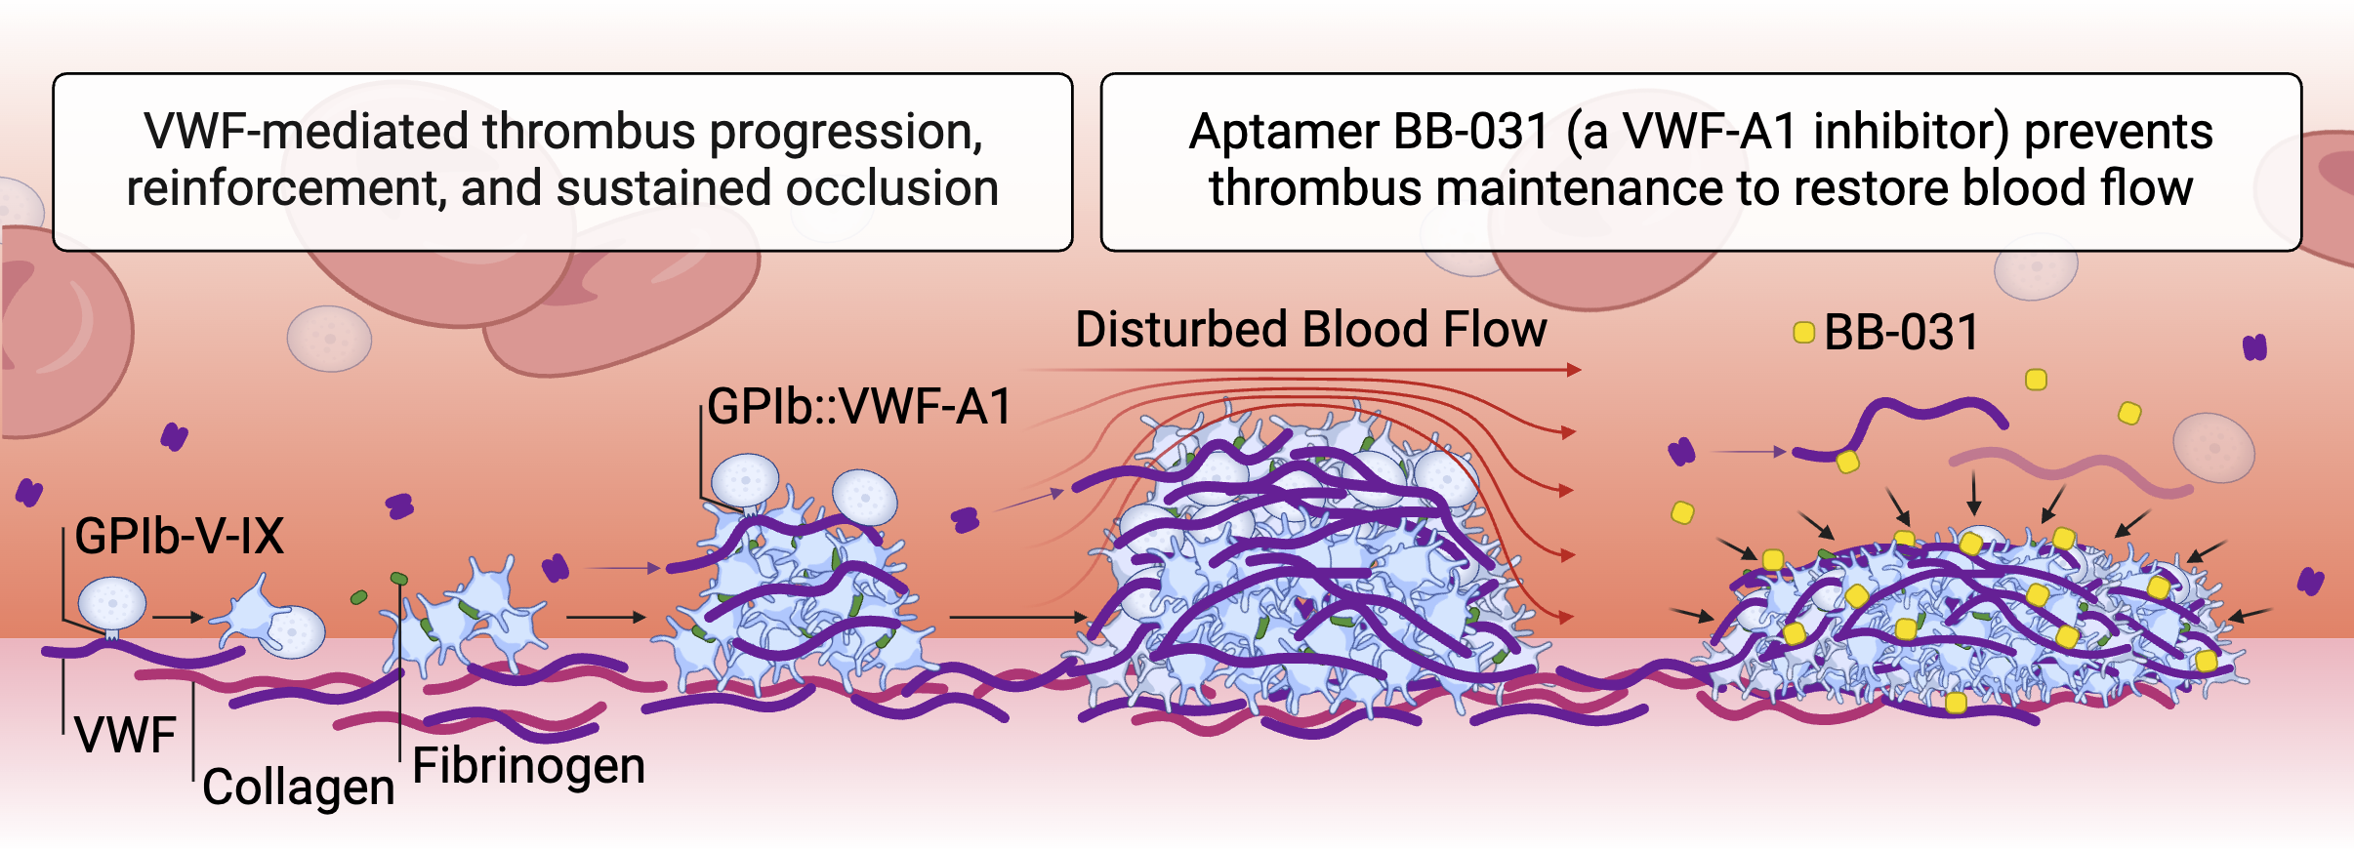
University of Pittsburgh
Department of Surgery
Trauma and Transfusion Medicine Research Center
Trauma and Transfusion
Medicine Research Laboratory
Our Team
Research Projects
News
Publications
Contact Us
Research Projects
Research Project #1
Research Project #1
We conduct actionable, evidence-based research to improve understanding of sustainability challenges. Our research enables decision-makers to devise effective strategies to address global change and enhance well-being for current and future generations. We take an integrated approach to sustainability science that considers the Earth's interconnected, co-evolving natural and societal systems in their full complexity.
We conduct actionable, evidence-based research to improve understanding of sustainability challenges. Our research enables decision-makers to devise effective strategies to address global change and enhance well-being for current and future generations. We take an integrated approach to sustainability science that considers the Earth's interconnected, co-evolving natural and societal systems in their full complexity. We conduct actionable, evidence-based research to improve understanding of sustainability challenges. Our research enables decision-makers to devise effective strategies to address global change and enhance well-being for current and future generations. We take an integrated approach to sustainability science that considers the Earth's interconnected, co-evolving natural and societal systems in their full complexity.
Research Project #2
Research Project #3
Research Project #4

Slide 3
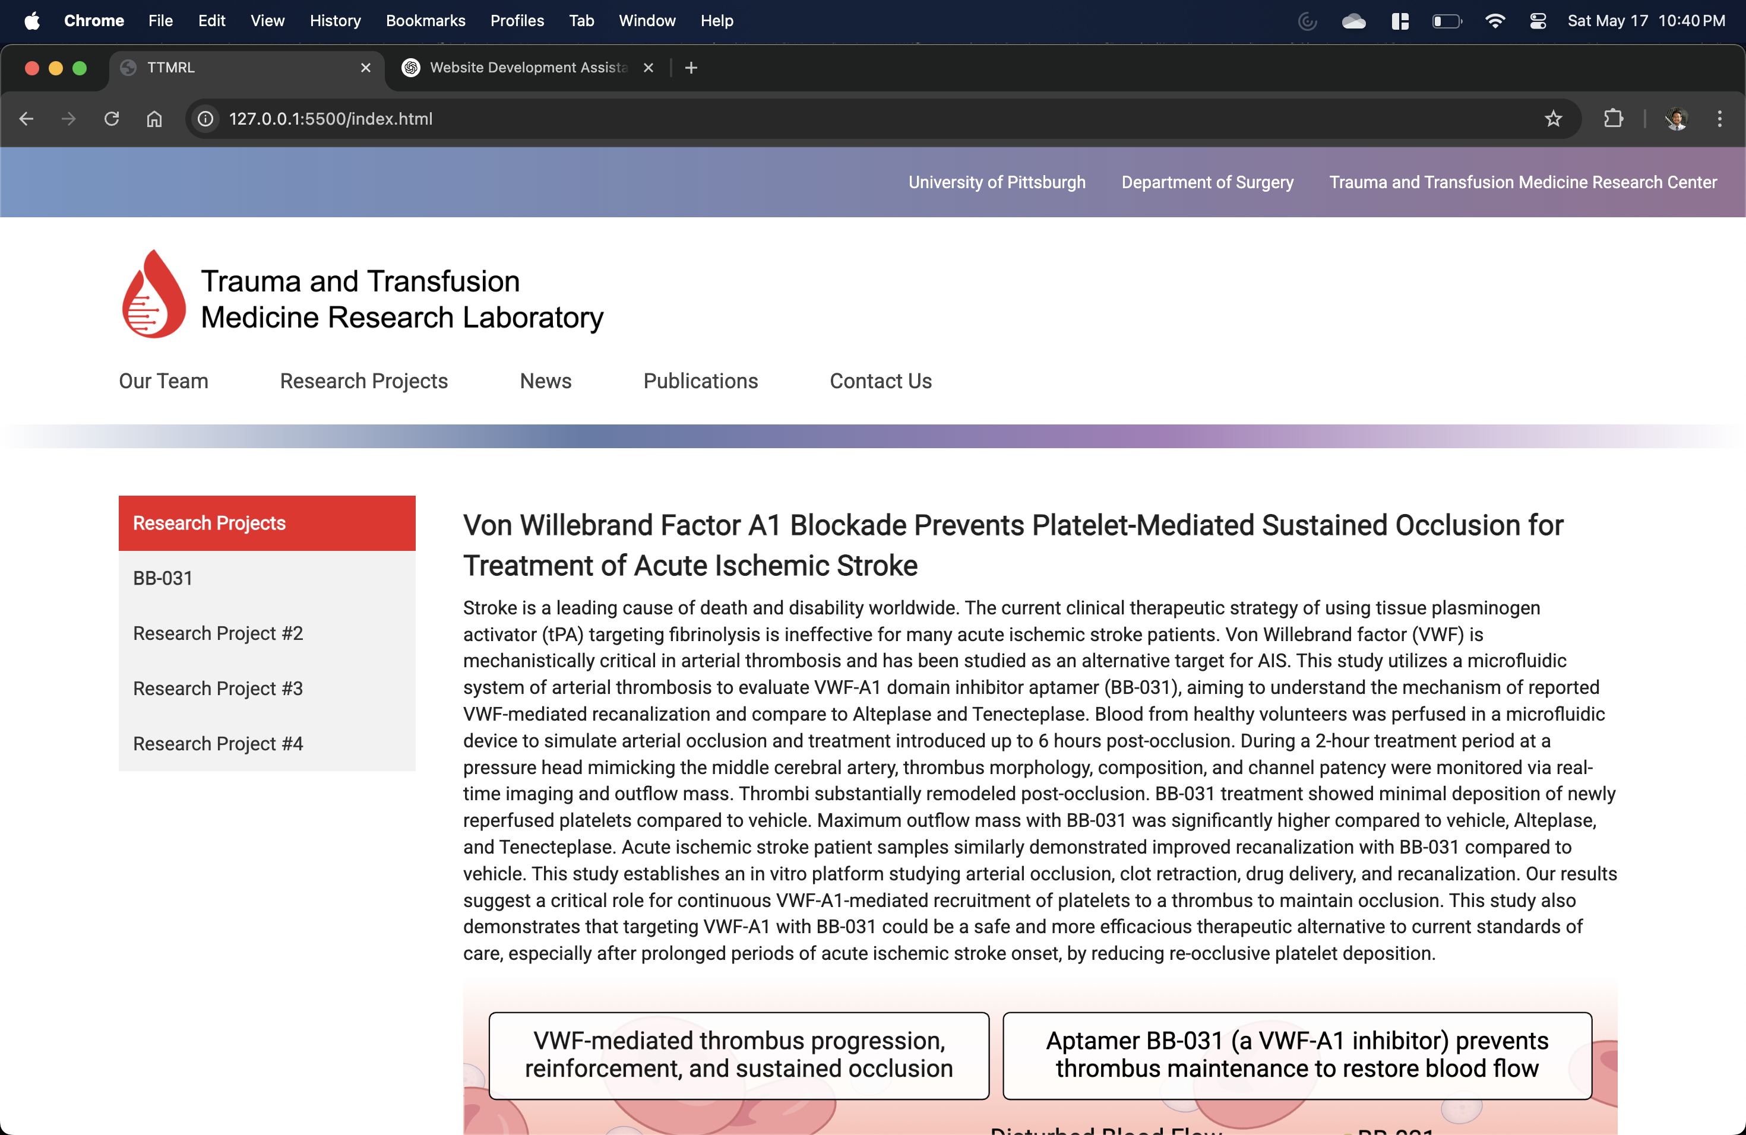
University of Pittsburgh
Department of Surgery
Trauma and Transfusion Medicine Research Center
Trauma and Transfusion
Medicine Research Laboratory
Our Team
Research Projects
News
Publications
Contact Us
Research Projects
Research Project #1
Research Project #1
We conduct actionable, evidence-based research to improve understanding of sustainability challenges. Our research enables decision-makers to devise effective strategies to address global change and enhance well-being for current and future generations. We take an integrated approach to sustainability science that considers the Earth's interconnected, co-evolving natural and societal systems in their full complexity.
We conduct actionable, evidence-based research to improve understanding of sustainability challenges. Our research enables decision-makers to devise effective strategies to address global change and enhance well-being for current and future generations. We take an integrated approach to sustainability science that considers the Earth's interconnected, co-evolving natural and societal systems in their full complexity. We conduct actionable, evidence-based research to improve understanding of sustainability challenges. Our research enables decision-makers to devise effective strategies to address global change and enhance well-being for current and future generations. We take an integrated approach to sustainability science that considers the Earth's interconnected, co-evolving natural and societal systems in their full complexity.
Research Project #2
Research Project #3
Research Project #4

Slide 4

interconnected, co-evolving natural and societal systems in their full complexity. We conduct actionable, evidence-based research to improve understanding of sustainability challenges. Our research enables decision-makers to devise effective strategies to address global change and enhance well-being for current and future generations. We take an integrated approach to sustainability science that considers the Earth's interconnected, co-evolving natural and societal systems in their full complexity.
Page was last updated May 17, 2025.
Trauma and Transfusion
Medicine Research Laboratory
Biomedical Science Tower
200 Lothrop Street.
W900
Pittsburgh, PA 15261
University of Pittsburgh
Department of Surgery
Trauma and Transfusion Medicine Research Center

Slide 5
University of Pittsburgh
Research Projects
Research Project #1
Research Project #2
Research Project #3
Research Project #4
Research Project #1
We conduct actionable, evidence-based research to improve understanding of sustainability challenges. Our research enables decision-makers to devise effective strategies to address global change and enhance well-being for current and future generations. We take an integrated approach to sustainability science that considers the Earth's interconnected, co-evolving natural and societal systems in their full complexity.

