Slide 1
KrishiRaksha – A Disease and Pest control App
PIP104 University Project-II
Batch Number
Roll Number | Student Name
20211CAI0010 | RONIT PATHAK
20211CAI0006 | SOHITH N.R
20211CAI0156 | CHAKRADHAR REDDY
20211CAI0036 | SHAMBHAVI K.M
Under the Supervision of,
Mr. Likith S.R
Assistant Professor
School of Computer Science & Engineering
Presidency University

Slide 2
Introduction
Why Agriculture Matters
Agriculture drives food security and economic stability.
Farmers face increasing challenges climate change, pest infestations, and soil degradation.
The Problem
20-40% annual crop losses caused by pests and diseases (FAO).
Traditional methods (manual checks, chemical sprays)
Inefficient and costly.
Harmful to the environment.
The Krishi Raksha Solution
AI-powered app using Gemini AI for real-time plant diagnostics.
Designed to be simple, accessible, and effective for farmers of all skill levels.

Slide 3
Literature Review
Existing Tools
PlantVillage: Machine learning-based, requires high-quality images and internet.
Plantix: AI-based image recognition but lacks real-time adaptability and scalability.
Limitations
High dependency on internet and image quality.
Lack of inclusivity for farmers with low digital literacy.
Gemini AI’s Advantage
Real-time analysis without preprocessing or extensive training.
Scalable and robust for varied agricultural conditions.
Need for Krishi Raksha
Bridges the gap with inclusivity, scalability, and environmental sustainability.

Slide 4
Research Gaps Identified
Technological Gaps
Limited disease and pest coverage across regions and climates.
Heavy reliance on stable internet and high-quality images.
User Barriers
Most tools are not designed for farmers with minimal digital literacy.
Lack of multilingual and voice-enabled interfaces.
Environmental Issues
Over-reliance on pesticides due to inaccurate diagnostics leads to ecological damage.
Need
A user-friendly, real-time, AI-powered diagnostic tool to address these gaps.

Slide 5
Proposed Methodology
Technology Stack
Frontend
Responsive UI with dynamic CSS styling for usability across devices.
Integrated camera for image capture and uploads.
Backend
Firebase Firestore for real-time database and cloud storage.
Cloud functions for processing images and AI integration.
AI Core
Gemini AI for pre-trained image recognition without preprocessing.
Workflow
Image upload via app or camera.
Processing by Gemini AI for diagnosis.
Results displayed with actionable recommendations.
Voice and text support for ease of use.

Slide 6
Objectives
Accurate Diagnostics Provide real-time, reliable plant health analysis.
Sustainable Farming Promote eco-friendly pest control and reduce pesticide overuse.
Empowering Farmers
Simple interface for users with low digital literacy.
Voice and multilingual support.
Boost Productivity Reduce crop losses and improve yields while lowering costs.
Global Vision Expand AI-driven solutions to meet diverse agricultural needs worldwide.

Slide 7
System Design & Implementation
System Overview
AI-powered diagnostics using Gemini AI.
Real-time cloud analytics with Firebase integration.
Simple, intuitive user interface designed for inclusivity.
Key Features
Voice assistance for illiterate users.
Multilingual text outputs.
Image capture and upload for real-time diagnosis.
Implementation Steps
Parallel frontend and backend development.
Iterative testing for quality assurance and user feedback.
Deployed globally via Firebase.

Slide 8
Timeline of Project

Slide 9
Outcomes / Results Obtained
Performance
90% accuracy in diagnosing diseases and pests.
Processing time 3–5 seconds per image.
User Feedback
High usability for farmers with limited technical skills.
Effective for identifying common and complex diseases.
Scalability
Cloud-based design supports multiple simultaneous users.
Limitations
Accuracy affected by low-quality images.
Need for expert validation in unclear cases.

Slide 10
Conclusion
Key Achievements
Accurate and accessible diagnostics for smallholder farmers.
Cost-effective and sustainable farming practices.
Empowered rural communities through digital inclusion.
Broader Impact
Enhanced food security by minimizing crop losses.
Strengthened rural economies with higher productivity and reduced input costs.
Future Vision
Integrate IoT for real-time monitoring (e.g., soil, weather).
Develop offline capabilities for remote regions.
Make Krishi Raksha the leading global AI solution for agriculture

Slide 11
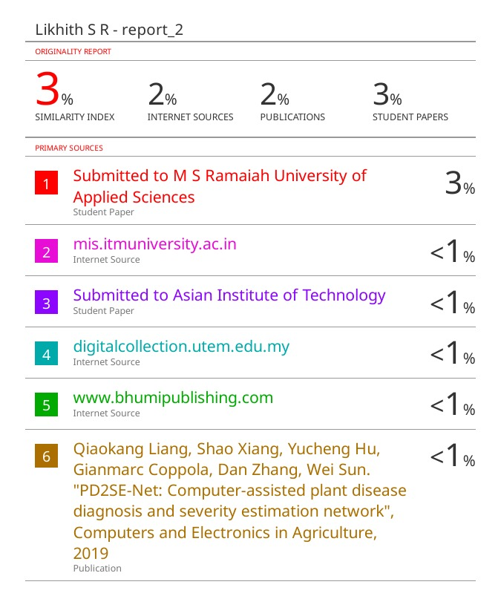
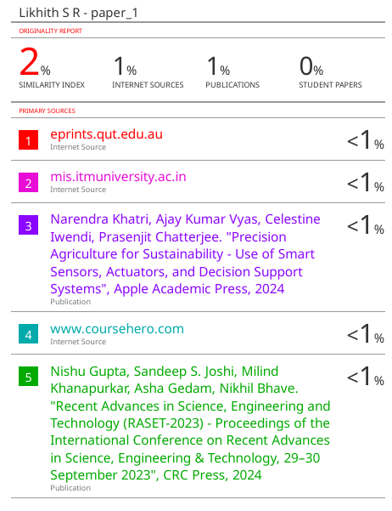
Similarity Report

Slide 12
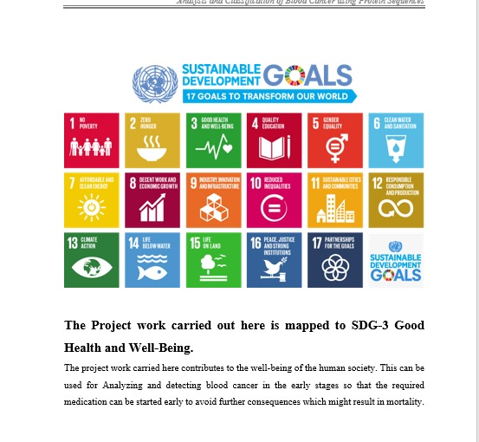
SDG Mapping

Slide 13
Reference
Food and Agriculture Organization of the United Nations (FAO). (2021). The State of Food and Agriculture 2021 Making Agri-Food Systems More Resilient to Shocks and Stresses. Retrieved from https //www.fao.org
Mohanty, S. P., Hughes, D. P., & Salathe, M. (2016). Using Deep Learning for Image-Based Plant Disease Detection. Frontiers in Plant Science, 7, 1419. https //doi.org/10.3389/fpls.2016.01419
Kamilaris, A., & Prenafeta-Boldú, F. X. (2018). Deep Learning in Agriculture A Survey. Computers and Electronics in Agriculture, 147, 70-90. https //doi.org/10.1016/j.compag.2018.02.016
Wang, G., Sun, Y., & Wang, J. (2017). Automatic Image-Based Plant Disease Severity Estimation Using Deep Learning. Computational Intelligence and Neuroscience, 2017, Article ID 2917536. https //doi.org/10.1155/2017/2917536
Singh, V., & Misra, A. K. (2017). Detection of Plant Leaf Diseases Using Image Segmentation and Soft Computing Techniques. Information Processing in Agriculture, 4(1), 41-49. https //doi.org/10.1016/j.inpa.2016.10.005

Slide 14
Proof of publication

Slide 15
Thank You

