Slide 1

SUMMER TRAINING / INTERNSHIP REPORT
Smart City Delivery
Network Optimizer
Graph-Based Route Planning & Connectivity Analysis in C++
COURSE NAME
ORGANIZATION
Data Structures & Algorithms (C++)
Lovely Professional University
PROJECT
SUBMITTED BY
Smart City Delivery Network Optimizer
Ronit Rai

Slide 2







Instructor Detail
TRAINING COVERED
Puneet Gupta
Core data structures
Instructor
Algorithmic problem-solving
DESIGNATION
Teacher
Complexity analysis
DEPARTMENT
Placement Cell
Regular code reviews & project mentorship
The training was conducted under the guidance of the above instructor, with regular code reviews and project mentorship throughout the course.
Smart City Delivery Network Optimizer
2 / 8

Slide 3
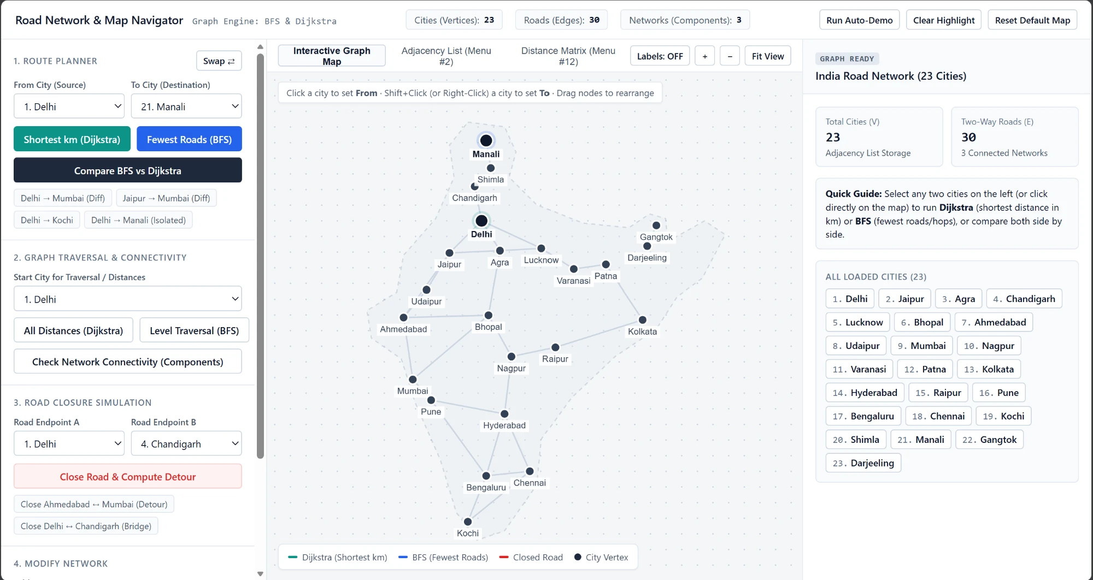





About the Project
C++ tool: cities = vertices, roads = weighted edges (km), solved with BFS + Dijkstra
Road connectivity
BFS finds separate road networks
Shortest distance
Dijkstra (min-heap): least-km route
Fewest roads
BFS (queue): route with fewest hops
Compare both
Same trip through BFS and Dijkstra
Interactive graph map: click cities to set From and To
Closures & editing
Detour and bridge check, add cities/roads
23
Cities
30
Roads
3
Networks
2
Algorithms
Smart City Delivery Network Optimizer
3 / 8

Slide 4
The Graph We Used
ADJACENCY LIST (HOW IT IS STORED)
Chandigarh
Lucknow
Delhi : Jaipur(280), Agra(233),
Chandigarh(245), Lucknow(555)
Agra : Delhi(233), Jaipur(240), ...
Jaipur : Delhi(280), Agra(240), ...
245
555
Delhi
335
WHY ADJACENCY LIST?
280
233
Space O(V + E), matrix needs O(V²)
Road maps are sparse: few roads per city
Visiting a city's neighbours is fast
Jaipur
240
Agra
Smart City Delivery Network Optimizer
4 / 8

Slide 5
BFS: Breadth-First Search
Explores the map level by level: all cities 1 road away, then 2 roads away, and so on, using a queue.
Level 0
Level 1
Level 2
Jaipur
Ahmedabad
1
Put the start city in a queue
Delhi
Agra
Bhopal
2
Take a city out, visit its unvisited neighbours
Lucknow
Varanasi
3
Repeat until the queue is empty
Delhi's neighbours first, then theirs
WHY WE USE IT
Fewest roads, reachability and connectivity checks
TIME
O(V + E)
SPACE
O(V)
Smart City Delivery Network Optimizer
5 / 8

Slide 6
Dijkstra's Algorithm
Finds the shortest total distance (km) from one city to all others, always expanding the nearest unvisited city using a min-heap.
Udaipur
395
1
Start city distance = 0, all others = infinity
Jaipur
Mumbai
260
660
525
2
Pick nearest city, update shorter distances
Ahmedabad
3
Repeat; rebuild route from parent[]
Jaipur to Mumbai: 395 + 260 + 525 = 1180 km beats 660 + 525 = 1185 km
WHY WE USE IT
Least-km route, detours after a road closure
TIME
O((V + E) log V)
SPACE
O(V)
Smart City Delivery Network Optimizer
6 / 8

Slide 7
BFS vs Dijkstra
 | BFS | Dijkstra
Minimises | Number of roads | Total km
Uses | Queue | Priority queue (min-heap)
Edge weights | Ignored | Used (non-negative)
Time | O(V + E) | O((V + E) log V)
Space | O(V) | O(V)
Used for | Connectivity, hops | Shortest route, detours
SAME TRIP, DIFFERENT ANSWER
Delhi to Mumbai
BFS
3 roads | 1465 km
Dijkstra
4 roads | 1460 km
Both run on the same adjacency list. BFS is faster, Dijkstra is needed once roads have different lengths.
Smart City Delivery Network Optimizer
7 / 8

Slide 8

Conclusion
Roads modelled as a weighted graph with an adjacency list
BFS gives fewest roads and checks connectivity in O(V + E)
Dijkstra gives the shortest km route in O((V + E) log V)
Road-closure simulation shows detours and cut-off cities
Thank You
Ronit Rai | Lovely Professional University

