Slide 1


Slide 2
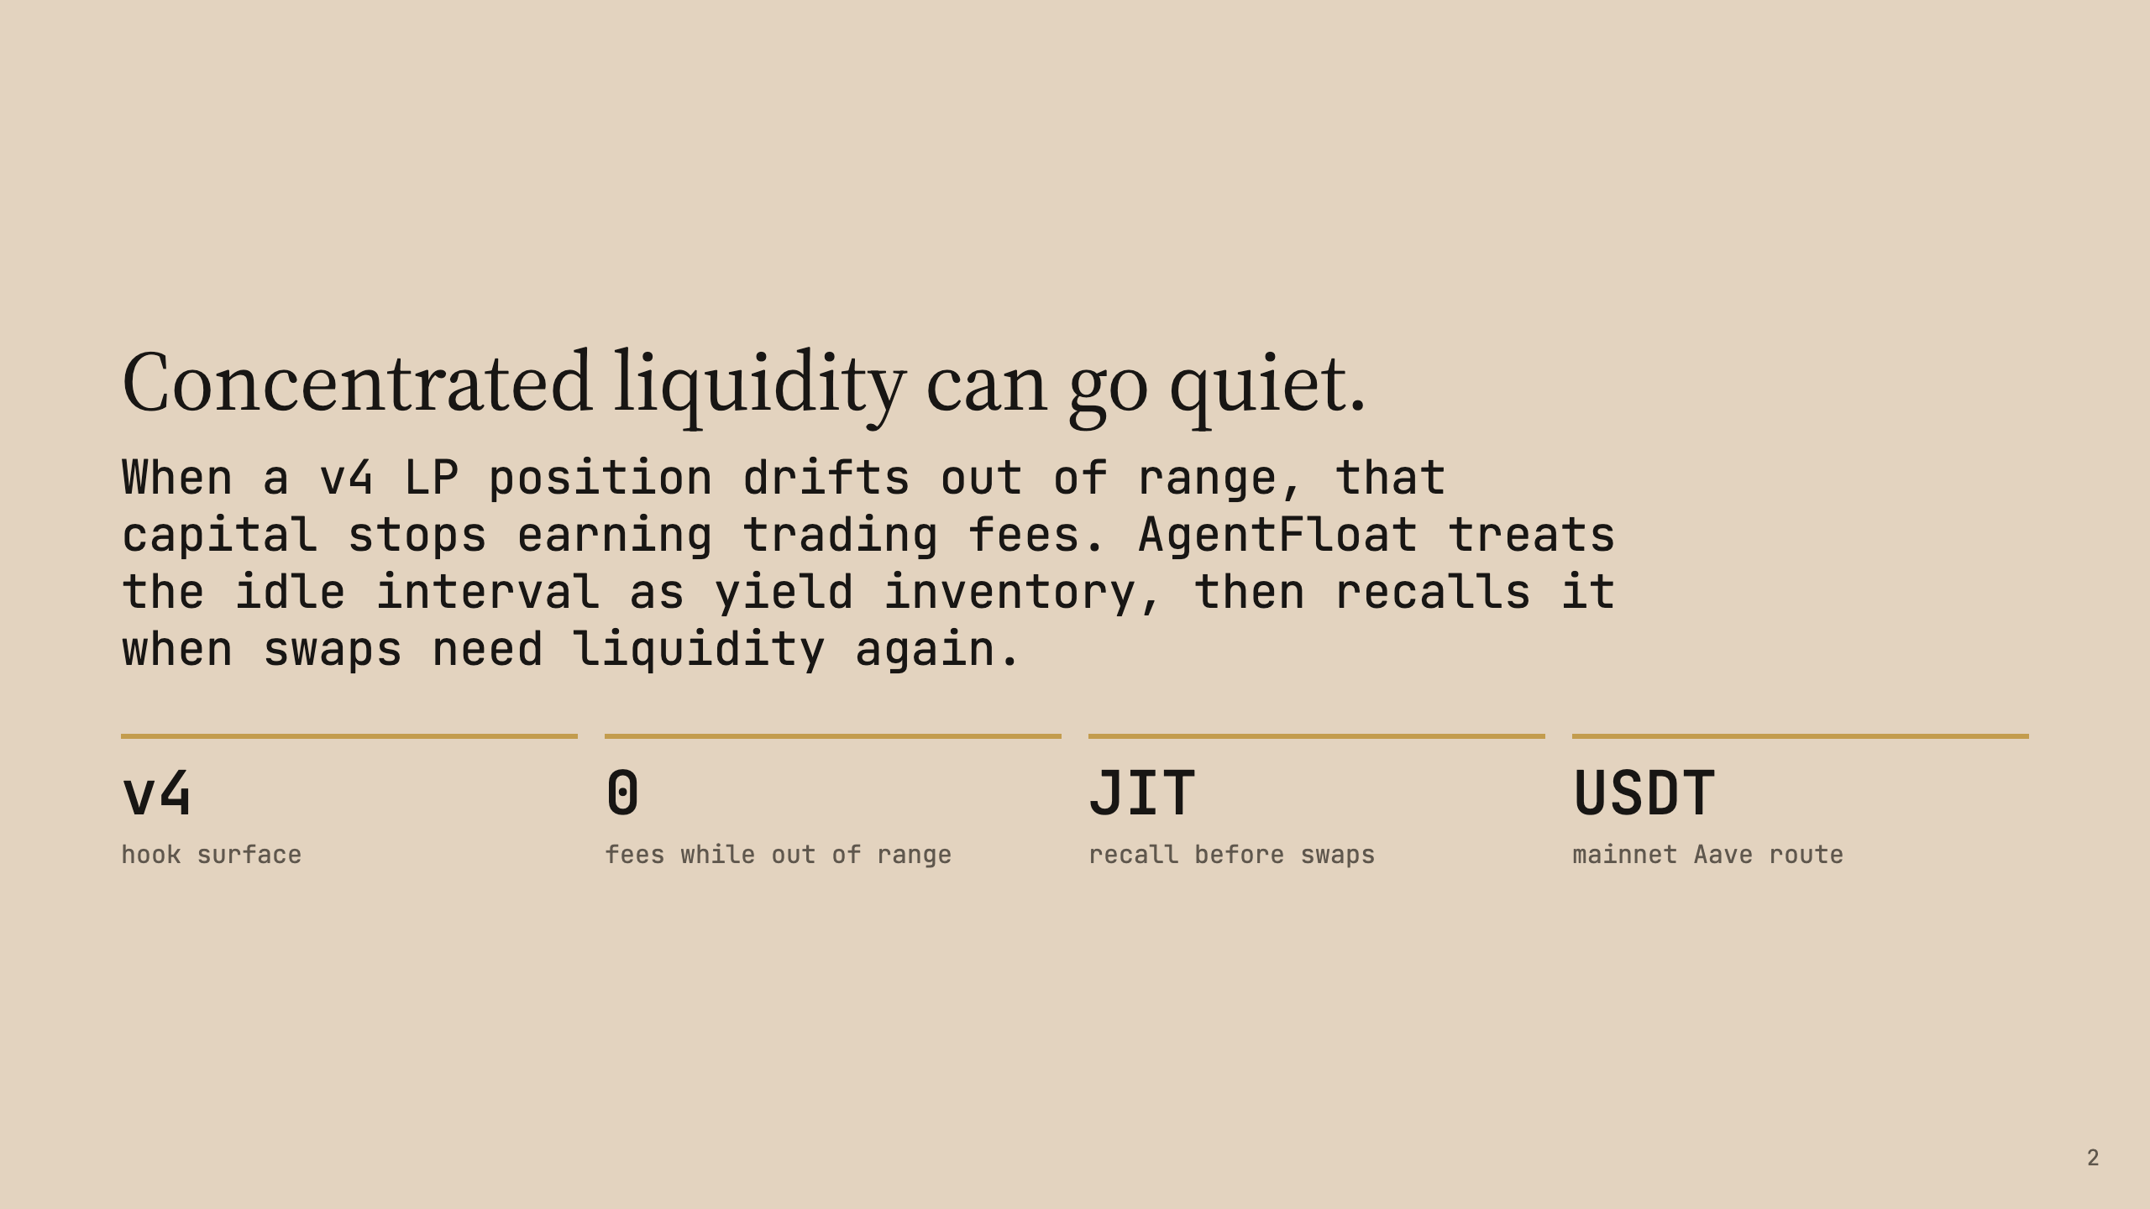

Slide 3
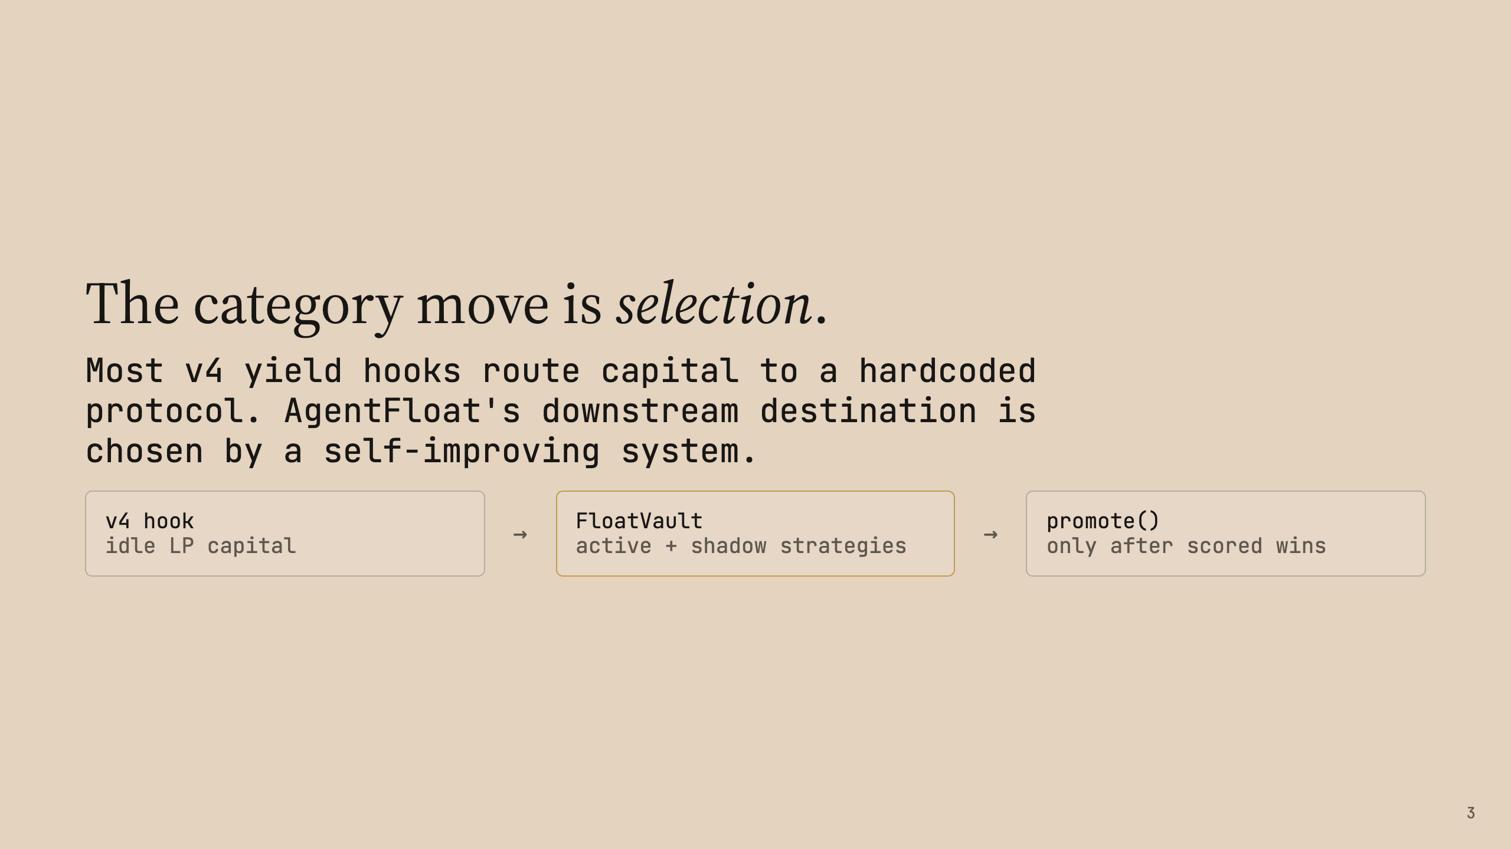

Slide 4
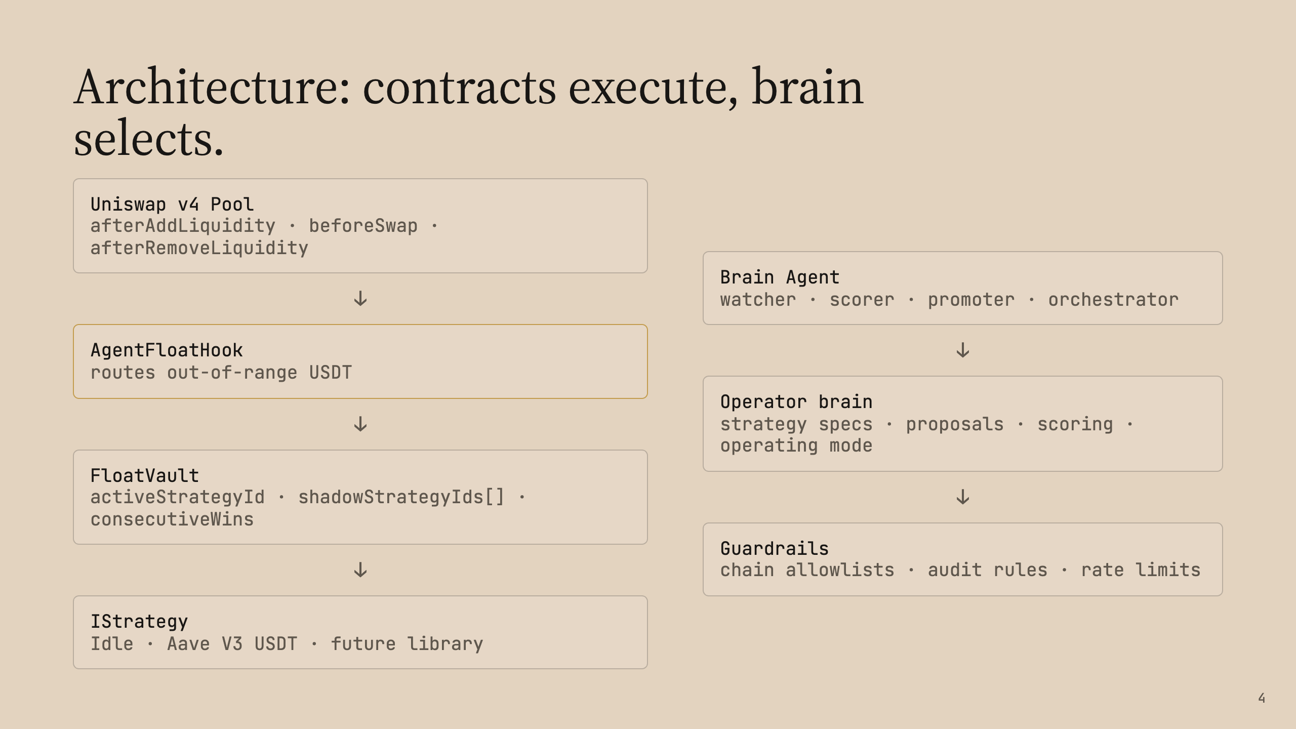

Slide 5
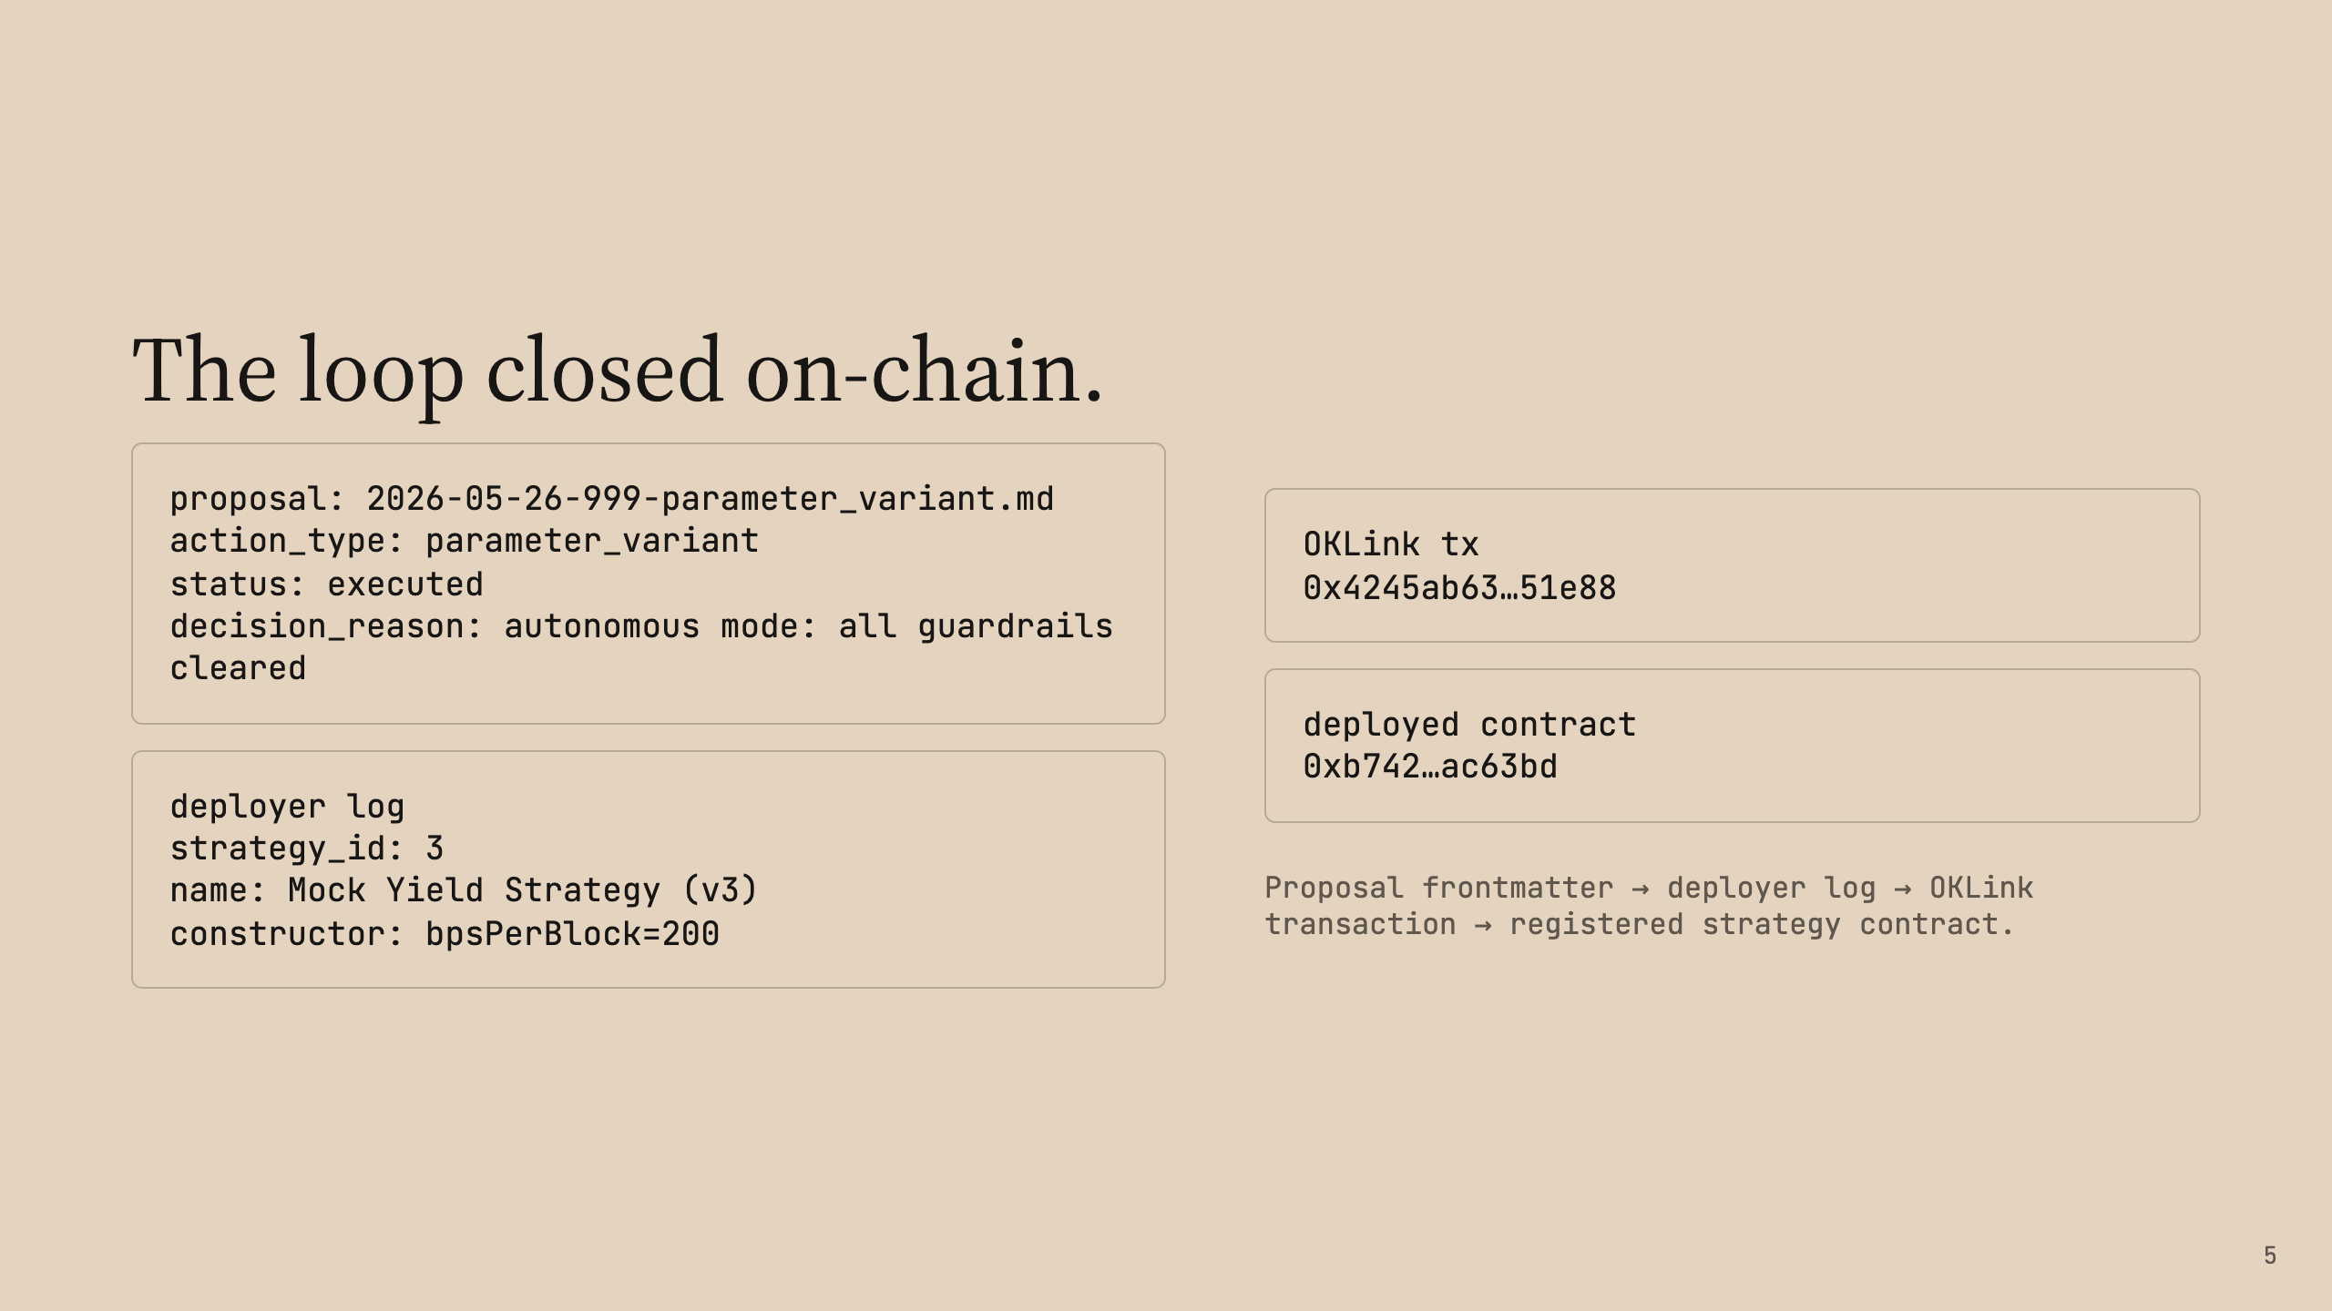

Slide 6
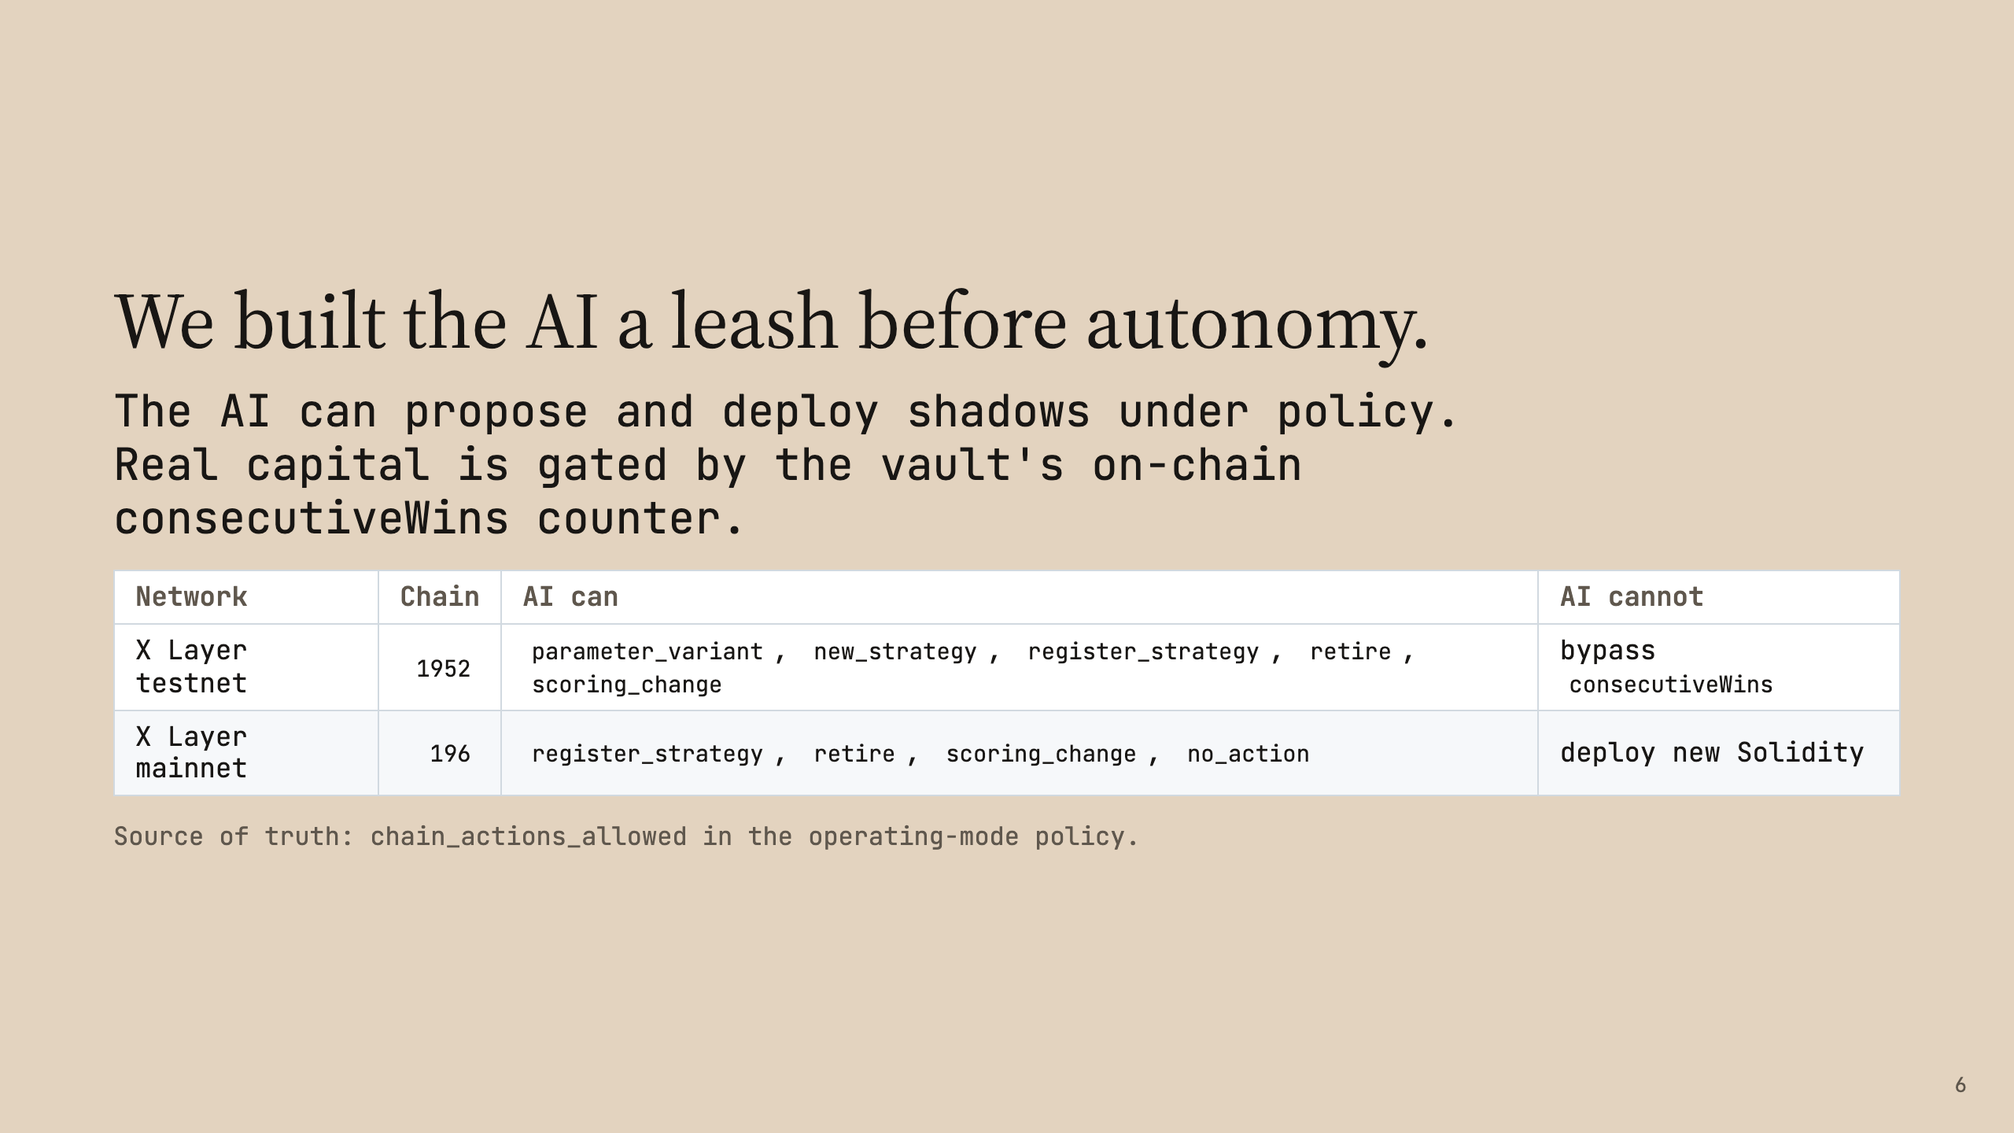

Slide 7
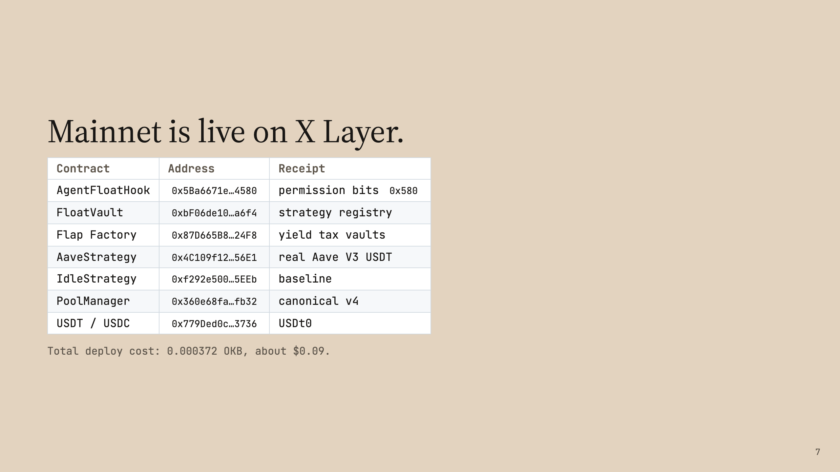

Slide 8
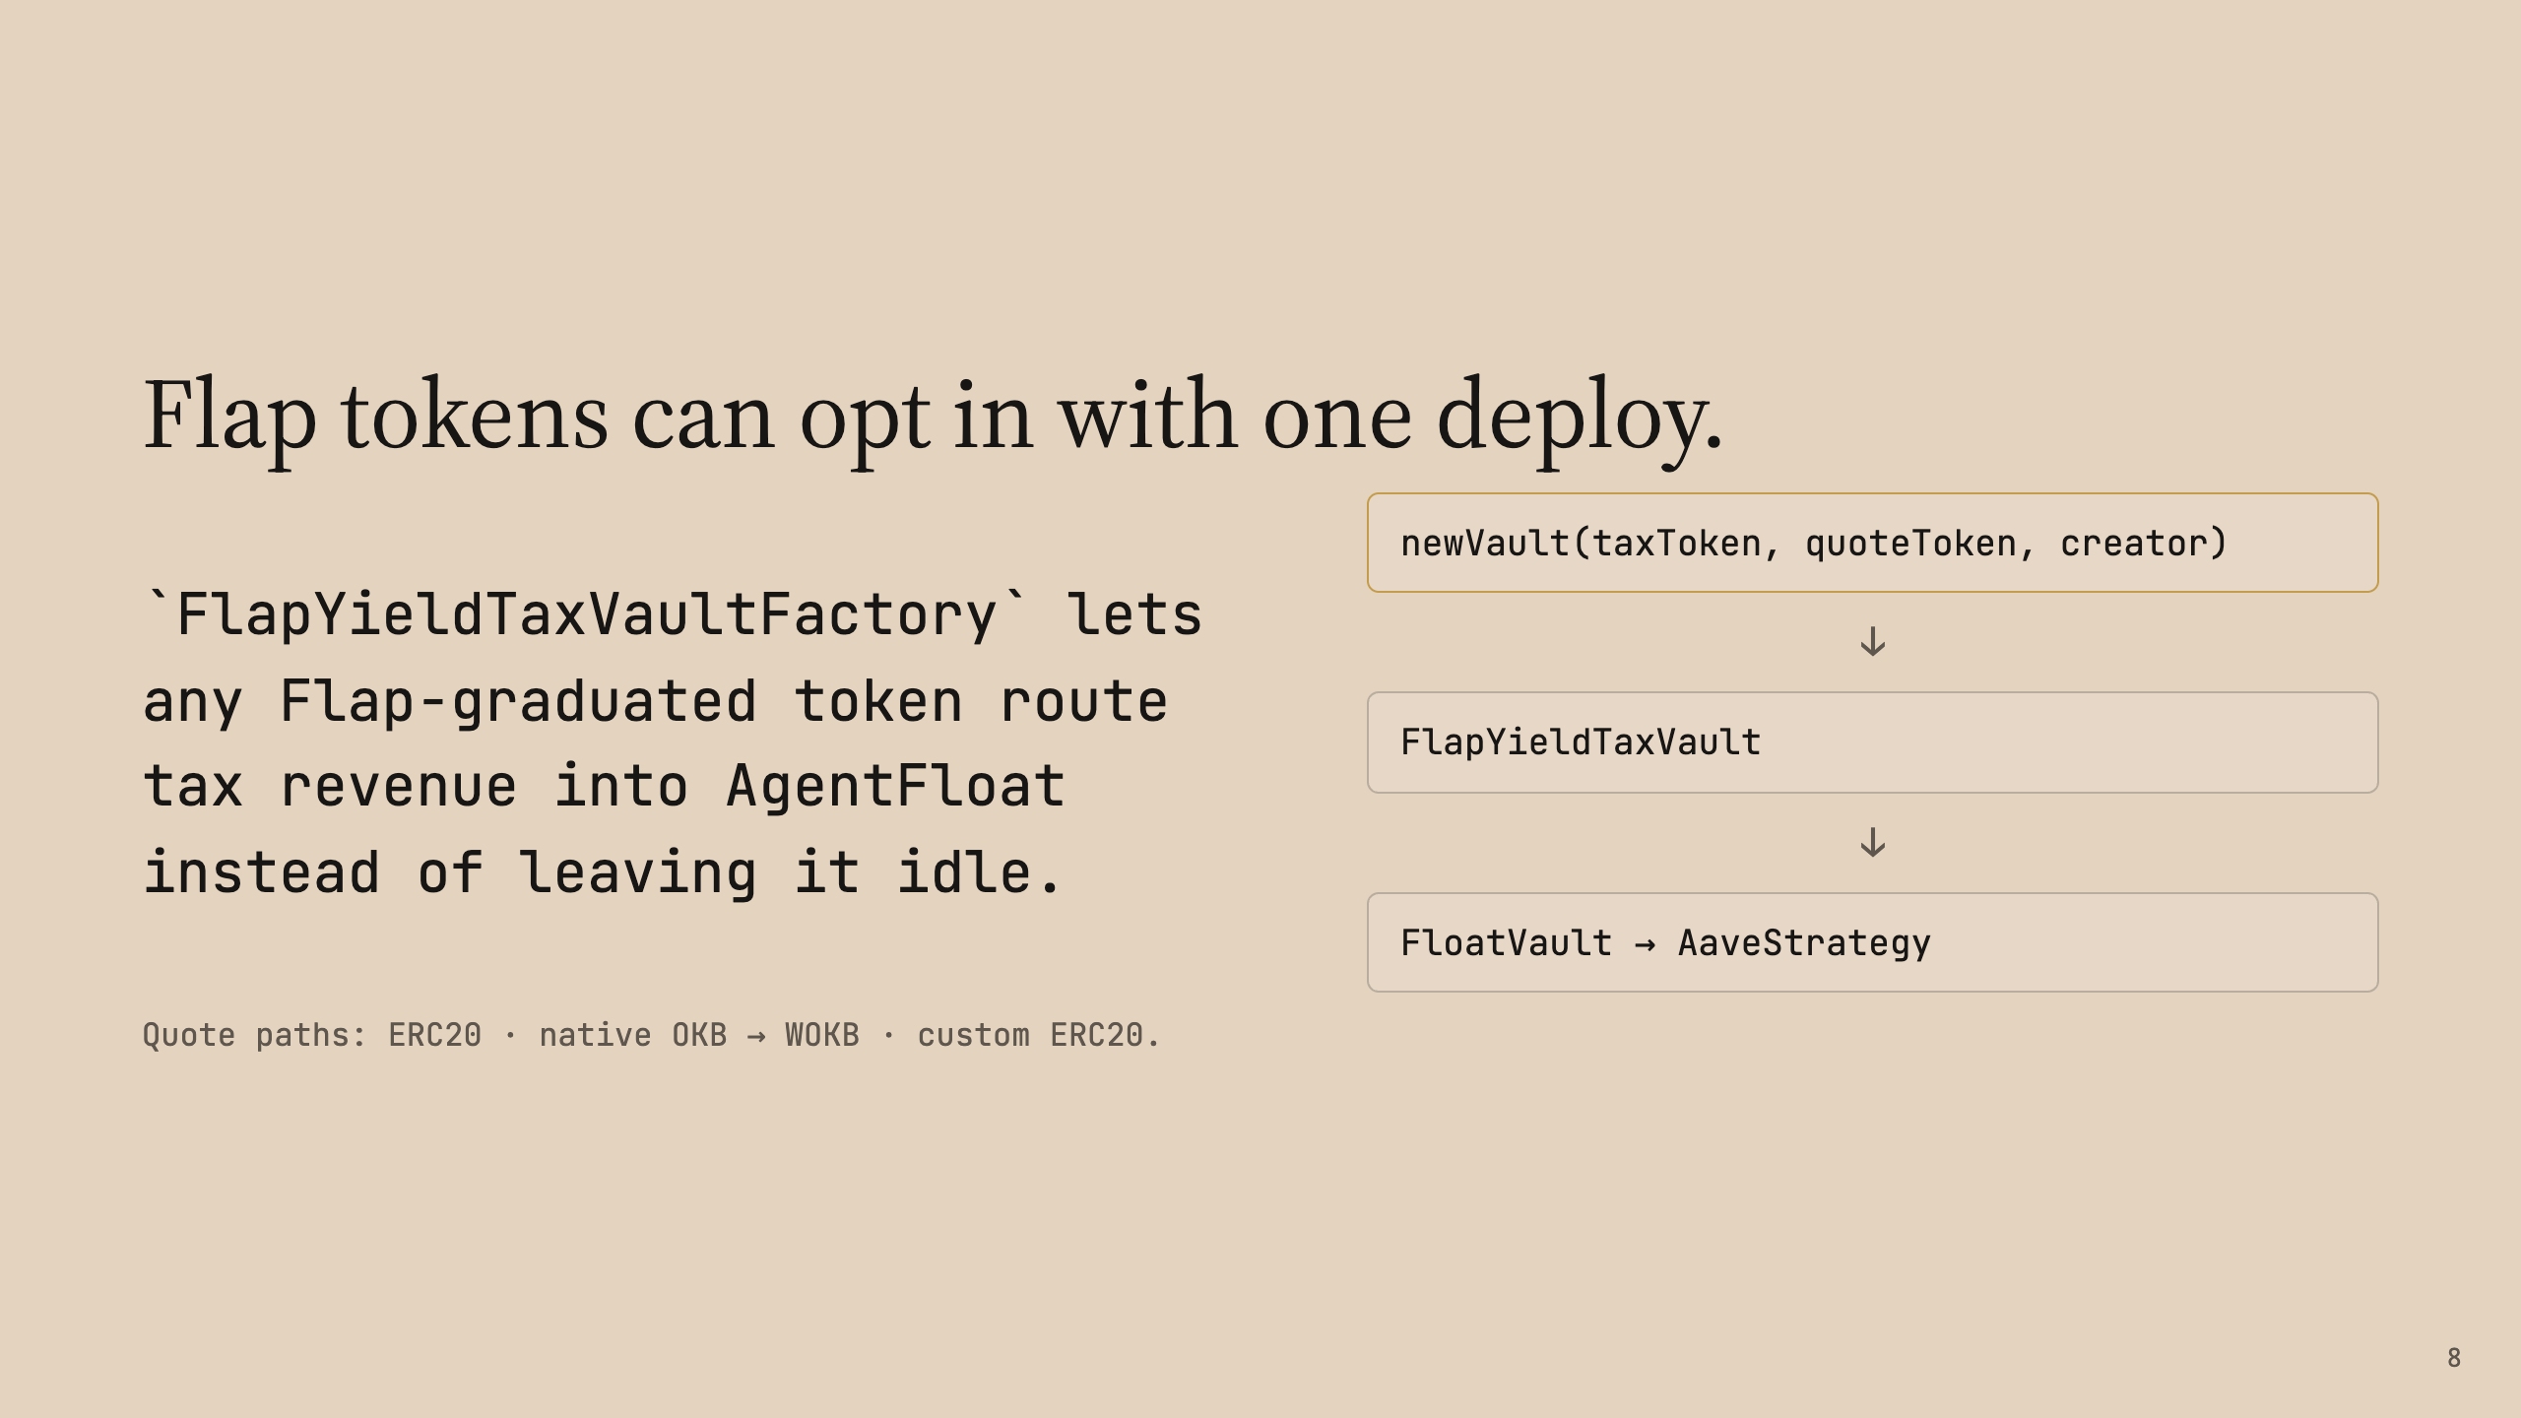

Slide 9
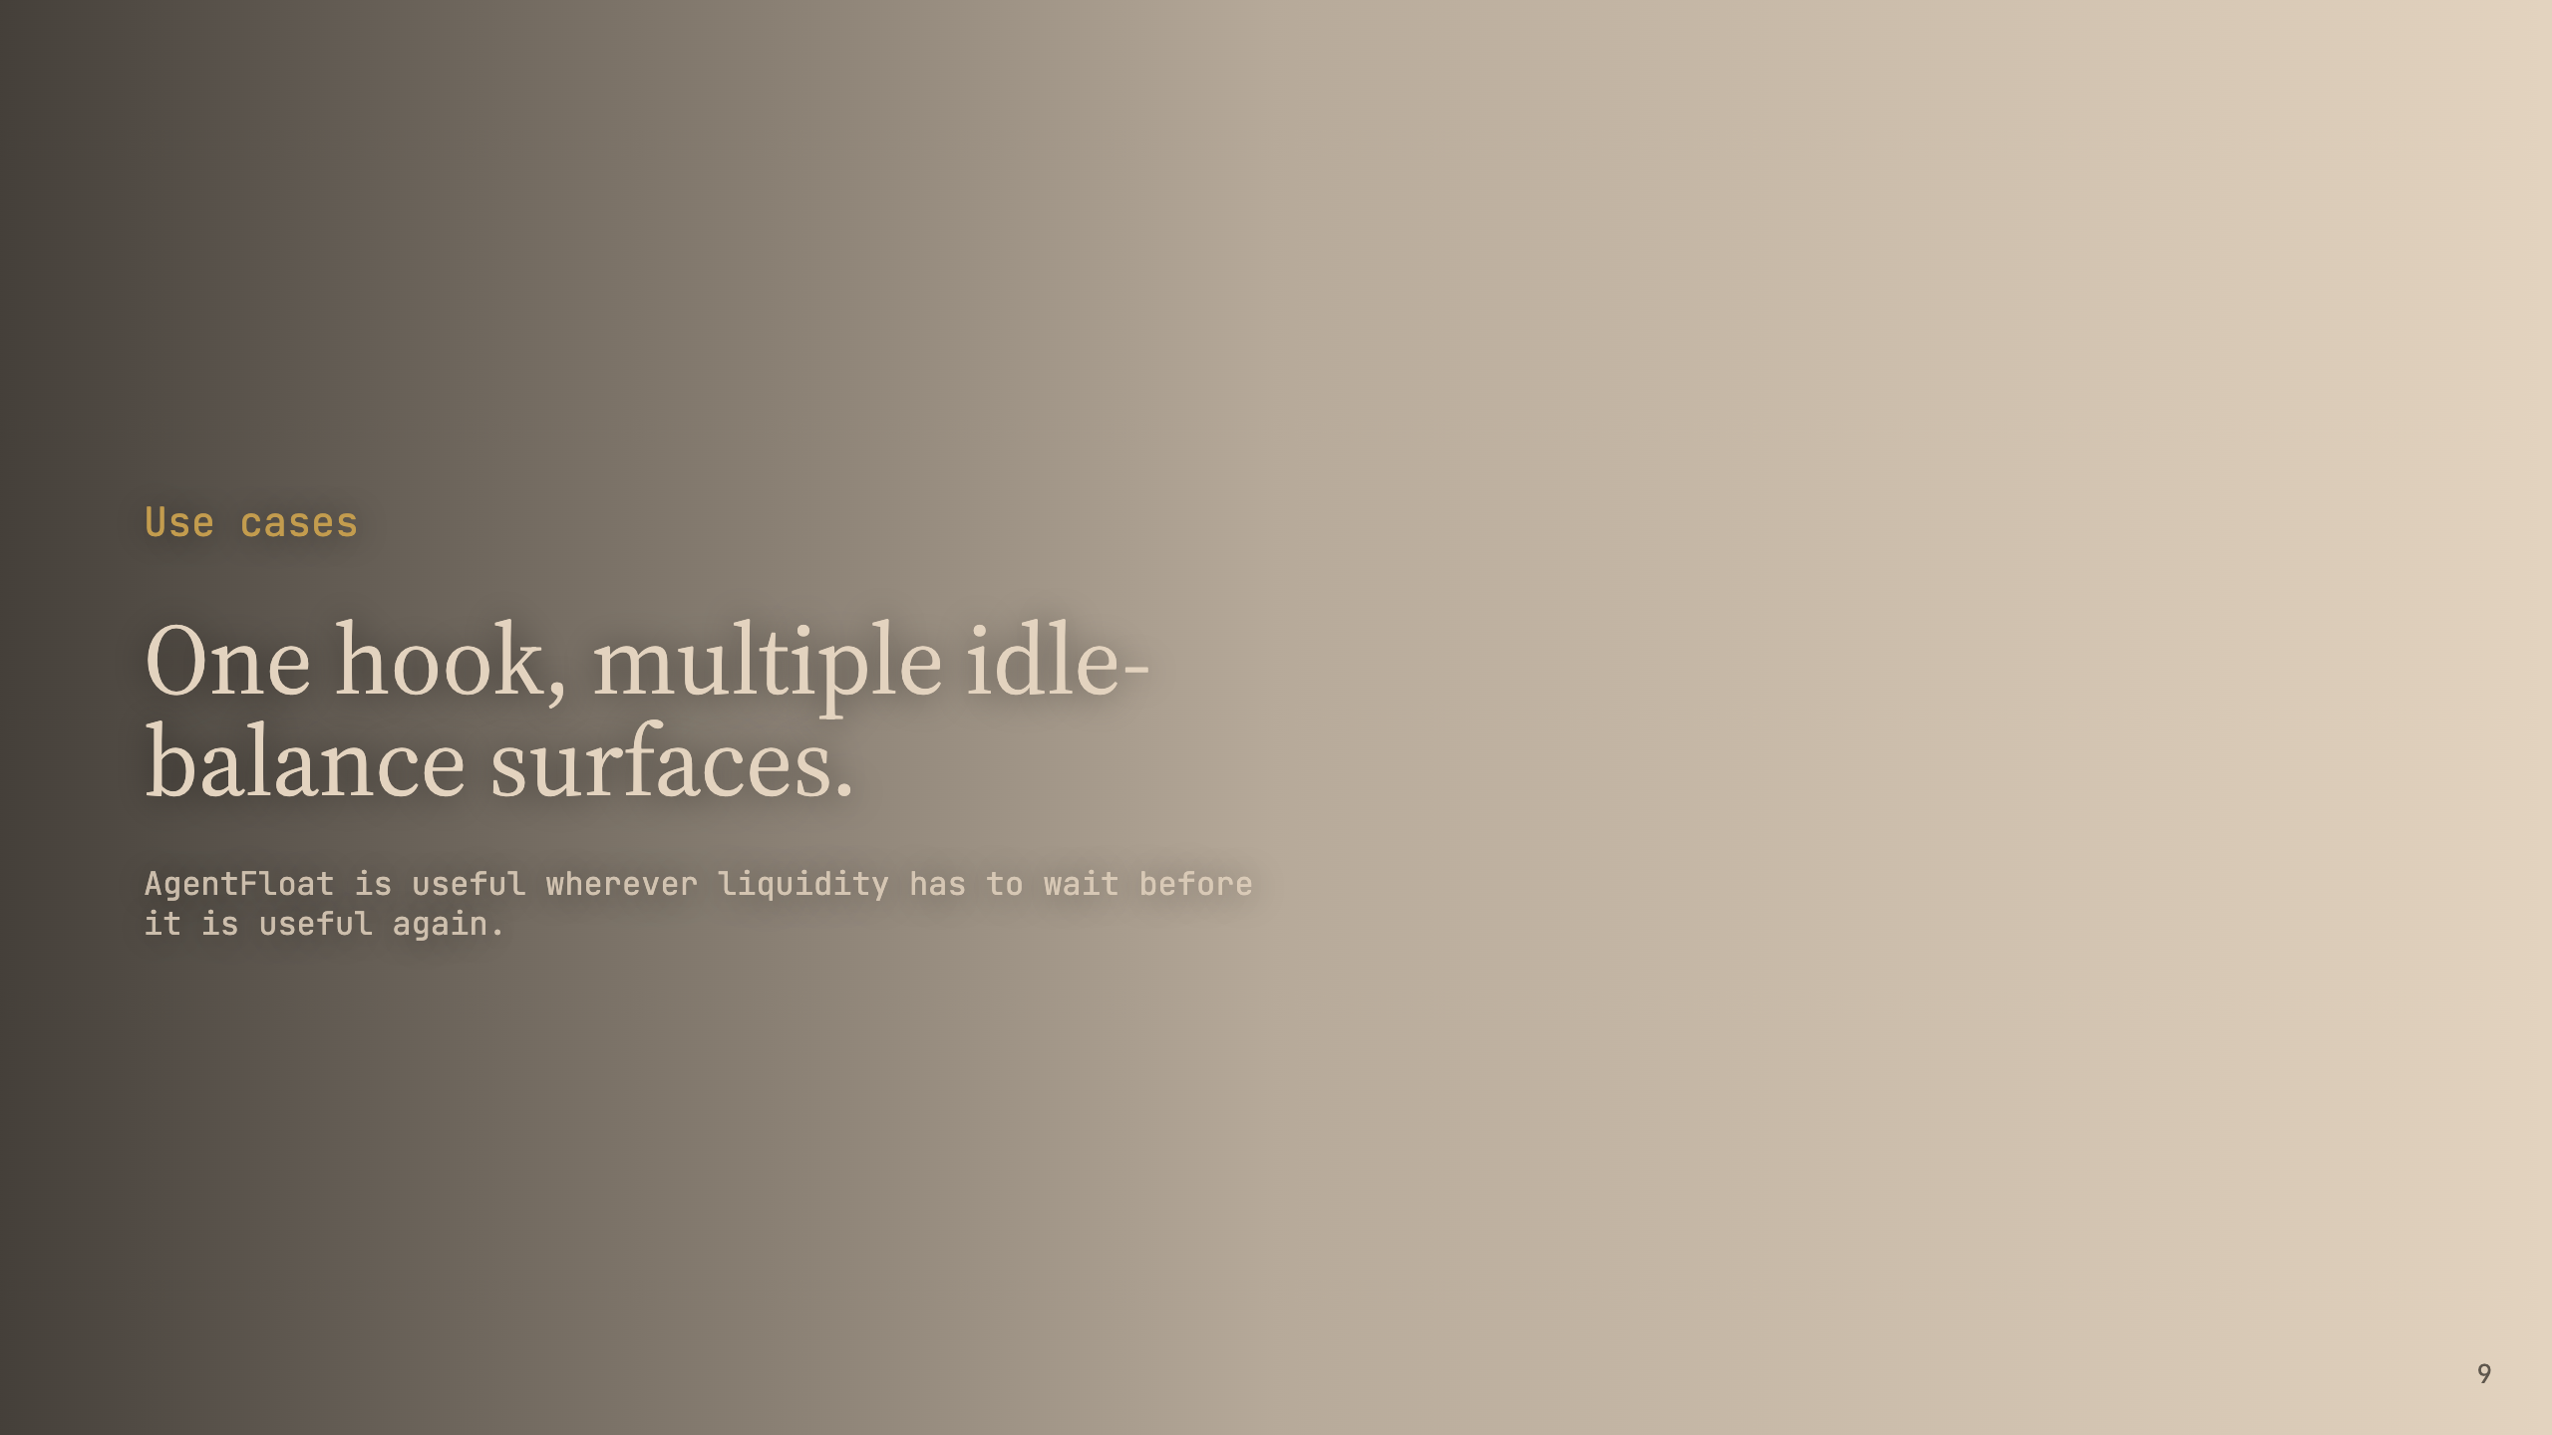

Slide 10
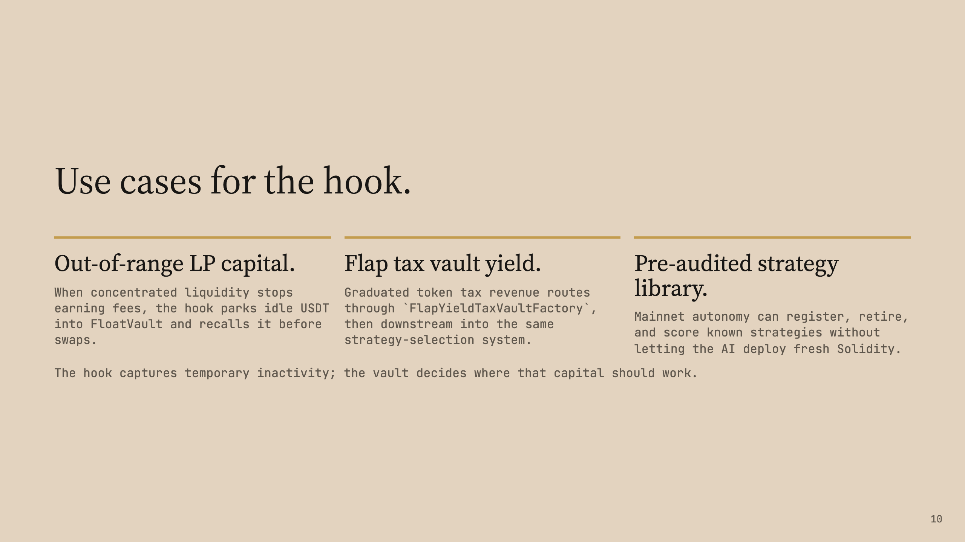

Slide 11
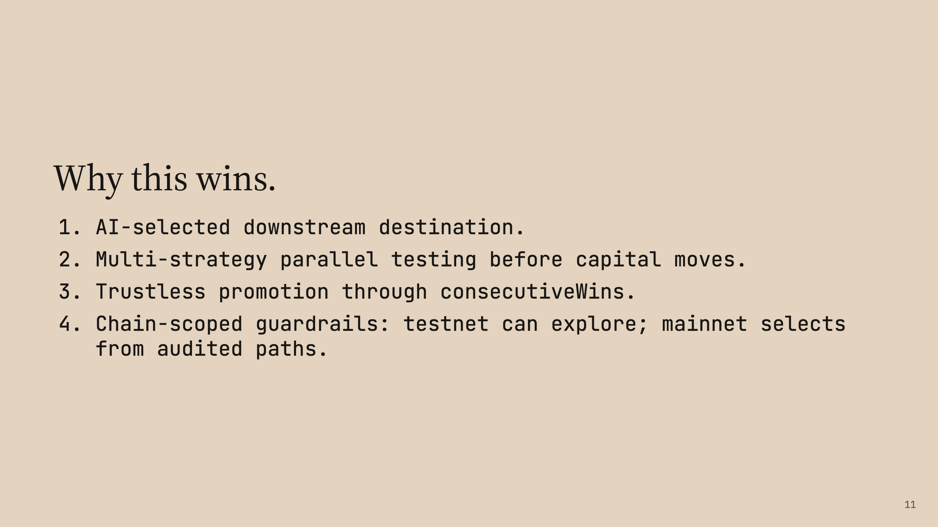

Slide 12
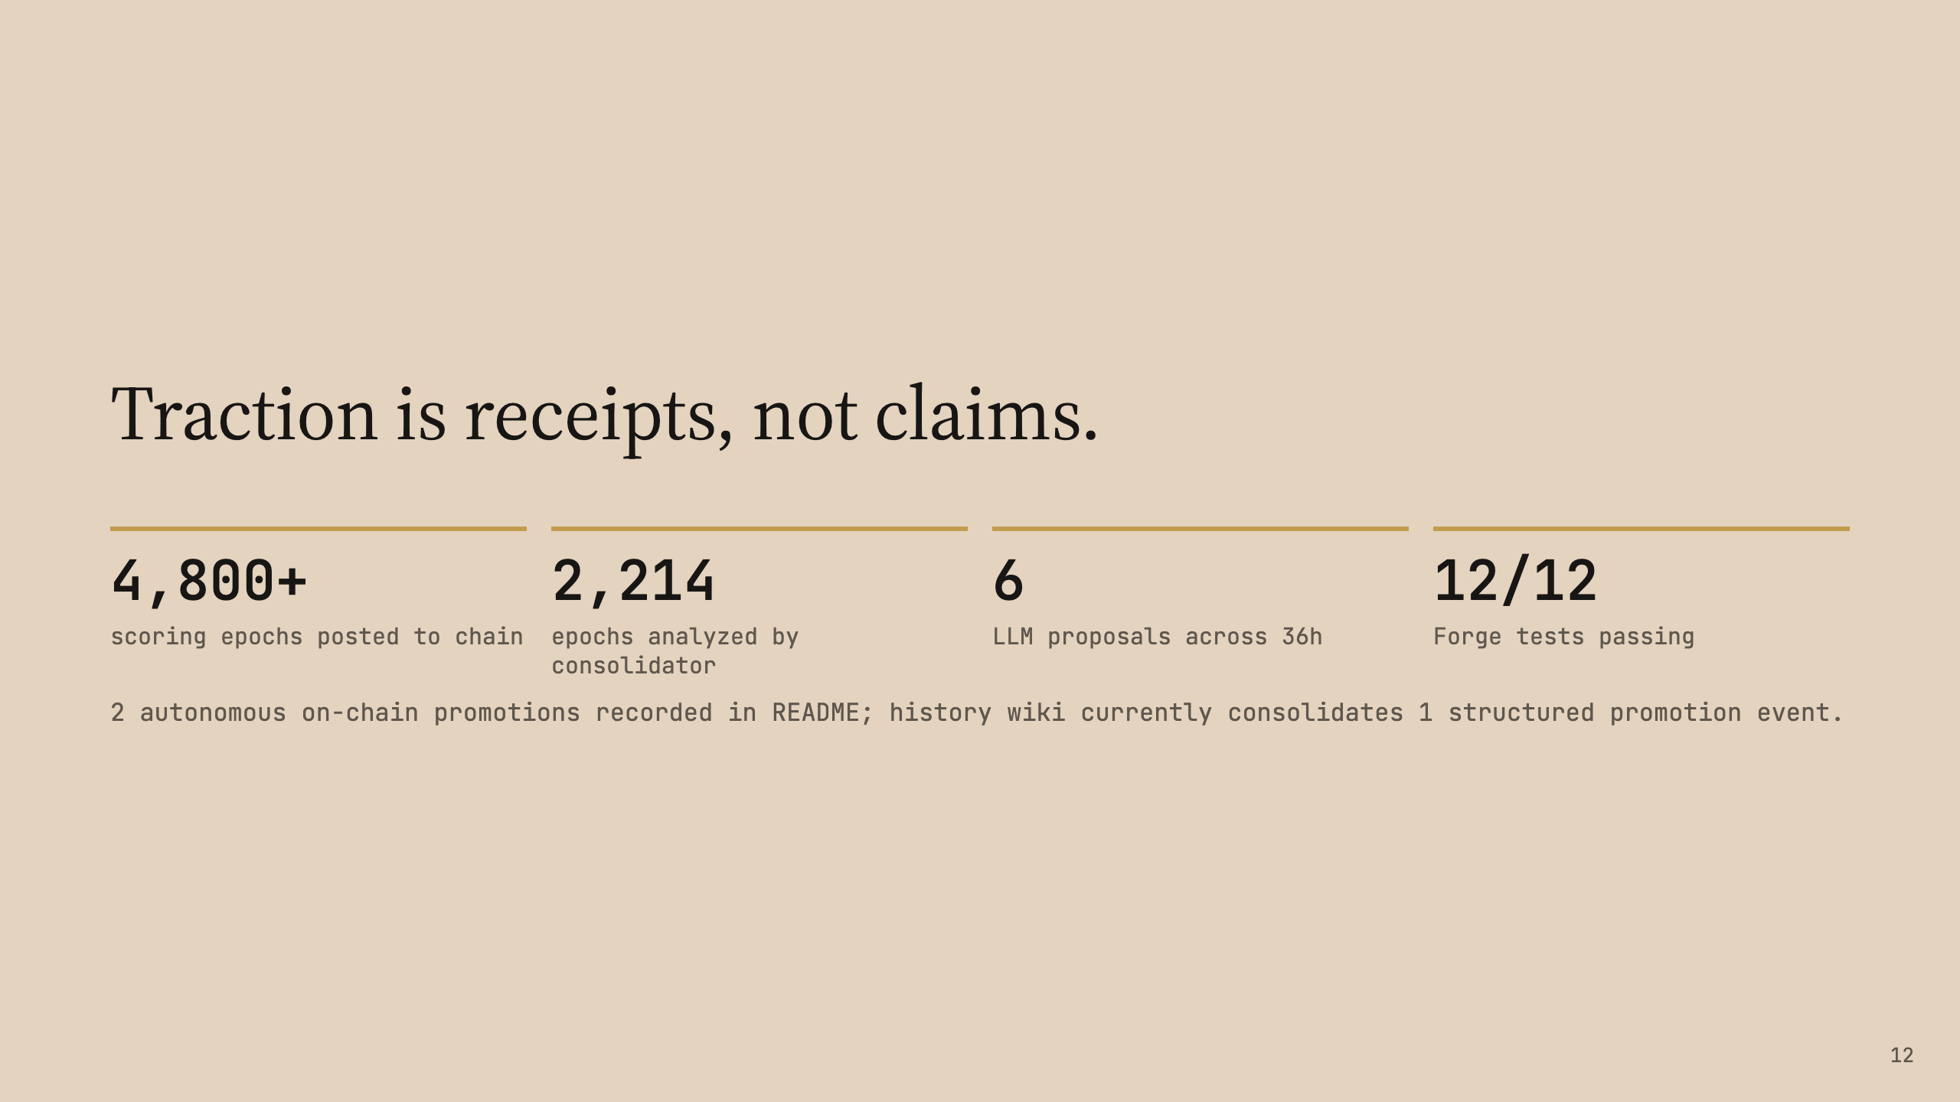

Slide 13


Slide 14
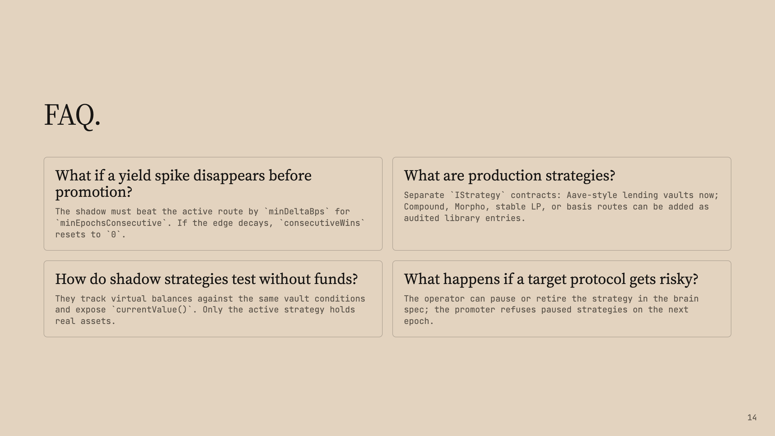

Slide 15
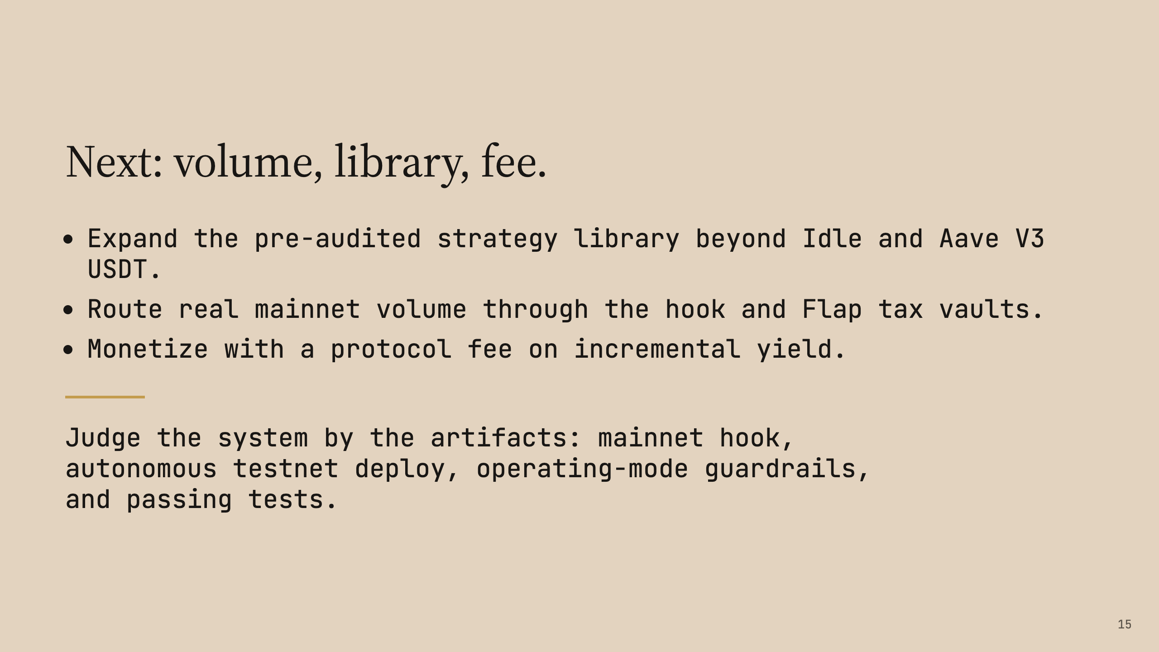
Notes:
Compile to PDF: marp ~/Documents/vibecoding/agentfloat-hook/docs/pitch-deck.md -o pitch-deck.pdf Compile to PPTX: marp ~/Documents/vibecoding/agentfloat-hook/docs/pitch-deck.md -o pitch-deck.pptx

