Slide 1
Zener Diodes: An extension of semiconductors
by Amarjeet Bharj and Gurraunak Singh Bedi

Slide 2
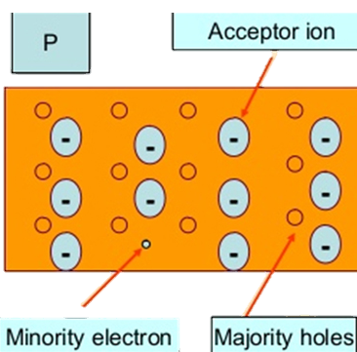
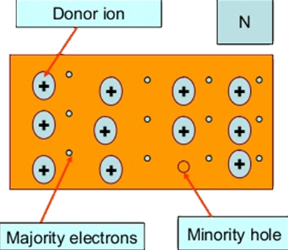
What are semiconductors?
Semiconductors are materials with electrical conductivity between that of conductors and insulators
Two main types – P-type semiconductor and N-type semiconductor
Their behavior can be controlled by doping, temperature, or applied voltage.

Slide 3
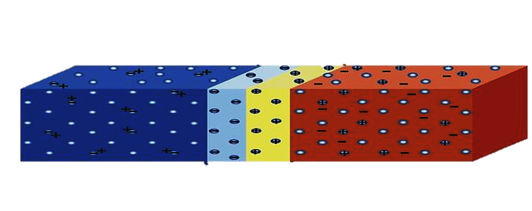
Semiconductor diodes
A semiconductor diode is a device made from a p-n junction in a semiconductor material, allowing current to flow in one direction while blocking it in the opposite direction
P-type semiconductor
N-type semiconductor
Depletion region

Slide 4
What are Zener diodes ?
Zener diodes are a special class of diodes designed to operate in reverse breakdown mode.
Two main types – Zener breakdown diode and Avalanche breakdown Diode
Their primary function is to provide voltage regulation, protection, or voltage reference in electrical circuits.

Slide 5
Comparison of Zener and Avalanche Diodes
Features | Zener Breakdown | Avalanche Breakdown
Voltage Range | 𝑉_{𝑍} < 5V | V_{Z}​ > 5V
Breakdown mechanism | Quantum Tunneling | Impact Ionization
Temperature Coefficient (𝛼) | Negative (𝛼 < 0) | Positive (𝛼 > 0)
Depletion Region Width | Narrow | Wider
Applications | Precision Voltage Regulation | Higher Voltage Applications

Slide 6
Experiment 1: Determining the Breakdown Voltage (𝑉_{𝑍}) of a Zener Diode

Slide 7
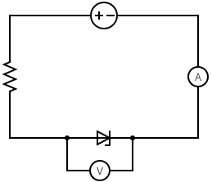
Setup and method
A 270Ω resistor was used
Input voltage, V_{I} was Gradually increase the from 0 V
For each step, the following were record:
Voltage across the Zener diode, V_{Z} and V_{I}
Current through the Zener diode, I_{Z}
The point where the voltage stabilizes was identified
This was done for both Zener diode and Avalanche diode

Slide 8

Result and Analysis
Reverse I-V characteristics of the Zener diode was plotted
The point where the current starts to increase rapidly and the voltage stabilizes, was located. This voltage is the breakdown voltage (V_{Z}).
A linear regression and a verification was performed using the eq $V_{I}=I_{Z}R+V_{Z}$

Slide 9
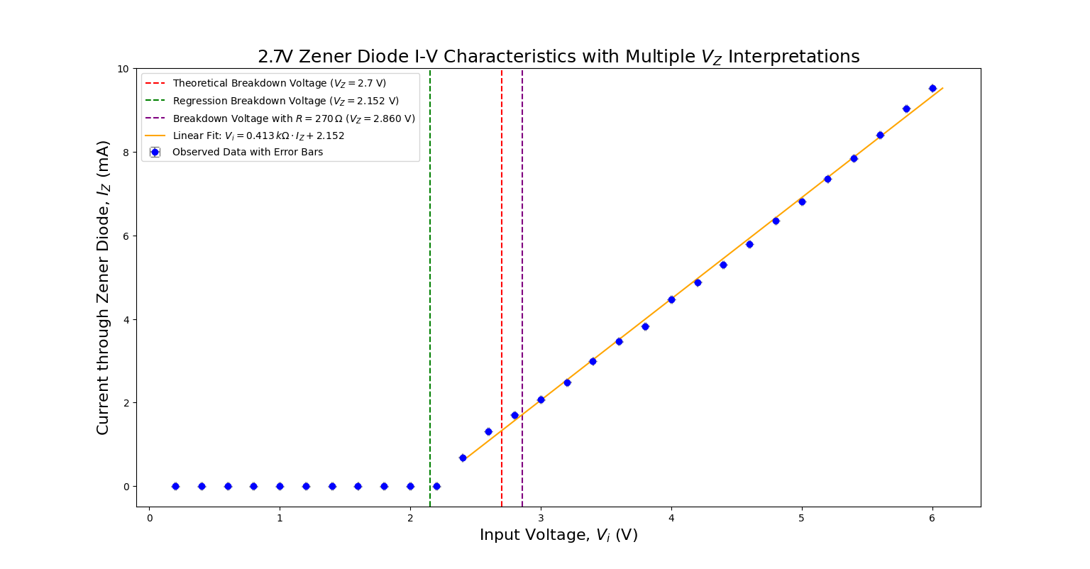

Slide 10
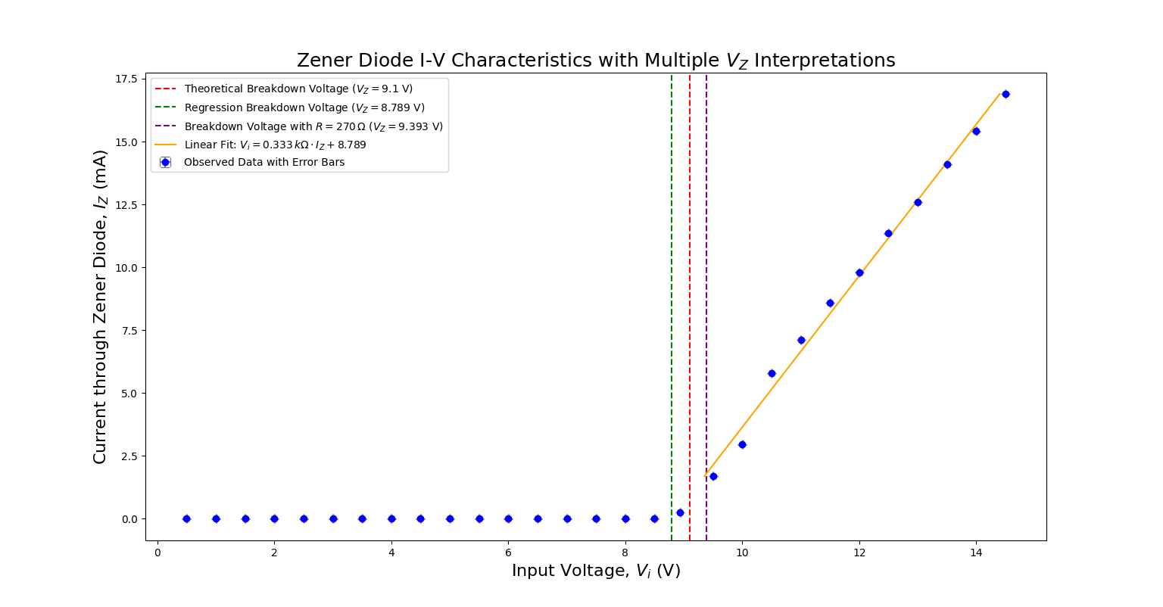
9.1V

Slide 11
Experiment 2: Voltage Regulation Test

Slide 12
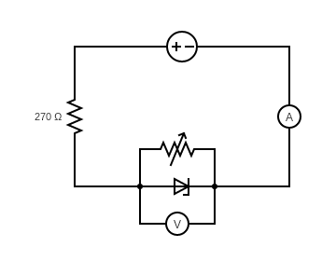
Setup and method
A 270Ω series resistor and a variable load resistor was used
Input voltage, V_{I} was Gradually increase the from 0 V in small steps
For each step, the following were record:
Voltage across the load resistor, V_{Z} and V_{I}.
Current through the Zener diode, I_{Z}
This was done for a range of load resistances but was only done for the avalanche diode

Slide 13
Result and Analysis
Similar V-I characteristics graph, to the previous experiment, were obtained
The voltage across the load resistor or the Zener diode remains near constant at the breakdown voltage
This was verified using different values of resistances

Slide 14
V_{Z} = 9.1 V
For 500 Ω
For 600 Ω
For 700 Ω
For 800 Ω
For 900 Ω
Vi | Vz
1 | 0.346
2 | 0.637
3 | 0.713
4 | 0.742
5 | 0.757
6 | 0.77
7 | 0.78
8 | 0.789
9 | 0.795
10 | 0.803
11 | 0.809
12 | 0.814
13 | 0.819
14 | 0.824
15 | 0.829
Vi | Vz
1 | 0.398
2 | 0.672
3 | 0.723
4 | 0.745
5 | 0.759
6 | 0.77
7 | 0.779
8 | 0.787
9 | 0.793
10 | 0.8
11 | 0.804
12 | 0.81
13 | 0.814
14 | 0.819
15 | 0.824
Vi | Vz
1 | 0.42
2 | 0.683
3 | 0.739
4 | 0.768
5 | 0.793
6 | 0.814
7 | 0.833
8 | 0.849
9 | 0.866
10 | 0.88
11 | 0.82
12 | 0.827
13 | 0.832
14 | 0.839
15 | 0.845
Vi | Vz
1 | 0.481
2 | 0.692
3 | 0.732
4 | 0.754
5 | 0.769
6 | 0.78
7 | 0.79
8 | 0.789
9 | 0.796
10 | 0.801
11 | 0.806
12 | 0.811
13 | 0.815
14 | 0.82
15 | 0.823
Vi | Vz
1 | 0.476
2 | 0.698
3 | 0.732
4 | 0.751
5 | 0.765
6 | 0.775
7 | 0.783
8 | 0.789
9 | 0.796
10 | 0.801
11 | 0.806
12 | 0.812
13 | 0.816
14 | 0.82
15 | 0.825

Slide 15

Errors and precautions
The resistor values chosen were below the diode’s maximum rating.
The maximum power dissipation of the Zener diode given by $P_{Z}=V_{Z}∙I_{Z}$ was not exceeded
Proper grounding and secure connections were ensured
Some leakage current was also taken into account

Slide 16
Conclusion
The Zener diode maintained a stable breakdown voltage (𝑉_{𝑍}) in reverse bias, confirming its role in voltage regulation.
It effectively stabilized output voltage under varying input or load conditions.
Its non-linear I-V behavior highlights its utility in power supplies and overvoltage protection in circuits.

Slide 17
Questions

