Slide 1

DriverPass System Analysis
Renaldo Musto

Slide 2

System Requirements
The system will verify user credentials when a login is attempted
The system will allow the customer to interact with their online classes as necessary
The system needs to be able to be accessed by all the major web browsers
The system should allow the customer to create modify or delete their account with DriverPass
Notes:
The ability for the system to verify user credentials every time someone logs in is essential to security and the systems integrity overall. In order for the system to meet basic requirements for use by the customer the system will need to provide the customer with the ability to interact with their online classes in all the necessary ways and to allow them to create, modify or delete their account with DriverPass.In order to ensure that we can reach as many potential customers as possible we will add compatibility for all the major web browsers such as Firefox, Chrome and Edge.

Slide 3
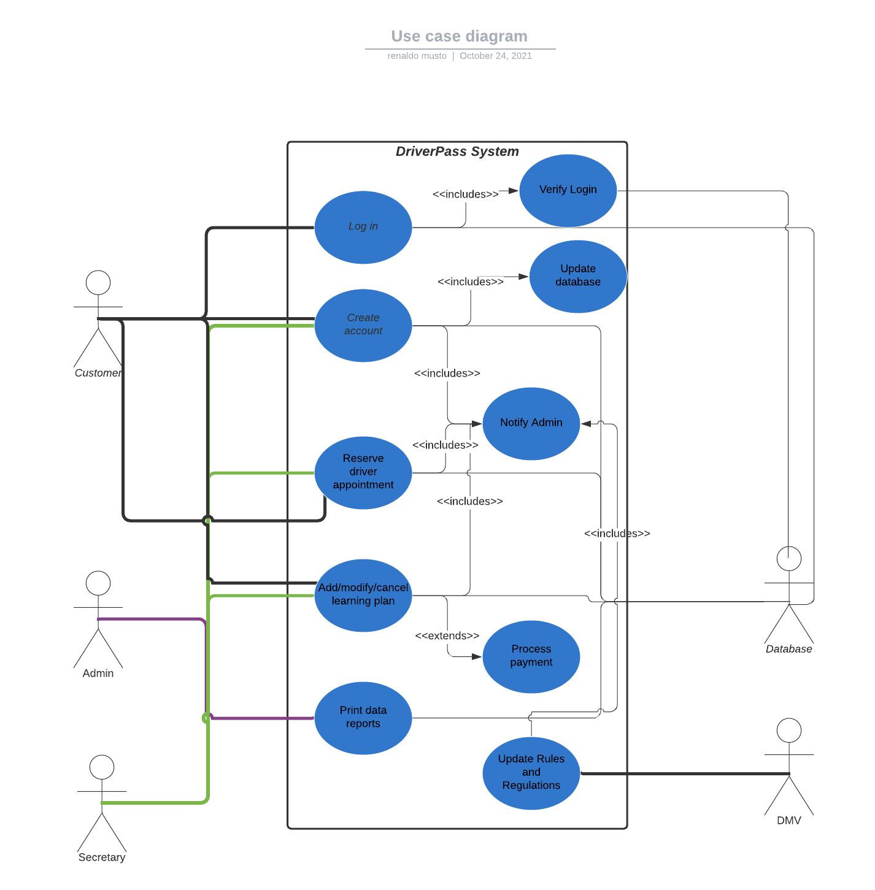
Use Case Diagram
[Insert your use case diagram here.]
Notes:
My use case diagram describes three different types of accounts that will be regularly interacting with the system. We have the customer account that has the ability to login in, create an account, reserve a driver appointment and add, modify or cancel their learning plan. The secretary account has the ability to login in, create accounts on behalf of the users, add, modify or cancel their learning plans and reserve drive appointments on their behalf. Finally the Admin account will have access to everything the customer and secretary can do as well as download data reports from the system and receive notifications from the system when necessary. Whenever someone makes a change to the system the admin is notified of the change and is given a detailed report of the change. The two main external systems that will be interacting with DriverPass are the cloud database we employ and the DMV website. The DMV will notify the admin of any changes made to the rules and regulations and any changes made to the system will be updated with the database. Logins will also be verified with the credentials stored in the database.

Slide 4
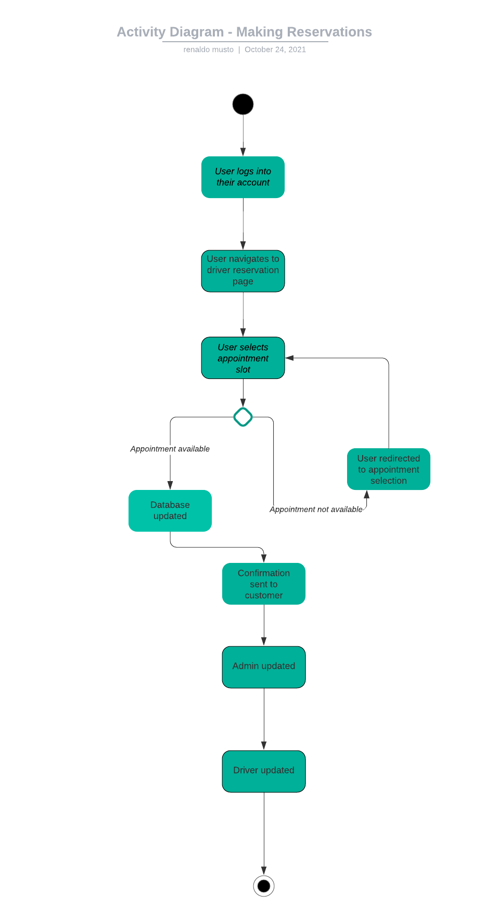
Activity Diagram
Notes:
[Explain your diagram. Which use case are you breaking down? What are the steps for this use case? How did you account for DriverPass’s needs in your design? In your explanation, keep your audience in mind. Avoid the use of technical terms such as “nodes,” “control flows,” and so on.]
The use case that I chose to break down here is for when a customer would go to make a reservation. The process would be basically identical for a secretary but with a couple small differences so I chose to separate them. First the user would log into their account which is something that deserves an entire activity diagram for itself then the user would navigate to the driver reservation page. From there the user would need to select an appointment time. Now the program would have to decide based on the information available to it whether the selected appointment is available to the customer or not. If it is not available the user would be redirected to the appointment selection page so they could choose again and it if it is available then the database would be updated to reflect the new availability, next a confirmation would be sent to the customer the admin would also be notified of the new appoint and so would the driver.

Slide 5
Security
Verified login every time
Different accounts with varying levels of access
Security is handled by the cloud service hosting our database
Notes:
During our interview you requested that security be primarily handled by the cloud service we are going to use for our websites database. So we are going to have all information about the system securely stored remotely in this cloud based database. But we were able to add in some extra functionality on our end to help prevent unauthorized access to that information. Every time someone attempts to login to the system their login information will be verified against th true copy stored in the database in a secure way. Next to make sure nobody makes and changes or views information they aren’t supposed to we have three accounts with varying levels of access. The Admin account will have full control over the system and be able to access sensitive information about customers and the system itself, the secretary account will have the ability to make and edit any user account and the customer account will only be able to access and edit their own account.

Slide 6
System Limitations
We need to be finished by May 10th
We must stay within the budget of DriverPass
We need to make sure that the system is able to be run by the average customers computer
The website should not need a lot of data transfer to operate and should be able to run on average internet connection speeds.
Notes:
While I believe that we hit all the desired functionality staying within the budget and deadline forced us to make a few compromises when it came to the design of this system. For example we were not able to allow you to easily add and change classes on your own as you requested in the interview but if it were in the budget to hire a developer then that would have been possible. Also we focused mainly on functionality and did not include in the timeframe any space for extra ease of use other than what was required. We did need to keep the website relatively simple and couldn’t add many flashy animations or anything like to ensure that it could run on the average computer and internet connection.

