Slide 1
SCRUB the Shard
model unlearning approach
presented by Ronnakorn Rattanakornphan | 04/19/2024
Notes:
Published in ICLR 2015

Slide 2
Overview
In this work, we present
Model unlearning approach, combining
SISA: model unlearning by retrain a model slice
SCRUB: model unlearning by teacher-student learning
SCRUB the Shard

Slide 3
Background
SCRUB the Shard
Explaining and Harnessing Adversarial Examples

Slide 4
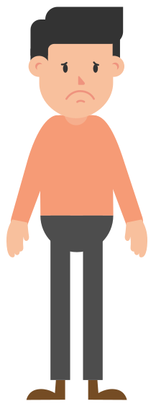
Background
What does model unlearning even mean?
Bob previously allows his data to be included in AIDS prediction model, but now he doesn’t want his data to be included anymore.
We want to not only remove Bob from training set,
but also any influence of Bob in the model
Remove influence => model unlearning
Remove my data!
SCRUB the Shard
Notes:
Might add another slide “why model unlearning is difficult”

Slide 5
Background
Model unlearning (formally)
Output on unlearned model trained on D_{all} the same as
Output on model trained on D_{r}
given dataset
D_{all} = D_{u} ⋃ D_{f}
D_{all} = all data
D_{f} = (to be) forget data
D_{r} = retained data
A = learning algorithm
SCRUB the Shard

Slide 6
Background
Challenge in unlearning
Hard to understand impact of a data point
Especially worse in NN
Stochastic training
Training is non-deterministic
Incremental training
An update on a training point affect later update following that training point
SCRUB the Shard
Notes:
Might add another slide “why model unlearning is difficult”

Slide 7
Background
Model unlearning method (naive)
Just remove the unlearn data D_{f} and retrain the whole model
Golden standard (this is exactly what we want)
Disadvantage
Slow to retrain the model from scratch
Might not have initial data, D_{r}
Common in federated learning
SCRUB the Shard

Slide 8
Background
Model unlearning approaches
Data reorganization
self-poison
Data pruning
divide dataset into multiple pieces, then aggregate them later
Data replacement
transform training data
SCRUB the Shard
Notes:
Data obfuscation
We want to unlearn x of class 5
Add duplicate of x with class =/= 5
Fine-tuning model on poisoned data

Slide 9
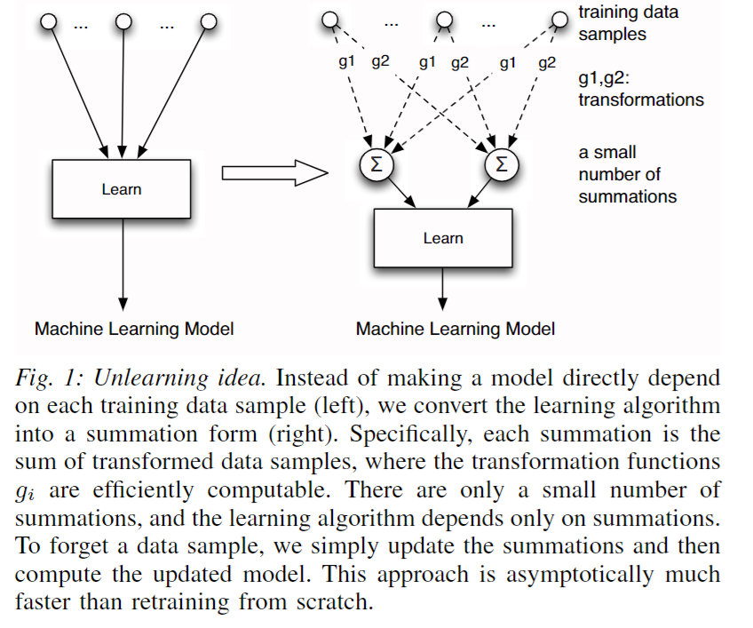
Background
Model unlearning approaches
SCRUB the Shard
Notes:
Data obfuscation
We want to unlearn x of class 5
Add duplicate of x with class =/= 5
Fine-tuning model on poisoned data

Slide 10
Background
Model unlearning approaches
Model shifting
directly update the model parameter by offsetting the computed impact of data point(s)
Model replacement
directly replaces some parameters with pre-calculated parameters
Model pruning
prunes some parameters from the trained models
require fine-tuning process to recover performance
SCRUB the Shard
Notes:
Data obfuscation
We want to unlearn x of class 5
Add duplicate of x with class =/= 5
Fine-tuning model on poisoned data
Model shifting
many model shifting-based unlearning schemes
are based on specific assumptions. For example, Guo et al.’s [41] unlearning algorithms are
designed for linear models with strongly convex regularization
Model replacement
Ex. decision tree, random forest

Slide 11
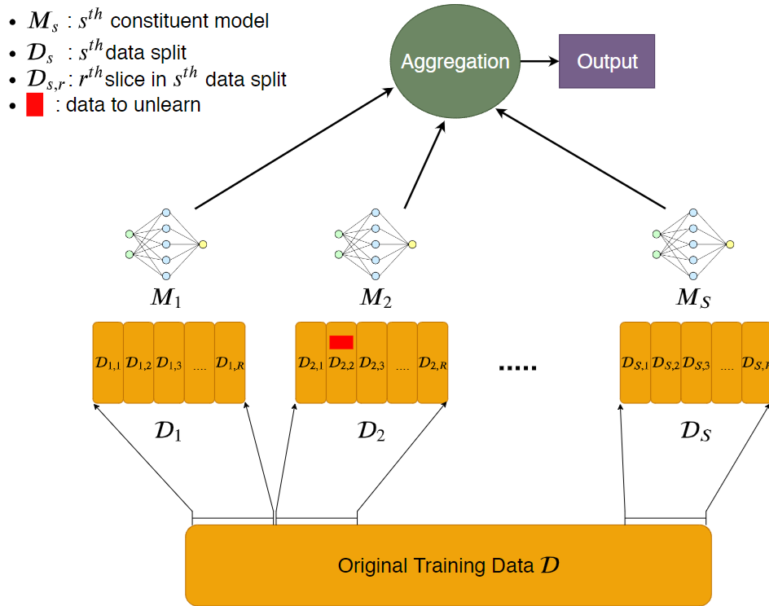
Reference work: *SISA
Instead of naively retrain the whole model, what if we just retrain part of it?
*published: 2021 IEEE Symposium on Security and Privacy (SP)
SCRUB the Shard

Slide 12
Reference work: SISA
Divide dataset into shards
Divide each shards into slice
Train one model for each shard
Train slice one by one, save checkpoints
At inference, aggregate the output
When unlearn, retrain only the shard from checkpoint onwards
SCRUB the Shard

Slide 13
Reference work: SISA
Pros | Cons
Guarantee exact unlearning | Still slow
Less unlearn time, compared to naive unlearning | Would not help if too many unlearn request that spread across all shard. Would be the same as naive unlearning
Model agnostic (can be use in any model) | Each model is now “Weak learner”
Simple to implement | Require more storage (many model to store)
Does not require all initial training sample. Can work in federated learning setting, if the unlearning happen on the owned shard. | Require more dataset (to maintain good performance)
SCRUB the Shard

Slide 14
Reference work: *SCRUB
Teacher-student framework for model unlearning
Recall
D_{f} = forget data, D_{r} = retained data
Goal:
Forget D_{f}, while remember D_{r}, that is
Listen to the teacher when talking about D_{r}
Disobey teacher when talking about D_{f}
*published: 37th Conference on Neural Information Processing Systems (NeurIPS 2023)
SCRUB the Shard

Slide 15





Reference work: SCRUB
Objective function (building block):
is KL-divergence between the student and teacher output distributions (softmax probabilities) for the example x
weight of original model, the teacher
weight of unlearned model, the student, this is the same as at the beginning
function parameterized by trainable weights w, the “model”
SCRUB the Shard

Slide 16
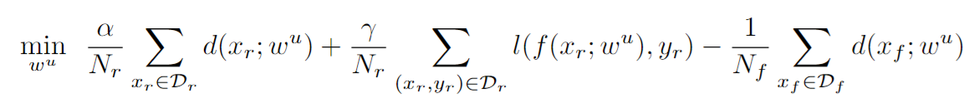
Reference work: SCRUB
Objective function:
Retained data
Minimize divergence
with teacher
Retained data
Minimize task loss
Forget data
Maximize divergence
with teacher
We want to forget x_{f} ∊ D_{f}, while remember x_{r} ∊ D_{r}
SCRUB the Shard

Slide 17
Reference work: SCRUB
Objective function:
Retained data
Minimize divergence
with teacher
Retained data
Minimize task loss
Forget data
Maximize divergence
with teacher
For forget data, x_{f} , We want the student to stay away from teacher.
We do this by maximize the divergence between student and teacher output, given x_{f}
SCRUB the Shard

Slide 18

Reference work: SCRUB
Objective function:
Retained data
Minimize divergence
with teacher
Retained data
Minimize task loss
Forget data
Maximize divergence
with teacher
However, training only previous objective will degrade the performance on retained data D_{r} , so we want to student to “stay close” to teacher when we see a retained sample x_{r} ∊ D_{r}, by minimize the divergence between student and teacher output
SCRUB the Shard

Slide 19
Reference work: SCRUB
Objective function:
Retained data
Minimize divergence
with teacher
Retained data
Minimize task loss
Forget data
Maximize divergence
with teacher
Finally, SCRUB want the student model to be good at the task, so it simultaneously optimize the model on the task loss
SCRUB the Shard

Slide 20
Reference work: SCRUB
Pros | Cons
Less unlearn time, compared to naive unlearning | Does not guarantee exact unlearning
Model agnostic (can be use in any model) | Require modification to training procedure
Faster unlearn process than SISA (require less epoch) | Require all initial training sample. Will not work in federated learning setting.
Scale to many unlearn request (does not revert to naive unlearning when there’re many unlearn request like SISA)
SCRUB the Shard

Slide 21
Method
SCRUB the Shard
Explaining and Harnessing Adversarial Examples

Slide 22
Method
Combining SISA and SCRUB
Naive unlearn
SISA
This work
SCRUB
Better unlearn guarantee
Faster unlearn
This work aims to improve upon SISA by using faster unlearn process of SCRUB while maintaining good unlearn guarantee under some scenario
SCRUB the Shard

Slide 23
Method
Combining SISA and SCRUB
In simple terms, we unlearn a shard in SISA by using SCRUB instead of naive unlearn
Compared to SISA, we have faster unlearn process that does not get reverted back to naive unlearning when there’re many unlearning request.
SCRUB the Shard

Slide 24
Method
Combining SISA and SCRUB
Compared to SCRUB, we can take advantage of different unlearn likelihood across different sample.
For example, the initial model might be trained on both public and private data. While private data is likely to get unlearned request, publicly available data might never receive unlearn request.
SCRUB by itself cannot take advantage of this information, however, in our case, we can separate the shard that has high and low likelihood of unlearn request and take advantage of that information.
SCRUB the Shard

Slide 25
Method
Combining SISA and SCRUB
For example, we may concentrate the unlearn request into particular shard(s) while keeping portion of model ensample (which is learn on stable/no unlearn request shard) the same.
We also have the option of separating the data into shard according to different privacy requirement.
For example, we might want to keep a highly sensitive dataset under one model shard and use normal retraining instead of SCRUB unlearning for a better privacy guarantee.
SCRUB the Shard

Slide 26
Method
Combining SISA and SCRUB (algo.)
Train the base model using SISA
divide data into shards
train independent model for each shard
normal training
This will be the base model
Handle unlearn request
For each affected data shards, separate it into forget set, retain set
Apply unlearn method on model shard, given forget set and retain set
SCRUB the Shard

Slide 27
SCRUB
Objective function:
Retained data
Minimize divergence
with teacher
Retained data
Minimize task loss
Forget data
Maximize divergence
with teacher
We want to forget x_{f} ∊ D_{f}, while remember x_{r} ∊ D_{r}
SCRUB the Shard

Slide 28

Method
Combining SISA and SCRUB
SCRUB inlearn: 3 optimization goal
Stay close to teacher on retain set
By good on task objective on retain set
Stay away from teacher on forget set
SCRUB the Shard

Slide 29
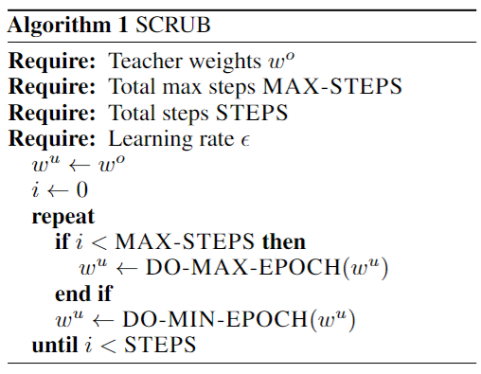
Method
SCRUB pseudocode
SCRUB the Shard

Slide 30
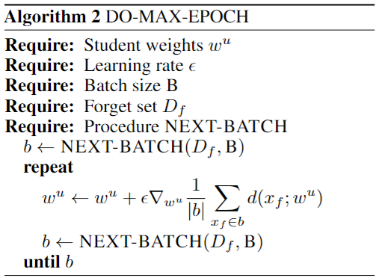
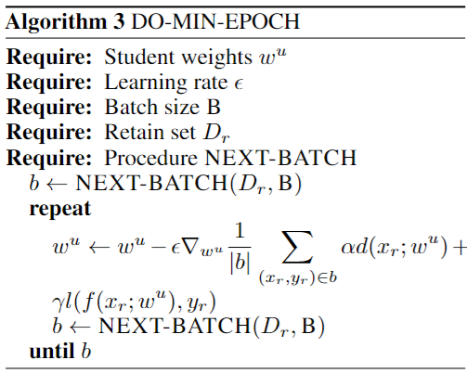
Method
SCRUB pseudocode
SCRUB the Shard

Slide 31
Experiment
SCRUB the Shard
Explaining and Harnessing Adversarial Examples

Slide 32
Experiment
Dataset
CIFAR-10
Model
ResNet50, pretrained on ImageNet
Framework
Pytorch (v2.0.1 + cuda support)
For model and training process
(python library) Adversarial Robustness Toolbox (ART)
For metrics
SCRUB the Shard

Slide 33
Experiment
Code reference
SISA
https://github.com/cleverhans-lab/machine-unlearning
SCRUB
https://github.com/meghdadk/SCRUB
Hardware
Processor Intel(R) Core(TM) i7-8750H CPU @ 2.20GHz 2.21 GHz
Installed RAM 16.0 GB (15.9 GB usable)
System type 64-bit operating system, x64-based processor
GPU NVIDIA GeForce RTX 2070, 16GB
SCRUB the Shard

Slide 34
Experiment
Experiment setup
3 sharding scenario
1 shard, 3 shards, 10 shards
Using normal unlearning vs SCRUB unlearning on the shards
2 unlearn scenario
100 samples (~0.8%)
1000 samples (~8%)
SCRUB the Shard

Slide 35
Experiment
Experiment setup
Data split
Training data
Test data
50,000
10,000
Predictor training data
Shadow model data
25,000
25,000
Sharding
S1
S2
Sn
12,500
12,500
Shadow training data
Shadow test data
SCRUB the Shard

Slide 36
Experiment
Experiment setup
Training parameter
resnet50, pretrained on ImageNet
10 epoch training
SGD optimizer, lr = 1e-3, momentum=0.9
SCRUB the Shard

Slide 37
Experiment
Metric
Classification accuracy
Check how much unlearned model performance has deteriorated compared to base model (naive unlearn model)
Membership inference attack (MIA) using shadow model
A substitute measure for unlearn success
attack success should be about the same as naive unlearn model
If attack success is high when naive unlearn model attack success is low, then it is a bad unlearning.
Training time
If training time is slow compared to naive unlearning, then it’s an inefficient unlearning
SCRUB the Shard

Slide 38
Experiment
Metric
Model classification loss (cross entropy loss)
Member vs non-member
Model average confidence (of predicted class)
Member vs non-member
SCRUB the Shard

Slide 39
Experiment
Looking for (in unlearned model)
Unlearn process should not hard accuracy
Unlearn process should be faster than naive retrain
Model loss on retain data should be similar to training data
Same goes for prediction confidence
Model loss on forget data should be similar to test data
Same goes for prediction confidence
Attack success rate on retain data should be similar to training data
Attack success rate on forget data should be similar to test data
SCRUB the Shard

Slide 40
Experiment
Baseline model
1, 3, 10 SISA model with naive retrain on each shard
(1 shard) SCRUB unlearn
SCRUB the Shard

Slide 41
Experiment
Overall process
Split the dataset
Train independent predictor model for each shard (record the training time)
Train shadow model
Randomly split 50-50 on shadow dataset
Train each shadow model on different split (same data, just split at different location)
Use shadow model, generate attack data (actual data, model’s label, actual label)
Train attack model
SCRUB the Shard

Slide 42
Experiment
Overall process (cont.)
Train attack model
Run evaluation on original model
Accuracy
member (training) set, non-member (test) set, retain set, forget set
Cross Entropy Loss
Average prediction confidence (softmax output)
Membership attack success rate
Make unlearn dataset (forget set, retain set)
Repeat 6
SCRUB the Shard

Slide 43
Result
SCRUB the Shard
Explaining and Harnessing Adversarial Examples

Slide 44
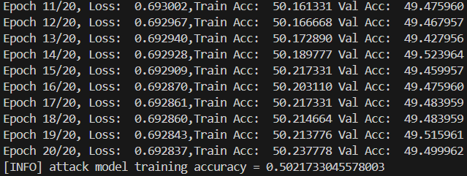
Result
Not very good
Attacker model doesn’t learn
attacker too weak
Target too strong
The accuracy gap is small
SCRUB the Shard

Slide 45
Result
Attacker model doesn’t learn
Model is pre-trained
Most layer was frozen, and only the last layer changes
SCRUB the Shard

Slide 46
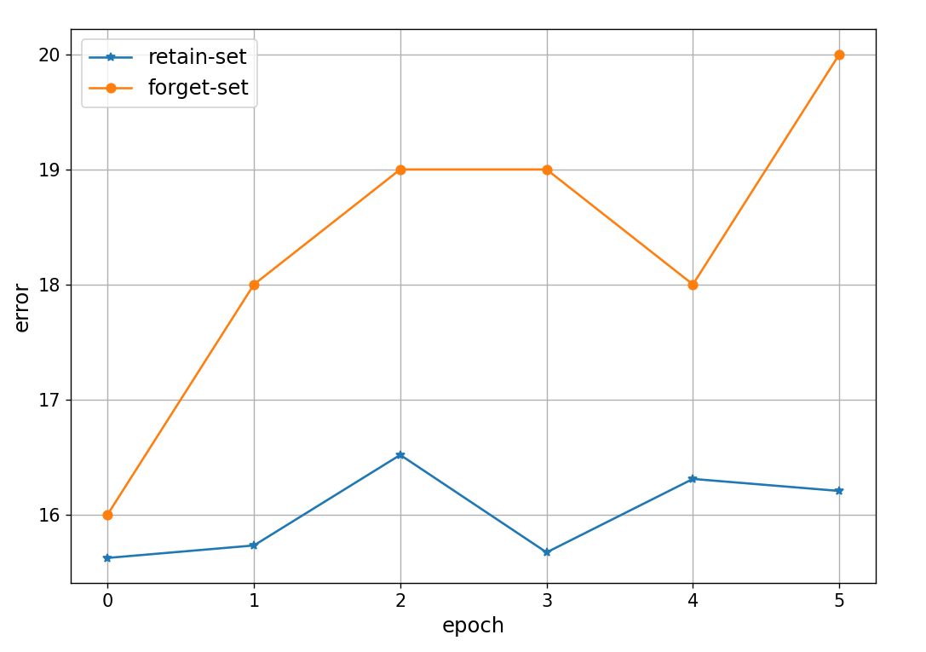
Result
Evaluating model loss
Model’s error rate on retain/forget set during SCRUB unlearn process
SCRUB the Shard

Slide 47
Result
model type | 1 shard | 1 shard (SCRUB) | 3 shard | 3 shard (SCRUB)
Task acc
original (train) | 0.7561 |  | 0.7239
original (test) | 0.7356 |  | 0.6964
100-point unlearn (retrain) | 0.7563 | 0.8408 | 0.7242 | 0.7246
100-point unlearn (forget) | 0.74 | 0.85 | 0.6965 | 0.6971
1000-point unlearn (retrain) | 0.755 | 0.8453 | 0.723 | 0.724
1000-point unlearn (forget) | 0.716 | 0.846 | 0.6944 | 0.6976
SCRUB the Shard

Slide 48
Result
model type | 1 shard | 1 shard (SCRUB) | 3 shard | 3 shard (SCRUB)
Model loss
original (train) | 0.7546 |  | 0.9234
original (test) | 0.7978 |  | 0.9746
100-point unlearn (retrain) | 0.7821 | 0.4514 | 0.9245 | 0.9197
100-point unlearn (forget) | 0.826 | 0.4127 | 0.9752 | 0.9725
1000-point unlearn (retrain) | 0.7604 | 0.4432 | 0.9315 | 0.9233
1000-point unlearn (forget) | 0.8293 | 0.4527 | 0.9831 | 0.9724
SCRUB the Shard

Slide 49
Result
model type | 1 shard | 1 shard (SCRUB) | 3 shard | 3 shard (SCRUB)
Model confidence
original (train) | 0.6602 |  | 0.5466
original (test) | 0.6563 |  | 0.5402
100-point unlearn (retrain) | 0.6327 | 0.8342 | 0.5471 | 0.5487
100-point unlearn (forget) | 0.6133 | 0.8314 | 0.5405 | 0.5421
1000-point unlearn (retrain) | 0.6561 | 0.8382 | 0.5428 | 0.5478
1000-point unlearn (forget) | 0.6481 | 0.8402 | 0.5358 | 0.5413
Training Time (seconds)
original training time | 2045.0419 |  | 1513.5583
100-point unlearn | 1901.6681 | 1412.399 | 615.7019 | 517.8624
1000-point unlearn | 1607.2881 | 1421.4885 | 524.1072 | 467.7787
SCRUB the Shard

Slide 50
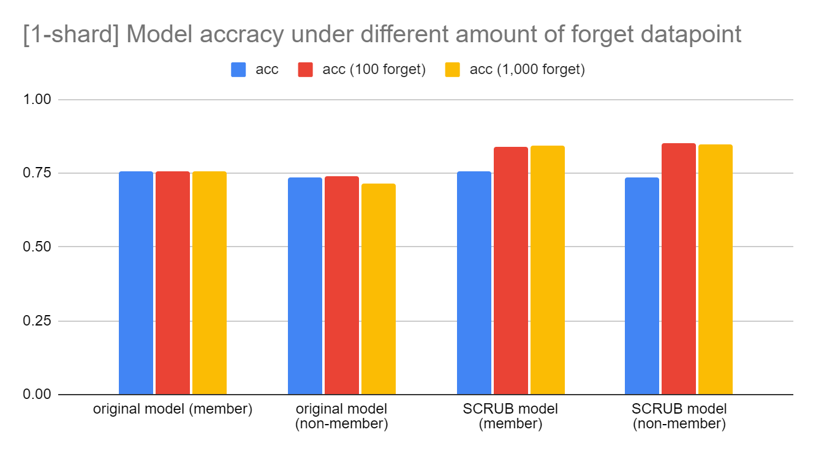
Result
SCRUB the Shard

Slide 51
Result
Analysis and interpretation
SISA+SCRUB achieves the goal of unlearning
metrics on retain set is similar to train set
metrics on forget set is similar to test set
However, the unlearn time of SCRUB remains constant regardless of unlearn size
On other hand, naive retrain is faster when unlearn size is large.
SCRUB process also optimize the model in the process
Lead to higher metric performance
Not visible in 3-shard scenario due to voting
SCRUB the Shard

Slide 52
Conclusion
SCRUB the Shard
Explaining and Harnessing Adversarial Examples

Slide 53
Conclusion
Conclusion
Model unlearning using SISA+SCRUB
Model agnostic
can handle different unlearn sensitivity profile on different data points
Some data might be more likely to get unlearn (sensitive), while some data might never get unlearn (public)
Metric profile on retain set is similar to training set
on forget set is similar to test set
SCRUB the Shard

Slide 54
Conclusion
Note: will refer to fully-trained model as saturated model
Flaw
Attack model not working as intended
Could be that attack is not strong enough
Attack with only 5 shadow model
Both shadow model and original model are not saturated, which could lead to larger difference between shadow model and target model
The difference in training error and test error on target model is quite low (~2%), which lead to smaller gap the attacker can exploit
SCRUB the Shard

Slide 55
Conclusion
Flaw
SCRUB model has high metric score than original data
SCRUB process also optimize the model
Not as pronounced in saturated model, but very noticeable effect on non-saturated model
Hard to make fair comparison on non-saturated model
SCRUB the Shard

Slide 56
Interesting question
How to guarantee unlearning in model with differential privacy?
What should be the result when unlearn the whole dataset?
Exact unlearn
Approximate unlearn
Bonus: https://awesome-machine-unlearning.github.io/
SCRUB the Shard

Slide 57
Reference
Bourtoule, L., Chandrasekaran, V., Choquette-Choo, C. A., Jia, H., Travers, A., Zhang, B., ... & Papernot, N. (2021, May). Machine unlearning. In 2021 IEEE Symposium on Security and Privacy (SP) (pp. 141-159). IEEE.
Nguyen, T. T., Huynh, T. T., Nguyen, P. L., Liew, A. W. C., Yin, H., & Nguyen, Q. V. H. (2022). A survey of machine unlearning. arXiv preprint arXiv:2209.02299.
Kurmanji, M., Triantafillou, P., Hayes, J., & Triantafillou, E. (2024). Towards unbounded machine unlearning. Advances in Neural Information Processing Systems, 36.
Shokri, R., Stronati, M., Song, C., & Shmatikov, V. (2017, May). Membership inference attacks against machine learning models. In 2017 IEEE symposium on security and privacy (SP) (pp. 3-18). IEEE.
SCRUB the Shard

Slide 58
Appendix
SCRUB the Shard
Explaining and Harnessing Adversarial Examples

Slide 59
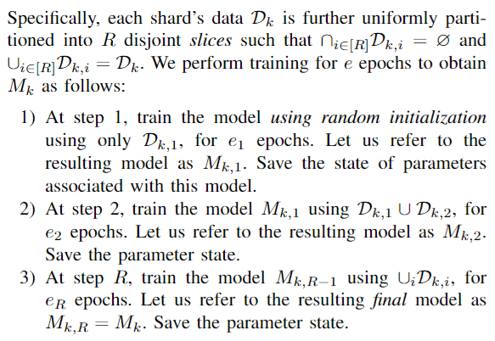
Appendix
SISA pseudocode
SCRUB the Shard

Slide 60
Appendix
SCRUB pseudocode
SCRUB the Shard

Slide 61
Appendix
SCRUB pseudocode
SCRUB the Shard

