Slide 1
R
LUNAR MAIL
BY LUNAR RAILS
AI-Powered Email
Management Platform
Draft · Review · Approve · Send — all in one intelligent inbox
Management Overview · April 2026
PHASE 1

Slide 2
PLATFORM OVERVIEW
What is Lunar Mail?
A centralised AI-assisted inbox for financial services teams — built for speed, compliance, and control.
📧
🤖
✅
Smart Inbox
AI Draft Replies
Approval Workflow
Unified mailbox for multiple client accounts with priority filtering and unread badges.
AI generates contextual reply drafts at configurable confidence levels ready for one-click approval.
Analysts draft, managers approve. Role-based controls ensure only authorised staff send replies.
🔒
💬
🔍
Compliance Flags
Internal Notes
Search & Filter
Automatic escalation of compliance-sensitive emails with full audit trail and team notifications.
Private team annotations per email — comments, context, and handoff notes not visible to clients.
Real-time filtering by company, status, category, or keyword across the entire email history.

Slide 3
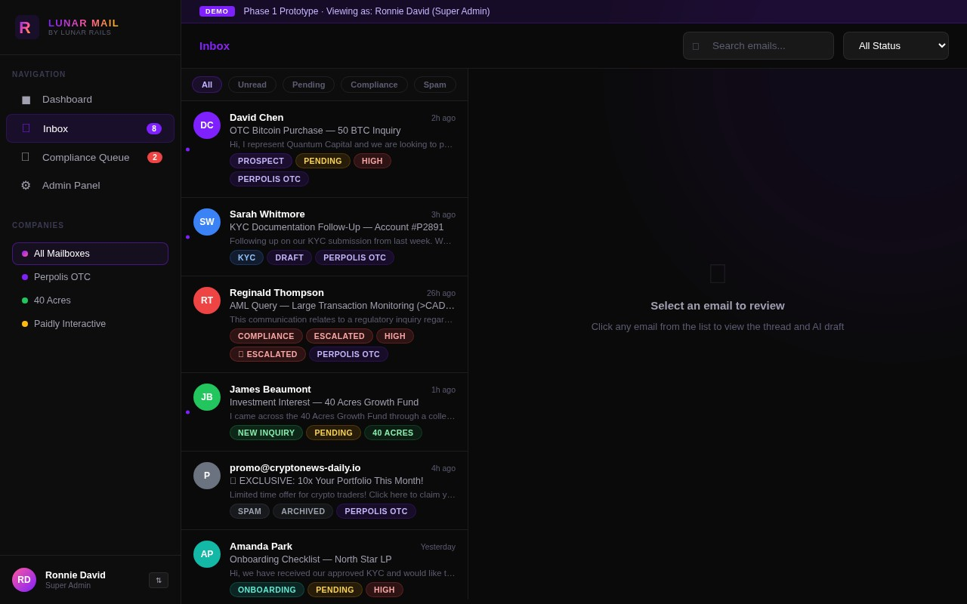
FEATURE 1
Unified Smart Inbox
Aggregates emails from multiple client accounts into a single, prioritised inbox
Real-time unread badges and urgency indicators (High Priority, Pending, Draft Ready)
Filter by company — Perpolis OTC, 40 Acres, Paidly Interactive and more
Category chips: Prospect, Compliance, Onboarding, Trade Execution, Off-boarding
Status filter dropdown: All / Pending / Draft Ready / Approved / Escalated
Role-aware views — Analysts see drafts; Managers see approval queues

Slide 4
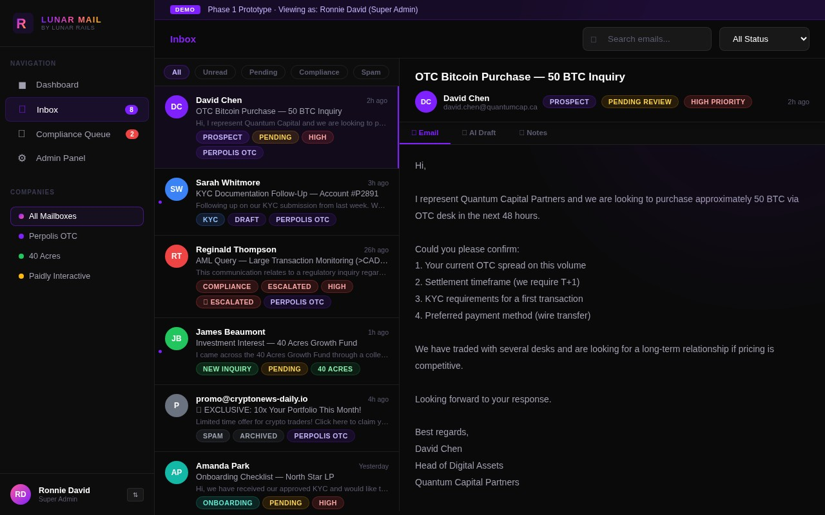
FEATURE 2
Threaded Email Detail View
Full email body rendered with sender info, timestamps, and status badges
Three-tab navigation: Email body · AI Draft · Internal Notes
Sticky header persists while scrolling through long email threads
Compliance Alert banners appear automatically for flagged messages
Read-only mode for Analysts — prevents accidental send actions
One-click navigation between sections via tab scroll-spy

Slide 5
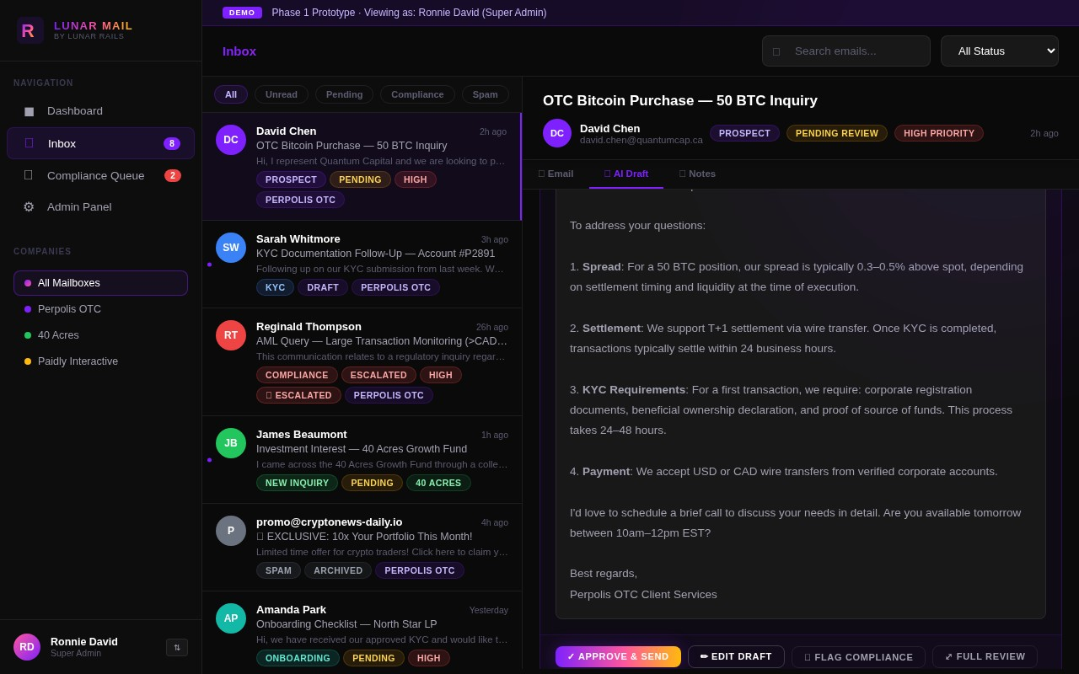
FEATURE 3
AI-Generated Draft Replies
AI drafts contextual, professional responses tailored to each email type
Confidence score indicator (e.g. ✓ High confidence) shown alongside drafts
Inline editing — managers can refine the draft before approving
Canned Response Templates panel for quick insertion of standard replies
One-click "Approve & Send" queues the reply via Front for dispatch
Full Review link opens a dedicated deep-review page for complex cases

Slide 6
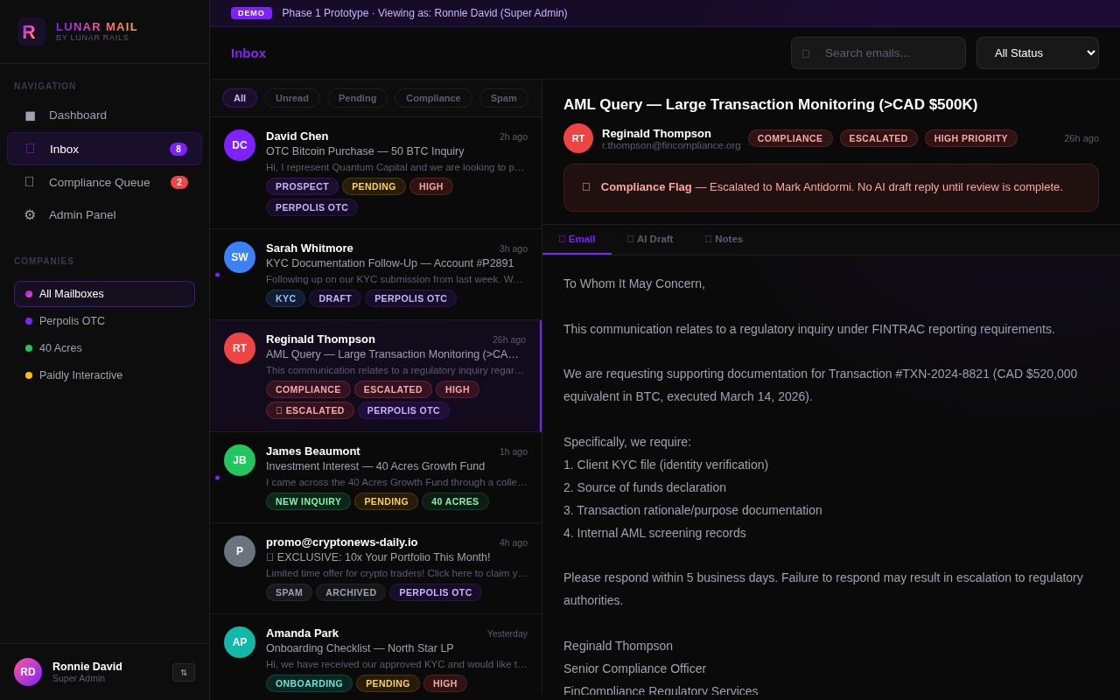
FEATURE 4
Compliance & Risk Management
Automatic detection and flagging of regulatory or high-risk emails
Escalated emails are locked — no AI draft until compliance review is complete
Red Compliance Flag banner clearly identifies escalated threads
Instant Slack notification sent to compliance team on escalation
Dedicated 'Compliance Queue' sidebar section for focused review
Full audit trail maintained for all flagged and reviewed communications

Slide 7
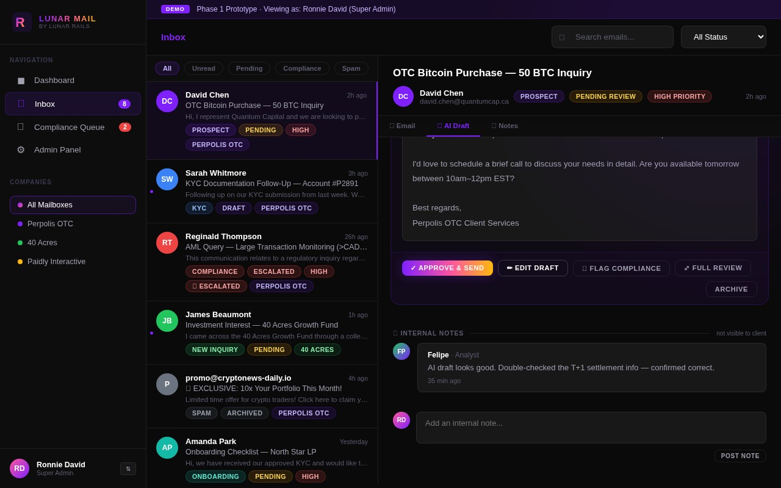
FEATURE 5
Internal Notes & Collaboration
Private annotation layer per email — never visible to the client
Timestamped comments from any team member with role attribution
Enables seamless analyst-to-manager handoffs with full context
Notes persist across sessions and are accessible in the full review page
Inline note composition with 'Post Note' button directly in the detail view
Supports multi-user collaboration across Analyst, Manager, and Compliance roles

Slide 8
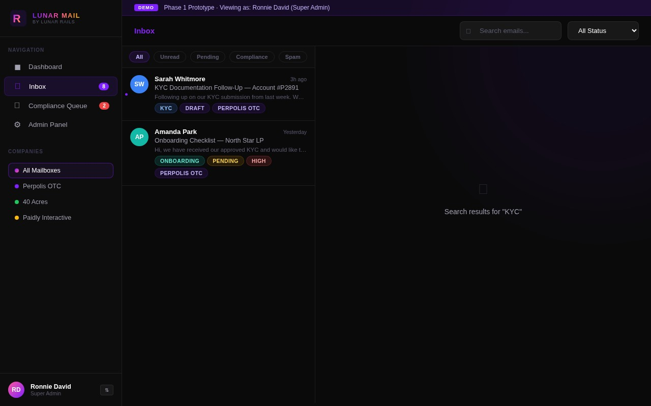
FEATURE 6
Powerful Search & Filtering
Live search across sender names, subjects, and email body content
Instant results update as you type — no page reload required
Category filter chips: All, Unread, Pending, Compliance, Spam
Company-level filtering to focus on a single client's inbox
Status dropdown: All / Pending / Draft Ready / Approved / Escalated / Archived
Combined filters stack — e.g. Compliance + Perpolis OTC + Escalated

Slide 9
LUNAR MAIL
SUMMARY
Built for Financial Services Teams
6
3
AI
Core Features
Delivered
User Roles
(Analyst · Manager · Compliance)
Draft Generation
with Approval Workflow
Next Steps
Connect Lunar Mail to live Front mailboxes for real client email ingestion
Integrate with CRM / KYC system for automated client context enrichment
Enable configurable AI confidence thresholds per email category
Expand role-based access control with granular permissions per company
Mobile-responsive layout optimisation for on-the-go review and approvals
Lunar Mail · Phase 1 Prototype · Confidential
ronnie@lunarrails.io

