Slide 1
MSc Artificial Intelligence in Engineering and Design – EE52037
A Physically Motivated Noise Model for
Robust EIT Tactile Classification Under Simulated Domain Shift
Author: Ronald Piku
Supervisor: Prof. Manuchehr Soleimani
Department of Electronic and Electrical Engineering, University of Bath
Notes:
[Title – 0:00 – ~12s]
Hi, I'm Ronald Piku. Thank you for joining me as I present my dissertation: a physically motivated noise model for robust EIT tactile classification under simulated domain shift.

Slide 2
INTRODUCTION
What This Presentation Covers
This project asks whether a physically motivated noise model can close the simulation-to-reality gap in EIT tactile sensing, and which noise sources need to be in it.
1
The problem and the gap
why simulated EIT classifiers fail on realistic measurements, and what “the gap” means.
2
Three results
what closes the gap, how it was tested, and the minimal model that is left standing.
3
Testing the claims, and their limits
stress-testing assumptions, then reviewing the limitations.
2
Notes:
[Introduction – 0:12 – ~23s]
Here's how this presentation is structured.
First, I define the problem this creates and what I mean by the simulation-to-reality gap.
Then three results follow: what closes that gap, how it was evaluated, and the smallest noise model that still works.
Finally, I review the conclusions and discuss the work's limitations.

Slide 3
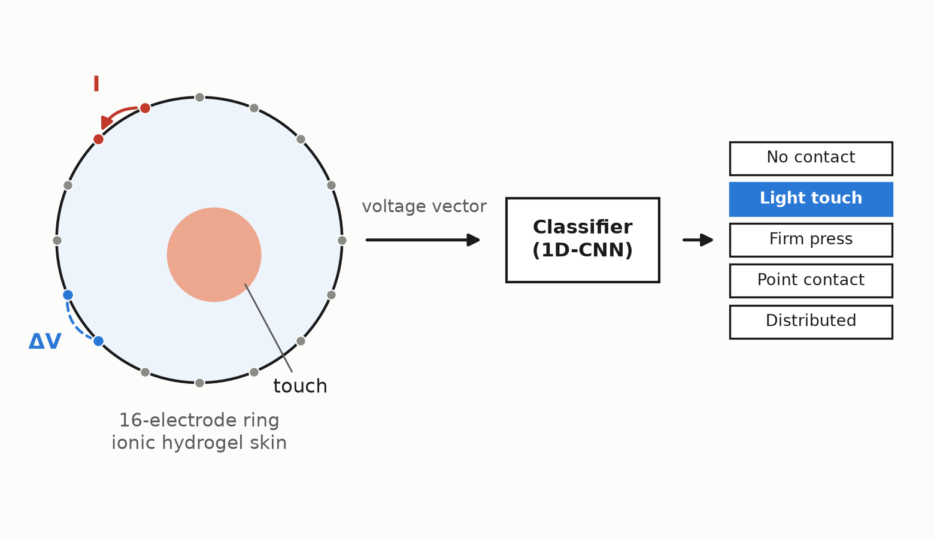
THE PROBLEM
How do we get Prosthetics to Feel?
57.7 million people live with limb loss (McDonald et al., 2021).
More than a third abandon myoelectric
prostheses — the absence of touch
is a leading reason (Biddiss and Chau, 2007).
A prosthetic arm has no way of sensing how it is touched or handled, by its wearer or by someone else, without looking at it.
Electrical Impedance Tomography (EIT) turns a sheet of soft material into one continuous touch sensor:
Figure 1. EIT sensing principle applied to a prosthetic arm.
3
Notes:
[The problem – 0:35 – ~56s]
Around fifty-eight million people live with limb loss, and more than a third abandon a powered prosthetic arm — the most cited reason is that the device itself has no sense of touch, so it can't tell when or how it is being handled.
Electrical Impedance Tomography, or EIT, gives it that awareness. As Figure 1 shows, sixteen electrodes sit around a soft sensing disc covering the arm, modelled on an ionic hydrogel skin for its sensing fidelity and direct comparability to leading EIT research. By iinjecting a small current between one pair and measureing the voltage at another, Wherever somebody presses causes a voltage shift, creating a full set of measurements as a vector that can feed straight into a classifier.

Slide 4
WHERE THE FIELD IS
Excellent simulation performance, Unreliable in Deployment
Published EIT touch classifiers report 98–99% accuracy (Park et al., 2022; Chen et al., 2023). Almost all are trained on simulated measurements, because labelled real data is expensive.
The sim2real gap: the drop in performance when a model trained on idealised simulated data meets the imperfections of real hardware. Documented in other ML domains such as robotics and computer vision (Tobin et al., 2017) but rarely modelled in EIT tactile sensing.
Within EIT, four sources dominate:
Thermal (Gaussian) noise
in the amplifiers
Contact impedance
varies electrode to electrode
Electrode placement
is never exactly where the model assumes
Quantisation
from the analogue-to-digital converter
Prior work augments predominantly with Gaussian noise only, if any.
4
Notes:
[Where the field is – 1:32 – ~47s]
Published EIT touch classifiers report up to ninety-eight and ninety-nine per cent accuracy, but are almost all trained on simulated measurements. This is because labelled real data is expensive to collect.
However, a simulator gives you a perfect measurement, but hardware never does. This is the same gap Tobin and colleagues closed in robotics and computer vision by training on deliberately varied simulation, and the gap this research aims to
close for EIT.
Within EIT, four sources dominate: thermal noise, tupically represented as Gaussian noise, contact impedance, electrode placement, and quantisation.
When prior work adds noise at all, it's almost always just Gaussian noise. This project asks whether that's enough, and if not, which of the four matter.

Slide 5
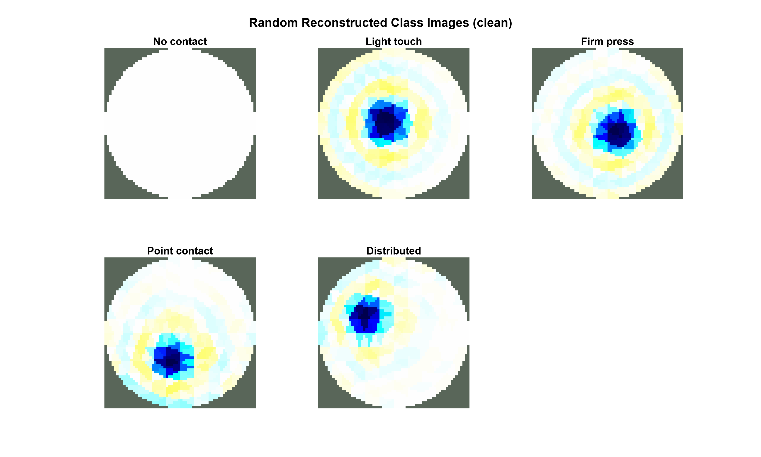
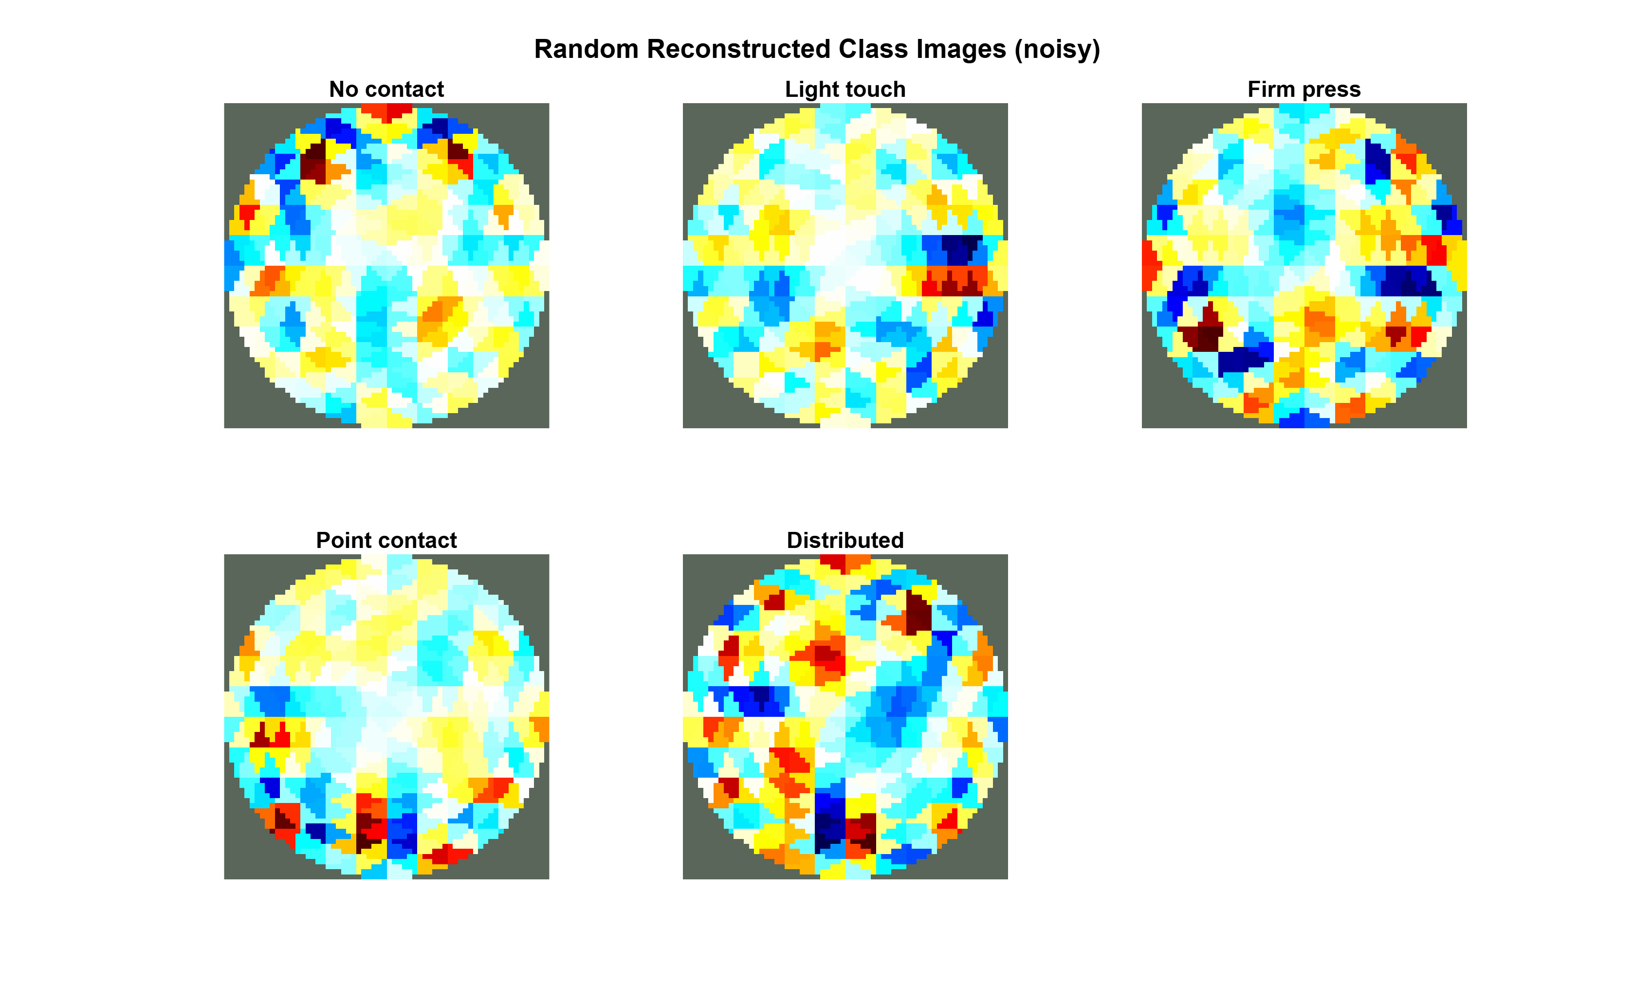
VISUALISING THE GAP
What Noise Does to the Signal
Clean simulation
With noise
Same five touches. The contact is plainly visible on the left and gone on the right.
Figure 2. Reconstructed touch classes under clean (left) and noisy (right) measurement conditions.
5
Notes:
[The gap, made visible – 2:19 – ~35s]
Before any classification, here's the problem in one picture. On the left, Figure 2 shows five touch types reconstructed from clean simulated measurements: you can see exactly where the contact is in each one, and each class is clearly separable by its pressure intensity and contact area.
On the right, the same five with realistic noise switched on. The clear distinction between classes has gone and classification is difficult even to the human eye, let alone a classifier.

Slide 6
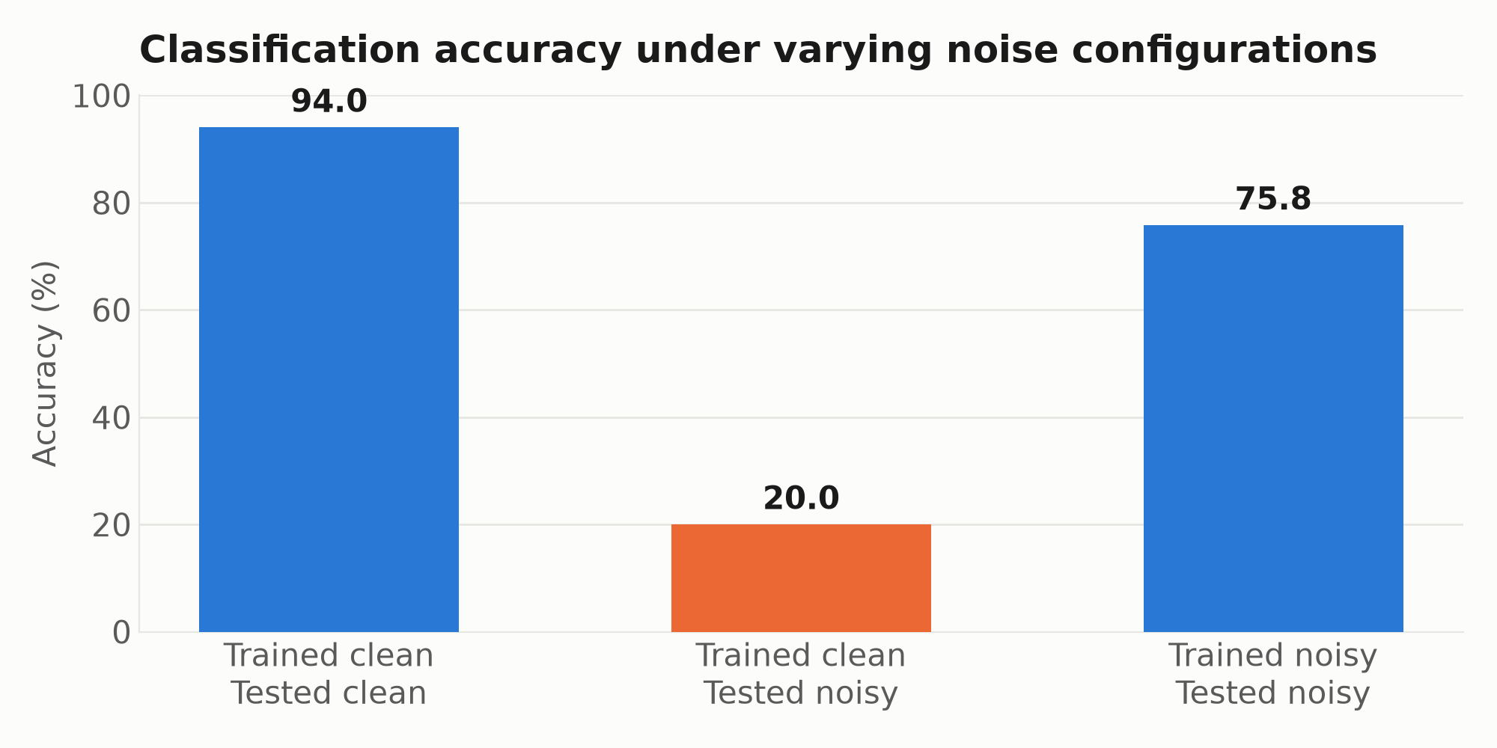
RESULT 1
Identifying and Closing the Sim-to-Real Gap
Figure 3. A 1D-CNN trained and evaluated across clean and noisy conditions.
Four architectures, three feature representations, same collapse. It is not a capacity problem — it is a distribution problem.
6
Notes:
[Result 1 – 2:54 – ~47s]
To see how serious this gap is, four classifiers were trained — a random forest, a support vector machine, a multilayer perceptron and a 1D convolutional neural network — each on 25,000 simulated touches, clean and noisy in three combinations.
As Figure 3 shows, on clean data the network reaches ninety-four per cent, close to published results. Trained clean but tested noisy, it collapses to twenty per cent which is as good as guessing. Train and test on noisy data instead, and it recovers to seventy-six: a fifty-five-point gain. That pattern held for all four classifiers, so it isn't something a bigger model fixes on its own.

Slide 7
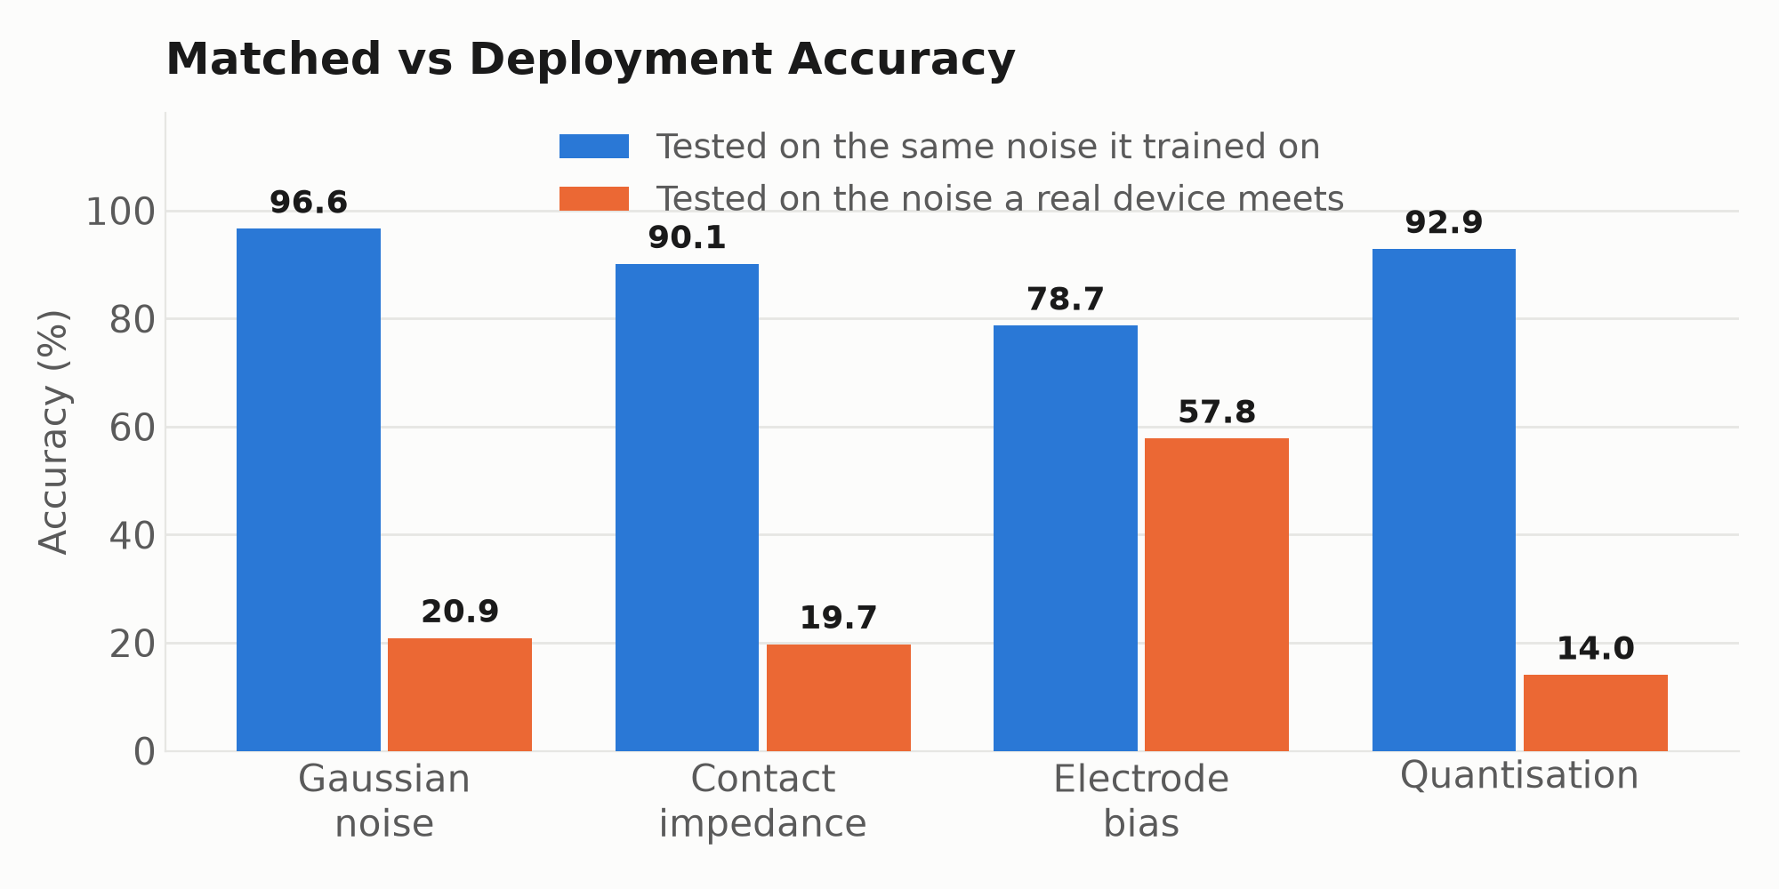
RESULT 2
Which Noise Components Matter?
Figure 4. Each noise component scored under its own matched protocol versus full deployment corruption.
Blue is the conventional protocol. It rewards a model for defining an easier world, not for surviving a real one.
7
Notes:
[Result 2, the main contribution – 3:41 – ~51s]
The ablation study tests each noise source alone. There are two ways to score it.
You can test each model on the same noise it trained with, which is shown by the blue bars in Figure 4. In this analysis, Gaussian noise looks harmless at ninety-seven per cent accuracy, with electrode bias being the most damaging.
Or you can test against the full corruption a real device produces, shown by the orange bars. Here the story reverses: electrode bias is the only source anywhere close to surviving as the rest fall close to chance. This is to be expected as electrode positioning error is already flagged in the EIT literature as a dominant modelling error (Kolehmainen et al., 1997), and this result confirms it under the correct protocol.

Slide 8
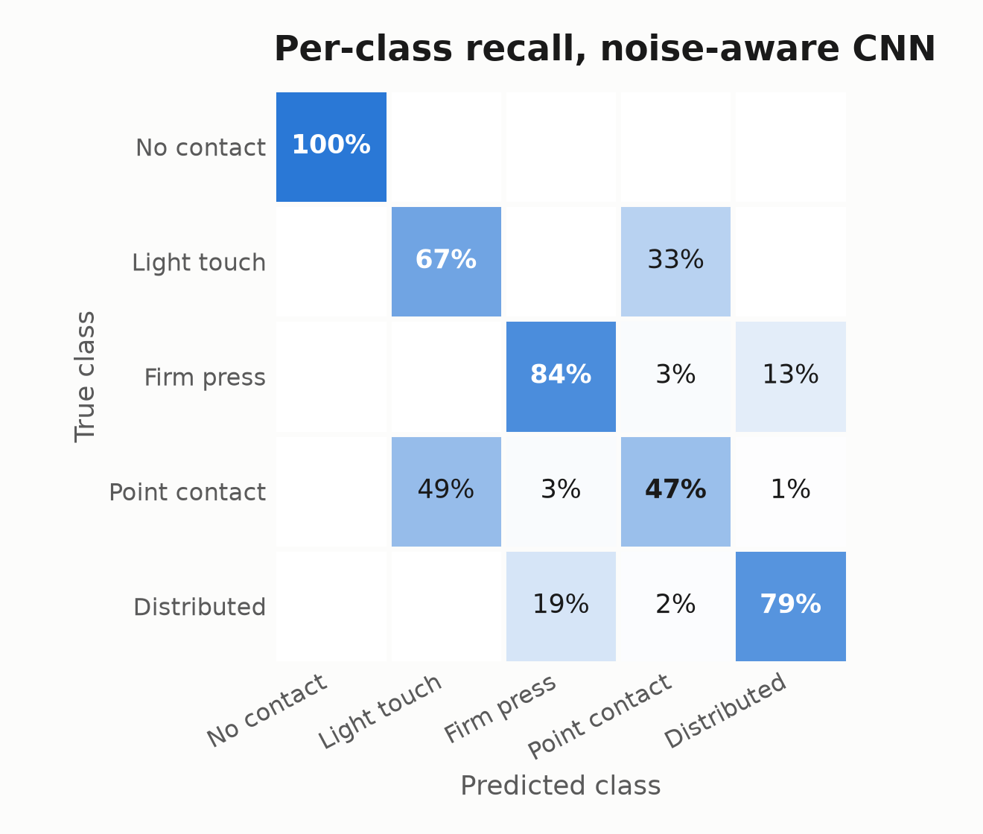
RESULT 3
The Optimal Noise Model
• Electrode bias + Gaussian noise reaches 76.5% — level with the full four-component model.
• Contact impedance and quantisation add nothing measurable.
• The 'no contact' class is an exact zero vector in simulation. Remove it, and electrode bias alone matches the full model (70.5% vs 69.8%).
• Gaussian noise was never conferring robustness; it was making one degenerate class detectable.
Figure 5. Confusion matrix, noise-aware CNN.
One component to tell touches apart. A noise floor to notice touch at all.
8
Notes:
[Result 3 – 4:32 – ~57s]
Using the correct protocol, two of the four components carry everything: electrode bias plus Gaussian noise reaches 76.5 per cent, which is level with the full model. This halves the noise model with no loss of accuracy.
That decomposes further. The 'no contact' class in simulation is an exact vector of zeros, so I removed it and reran on the four real touches alone. Electrode bias alone then matches the full model, meaning Gaussian noise was never providing any robustness, just making a class that’s degenerate in training recognisable when it arrives noisy.
Figure 5 shows why that matters: no-contact is recovered perfectly, which is a direct consequence of that Gaussian floor, while point contact is the weakest class. This means one component discriminates between touches, whilst a noise floor helps to detect touch at all.

Slide 9
LIMITATIONS
What this is, and what it is not
What the research supports
What it doesn't
Which noise sources a training model needs, and why.
That the conventional ablation protocol inverts that answer.
A mechanism for the architecture result, tested rather than assumed.
Every number here is from simulation. There is no hardware validation.
Electrode bias is assumed independent per electrode; a stretched sheet would correlate it.
76% is not deployable. Detecting that contact happened is reliable; identifying which touch it was is not.
9
Notes:
[Limitations – 5:28 – ~54s]
Based on these results, the research can justify the following claims: Which noise sources matter and why, that the ablation protocol inverts that answer and a tested mechanism for the architecture result.
Its limitations are as follows: I cannot claim any of it survives contact with hardware. Every number is simulated in 2D — a real device isn't, and I only classify single, static frames, so drift over time isn't represented at all. My electrode bias is drawn independently per electrode, and on a stretched sheet it would be spatially correlated — measuring that covariance is the first experiment I'd run next. And seventy-six per cent isn't deployable: detecting contact is reliable, saying which touch it was is not.

Slide 10
Conclusions
1
Realistic noise collapses simulated accuracy from 94% to 20%; training on it recovers 76%.
2
How you evaluate an ablation decides its conclusion, not just its result.
3
Electrode bias and Gaussian noise, together, are necessary and sufficient.
Noise-aware training closes most of the simulation-to-reality gap, but only if you test it against the world the device will meet.
10
Notes:
[Close – 6:22 – ~31s]
In conclusion: realistic noise collapses accuracy from ninety-four to twenty per cent, and training on it recovers seventy-six. How you evaluate an ablation decides its conclusion, not just its result, and an electrode bias and gaussian noise model is sufficient to match optimal deployment on domain shifted environments.
This shows that noise-aware training closes most of the gap, but only if you test it against the world the device will meet.

Slide 11
References
Biddiss, E. and Chau, T. (2007) 'Upper-limb prosthetics: critical factors in device abandonment', American Journal of Physical Medicine & Rehabilitation, 86(12), pp. 977–987.
Chen, H., Langlois, K., Brancart, J., Roels, E., Verstraten, T. and Vanderborght, B. (2023) 'A novel physical human–robot interface with pressure distribution measurement based on electrical impedance tomography', IEEE Sensors Journal, 23(18), pp. 21914–21923.
Costa Cornellà, A., Hardman, D., Costi, L., Brancart, J., Van Assche, G. and Iida, F. (2023) 'Variable sensitivity multimaterial robotic e-skin combining electronic and ionic conductivity using electrical impedance tomography', Scientific Reports, 13(1), 20004.
Kolehmainen, V., Vauhkonen, M., Karjalainen, P.A. and Kaipio, J.P. (1997) 'Assessment of errors in static electrical impedance tomography with adjacent and trigonometric current patterns', Physiological Measurement, 18(4), pp. 289–303.
McDonald, C.L., Westcott-McCoy, S., Weaver, M.R., Haagsma, J. and Kartin, D. (2021) 'Global prevalence of traumatic non-fatal limb amputation', Prosthetics & Orthotics International, 45(2), pp. 105–114.
Park, K., Yuk, H., Yang, M., Cho, J., Lee, H. and Kim, J. (2022) 'A biomimetic elastomeric robot skin using electrical impedance and acoustic tomography for tactile sensing', Science Robotics, 7(67), eabm7187.
Tobin, J., Fong, R., Ray, A., Schneider, J., Zaremba, W. and Abbeel, P. (2017) 'Domain randomization for transferring deep neural networks from simulation to the real world', 2017 IEEE/RSJ International Conference on Intelligent Robots and Systems (IROS), pp. 23–30.
11
Notes:
[References – 6:53 – ~10s, not narrated]
Thank you for listening, I’m happy to take questions.

