Slide 1
PRISM Energy Intelligence
NTPC generation and investment research
A working prototype with dated evidence, historical evaluation,
financial context and a grounded research assistant.
1.50%
8 quarters
53 reports
day-60 generation MAPE
historical comparisons
unique CEA originals
Developed by Sutanu Chatterjee (Trial Task for PRISM)
Sutanu Chatterjee / PRISM Trial Task
01
Notes:
Independent trial task. Author: Sutanu Chatterjee. Prepared 29 October 2026. Repository: https://github.com/ronnismad/prism-ntpc-research-dashboard. Demo: https://ronnismad.github.io/prism-ntpc-research-dashboard/. Scope and results: repository README and docs/BACKTEST_RESULTS.md.

Slide 2
The project answers each part of the brief
Brief requirement | Completed project response
Define the problem | Help an analyst assess early operating momentum and the financial case for NTPC.
Build a working prototype | React dashboard, public reports, a fixed station sample, transparent calculations and dated inputs.
Present the result | Generation evaluation, financial assessment, valuation scenarios, source audits and Prismy.
Document the work | README, source manifests, tests, setup, findings, limitations and the next improvements.
The scope prioritises inspectable research and judgment over a production trading model.
Sutanu Chatterjee / PRISM Trial Task
02
Notes:
Requirements paraphrased from the user-provided Short Trial Project screenshot. The original asks for problem definition, a working prototype, a useful result and documented approach, assumptions, limitations and improvements. No time-spent claim is made.

Slide 3
Two evidence streams meet in the research view
Operating study
Financial snapshot
Public CEA reports
Consolidated filings
Same eight thermal station IDs
Annual results and June-quarter results
Historical cutoff
Earnings, cash and debt
Only eligible captured reports
Tax effects and financing interest
Quarter estimate
Dated NSE close
Run rate and two comparison baselines
28 October 2026 price snapshot
Later outcome scoring
Valuation assumptions
Eight quarters and all three cutoffs
Earnings haircut, P/E and safety margin
Research assessment and Prismy’s source-linked answers
Sutanu Chatterjee / PRISM Trial Task
03
Notes:
https://github.com/ronnismad/prism-ntpc-research-dashboard/blob/main/src/MethodFlow.jsx
https://github.com/ronnismad/prism-ntpc-research-dashboard/blob/main/README.md
https://nsearchives.nseindia.com/corporate/9425178051_23052026151711_NTPCAFR26.pdf
https://ntpc.co.in/sites/default/files/financial_results/2026/QFRQ1FY27.pdf
Later actuals enter generation scoring only. Source availability uses a printed-date proxy, not a verified first-public timestamp.

Slide 4
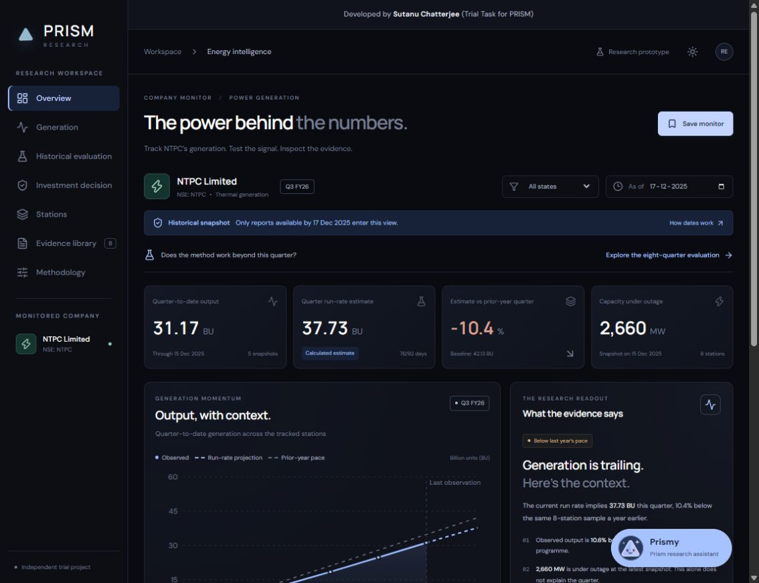
The dashboard makes evidence easy to inspect
Seven research views
Operations, evaluation, financials, sources and methodology.
Traceable outputs
Open preserved PDFs, inspect source rows and export results.
Simple handoff
Static hosted demo and reproducible local setup.
Sutanu Chatterjee / PRISM Trial Task
04
Notes:
https://github.com/ronnismad/prism-ntpc-research-dashboard/blob/main/README.md
Screenshot: actual local dashboard, docs/project-preview.png. React/Vite application. Seven views, hash navigation, dark/light themes, CSV exports and source inspection.

Slide 5
Run rate improves on the seasonal baseline
1.50%
2.20%
5 / 8
run-rate MAPE
seasonal-profile MAPE
quarters beating seasonal
Remaining-output MAPE: 3.81% vs 5.54%. Small sample, publication proxies and correlated cutoffs limit confidence.
Sutanu Chatterjee / PRISM Trial Task
05
Notes:
https://github.com/ronnismad/prism-ntpc-research-dashboard/blob/main/docs/BACKTEST_RESULTS.md
https://github.com/ronnismad/prism-ntpc-research-dashboard/blob/main/docs/backtest-day-60.csv
Day-60 results computed from src/data/backtest.json using src/backtest.js. Full-quarter MAPE weights eight distinct quarters equally. Remaining-period errors exclude already observed output.

Slide 6
Tax effects and reinvestment complicate the buy case
Evidence | Period | Result
Owners’ profit growth | FY26 | +15.5% YoY
Revenue from operations | FY26 | −0.4% YoY
Owners’ profit | Q1 FY27 | ₹6,721.05 crore, +11.8% YoY
Borrowings, excluding leases | 30 Jun 2026 | ₹2,72,081.67 crore
Company debt-service coverage | FY26 | 1.23×
A deferred-tax credit interacts with regulatory movements. Verified normalized consolidated EPS remains an open research question.
Sutanu Chatterjee / PRISM Trial Task
06
Notes:
https://nsearchives.nseindia.com/corporate/9425178051_23052026151711_NTPCAFR26.pdf PDF pages 16–18, 20, 22.
https://ntpc.co.in/sites/default/files/financial_results/2026/QFRQ1FY27.pdf PDF pages 10–11.
Financial values: src/data/financials.json. Annual presentation retains original May revenue figures. July reclassifies FY26 revenue/other income without changing total income or profit. Owners' profit and group profit are labelled separately.

Slide 7
Operating cash does not cover capex plus interest
FY26 selected cash bridge, ₹ crore
₹6,852 crore after capex becomes −₹10,686 crore after cash interest.
Interest sits in financing. The selected residual after dividends excludes other flows and is not a complete cash reconciliation.
Sutanu Chatterjee / PRISM Trial Task
07
Notes:
https://nsearchives.nseindia.com/corporate/9425178051_23052026151711_NTPCAFR26.pdf PDF page 20, consolidated statement of cash flows. CFO 50901.81; gross cash capex 44049.78; cash interest 17537.73; dividends paid 8759.26, all ₹ crore. Financing interest is separate from CFO. This selected bridge excludes other investing/financing flows and does not equal the change in cash.

Slide 8
The entry-price screen exposes the assumptions
Dated NSE close
Example entry threshold
₹303.75
₹248.22
10.61× reported trailing P/E
Wait under these assumptions
Example assumptions
15% earnings haircut, 12× assumed fair P/E, 15% margin of safety.
What changes the result
Editable inputs change the screen. Recurring earnings and a funding plan still need to support the thesis.
TTM EPS is reported, not normalized. The screen evaluates assumptions and does not predict investment returns.
Sutanu Chatterjee / PRISM Trial Task
08
Notes:
https://nsearchives.nseindia.com/corporate/9425178051_23052026151711_NTPCAFR26.pdf EPS page 17 and dividend recommendation page 2.
https://ntpc.co.in/sites/default/files/financial_results/2026/QFRQ1FY27.pdf EPS page 11.
https://nsearchives.nseindia.com/products/content/sec_bhavdata_full_28102026.csv
Price: 303.75 on 28 Oct 2026. TTM EPS 27.90 + 6.93 − 6.20 = 28.63. Example assumptions: 15% earnings haircut, 12× fair P/E and 15% margin of safety. Illustrations are not peer-calibrated or company guidance.

Slide 9
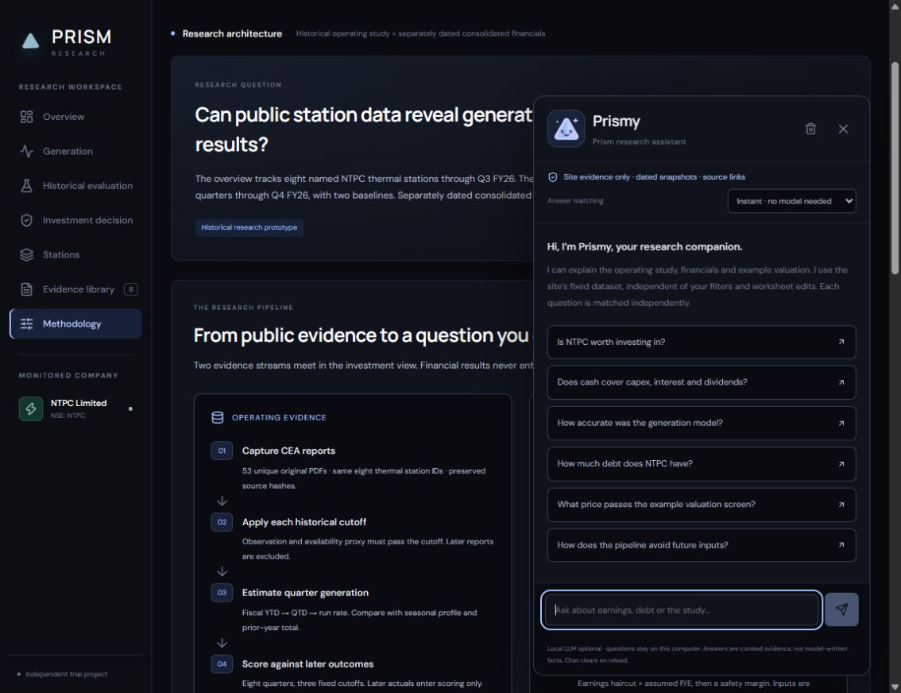
Prismy answers from the site’s evidence
A bounded answer surface
Six preset questions and typed queries over 14 canonical evidence cards.
Sources accompany answers
Unknown questions receive an explicit evidence-gap response.
Optional model routing
Local Ollama selects evidence IDs. Static hosting uses instant matching.
Sutanu Chatterjee / PRISM Trial Task
09
Notes:
https://github.com/ronnismad/prism-ntpc-research-dashboard/blob/main/src/knowledge.js
https://github.com/ronnismad/prism-ntpc-research-dashboard/blob/main/src/ResearchAssistant.jsx
https://github.com/ronnismad/prism-ntpc-research-dashboard/blob/main/scripts/assistant_server.mjs
Screenshot: docs/prismy-preview.png. 14 canonical evidence cards and six preset questions. Model selects IDs only; client renders canonical text and citations. Five local smoke cases passed. Hosted GitHub Pages runs instant mode only; Ollama mode remains local.

Slide 10
The most useful findings changed the design
A stronger baseline changes the claim
The seasonal profile wins three of eight day-60 quarters. I retained every quarter and all cutoff comparisons.
Known output makes headline error look better
I added remaining-output error so the reader can assess the genuinely unobserved part of the quarter.
Cash classification changes the interpretation
I subtracted financing interest explicitly before discussing cash available after reinvestment.
Restricted generation improves factual control
Prismy renders source-backed cards. The LLM can match a question but cannot write new factual claims.
Sutanu Chatterjee / PRISM Trial Task
10
Notes:
https://github.com/ronnismad/prism-ntpc-research-dashboard/blob/main/README.md
https://nsearchives.nseindia.com/corporate/9425178051_23052026151711_NTPCAFR26.pdf PDF pages 20 and 22.
https://github.com/ronnismad/prism-ntpc-research-dashboard/blob/main/docs/BACKTEST_RESULTS.md

Slide 11
The next version would strengthen provenance and economics
First priority: verify historical availability
Capture first-public timestamps and revision vintages, then reserve prospective quarters before testing.
Second: expand coverage consistently
Map legal entities, technologies and commissioning events across the full fleet.
Third: model recurring earnings and funding
Separate tariff economics, normalize interacting adjustments, test project returns and financing needs.
Fourth: broaden assistant evaluation
Use a larger paraphrase and unsupported-question set. Add a secured hosted model only if it is useful.
Sutanu Chatterjee / PRISM Trial Task
11
Notes:
https://github.com/ronnismad/prism-ntpc-research-dashboard/blob/main/README.md. These are proposed improvements, not completed features. No durable statistical edge, whole-company generation forecast or stock-return backtest has been established.

Slide 12
A reviewer can reproduce the result
Live dashboard
https://ronnismad.github.io/prism-ntpc-research-dashboard/
Source repository
https://github.com/ronnismad/prism-ntpc-research-dashboard
Suggested five-minute review
Historical evaluation, Investment decision, Methodology, then a Prismy question and a source link.
Reproducible handoff
28 tests, source hashes, full-precision CSVs, README and local setup.
Prepared by Sutanu Chatterjee for the PRISM trial task. Data and market quote are dated snapshots.
Sutanu Chatterjee / PRISM Trial Task
12
Notes:
https://github.com/ronnismad/prism-ntpc-research-dashboard
https://ronnismad.github.io/prism-ntpc-research-dashboard/
See README for local setup, source definitions and limitations. Tests: 28 automated checks. Local run: npm install, npm run dev. Production build: npm run build. Source originals included under public/sources.

