Slide 1
Do we really need to recalibrate or retrain
a brain-to-text decoder every day?
AdaptLadder-BCI: Drift Geometry and Minimal Calibration in Brain-to-Text BCI
Ron Nuriel
Yacov (Toky) Hel-Or, Doron Friedman, Itzhak Fried Rafael Malach, Eilon Vaadia, Sarel Cohen
Start from the end:
Not yes. Not no. The decoder can stay frozen — but the input state must be chosen.
previous → geometry retrieval → calibration only if needed
AdaptLadder-BCI · 1/9
Notes:
פתיחה: להתחיל בשאלה. להגיד שזו לא שאלה תיאורטית, כי calibration יומי עולה זמן ודאטה מתויג. הממצא: לא כן ולא לא — ה-GRU יכול להישאר קפוא, אבל צריך לבחור נכון את ה-input state של היום.

Slide 2
Start from the end: input state is the bottleneck
Same frozen GRU. Different input state. Huge difference in phoneme error.
9.06%
native-day
correct daily input state
22–34%
wrong input state
decoder breaks
22.73%
mean / variance
correction fails
18.59%
20 labeled trials
partial recovery
12.21%
previous input state
strongest simple policy
12.74%
geometry retrieval
close, needs threshold
PER = phoneme error rate: lower is better.
Take-home: before retraining, ask which input state should feed the frozen decoder.
This turns drift from “train every day” into “select or lightly adapt the input layer.”
AdaptLadder-BCI · 2/9
Notes:
כאן להראות את התוצאות מהסוף: native 9.06%, wrong input עולה ל-22–34%, moment matching לא עוזר, calibration עוזר חלקית, previous ו-geometry טובים יותר. להסביר PER = phoneme error rate, כמה טעויות ברמת הצלילים.

Slide 3
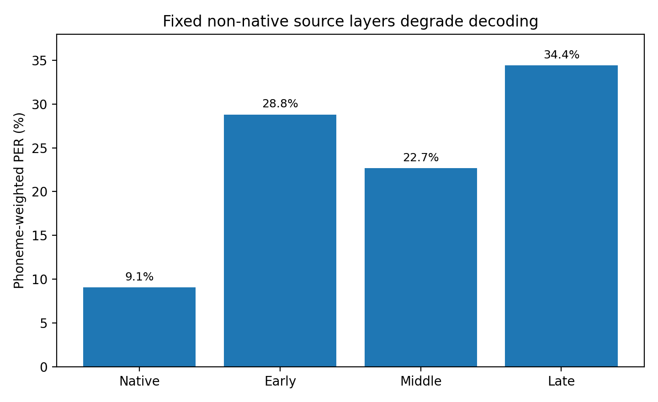
Result 1: wrong input-state selection breaks decoding
The GRU is not necessarily the problem — the interface into it is.
Input-state mismatch audit
• Native-day input layer: 9.06% PER
• Fixed non-native layer: 22.67–34.43% PER
• Channel-wise moment match: 22.73% PER
• Input-layer calibration, K=20: 18.59% PER
Interpretation
Mean / scale correction is too weak.
Small supervised calibration helps, but does not recover native-day performance.
Best first move: choose the right input state.
Question created by this result: can we find a compatible state from history?
AdaptLadder-BCI · 5/9
Notes:
כאן לא לקרוא לזה stress test. להגיד: עשינו input-state mismatch audit. שמנו input layer לא נכון וראינו שהשגיאה קופצת. moment matching לא עוזר. calibration קטן עוזר חלקית. לכן נשאלת השאלה: האם אפשר למצוא state מתאים מהעבר?

Slide 4
What do we mean by “neural geometry”?
Trials × time bins × neural features → a cloud of neural-feature vectors.
T15 data shape
trials / sentences
×
time bins
×
neural features
Flatten trials + time
session = point cloud
in channel space
Each point = one
time-bin vector
Geometry = cloud shape
Covariance tells us
how neural channels
move together.
→
→
If today’s cloud shape resembles a past day, that past input layer may still be compatible.
distance used: relative Frobenius covariance distance
also checked: subspace + principal angles
Not raw spikes alone: neural features / channels after preprocessing.
AdaptLadder-BCI · 3/9
Notes:
להסביר פשוט: הדאטה הוא trials × time × features. כל time bin הוא נקודה במרחב רב-ממדי. כל session הוא ענן נקודות. covariance הוא צורת הענן — איך הערוצים משתנים ביחד.

Slide 5
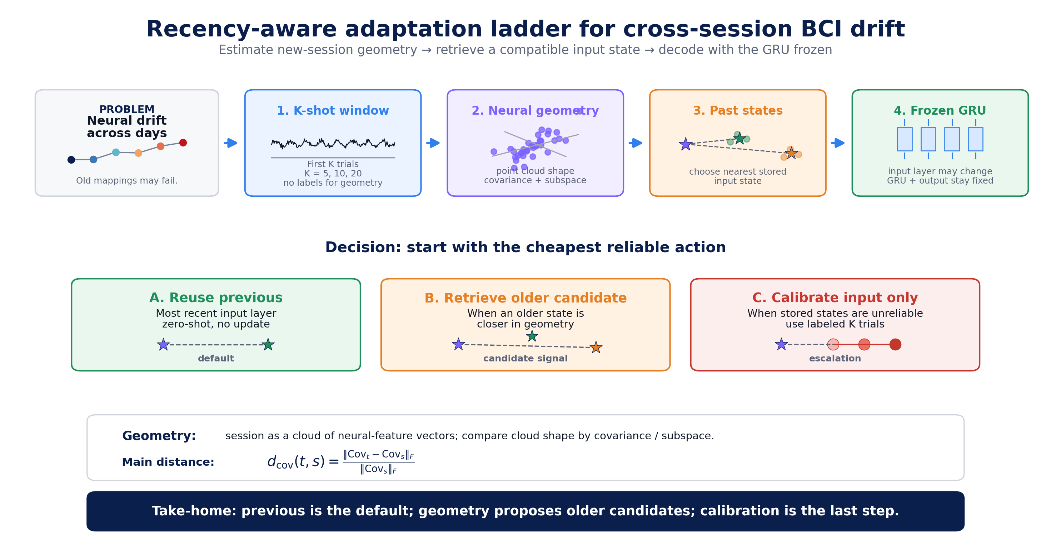
The adaptation ladder: start cheap, escalate only when needed
Figure 1 from the paper — the whole method in one picture.
Previous is the default. Geometry retrieves candidates. Calibration is last.
AdaptLadder-BCI · 4/9
Notes:
להציג את Figure 1: חלון קצר בתחילת היום, מחשבים geometry, משווים לספריית input states. קודם previous, אחר כך older candidate, ורק בסוף calibration. ה-GRU וה-output נשארים קפואים.

Slide 6
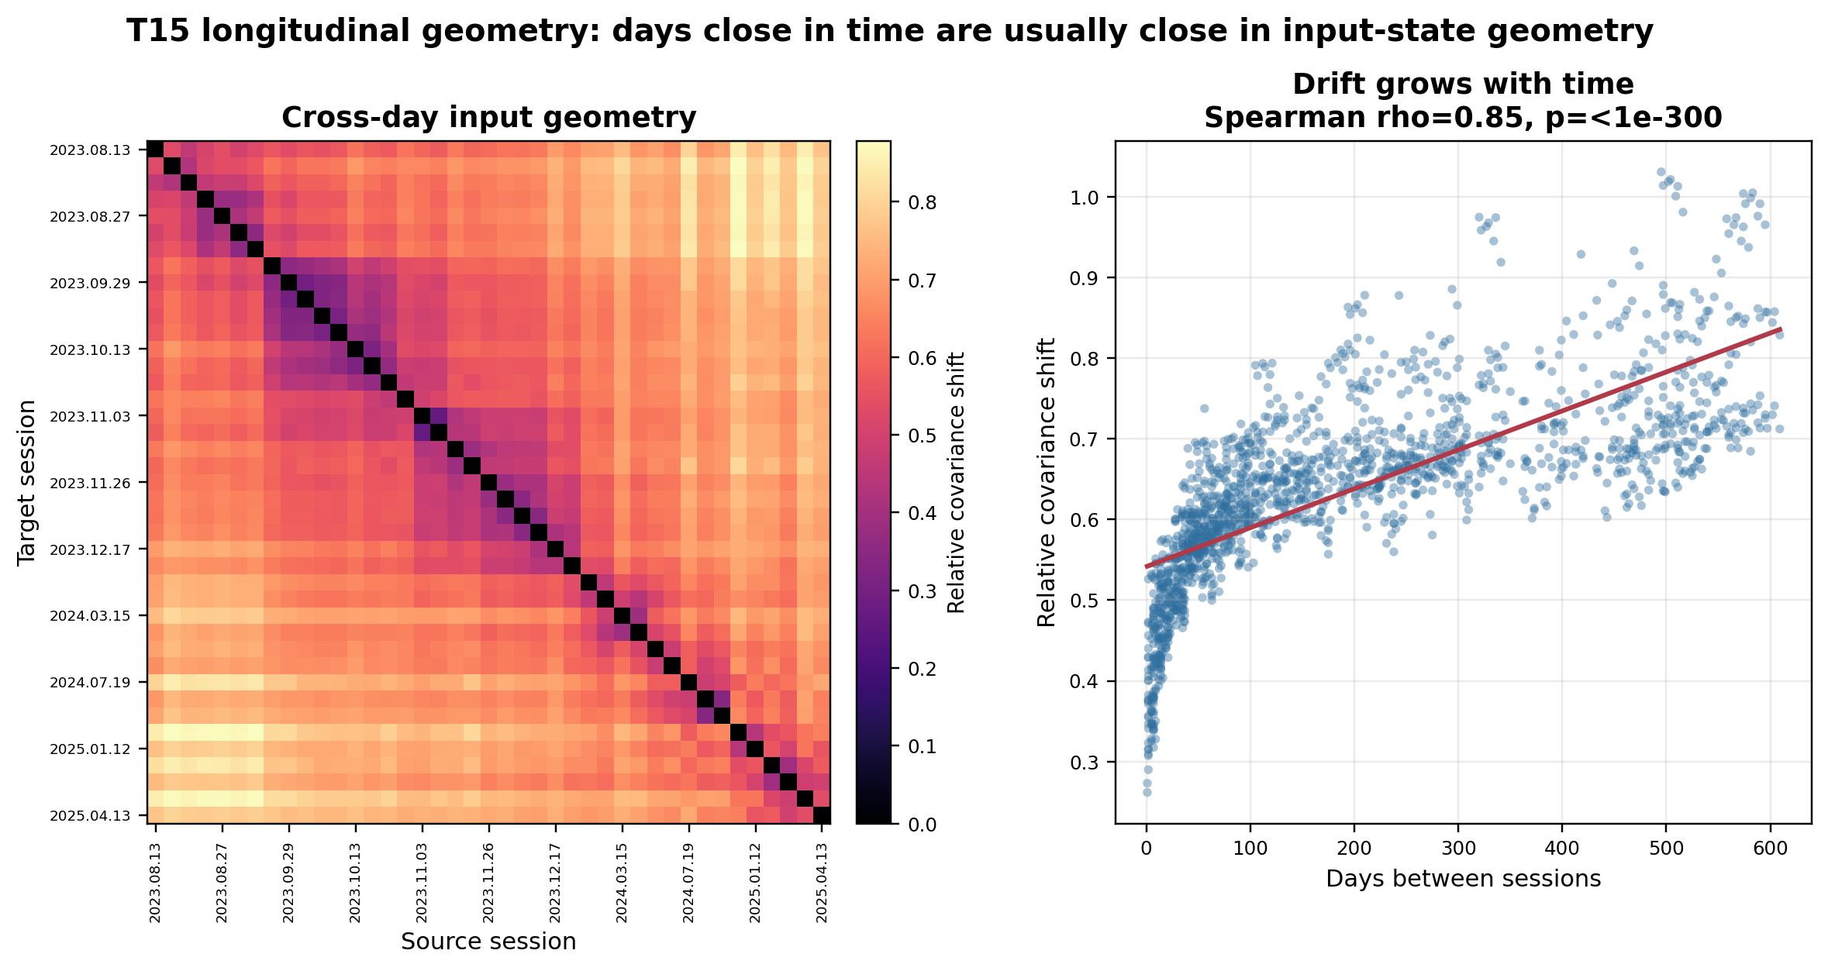
Result 2: drift is structured, not random
Nearby days are often nearby in input-state geometry — but the trajectory is not perfectly monotonic.
diagonal band = nearby days have similar geometry
Spearman ρ = 0.85 = drift grows with time
non-monotonic cases = older states can matter
AdaptLadder-BCI · 6/9
Notes:
להסביר: heatmap עם פס אלכסוני אומר שימים קרובים דומים גיאומטרית, וזה מסביר למה previous חזק. אבל יש גם לא-מונוטוניות ולכן older states יכולים להיות רלוונטיים.

Slide 7
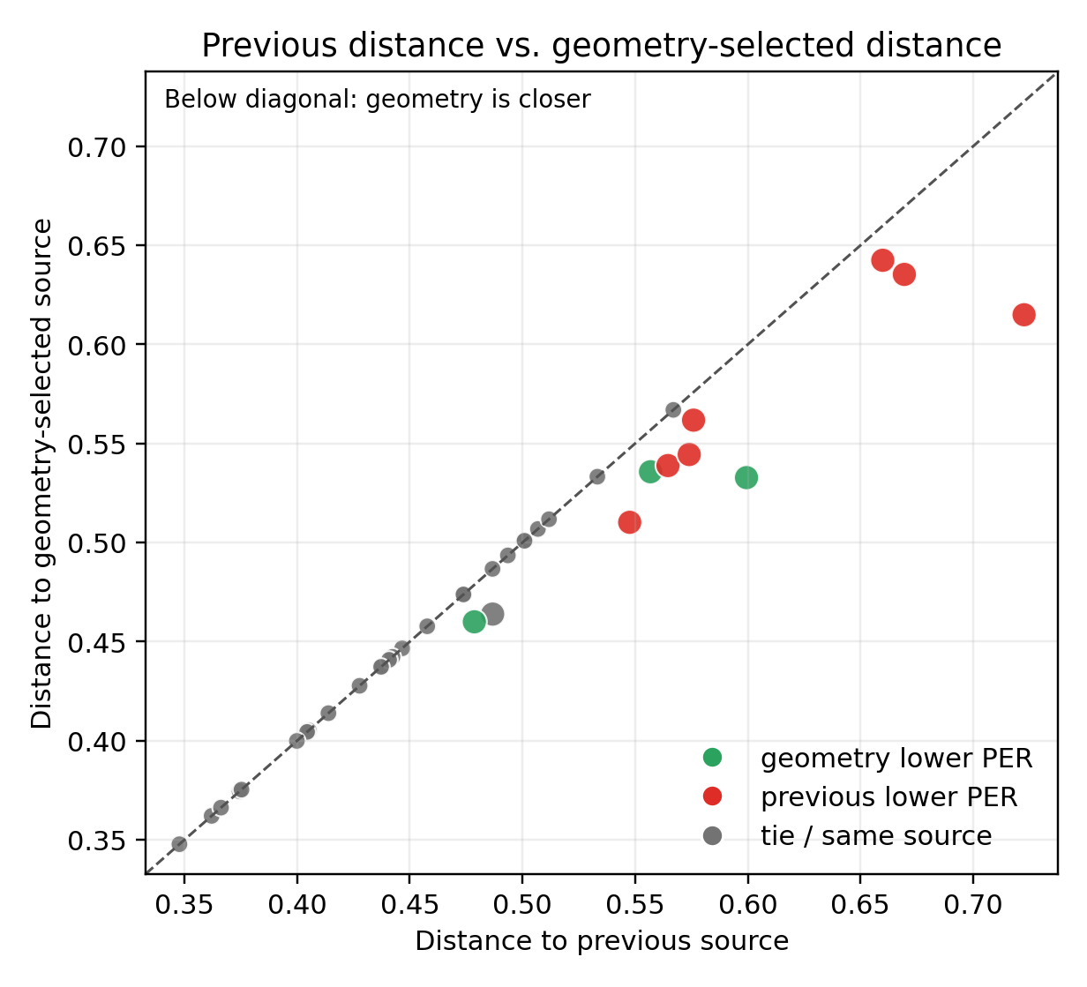
Result 3: geometry proposes candidates — confidence threshold needed
Closer in covariance is not always lower PER.
26
geometry selected
previous sessions
11
geometry selected
older sessions
3/11
older source
wins cases
7/11
previous still
better cases
False-positive retrieval cost:
3.23 percentage points PER on average
Conclusion: geometry should propose older states, not blindly override recency.
AdaptLadder-BCI · 7/9
Notes:
כאן להדגיש את הכנות המדעית: בהתחלה חשבנו שאולי geometry תפתור הכל, אבל גילינו שהיא signal ולא policy. לכן צריך confidence threshold לפני שמחליפים את previous.

Slide 8
Operational answer: manage input states, not the decoder
A 6-minute summary of the paper in one decision ladder.
1. Reuse previous
If the last state is recent
0–3 days: 9.97% PER
2. Retrieve by geometry
If previous is stale
K=20 geometry: 12.74% PER
3. Calibrate input only
If no stored state is reliable
22.67 → 18.59% PER
→
→
The decoder can stay frozen; the system selects or lightly adapts the input state.
Next: confidence threshold, WER + LM decoding, and closed-loop validation.
reuse → retrieve → calibrate
AdaptLadder-BCI · 8/9
Notes:
סיום: זה לא daily retraining. זה input-state management. קודם previous, אם stale אז geometry retrieval, ואם אין התאמה אז calibration לשכבת הקלט בלבד.

Slide 9
The decoder can stay frozen.
What needs to adapt is the input state.
Three takeaways:
1. Wrong input states break decoding
2. Drift has measurable geometry
3. Geometry needs a confidence threshold
Thank you
AdaptLadder-BCI · 9/9
Notes:
סגירה קצרה מאוד: שלושה takeaways והמשפט המרכזי.

