Slide 1
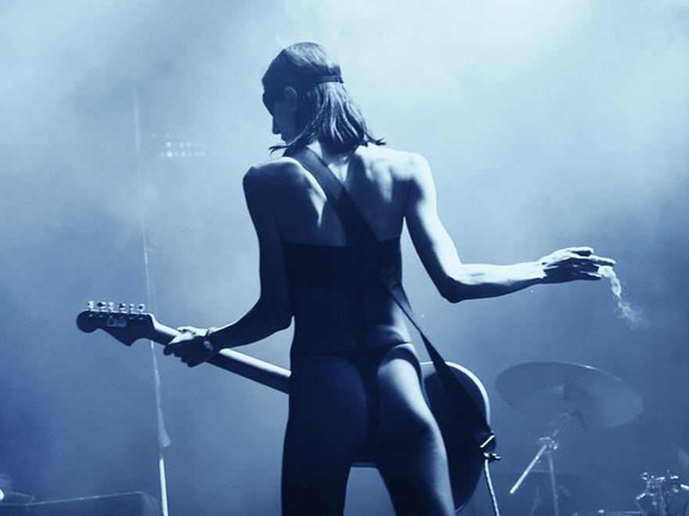
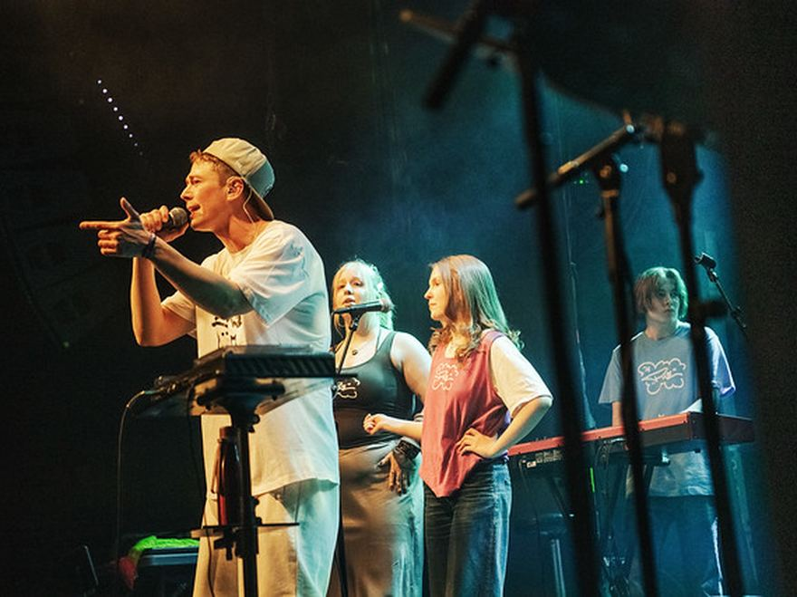
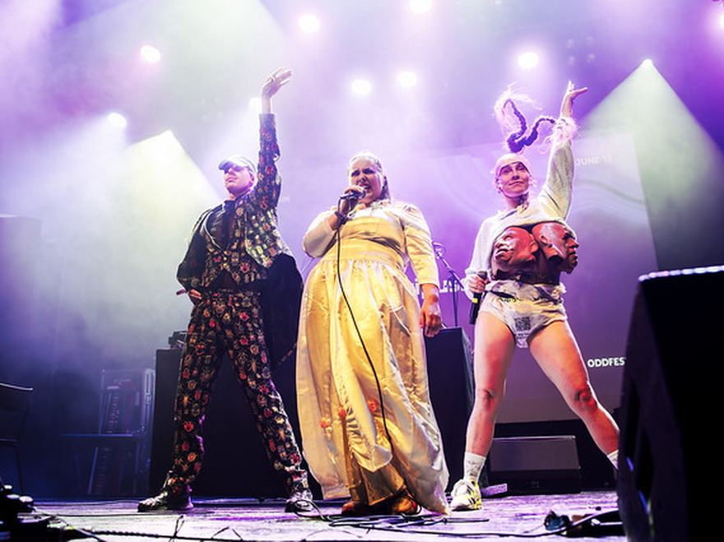
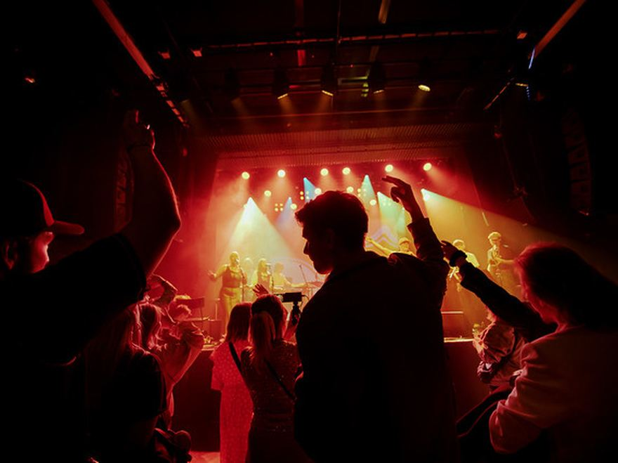

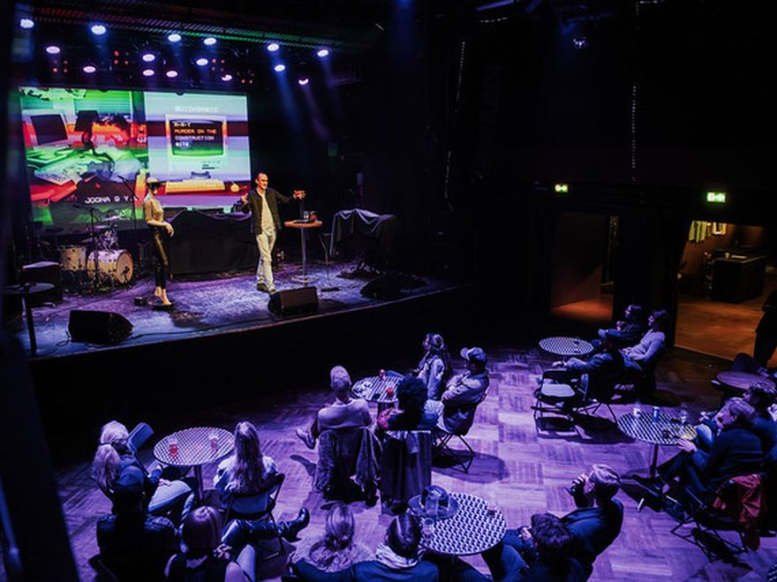
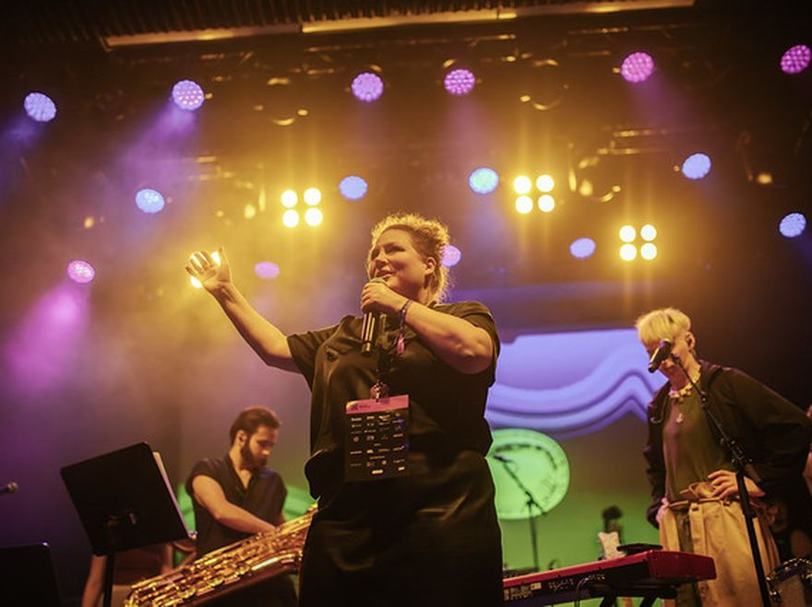
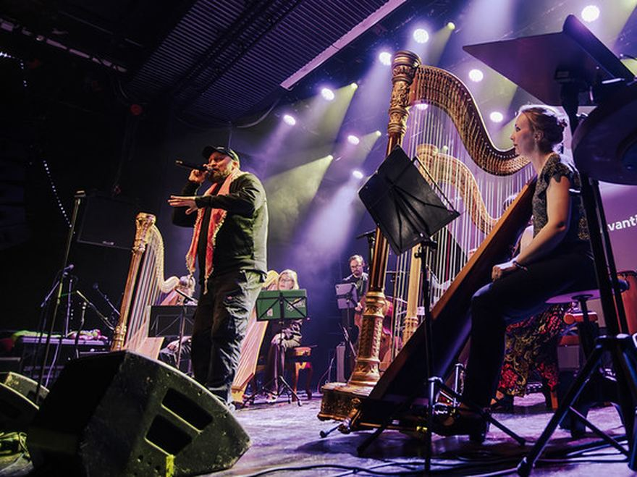
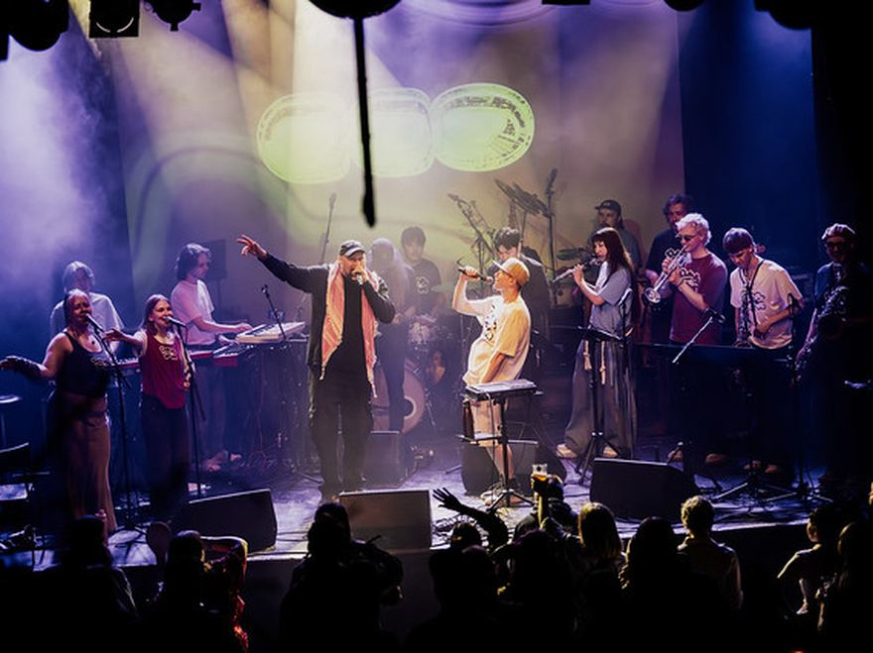
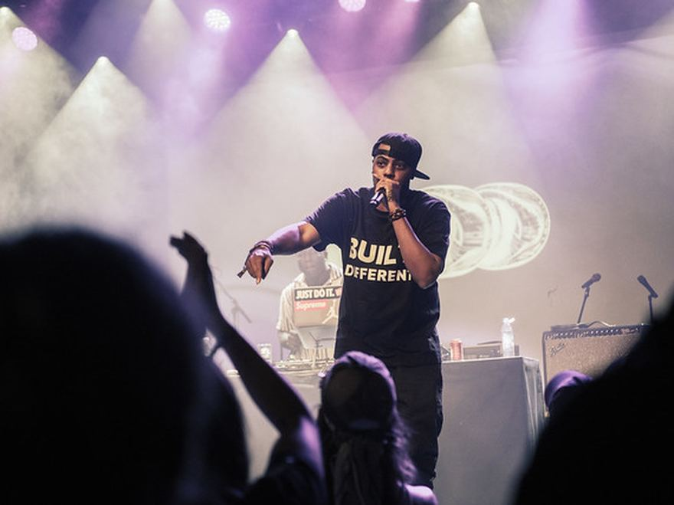
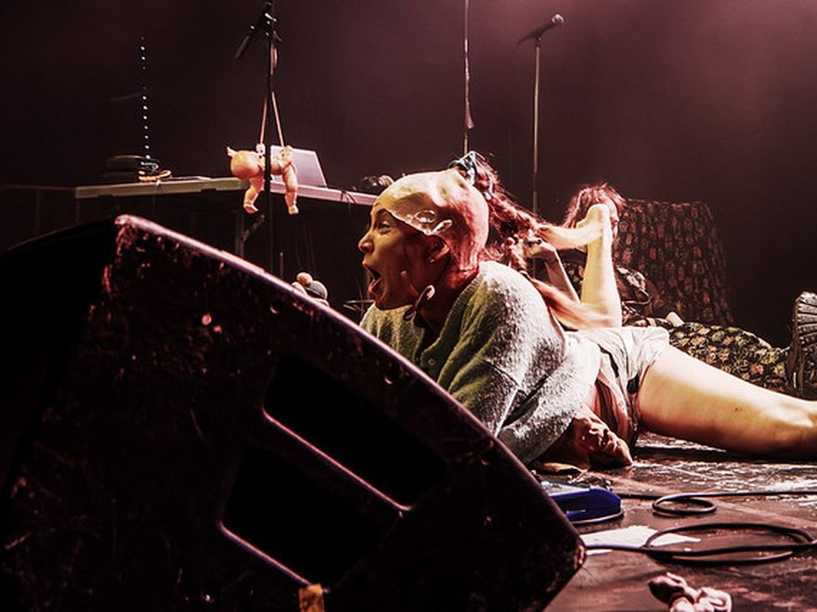
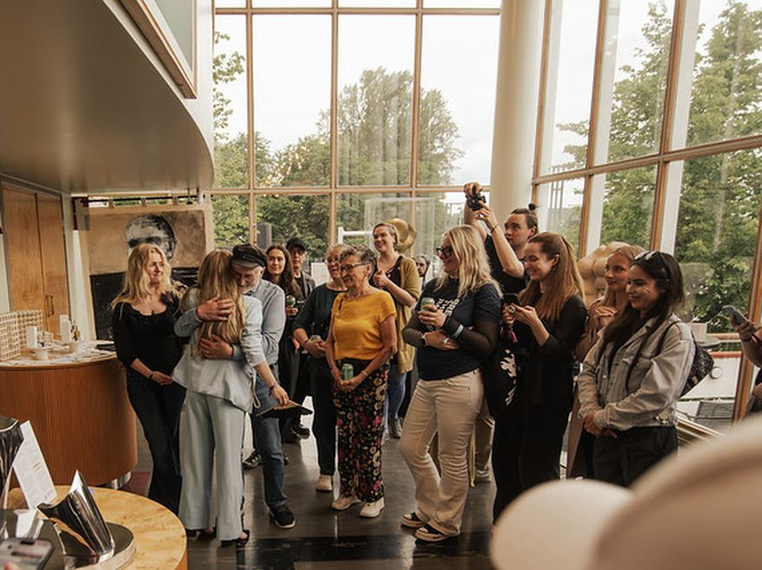
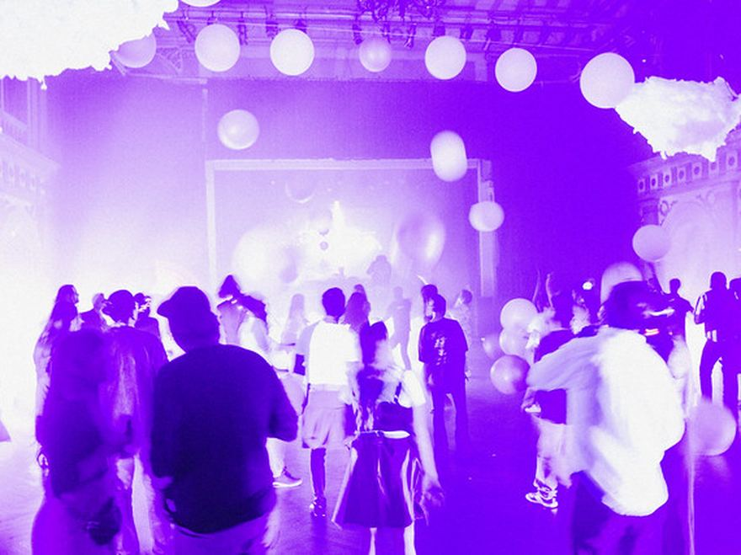
ODD exists to build better conditions for creative work — and to bring creative and cultural fields closer to business and wider society.
HELSINKI · NEW NORDIC WAY RF
ALLTHINGSODD.CO
Notes:
All Things ODD: ODDfest, ODDference, ODDspace, and the work around them.

Slide 2
ABOUT ODD
WHY ODD
Finland has creative talent. What’s missing are the structures that help it grow, connect and last.
Notes:
The argument in one breath: the talent is here, the structures around it are not.

Slide 3
ABOUT ODD
WHAT WE BUILD
Different problems need different structures.
01
02
03
Events create reasons to gather
Spaces give people somewhere to return
Projects and relationships let something continue
ODDfest makes creative activity across Helsinki visible as one shared week. ODDference creates a deliberately composed professional room around creative expertise.
ODDspace is the everyday layer: somewhere to work, meet, host things and keep going between projects and events.
ODDagency, partnerships and the developing ODDnetwork create ways to keep working together when there is a real reason to do so.
Notes:
One annual event cannot create continuity on its own. Three formats, three jobs.

Slide 4



ALL THINGS ODD
ODD is operated by New Nordic Way rf, a Finnish non-profit association based in Helsinki.
ACROSS HELSINKI
BUSINESS & SOCIETY
VALLILA · YEAR-ROUND
Helsinki’s creative week, bringing independent events, ideas and creative communities into one shared week.
A business conference exploring what business and society can learn from the creative world.
A year-round home for creative work — workspace, studios, events and community under one roof.
FOR ORGANISATIONS
Bring us a question, brief, event or partnership idea. We build the right team, format and creative expertise around it.
Work with ODD
EXPLORE WORK WITH ODD
Notes:
One mark, three ways in, and a fourth that starts as a conversation.

Slide 5
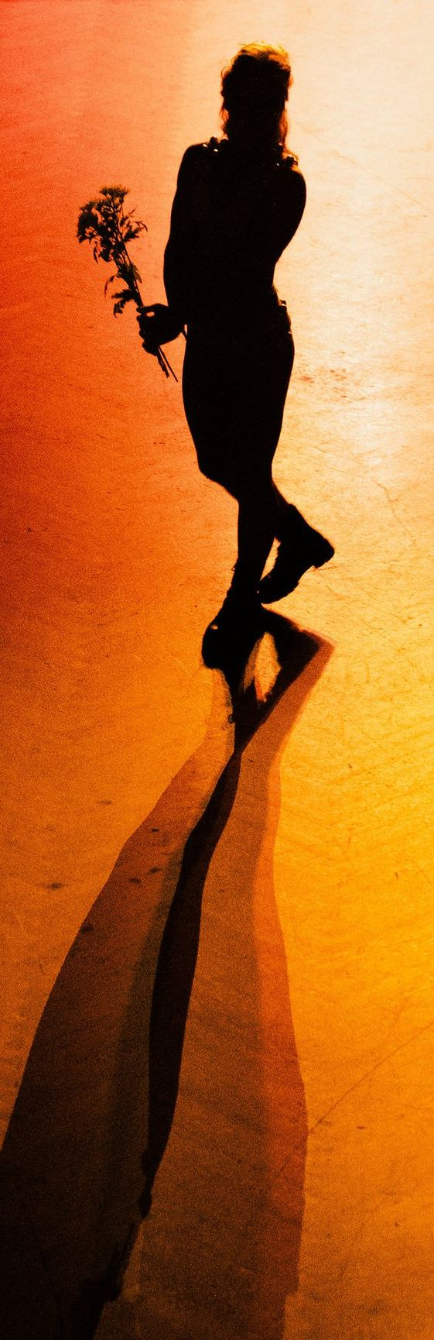
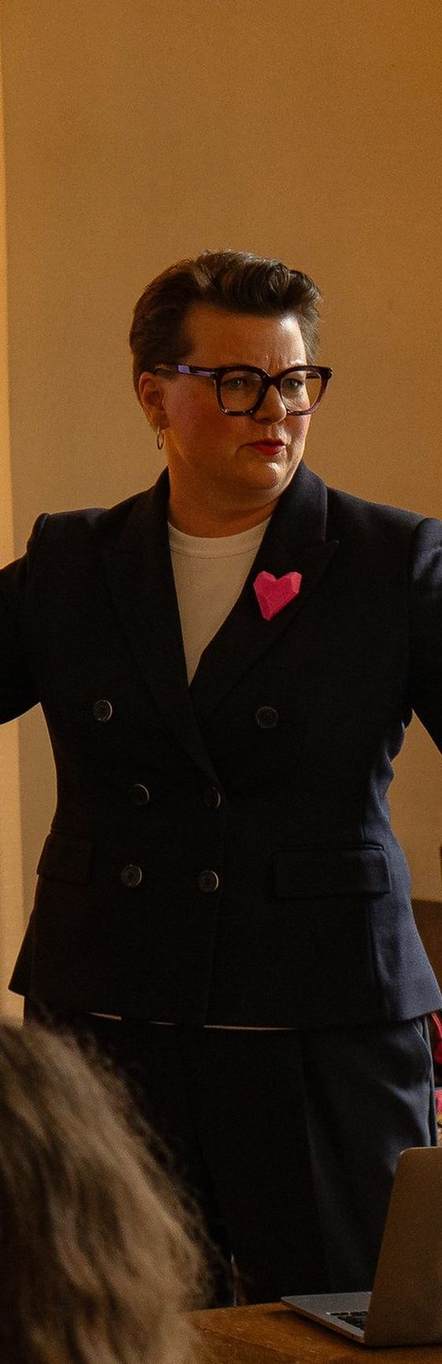
WHO ODD IS FOR
ODD brings two worlds together — creative and cultural people, and businesses that want to work with them.
FOR CREATIVES
FOR BUSINESS
Work, create and connect with other creatives.
Get closer to creative expertise and the people behind it.
Work from ODDspace. Bring something of your own to ODDfest.
Come to ODDference, build a partnership, or bring us a brief.
ODDFEST
ODDFERENCE
ODDSPACE
WORK WITH ODD
Notes:
Two audiences, one organisation. Creative first, always.

Slide 6
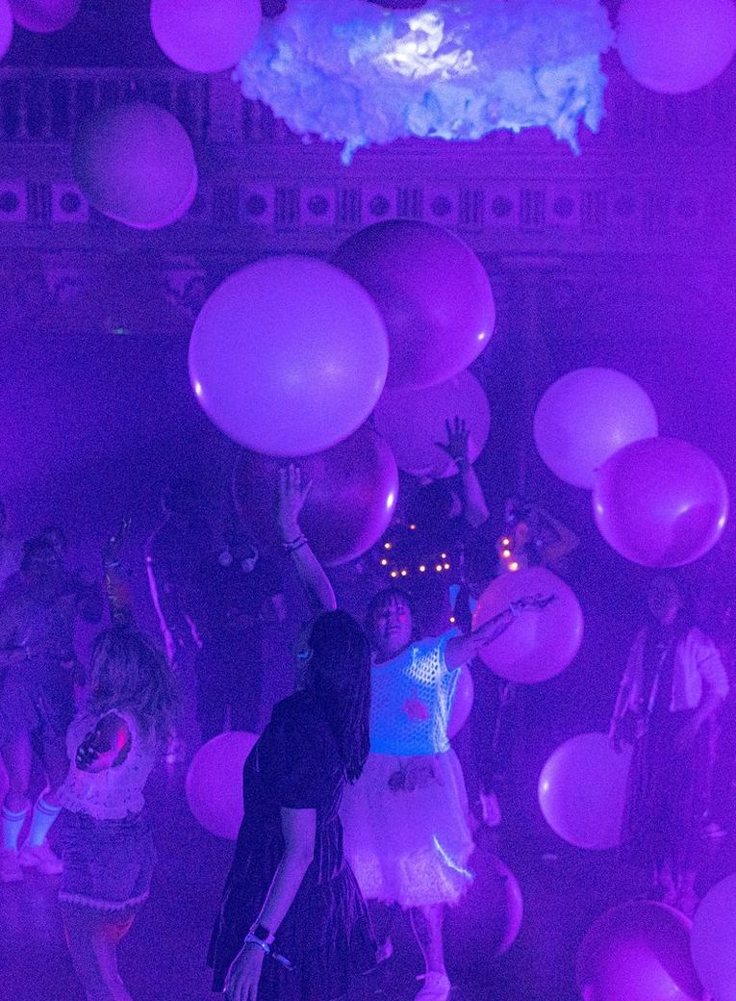
ODDFEST
One shared week, made by Helsinki’s creative communities.
ODDfest is a week of independently made events across Helsinki, and in 2026 it brought more than 150 acts to five venues.
ODDfest 2026 · ODDtheatre at Vanha Ylioppilastalo
Notes:
Helsinki’s creative week: independently made events, one shared week, next in 2027.

Slide 7
ODDFERENCE
What can business and the rest of society learn from creative expertise?
FIVE FIRESIDE CHATS · ODDFERENCE 2026
From Products to Worlds: Who Wins in the Experience Economy?
Leading Organizational Creativity — How To Make It or Break It
What World-Class Brands Do Differently: Inside Creative Work at the Highest Level
The 2026 edition ran over two days in central Helsinki, with 25 speakers and more than 30 sessions.
New Media in the Attention Economy — What Has Changed?
The Art of Renewal: Rewiring Organizational Change
GET YOUR TICKET
Notes:
The premise, and what it actually sounded like on stage in 2026. Tickets: €299 Blind Bird + VAT 13.5%.

Slide 8

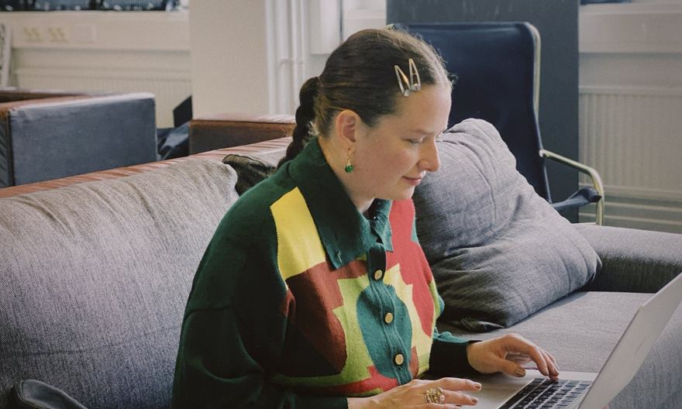
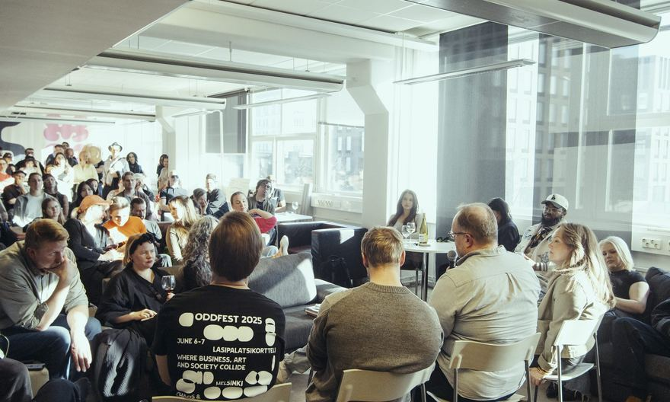
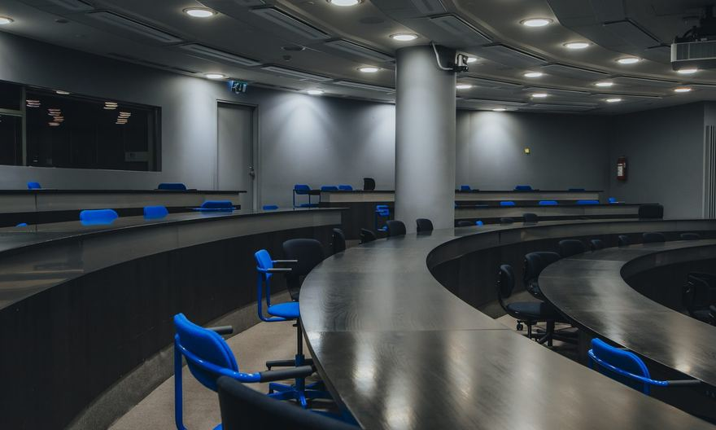
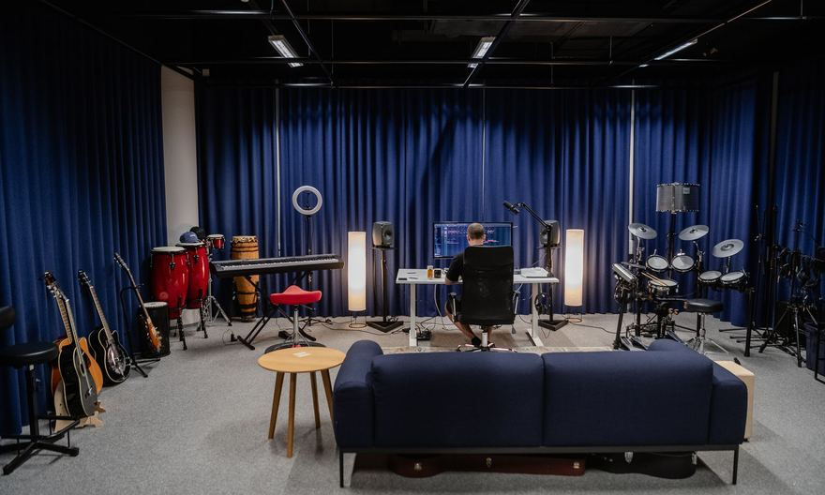
ODDSPACE · VALLILA
A year-round home for creative work.
Workspace, studios, events and community under one roof — in Vallila, for people working across art, culture, design, media, technology and business.
Co-working space
Event & gallery space
Auditorium
ODDstudio
BECOME A MEMBER
Teollisuuskatu 9D, Vallila, Helsinki
Notes:
ODDspace is the light theme of the whole system: the everyday, daylight layer of ODD.

Slide 9
ABOUT ODD
OUR STORY
How we got here.
2023
New Nordic Way rf
The association is founded in Helsinki. The idea that becomes ODD is still taking shape.
2024
Finding the gap
The question becomes clearer: more can happen when there is greater continuity around the work, and stronger links between creative fields and the rest of society.
2025
The first ODDfest
The first public experiment brings 2,600+ participants, 350+ contributors and 70+ partners together in Helsinki.
2026
More than one event
Creative Week tests a distributed city-wide model. ODDference tests the professional proposition. ODDspace creates a year-round physical base.
Notes:
2027: Creative Week becomes ODDfest, ODDference stands on its own, ODDspace continues year-round.

Slide 10
ALL THINGS ODD
ALREADY IN MOTION
Two years in, this is what
has already happened.
ODD began with the first ODDfest in 2025. Since then, ODDference and ODDspace have joined it, alongside project work with organisations. The figures below are cumulative across that work.
5,000+
500+
100+
€400K+
PARTICIPANTS
COLLABORATORS
PARTNERS
DIRECTLY INTO CREATIVE & CULTURAL INDUSTRIES
Notes:
Cumulative across ODDfest 2025, ODDfest and ODDference 2026, ODDspace and project work.

Slide 11
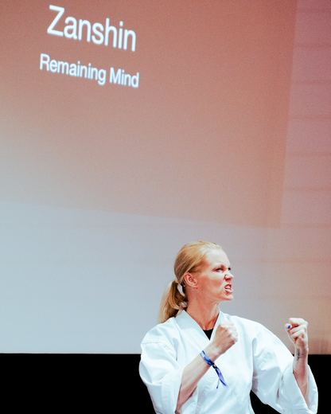
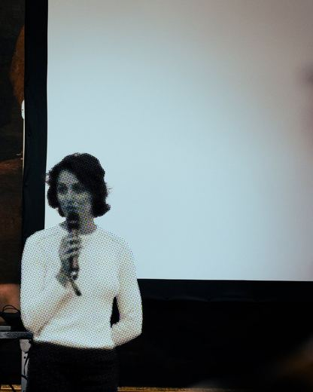
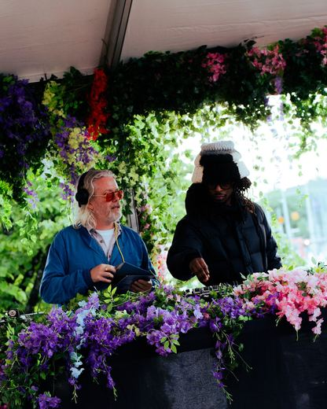
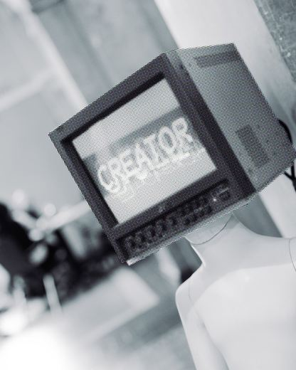
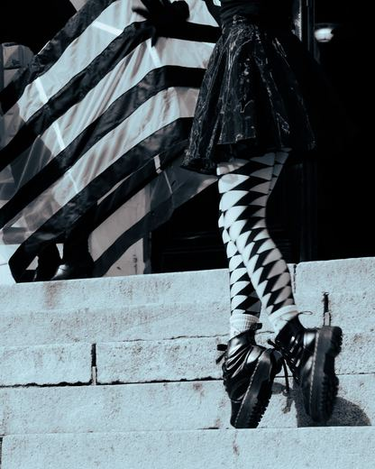
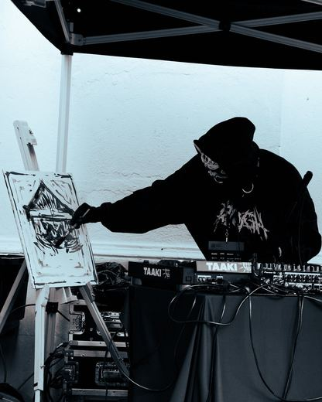
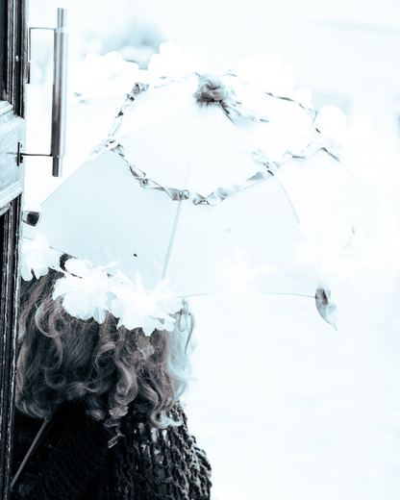
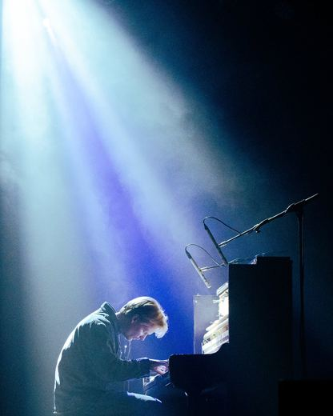
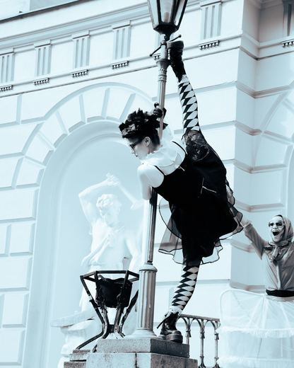
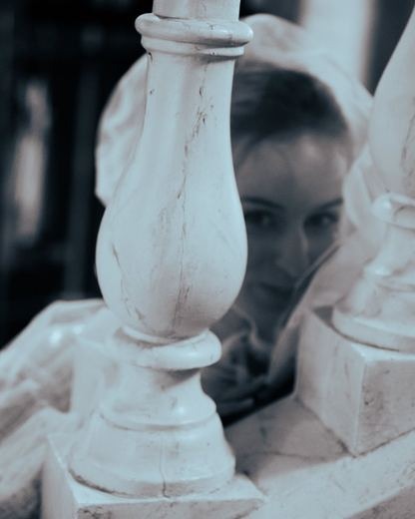
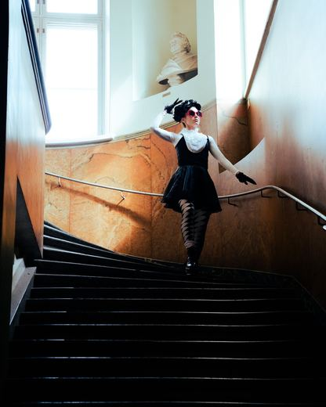
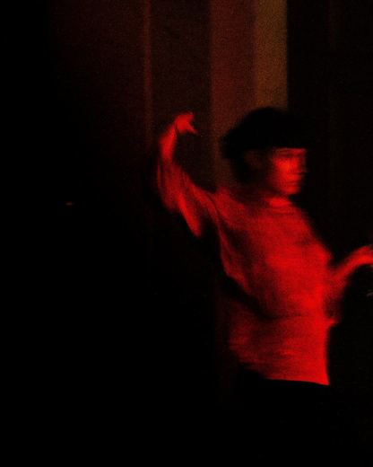
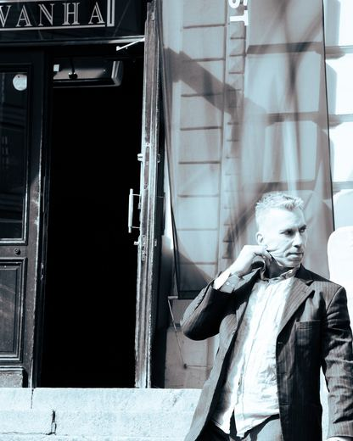
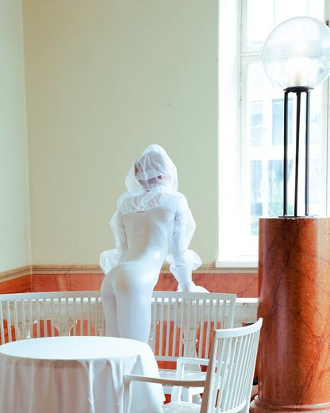
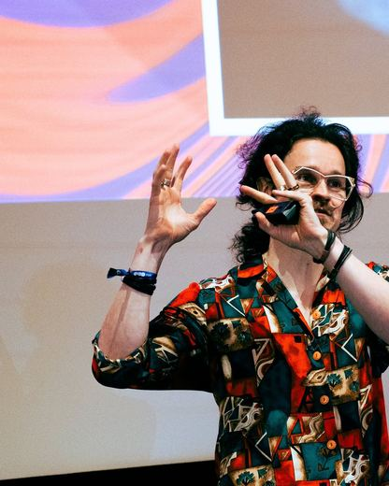
ODDFEST 2026
WHAT HAPPENED IN 2026
274
people, artists, collectives and organisations made ODDfest 2026. Together.
Creative Week ran June 8–14. ODDference took two days — more than 50 speakers and more than 30 sessions. ODDfest ran from the Friday through Saturday, with more than 150 acts across central Helsinki.
Notes:
274 names, counted from the credits on the thank-you page — never typed in by hand.

Slide 12
ALL THINGS ODD
WAYS TO TAKE PART
Bring something of your own.
Host something at ODDfest. Join ODDspace. Come to ODDference. Or build something with ODD.
HELLO@ODDFEST.CO
ALLTHINGSODD.CO
New Nordic Way rf · Helsinki
Notes:
Close on the ask, not on a thank-you slide. hello@oddfest.co — never an @allthingsodd.co address.

