Slide 1
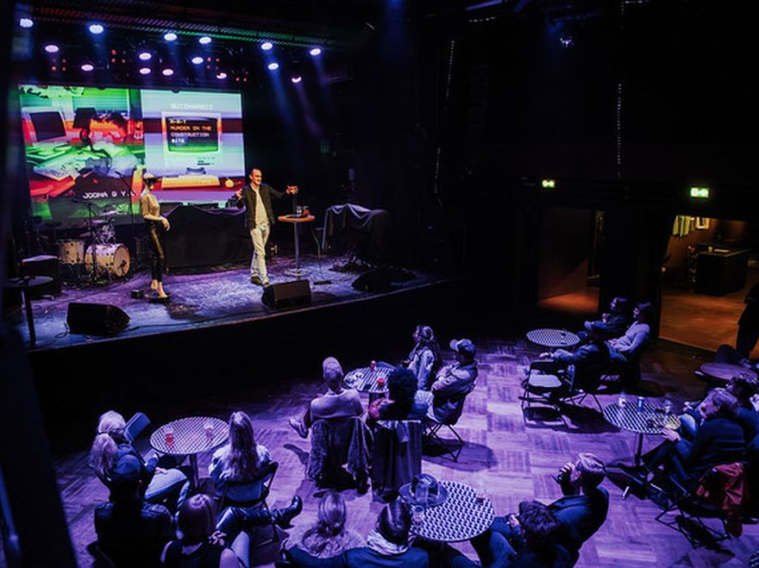
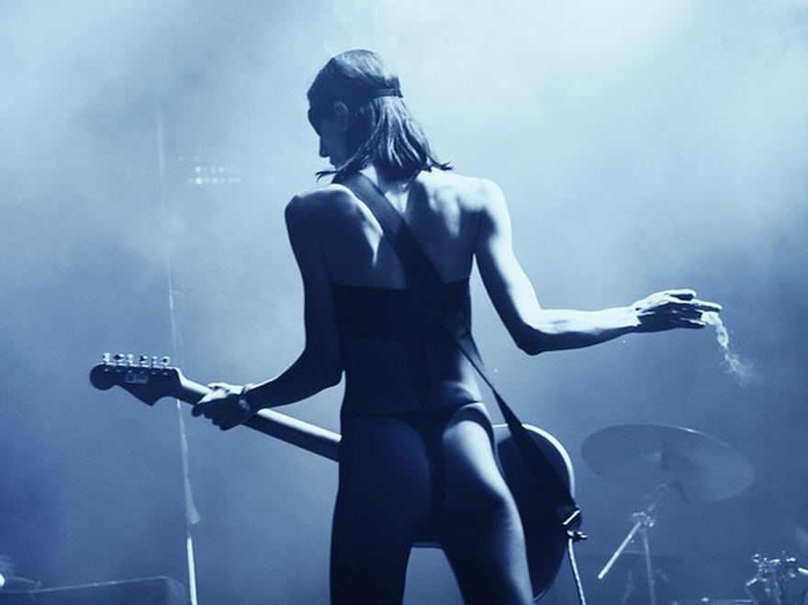
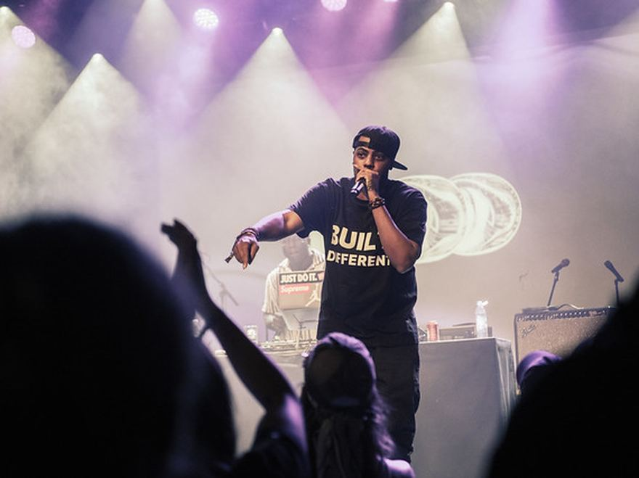
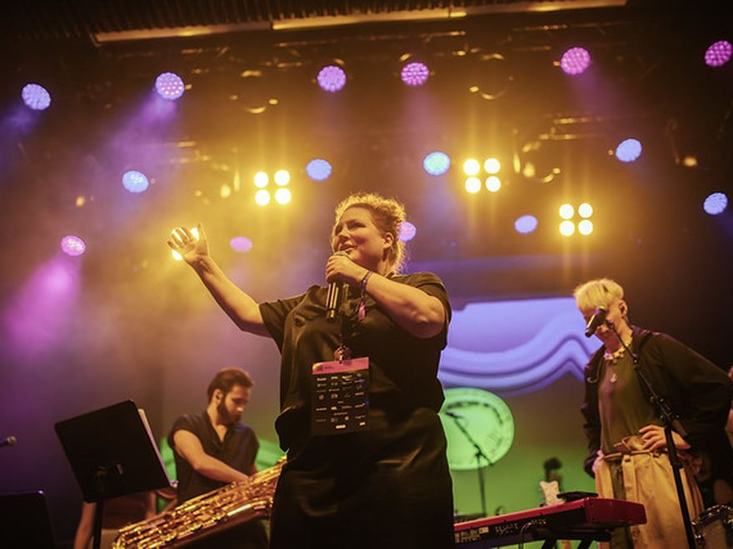

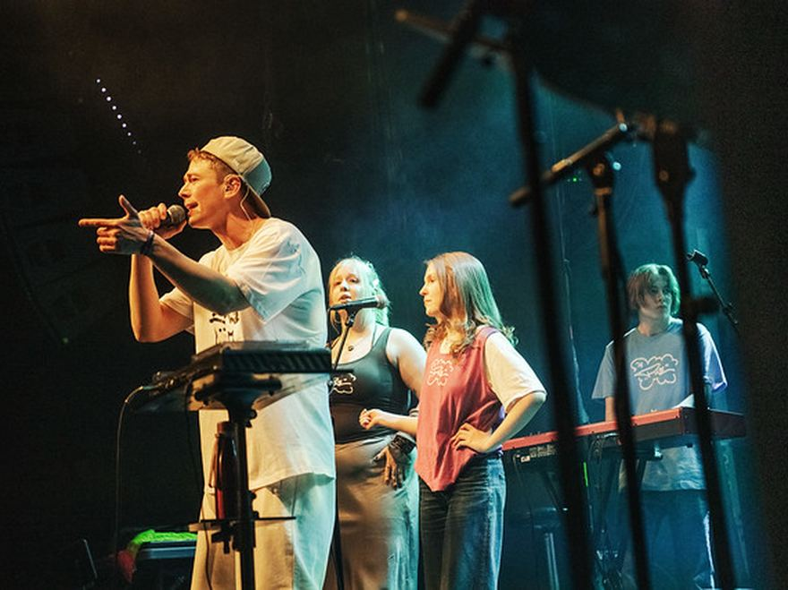
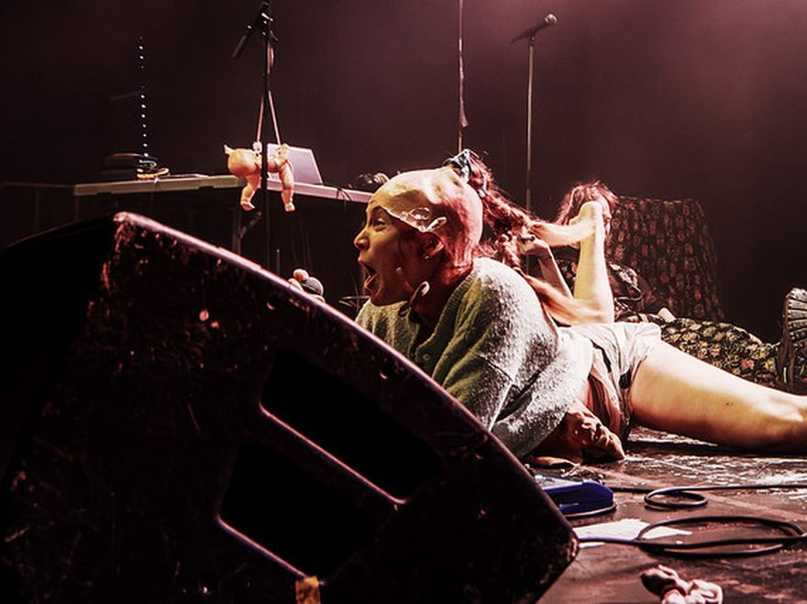
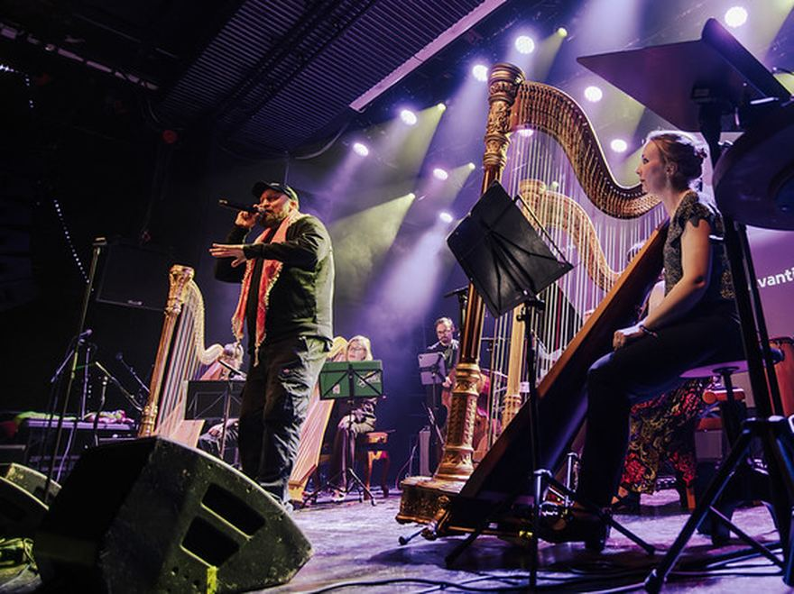
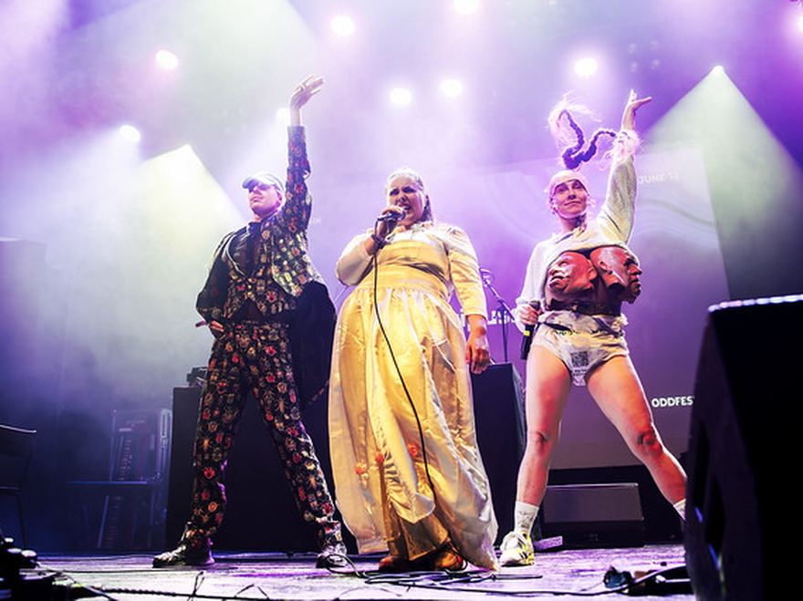
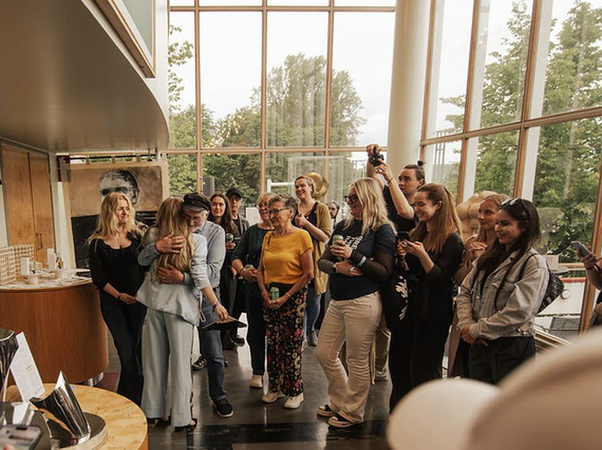
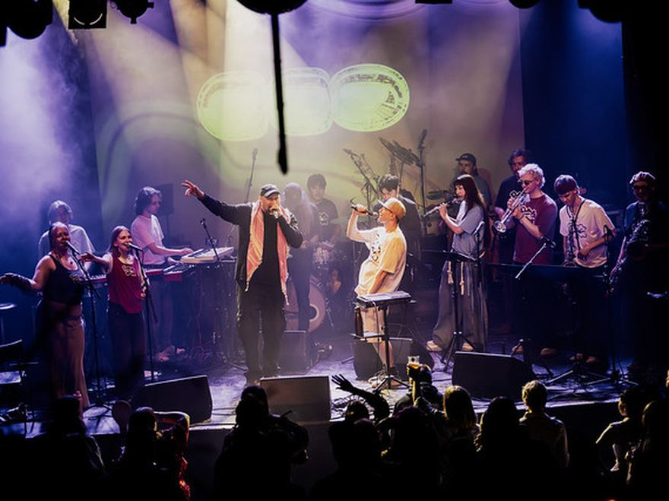
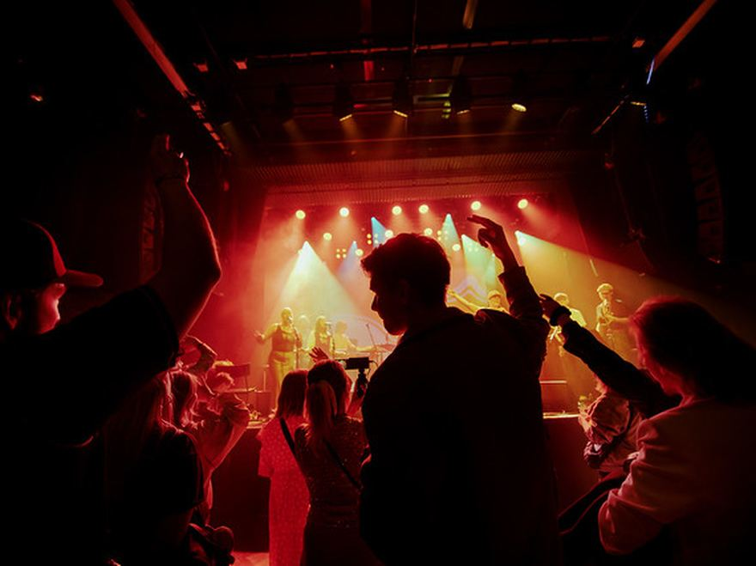
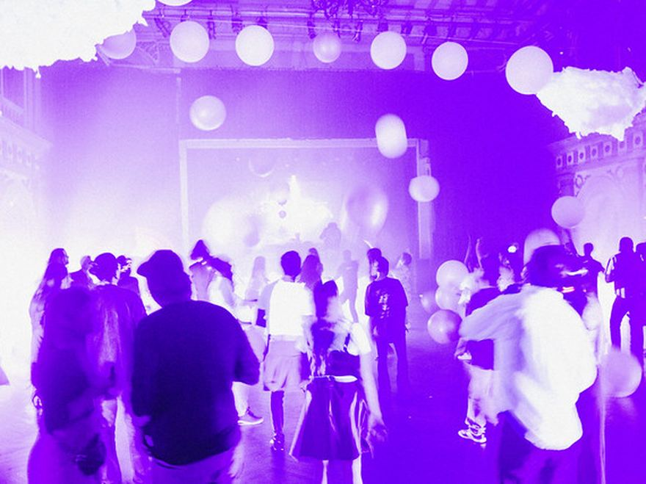
ODD exists to build better conditions for creative work — and to bring creative and cultural fields closer to business and wider society.
HELSINKI · NEW NORDIC WAY RF
ALLTHINGSODD.CO
Notes:
COVER — the ODD hero, one per deck.
The mark sits in the middle of a hairline mosaic of real archive photographs (never stock, never one hero image), dimmed by an Ink scrim so the statement reads. Replace the twelve photos with whatever the deck is about; keep the 4x3 grid and the 1px gaps. The line under the mark is a Heading, not a Hero: the mark is the loudest thing here.

Slide 2

ABOUT ODD
Creativity belongs closer to the centre.
NEW NORDIC WAY RF · HELSINKI
ALLTHINGSODD.CO
Notes:
MINIMAL COVER — the daylight alternative to slide 01, for a document-like deck: a proposal, a board paper, a report.
Paper ground, Ink mark at nav size, the title at Hero anchored to the bottom half. Nothing else. Headlines are sentences and end with a full stop; Forta capitalises for you, so write in sentence case.

Slide 3
ALL THINGS ODD
WHY ODD
Finland has creative talent. What’s missing are the structures that help it grow, connect and last.
Notes:
MANIFESTO — the argument in one breath. One per deck, never two.
Premise, then point: the first sentence sits in quiet grey, the second in full Paper, in one text box with two runs. Hero is the only size on the slide; if the statement needs more than six lines, it is not a statement yet.

Slide 4
2027
02
HELSINKI
CHAPTER TWO
Helsinki’s creative week.
ODDfest
WHAT ODDFEST IS · HOW TO JOIN · HIGHLIGHTS FROM 2026
Notes:
SECTION DIVIDER — one per chapter, and only if the deck really has chapters.
The number is the loudest thing on it (Forta at Hero, in quiet grey), the chapter title sits at Display under a hairline, and the line of small capitals at the bottom says what is in the chapter. The rail is optional and belongs on two to four slides at most — it is a ticker, not a frame.

Slide 5
ODDFERENCE
THE PREMISE
What can business and the rest of society learn from creative expertise?
HELSINKI · 2027
ODDference is a business conference built around creative and cultural expertise. It brings that expertise into the questions business and society are facing now.
Notes:
BIG IDEA — one sentence at Hero, with the support underneath it rather than beside it.
Everything below the hairline is quiet: a label on the left, two or three lines of Body on the right. The empty space above the hairline is doing work; do not fill it.

Slide 6
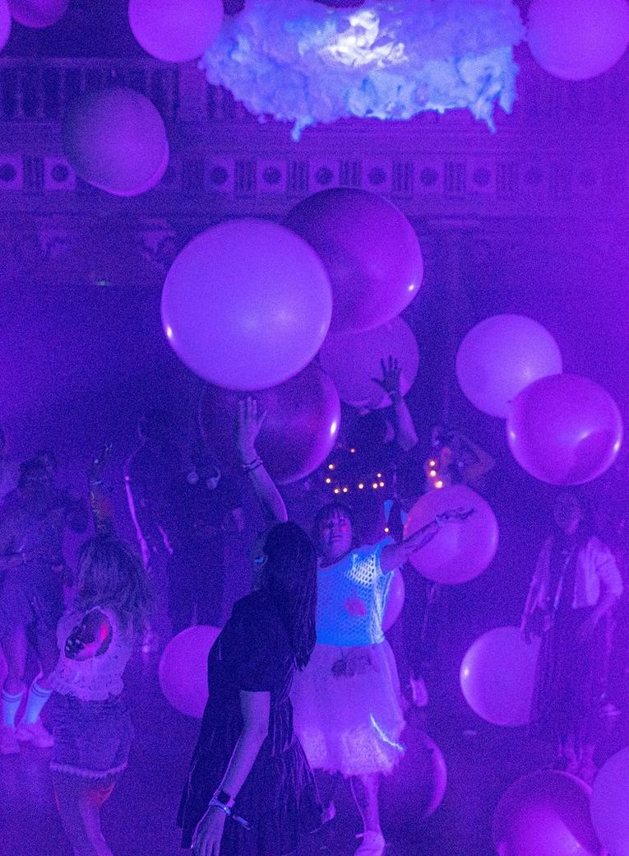
ODDFEST
WHAT ODDFEST IS
One shared week, made by Helsinki’s creative communities.
ODDfest is a week of independently made events across Helsinki. Artists, collectives, venues, organisations and companies make and produce their own.
SUBMIT AN EVENT IDEA
Notes:
TEXT + IMAGE — the workhorse. Text on the left, one photograph bleeding off the right edge, full height.
The photo is evidence, so crop it to the action. Keep the 1.28in gutter between the text column and the picture; nothing else sits in it. Round belongs only to the thing you act on: the pill.

Slide 7
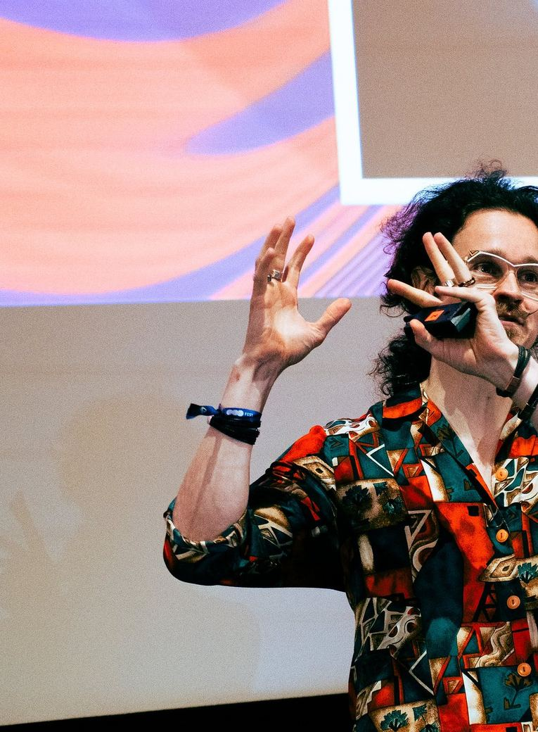
ODDFERENCE
02 · MEET
Connect with people outside your usual circuit.
ODDference brings together creative leaders, business leaders, founders, policymakers, institutions and researchers — putting potential clients, partners and collaborators in the same room who rarely meet at a single-industry conference.
Notes:
IMAGE + TEXT — slide 06 mirrored. Alternate the two so a run of them reads as a rhythm rather than a list.
Numbered eyebrows (01, 02, 03) tie a run together. Body copy stops at six lines; past that it is two slides.

Slide 8
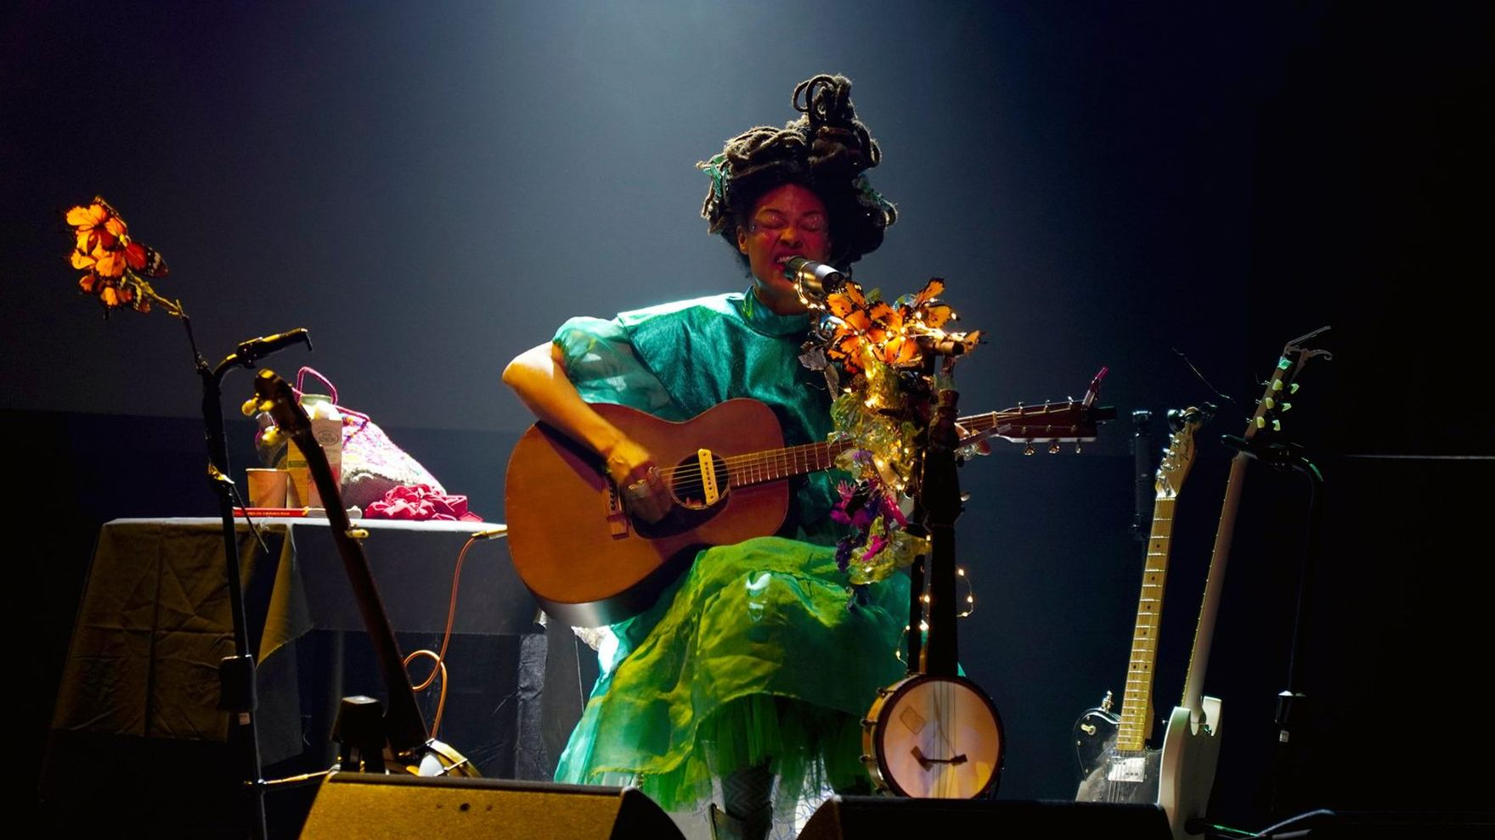
ODDFEST 2026
The theme was Bravery. Turned out it wasn’t just a theme.
ODDfest 2026 · Vanha Ylioppilastalo
Photo: ODDfest
Notes:
FULL-BLEED PHOTOGRAPH — a breath between chapters, or the proof under a claim.
Scrim rules: Ink only (never black), a light wash over the whole frame and a stronger one where the type sits. Caption bottom left, credit bottom right, both Small at 60%. Real ODD moments only — no stock, no mock-ups.

Slide 9
ODDFEST 2026
THANK YOU
“A hero is an ordinary individual who finds the strength to persevere and endure in spite of overwhelming obstacles.”
— CHRISTOPHER REEVE
Notes:
QUOTE — someone else’s words, never dressed up as ODD’s.
Display size, centred, with the part that matters in full Paper and the rest quiet — the same premise-then-point move as a two-sentence headline. Attribution in small tracked capitals. No quotation-mark decoration beyond the marks themselves.

Slide 10
ABOUT ODD
WHAT WE BUILD
Different problems need different structures.
01
02
03
Events create reasons to gather
Spaces give people somewhere to return
Projects and relationships let something continue
ODDfest makes creative activity across Helsinki visible as one shared week. ODDference creates a deliberately composed professional room around creative expertise.
ODDspace is the everyday layer: somewhere to work, meet, host things and keep going between projects and events.
ODDagency, partnerships and the developing ODDnetwork create ways to keep working together when there is a real reason to do so.
Notes:
THREE COLUMNS — three things of the same kind, numbered. Not a list of features: three answers to one question.
Raised Backstage cells with 1px gaps between them, so the Ink ground draws the grid. Numbers in small tracked capitals, titles at Heading, body at Small. Two columns or four work the same way; five do not.

Slide 11
ALL THINGS ODD
ALREADY IN MOTION
Two years in, this is what
has already happened.
ODD began with the first ODDfest in 2025. Since then, ODDference and ODDspace have joined it, alongside project work with organisations. The figures below are cumulative across that work.
5,000+
500+
100+
€400K+
PARTICIPANTS
COLLABORATORS
PARTNERS
DIRECTLY INTO CREATIVE & CULTURAL INDUSTRIES
ODDfest 2026 was a co-created effort.
CHECK OUT THE THANK-YOU PAGE
Notes:
NUMBERS — the daylight slide. Paper ground, Ink type: a full inversion, not a lighter dark slide.
Figures in Forta at Display, what they count in small tracked capitals under them, 1px hairlines between. Four figures is the most that stays readable. Never invent one: every figure here is on allthingsodd.co.

Slide 12
ABOUT ODD
OUR STORY
How we got here.
2023
New Nordic Way rf
The association is founded in Helsinki. The idea that becomes ODD is still taking shape.
2024
Finding the gap
The question becomes clearer: more can happen when there is greater continuity around the work, and stronger links between creative fields and the rest of society.
2025
The first ODDfest
The first public experiment brings 2,600+ participants, 350+ contributors and 70+ partners together in Helsinki.
2026
More than one event
Creative Week tests a distributed city-wide model. ODDference tests the professional proposition. ODDspace creates a year-round physical base.
Notes:
TIMELINE — years as rows, separated by hairlines. Reads as a record, not a roadmap.
Year in Forta at Heading, the name of the year in Gabarito SemiBold at Body size, what happened in Body at 60%. Rows can be different heights; the hairlines keep them one system. Do not put a year on it that has not happened unless the slide says so.

Slide 13



ALL THINGS ODD
ODD is operated by New Nordic Way rf, a Finnish non-profit association based in Helsinki.
ACROSS HELSINKI
BUSINESS & SOCIETY
VALLILA · YEAR-ROUND
Helsinki’s creative week, bringing independent events, ideas and creative communities into one shared week.
A business conference exploring what business and society can learn from the creative world.
A year-round home for creative work — workspace, studios, events and community under one roof.
FOR ORGANISATIONS
Bring us a question, brief, event or partnership idea. We build the right team, format and creative expertise around it.
Work with ODD
EXPLORE WORK WITH ODD
Notes:
ECOSYSTEM — what ODD is made of, in one picture. Use it early, once.
The mark at the top, hairlines down to the three lockups, and the band underneath for the fourth way in. Lockups are never retyped, recoloured or stretched: place the PNG at a height and let the width follow. Clear space around a lockup is half the mark’s height. The Ember keyline on the band is the one accent on the slide.

Slide 14






















ALL THINGS ODD
PARTNERS & SUPPORTERS
Made with organisations like these.
Notes:
PARTNERS — other people’s marks, in one weight, in one grid.
Every logo is rendered monochrome in the figure colour (the site’s brightness(0) invert(1)) and sits inside its own cell with equal air around it — never scaled to the same width, never given a coloured tile. Empty cells at the end are part of the grid, not a mistake. Keep the order stable: alphabetical or by the order they joined, and never by size of cheque.

Slide 15
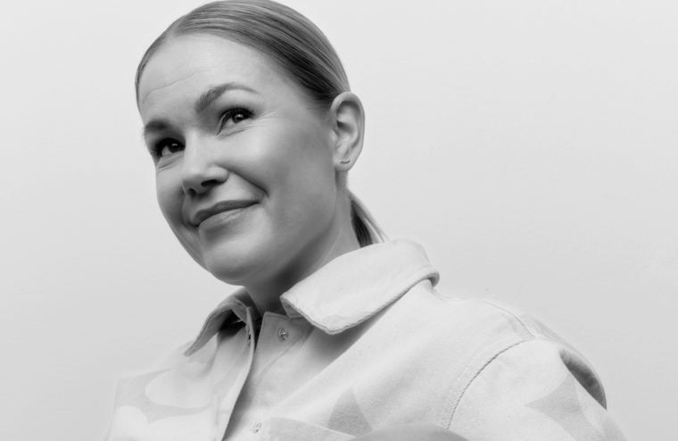
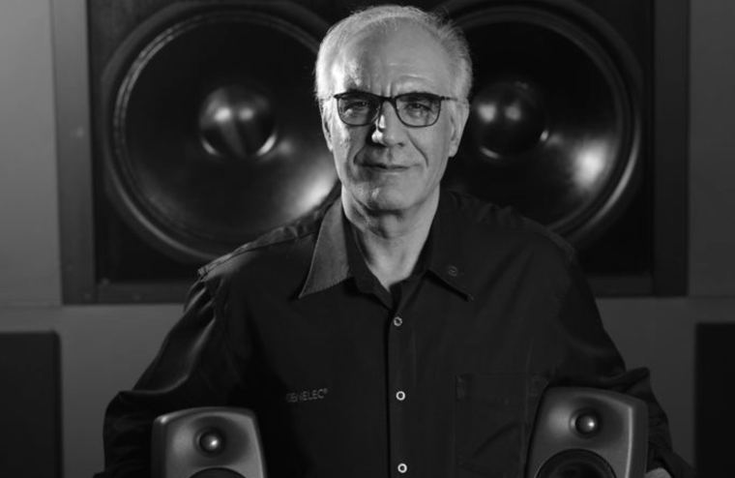
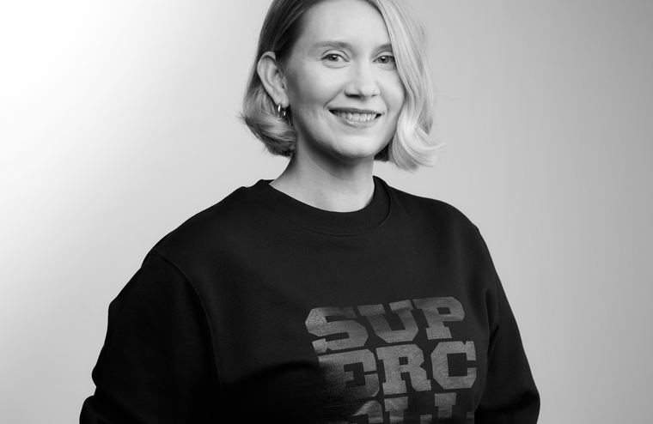
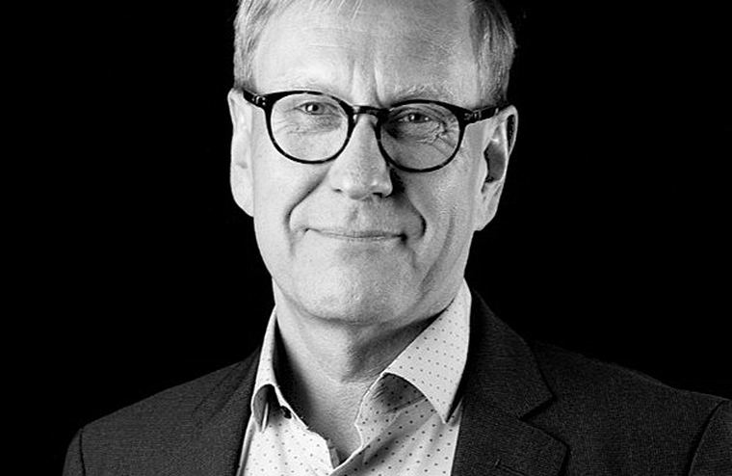
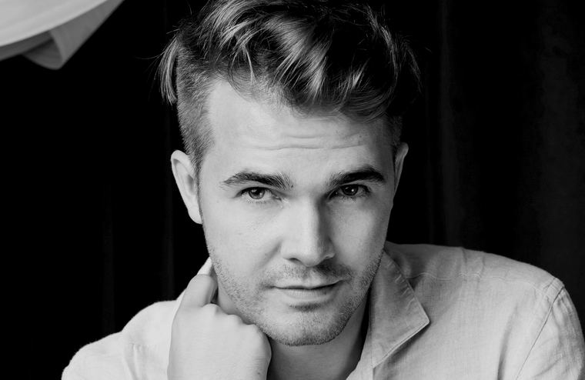
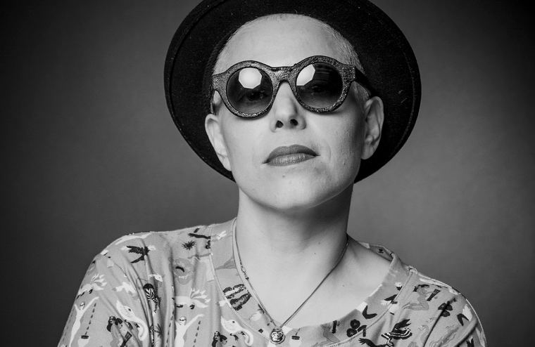
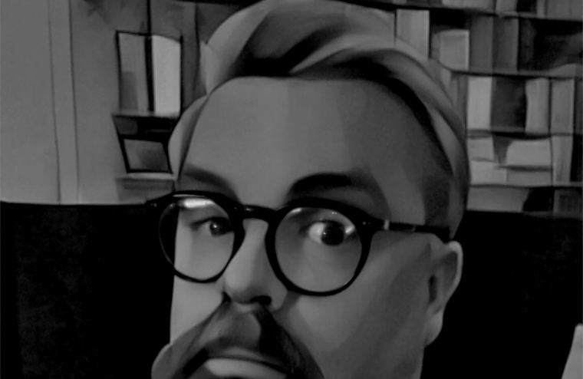
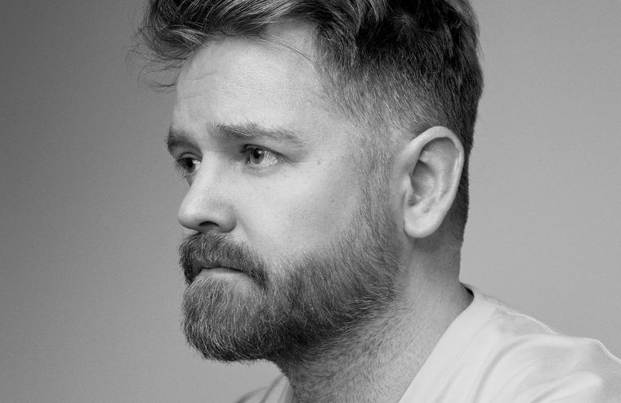
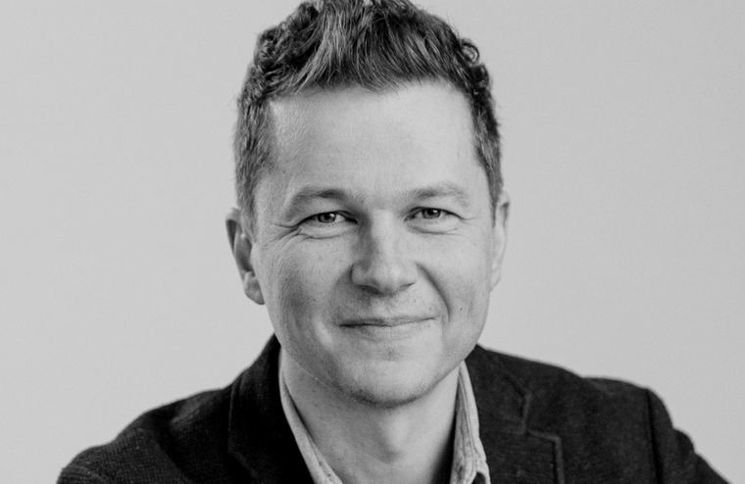
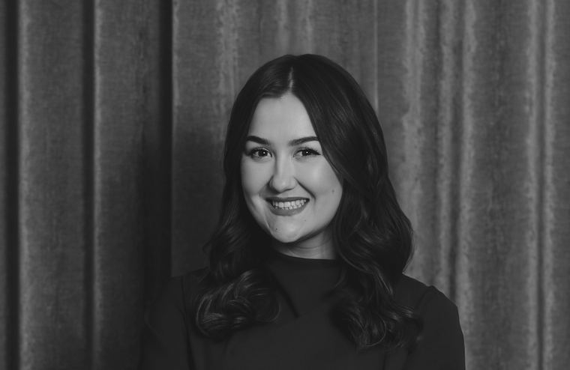
ODDFERENCE 2026
PAST SPEAKERS · ODDFERENCE 2026
People who joined us last time.
Sanna-Kaisa Niikko
Siamäk Naghian
Ashley Jex Wagner
Atte Jääskeläinen
Perttu Pölönen
CMO — Marimekko
CEO — Genelec
Head of Live Experiences — Supercell
President — Sitra
Futurist, Inventor & Author
Galit Ariel
Alf Rehn
Rolf Ekroth
Samppa Lappalainen
Anna Brchisky
Techno-Futurist & Author
Professor of Innovation & Management
Fashion Designer
Architect & Entrepreneur
CEO — Bamla
Notes:
PEOPLE — a room, not a wall of headshots. Ten is the most that stays a room.
Portraits greyscale (colour is for the work, not the people), each in its own cell over a Backstage band with the name in Forta at Small and the role in Gabarito under it. Crop to the face. Same crop, same greyscale, same order every time — no one is bigger than anyone else.

Slide 16
ODDFERENCE 2026
SESSION HIGHLIGHTS · ODDFERENCE 2026
What was actually on stage.
From Products to Worlds: Who Wins in the Experience Economy?
FIRESIDE CHAT
Ashley Jex Wagner, Marley Prudeaux & Miika Salmi Lipiäinen
Leading Organizational Creativity — How To Make It or Break It
FIRESIDE CHAT
Siamäk Naghian, Aino Ahlnäs, Timo Karanko & Kimmo Timonen
What World-Class Brands Do Differently: Inside Creative Work at the Highest Level
FIRESIDE CHAT
Alexander Pihlainen, Risto Lähdesmäki & Kivi Sotamaa
New Media in the Attention Economy — What Has Changed?
FIRESIDE CHAT
Anna Brchisky, Klaus Hietala & Olli Seuri
The Art of Renewal: Rewiring Organizational Change
FIRESIDE CHAT
Karoliina Jarenko, Simo Routarinne & Mikko Heikinpoika
Notes:
PROGRAMME — sessions as rows: what it was called on the left, what kind of thing it was and who was in it on the right.
Session titles are Forta at the Body size, not a sixth type size. The format label carries the one accent on the slide — Signal for the business side, Ember for the creative one. Names in Small at 60%: the session is the headline, the people are the detail.

Slide 17
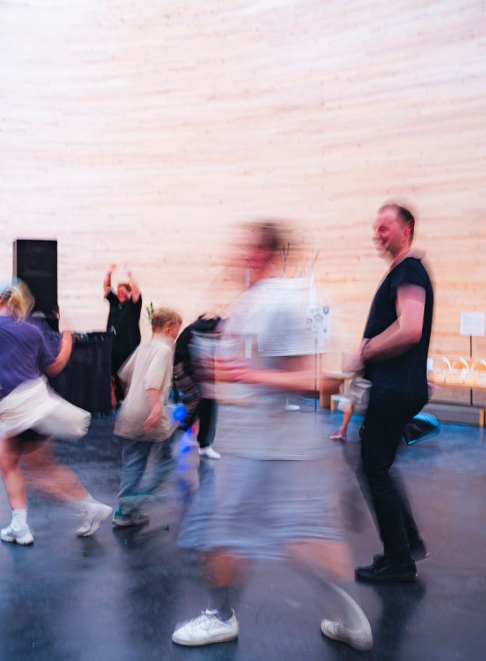
ODDFEST 2026
ODDFEST 2026 · KAMPPI CHAPEL
ODD Deep Space
With Simo Vassinen and 13 facilitators
ODD Deep Space transformed Kamppi Chapel into a dreamlike satellite where body, mind and urgent questions about the future came together through movement, sound and experimental formats. Across two days, visitors explored themes from work, wellbeing and money to AI, planetary limits and feminist futures, guided by artist and somatic facilitator Simo Vassinen and a diverse group of thinkers, movers and makers.
Notes:
CASE STUDY — one thing that happened, with the photograph as the evidence.
Eyebrow says where and when, the title is what it was called, the “With…” line credits the people who made it, and the body is what actually happened. Made with someone else, always: the credit line is not optional.

Slide 18
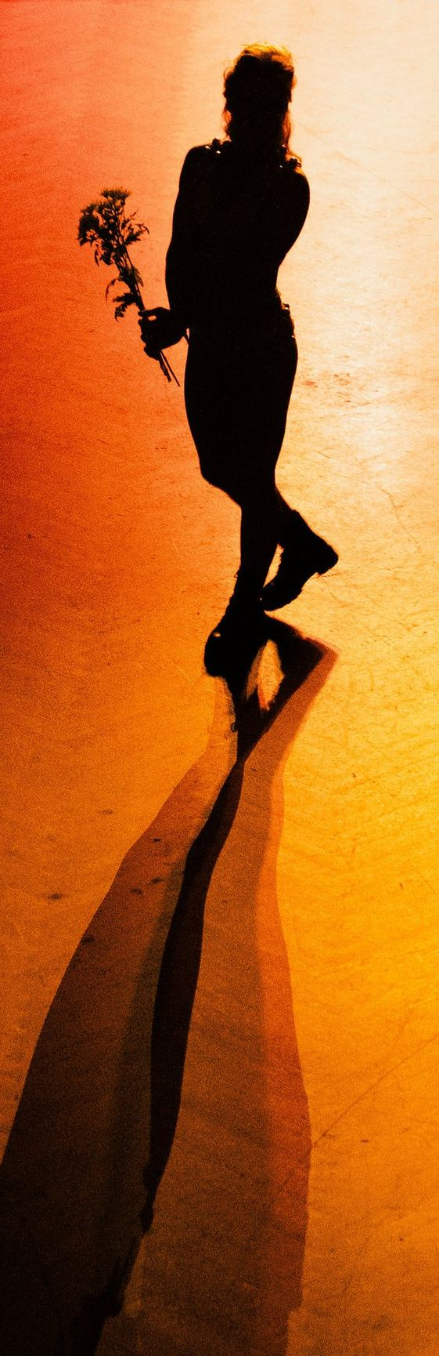
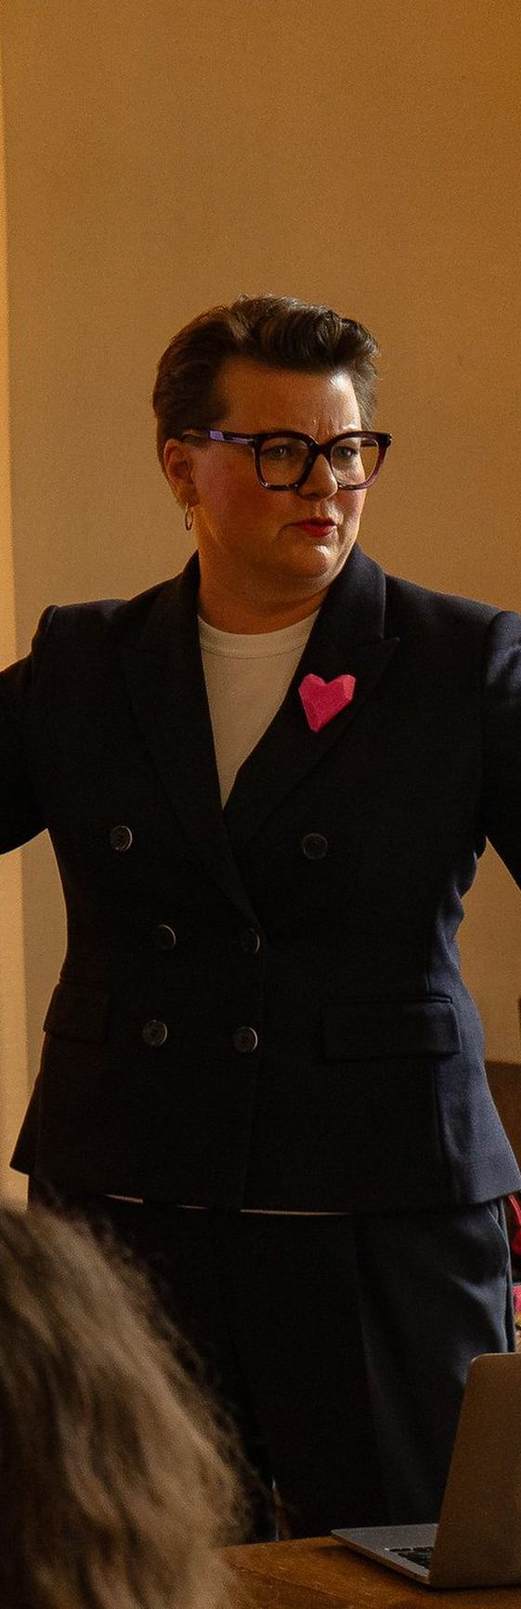
ALL THINGS ODD
ODD brings two worlds together — creative and cultural people, and businesses that want to work with them.
FOR CREATIVES
FOR BUSINESS
Work, create and connect with other creatives.
Get closer to creative expertise and the people behind it.
Work from ODDspace. Bring something of your own to ODDfest.
Come to ODDference, build a partnership, or bring us a brief.
ODDFEST
ODDFERENCE
ODDSPACE
WORK WITH ODD
Notes:
TWO SIDES — the only slide where both accents appear. Creative always first, on the left, in Ember; business on the right, in Signal.
The two columns are mirrored around the hairline, not simply repeated: the creative side is flush right, the business side flush left. Keep the two bodies within a line of each other in length — the symmetry is the argument.

Slide 19
ODDFEST 2027
HOW TO JOIN
Bring something to ODDfest 2027.
We are collecting event ideas now, before the dates are fixed — which is the best moment to bring one. An idea still at the notes-on-your-phone stage is a fine thing to send.
SUBMIT AN EVENT IDEA
ASK US A QUESTION FIRST
Notes:
CLOSING STATEMENT — the ask, on a raised Backstage panel so it reads as the one thing to do next.
One Hero sentence, one sentence of support, one primary pill and at most one secondary. Two solid pills side by side is one ask too many.

Slide 20
GET IN TOUCH
EMAIL
hello@oddfest.co
Say hello.
WEB
allthingsodd.co
ODDSPACE
Teollisuuskatu 9D, Vallila, Helsinki
A question, idea, project, press request, ODDfest submission or something else — send us a note. We’ll get it to the right person.
INSTAGRAM
@allthingsodd.co
LINKEDIN
linkedin.com/company/all-things-odd
HELLO@ODDFEST.CO
YOUTUBE
youtube.com/@all-things-odd
NEWSLETTER
oddfest.beehiiv.com
New Nordic Way rf · Helsinki
Notes:
CONTACT — the last slide, on Paper.
The address is always hello@oddfest.co, never an @allthingsodd.co address; the site is allthingsodd.co. The email is a pill because it is a thing you act on. Check the ODDspace address against the site before sending a deck out.

Slide 21
ALL THINGS ODD
Notes:
BLANK — the frame, and nothing else: Ink ground, meta line, page number.
For a composition none of the other twenty archetypes fit. The grid still applies: 0.625in side margins, 0.5in top and bottom, 12 columns with a 0.25in gutter. Five type sizes (Hero 72 / Display 48 / Heading 30 / Body 18 / Small 14), Forta for statements, Gabarito for anything read or operated. One accent, used as text or a keyline — never as a fill. If the slide needs a sixth size or a second accent, it needs two slides.

