Slide 1
Quantitative Data Analysis
Ronny Porsch
Flavian Kanickairaj
1 | 2022

Slide 2

Initial situation – a huge pile of CRM data
We have a large dataset with customer data
Dataset provided by Mirgando – a company that helps deals with immigration law
Goal: predicting sales based on the dataset
Problem: the dataset has over 40,000 entries and around 100 rows – too large to manually examine
Bildquelle: Migrando UG

Slide 3
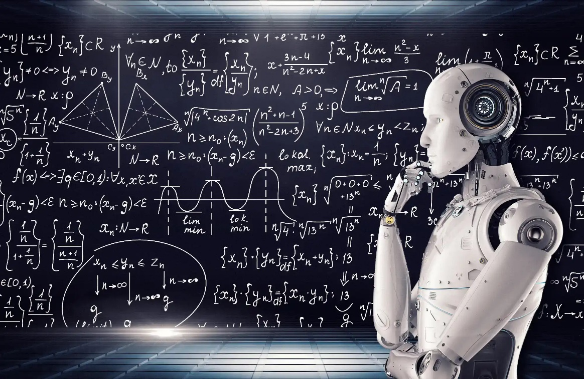
Idea – Let’s use Machine Learning!
ML can be used to find patterns in data
ML can be divided in Supervised and Unsupervised Learning [1]
Usage of Machine Learning (ML) to predict sales
Here we have labels in our data, therefore we use supervised Learning
Bildquelle: smc.it
[1] Alloghani, M., Al-Jumeily, D., Mustafina, J., Hussain, A., Aljaaf, A.J. (2020). A Systematic Review on Supervised and Unsupervised Machine Learning Algorithms for Data Science.
In: Berry, M., Mohamed, A., Yap, B. (eds) Supervised and Unsupervised Learning for Data Science . Unsupervised and Semi-Supervised Learning. Springer, Cham. https://doi.org/10.1007/978-3-030-22475-2_1

Slide 4
Approach
Cleaning the Dataset
Joining of both data sets
Removal of Visitor_Score
Transformation of sales column: 0 -> 0, rest -> 1
Replacement of potentially problematic chars (for example spaces)
Merging of phone-columns with their non-phone-equivalents (where those existed)
Creation of dummy values for categorical features
Replaced NaN with 0 where applicable
Transformed floats to Integers where applicable (years, number of children etc.)

Slide 5
Approach
Feature Selection
Excluded features that looked too hard to deal with or seemed not worth it
Calculated a correlation matrix
Removed highly interrelated features
Too many features might lead to overfitting[2]
Features most related (positively or negatively) to the sales variable should be selected for building the models
Multiple options of maximum numbers of features were tested
In this case: No overfitting when using all features
Final Dataset structure (with upsampling): 78734 rows x 628 columns
[2] Badillo, S., Banfai, B., Birzele, F., Davydov, I.I., Hutchinson, L., Kam-Thong, T., Siebourg-Polster, J., Steiert, B. and Zhang, J.D. (2020),
An Introduction to Machine Learning. Clin. Pharmacol. Ther., 107: 871-885. https://doi.org/10.1002/cpt.1796

Slide 6
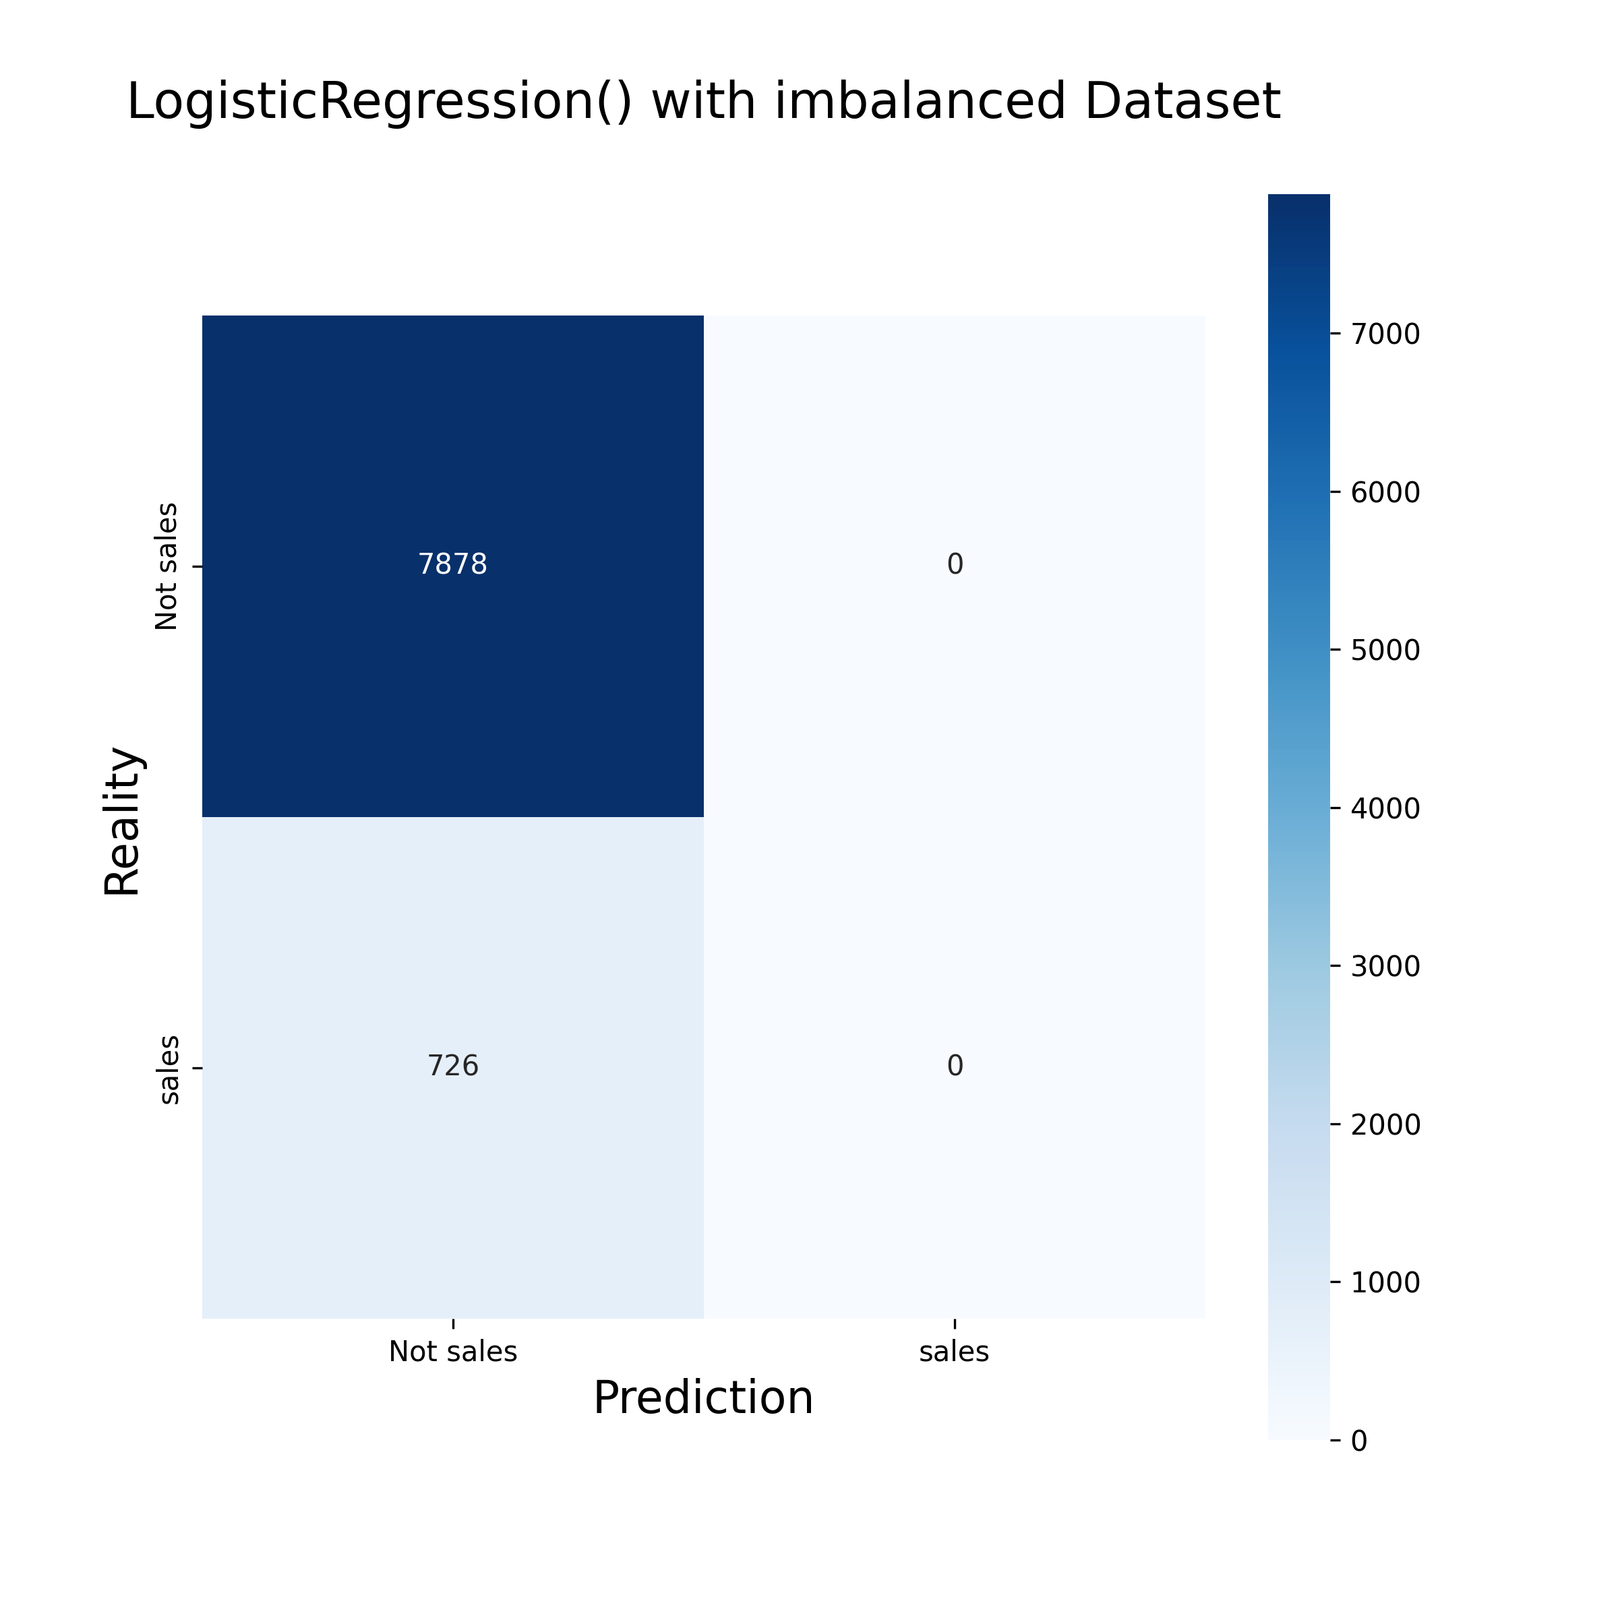
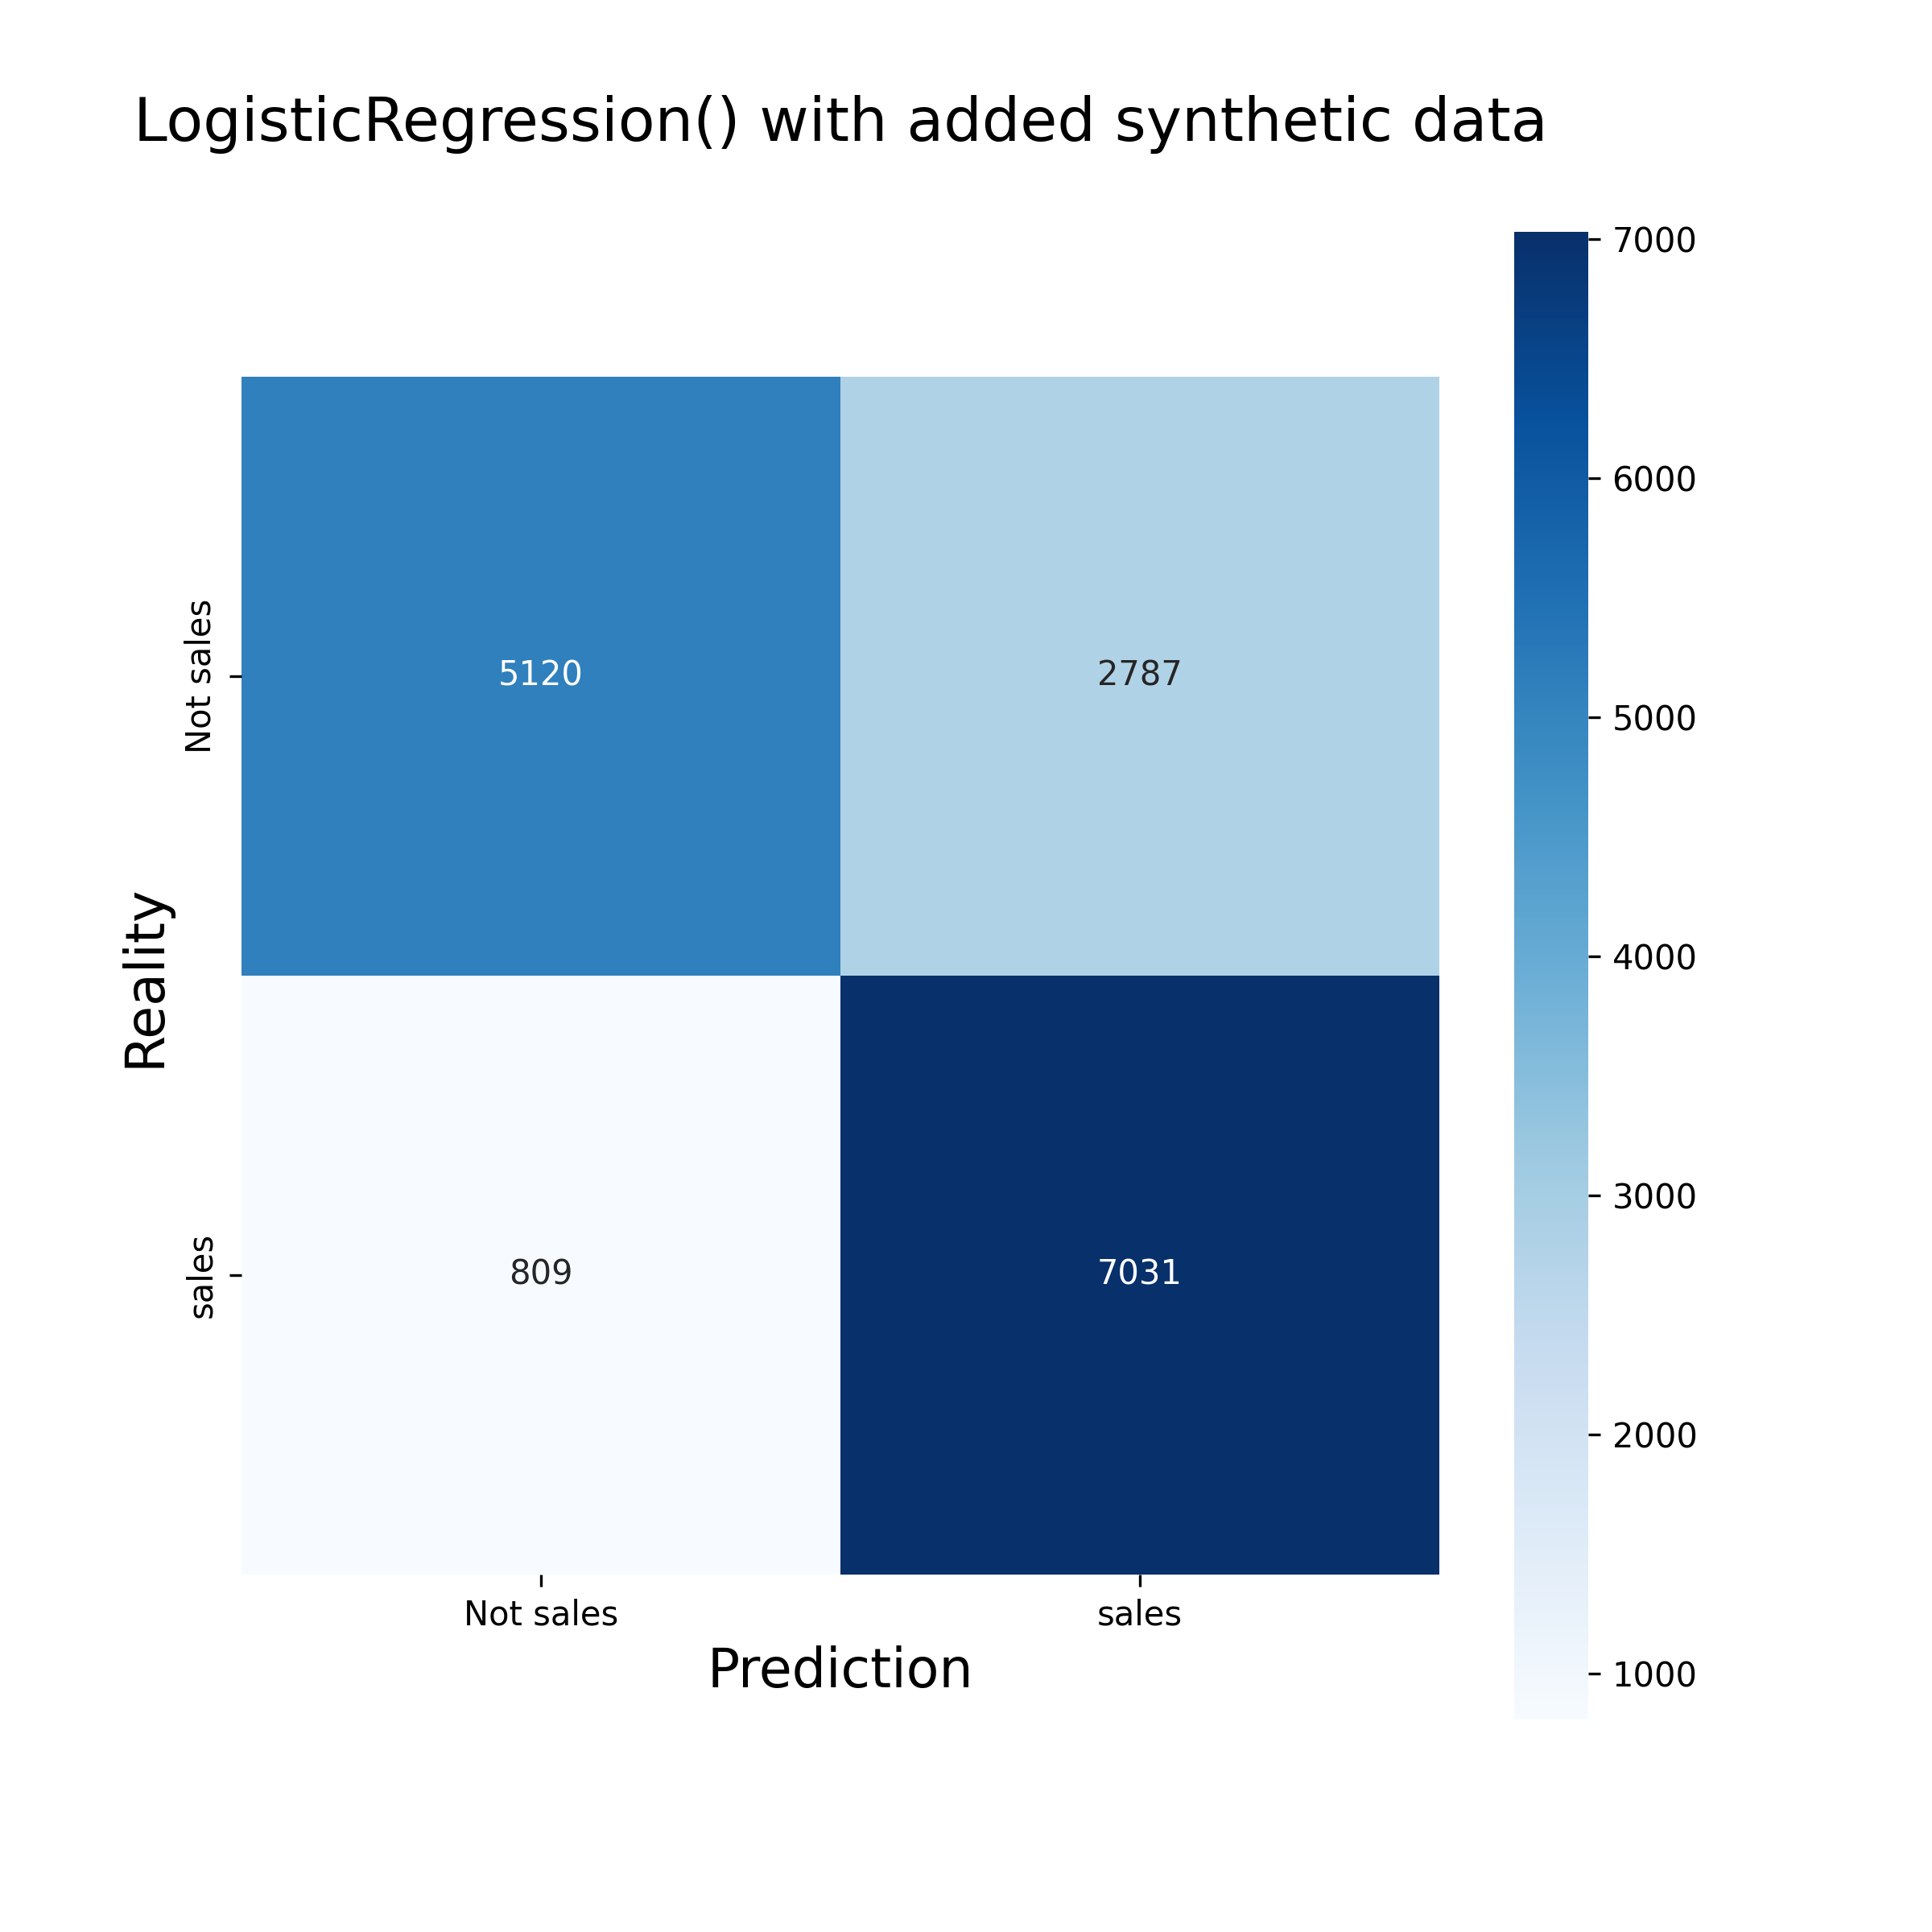
Approach
Building the models
Splitting the data into train and test (80/20)
Problem: Most datapoints did not lead to a sale -> imbalanced dataset
Solution: Use of upsampling to balance the data

Slide 7
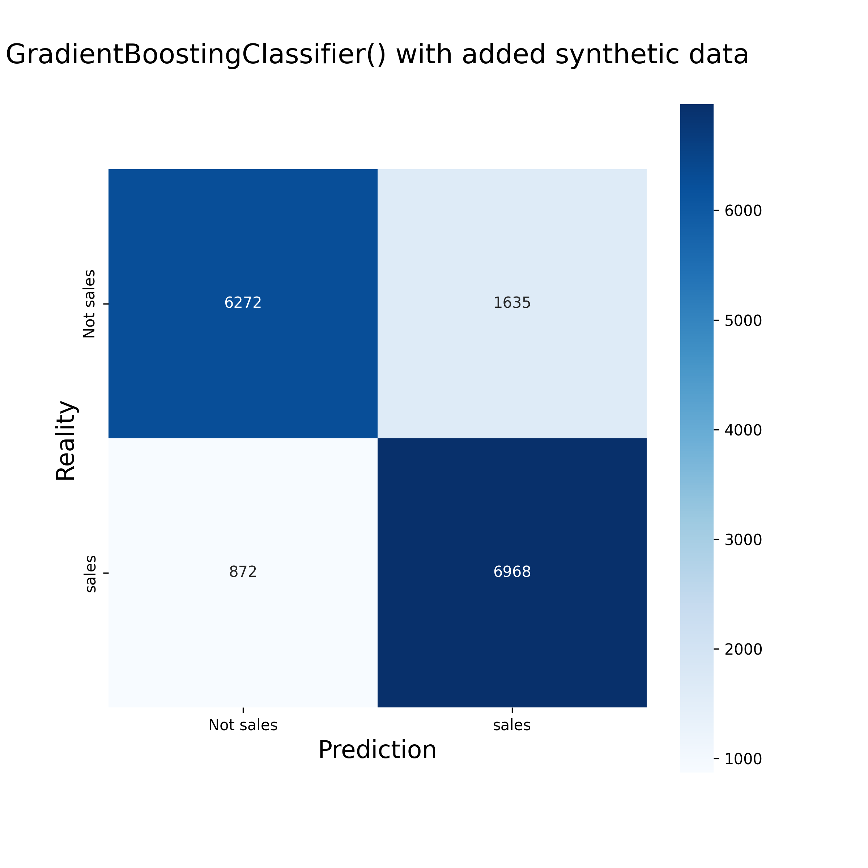
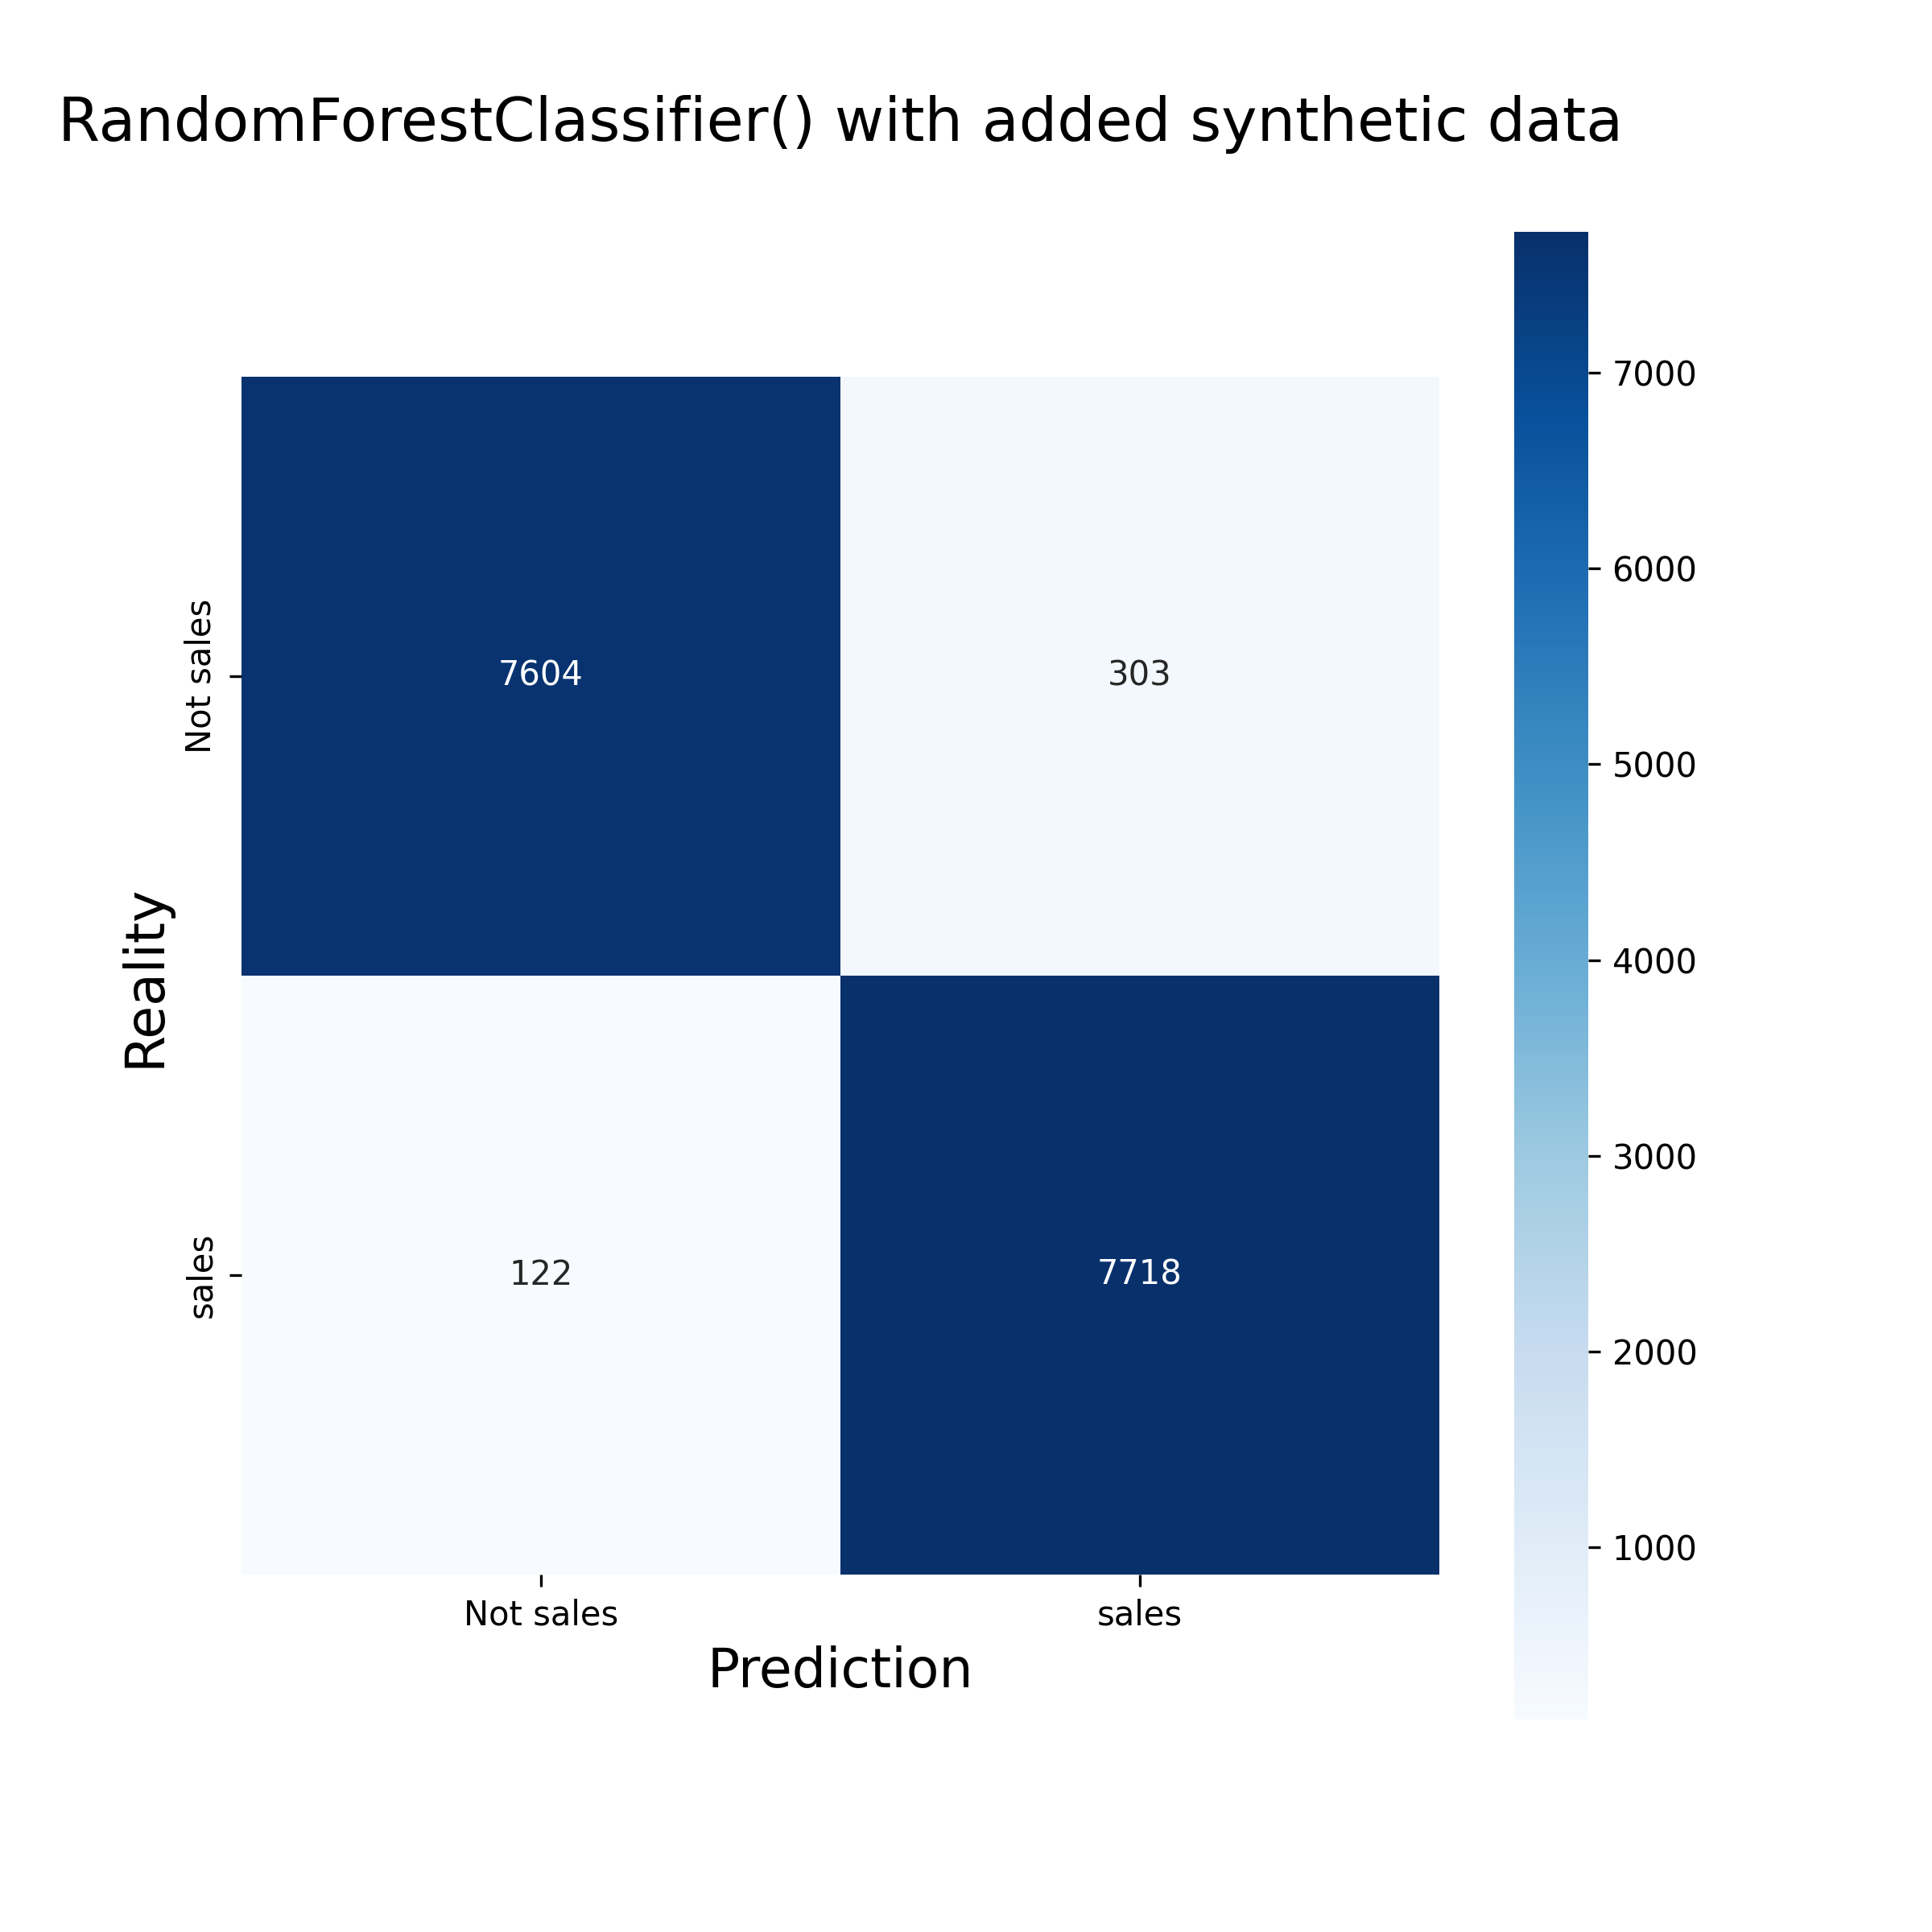

Approach
Finding the best model
Models tried: Gradient Boosting Classifier, Logistic Regression, Gaussian Naive Bayes, Perceptron, Random Forest
Best model: Random Forest with 98% accuracy

Slide 8
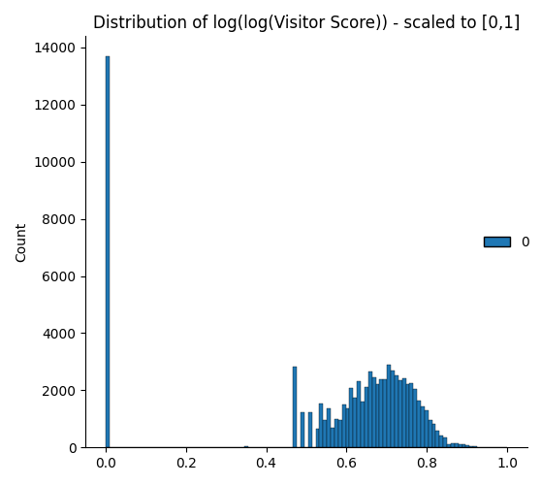
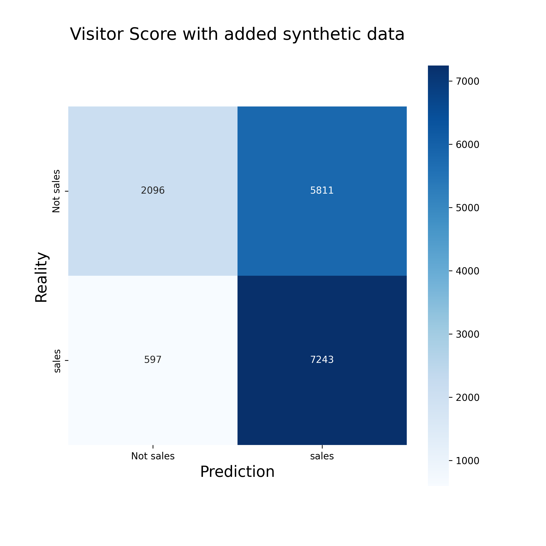
Evaluation
Comparing the best model with the Visitor_Score
Shapiro Test on Visitor_Score gives very low p-value
Therefore, we use log(log(Visitor_Score)) and scale it to [0,1]
Accuracy of the Visitor_Score: 59%

Slide 9
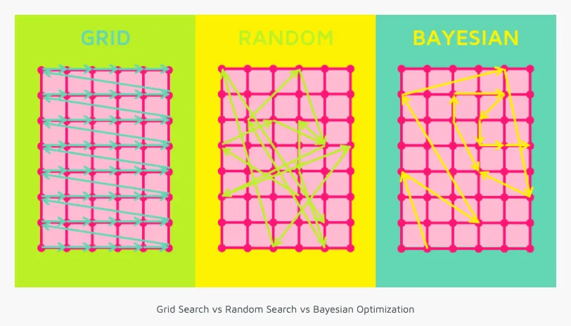
Possible Future Optimizations
Hyperparameter Tuning
Goal: Finding best hyperparameters for optimal model performance[3]
Options:
GridSearch
Systematically tries all possible hyperparameter combinations
Very computationally expensive
Random Search
Random choice of hyperparameters for each iteration
Returns the best combination after a specified number of iterations
Bayesian Optimization
Uses probabilistic model to predict promising hyperparaeters
Minmizes number of necessary evaluations
Optimizes search by using previous iterations
Bildquelle: medium.com
[3] Bischl, B., et al. (2023). Hyperparameter optimization: Foundations, algorithms, best practices, and open challenges.
WIREs Data Mining and Knowledge Discovery, 13(2), 1–43. https://doi.org/10.1002/widm.1484

Slide 10
Super additional task
Recommendations for better data collection
Only allow datatypes that make sense (for example, no strings in Einreisejahr)
Check length of values where applicable (for example: "Geburtsjahr" should always consist of 4 digits)
allow only categorical values for fields like "Grund der Absage" -> some values are semantically the same but differ in syntax -> data cleaning necessary
Use a consistent naming scheme (sometimes all lower case, sometimes first letter is upper case; randomly changing between German and English)

Slide 11
Literature
Alloghani, M., Al-Jumeily, D., Mustafina, J., Hussain, A., Aljaaf, A.J. (2020). A Systematic Review on Supervised and Unsupervised Machine Learning Algorithms for Data Science. In: Berry, M., Mohamed, A., Yap, B. (eds) Supervised and Unsupervised Learning for Data Science . Unsupervised and Semi-Supervised Learning. Springer, Cham.
Badillo, S., Banfai, B., Birzele, F., Davydov, I.I., Hutchinson, L., Kam-Thong, T., Siebourg-Polster, J., Steiert, B. and Zhang, J.D. (2020), An Introduction to Machine Learning. Clin. Pharmacol. Ther., 107: 871-885. https://doi.org/10.1002/cpt.1796
Bischl, B., et al. (2023). Hyperparameter optimization: Foundations, algorithms, best practices, and open challenges. WIREs Data Mining and Knowledge Discovery, 13(2), 1–43. https://doi.org/10.1002/widm.1484

