Slide 1
A PRESENTATION ON COMMENT SENTIMENTAL ANALYSIS WITH N-GRAM METHODOLOGY
Supervised By :
Joyassree Sen
Assistant Professor
Department of Computer Science & Engineering
Submitted By :
M.M.Mamuduzzaman
Roll no : 1414026
Reg. no : 1145
Session : 2014-2015
Department of Computer Science & Engineering
Islamic university, Kushtia, Bangladesh

Slide 2
INTRODUCTION
Sentimental analysis has been studied in wide area of domain such as movie review , teaching review , product review , e-learning , hotel review and many more. Most scholars focused to quantitative data analysis. However , some studies have been done on quantitative data using sentiment analysis.
Sentimental analysis is the interpretation and classification of emotions (positive , negative and neutral ) within text data using text analysis techniques .

Slide 3
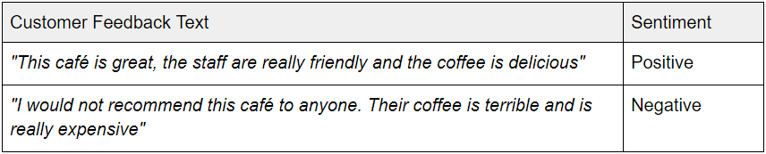
The task of sentiment analysis typically involves taking a piece of text, whether it’s a sentence, a comment or an entire document and returning a “score” that measures how positive or negative the text is.
For example in customer feedback:

Slide 4
REQUIREMENTS
SOFTWARE REQUOREMENTS
Operating systems: Microsoft windows.
Front End: HTML5, CSS, Java Script
Back End: PHP5
Data Base: MySQL
Apache HTTP server.
Sublime text.
Web Browser
XAMPP
Chorome Developer Tools

Slide 5
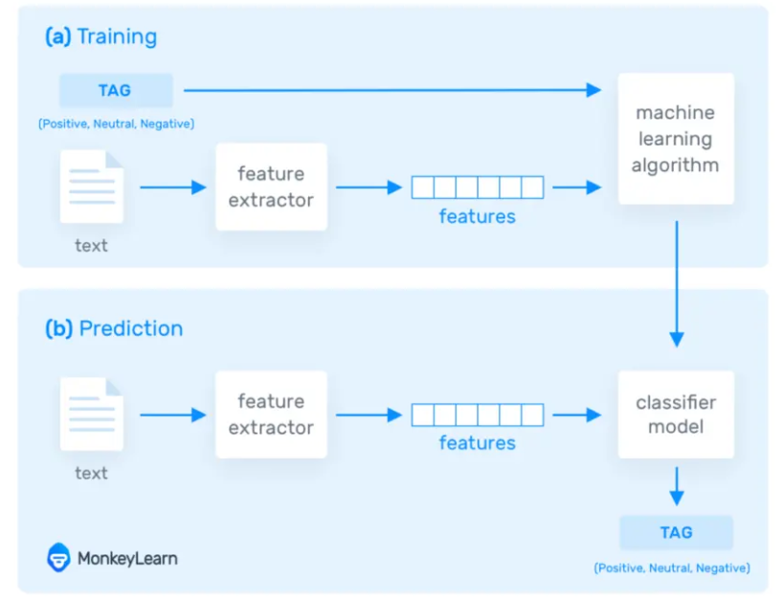
How Sentiment analysis work

Slide 6
What are N-Grams :
N-grams of texts are extensively used in text mining and natural language processing tasks. They are basically a set of co-occuring words within a given window and when computing the n-grams you typically move one word forward (although you can move X words forward in more advanced scenarios). For example, for the sentence "The cow jumps over the moon". If N=2 (known as bigrams), then the ngrams would be:.
the cow
cow jumps
jumps over
over the
the moon

Slide 7
N-Gram Function:
So you have 5 n-grams in this case. Notice that we moved from the->cow to cow->jumps to jumps->over, etc, essentially moving one word forward to generate the next bigram.
If N=3, the n-grams would be:
the cow jumps
cow jumps over
jumps over the
over the moon
So you have 4 n-grams in this case. When N=1, this is referred to as unigrams and this is essentially the individual words in a sentence. When N=2, this is called bigrams and when N=3 this is called trigrams. When N>3 this is usually referred to as four grams or five grams and so on.
If X=Num of words in a given sentence K, the number of n-grams for sentence K would be:
Ngramsk = X-(N-1)

Slide 8
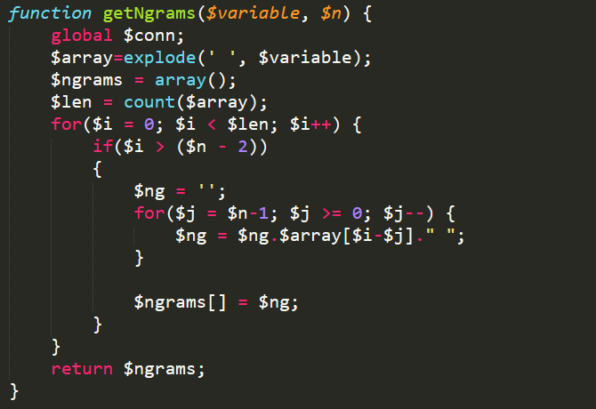
The code block for N-gram generation:

Slide 9
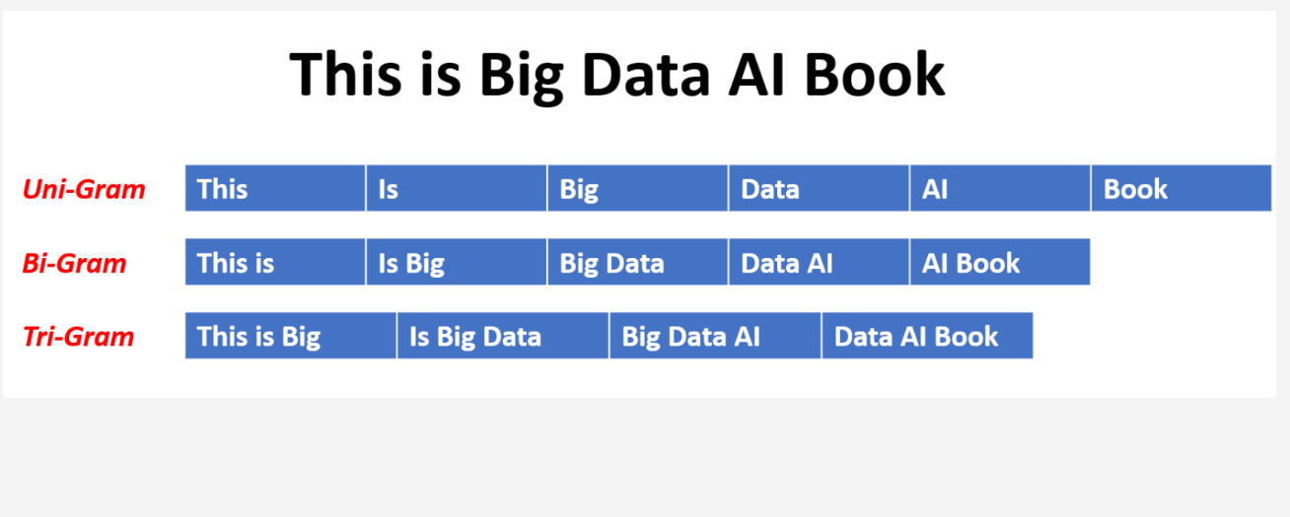
N-Gram data MODEL :

Slide 10
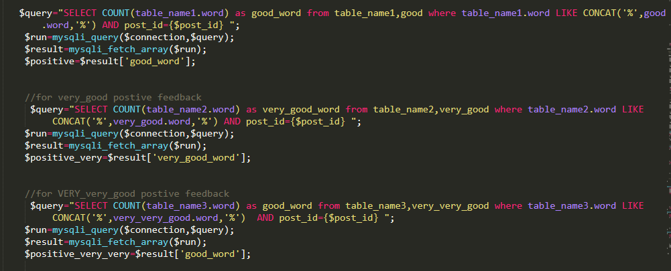
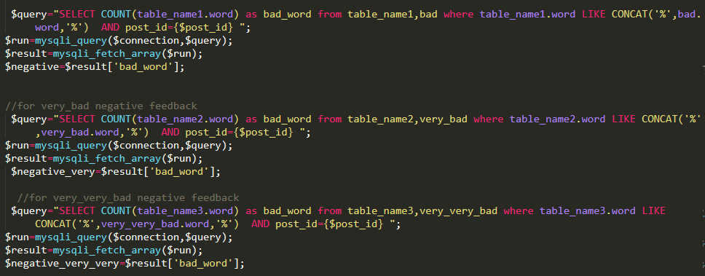
Code for positive & negative feedback

Slide 11
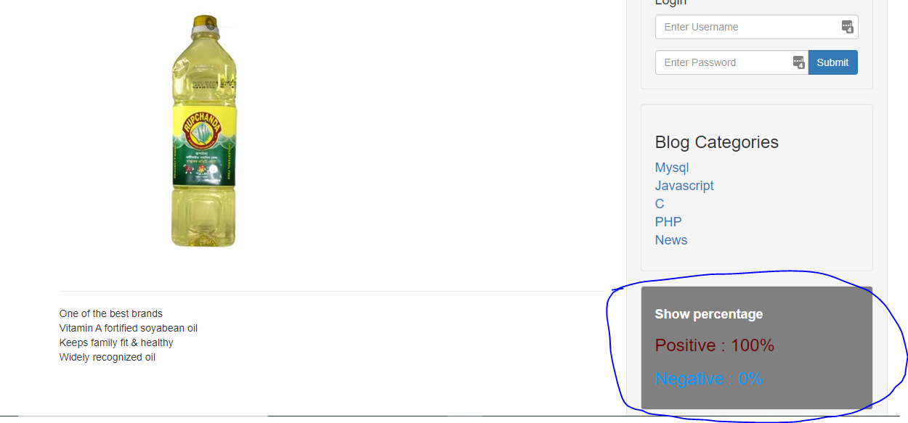
Show percentage:

Slide 12
ADVANTAGE
Social media monitoring
Customer Support
Customer feedback
Brand monitoring
User friendly

Slide 13
LIMITATION
Need lots of data to implement this system.
Sometime huge number of data can cause the time error.
A need for customer skill to deal with computers and browsers.
Many people who are not comfortable with computers and
the Internet, often find it difficult to use internet banking.
Training & maintenance.
Security.

Slide 14
THANK YOU

