Slide 1
SLIMER Status – July 2012
Steve Elliott and Mary Kidd
Note that Suhas Pol has joined our effort as of this week.

Slide 2
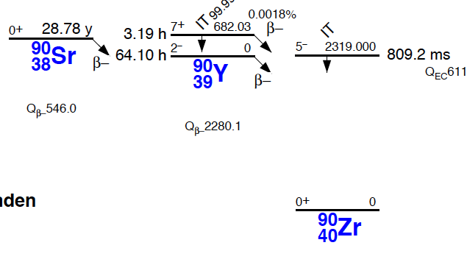
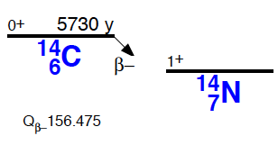
Sr-90 decay, C-14 inset

Slide 3
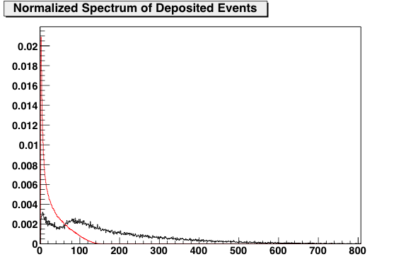
Simulation of ⁹⁰Sr/⁹⁰Y (black) and ¹⁴C (red)
Energy (keV)

Slide 4
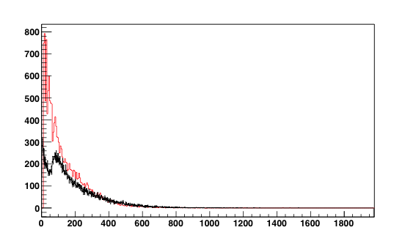
Simulated ⁹⁰Sr/⁹⁰Y (black) and Measured Spectra
Measured spectra scaled to “fit by eye”
Energy (keV)

Slide 5
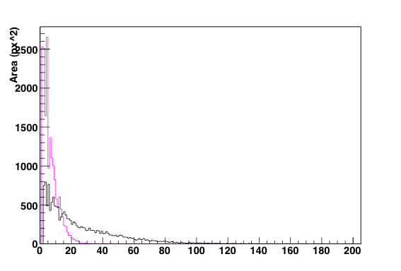
Sr minus background (black) and background (red)
Measured spectra, x axis is in units of area

Slide 6
Status
We can easily see alpha particles.
We can easily see beta particles from Sr/Y, but the Y spectrum extends to 2.28 MeV.
The C endpoint is 156 keV.
The noise spectrum is similar in shape and endpoint to where we expect the C to lie.
With low rate C data, we do see a very slight excess in rate, but not clear enough for any analysis yet.
Understanding the noise is our present focus.

