Slide 1

Welcome to Pokemon Training

Slide 2


Slide 3
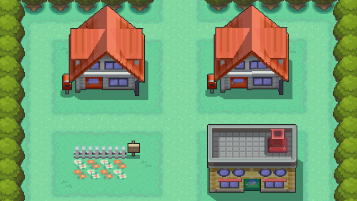

Slide 4
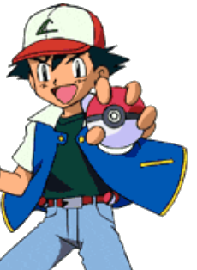
                Hi! My name is Ash.
                I want to be the best trainer.
                I want the strongest Pokemon.

Slide 5
Visit Professor Oak

Slide 6
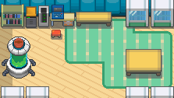

                Hello! My name is Professor Oak.
                Welcome to Pokemon Training.
                I will help you learn English.

Slide 7

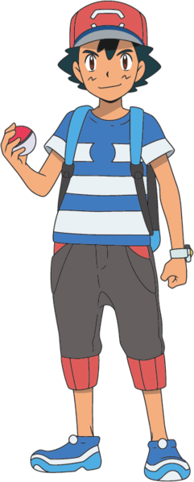
                There are many Pokemon in Kanto.
                You can befriend them.
                You can train them.

Slide 8
This is you.

Slide 9
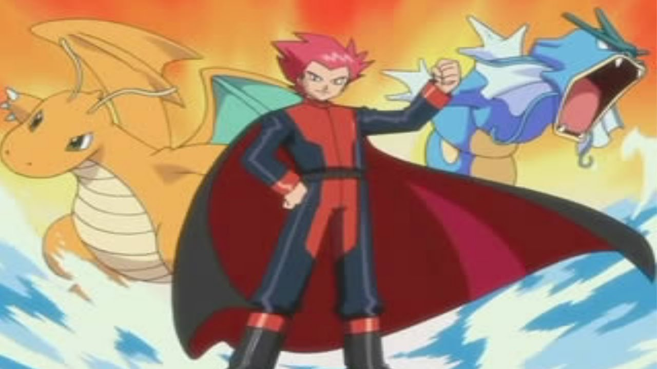
                This is Lance.
                He is the best trainer.
                He has the strongest Pokemon.
                He has the rarest Pokemon.

Slide 10







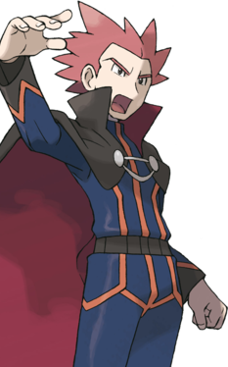



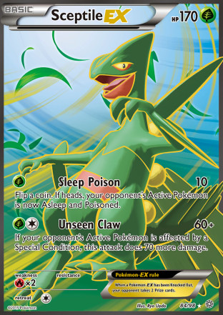
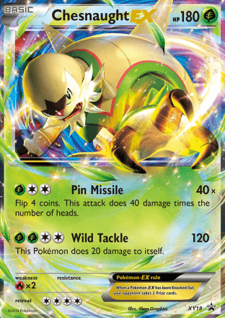






                PROFESSOR OAK!
                There is an emergency.
                All of my Pokemon are missing.
                Can you help me find them?

Slide 11
                Many strong Pokemon are missing.
                Can you find the missing Pokemon?

Slide 12
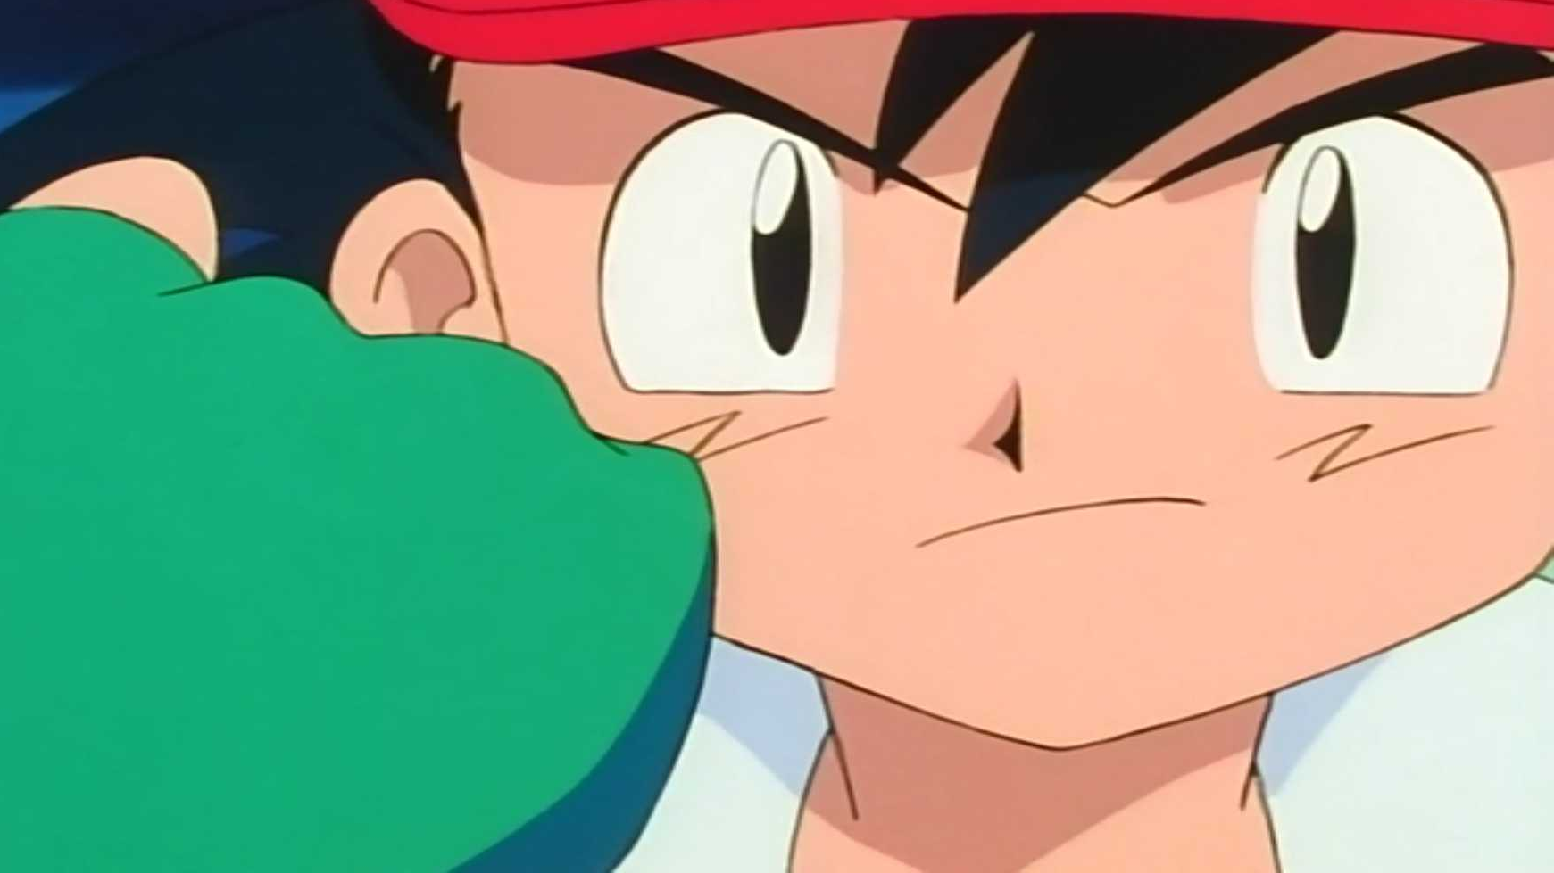
                First, choose a Pokemon.
                They can help you befriend more!

Slide 13

Ash
LVL | 1
XP | 0
This is your level
This is your XP
                When you participate in class, you get XP.
                When you get enough XP, your Pokemon can level up!

Slide 14
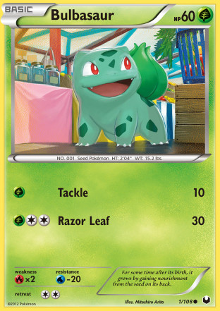

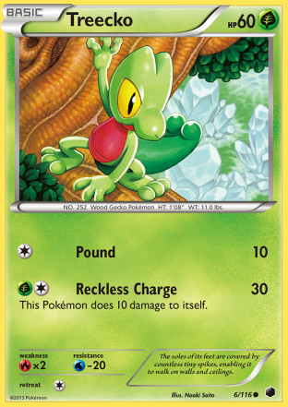

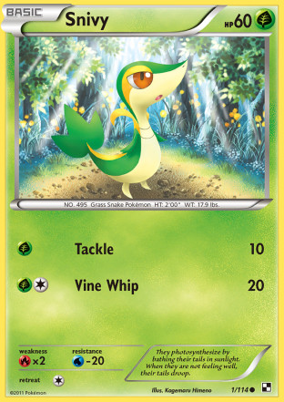
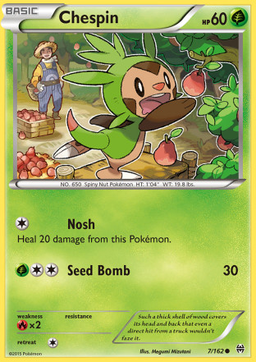
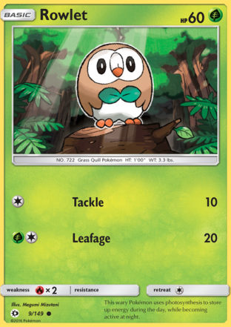
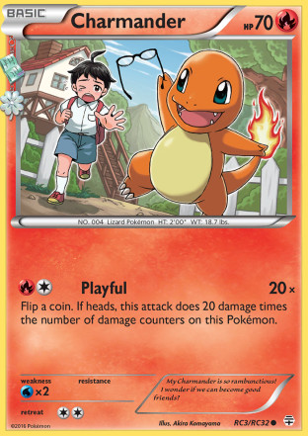
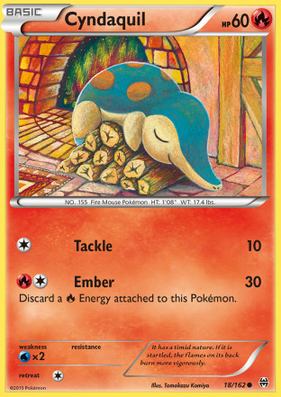
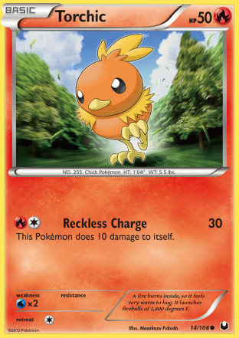
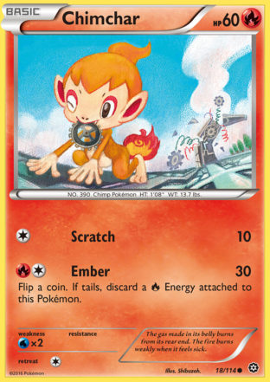

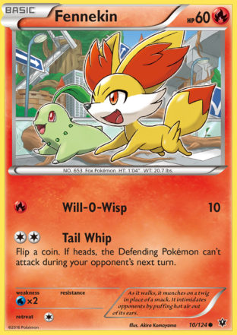
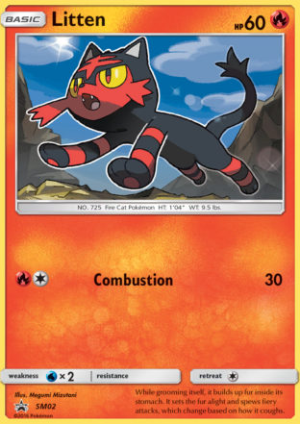





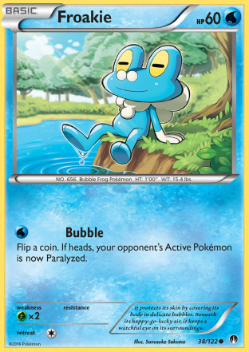
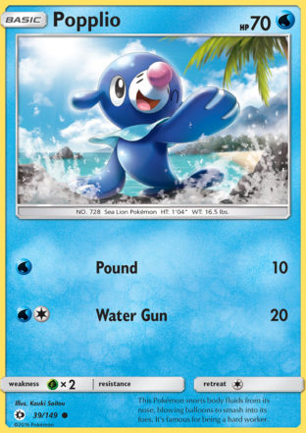
1
2
3
4
5
6
7
1
2
3

Slide 15
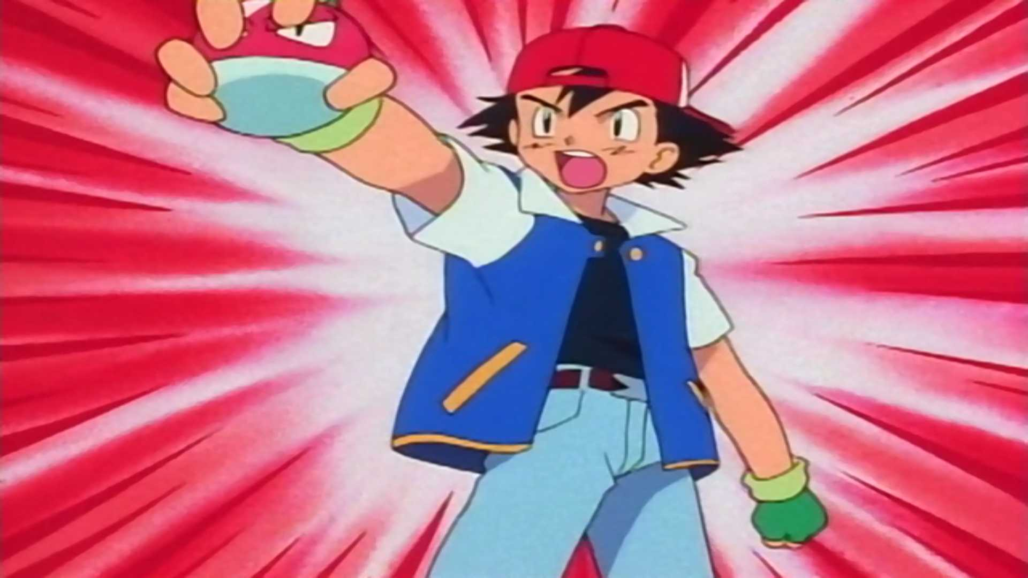
                Congratulations!
                You are now ready to train your Pokemon and befriend more.
                One last thing before you go...

Slide 16






Respect everyone
Open mind
Calm
Keep voice low
Energy positive
Track the speaker

Slide 18
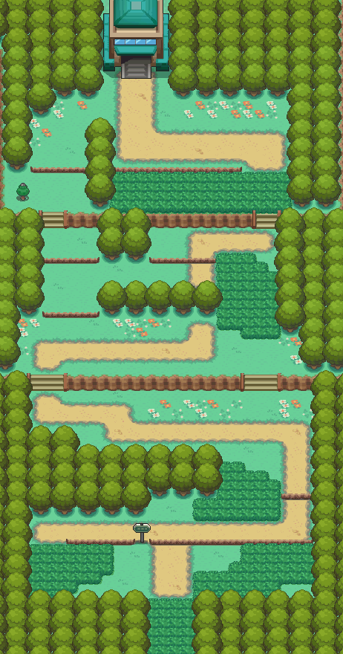

Slide 20



Slide 23
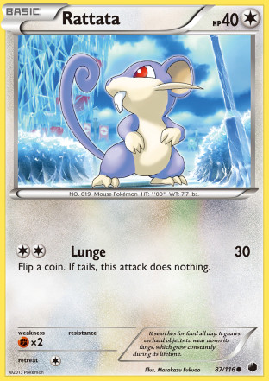

Slide 26
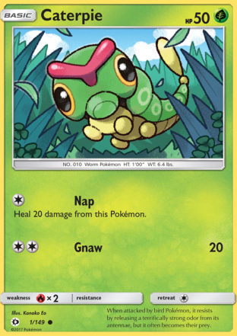

Slide 27
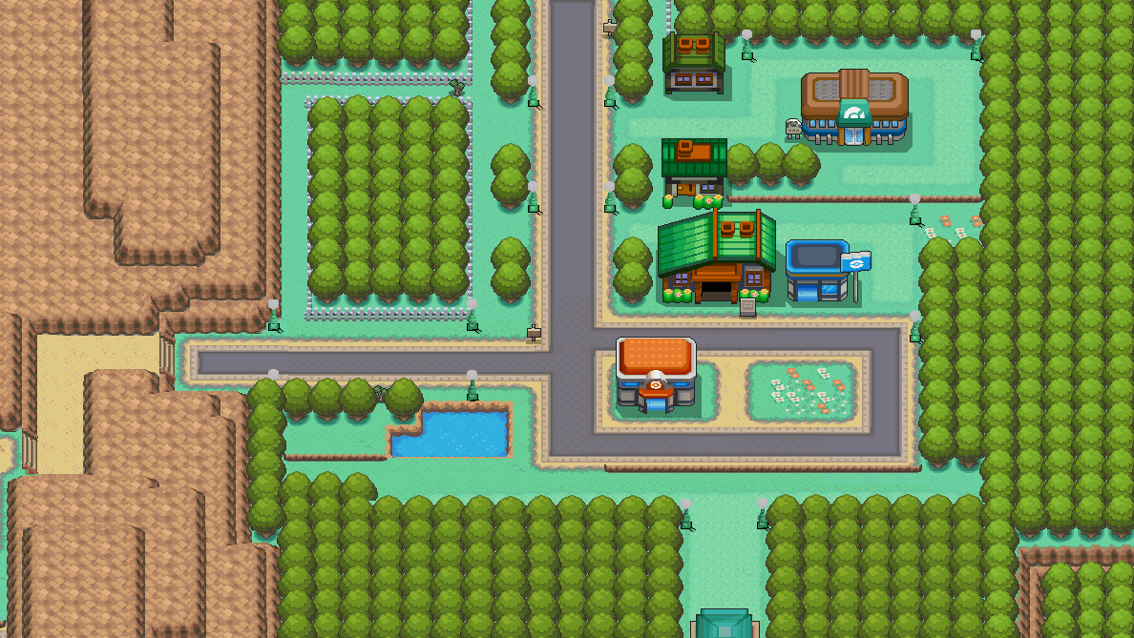

Slide 28
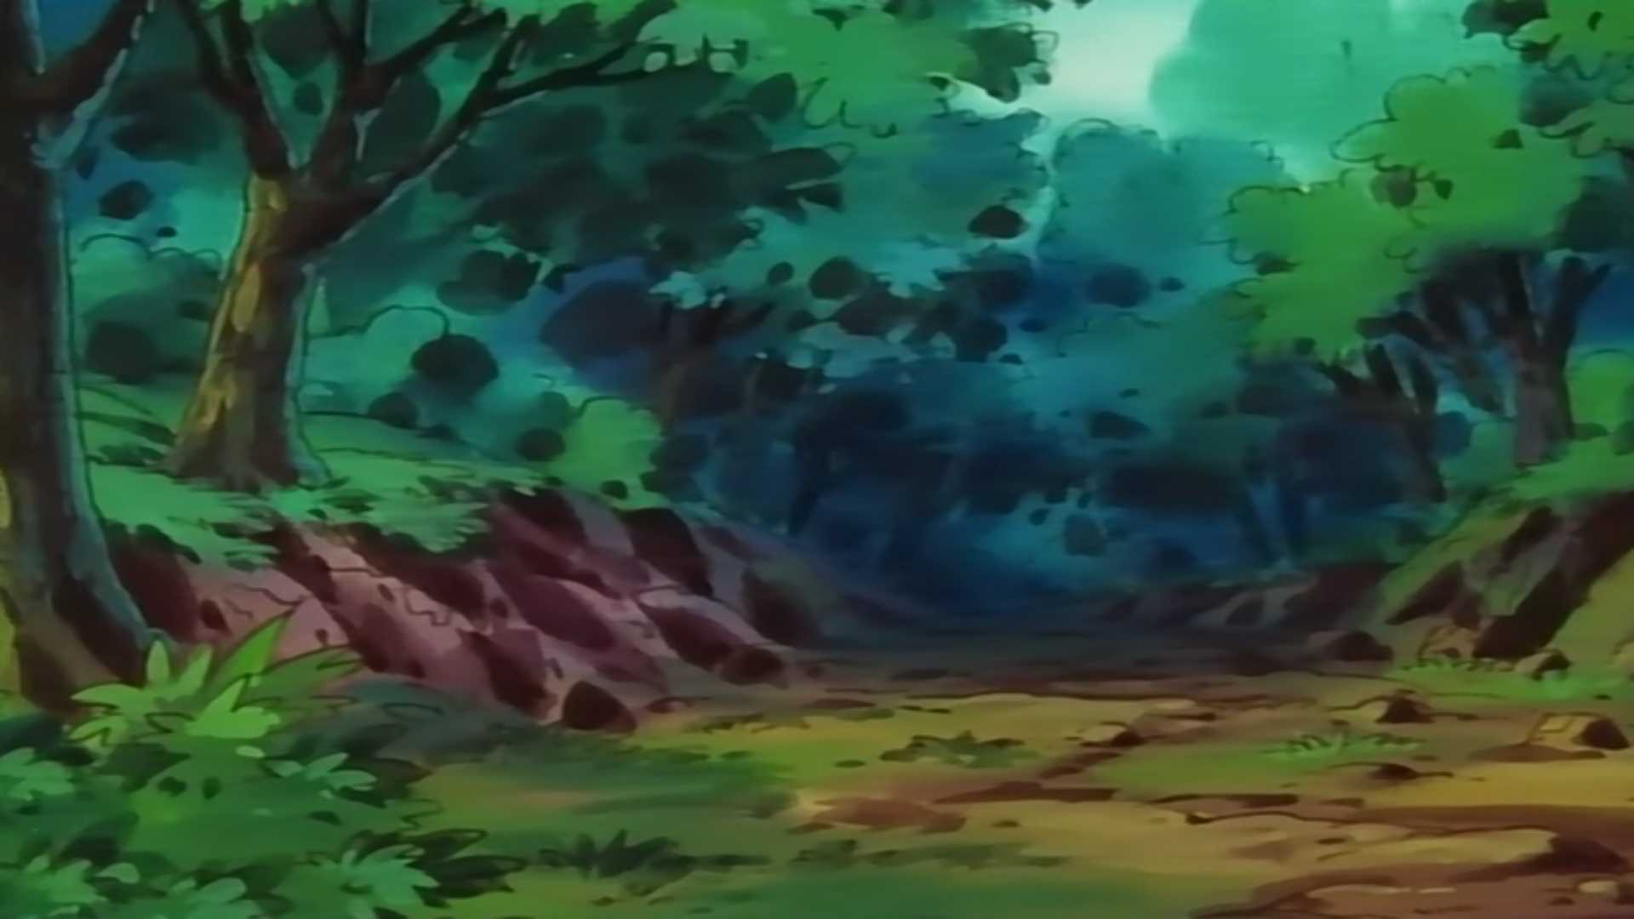
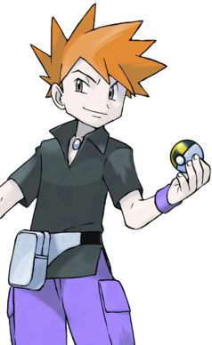
                I am Gary.
                I can give you a Pokemon.
                If you answer some questions.

Slide 29








Badges

Slide 30







Dice Points - No Badge
=10
=20
Good rolls depend on the energy in the classroom

