Slide 1
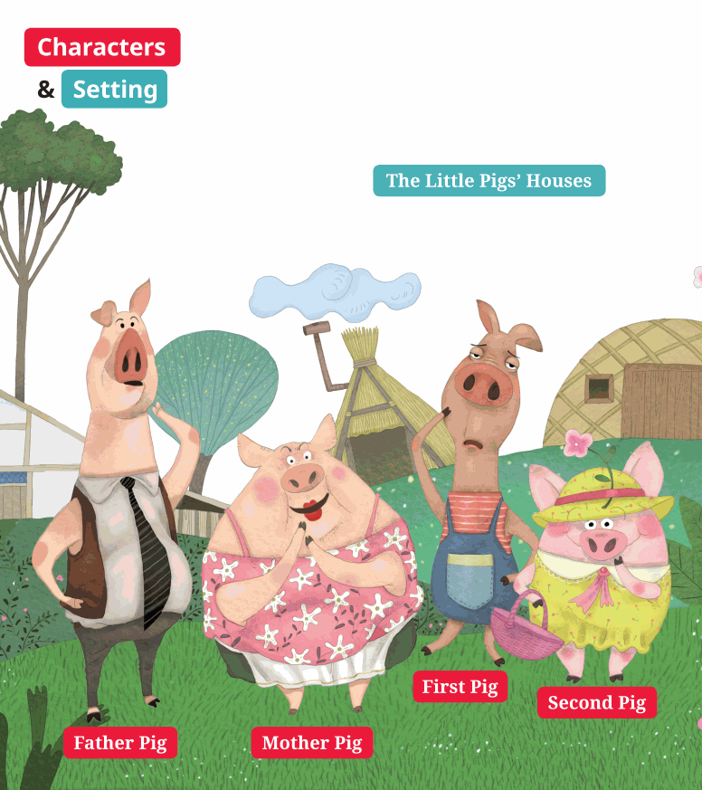
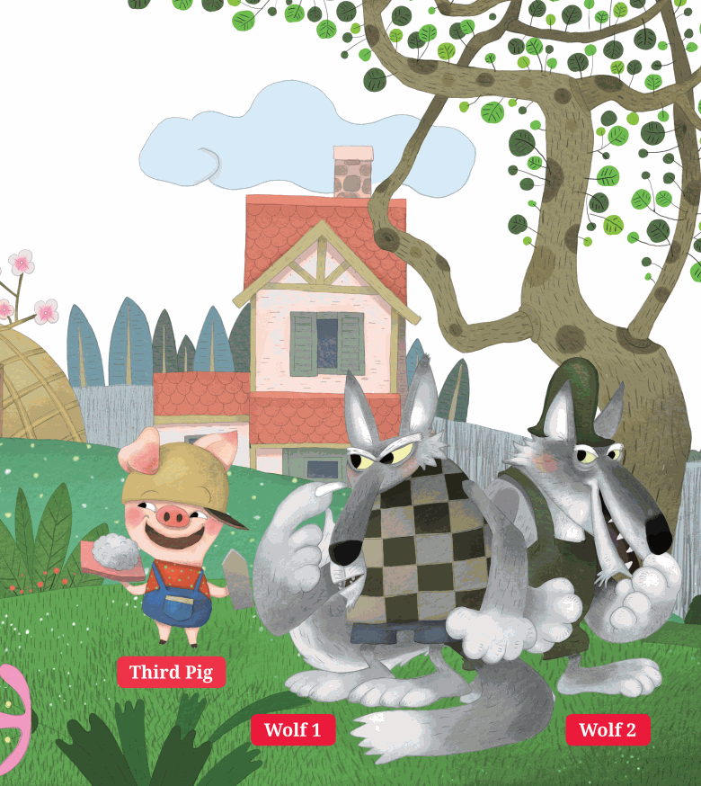
SB pg. 2-3

Slide 2
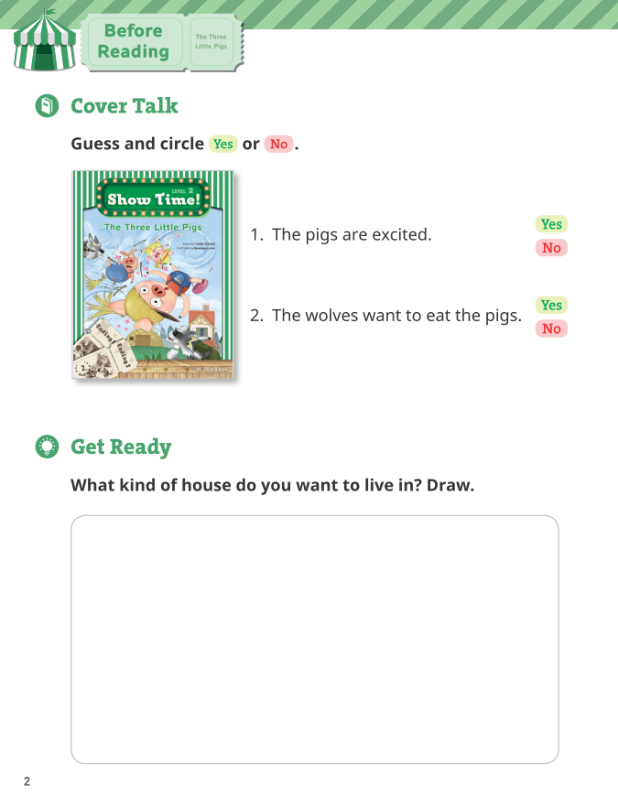
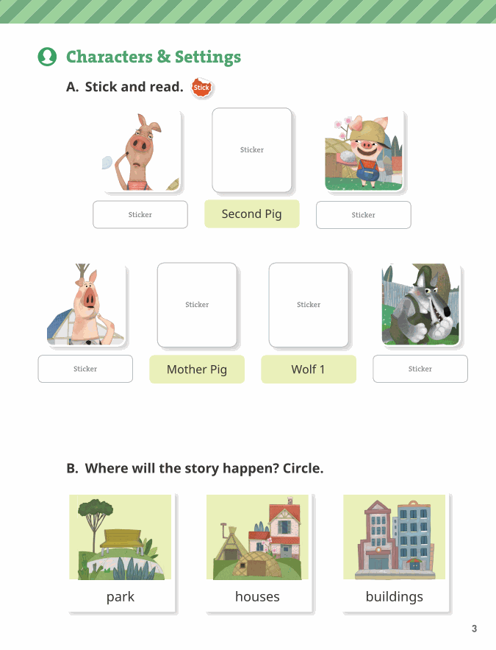
WB pg. 2-3

Slide 3
WB pg. 2

Slide 4

WB pg. 2

Slide 5

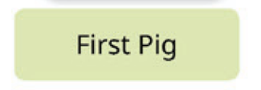
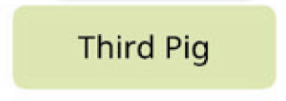


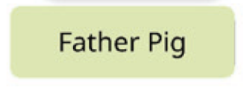

WB pg. 3

Slide 6
WB pg. 3

Slide 7
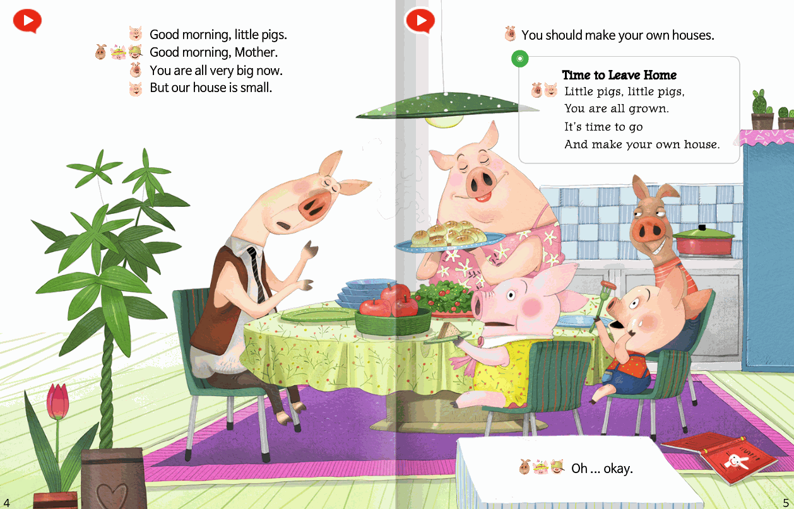
SB pg. 4-5

Slide 8
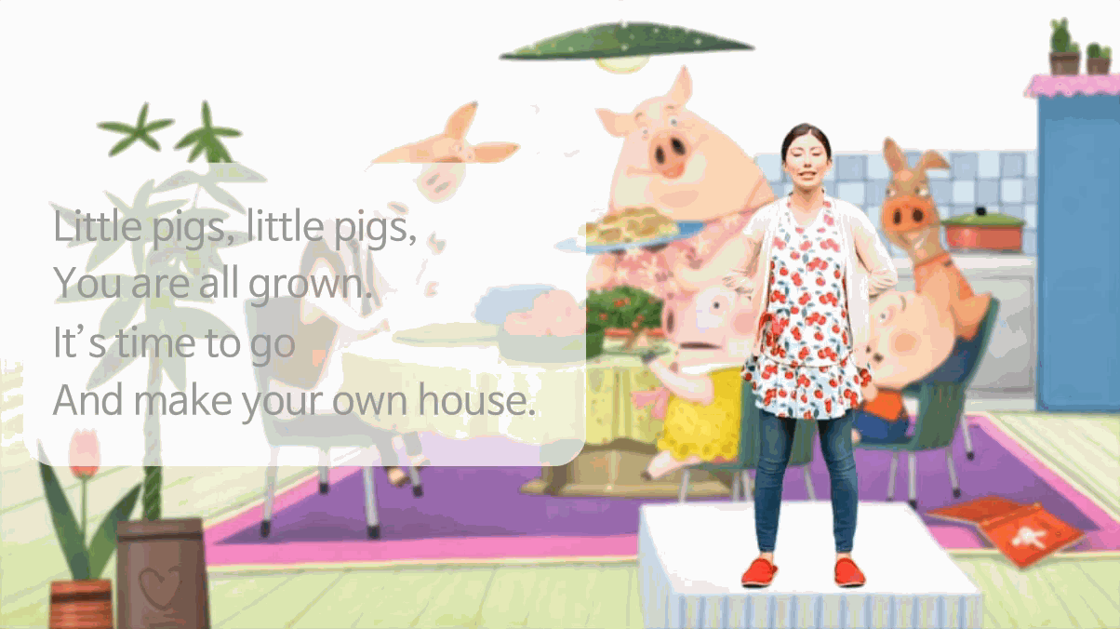

Slide 9
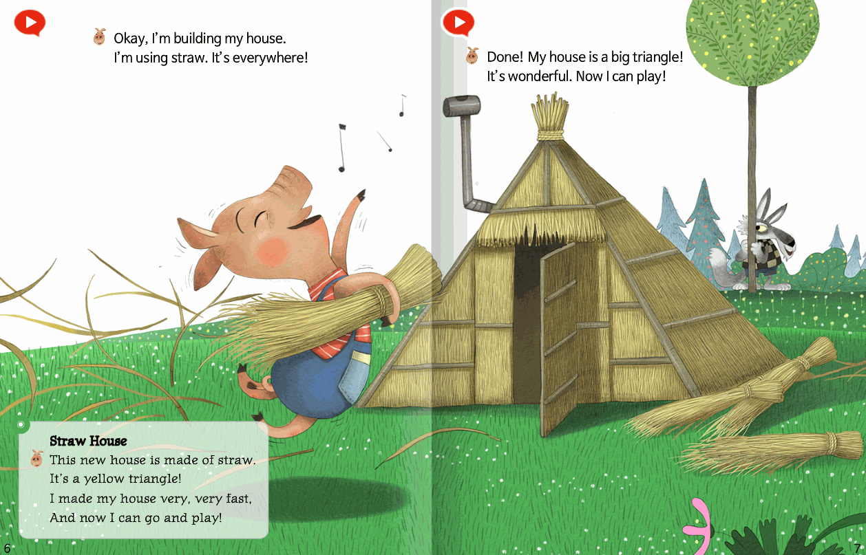
SB pg. 6-7

Slide 10
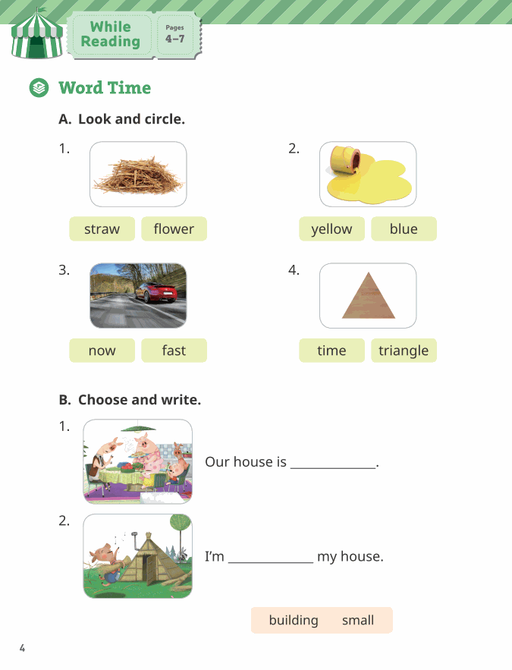
WB pg. 4

Slide 11
WB pg. 4
small
building

Slide 12
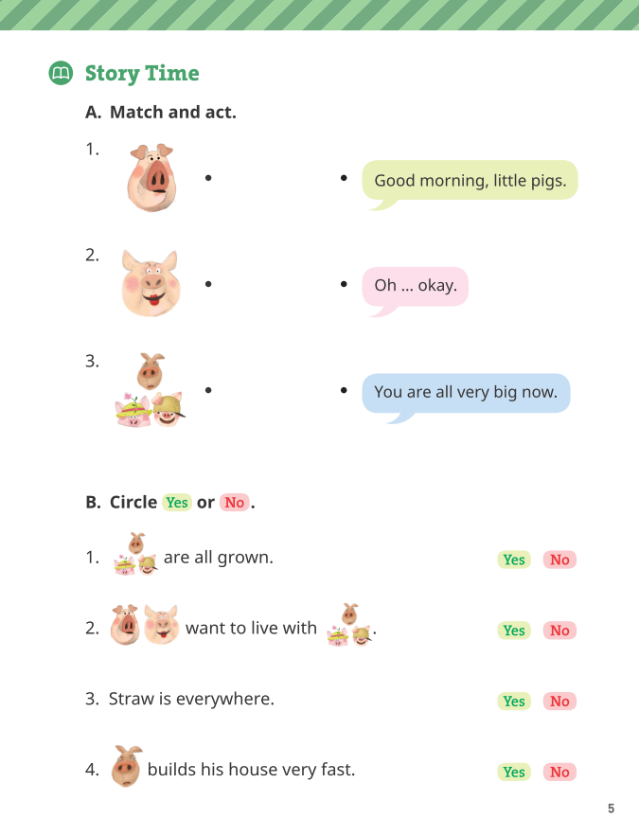
WB pg. 5

Slide 13
WB pg. 5

Slide 14
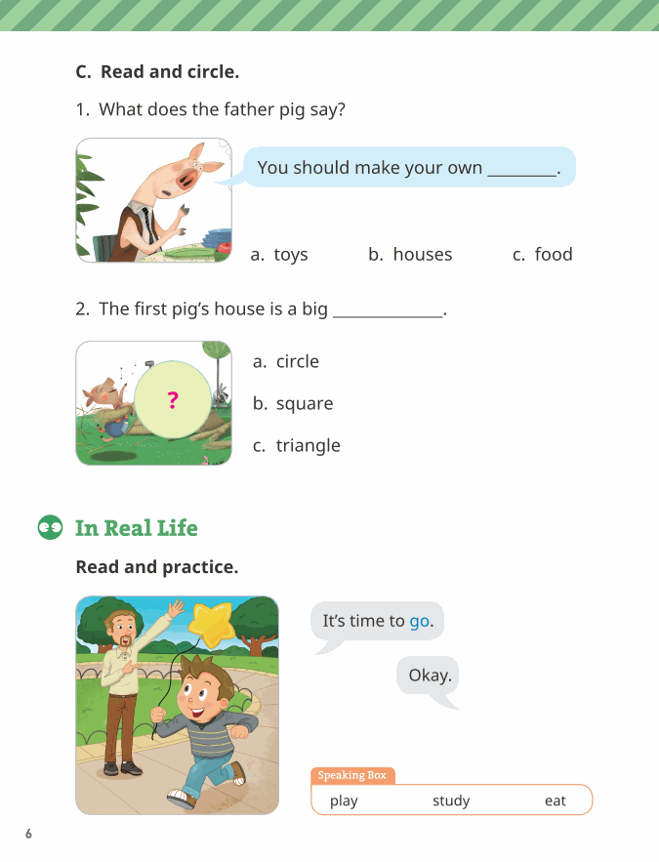
WB pg. 6

Slide 15
WB pg. 6

Slide 16
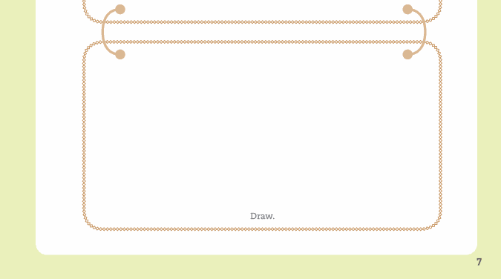
WB pg. 7

Slide 17
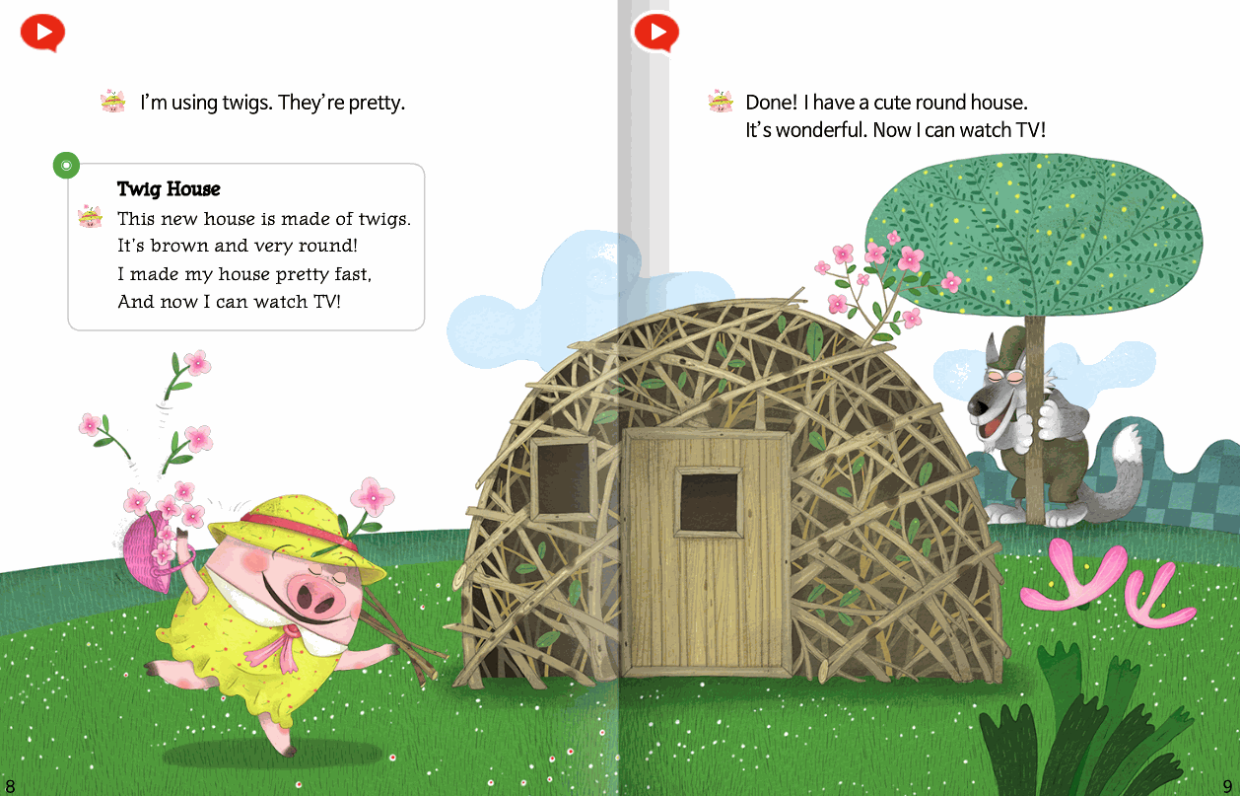
SB pg. 8-9

Slide 18
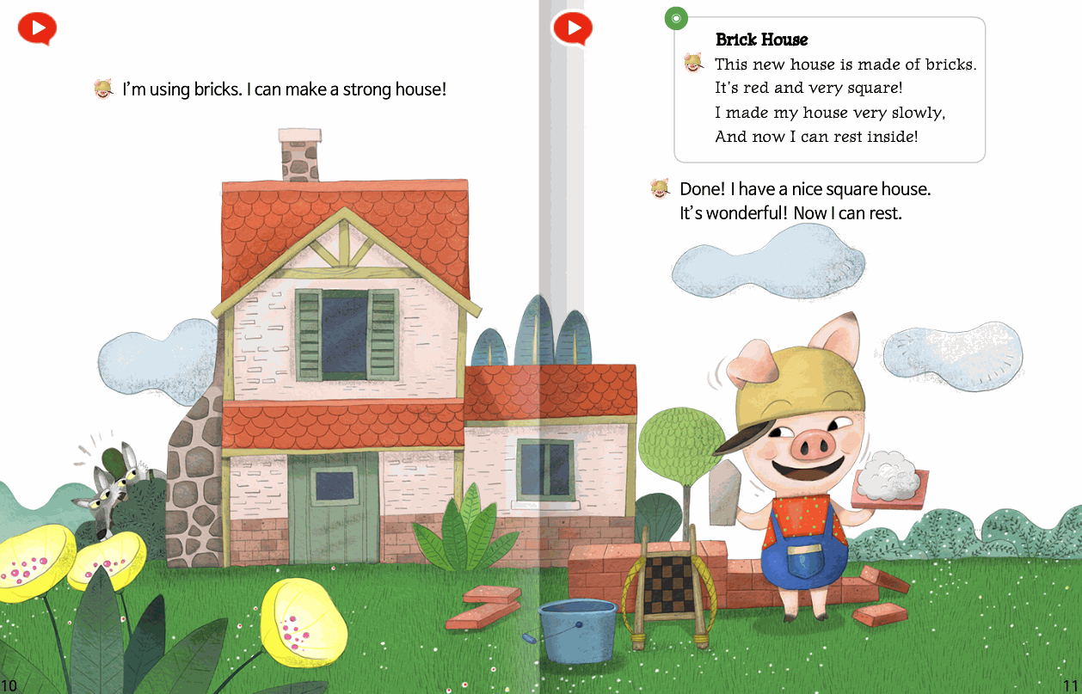
SB pg. 10-11

Slide 19
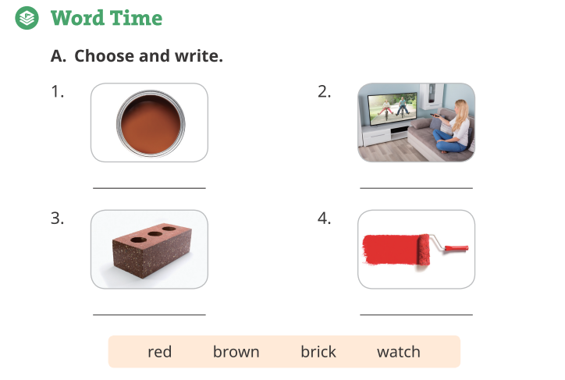
WB pg. 8
brown
watch
brick
red

Slide 20
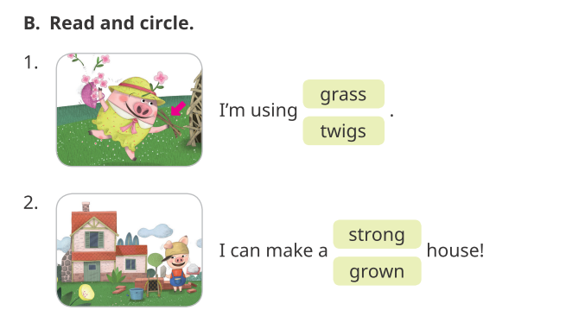
WB pg. 8

Slide 21
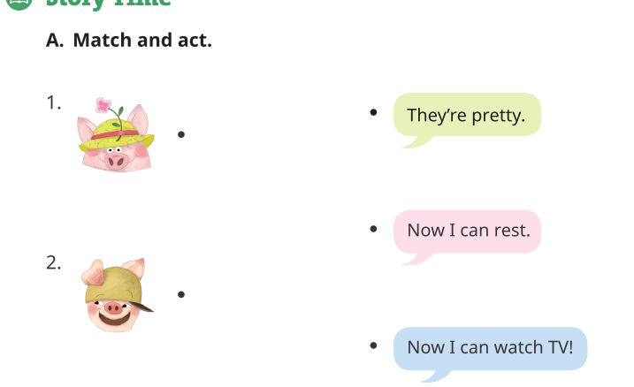
WB pg. 9

Slide 22
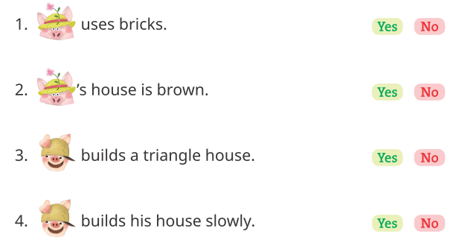
WB pg. 9

Slide 23
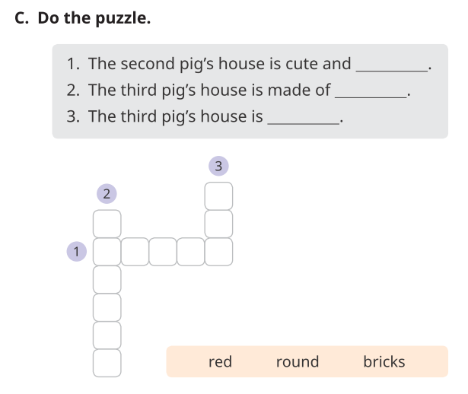
WB pg. 10
r
e
b
i
c
k
s
round

Slide 24
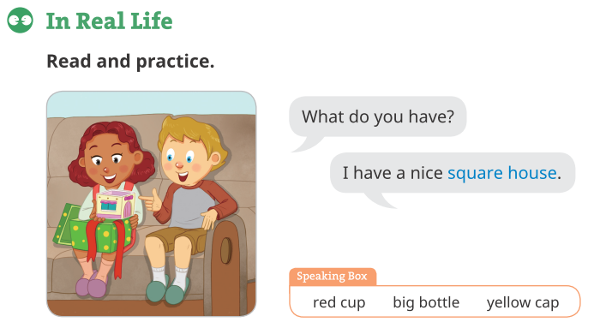
WB pg. 10

Slide 25
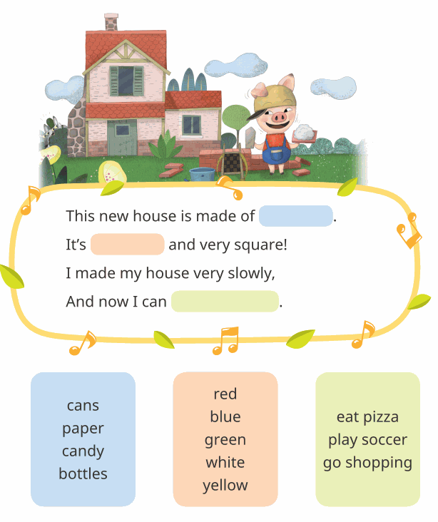
WB pg. 11

Slide 26
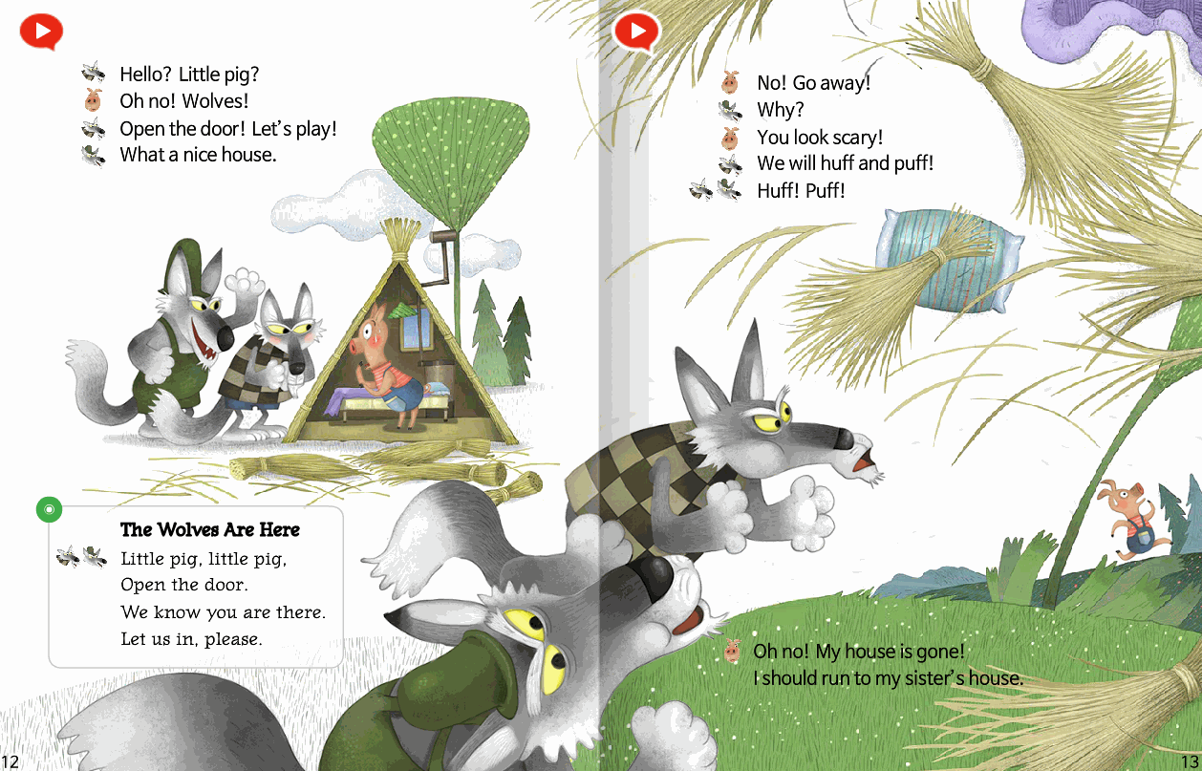
SB pg. 12-13

Slide 27
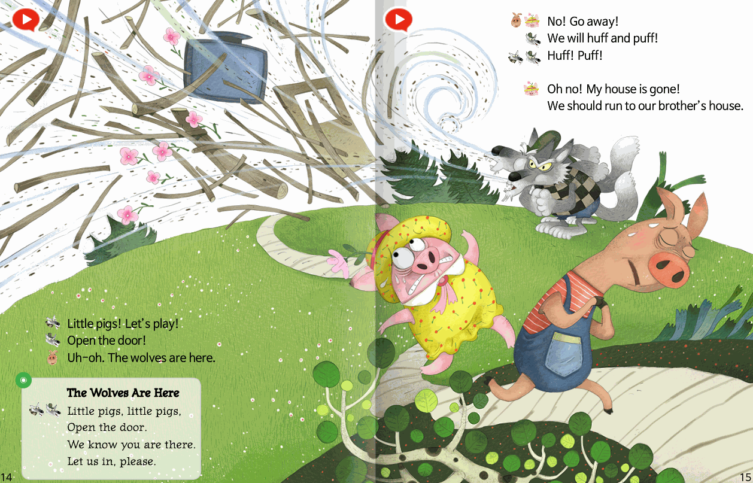
SB pg. 14-15

Slide 28
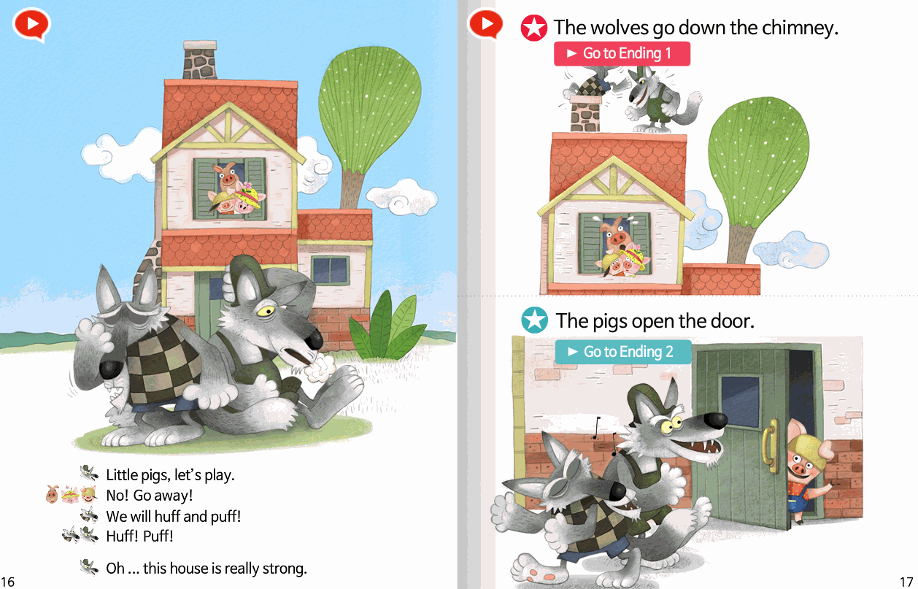
SB pg. 16-17

Slide 29
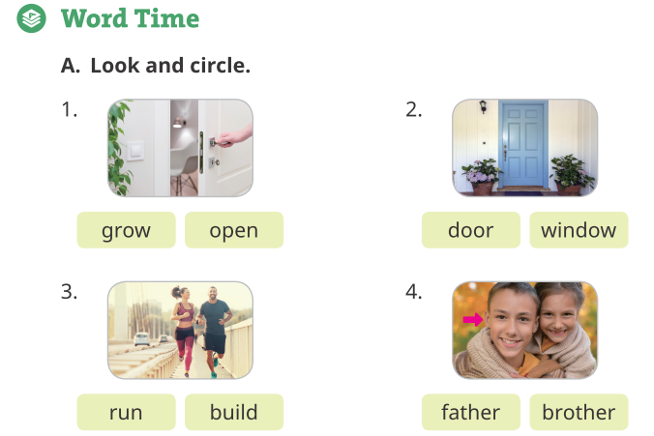
WB pg. 12

Slide 30
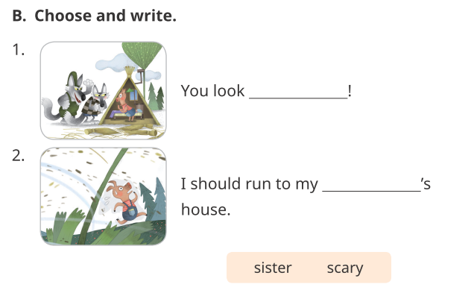
WB pg. 12
scary
sister

Slide 31
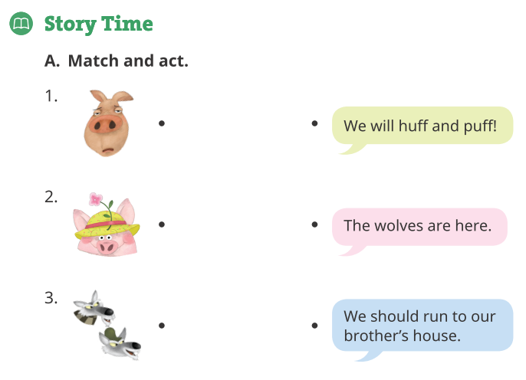
WB pg. 13

Slide 32
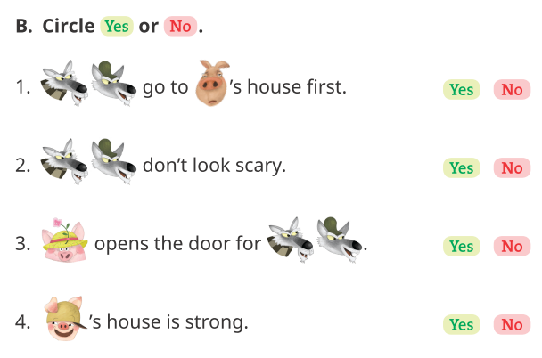
WB pg. 13

Slide 33
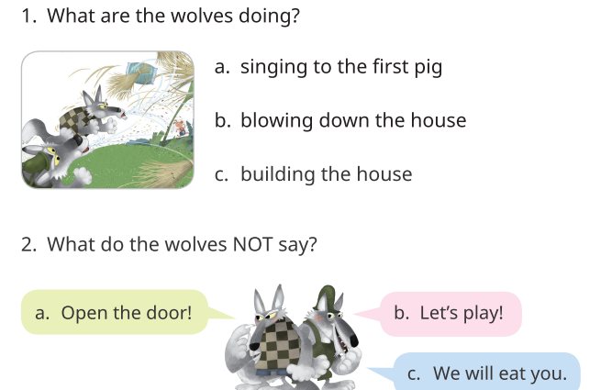
WB pg. 14

Slide 34
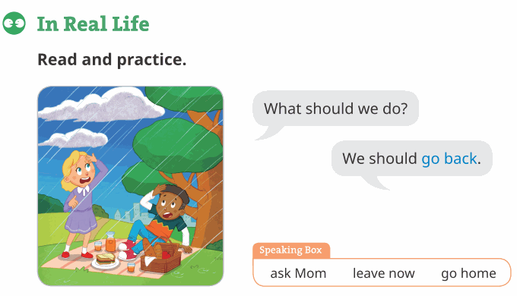
WB pg. 14

Slide 35
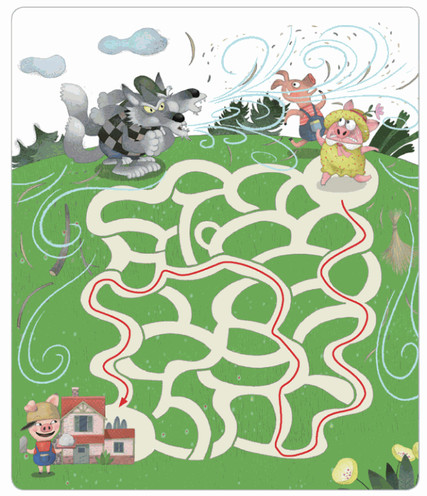
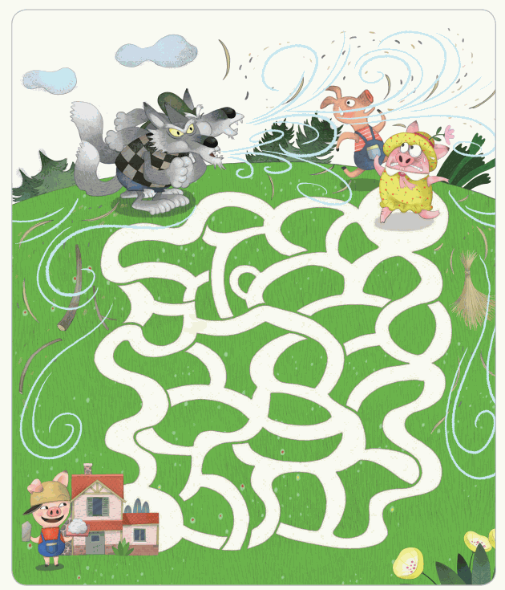
WB pg. 15

Slide 36
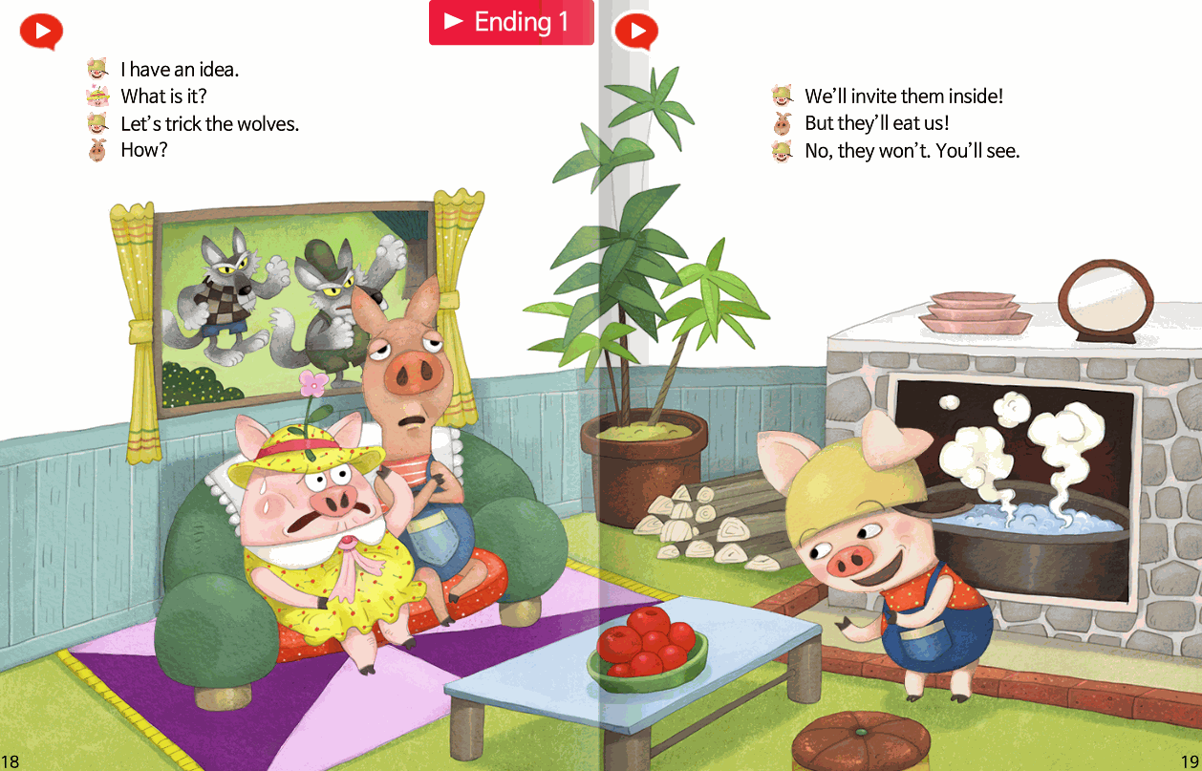
SB pg. 18-19

Slide 37
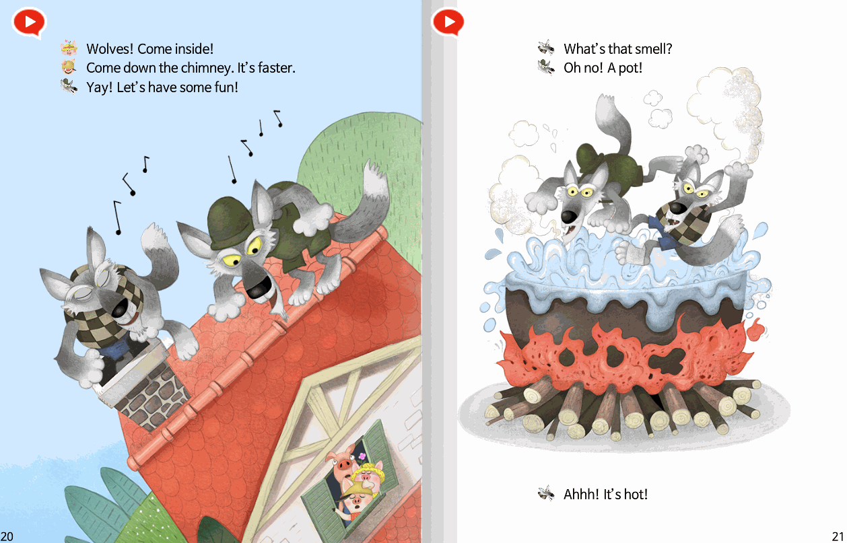
SB pg. 20-21

Slide 38
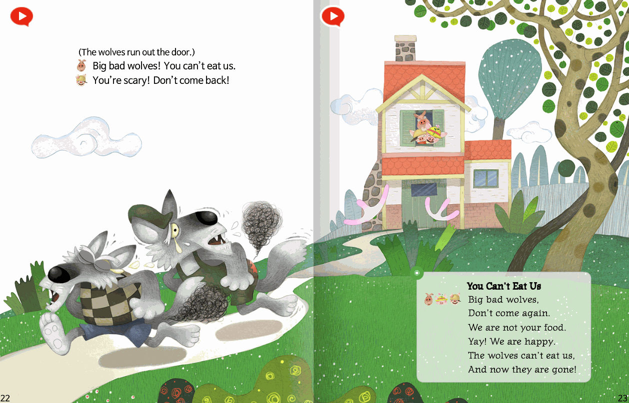
SB pg. 22-23

Slide 39
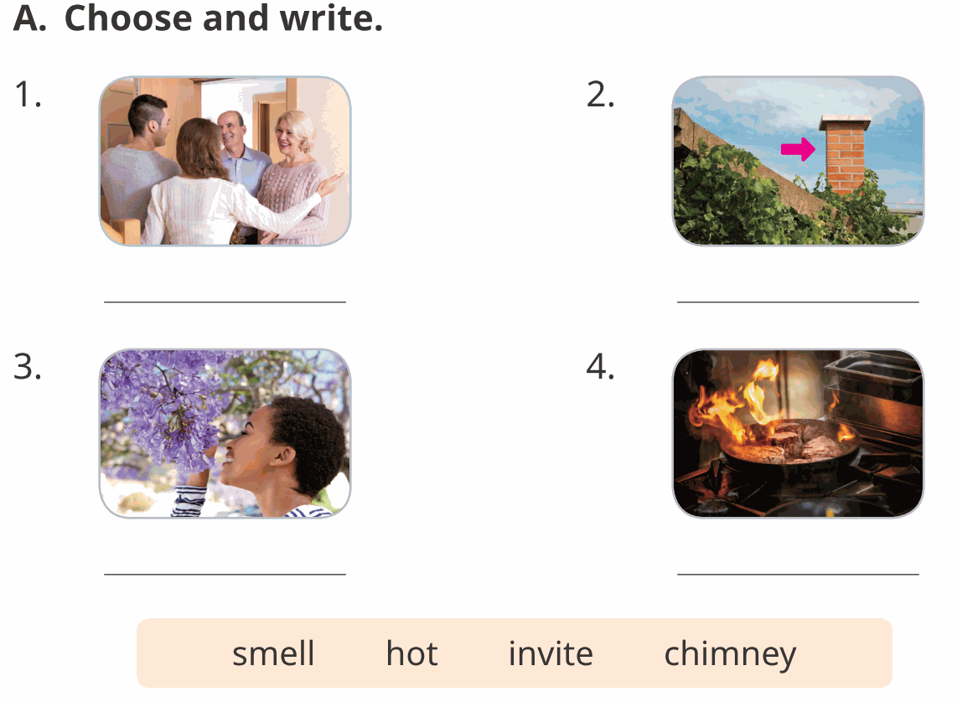
WB pg. 16
invite
chimney
smell
hot

Slide 40
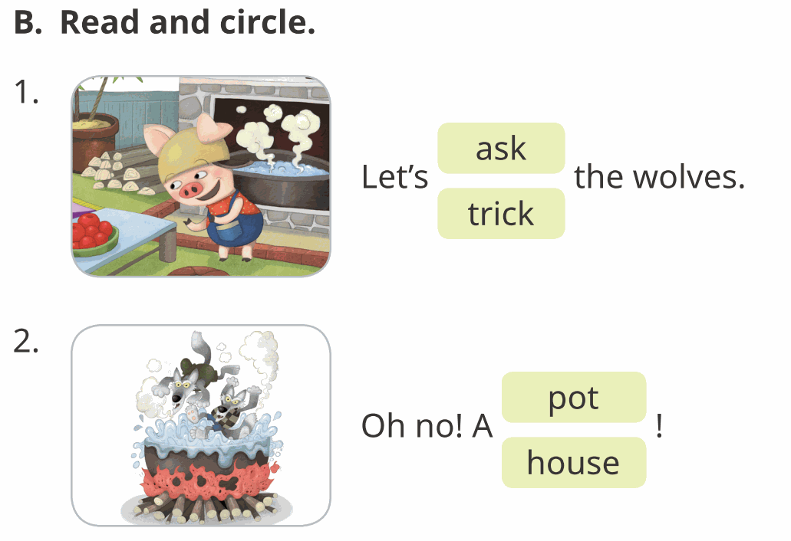
WB pg. 16

Slide 41
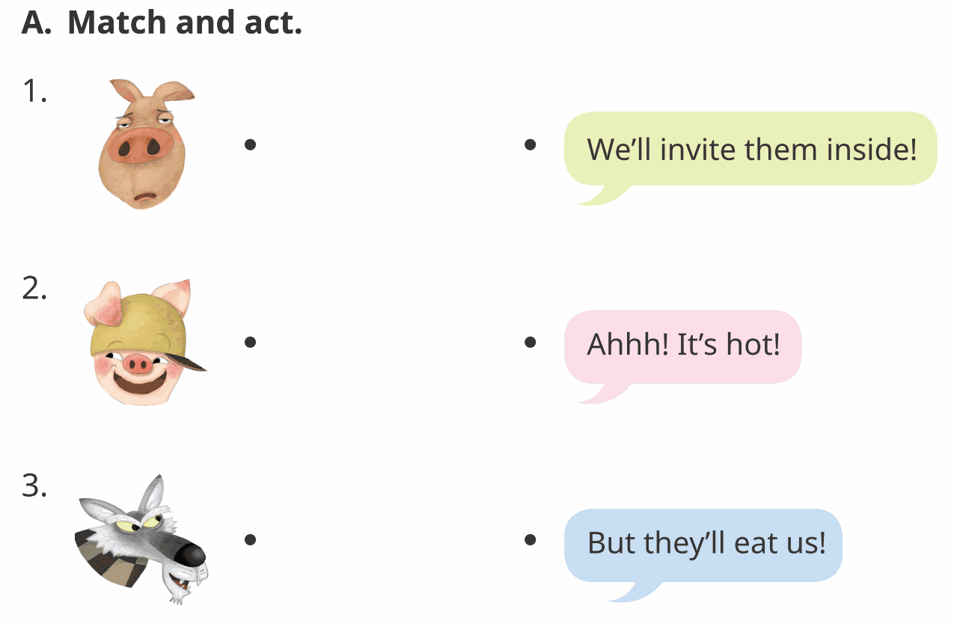
WB pg. 17

Slide 42
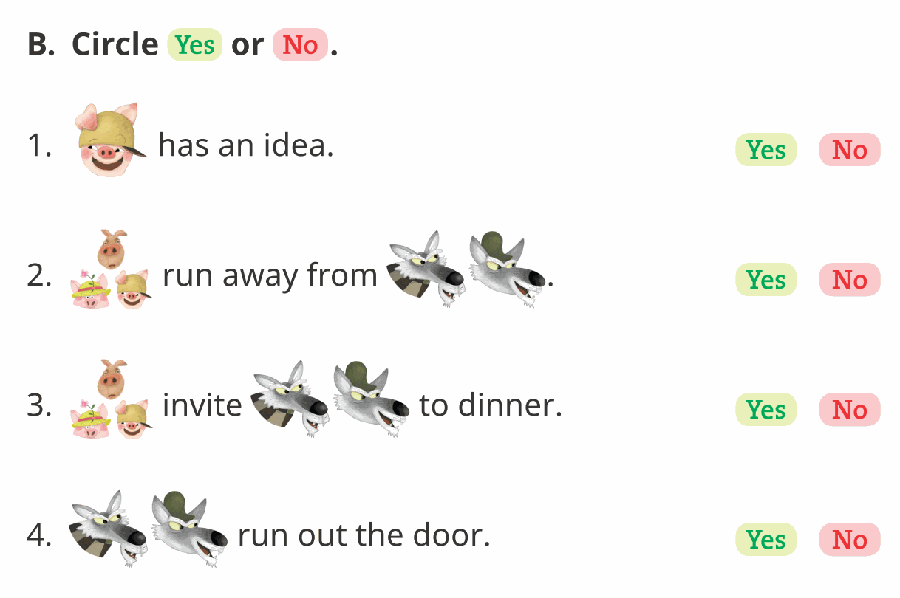
WB pg. 17

Slide 43
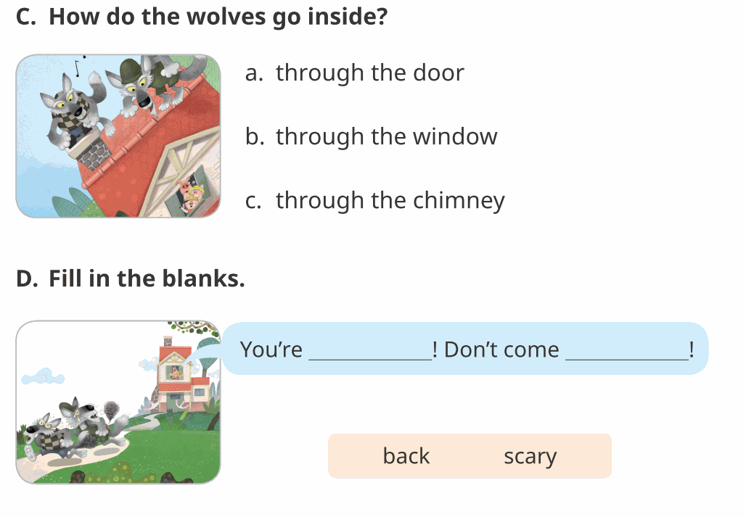
WB pg. 18
scary
back

Slide 44
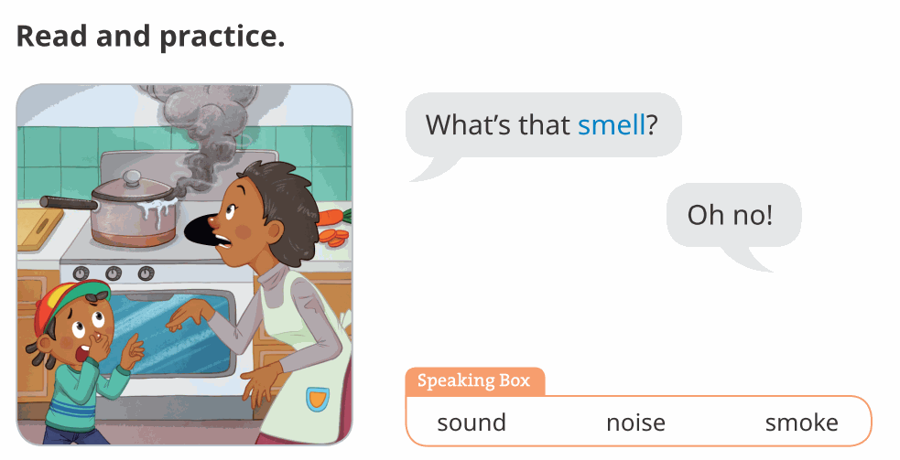
WB pg. 18

Slide 45
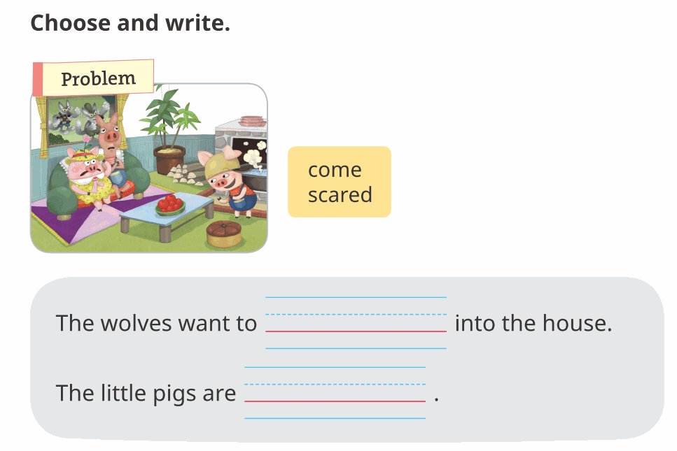
WB pg. 19
come
scared

Slide 46
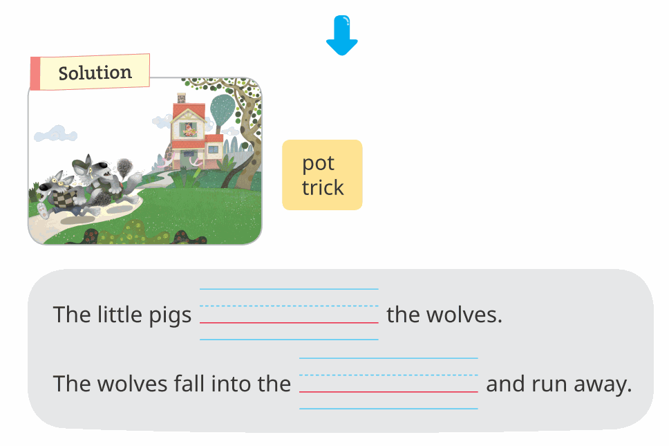
WB pg. 19
trick
pot

Slide 47
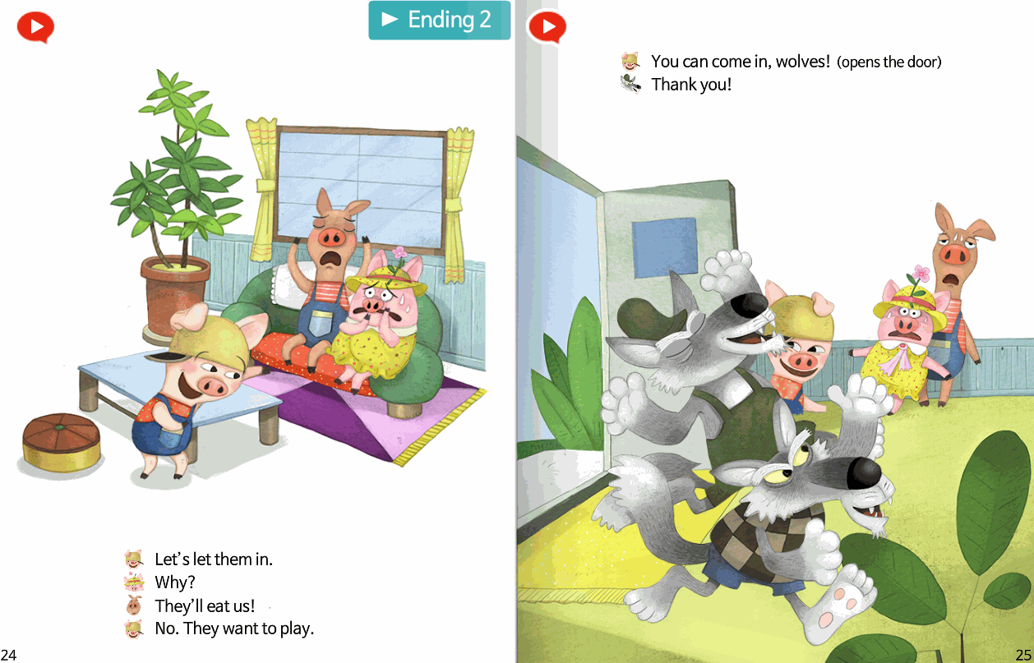
SB pg. 24-25

Slide 48
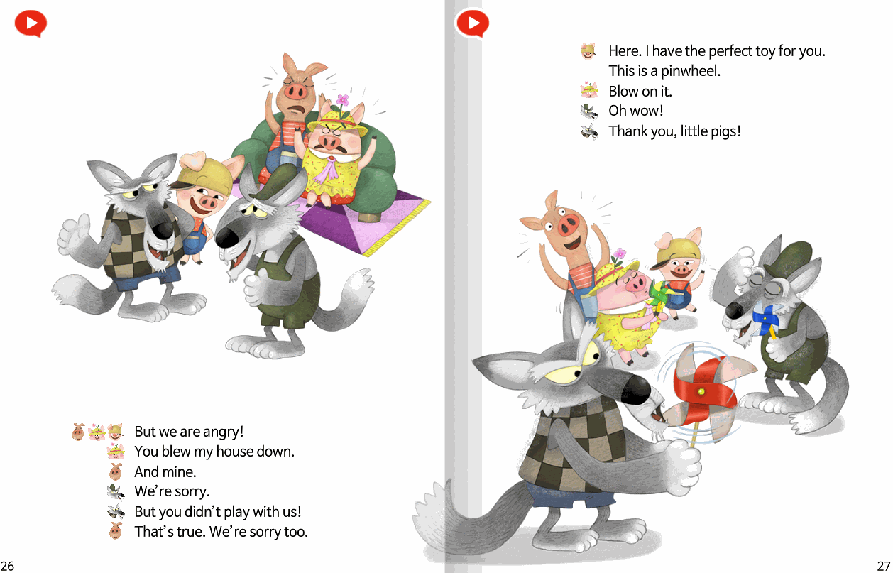
SB pg. 26-27

Slide 49
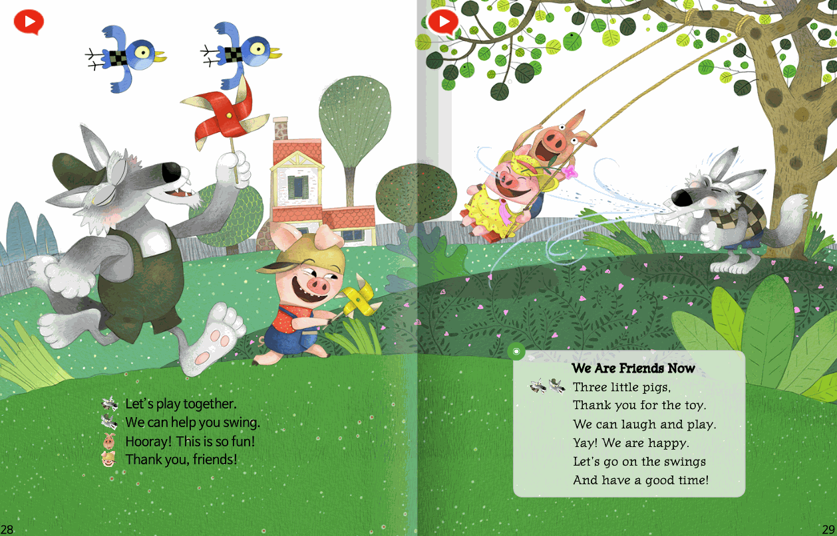
SB pg. 28-29

Slide 50
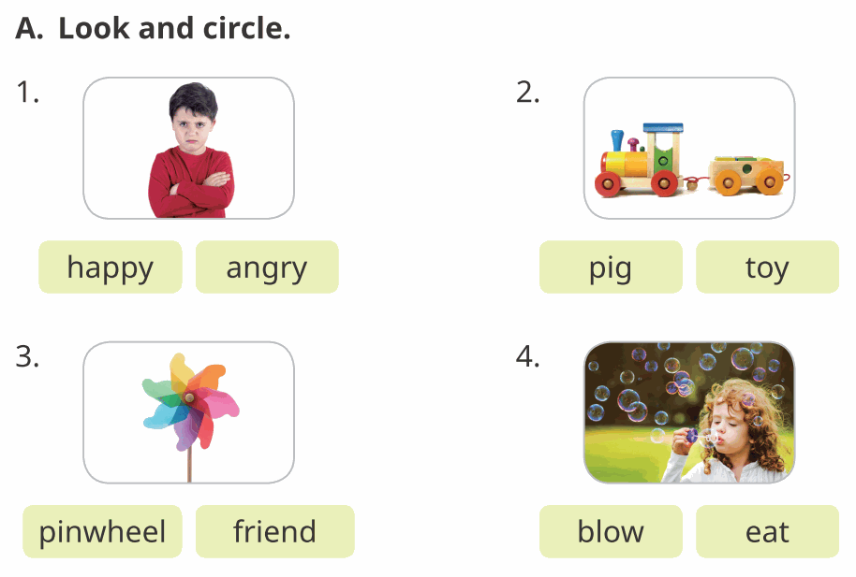
WB pg. 20

Slide 51
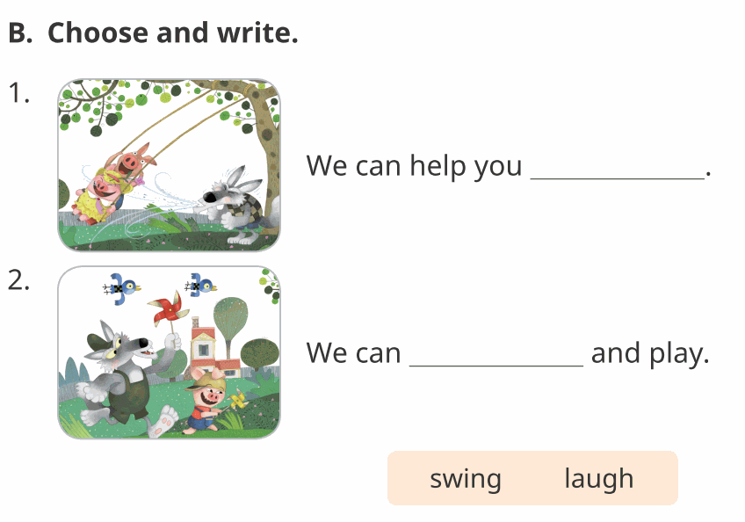
WB pg. 20
swing
laugh

Slide 52

WB pg. 21

Slide 53

WB pg. 21

Slide 54

WB pg. 22
But you didn’t play with us.

Slide 55

WB pg. 22

Slide 56

WB pg. 23
friends
pinwheel
swing

Slide 57



WB pg. 24

Slide 58



WB pg. 24

Slide 59


WB pg. 25
C
F
A
D
B

Slide 60




WB pg. 26

Slide 61

WB pg. 27
The Three Little Pigs
Caitlin Schmitt
Byeongjun Jeon

Slide 62






WB pg. 27

Slide 63

WB pg. 28

Slide 64



WB pg. 28

