Slide 1


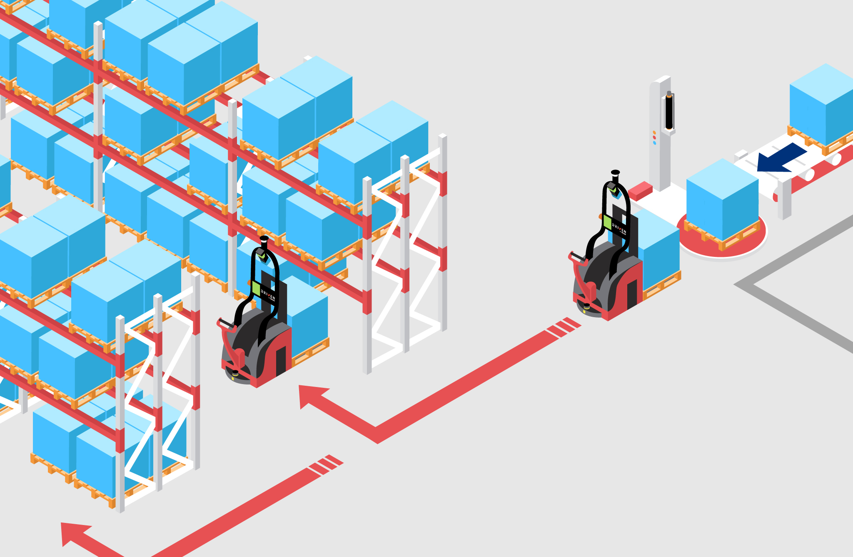
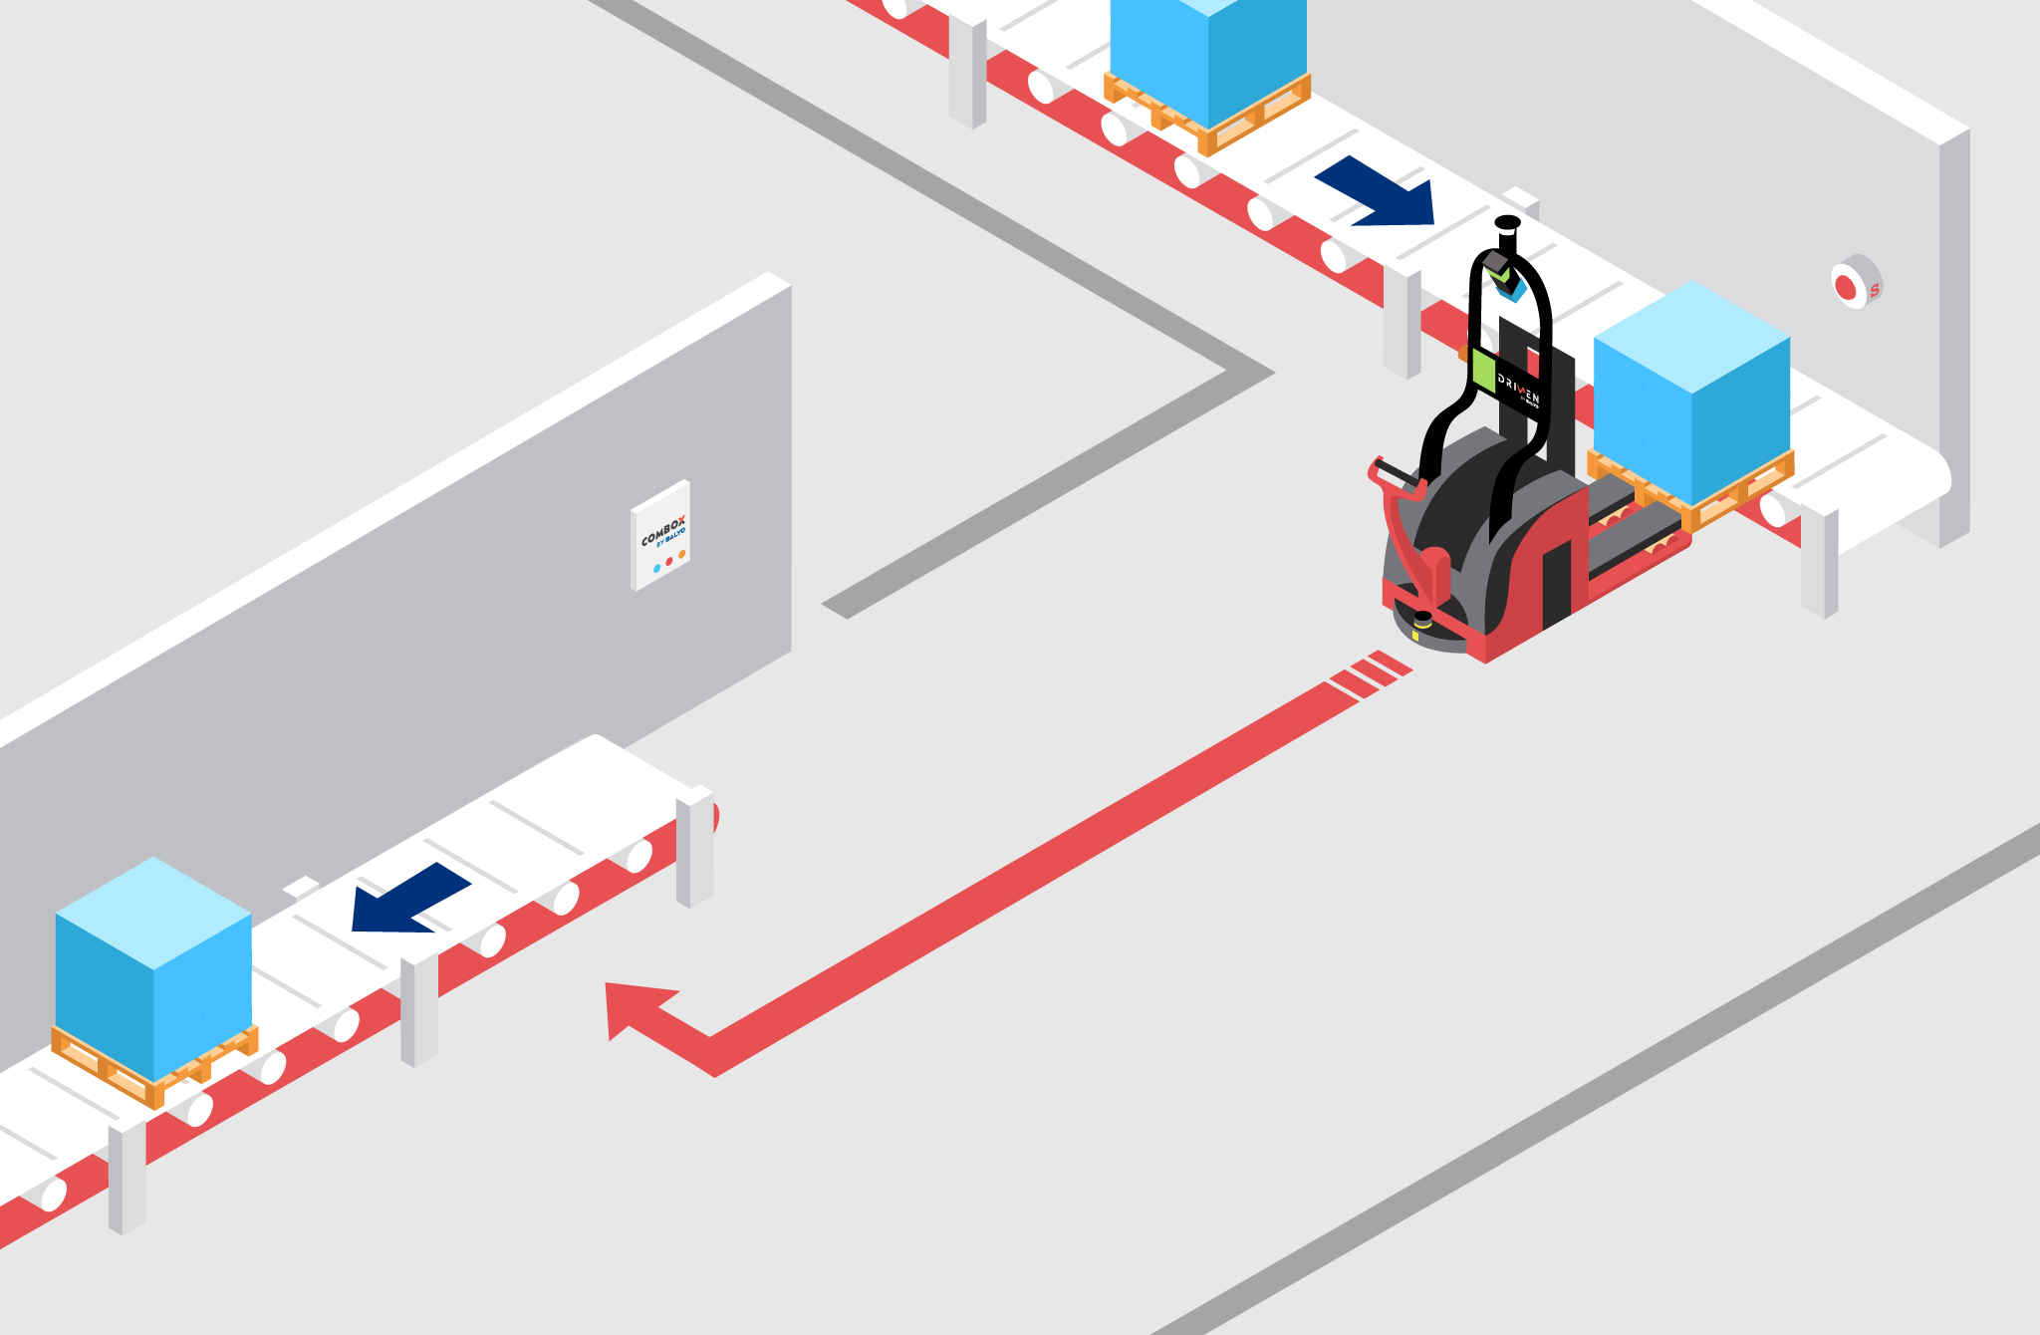
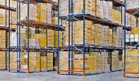
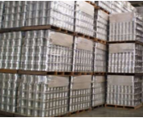
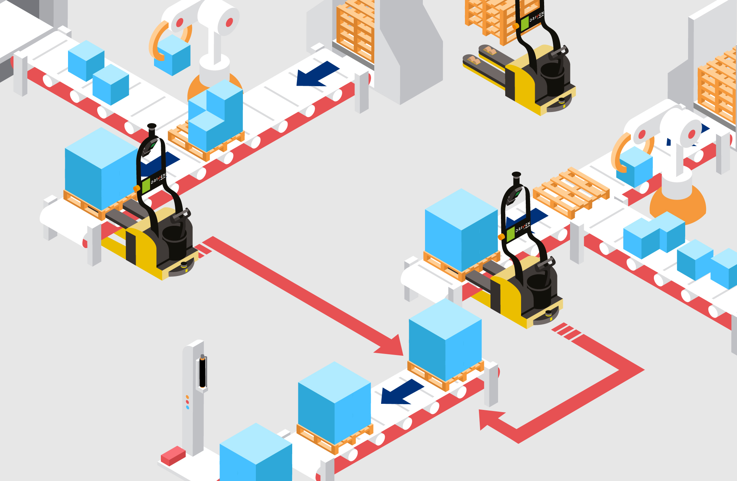
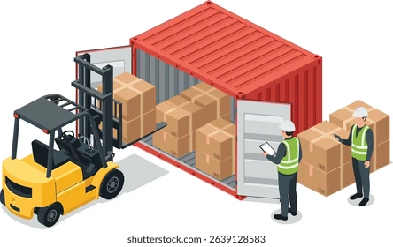
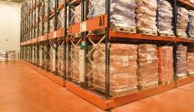
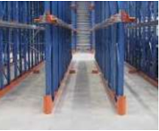
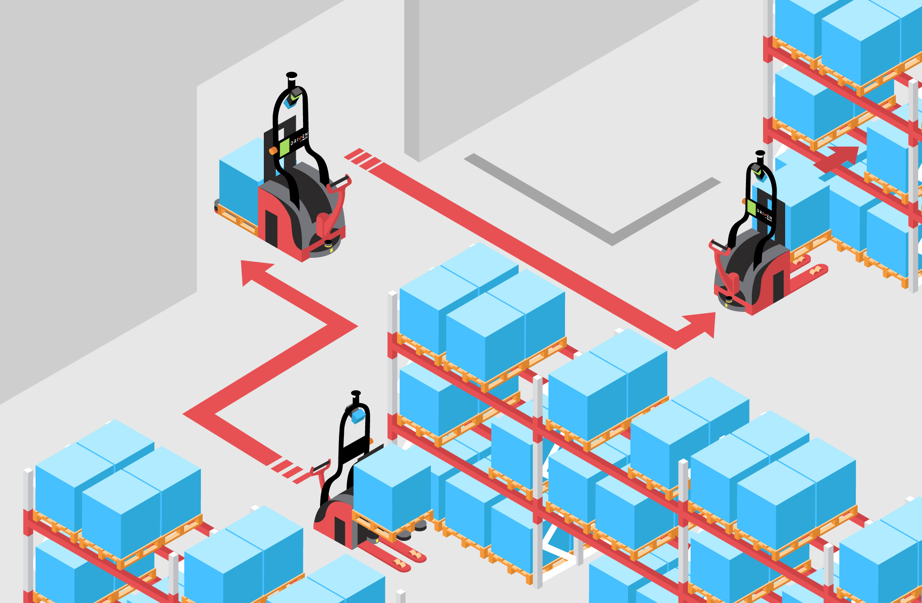
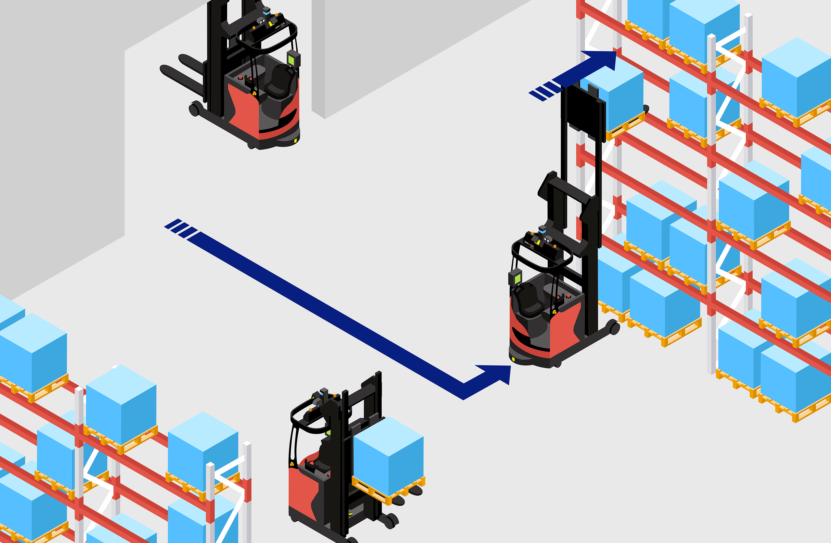
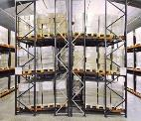
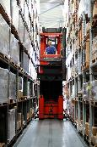
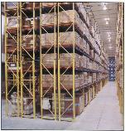
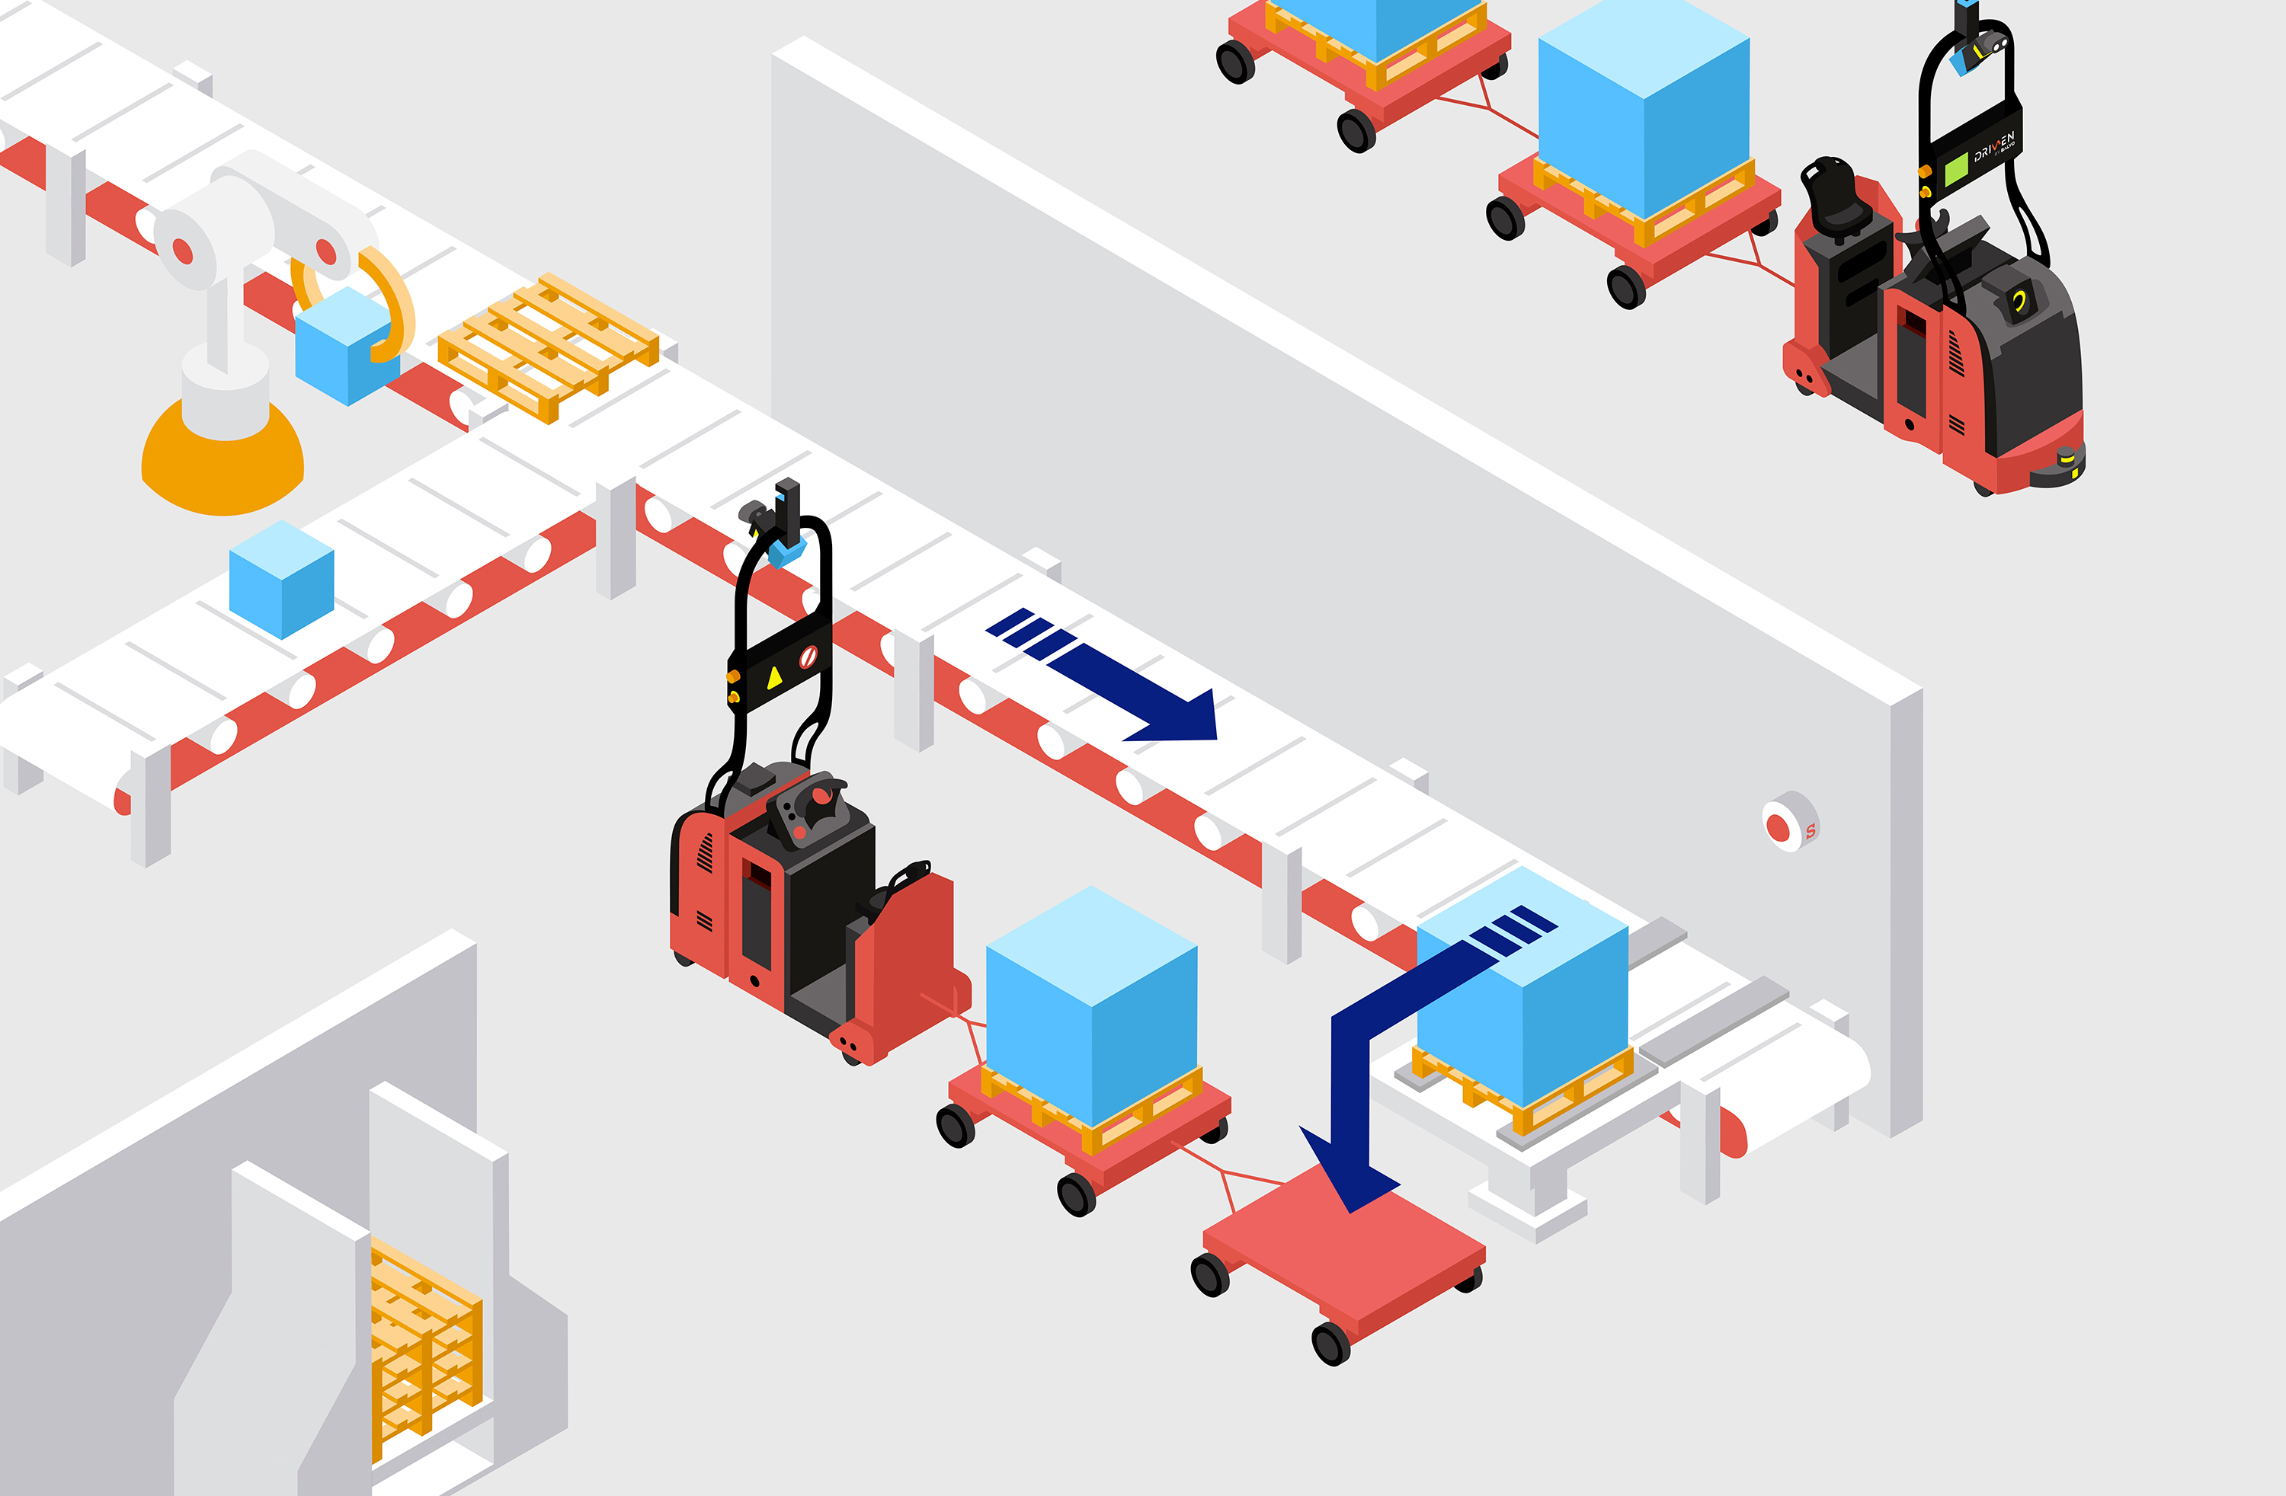
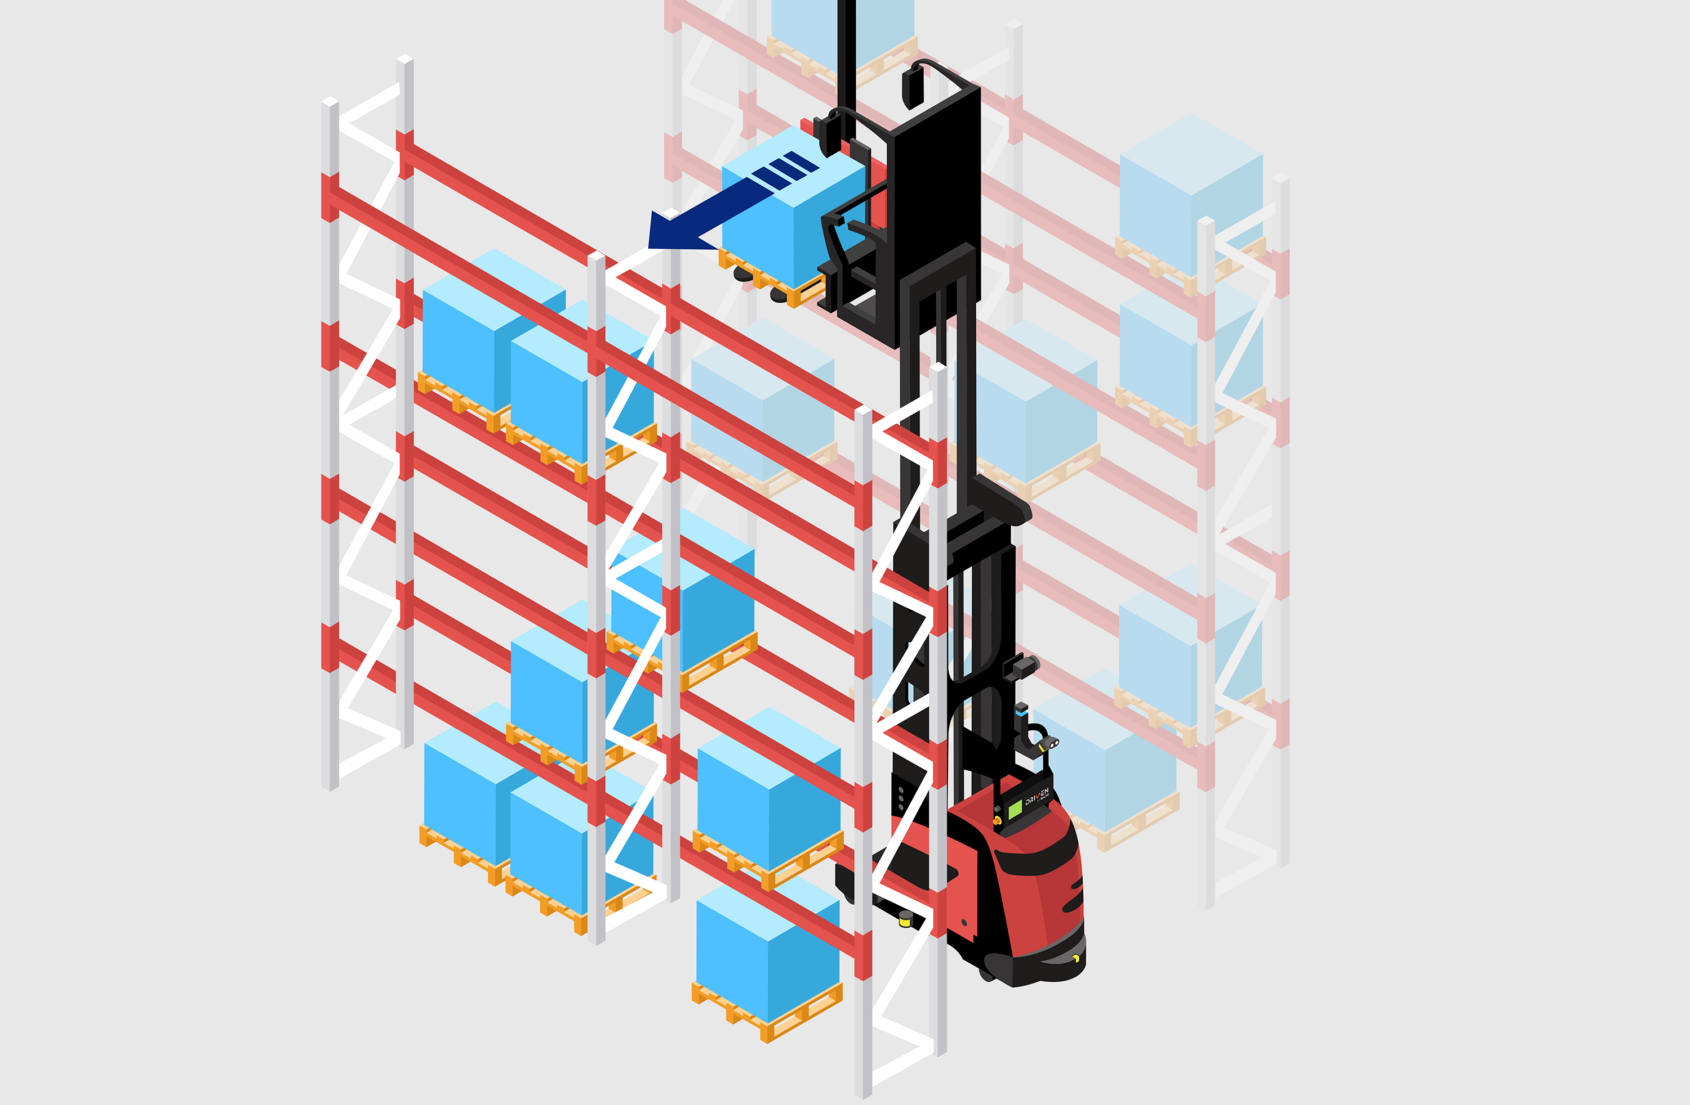
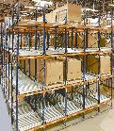
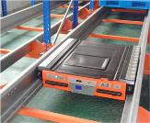
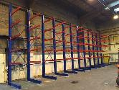
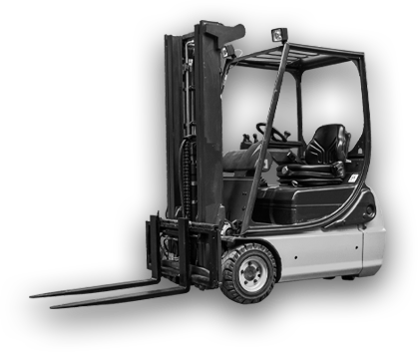
Your machine-agnostic Physical AI partner
Hive enhances the fleet you already own to make it autonomous and self-learning — a general-purpose physical AI, supervised by humans until it owns the edge cases. Everyone else automates a task; Hive runs a model.
WHY HIVE
One model, every machine A single AI model across the whole fleet — not a separate integration per machine type.
Enhancement, not replacement Sensors, lidar and a control cabinet on machines you already own. Installed in days, fully reversible.
Human-in-the-loop by design Supervision is the product, not the fallback. The edge cases that stop other AMRs become the next training set.
ROI from Month 1 No upfront Capex, no change management. Operation-ready within two weeks.
MATERIAL FLOWS IT HANDLES
RACKING APPLICATIONS
Conveyor interface
Photo n/a
End-of-line & storage
Standard (to 11m)
Block storage
Container loading/unloading
Photo n/a
Machine interface
Mobile rack
Drive-in
Stacking
High storage
VNA (to 12m+)
Double-deep
Push-back
Logistics train
Very high storage
Shuttle (soon)
Cantilever
Gravity
Output:
Example of a Hive-enhanced machine
“This is a unique addition to Toyota’s product portfolio and the first technology launch of its kind in Norway. The partnership enables the automation of a wide range of truck types, both existing and new models.”
— Lars Petter Bjørgen
Director of Sales, Toyota Material Handling Norway
30% Lower Labour Cost from Month 2
RaaS model
2× end-to-end workflow speed vs AMRs
Up to 50% fewer vehicles needed vs AMRs
Safety guaranteed with 90-100% Damage cases removed
Lidar
Camera
Camera
Live in operation today at market-leading companies in cold chain, grocery distribution, fish farming, waste management and industrial distribution.
Where Hive operates — where others can’t
Indoor & outdoor — one machine
Any floor — wet, glossy, uneven
Containers — no reflectors
Operating at height — 3× mast
Stacking — bags, drums, totes
Cold chain — sub-zero
Lidar
Control Cabinet

