Slide 1























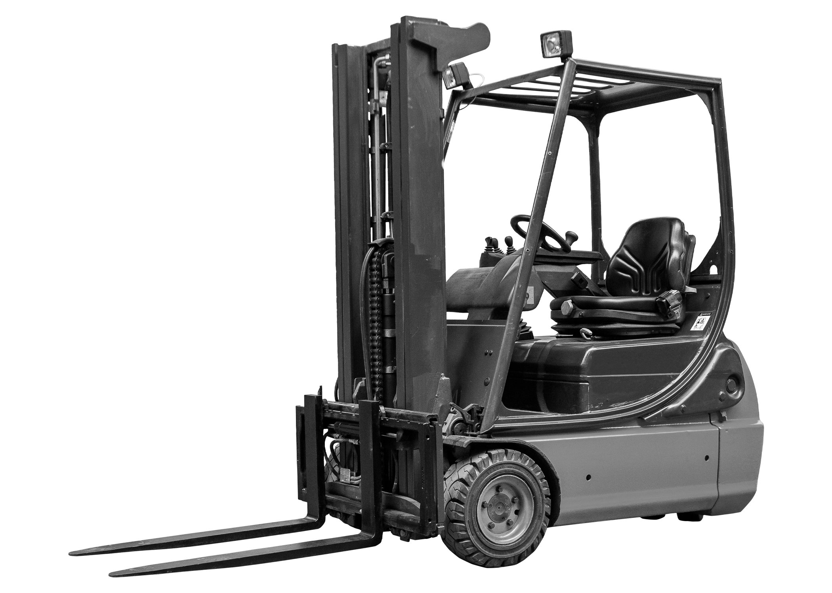

[INDUSTRIAL MACHINE INTELLIGENCE]
Your machine-agnostic
Physical AI partner.
Hive enhances the fleet you already own to make it autonomous and self-learning — a general-purpose physical AI, supervised by humans until it owns the edge cases. Everyone else automates a task; Hive runs a model.
MATERIAL FLOWS
RACKING APPLICATIONS
Conveyor interface
End-of-line & storage
Standard (to 11m)
Mobile rack
Machine interface
Stacking
Push-back
Gravity
Logistics train
High storage
Cantilever
Block storage
Very high storage
Container load/unload
Drive-in
VNA (to 12m+)
Double-deep
Shuttle (soon)
WHY HIVE
One model,
every machine
Enhancement,
not replacement
Human-in-the-loop
by design
ROI from
Month 1
A single AI across the whole fleet — not a separate integration per machine type.
Sensors + lidar on machines you already own. Installed in days, fully reversible.
Supervision is the product, not the fallback. Edge cases become the next training set.
No upfront Capex, no change management. Operation-ready within two weeks.
CAMERA
LIDAR
EXAMPLE OF A HIVE-ENHANCED MACHINE
LIDAR
Front-mounted · distance sensing & obstacle detection
CAMERA
Operator zone & mast · visual environment mapping
CONTROL CABINET
Onboard Hive AI compute · edge intelligence module
CONTROL CABINET
OUTPUT
30%
2×
50%
90–100%
lower labour cost
from Month 2
end-to-end workflow
speed vs AMRs
fewer vehicles
needed vs AMRs
damage cases
removed
“This is a unique addition to Toyota’s product portfolio and the first technology launch of its kind in Norway. The partnership enables the automation of a wide range of truck types, both existing and new models.”
— Lars Petter Bjørgen · Director of Sales, Toyota Material Handling Norway
WHERE HIVE OPERATES — WHERE OTHERS CAN’T
→ Indoor & outdoor — one machine
→ Operating at height — 3× mast
→ Any floor — wet, glossy, uneven
→ Stacking — bags, drums, totes
→ Containers — no reflectors
→ Cold chain — sub-zero
Live in operation today at market-leading companies in cold chain, grocery distribution, fish farming, waste management and industrial distribution.
[INDUSTRIAL MACHINE INTELLIGENCE] · CONFIDENTIAL
hiveautonomy.no

