Slide 1
CHAP. 8: Concurrency Control Techniques
Key points
Introduction
Transaction
Methods for Serializability
Concurrency Control

Slide 2
Concurrency Control Techniques
Concurrency control is a crucial aspect of database management systems (DBMS) that ensures multiple transactions can execute concurrently without compromising the consistency and integrity of the database. Transactions are sequences of one or more SQL statements that are executed as a single unit of work.
Concurrency control techniques help manage access to shared resources, such as database tables, to prevent conflicts and maintain data integrity.

Slide 3
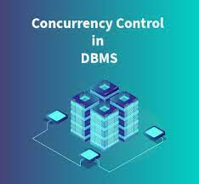
Here's an introduction to some common concurrency control techniques:
Locking:
Overview: Locking is a fundamental technique that prevents multiple transactions from accessing the same resource simultaneously.
Timestamp Ordering:
Overview: Each transaction is assigned a unique timestamp, and transactions are ordered based on these timestamps.
Multi-Version Concurrency Control (MVCC):
Overview: Instead of locking data, multiple versions of a data item are maintained to allow concurrent transactions to access the database without conflicts.

Slide 4
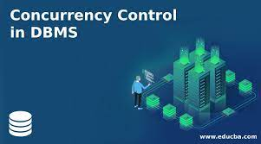
Here's an introduction to some common concurrency control techniques:
4.Optimistic Concurrency Control:
Overview: Assumes that conflicts between transactions are rare, so it allows transactions to proceed without locks.
Concurrency Control:
Transactions are validated before committing to ensure they didn't interfere with each other.
If a conflict is detected, one or more transactions may be rolled back and restarted.
5.Deadlock Detection and Resolution:
Overview: Detects and resolves deadlocks, which occur when transactions are waiting for each other to release locks.
Techniques:
Timeout-based resolution.

