Slide 1












Roey Fabian, Ron Sharabi, Amit Cohen, Eren Fishbein
Vox Populi Platform
Open-source framework
for data collection from
encrypted social networks
Supervisor: Dr. Nir Greenberg

Slide 2







Goal
To develop a platform that enables the collection of private information in
Hebrew from various platforms with
different communication protocols, and
make the platform accessible as open-source

Slide 3




Features
QR Generation
Connection to different IM apps
Data anonymization
Shared chats selection
UI for user and data management

Slide 4
The Work
So Far
Connection to Whatsapp and Telegram
Working NER model & Regex for anonymization
Data Processing
Data Tagging

Slide 5
!
Data
extraction of chats from a client
we built into a database
Marathon’s Goals
Model
Bug fixes, experiments and results
UI
A skeleton of the platform’s website.

Slide 6

01
System
Work Achieved Today
03
02
Interface
anonymization
Final checks before posting

Slide 7
1
System

Slide 8
What’s next?
Signal bridge
Integration with authentication
service and user management
Migration to Kubernetes

Slide 9



Dictabert NER
2
Anonymization
RegEx
Chat Processing
Notes:
מודלי ברט
קלט ופלט
קצת מפספס שעות וכתובות
לא בודק מספר טלפון ותזים וכו
בשביל זה יש רגקס
עיבוד הדאטה בכך שניקינו קודם כל את הצ'אטים ולאחר מכן השתמשנו בהפרשי זמן על מנת לקבץ הודעות

Slide 10
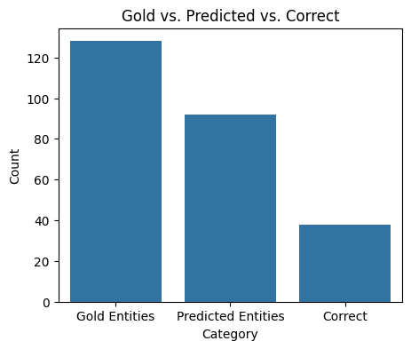
=== First Evaluation Results ===
Total Gold Entities: 128
Total Predicted Entities: 92
Correct: 38
Precision: 0.413 Recall: 0.297 F1: 0.345

Slide 11
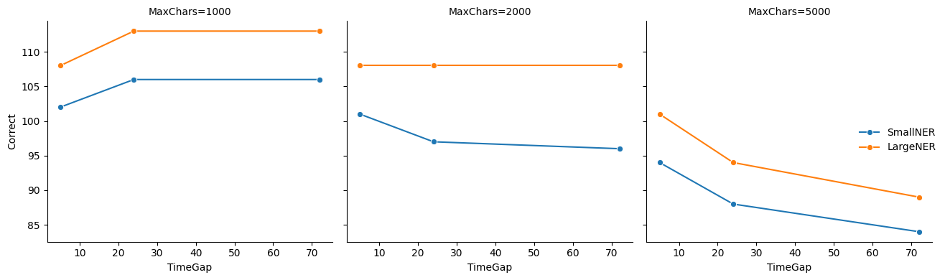
Experiments with time gap
and character limit
dictabert-ner VS dictabert-large-ner

Slide 12
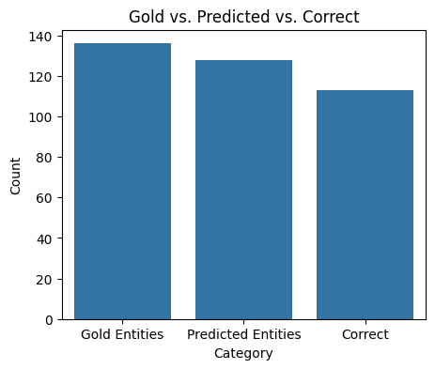
=== Best Evaluation Results ===
Total Gold Entities: 136
Total Predicted Entities: 128
Correct: 113
Precision: 0.883 Recall: 0.831 F1: 0.856
Parameters
Max gap = 24h
Max char = 1000

Slide 13



Slide 14
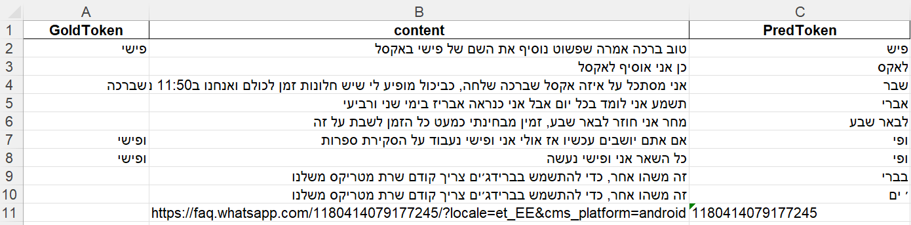
False Positive Examples

Slide 15
What’s next?
Typos handling
Extreme cases
Data Tagging & Fine Tuning
Notes:
המודל אומן בעיקר על טקסטים מכתבות ובלוגים, לכן הוא לא מותאם לחלוטין לאופן שבו אנחנו מדברים בצ'אטים

Slide 16
3
User Interface

Slide 17
What’s next?
User management
Chats selection
Bridge tracking
Statistics
s

Slide 18


Mar 22: Data processing and database connection
Mar 29: Anonymization model - Handle typos and extreme cases
MAR25
Road Map
Apr 19: Integration with authentication service and user management
Apr 20: Tagged Data
Apr 30: Migration to Kubernetes
APR25

Slide 19
May 10: Anonymization model - Fine Tuning
May 20: Web UI
MAY25
Road Map
JUN25
Jun 15: Testing and bug fixes
Jun 15: Collaboration with survey company

Slide 20


thank you!

