Slide 1



Q-HPC
Home
Abstract
Content
Others
PROJECT SYNOPSIS ON:
AUTONOMOUS MULTI-AGENT REASONING BRIDGED WITH MULTI-NODE MPI AND CUDA HARDWARE ACCELERATION
Q-HPC
INTELLIGENT QUANTUM-CLASSICAL EXECUTION FRAMEWORK VIA AI AGENTS AND DISTRIBUTED HPC
AUTHORS:
RUDRANIL CHOWDHURY
HIMADRI MAZUMDER

Slide 2

Q-HPC
Home
Abstract
Content
Others
Abstract
  Q-HPC is an AI-driven framework that intelligently selects and executes classical or quantum algorithms based on a user's computational problem and resource constraints.
  A local LLM agent analyzes natural language problem statements and converts them into structured metadata for automated algorithm recommendation.
  A Resource Estimator predicts memory, qubit requirements, execution time, and hardware suitability before launching computation.
  The framework dispatches workloads to the most appropriate CPU, GPU (CUDA), or distributed MPI backend, enabling efficient hybrid execution.
  A runtime-aware Critic Agent monitors execution feedback and adaptively refines algorithm selection or execution parameters to improve performance and reliability.

Slide 3
Q-HPC
Home
Abstract
Content
Others
Introduction & Motivation
  Modern workloads require complex trade-offs between classical heuristics (e.g., XGBoost, SVM) and quantum algorithms (e.g., QAOA, VQE, QSVM).
  Quantum state-vector simulations scale exponentially (2ᴺ complex amplitudes for N qubits), quickly exhausting single node memory limits.
  Manual hardware allocation across CPU cores, VRAM, and distributed nodes is error prone and non-optimal.
  Existing computational pipelines lack automated runtime introspection when hardware memory bounds or timeouts are exceeded.
  Q-HPC bridges this gap by coupling an intelligent agentic frontend with an MPI + CUDA accelerated backend.

Slide 4
Q-HPC
Home
Abstract
Content
Others
Literature Reviews
  Cao et al. (2025): Demonstrated autonomous multi-agent LLM orchestration for closed-loop quantum laboratory experiments.
  Chundury et al. (2025): Introduced a scalable hybrid Quantum-HPC framework integrating MPI, Qiskit Aer, and multiple quantum simulators.
  Sultanow et al. (2025): Established the architectural foundations of quantum-enabled autonomous AI agents for intelligent decision-making.
  Fu et al. (2025): Developed an LLM-powered multi-agent system for automated OpenQASM generation and quantum program verification.
  Shiraishi et al. (2026): Proposed AI-driven execution orchestration for hybrid quantum-HPC environments using the Model Context Protocol.

Slide 5
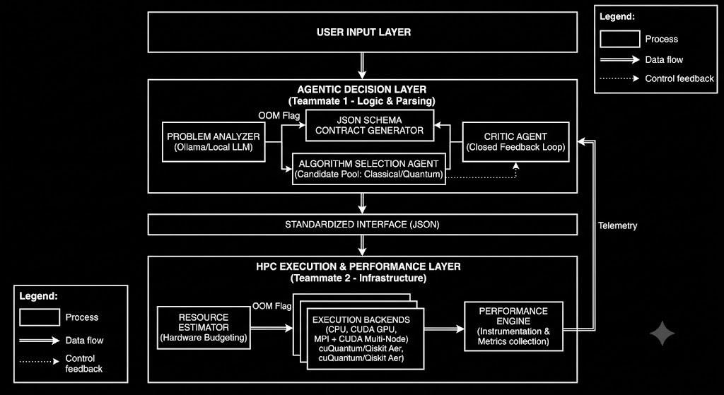
Q-HPC
Home
Abstract
Content
Others
Proposed Architecture
  Decouples high-level probabilistic reasoning from low-level deterministic HPC execution through a multi-stage pipeline.
  Raw user problem statements pass through the Problem Analyzer to extract structured features and dataset parameters.
  Standardized JSON contracts enforce strict execution schemas (dimensions, algorithm type, time, and memory limits).
  The Resource Estimator inspects the JSON payload to configure the optimal execution target: CPU, CUDA, or MPI + CUDA.
  Execution outputs and telemetry flow into a Performance Engine, feeding back into the Agent Critic to close the loop.

Slide 6
Q-HPC
Home
Abstract
Content
Others
AI Agent Layer
  Problem Analyzer: Uses a locally hosted Qwen2.5-7B-Instruct (Ollama) model to convert natural-language problem statements into structured computational metadata.
  Algorithm Selection Agent: Identifies the problem type and recommends the most suitable classical (SVM, Random Forest, XGBoost) or quantum (QAOA, VQE, QSVM) algorithms.
  Execution Plan Generator: Produces a standardized JSON execution contract containing algorithm choice, parameters, constraints, and hardware requirements.
  Runtime Critic Agent: Monitors execution logs and performance metrics to detect failures, memory constraints, or slow convergence during execution.
  Adaptive Decision Loop: Refines execution parameters or switches algorithm candidates based on runtime feedback before re-submitting the execution plan to the HPC backend.

Slide 7
Q-HPC
Home
Abstract
Content
Others
HPC Engine - CUDA Implementation
  Utilizes CUDA-enabled GPUs to accelerate computationally intensive quantum simulation workloads on a single node.
  Integrates Qiskit Aer GPU backend for faster state vector simulation compared to CPU-only execution for compatible workloads.
  Executes parallel matrix and tensor operations efficiently using the GPU's massively parallel architecture.
  Supports large-scale quantum circuit simulation within the memory limits of a single GPU device.
  Serves as the preferred execution backend when the Resource Estimator identifies GPU execution as the most suitable option.

Slide 8
Q-HPC
Home
Abstract
Content
Others
HPC Engine - MPI Implementation
  MPI-based distributed execution enables quantum simulations to scale beyond the memory limits of a single CPU or GPU node.
  Large quantum state vectors are partitioned across multiple cluster nodes, allowing each node to process a portion of the computation.
  Parallel execution across multiple MPI ranks improves scalability and resource utilization for high-dimensional workloads.
  Collective communication and synchronization combine intermediate results during distributed quantum computations.
  The distributed backend is selected automatically when the Resource Estimator predicts that a workload exceeds single-node resource capacity.

Slide 9
Q-HPC
Home
Abstract
Content
Others
Closed Loop Integration
  Binds one MPI rank per GPU device to coordinate inter-node scaling with intra-node CUDA compute density.
  The Resource Estimator auto-generates cluster launch commands (e.g., mpirun -n <ranks> with GPU flags) from the LLM contract.
  Intercepts hardware-level anomalies (such as Out-of-Memory faults or slow convergence) before complete job failure occurs.
  The Critic parses error telemetry and requests increased MPI node allocations or alternative algorithm representations.
  Creates a self healing computational workflow that functions without manual human intervention between experiment runs.

Slide 10
Q-HPC
Home
Abstract
Content
Others
Expected MVP Outcomes
  Successful conversion of natural language problems into validated JSON execution plans.
  Automated recommendation of classical or quantum algorithm candidates.
  Resource estimation for CPU, GPU, and MPI execution targets.
  Runtime-aware feedback capable of suggesting alternate execution strategies.
  Future integration with SLURM schedulers and real quantum processing units.

Slide 11
Q-HPC
Home
Abstract
Content
Others
References
  [1] M. Abou Ali, F. Dornaika, and J. Charafeddine, Agentic AI: A Comprehensive Survey of Architectures, Applications, and Future Directions, Artificial Intelligence Review, 2025.
  [2] Qiskit Development Team, Qiskit Aer Documentation, IBM Quantum, 2025.
  [3] NVIDIA Corporation, cuQuantum Documentation and Qiskit Integration Guide, 2024.
  [4] S. Bhagat et al., Circuit Partitioning and Full Circuit Execution: A Comparative Study of GPU-Based Quantum Circuit Simulation, IEEE HiPC, 2024.
  [5] Qiskit Aer Contributors, Qiskit Aer Release Notes and GPU/MPI Enhancements, IBM Quantum, 2024.

Slide 12
Q-HPC
Home
Abstract
Content
Others
THANK YOU
THANK YOU
THANK YOU

